Slide 1
Kentico software
Dominik Pintér (Technical Leader)
Štěpán Kozák (Developer)
Antonín Moravec (Project Manager)

Slide 2


Kentico software
2004
  1 employee (Petr Palas, former FI MU student)
  1 dog
  1 product – Kentico CMS (Bachelor thesis)
2011
  65 employees CR
  7 employees USA
  1 employee UK
  5 dogs
  1 product – Kentico CMS
  7000+ web sites
  1200+ partners in 80+ countries
Fastes gorwing czech technological company – Deloitte FAST 50, 2010
Microsoft Gold Certified Partner and Microsoft Visual Studio Industry Partner

Slide 3
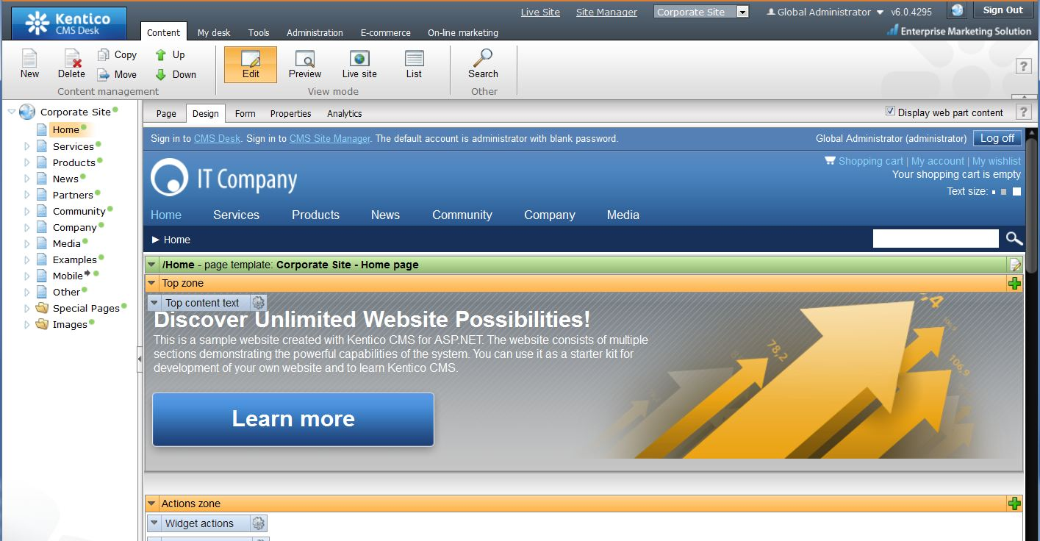
Kentico CMS
CMS = Content Management System
CMS = system for building and maintaining websites
Drupal, Joomla, DotNetNuke
ASP.NET application writen in C#

Slide 4
Our customers

Slide 5
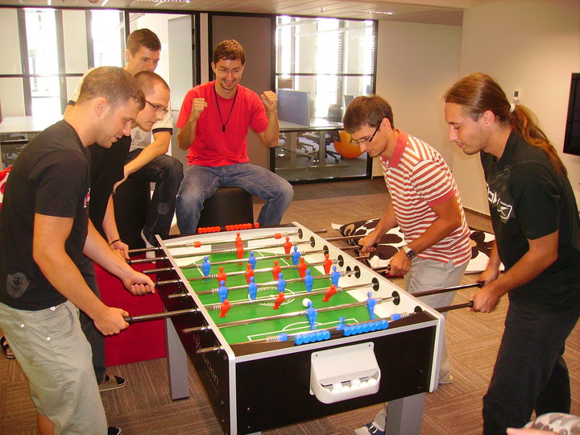

Why Kentico?
What do we have in common?
Amazing job
Worldwide successful product
Fashionable office in Brno city center
Inovation time & Summer of code

Slide 6

Links
General information http://www.kentico.com
Web for developers http://devnet.kentico.com
Trees for bugs http://trees.kentico.com/Home.aspx
Summer of code http://www.kentico.com/trainee.aspx
Job opportunities http://www.kentico.com/jobs.aspx
Theses http://www.kentico.com/theses.aspx
Free edition http://www.kentico.com/Download-Demo/Free-Edition

Slide 7
ASP.NET Web Applications Basics
Štěpán Kozák

Slide 8
List of contents
What is ASP.NET?
What is a request?
How does ASP.NET deal with stateless http?
ASP.NET request life cycle
ASP.NET page/control life cycle

Slide 9
What is ASP.NET?
Active Server Pages .NET
Platform for creating dynamic web applications
You can use any .NET language as a code-behind
Development of ASP.NET WebForms applications can be similar to the development of WinForms applicatons. Similar, not same!

Slide 10
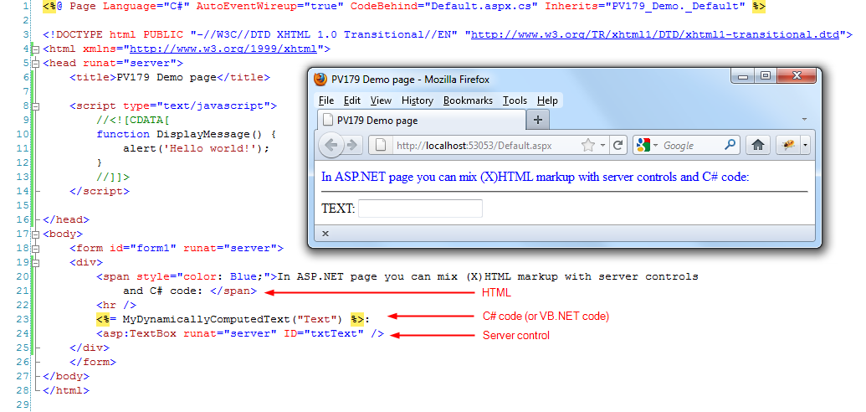
Example of ASP.NET page

Slide 11
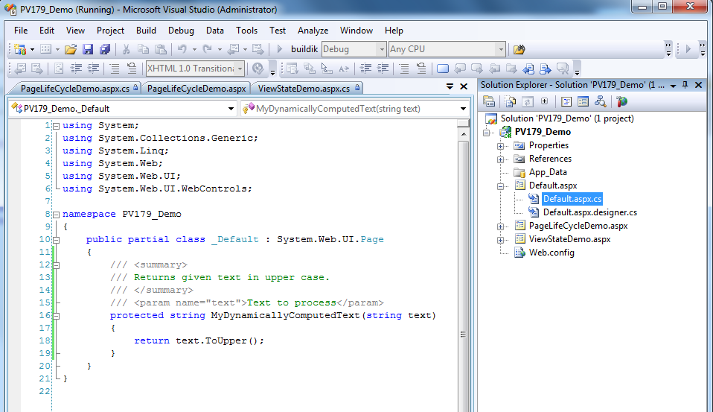
ASP.NET page – code behind

Slide 12
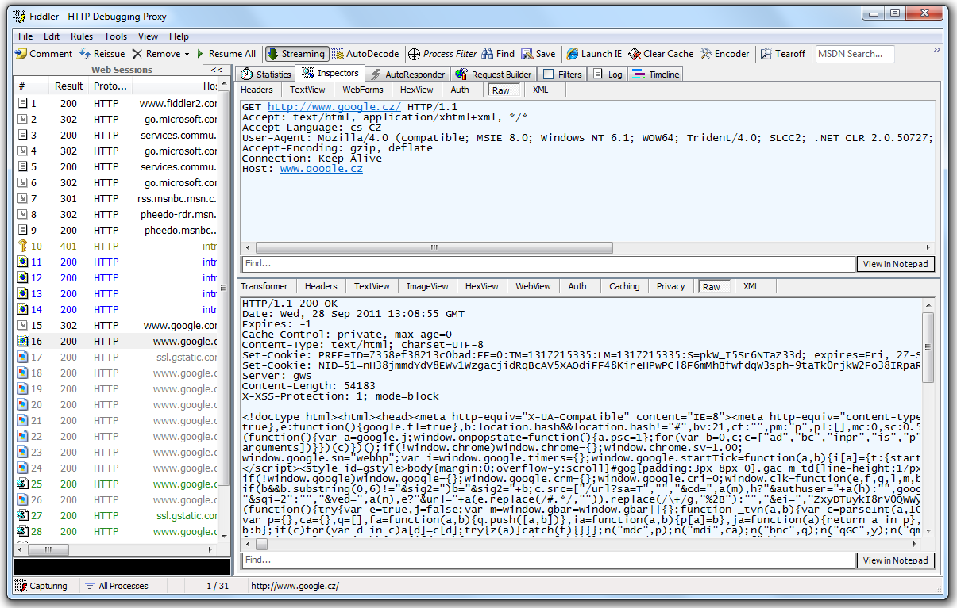
What is a request?

Slide 13
What is a request?
Main thing you need to remember about HTTP protocol:
HTTP is stateless protocol!
But we need state in dynamic web applications!

Slide 14
How does ASP.NET deal with stateless http?
The answer is ... ViewState!
It is a technique used by an ASP.NET Web page to persist changes to the state of a Web Form across postbacks (HTTP POST to the same page that the form is on).
Use ViewState carefuly and only when it‘s really needed! It‘s helpful technique, but it might become too greedy and can cause the application to be less effective.

Slide 15
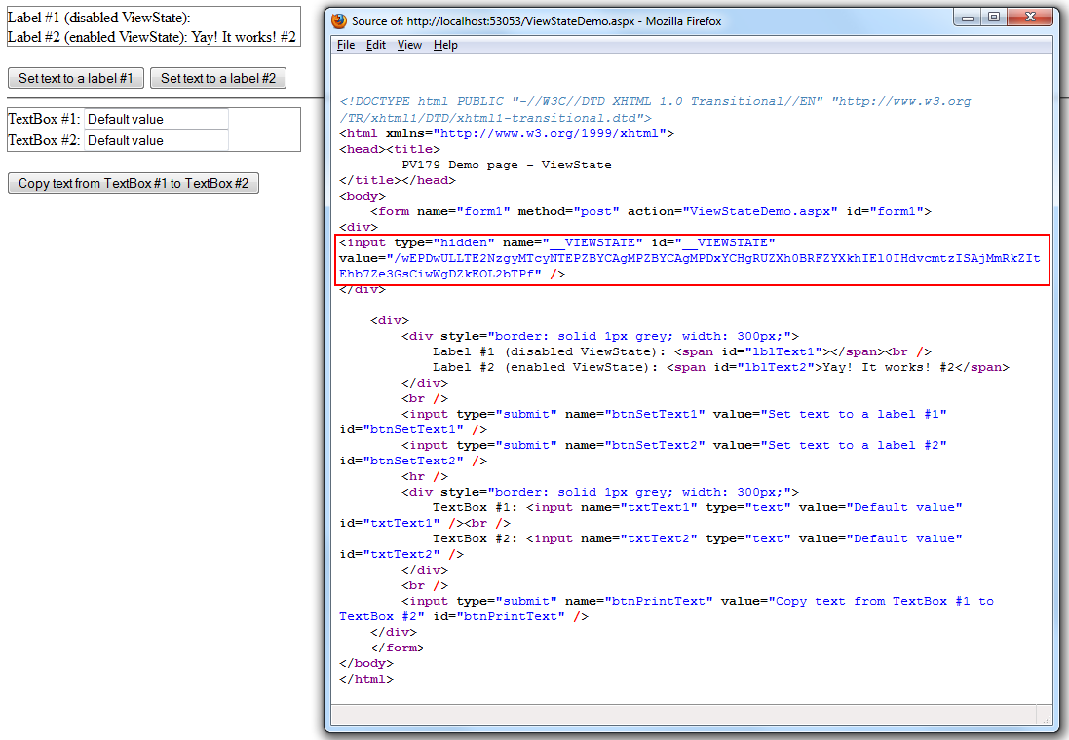
ViewState – How is it send within requests?

Slide 16
ASP.NET page/control life cycle
To be able to work with ASP.NET pages and controls properly you need to understand the life cycle of these elements.
Most importat phases of page/control life cycle are:
  PreInit
  Init
  Load
  PreRender
  Render

Slide 17
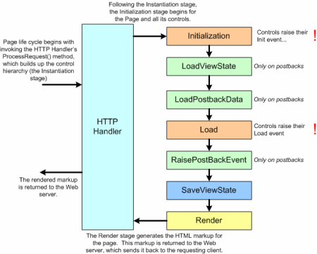
ASP.NET page/control life cycle
Source: http://i.msdn.microsoft.com/dynimg/IC152667.gif

Slide 18
Where to get more information?
Where to start:
http://msdn.microsoft.com/en-us/library/ywdtth2f%28v=vs.71%29.aspx
More about page life cycle:
http://msdn.microsoft.com/en-us/library/ms178472.aspx
More details about how the ViewState works:
http://msdn.microsoft.com/en-us/library/ms972976.aspx

Slide 19
Q&A
?

Slide 20
Model view controller
Dominik Pintér, dominikp@kentico.com

Slide 21
MVC
Presentation layer
Model
Bussiness layer
View
Controller
Data layer

Slide 22
ASP.NET MVC
Additional programming model
Full control over HTML
http://www.asp.net/mvc
Controller + View = Result page
Routing
Razor engine

Slide 23
Kentico CMS & MVC
DEMO

Slide 24
Q&A
?

Slide 25
Windows Azure introduction
Dominik Pintér, dominikp@kentico.com

Slide 26
Agenda
Cloud computing
Windows Azure platform
Kentico CMS & Windows Azure

Slide 27
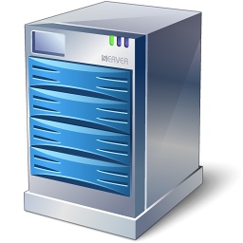

Cloud Computing
Models:
IaaS
PaaS
SaaS
Buy vs. rent

Slide 28
Windows Azure Platform
Windows Azure AppFabric
SQL Azure
Windows Azure

Slide 29
Windows Azure
Queue
LB
LB
LB
Table
Web role
Worker role
VM role
Blob
Windows Azure fabric controller

Slide 30
Blob storage
Container1
Blob1
Blob2
Contaner2

Slide 31
Windows Azure – Differences and Challenges
Multiple virtual machines environment
  Statelesness
  Scalability
Types of storage
  NTFS vs. Windows Azure storage
  Microsoft SQL server vs. SQL Azure
Development experience
  Software development kit and emulator
  New patterns
Workflow
Solution
Package
Deployment

Slide 32
Windows Azure internals
Your package
Deployment
Image
Change of single file => redeployment
Web role

Slide 33
Kentico CMS & Windows Azure
History:
Kentico CMS 5.5 R2
  First version
  Passed Windows Azure platform ready test
  Limitations
Kentico CMS 6
  Real support
  Lot of code changes
Development:
One developer, almost fulltime job
Changes: coding rules, build process, QA process

Slide 34
Q&A
?

Slide 35
Why don’t you get a job @ Kentico?
Just click, follow the instructions and send us your results to jobs@kentico.com

Slide 36
Thank you!
Thank you!
antoninm@kentico.com
dominikp@kentico.com
stepank@kentico.com

