Slide 1
Process Framework for Emergency Management in the Czech Republic
Tomáš Ludík
Lab Software Architectures and Information Systems
15. 12. 2011

Slide 2
Outline
The aim of my dissertation thesis
Related work
Comparison between the aim of thesis and related work

Slide 3
Process Framework for Emergency Management

Slide 4
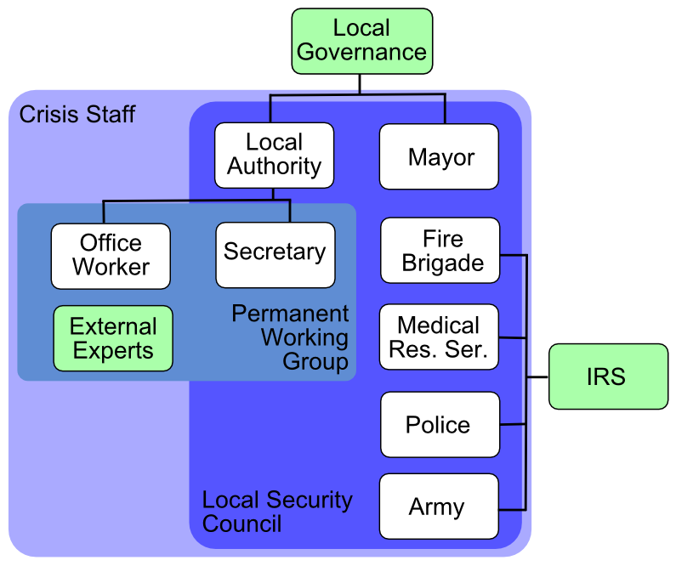
Features and Recommendations for Emergency Processes
Internal Factors
External Factors
Risk Analysis
Level of Automation
Psychological Aspects
Using of Standards
Legislation
Organisational Structure
Contingency Plans
Different Types of Information
Variability and Uncertainty

Slide 5
Case Study
Problem Domain Definition
Crisis Staff at Local Governance Level
Accidents Involving Dangerous Substances
Application of Methodology
Emphasis on Identification and Modelling phase
Architecture View
Bonita Open Solution

Slide 6
Process Management Related Work
Standards based on process management
ISO900x, ITIL, CMMI, Six Sigma
Organisations
Object Management Group
Workflow Management Coalition
Organization for the Advancement of Structured Information Standards
Companies
Oracle, IBM, SAP, Fujitsu, Adobe

Slide 7
Emergency Management Related Work
Legislation
Law No. 240/2000 on crisis management
Law No. 239/2000 on the Integrated Rescue System
Obligatory documents
Typical activities of IRS
Modell action plans at state level
Documents of Fire Brigade
Emergency plans on local, district, state level
Information systems
EMOFF, Krizkom, Argis, Krizport

Slide 8
Process and Emergency Management Related Work
Sell and Braun recognized that emergency plans are very similar to business processes.
Project Orchestra (Open service architecture for risk management) defines workflows that combine several services into one value-added service chain that achieves a certain goal.
Leoni et al. MOBIDIS: A Pervasive Architecture for Emergency Management. 2006.
Mak et al. Building online crisis management support using workflow systems. 1999.
Konečný et al. Dynamic geovisualisation in crisis management.
Fire Brigade. IRS information system.
Vondrák et al. Floreon+.
University of Defence. Security Laboratory.

Slide 9
Business Process Management
Field of combining management and technology focused on aligning organizations with the wants and needs of clients.
It is a complex management approach that promotes effectiveness and efficiency while striving for innovation, flexibility, and integration with technology.

Slide 10
Workflow Management

Slide 11
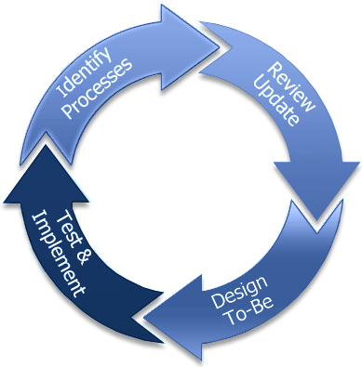
Business Process Reengineering

Slide 12
Emergency Plans in the Czech Republic
Textual form
Governance level
Local, District, State
Integrated Rescue System
Fire Brigade, Rescue Service, Police, Army
Coordination of activities
Strategic level, Operational level, Tactical level
Emergency Plans
evacuation plan, flood plan, internal/external emergency plan, response plan, model action plan, operational plan

Slide 13
Orchestra Project
Project Orchestra defines workflows that combine several services into one value-added service chain that achieves a certain goal.
Then they deploy such workflows as executable service instances. In particular, the solution uses several services distributed over the network that are orchestrated by an additional service that directly interacts with the client and executes the workflow defined in WS-BPEL, using active BPEL, an Open Source BPEL engine.
The starting points were the application of Data Flow Schemata, and UML Use Case and System Sequence Diagrams describing the risk assessment functionalities.
These diagrams were prepared in cooperation with the system end users during the requirements phase of the pilot development.

Slide 14
References
Bass, L., Clements, P., Kazman, R.: Software Architecture in Practice. Second Edition. Boston: Addison-Wesley, 2003.
Hollingsworth, D.: The Workflow Reference Model. Document Number TC00-1003. Workflow Management Coalition. 1995.
Ingmarsson, M., Eriksson, H., Hallberg, N.: Exploring Development of Service-Oriented C2 Systems for Emergency Response. In Proceedings of the 6th International ISCRAM Conference, Gothenburg, Sweden, 2009.
Klopfer, M., Kanellopoulos, I.: Orchestra, an open service architecture for risk management. The ORCHESTRA Consorcium. 2008.
Konečný, M. et al.: Dynamic Geovisualization in Emergency Management. Research Plan. 2010. Available at http://geokrima.geogr.muni.cz/, 25.11.2010.
Leoni, M., Rosa, F., Mecella, M.: MOBIDIS: A Pervasive Architecture for Emergency Management. In Proceedings of the 15th IEEE International Workshops on Enabling Technologies: Infrastructure for Collaborative Enterprises. Manchester, United Kingdom: IEEE Computer Society, 2006.
Mak, H., et al.: Building online crisis management support using workflow systems. In Decision Support Systems 25. Elsevier. 1999.
Reijers, H.: Design and Control of Workflow Process: Business Process Management for the Service Industry. Springer-Verlag. Berlin Heidelberg. 2003.
Rose, T., Peinel, G., Arsenova, E.: Process Management Support for Emergancy Management Procesures. In eChallenges e-2008 Conference. Stockholm, Sweden, 2008.
Rüppel, U. , Wagenknecht, A.: Improving emergency management by formal dynamic process-modelling. In 24th Conference on Information Technology in Construction, 2007.
Řepa, V.: Podnikové procesy, procesní řízení a modelování. (Business Processes, Process Management and Modelling) Praha: Grada, 2007.
Sell, Ch., Braun, I.: Using a Workflow Management System to Manage Emergency Plans. In Proceedings of the 6th International ISCRAM Conference. Gothenburg, Sweden, 2009. ISBN 9789163347153.
Silver, B.: BPMN Method and Style: A levels-based methodology for BPM process modeling and improvement using BPMN 2.0. Aptos: Cody-Cassidy Press. 2009.
Weske, M.: Business Process Management, Concepts, Languages, Architectures. Berlin Heidelberg New York: Springer, 2007.

Slide 15
Thank you for your attention.
Questions?

