Slide 1
[Your company name] presents:
Time Management & Effectiveness
#1
Personal Effectiveness – The Right Decisions
Michala Homolova

Slide 2
Agenda
Introduction
Organizational topics, planning
Course intro
Urgent / Important matrix
Assignment #1

Slide 3
About me
passionate about professionalism and development
ambition to help people develop and grow
10 years in management
Mentor, Coach, Consultant of Managers
Red Hat GSS Manager
Find me on LinkedIN ☺

Slide 4
About you
full-time students
full-time employees (studies ran in parallel)
entrepreneurs
always fire-fighting / as planned
busy / bored / overloaded
happy / stressed
urgently need help / just out of interest

Slide 5
Organizational
In-class only every other week (bi-weekly)
Next lecture on Monday, September 26th
No lecture on Monday 24th October and 31st October (I will send notification to your emails in advance)
This is a non-obligatory course
BUT
Excuse is: (1) polite, (2) part of the learning process (think of priorities)
Notes:
Attendance mandatory

Slide 6
Course agenda
Time management methodology – GTD
Planning
Task lists
Emails
Priorities
Delegation
Meetings
Brainstorming
Projects
Stakeholder engagement
Notes:
Attendance mandatory

Slide 7
WHERE IS MY TIME
?

Slide 8
Are you EFFECTIVE?
EFFICIENT?
PRODUCTIVE?

Slide 9
On Effectiveness
Effectiveness
do the right things
Efficiency
do the things right
What is more important?
(Continued on next slide.)

Slide 10
On Effectiveness
Efficiency
To be efficient is to use the fewest resources for the given task
Effectiveness
the function of goal accomplishment (either your achieve your goal or you don’t)
Hint
Determine what you should be doing.
Only then determine how best and most efficiently it can be achieved.
Overview: Four powerful FrontPage features
Lesson 1: Find and replace text across multiple Web pages
Lesson 2: Include a Web page inside another Web page
(Continued on next slide.)

Slide 11
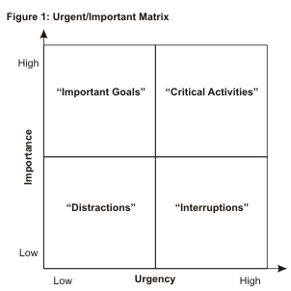
Eisenhower Matrix

Slide 12
Eisenhower Matrix
Important as well as urgent - Daily Fire Fighting
Most people spend a majority of time in this get nowhere rat race. Take care to reduce the time you spend in this on this quadrant and be quick to delegate.
Not Urgent but Important - Think strategically about the big picture.
Look for the forest instead of the tree. Maximize your quality time spent in this area.
Urgent but not Important - Someone else’s emergency, not yours
Minimize your investment in these activities. This is a where unhappy people spend most of their time.
Neither Urgent nor Important - Time Wasters
These activities are such as when you gossip over the phone, watch television, surf the internet for recreation. Be certain to minimize on this.
[Your company name] presents:
Personal Effectiveness – The Right Decisions

Slide 13
Where you are / want to be
[Your company name] presents:
There is no ideal for everyone, YOU are to figure out what YOUR ideal is. Track the actual and compare with the desired.

Slide 14
Assignment nr. 1
Deliverables:
Graph with your ideal distribution of time spent on Urgent/Important as per the matrix (4 categories)
Two paragraph justification for the graph (your situation, why did you decide to split in a way you did)
Graph with the actual distribution based on reality
Description of what you can do to cover the gap (if any) between the ideal and the actual)
CONSOLIDATED deliverable: DEADLINE NEXT MONDAY (26th September), to my email (format of your choice)
(Continued on next slide.)

Slide 15
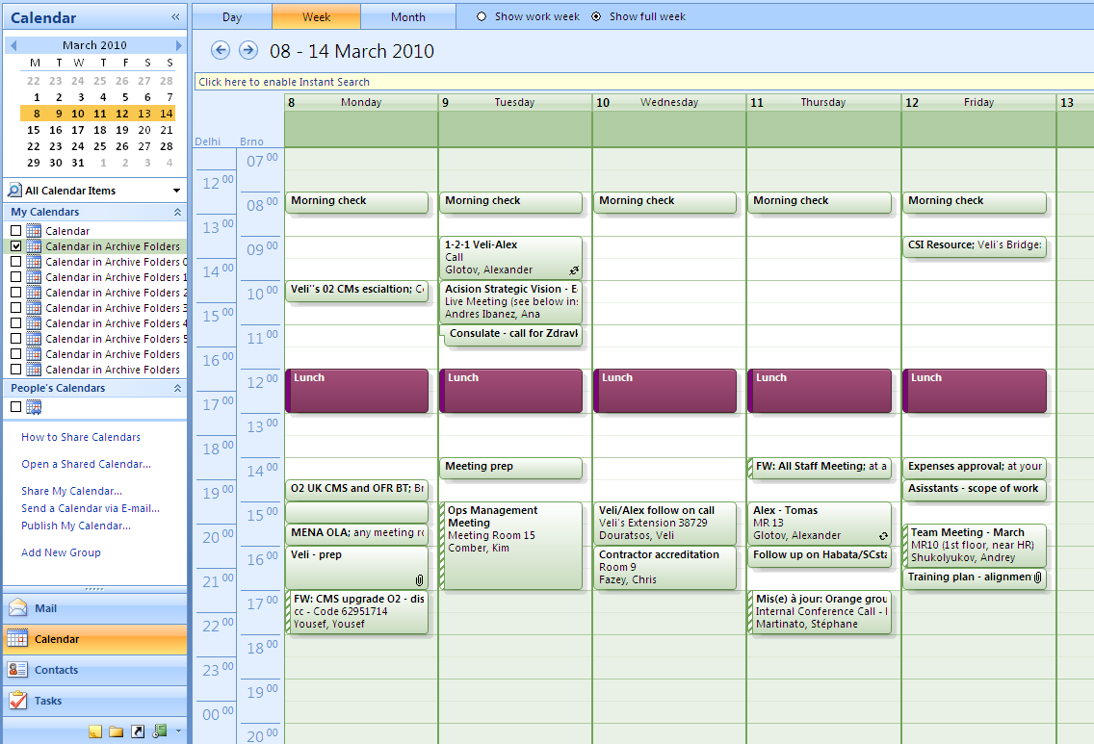
Works for me
Notepad + synchronized calendar (Outlook, Gmail Calendar)
Morning placeholders
date
name
Lunch placeholders

Slide 16
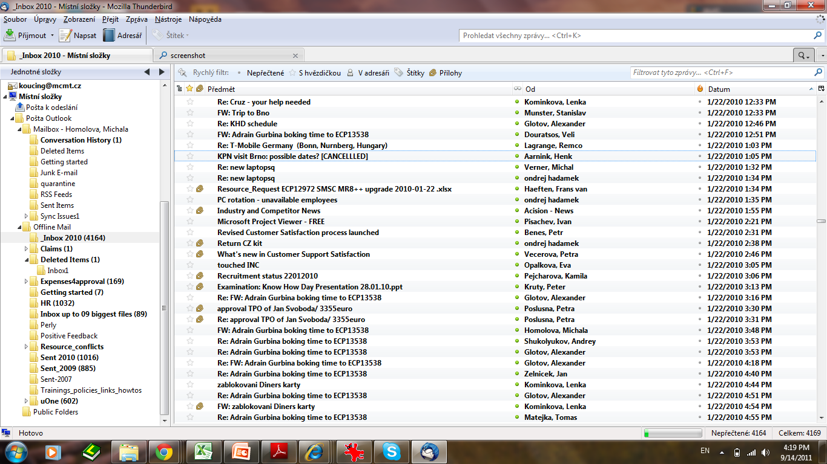
Some tools
date
name

Slide 17
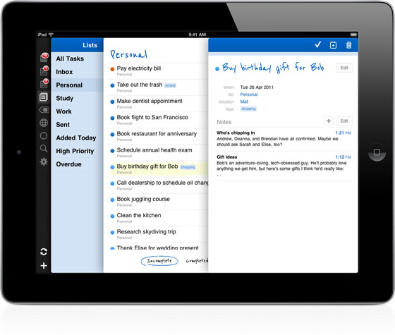
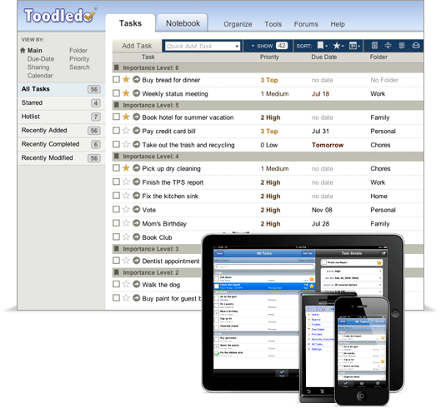
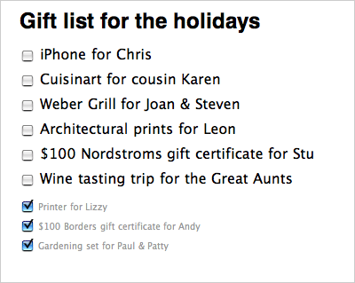
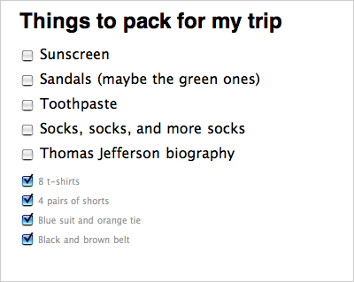
Some tools
Tadalist.com
Toodledo.com
Rememberthemilk.com

Slide 18
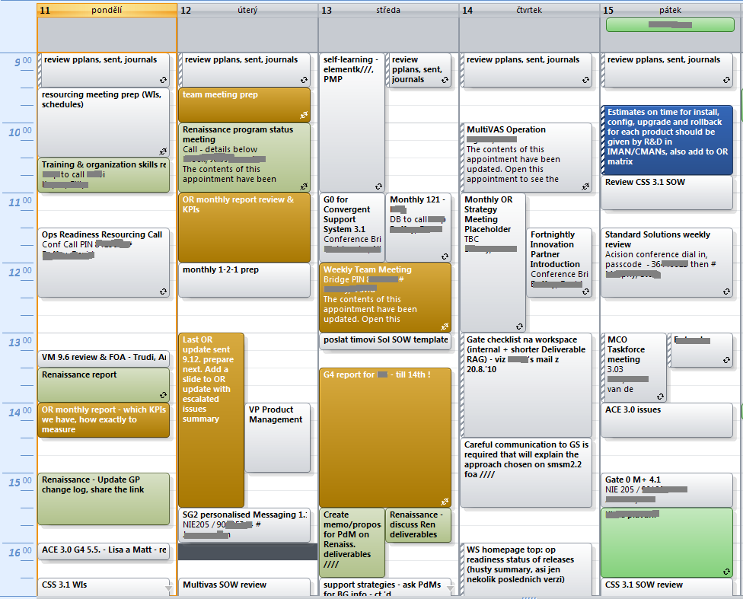
BUSY?

Slide 19
That’s it for today
QUESTIONS?
Individual

