Slide 1

Time Management & Effectiveness
# 3
Methodologies
Personal Effectiveness – The Right Decisions
Michala Homolova

Slide 2
Agenda
Getting Things Done
Pomodoro
NEXT COURSE NEXT WEEK, Monday,
17th October

Slide 3
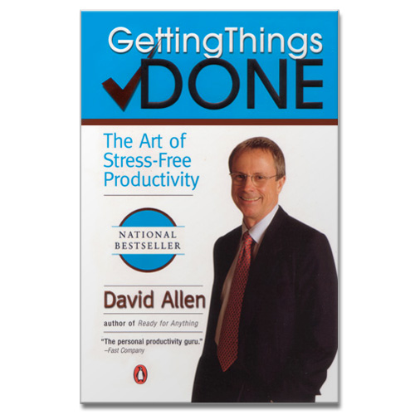
GTS
The most spread methodology
Elaborated, sophisticated system
First published in 2001, translated to 28 languages
According to Forbe’s: one of the Top5 Exec Coaches in US
http://www.davidco.com
Each lesson includes a list of suggested tasks and a set of test questions.

Slide 4
Implementation
Getting Started: preparation of space, time, and tools
Collection
Processing: folder/list clean-up
Organization: folder set-up
Evaluation: keep the system up and running
Each lesson includes a list of suggested tasks and a set of test questions.

Slide 5
Hints
Priorities
Getting control over projects
Power of data collection habit
Power of next steps planning
Power of focus to the goal
Each lesson includes a list of suggested tasks and a set of test questions.

Slide 6
1. Getting Started
Time
2 successive days:
6 hours data collection
8 hours data processing
2. Space – never shared!
Desk (space for writing and folder)
3. Tools
paper organizers (minimum 3)
pack of A4, pen
post-its, clips, stapler, adhesive tape, folders, diary, trash bin
Each lesson includes a list of suggested tasks and a set of test questions.

Slide 7
1. Getting Started: Tools
Paper organizer (entry folder, exit folder, two more in the middle for support info and reading materials)
Blank A4: one idea per sheet
Folder index system: handy, alphabetic sorting, with descriptions, availability of empty folders
Each lesson includes a list of suggested tasks and a set of test questions.

Slide 8
2. Collection
RULE: Free your mind so you can focus and be in control
Collect ALL working and personal tasks
(1 to 6 hours)
Physically: collect things you want to do something about to the box
Mentally: take note of every “stuff” requiring any action
Each lesson includes a list of suggested tasks and a set of test questions.

Slide 9
2. Collection
Hints:
Throw away trash immediately
Do not tidy (unless you have enough time to complete both)
Include your existing lists as inputs
Put urgent reminders to the input folder
Include date (input taken on dd.mm.yyyy)
Use systematic lists as reminders
Each lesson includes a list of suggested tasks and a set of test questions.

Slide 10
2. Collection
Example of systematic list reminder:
Working
Projects in progress
Projects to be started
Commitments to others
Boss, colleagues, subordinates, external people (customers, vendors, contractors)
Communication to process
Internal/external, phones, emails, voicemails, faxes, letters, memos
Other writings to be finished
Evaluations, proposals, articles, PR materials, manuals
Meetings you need to organize/attend
Who needs to get to know about what decisions?
Financials
Cash flow, statistics, budgets, forecasts, credit, banks
Planning
Objectives, next phase of running projects, future projects, events, presentations, changes in the building, travel
Each lesson includes a list of suggested tasks and a set of test questions.

Slide 11
2. Collection
Example of systematic list reminder:
Personal
Projects in progress
Projects to be started
Commitments to others
Partner, Spouse, children, family, friends, borrowed stuff, organizations, volunteerism
Communication to process
Family, friends, phones, emails, voicemails, faxes, letters, congratulations, birthday cards
Special events
Birthdays, namedays, weddings, graduations, vacations, travels, weekends, vacations, cultural events, sports events
Ideas
Interesting places, meetings (who to invite), bright ideas
Administrative
Banks, credits, taxes, investments, insurance
Household, PCs, Doctors, Hobbies . . .
Each lesson includes a list of suggested tasks and a set of test questions.

Slide 12
2. Collection
Inputs can’t stay in INPUT folder forever
Otherwise your mind will find out and start to fill again
Each lesson includes a list of suggested tasks and a set of test questions.

Slide 13
3. Processing
Once you’ll go through your inputs, you will have:
Thrown away what you don’t need
Finished all under-two-minutes tasks
Delegated all you can delegate
Reminders of more-than-2-minutes tasks in your organizer
Overview of all projects (complex commitments)
Each lesson includes a list of suggested tasks and a set of test questions.

Slide 14
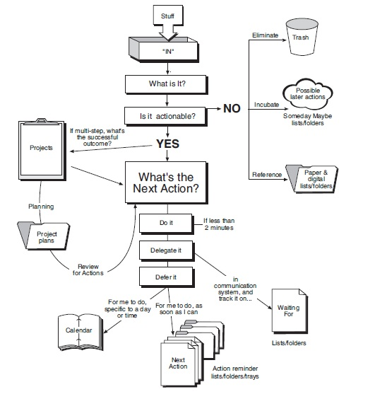
3. Processing
Each lesson includes a list of suggested tasks and a set of test questions.

Slide 15
3. Processing
Hints:
Process doesn’t mean ponder
Input folder is not a trash bin
One at a time
Name your projects
Each lesson includes a list of suggested tasks and a set of test questions.

Slide 16
4. Organizing
7 categories to maintain and control:
List of projects
Project inputs
Steps, tasks and info in diary
Lists of “next steps”
List of “Waiting for”
Archive
List “Sometime, Maybe”
Maintain boundaries, otherwise you can’t trust your system
Each lesson includes a list of suggested tasks and a set of test questions.

Slide 17
4. Organizing
Hints:
- To be functional, system of lists must be complete and up-to-date
Diary is for MUST DO THAT DAY ONLY (no nice-to dos)
Sort ASAPs by context (PC, calls, downtown, office, at home, read)
You may use physical folders rather than lists (for Read, Pay, etc.)
Do not store reminders for one thing to more places
Each lesson includes a list of suggested tasks and a set of test questions.

Slide 18
5. Maintenance
To be functional, system of lists must be complete and up-to-date
Diary – first thing to check every day
To do lists per context (office, calls, person, etc.) if diary allows (if not, no need to review)
Weekly evaluation is the key
Each lesson includes a list of suggested tasks and a set of test questions.

Slide 19
5. Weekly Maintenance / Evaluation
Run the Preparation, Collection, Processing, Organizing, and Evaluation on weekly basis (placeholder in diary)
Review papers
Process your notes (to diary, lists, archive)
Review past week in diary for follow ups
Collect what prep is needed in relation with your future diary items
Run a clean-up of your mind – note all new projects, ideas, tasks
Review all your lists “Waiting for”, “next steps”, etc.
Be creative
Each lesson includes a list of suggested tasks and a set of test questions.

Slide 20
Hints
Priorities
Getting control over projects
Power of data collection habit
Power of next steps planning
Power of focus to the goal
Refer to the book
Each lesson includes a list of suggested tasks and a set of test questions.

Slide 21

Pomodoro
Created in 1980s by Francesco Cirillo to improve his own study habits
Book for free download
http://www.pomodorotechnique.com/resources/ThePomodoroTechnique_v1-3.pdf
Start in two pomodoro units (2 x 25min),
7 to 20 days to mastery)
Pomodoro World Community
Notes:
Insert categories
Put X there where this criteria is not natural in your assessment

Slide 22
That’s it for today
QUESTIONS?
Individual

