Slide 1

Web application security
Juraj Komloši

Slide 2

Agenda
Why is web app security so important?
OWASP Top 10
Cross-site scripting (XSS)
SQL injection
Input validation
Client/server validation
Session attack – session fixation
Clickjacking
CSRF
Argument injection

Slide 3
Why is web application security so important?
Identity theft (session attacks)
  Allow access to illegitimate functions or data
Compromising application (SQLi, XSS, LDAP...)
  Availability, integrity and confidentiality could be affected
Loss of service - DoS, DDoS
Loss of reputation for organizations
Attack’s reasons:
  Commercial - Sony’s PlayStation Network, Acer Europe,
  Political - Iran's Ministry of Foreign Affairs,
  Profit - e-shop administration, BitCoin stock exchange

Slide 4
OWASP Top 10
OWASP - The Open Web Application Security Project
  open-source web application security project
OWASP Development Guide
  covers an extensive array of application-level security issues, from SQL injection through modern concerns such as phishing, credit card handling, session fixation, cross-site request forgeries, compliance, and privacy issues.
References
  OWASP official site
  OWASP development guide
  OWASP testing guide

Slide 5
2013 Application Vulnerability Population
http://blog.cenzic.com/2013/03/application-vulnerability-trends-report/

Slide 6
Cross-site scripting (XSS)
Enables attackers to inject client-side script
Inject malicious code segments that are run by your server in the victim's browser
Main types:
  Persistant - the code is added to the web site
  Non-persistant - the malicious code is contained in the URL
Common targets:
  Cookies
  Social engineering
XSS sources:
  URL, Flash, videos…

Slide 7
Cross-site scripting (XSS)
Result:
  Identity theft
  Accessing sensitive or restricted information
  Potential DoS attack
Finding XSS:
  Insert javascript code to:
    GET/POST parameters, form fields etc.
Avoiding XSS:
  Encode user inputs -> HttpUtility.HtmlEncode
  Web.config - > validateRequest="true"
  Protect cookies -> HttpOnly flag
Demo

Slide 8
SQL injection
Executing SQL code through a web application
Result:
  Attacker can read all data or the database schema, change it, edit it
Finding SQL injection:
  Insert ‘ (aphostrophe) to:
    All inputs – GET/POST parameters, input fields
Avoiding SQL injection:
  Escaping aphostrophe
  Stored procedures -> use query parameters
  Do not use ‘exec’ function
Demo

Slide 9
Input validation
All user input is evil
White list validation
  Involves defining what IS authorized
Character-set – accept only expected set of characters
  Amount - digits, zip code – regular expression
  US states – drop down list
Data format – accept only data containing the proper format
  e-mail – letters, numbers, „@“, dots
Escaping special characters
Black list validation
  Involves defining what IS NOT authorized
  Code names – can not contain special chars ($#_.,)

Slide 10
Client/Server validation
Client validation:
  Gives the user immediate feedback
Server validation:
  More advanced validations
Why do we need server side as well as client side validation?
  Client side validation may be subverted
Common mistake:
  Disabled UI doesn’t allow to perform any actions
  Form inputs are not validated
Demo

Slide 11
Session attack – session fixation
Attacker fixes the user’s session ID before the user logs into target server
Eliminate the need to obtain user’s session ID afterwards
How it works:
  Attacker logs in to the server (get SessionID)
  Attacker sends link containing logon page with session ID to the victim
  Victim opens link (session already exists, a new one is not created)
  Victim logs in (using attacker session ID)
  Attacker can access victim’s account

Slide 12
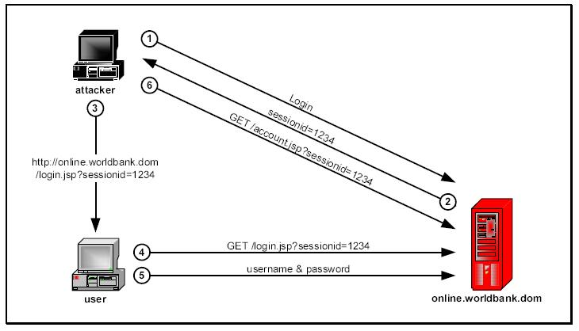
Session attack – session fixation

Slide 13
Session attack – session fixation
Fixation SessionID can be done by:
  URL argument
    ~/login.aspx?session=123456
  Hidden field
    Impractical
  Cookie
    The most commonly used / the most vulnerable
How can be cookie issued to the browser
  Cross-site scripting (XSS)-> document.cookie=“123456”
  Meta tag injection
    /<meta%20http-equiv=Set-Cookie%20content="sessionid=1234; %20Expires=Friday,%201-Jan-2010%2000:00:00%20GMT”>.idc
Demo

Slide 14
Clickjacking
UI is redesigned to carry some script code along the original code
Tricks a user into performing undesired actions by clicking on a concealed link
Clicking the visible buttons on the clickjacked page vs. performing actions on the hidden page
How to avoid clickjacking:
  X-Frames-Options: sameorigin | deny
Demo

Slide 15
CSRF - Cross Site Request Forgery
Allows an attacker to take arbitrary actions as the victim against a web site
How it works:
  Victim is logged on internet banking portal
  Attacker crafts HTML image element that references to bank portal
    <img src="http://bank.example/payment?account=XY&amount=10000&for=XYZ">
  Victim visits attacker web site
  Victim’s browser execute request with victim’s cookie
How to avoid CSRF:
  Using POST instead of GET
  Implementing secret tokens
Demo

Slide 16
Argument injection
Attack based on tampering with input parameters
Result:
  Attacker can see data which he normally can not see
  Attacker can modify data which he normally can not modify
How to find argument injection:
  Focus on query parameters
  Try to enumerate integer values in query strings (e.g. IDs)
How to avoid argument injection:
  Changing query parameters to e.g. GUID (less predictive)
  Check user permissions before modifying objects
Demo

Slide 17
Q&A

