Slide 1
Marketing Information Systems: part 5
Course code: PV250
Dalia Kriksciuniene, PhD
Faculty of Informatics, Lasaris lab.,
Autumn, 2013

Slide 2
Topics
MKIS concepts
Marketing planning, process modelling and decision making by using MKIS. Tools &software, lab work: Marketing plan Pro planning template
MKIS design (structure and processes)

Slide 3
Interrelationship of MIS, MkIS and IT concepts
Marketing IS concepts | Management IS creation concepts (O‘Brien, 1990) | IT concepts (O‘Brien, 1990), Zikmund et al 2003)
1 Integration of functional modules | Management operations processing | Transactional processing
2 Project and campaign | Creating strategic advantage ERP (enterprise resource planning) CRM | Analytic applications, EAI (enterprise application integration), CRM
3 Value chain system
4 Competitive system
5 End-user „ad hoc“ support
6 Support for marketing management processes 7 Marketing intelligence system 8 Multidimensional MkIS | Decision making support (DSS) Expert systems (ES) Executive information systems (EIS) Business intelligence systems (BI) | data warehouses, data mining, OLAP (online analytical processing)

Slide 4
Marketing IS concepts
• 1 Integration of functional modules
• 2 Project and campaign
• 3 Value chain system
• 4 Competitive system
• 5 End-user „ad hoc“ support
• 6 Support for marketing management processes
• 7 Marketing intelligence system
• 8 Multidimensional MkIS

Slide 5
1 Integration of functional modules
This concept is the most prevailling.
• MkIS modules are composed by creating collection of functional modules, each of them designed for specialized marketing-related function.
• The concept correspond to the theoretical works which present marketing function of the enterprise as list of activities and personal responsibilities
• The input information for each module is different and related to functions (e.g. sales, customer service, advertisement)
• Output- standardized reports and analytical possibilities

Slide 6
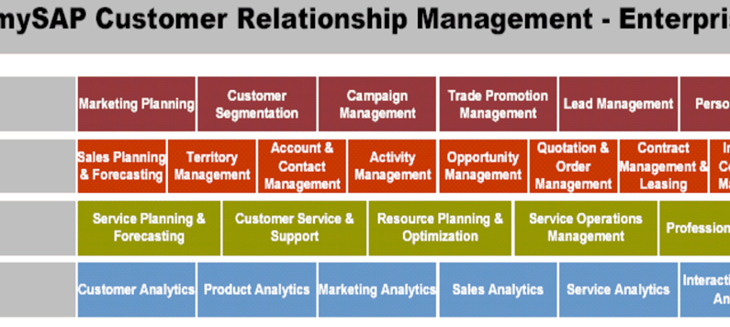
Example : SAP integrated system:
System modules are composed of various functional blocks.

Slide 7
2 Project and campaign
This concept corresponds to the idea that marketing lacks structure and rules.
• Each marketing activity is organized in an unique and original way; unexpected and innovative solutions created competitive advantage.
• It includes creating marketing campaigns, surveys of loyalty and satisfaction are organized by applying project management priciples
• Such type of systems have mainly general functionality (not necessarily related to marketing).
• Examples- Microstrategy 3-step campaign module (pre-campaign, during and post-campaign activities); marketing 4P mix search
• This concept involves matching information and goal

Slide 8
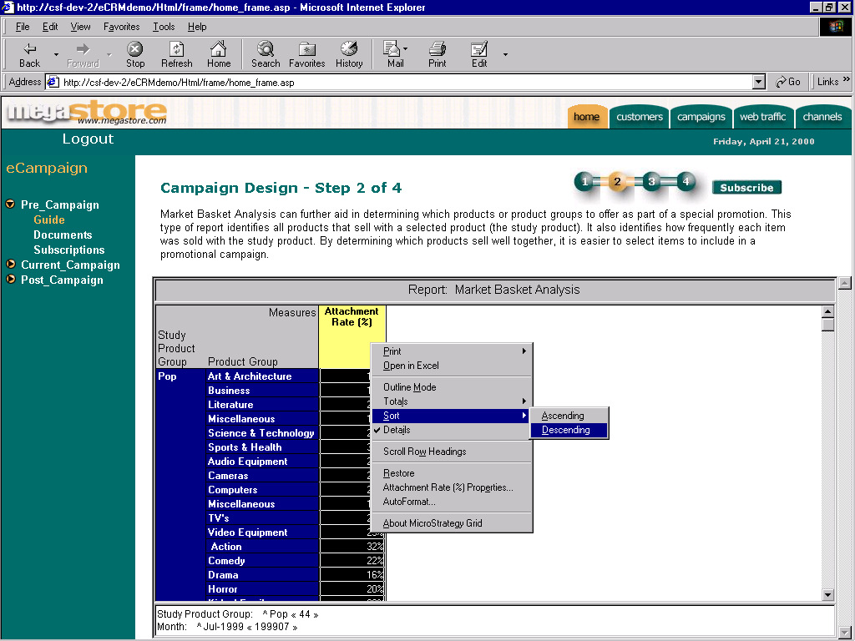

Slide 9
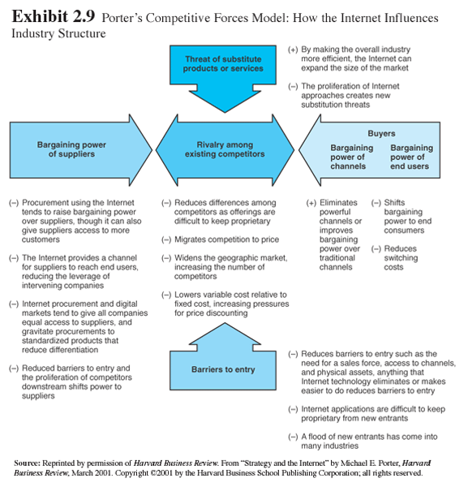
Porter’s Five Competitive Forces Model

Slide 10
3 Value chain system
These are MkIS aiming effective supply of marketing department by information from various sources emanatinng in the enterprise value chain: warehouses, point of sales terminals, mobile communications, call centres, etc
• Information from various sources is stored in data warehouses for further analysis

Slide 11
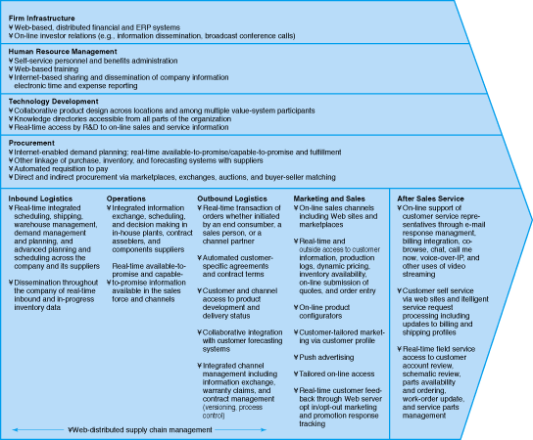
The Value chain Framework (M.Porter)

Slide 12
4 Competitive system
MkIS system has functionality which creates barrier for competitors to entry.
• Functions are specialized for business
• Airline reservation (Smart Amadeus, SABRE), pharmacy (Microstrategy Inc., SAP), parcel sending services (UPS; TNT; DHL)

Slide 13
5 End-user „ad hoc“ support
Information supply for the“ad hoc” needs of the user (high level , mid level managers)
• Include expert, executive information, rule based procedures.
• Mainly are related to dashboards

Slide 14
6 Support for marketing management processes
MkIS modules for planning, control, audit, accounting methods
• Information sources and methodology is selected by the marketing specialist
• E.g. marketing planning software

Slide 15
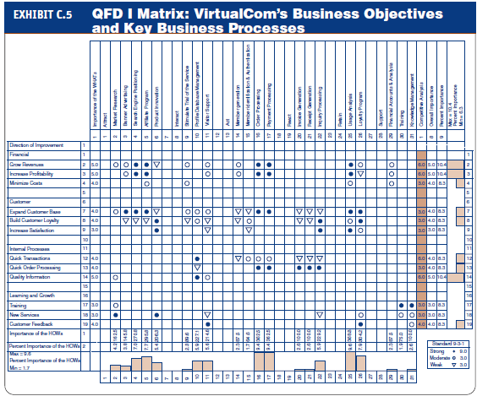
Application of Quality Function Deployment methodology for marketing (example)

Slide 16
7 Marketing intelligence system
Marketing knowledge and intelligence management
• Includes methods and functions for capturing information (surveys, social network, transcation)
• Data mining methods, computational intelligence for detecting hidden relationships

Slide 17
8 Multidimensional MkIS
Multidimensional MkIS is defined as a system,
created for providing information for marketing management processes (decision support, planning, control, organizing marketing activities),
where the input information, describing the marketing-related phenomena, is transformed into multidimensional space,
and analysed along the following dimensions:
marketing relationships,
knowledge and
balanced scorecard

Slide 18
The levels of analysis in MkIS
The analyzed MkIS can be applied for one or two levels of analysis and only for partial presentation of situation and dynamics.
• The most advanced systems from the multidimensional point of view are the CRM systems, created for enterprise relationships. They present possibility to map customer relationships, connected with related information created in various functional modules of the integrated system or ERP (MS Axapta, Microstrategy, SAP).
• The software for control by interrelated indicators (e.g.balanced scorecard, KPI, Six Sigma, etc.) is implemented in several certified integrated systems .
• The control modules exist separately and cannot express the marketing processes, situation and development in
enterprise, however they present possibility for their 20
conceptual integration into multidimensional MkIS.

Slide 19
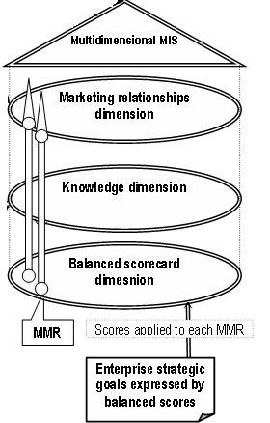
Structure and functioning of multidimensional MkIS
In the marketing relationships dimension the chart of main marketing relationships gives logical view of enterprise marketing structure.
The knowledge dimension of MkIS is formed by attaching sources of information related by context to the marketing relationships.
The balanced scorecard dimension implements the goals level, created for feedback and control of the MkIS.
New conceptual element of MkIS structure is the multidimensional marketing relationship (MMR). It is formed and parameterized at the three dimensions of MkIS (Kriksciuniene, D. 2004). 21

Slide 20
Structure and functioning of multidimensional MkIS
The understanding of vertical MkIS structure, consisting of the set of multidimensional marketing relationships, which can be formed and adapted for each enterprise .
This structure is used instead of traditional horizontal MkIS structure, combined of operational modules of various functionality.
The functioning of MkIS is based on the decomposing principle, where all the marketing processes and activities are represented as groups of related MMR

Slide 22
MKIS examples
IBM tools for marketing (Video) http://ibmtvdemo.edgesuite.net/software/analytics/cognos/videos/launch_oct2012

Slide 23
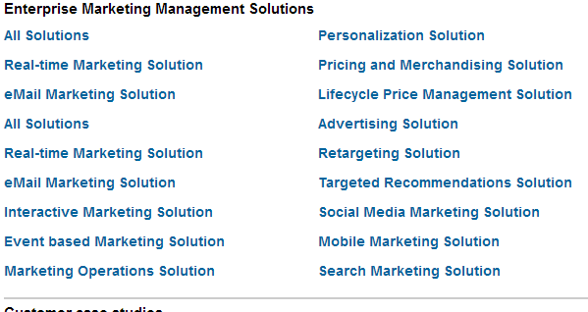
MKIS examples
http://www-03.ibm.com/software/products/en/category/SWX00?lnk=msoST-emma-usen
http://www-01.ibm.com/software/marketing-solutions/launch-fr13/index.html

Slide 24
MKIS examples

Slide 25
MKIS in real enterprises
The empirical survey results (Study materials)

Slide 26
MkIS structures in theoretical works
Ph.Kotler
McCarthy
Brandaid
Etc. modified structurograms

Slide 27
The MkIS model (subsystems)
Model : Kotler P. (2003)

Slide 28
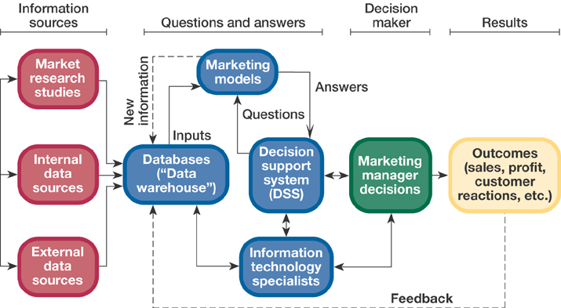
The MkIS model (McCarthy)

Slide 29
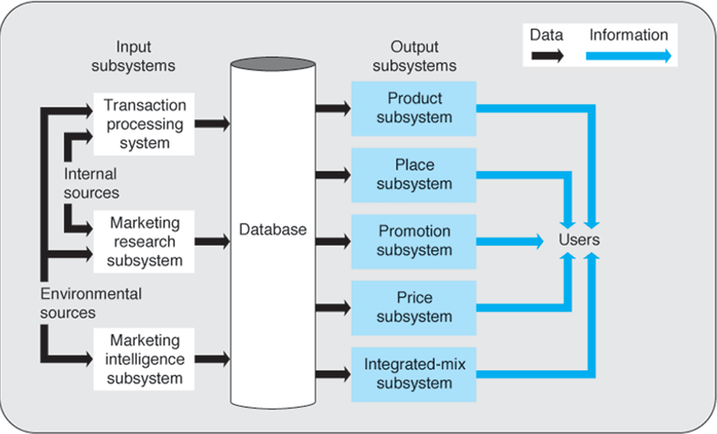
The MkIS Brandaid model (4P)

Slide 30
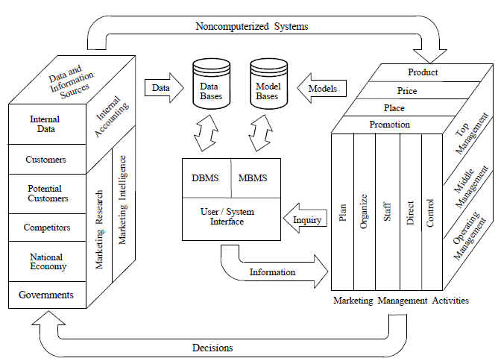
The MkIS in empirical research :
Marketing Information Systems in the Top U.S. Companies: A Longitudinal Analysis

Slide 31
Assignment 3
By using template for marketing planning (Marketing Plan Pro 6), make design for the MkIS of the enterprise
The sample enterprise- your own idea or your enterprise developed by CESIM simulation

