Slide 1
NoSQL
Marián Rusnák
Seminar of DISA Laboratory
9.12.2013

Slide 2
Outline
Motivation
What is NoSQL
Key-Value stores
Wide-Column stores
Document stores
Summary

Slide 3
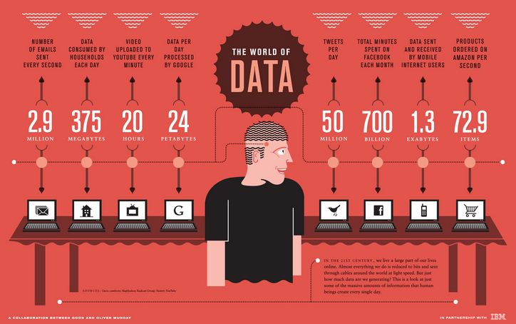

Slide 4
Motivation
Massive data volumes
Extreme query workload
Schema evolution

Slide 5
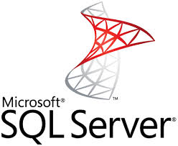
Traditional RDBMS
Transactions – ACID
Integrity
Complex queries

Slide 6
But…
Modern web apps may have different needs
Low latency
Scalability & elasticity
High availability
Flexible schemas / semi-structured data
Distributed

Slide 7
What is NoSQL
Term NoSQL
Not Only SQL
Non-relational database
Databases different from traditional RDBMS

Slide 8
What is NoSQL
Meet modern web apps requirement
Scalable
huge volumes of data
Distributed
multiple nodes
multiple datacenters
Flexible
no strict schema

Slide 9
What is NoSQL
Umbrella term for different types of datastores
Key-Value stores
Wide column stores / column families
Document stores
Graph databases
Other…

Slide 10
What is NoSQL
http://nosql-database.org/
150 NoSQL databases
Almost every big company has own solution

Slide 11
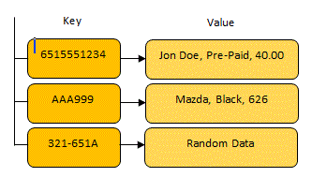
Key-Value Stores
Simplest
Largest group
Something like distributed hash tables
Examples
Amazon Dynamo
Amazon DynamoDB
Voldemort
Redis
Oracle NoSQL Database
SimpleDB

Slide 12
Dynamo
Key-Value distributed storage system
Pioneer in the area
Many features incorporated by others
Peer-to-Peer
Simple data model – unique keys, no schema

Slide 13
Dynamo
Consistent hashing
“Ring” of nodes
Virtual nodes – node has several positions in the ring
Replication
Successors in the ring

Slide 14
Dynamo
Quorum
Coordinator
R+W > N
Gossip
Failure detection
Object versioning

Slide 15
Voldemort
LinkedIn, now open-source
Based on Dynamo
Written in Java

Slide 16
Wide-Column Stores
Key is associated with multiple attributes
Inspired by Google BigTable
Examples
Google BigTable
HBase
Cassandra

Slide 17
BigTable
Proprietary
Only short info paper released
Sparse, distributed multi-dimensional sorted map
<row_key,column_key,timestamp> → <value>

Slide 18
BigTable
Rows
Data sorted by row key
Tablets
Sequence of rows
Distributed
Columns, Column families
Unlimited numbers of columns

Slide 19
BigTable
Versioning
Timestamps
Garbage collection
Stores data on Google File System

Slide 20
HBase
Inspired by BigTable
Open-source – Apache
Uses Hadoop Distributed File System

Slide 21
Cassandra
Facebook
Fast inbox search
Now open-source Apache project
Data model of BigTable
Infrastructure of Dynamo

Slide 22
Document Stores
Value is more than a string
JSON
BSON
Inspired by IBM Lotus Notes
Very flexible schema
Examples
MongoDB
CouchDB

Slide 23
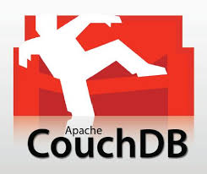
CouchDB
Open-source Apache project
Schema free
JSON format
B-Tree storage
MVCC, no locking
No joins, no primary or foreign keys
Written in Erlang
REST API

Slide 24
MongoDB
Open-source
BSON format – similar to JSON
Queries can be objects
Multiple types of indexing
Master/slave replication
Written in C++
Drivers in many languages
Most popular
23 000 questions on stackoverflow

Slide 25
Trends

Slide 26
Trends
Gaining in popularity…

Slide 27
Trends
…but still got a long way to go

Slide 28
Summary
NoSQL is suitable for modern web apps
Scalable
Distributed
Flexible
4 main types
Key-Value stores
Key to value mapping
Wide column stores / column families
More attributes associated with key
Document stores
Key to document mapping, not only to string
Graph databases
Connection between objects

Slide 29
References
SlideShare
http://www.slideshare.net/marin_dimitrov/nosql-databases-3584443
http://www.slideshare.net/dstainer/introduction-to-nosql-databases
http://www.slideshare.net/quipo/nosql-databases-why-what-and-when
Google BigTable paper
http://static.googleusercontent.com/media/research.google.com/sk//archive/bigtable-osdi06.pdf
Stanford course
http://infolab.stanford.edu/~widom/cs145/NoSQL_activity.pdf
http://www.mongodb.com/learn/nosql

