Slide 1
Towards Effective Human Motion Descriptors
Jakub Valcik
Supervisor: Pavel Zezula
Consultant: Jan Sedmidubsky
NOV 18, 2013

Slide 2
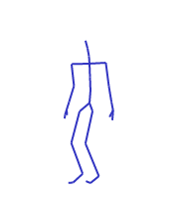
Outline
Motion Capture Data
Motivation
Evaluation Methodology
Results
Summary

Slide 3
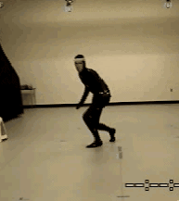
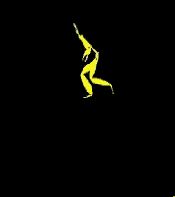
Motion Capture Data
Digitalized human motion
joint coordinates,
euler angles
Features
Derived descriptors
Movement
MoCap Data
Features

Slide 4
Optical Systems
Triangulations of the 3D position from image sensors data
Multiple high-speed video cameras 2~48 (even 300)
Markers or surface features
Passive markers
Retro-reflective material reflects light generated near the camera lens
+Wireless -Marker swapping
Active markers
LED emitting own light
Marker identified by modulation of amplitude, pulse width, time window

Slide 5
Optical Systems, cont.
Passive imperceptible markers
Up side down approach
Photosensitive markers
Depth Map
Markerless
Analysis of video
Identify human forms and brake down into constituent parts for tracking
Stanford, UMD, MIT, MPI
MS Kinect, Asus Xtion, PrimeSense Carmine, Organic Motion, Xsens

Slide 6
Non-optical systems
Inertial systems
Miniature inertial sensors
Wireless comunication
Position error accumulates over time
Wii controller
Mechanical systems
Exo-skeleton system tracks angles directly
Magnetic systems
Relative intensity of the voltage or current of coils

Slide 7
Applications
Health care – success of rehabilitative treatments
Range of joint angle rotation
Sports – performance aspect comparison
Variability of same motion – pole-jump, figure skating
Security – person identification, event detection
Gait recognition, stealing, fighting
Home for the elderly
Computer animation – realistic motion synthesis
Motion retrieval

Slide 8
Premise
Ultimate descriptor solving problems of all applications does not exist

Slide 9
Purpose
Application => Purpose
Action oriented
What?
Action, style of action, event detection
Logically similar movements
Subject oriented
Who?
Subject recognition, age, gender, drunkenness, pregnancy, skeletal disease

Slide 10
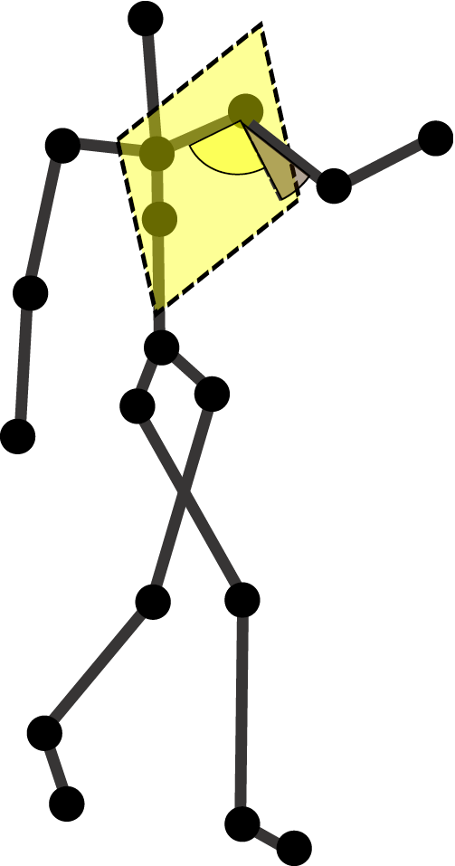
Similarity Model
Pose – skeleton configuration in one frame
Pose features – extracted from one pose
Distances between joints/planes, joint angles, velocities, accelerations, powers, torques, directions
Optional quantization
relational features, fuzzy features
Distance between:
Poses – L_{P}, Hamming, Mahalonobis
Sequences – DTW, UTW, Uniform scaling

Slide 11
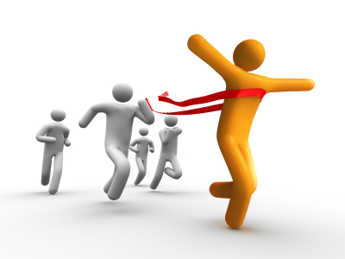
Evaluation Methodology
Choose optimal descriptor for given purpose
Test Dataset
How to interpret purpose?
Purpose
Similarity Models
Joint Angles
L1
UTW
Muller Features
Hamming distance
DTW
How to chose optimal model
Torso Declination
L1
UTW

Slide 12
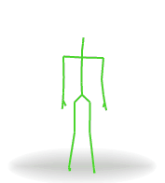
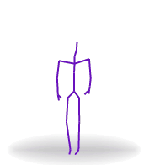
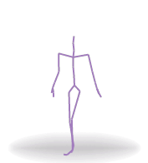
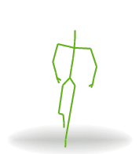
Ground Truth as a Purpose
Purpose represented by ground truth to the given test dataset
Subject_1: Seq1, Seq4, Subject_2: Seq2, Subject_3: Seq3
Bending: Seq1, Jumping: Seq2, Seq4, Throwing: Seq3

Slide 13
Measures
Retrieval Oriented
Mean Average Precision (MAP)
Mean Reciprocal Rank (MRR)
Discounted Cumulative Gain (DCG)
K-Nearest Neighbors
Space Oriented
Dunn index
Davis-Bouldin index
Distance Distribution
Time consumption

Slide 14
Results
Dataset : HDM, CMU

Slide 15
Summary
Purpose oriented descriptor evaluation
Purpose represented as a ground truth
Provided measures
Future work
Distance distribution
Statistical testing

Slide 16
Towards effective human motion descriptors
Q & A
Thank you for your attention

