Slide 1
Product and Service Dominant Logic
Introduction to Service Science
© Leonard Walletzký

Slide 2
History of economics paradigms
Economics Offering | Commodity Goods | Packaged Goods | Commodity Services | Consumer Services | Business Services
Economy | Agrarian | Industrial | Service | Experience | Transformation
Economic Function | Extract | Make | Deliver | Stage | Co-create value growth
Nature of Offering | Fungible | Tangible | Intangible | Memorable | Effectual
Key Attribute | Natural | Standard | Custom | Personal | Value growth relationship
Method of Supply | Stored in Bulk | Inventory of product | Delivered on demand | Reveal over duration | Sustained over time
Settler | Trader | Manufacturer | Provider | Stager | Collaborator
Buyer | Market | Customer | Client | Guest | Collaborator
Factors of Demand | Characteristics | Features | Benefits | Sensations | Capabilities (Cultural values)

Slide 3
Product dominant logic paradigms
A manufacturer develops a product
The manufacturer makes the product
The product is given to the market
A consumer buys the product
The consumer uses the product
The supplier eventually provides additional support of the product
The consumer gets rid of the product

Slide 4
Product dominant logic
The process is considered as an ownership transfer
The producer and buyer are not closely connected
They are in touch only in the moment of ownership transfer
The product is tangible and it is easy to convert it to money
The major task in production is an optimization of product quantity according to fixed and variable costs
The main goal is to achieve maximum profit in short term
Only difference for the services is immateriality

Slide 5
Service Economy
Service is
Associated with the work that servants did for their masters
Set of the benefits delivered from accountable service provider, mostly in close co-action with his service suppliers, generated by the functions of technical systems and/or by distinct activities of individuals, commissioned according to the needs of his service customers (Spohrer)
Application of specialized competencies through deeds, processes and performances for benefit of another entity or entity itself (Vargo and Lush)
Application of competencies for the benefit of another, meaning that service is kind of action, performance or promise that is exchanged for value between provider and client (Spohrer)

Slide 6
Service dominant logic
The emphasis is not on tangible product
Is on services the customer can get
No matter if the service is realized through the product or someone else to perform the service
Ownership is not important
The customer obtain benefits by renting to:
use a physical object
hire the labour and expertise
pay for access to facilities and networks

Slide 7
Example
Toothbrush
You buy toothbrush to clean your teeth
The service (problem to solve) = to clean dirty teeth to impress a girl / boy
The service can be enlarged by communication with the customer
For mouth wash
Specialized tooth paste – white teeth, mint breath
Electric teeth brush

Slide 8
Service dominant logic
Customers do not buy goods or services
They buy offerings which render services that create value
Traditional division between goods and services is outdated
Activities render services
Things render services
The shift in focus to services leads to shift from producer perspective to customer perspective

Slide 9
Example
Supermarket services
Home delivery
Additional services
Playground corner for customers children
Toilets
Self cash desk
Return of the goods
Helpdesks

Slide 10
Service system
Provider
Individual
Organization
Technology that provider is responsible for
Client
Individual
Organization
Portion of reality owned by Client
Target
The reality to be transformed or operated on by Provider for sake of Client
People, dimensions of business
Dimensions of products, technology artifacts & environment
Information, codified knowledge

Slide 11
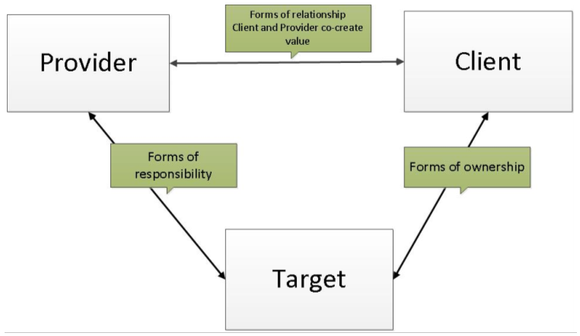
Service system

Slide 12
Basic Service Economy Paradigms
Service is the fundamental basis of exchange
The customer is always a co-creator of the value
All social and economics actors are the resource integrators
Value is always uniquely and phenomenologically determined by the beneficiary

Slide 13
Service is the fundamental basis of exchange
The application of operant resources
The seller uses his resources to provide the service
The basis for all exchange
There is not possible to simply exchange the product without using services or this possibility is only marginal
Service is exchanged for service
Services are used on both sides of the market to finish the transaction
Example: Credit cards transactions

Slide 14
The customer is always a co-creator of the value
The role of the customer is interactional
The customer can not be ignored
Without interaction with the customer the transaction can not be finished
Value creation is interactional
Example:
You can not provide the cloud service without communication with the customer and analysing of his/her needs

Slide 15
All social and economics actors are the resource integrators
Value creation is network of networks
The sellers needs to buy other services
The are customers for other providers
They also participate on value creation
The integration of the resources is kind of the service
Example
Internet provider needs to integrate:
Wired infrastructure – rent from the other company
Power supply – from electricity company

Slide 16
Value is always uniquely and phenomenologically determined by the beneficiary
Value is
Idiosyncratic
Designed for particular customer
Experiential
The knowledge and information are not static
Contextual
The combination of knowledge and information is unique in every particular case
Meaning laden
Client and provider should understand the meaning of the value (must see the value for both)

Slide 17
Advanced SDL Paradigms
Indirect exchange masks the fundamental basis of exchange
Goods are distribution mechanism for service provision
Operant resources are the fundamental source of competitive advantage
All economies are service economies
The enterprise cannot deliver value, but only value proposition
A service-centered view is inherently customer oriented and relational

Slide 18
Indirect exchange masks the fundamental basis of exchange
The application of specialized skills and knowledge is the fundamental basis of exchange
Service is provided through complex combinations of goods, money and institutions
Service basis of exchange is not always apparent
Example:
Operational leasing of the car
Car is seemed to be a prior goods
Prior is the service for the company – cost saving, additional services

Slide 19
Goods are distribution mechanism for service provision
Goods deliver their value through use
Using goods is the service
We are not buying goods to own them but to use them
Price difference is based on the difference of service the goods provide
Example:
Two phones – cheap and expensive
Both provide the basic service
The more expensive one should provide more services including prestige (Vertu luxury phones)

Slide 20
Operant resources are the fundamental source of competitive advantage
We speak bout knowledge an information intensive services
The services are provided by combination of specialized knowledge, ownership of information and combination of other resources (labour, capital)
The comparative ability to cause desired change drives competition
Example:
Apple and iPhones – new way of communication

Slide 21
All economies are service economies
Present economics systems can not exist without services
Even developing countries are dependent on services
Example: Payments are done by mobile phones
Services are now becoming more apparent with increased specialization and outsourcing
X as a Service, where X could be
Infrastructure
Software
Payment
Anything else

Slide 22
The enterprise cannot deliver value, but only value proposition
Not only enterprise, generally every entity providing a service (provider)
School, university, state
Provider can offer their applied resources for the value creation
Collaborate on value creation following acceptance of value propositions
Can not create and/or deliver value independently
Example:
University and its study programs

Slide 23
A service-centered view is inherently customer oriented and relational
Service is defined in terms of customer-determined benefit
Service is co-created with the customer
Only customer decide the final version of the service
Co-creation is inherently customer oriented and relational
Example
Development of the IT services
Always need to ask about the basic of the problem they are solving

Slide 24
Comparison:
Product Dominant Logic:
Customer is value destroyer
Customer has limited power to impact quality or features
Customer is motivated to destroy goods to buy new one
Seller is maximizing short time profit
Service Dominant Logic:
Customer is value co-creator
Customer communicate with seller about all features of the service
Long time relationship is preferred
Seller is maximizing the long time profit

Slide 25
Conclusion
Product Dominant Logic
Service Dominant logic
The paradigms of PDL and SDL
The examples of PDL and SDL

