Slide 1
Marketing Information Systems: part 1
Course code: PV250
Dalia Kriksciuniene, PhD
Faculty of Informatics, Lasaris lab., Autumn, 2014

Slide 2
Lecture 1
Definitions, functions, requirements for the marketing information systems (MKIS).
The careers and users of marketing information,
The user’ requirements for the information content, inputs, retrieval and presentation.
marketing decision making environment, complexity of rules and variables involved
  Tools &software (demo): CESIM simulation solutions for multi-stage market modelling games
  Lab work training: assignment for CESIM team simulation sessions

Slide 3
Marketing as a domain area
Object of interest in marketing information systems- marketing process, its entities and relations.
There exist many definitions of marketing- different accents (AMA-American marketing association defines)
Marketing is a social process by which individuals an groups obtain what they need and want through creating, exchanging products and value with others (Kotler, Turner, 1985)
Keywords:
  Needs, wants, demands
  Products
  Values and satisfaction
  Exchange and transactions
  Markets

Slide 4
  Needs, wants, demands
Need is a state of felt deprivation of some basic satisfaction
E.g. food, clothing –things of survival. These needs are not created by society or marketers, they exist in human biology
Wants are desires for specific satisfiers of deeper needs.
They are different is various societies: a person needs food and wants oyster, needs clothing and wants a Chanel outfit, needs esteem and wants fancy necklace. Wants are continuously reshaped by social forces and communities (families, schools, church, etc.) Marketing can create wants for the customers

Slide 5
  Needs, wants, demands
Demands are wants for specific products that are backed up by an ability and willingness to obtain them by exchange.
Wants become demands when backed up by purchasing power.
Companies have to measure not only how many people want their product but how many would actually be willing and able to buy it.

Slide 6
  Needs, wants, demands
These distinctions answer frequent critics for marketing “marketers create needs” or “marketers get people to buy things they don’t want”.
Marketers do not create needs- they preexist marketers. E.g. marketers do not create need for social status.
Along with other influential forces marketers influence wants. They suggest to consumers or try to point out how particular product would satisfy need (e.g. BMW car or Parker pen for satisfying need for social status)
Marketers try to influence demand by making product attractive, affordable, available. The demand is highly affected by competition: the want of the customer can be created by one firm but it becomes converted to the satisfied demand by the other (e.g. due to discount)

Slide 7
  Products
Broad understanding of product : anything that can be offered to someone to satisfy a need or want.
Product as a physical object serves as a vehicle for getting service (e.g. car for riding it). Services can be fulfilled by others: such as persons, places, activities, organizations, ideas.
Product covers all features (drivers) that are capable of delivering satisfaction of a want or need
Tangible and intangible products. Intangible products cover information and knowledge (tacit -which is often not documented or explicit-embedded in some format) and patents, technologies, brands (which can have certificates and can be sold (therefore obtained and exchanged in the market). Other terms for product: offer, satisfier, resource.

Slide 8
  Values and satisfaction
How do consumers choose among the products that might satisfy a given need ?
E.g. how can we travel ? By foot, roller skates, bicycle, car, plane or cruise ship.
The list makes a choice set.
According to it we make a product set
The goal set which we want to satisfy in need for traveling, e.g. speed, cost, ease. Each product has different capacity to satisfy goals.
What is the ideal product ? Product space is the rating of products by customer perception how far is is from ideal. Value (or utility) is greater if product is nearer to ideal

Slide 9
Exchange and transactions
Marketing exists when people decide to satisfy needs and wants in way we call exchange.
Four ways of exchange which can be desired by customer:
  Self production (e.g. relieve hunger by fishing) - no marketing, as there is no interaction
  Coercion (e.g. wrest food from other) – no benefit is offered to other party
  Begging (e.g. approach other)- no tangible offer, maybe except gratitude
  Exchange (offer resource in exchange for good: money, another good, service)- marketing arises from this approach
However even in the situations where there is no marketing, the marketing specialists can introduce it (e.g. computer games created for defeating enemies or robbing resources fulfill the needs of customer to experience situation of coercion

Slide 10
Exchange and transactions
Exchange is the defining concept underlying marketing- the act of obtaining desired product from someone offering something in return
Terms for exchange: leave them both better or not worse, that’s why exchange is a value creating process
Exchange has to be seen as a process, but not as event (two partied finding each other, negotiating, moving towards agreement, setting conditions, documenting, defining post-acquisition services or guarantees)
If agreement is reached, the transaction occurs.

Slide 11
Markets- different points of view
Economist view: market is the place where buyers (ask) and sellers (bid) gather and agree to make transaction (deal). Price is the main variable.
Accountants view: registering transactions and incurring costs/incomes/taxes (quantitative financial information accounting five main resources (financial, human, material, intangible, information)
Marketers view: market consists of all potential customers sharing a particular need or want, able for exchange to satisfy it. Markets are seen as buyers (their groupings, called segments), the sellers-as industries. They are connected with flows: Communication, Products (goods/services), Money, Information

Slide 12
Summary of marketing concepts
Marketing means human activity that takes place in relation to markets.
Marketer seeks for acquiring resource from someone and willing to offer something of value in exchange.
Marketer is seeking response from other party, and can take a role of seller or buyer.
The role of information system: to register activities (similar to accounting) and to play role in creating products, competitive advantage and decision making

Slide 13
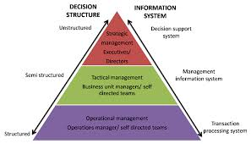
Management information system

Slide 14
Marketing management
It is the analysis, planning, implementation and control of programs
  designed to create, build, and maintain beneficial exchanges and relationships with target markets
    for the purpose of achieving organizational objectives
The organization forms the idea of a desired level of transactions with the target market. It has a task of influencing the level, timing, composition of demand according to goals.
States of demand to cope: negative absent, latent, falling, irregular, full, overfull, unwholesome demand

Slide 15
Marketing management
Marketing orientation | Focus | Means | Ends
Production concept | Mass production lowering costs and price | High production efficiency and wide distribution coverage | Sell what is produced. Leads to impersonality of consumer
Product concept | Consumer favors only products that offer most quality, performance and features | Make good products and improve them over time | Sell what producers “love” cause marketing “myopia” losing sight what customer wants
Selling concept | Product | Selling and promotion | Profits through sales volume
Marketing concept | Meet customer needs | Integrated marketing | Profits through customer satisfaction.
Societal marketing concept | Determine customer needs | Deliver needs fulfillment better than competitors | Preserve and ensure long-run society welfare

Slide 16
Marketing’s role in a company
Equal function or primary four: marketing, production, finance, personnel
More important function
Central major function
Customer –central function for controlling 4 primary functions
Customer as controlling, marketing and integrative function in the center

Slide 17
Marketing’s role in a company
Production
Finance
Marketing
Personnel
Marketing
Production
Finance
Personnel
Production, Finance, Personnel
Marketing
Customer

Slide 18
Marketing theories
Most prevailing theory is 4P (McCarthy, 1968)- marketing mix (customer, markets, etc. missing here).
Extensions of the 4P theory:
Kotler (megamarketing) 4+2P
Booms&Bitner (Service marketing) 4+3P
Baumgartner (1991) – 15P
The mix concept was initially developed by Neil Burden (1964) derived from Culliton (1948) : marketing is a mix of ingredients (12 elements +4 forces) (Product planning, pricing, branding, channels of distribution, personal selling, advertising, promotions, packaging, display, servicing, physical handling, fact finding and analysis) + (behavior of : consumers buying, trades’ (ret.wh), competitors and their position, governmental
and search for suitable set of ingredients for each transaction with customer.

Slide 19
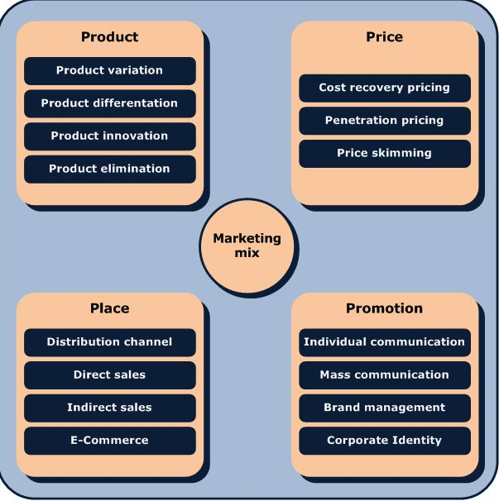
4P – marketing mix component system is too brief for its real implementation.
Its real content covers various problem areas:

Slide 20
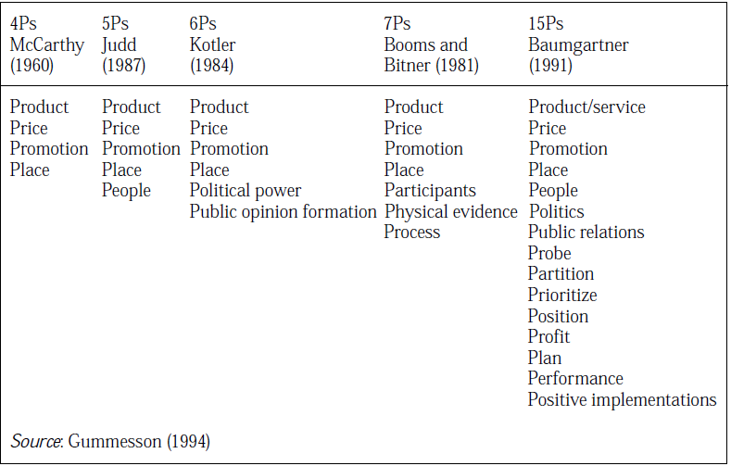
Marketing theories- summary

Slide 21
Development of marketing theories: from mix to relationships
Relationship marketing theory (Gronroos1996, Gummesson,1999 and USA “school”.
Christopher, Payne, Ballantyne (1991) Six markets
Kotler (1992) Ten players
Morgan, Hunt (1994) Ten partnerships
Gummesson 30R :classical relationships (3), special (14), mega (6), nano (7)
Relationship history of communication with customer leads to future activities including transactions.
Relationship processes can be considered as tangible, as they use resources and can be measured by quantitative indicators. They have life cycle. (Gronroos, 1996).
4P marketing is implemented by special department, and in RM all employees ar considered as “part-time marketers” (Gummesson, 1999)

Slide 22
Marketing and management processes (functions)
5 Key Functions of Management
Plan
Organise
Make decisions (Command)
Co-ordinate
Control
If the specialist does not perform any of these functions, he cannot be considered as manager.

Slide 23
Marketing work and careers
Sales manager
Sale representative
Advertising and promotion manager
Marketing researcher
Customer service manager
Product manager
Market manager
Marketing vice-president
Extensive career specifications exist in enterprises

Slide 24
Marketing work and careers (e.g. certification)
Identify information and research requirements for business and marketing decisions.
Manage the acquisition of information and the Marketing Information System (MkIS).
Contribute information and ideas for business and marketing decisions.
Create a competitive operational marketing plan appropriate to the organization's context.
Integrate appropriate marketing mix tools and manage them to achieve the effective implementation of plans

Slide 25
Marketing work and careers (e.g.certification)
Define and use appropriate measures to evaluate the effectiveness of marketing plans and activities.
Create an effective communications plan for a specific campaign.
Manage marketing communications activities.
Develop and manage support to customers and members of marketing channels.
Plan a marketing project.
Manage a team for marketing project or tasks.
Make recommendations for changes and innovations to the marketing process for value enhancement

Slide 26
Marketing skills learned by simulation tools: example of SimBrand (Cesim)
The business simulation game covers marketing skills:
product life cycle management,
segmentation,
positioning,
distribution channel investments,
advertising budget allocation,
after sales services,
pricing,
sales forecasting,
marketing research, competitor analysis,
research and development,
and financial indicators.

Slide 27
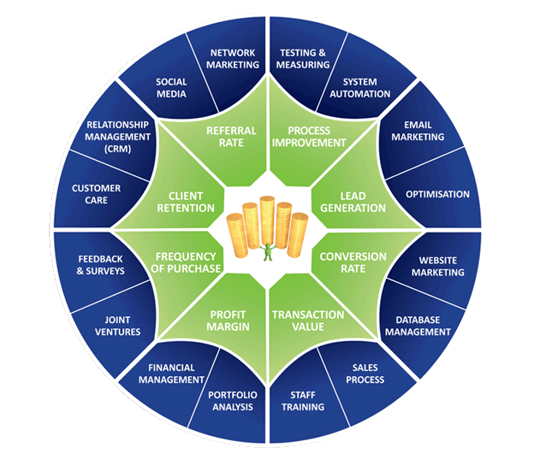
Marketing skills overview

Slide 28
Communication barrier between Market (M) and Enterprise (E)
How M evaluates E ?
If the E fits to M demands, M participants are aware of and are interested to buy E products, acquire shares, make career here. The goal is to balance supply and demand, which also ensures growth of E resources.
How M reacts to E efforts ?
M serves all customers and all competitors. M reacts in full complexity of existing relationships/hidden rules. M learns from E and creates new effects
How E evaluates M ?
If E acknowledges suitability of M for its activities, E makes efforts and supports them by its resources to make customers informed and interested for desired period of activity. E needs appropriate indicators.
How E reacts to M ?
E tries to guess which type of effort makes biggest impact to M. E can affect only part of rules of M and has only partial info for revealing them. That makes communication barrier. E needs to influence indicators

Slide 29
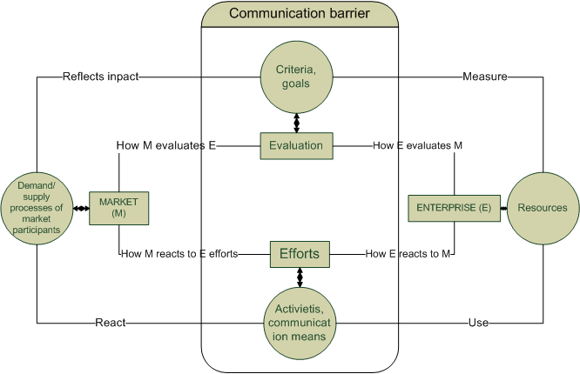
“Battlefield” for performing marketing tasks

Slide 30

MkIS as information equivalent of marketing management of the enterprise
Management information systems have to reflect reality. By looking at the system we should be aware of structure and dynamics of processes of the entire scope of marketing.
E.g. accounting system of the enterprise consists of chart of accounts interrelated by double entry principle.
What are the components of marketing system, can we consider their entirety as information equivalent of marketing?

Slide 31
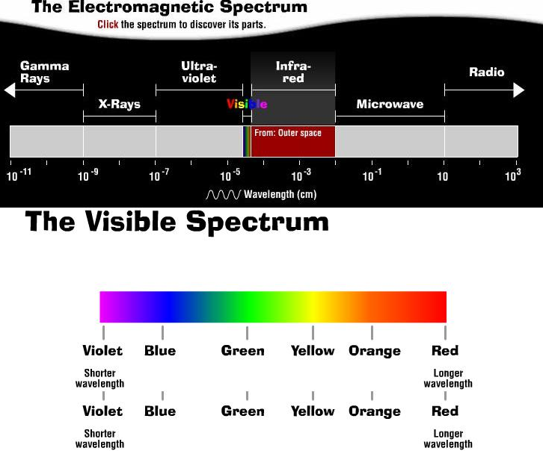

MkIS and marketing of the enterprise. What entirety we understand as system ?
Can we see more than any naked eye, or we are wearing pink-lense glasses for observing real market and our own enterprise?

Slide 32
Definitions of MkIS
MIS may be defined as a set of procedures and methods for the regular, planned collection, analysis, and presentation of information for use in making marketing decisions(Cox &Good, 1967)
MkIS comprises all computer and non-computer systems, which assist the marketing function to operate effectively. MkIS include many systems, which are not generally thought of in marketing terms, e.g. general ledger or production-planning systems.(O’Connor & Galvin 1997)
Marketing information systems are people, equipment, and procedures to gather, sort, analyze, evaluate, and distribute needed, timely, and accurate information to marketing decision makers (Armstrong & Kotler, 2007)
.. there are many more authors and definitions..

Slide 33
Requirements for MkIS by definitions

Slide 34
MkIS definition summary
The essence of a modern MkIS is
people,who take part in the processes of marketing management
by using the most recent achievements of IT.
these processes are based on the flow of information,
which enables to solve encountered problems
and generate adequate marketing decisions.

Slide 35
MkIS definition summary
MkIS definitions echo the management information system, no specific marketing-related features are presented.
The marketing manager is mentioned in the definitions without distinguishing between various types of activities, marketing tasks or hierarchical level.
MkIS is not defined as a general type of system (I-O-F), rather it is composed of computerized and non-computerized elements assisting marketing management processes.
The MkiS structure is not stable, due to changing needs in each stage of marketing processes, availability of information technologies and data, risk, uncertainty.

Slide 36
MkIS definition summary
The managers become part of group which plans information needs and implementation of MkIS. That makes MkIS unique in each enterprise.
The qualification of managers is related to information quality. Improvement of information quality characteristics should go in tune with increasing skills.
The changing environment for marketing decisions requires flexibility of inclusion required information sources.
It means that the process of creating MkIS can become ongoing, its structure composed in a flexible way from various subsystems, and corresponds to subjective needs of the managers.

Slide 37
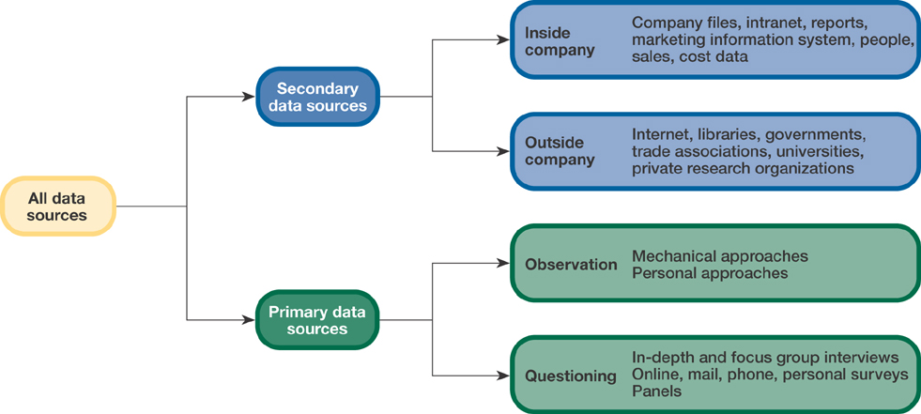
Types of information needs (classical)
Third source - knowledge of marketing manager, consisting of experience, intelligence and wisdom emanating from ability to merge and comprehend information

Slide 38
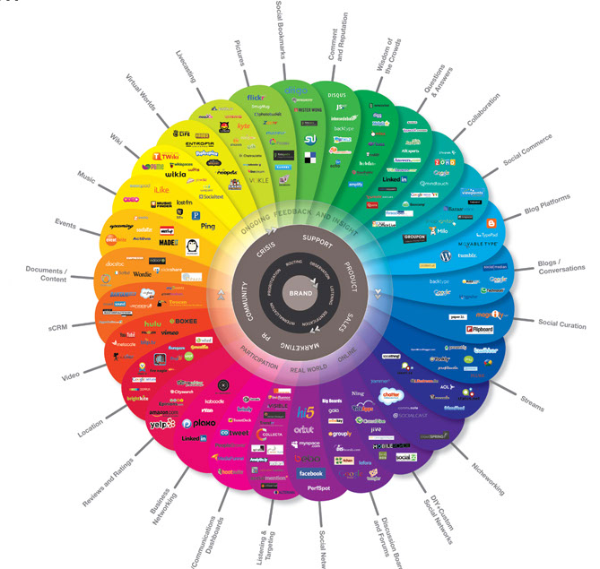
… and many more types of information sources
Where do we get information?
Who prepares it to marketing managers ?
What is the format of knowledge?

Slide 39
Influence of marketing theories to MkIS
Marketing is planned according to the 4P, it is implemented by performing different specialized tasks (market analysis, advertising, sales, customer service, etc.), it is controlled by applying historical financial indicators, although all marketing activities aim to bring changes in future.
Relationship marketing suggests describing marketing of the enterprise by its set of relationships and their dynamics.
Therefore in contrary to “4P” , the RM can serve as basis for information equivalent of the enterprise, as it creates, develops, quits R; plans, controls, organizes, makes decisions on R. R-becomes object for creating its info equivalent.

Slide 40
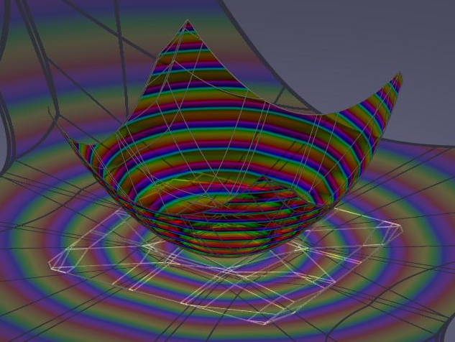
MkIS and marketing of the enterprise. What entirety makes the model of MkIS system ?
Structure of the model
Dynamics of the processes
Information describing the processes
Evaluation of the performance (measures)
Different levels of MkIS representation suggest of its multidimensional origin

Slide 41
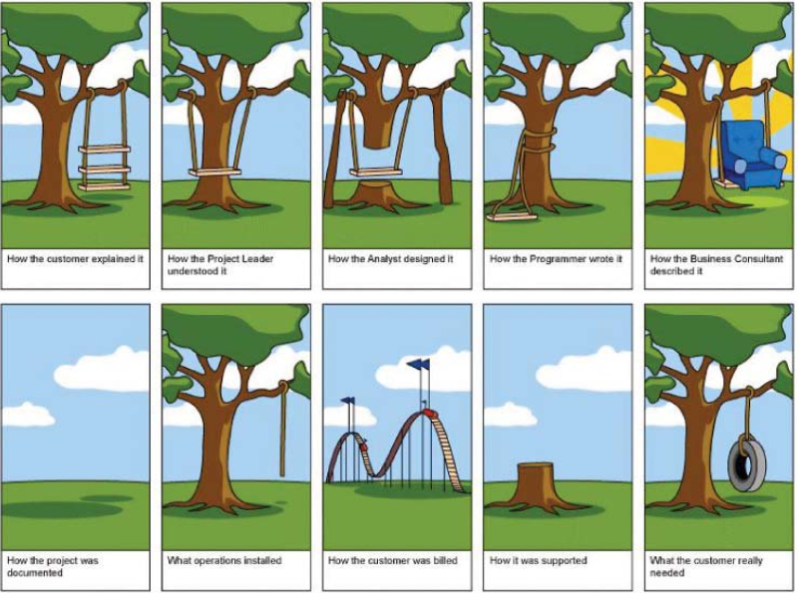
Importance of MkIS concept and model as adequate information equivalent of marketing

Slide 42
Structure of MkIS model
Many authors present their own MkIS model
What is the system model in general? What parts does it consist of?
What dimensions can be observed in marketing system?
Evaluated from system theory perspective, the suggested models can be considered as illustrative structures.
Model should reflect structure and dynamics of the system, ensuring porssibility to transfer conceptual model to the IS architectural model and implementation by IT.

Slide 43
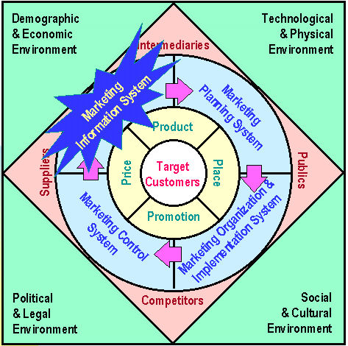
The MkIS place in marketing (Kotler)
Model : Kotler P. (2003)

Slide 44
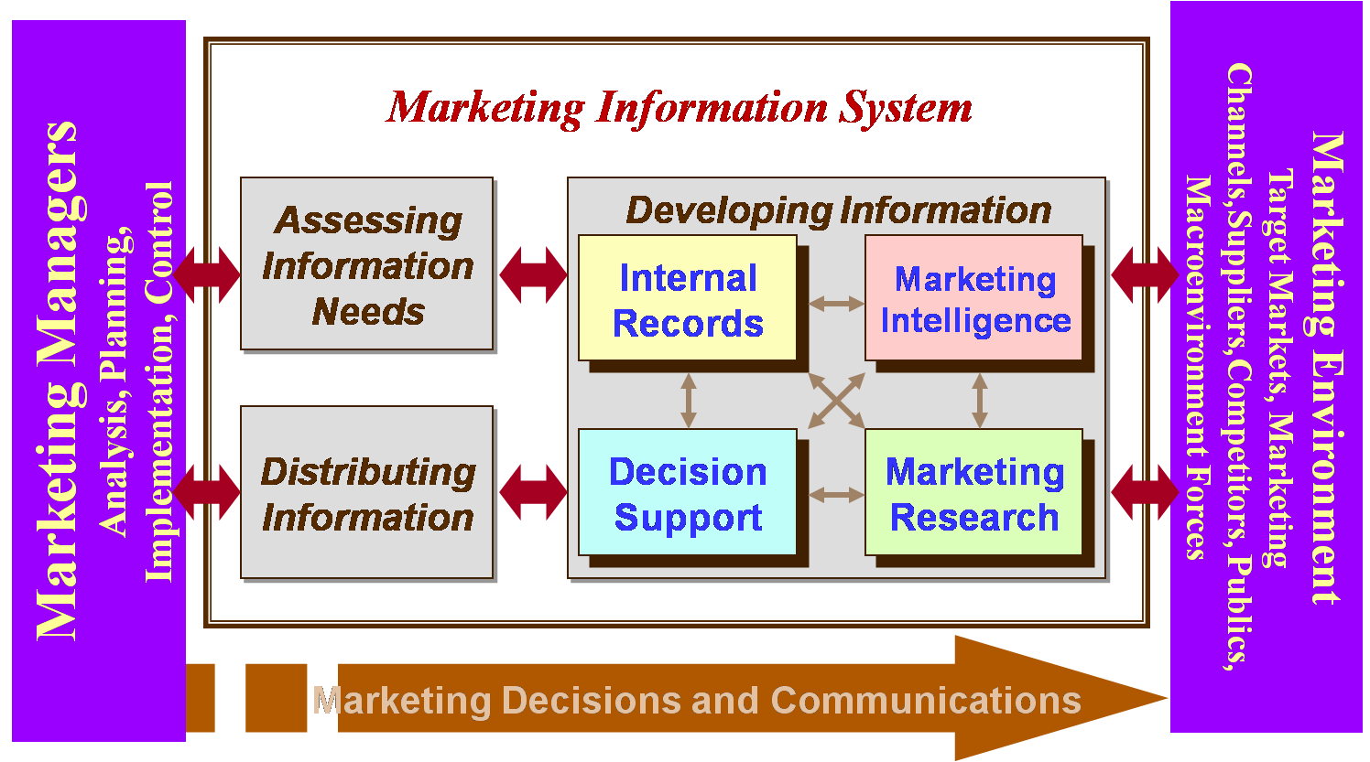
The MkIS model (subsystems)
Model : Kotler P. (2003)

Slide 45
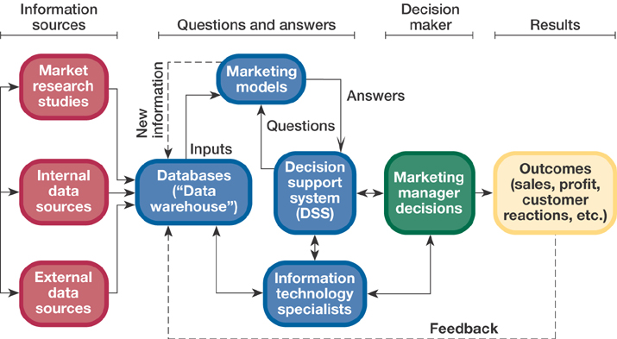
The MkIS model (McCarthy)

Slide 46
MKIS (Brandaid model)
An MKIS (Brandaid model) is made up of input and output subsystems connected by a database
The Input Subsystems are:
      Transaction processing system
      The marketing research subsystem
      The marketing intelligence subsystem
Each output subsystem provides information about four critical elements in the marketing mix:
    The product subsystem
    The place subsystem
    The promotion subsystem
    The price subsystem

Slide 47
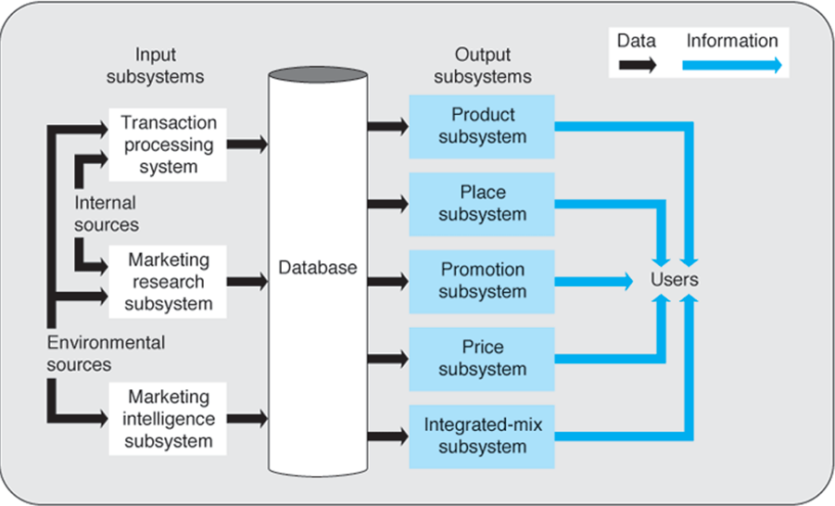
The MkIS Brandaid model (4P)

Slide 48
MkIS category of functional goal | Author, source
MkIS for collecting information and marketing research, intelligence, senvironment scanning | Kelley, 1965; Kotler, 2001
Computer support for marketing information processing, modeling | Kotler, 1985; Proctor, 1991
Creating marketing information resources for competitive advantage | O’Brien, 1990
MkIS information support to marketing functions: sales management, advertising, customer management, etc. | Moriarty and Swartz, 1989
Information support to marketing management processes, such as planning, decision- making and control. | Lucey, 1991
MkIS for needs of marketing management hierarchical levels | Lucey, 1991; O’Brien, 1990
MkIS supporting specialized functions: data processing, reporting, expert systems, decision support systems | Sprague and Carlson, 1995
MkIS specialized for business area of enterprise | Integrated IS provided by firms: Forpost, Nasdaq, Smart Amadeus, Gabriel, Sabre, Sirena, BABS,
MkIS as inseparable part of IT-enabled marketing functions: database marketing, customer relationship marketing, etc. | Integrated IS provided by firms: Oracle, Baan, Peoplesoft, Microstrategy, SAS, SAP

Slide 49
Influence factors to MkIS creation
Factor | Description
Specialization for the business area | Specialization means that MkIS is created for fulfillment and analysis of the operations of specific business: service, retailing, banking, travel agency or stock exchange. Specialization is aimed to fully adjust systems to particular set of marketing activities, related to sales management, customer service, or daily operations of marketing personnel of applied business area.
Integration of information sources of various origin | The information for marketing management is combined from sources originating in the departments of the enterprise and in its external environment. It can be intentionally collected while conducting market research as well. The important source of information is the experience and knowledge of marketing manager, as their work usually involves complex decision- making activities and require both comprehensive analysis of changing environments and a synthesis of useful information (Mintzberg, 1994a, 1994b).

Slide 50
Influence factors to MkIS creation
Factor | Description
Computerization of MkIS | The selection of possibilities for serving information needs of marketing managers is increasing with the development of information technologies. In most enterprises the computerization tools of various functionality coexist simultaneously. Surveys reveal that the most widely used computer- based systems in marketing are general IT tools such as spreadsheets, graphic packages, word processing, electronic mail, relational database systems and statistic packages. The advanced IT used for marketing are: data warehousing, OLAP, data mining, fuzzy logics, which enable to process complicated inquires, search for patterns in data, and handle imprecise decision rules.
Integration of MkIS subsystems and functions | The axis of integration of MkIS subsystems and functions indicates MkIS scope, which can vary from the tools, serving separate functions of marketing activities, to the integrated view of marketing management activities. The integrated systems include planning, decision-making or control subsystems. The functional tools include customer relationship management, e-procurement operations along supply chain, e-communication with customers and partners via internet and extranets.

Slide 51
MkIS classification

Slide 52
The MkIS model evaluation
The analysed MkIS can be applied for one or two levels of analysis and only for partial presentation of situation and dynamics.
The most advanced systems from the multidimensional point of view are the CRM systems, created for enterprise relationships, directed to customers. They present possibility to map relationships, connected with related information created in various functional modules of integrated system (MS Axapta, Microstrategy, SAP).
The software for control (e.g.balanced scorecard) is created in several integrated systems (Axapta, SAP), These parts exist separately and cannot express the marketing processes, situation and development in enterprise, but present possibility for their conceptual integration in a MkIS
The new theoretical developments of relationship marketing, knowledge management, balanced scorecard have major influence for MkIS creation principles. Their integrated use enables the information processing in three levels- logical, informational and goals- and can serve as basis for multidimensional MkIS structure

Slide 53
Decision-making process in MkIS

Slide 54
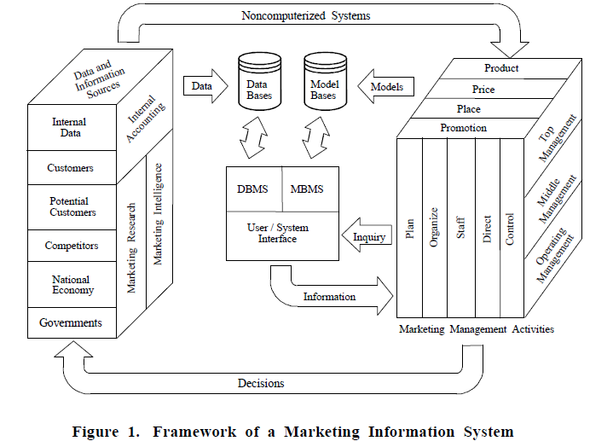
What do you look for in the enterprise if you analyse MkIS ? – there’s no standard model
Eldon Y. Li Marketing Information Systems in the Top U.S. Companies: A Longitudinal Analysis. Information & Management, 28(1), 1995, 13-31

Slide 55
IT approach : Business intelligence and analytics tools : no standard model too
Visualization empowerment
Creating variables and indicators from available data
Making analytics for extracting knowledge about their interrelationships and rule
(Examples)

Slide 56
Interrelationship of MIS, MkIS and IT concepts
Marketing IS concepts | Management IS creation concepts (O‘Brien, 1990) | IT concepts (O‘Brien, 1990), Zikmund et al 2003)
1 Integration of functional modules | Management operations processing | Transactional processing
2 Project and campaign | Creating strategic advantage ERP (enterprise resource planning) CRM | Analytic applications, EAI (enterprise application integration), CRM
3 Value chain system
4 Competitive system
5 End-user „ad hoc“ support
6 Support for marketing management processes 7 Marketing intelligence system 8 Multidimensional MkIS | Decision making support (DSS) Expert systems (ES) Executive information systems (EIS) Business intelligence systems (BI) | data warehouses, data mining, OLAP (online analytical processing)

Slide 57
Interrelationship of MIS, MkIS and IT concepts
Different concepts can be identified by analysis of functionality and structure of the existing MkIS models.
However they all are based on combining different information processing methods implemented in MkIS functional subsystems and cannot serve the multidimensional origin of information processing of marketing managers
The MIS and IT concepts for MkIS implementation describe different perspectives of the same system.

Slide 58
Examples of IT roles in marketing
http://www.esri.com/
http://www.microstrategy.com/
http://www.microsoft.com/en-us/dynamics/crm-customer-center/create-or-edit-a-campaign-in-the-crm-marketing-work-area.aspx

Slide 59
Assignment
  Tools &software (demo): CESIM simulation solutions for multi-stage market modelling games
  Lab work training: assignment for CESIM team simulation sessions.
  The game Simbrand
  Game description video: www.cesim.com /resources
  Team access http://sim.cesim.com/
  User names: Assignment_1.doc
  The simulation: Rinkos modeliavimas (RMOD)
  Timetable for submitting decisions set in the simulation area

Slide 60
Literature
Berry, M.,J.A., Linoff, G.S. (2011), "Data Mining Techniques: For Marketing, Sales, and Customer Relationship Management", (3rd ed.), Indianapolis: Wiley Publishing, Inc.
Wood, M., B. (2005). The marketing plan handbook (2nd edition). Upper Saddle River, New Jersey: Pearson Education Inc. (Marketing Plan Pro 6.0 software embedded)
Ball, D., A., McCulloch, W., H., Frantz, P., L., Geringer, J., M., Minor, M., S. (2006) International business. The challenge of global competition. 10th edition. McGraw-Hill/ Irwin
CESIM business modelling games (www.cesim.com)
Sugar CRM Implementation http://www.optimuscrm.com/index.php?lang=en
Statsoft: the creators of Statistica http://www.statsoft.com
Viscovery Somine http://www.viscovery.net/
MS Axapta Dyn. http://www.microsoft.com/en-us/dynamics/erp-ax-overview.aspx
Online scientific databases accessed via library.muni.cz
Kotler, Ph. Marketing management (any edition)

