Slide 1
Marketing Information Systems: part 3
Course code: PV250
Dalia Kriksciuniene, PhD
Faculty of Informatics, Lasaris lab., Autumn, 2014

Slide 2
Computational methods for marketing
Business intelligence: analytical reporting (pivoting)
Statistical methods: probabilistic
Artificial intelligence: directed learning:
  Neural networks NN
  Memory-Based Reasoning MBR
  Survival analysis
Artificial intelligence: undirected learning:
  Segmentation
  Clustering
  Association rules
Fuzzy inference (possibilities, natural language reasoning)
Web data mining

Slide 3
Data Mining Techniques Applications
Marketing – Predictive DM techniques, like artificial neural networks (ANN), have been used for target marketing including market segmentation.
Direct marketing – customers are likely to respond to new products based on their previous consumer behavior.
Retail – DM methods have likewise been used for sales forecasting.
Market basket analysis – uncover which products are likely to be purchased together.

Slide 4
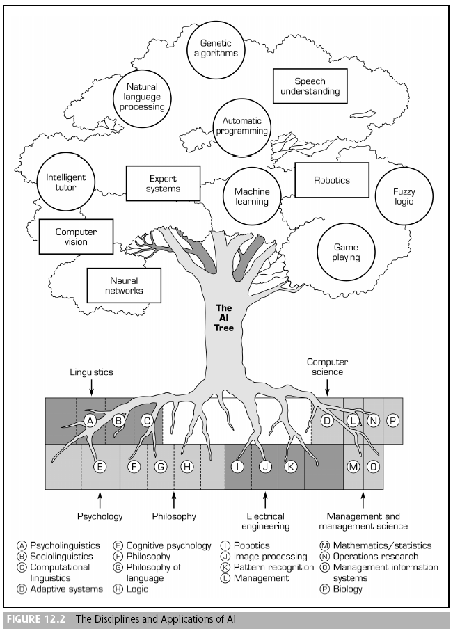
  Artificial intelligence (AI):
  The subfield of computer science concerned with symbolic reasoning and problem solving

Slide 5
Characteristics of artificial intelligence
  Symbolic processing (versus Numeric)
  Heuristic (versus algorithmic)
  Inferencing
  Machine learning
  Heuristics
  Informal, judgmental knowledge of an application area that constitutes the “rules of good judgment” in the field. Heuristics also encompasses the knowledge of how to solve problems efficiently and effectively, how to plan steps in solving a complex problem, how to improve performance, and so forth.
  It can be transferred as tacit knowledge
  Marketing activities are heuristic to high extent

Slide 6
Characteristics of artificial intelligence
  Inferencing
    Reasoning capabilities that can build higher-level knowledge from existing heuristics
    Expert knowledge and experience capturing
  Machine learning
    Learning capabilities that allow systems to adjust their behavior and react to changes in the outside environment

Slide 7
Designing the Knowledge Discovery System
  Business Understanding – To obtain the highest benefit from data mining, there must be a clear statement of the business objectives.
  Data Understanding – Knowing the data well can permit the designer to tailor the algorithm or tools used for data mining to his/her specific problem.
  Data Preparation – Data selection, variable construction and transformation, integration, and formatting
  Model building and validation – Building an accurate model is a trial and error process. The process often requires data mining specialist to iteratively try several options, until the best model emerges.
  Evaluation and interpretation – Once the model is determined, the validation dataset is fed through the model.
  Deployment – Involves implementing the ‘live’ model within an organization to aid the decision making process.

Slide 8
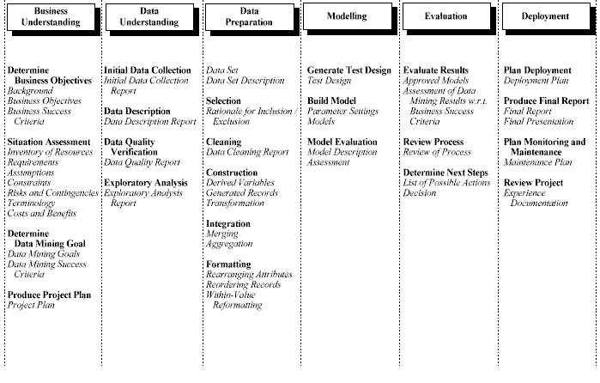
CRISP-DM Data Mining Process Methodology

Slide 9
The Iterative Nature of the Knowledge Discovery process

Slide 10
Data Mining Technique categories
Predictive Techniques
  Classification: serve to classify the discrete outcome variable.
  Prediction or Estimation: predict a continuous outcome (as opposed to classification techniques that predict discrete outcomes).
Descriptive Techniques
  Affinity or association: serve to find items closely associated in the data set.
  Clustering: create clusters according to similarity defined by complex of variables of input objects, rather than an outcome variable.

Slide 11
Web Data Mining - Types
Web structure mining – Examines how the Web documents are structured, and attempts to discover the model underlying the link structures of the Web.
  Intra-page structure mining evaluates the arrangement of the various HTML or XML tags within a page
  Inter-page structure refers to hyper-links connecting one page to another.
Web usage mining (Clickstream Analysis) – Involves the identification of patterns in user navigation through Web pages in a domain.
  Processing, Pattern analysis, and Pattern discovery
Web content mining – Used to discover what a Web page is about and how to uncover new knowledge from it.

Slide 12
Barriers to the use of DM
Two of the most significant barriers that prevented the earlier deployment of knowledge discovery in the business relate to:
  Lack of data to support the analysis
  Limited computing power to perform the mathematical calculations required by the data mining algorithms.

Slide 13
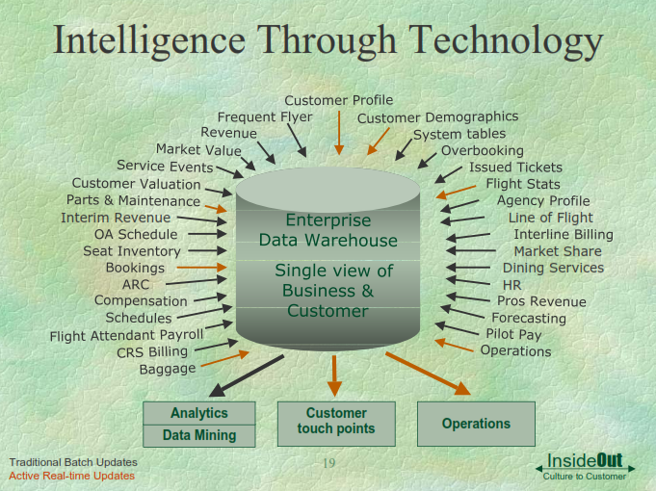
Variables for consideration in airline planning

Slide 14
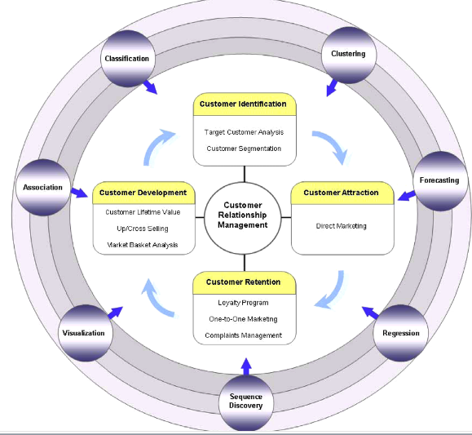
Classification of data mining methods for CRM

Slide 15
Neural networks
They are used for classification, regression, time series forecasting tasks
Supervised and unsupervised learning
Supervised means, that you have data samples with the known outcome (e.g. credit success and failure cases). Theses samples are used for creating NN model by learning. The outcome for new unknown samples is computed according to NN model
Unsupervised means, that we do not know the outcome for samples, but we can cluster them according to their similarity by taking into account all known information, put into data records consinsting of many variables.

Slide 16
Good NN problem has following characteristics
Inputs are well understood. You know which features (indicators) are important, but not necessarily know how to combine them
Outputs are well understood. You know wht you try to model
Experience is available- you have enough examples where both input and output are known. These cases will be used to train network
A black box model is acceptable. Explaining and interpreting model is not necessary

Slide 17
Neural network analysis
Neural network performance is based on node’s activation function
Inputs are combined into single value, then passed to transfer function to produce output
Each input has its own weight
Usually combination function is a weighted sum
Other possibilities-max function (e.g. radial basis network has other combination)
Transfer function is made by 0-1 or sigmoid (continuous)
If linear- neural network is the same as linear regression
Sigmoid is sensitive in middle range: small change makes big difference

Slide 18
Neural network analysis
NN has linear behavior similarity in large ranges and non-linear in small
Power of NN is in non-linear behavior due to activation of constituent unite
It leads to requirement to have similar ranges of inputs (standardized or near to 0)
In this case weight adjustment will have bigger impact

Slide 19
Neural network models
The generally applied network types for designing neural network models are Multilayer Perceptron, Radial Basis Function and Probabilistic Neural Network.
The main difference is in their algorithms, used for analysis and grouping of the input cases for further classification.

Slide 20
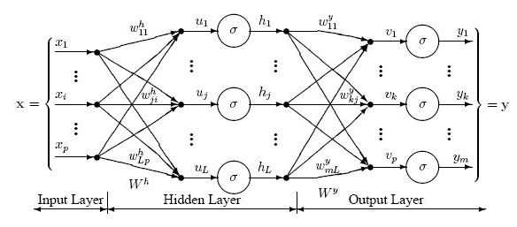
The Multilayer Perceptron NN model
The following diagram illustrates a perceptron network with three layers:
This network has an input layer (on the left) with three neurons, one hidden layer (in the middle) with three neurons and an output layer (on the right) with three neurons.
There is one neuron in the input layer for each predictor variable. In the case of categorical variables, N-1 neurons are used to represent the N categories of the variable.

Slide 21
Multilayer perceptron
Hidden layer gets inputs from all nodes in input layer
Standardization is important
In hidden layer – hyperbolic tangent is preferred, as it gives positive and negative values
Transfer function depends on target
  For continuous- linear is preferred
  For binary- logistic, which behaves as probability
One hidden layer is usually sufficient
The wider it is, the bigger capacity NN gains
The drawback of increasing hidden layer is memorizing instead of generalizing (overfit)

Slide 22
Multilayer perceptron
A small number of hidden layer nodes with non-linear transfer functions are sufficient for very flexible models
Output is weighted linear combination
Usually output is one value and is calculated from all nodes of hidden layer
One additional input- constant which is weighted as well
Topologies can vary- NN can have more outputs (e.g. calculating probability that customer will by in each of the departments NN has output for each department)
The results can be used in different ways, usually selected by experimenting: take max, take top 3, take those above threshold, take meeting percentage from maxs

Slide 23
Multilayer perceptron
Training is performed for one set in order to test performance with the other
It is similar to finding one best fit line for regresssion
In NN there is no single case of best fit, it uses optimization
Goal is to find set of weights which minimize the overall error function, e.g. average square error

Slide 24
Multilayer perceptron
First successful training method- back propogation, 3 steps:
Get data, compute outputs with existing weights of the system (e.g. random)
Calculate overall error by taking difference of actual values
Error is sent back to network, weights are adjusted
Then blame is adjusted to nodes, and weights adjusted for these nodes
(complex math procedure of partial derivatives is used)
After sufficient generations and showing sufficient training samples the error no longer decreases- stop

Slide 25
Multilayer perceptron
The weights are adjusted: if their change decrease overall error (not eliminate)
After sufficient generations and showing sufficient training samples the error no longer decreases- stop
Training set has to be balances to have enough various cases as goal is to generalize
This technique is called generalization delta rule-2 param:
  Momentum- weight remembers which direction is was changing, it tries to go same direction. If momentum is high the NN responds slowly to samples which try to change direction. Low momentum allows flexibility
  Learning rate controls how quickly weights change. Best approach is to start big and decrease slowly as NN is being trained.

Slide 26
Multilayer perceptron
Initially weights are random
Large oscillations are useful
Getting closer to optimal, learning rate should decrease
There are more methods, the goal for all of them – to arrive quickly to optimal

Slide 27
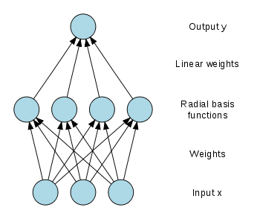
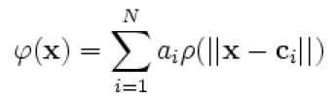

Radial basis function network
Fitting a curve exactly through a set of points
  Weighted distances are computed between the input x and a set of prototypes
  These scale distances are then transformed through a set of nonlinear basis functions h, and these outputs are summed up in a linear combination with the original inputs and a constant.
Radial basis function network
Notes:
27

Slide 28
Radial basis function network RBF
They differ from MLPin 2 ways:
  Interpretation relies on geometry rather than biology
  Training method is different as in addition to optimizing weights used to combine outputs of RBF nodes , the nodes themselves have parameters that can be optimized
As with other types of NN the data processed is always numeric, so it is possibles to interpret any input record as point in space

Slide 29
Radial basis function network
In RBF network hidden layer nodes are also points in same space, Each has address specified by vector of elements which number equals to no. of variables
Instead of combination and transfer functions the RBF have distance and transfer functions
Distant function os standard Euclidean – suqare root of quadratic distances of each dimension
The nodes output is non-linear function of how dimension is close to the input is: the closer the input, the stronger the output.

Slide 30
Radial basis function network
„Radial“ refers to the fact that all inputs of same distance from node‘s position produce same output
In two dimensions they produc circle, in 3D- sphere
RBF nodes are in hidden layer and also have transfer functions
Instead of S-shape (as in MLP) these are bell-shape Gaussians (multidimensional normal curve)
Unlike MLP the RBF does not have weights associated with connections between input and hidden layers

Slide 31
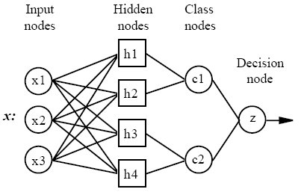
Probabilistic NN

Slide 32
Probabilistic Neural Network model
This type of network copies every training case to the hidden layer of the network, where the Gaussian kernel-based estimation is further applied. The output layer is then reduced, by making estimations from each hidden unit.
The training is extremely fast, as it just copies the training cases after their normalization to the network. But this procedure tends to make the neural network very large, therefore this makes them slow to execute.

Slide 33
Probabilistic Neural Network model
During the testing stage the Probabilistic Neural Network model requires a number of operations approximately proportional to the square of the number of training cases, therefore for the large number of cases the total duration of creating model becomes similar to the other network types that are usually described as being far slower to train (e.g. multilayer perceptrons).
If the prior probabilities (of class distribution) are known and different from the frequency distribution of the training set, they can be incorporated in training of the network model, otherwise the distribution is described by frequency (StatSoft Inc.).

Slide 34
  Memory-Based Reasoning MBR
MBR belong to the class of tasks- Nearest neighbour techniques
MBR results are based on analogous situations in past
Application:
  Collaborative filtering (not only similarity among neighbours but also their preferences), customer response to offer
  Text mining approach
  Acoustic engineering: mobile app Shazam which identifies songs from snippets captured in mobile phone
  Fraud detection (similarity to known cases)

Slide 35
Memory-Based Reasoning MBR
MBR uses data as it is. Unlike other DM techniques it does not care of data formats
Main components: distance function between two records and combination function (combine results from several neighbors and give result)
Ability to adapt- add new categories
Does not need long training, e.g. for Shazam app new songs are added on daily basis and app just works
Disadvantage- method requires larga sample data base. Classifying new record needs processing all historizal records

Slide 36
  Survival analysis
  It means time-to-event analysis. It tells when to start worrying about customers doing something important
  It identifies which factors are most correlated with the event
  Survival curves provide snapshots of customers and their life cycles, it takes care of very important facet of customer behaviour- tenure.
    When customer is likely to leave
    .. Or migrate to other customer segment
    Compound effect of other factors to tenure

Slide 37
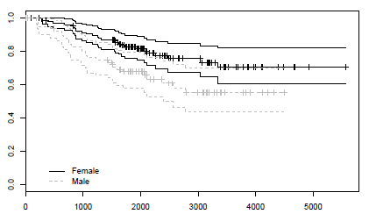
Survival analysis
Survival curve plotting: proportion of customers that are expected to survive up to particular point in tenute, based of historical info, how long customers survived in past : starts at 100%, decreases
Graph procedures: Cox proportional hazards regression model. It shows how many customers are here after some time (e.g. 2000 days). Likelihood that they will stay longer.and the differences between two groups

Slide 38
Association rules
They allow analysts and researchers to uncover hidden patterns in large data sets, such as "customers who order product A often also order product B or C" or "employees who said positive things about initiative X also frequently complain about issue Y but are happy with issue Z.“
Supports all common types of variables or formats in which categories, items, or transactions are recorded:Categorical Variables, Multiple Response Variables, Multiple Dichotomies. STATISTICA Association Rules (e.g., information regarding purchases of consumer items)

Slide 39
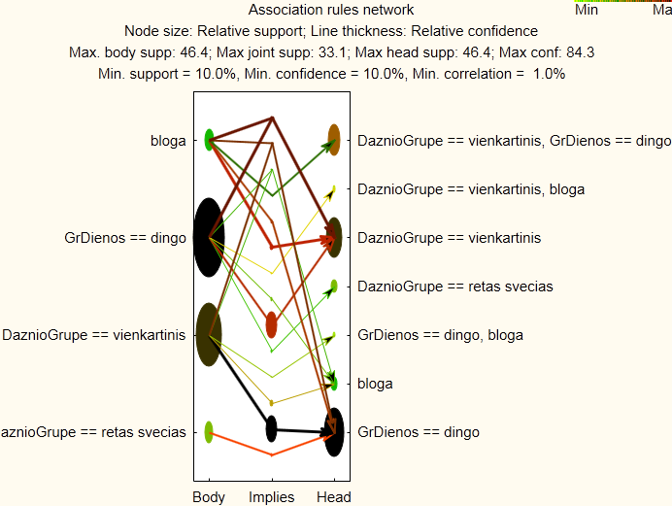
Association rules

Slide 40
SOM – self organizing maps
A self-organizing map (SOM) or self-organizing feature map (SOFM) is a type of artificial neural network that is trained using unsupervised learning to produce a low-dimensional (typically two-dimensional), discretized representation of the input space of the training samples, called a map. Self-organizing maps are different from other artificial neural networks in the sense that they use a neighborhood function to preserve the topological properties of the input space.

Slide 41
SOM – self organizing maps
For data mining purposes, it has become a standard to approximate the SOM by a two-dimensional hexagonal grid. The “nodes” on the grid are associated so-called “reference vectors” which point to distinct regions in the original data space. Starting with sets of numerical, multivariate data, these reference vectors on the grid gradually adapt to the intrinsic shape of the data distribution, whereby the reference vectors of neighbored nodes point to adjacent regions in the data space. Thus the order on the grid reflects the neighborhood within the data, such that data distribution features can be read directly from the emerging landscape on the grid.

Slide 42

SOM – self organizing maps

Slide 43
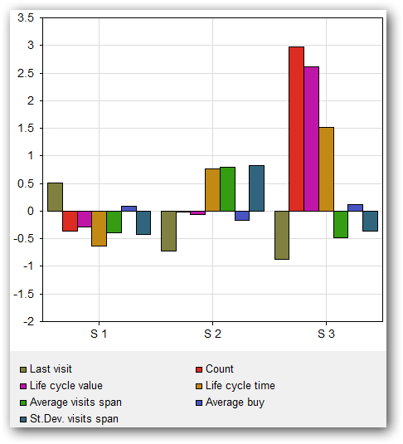
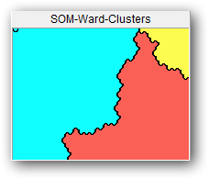
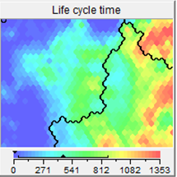
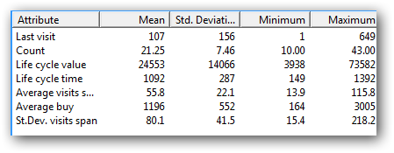
SOM – self organizing maps: cluster differences, influence of single variable to cluster separation

Slide 44
Fuzzy inference
Basic approach of ANFIS
Adaptive networks
Generalization
Specialization
Neural networks
Fuzzy inference
systems
ANFIS
Notes:
Our approach of using ANFIS as a neuro-fuzzy modeling tool is like this. First we generalize neural networks?architectures to obtain adaptive networks, and then we do a specialization to derive fuzzy inference systems represented by adaptive networks, and that ANFIS. During the processes of generalization and specialization, the backpropagation techniques used for training neural networks can be carried over directly, so we can train ANFIS using the same techniques. (In fact backpropagation is too slow, so we have some other technique to speed up training in ANFIS.)

Slide 45
Fuzzy Sets
Sets with fuzzy boundaries
A = Set of tall people
Crisp set A
Fuzzy set A
1.0
1.0
.9
.5
Membership
function
170
170
180
Heights
(cm)
Heights
(cm)
Notes:
A fuzzy set is a set with fuzzy boundary. Suppose that A is the set of tall people. In a conventional set, or crisp set, an element is either belong to not belong to a set; there nothing in between. Therefore to define a crisp set A, we need to find a number, say, 5??, such that for a person taller than this number, he or she is in the set of tall people. For a fuzzy version of set A, we allow the degree of belonging to vary between 0 and 1. Therefore for a person with height 5??, we can say that he or she is tall to the degree of 0.5. And for a 6-foot-high person, he or she is tall to the degree of .9. So everything is a matter of degree in fuzzy sets. If we plot the degree of belonging w.r.t. heights, the curve is called a membership function. Because of its smooth transition, a fuzzy set is a better representation of our mental model of all? Moreover, if a fuzzy set has a step-function-like membership function, it reduces to the common crisp set.

Slide 46
Membership Functions (MFs)
  Subjective measures
  Not probability functions
MFs
“tall” in Taiwan
.8
.5
“tall” in the US
“tall” in NBA
.1
180
Heights
(cm)
Notes:
Here I like to emphasize some important properties of membership functions. First of all, it subjective measure; my membership function of all?is likely to be different from yours. Also it context sensitive. For example, I 5?1? and I considered pretty tall in Taiwan. But in the States, I only considered medium build, so may be only tall to the degree of .5. But if I an NBA player, Il be considered pretty short, cannot even do a slam dunk! So as you can see here, we have three different MFs for all?in different contexts. Although they are different, they do share some common characteristics --- for one thing, they are all monotonically increasing from 0 to 1. Because the membership function represents a subjective measure, it not probability function at all.

Slide 47
Fuzzy Inference System (FIS)
If speed is low then resistance = 2
If speed is medium then resistance = 4*speed
If speed is high then resistance = 8*speed
MFs
low
medium
high
.8
.3
.1
2
Speed
Rule 1: w1 = .3; r1 = 2
Rule 2: w2 = .8; r2 = 4*2
Rule 3: w3 = .1; r3 = 8*2
Resistance = Σ(wi*ri) / Σwi
= 7.12
Notes:
A single fuzzy rule is not very interesting. But if we have a collection of fuzzy rules, we can use them to describe a system behavior. This leads to a fuzzy inference system. For instance, we can describe the resistance experienced by a moving object by the following three rules: .... Then given a crisp speed value, how do we find the resistance value from these three rules? It quite simple and can be done in three steps. In the first step, we find the membership grades for ow? edium? and igh? For instance, if speed is 2, the membership grades for ow? edium?and igh?are .3, .8, and .1, respectively. These numbers also represent how the given input condition peed = 2?satisfies the IF part of the rules. Sometimes these numbers are called the firing strengths of the rules. In the second step, we find the output of each rule, given speed is 2. In the third step, we apply a weighted average method to find the overall resistance, where the weighting factors are equal to the firing strengths of the rules. The whole process to derive the output from a given input condition is called fuzzy reasoning. For a two-input FIS, the process of fuzzy reasoning is better represented by the following diagram.

Slide 48
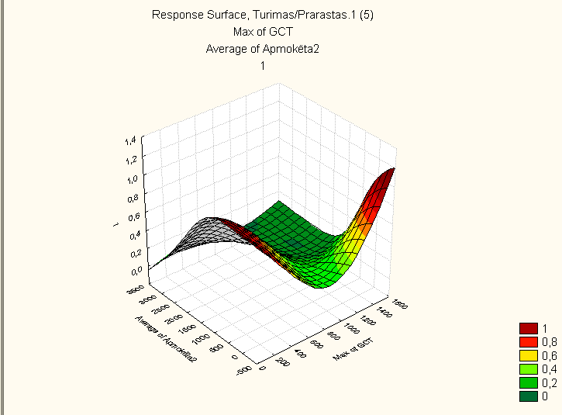
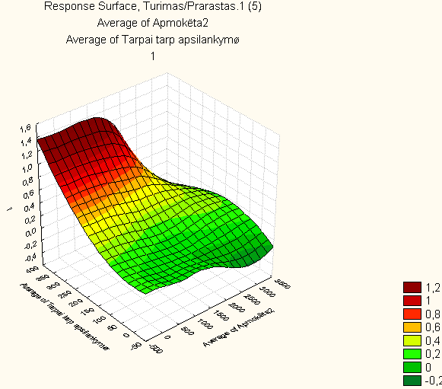
Fuzzy inference: surface diagrams for relationship among variables

Slide 49
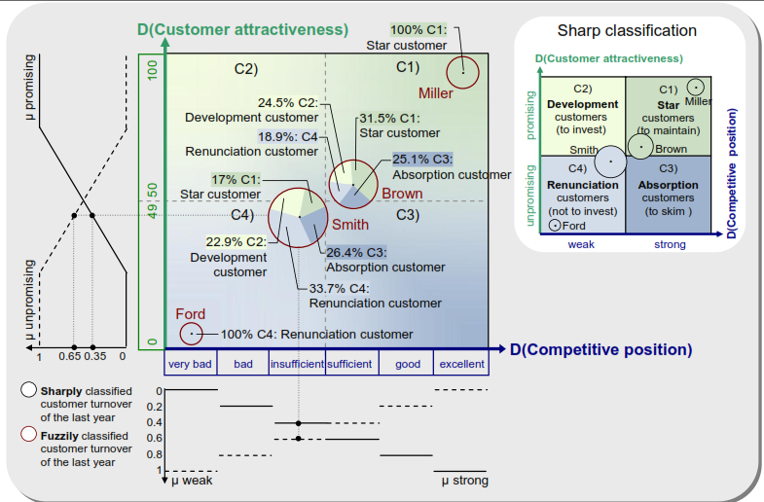
Fuzzy methods for marketing

Slide 50
Combining methods for exploring customer performance
Computing and dynamically updating CRM variables
Classification by neural networks
Defining sensitivity of variables during life cycle of customer base
Defining clusters and ranking variable sets
Fuzzy rules for assigning customers to clusters
Migrating customers among clusters

Slide 51
Web data mining
Indicators for evaluation
Opinion mining
Text mining approaches and process
Static analytic
Dynamic analytic
Sentiment analysis
Classification
Social network generation for analysis
Social network analysis approach

Slide 52
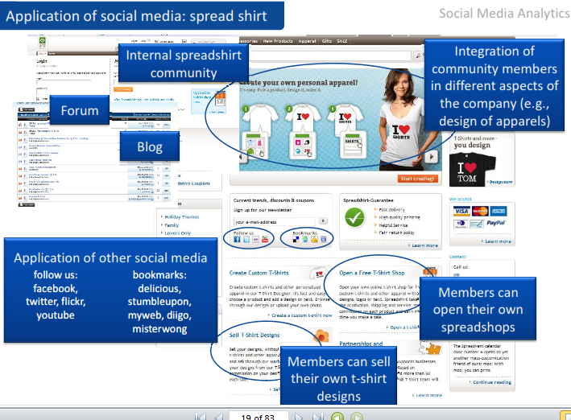
Social media analytics

Slide 53
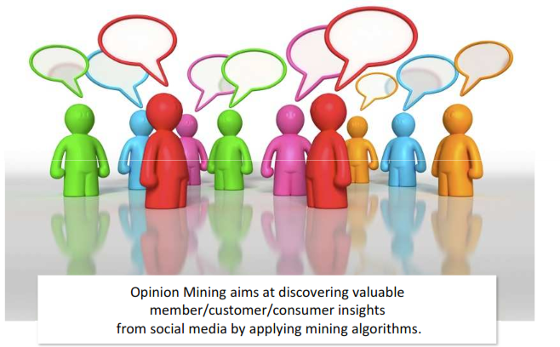
Analytic types in social media: Opinion mining

Slide 54
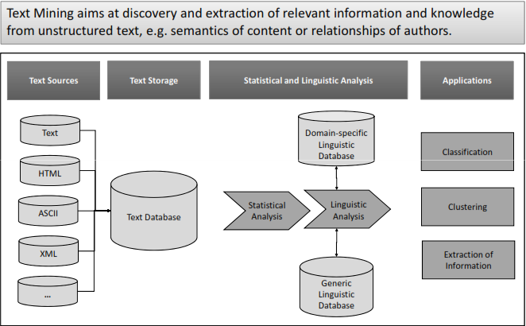
Analytic types in social media: text mining

Slide 55
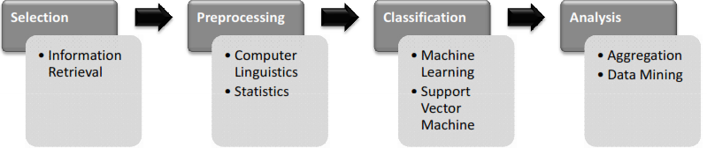
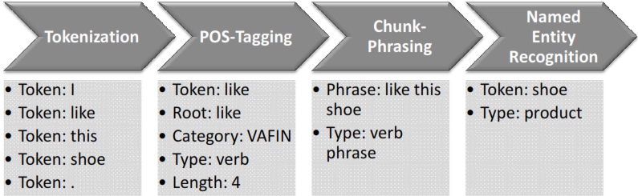
Mining process
Example “I like this shoe”

Slide 56
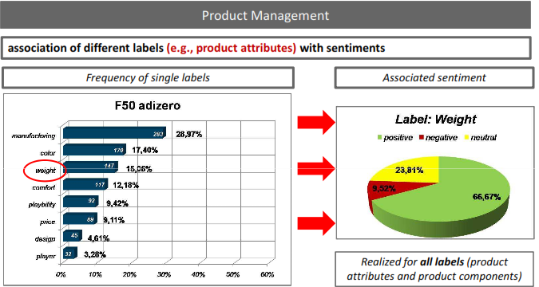
Static analytics (reporting, pivoting)

Slide 57
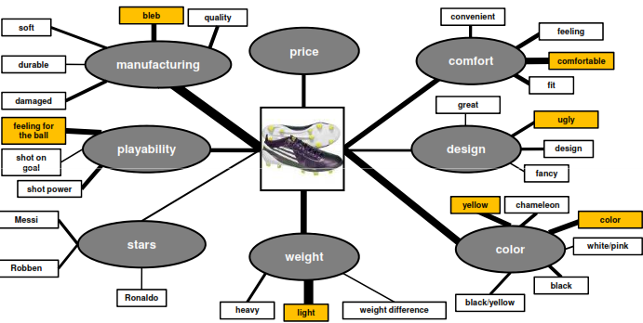
Static analytics (reporting, pivoting)

Slide 58
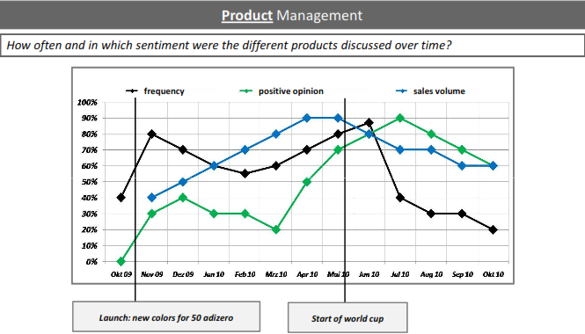
Dynamic analytics

Slide 59
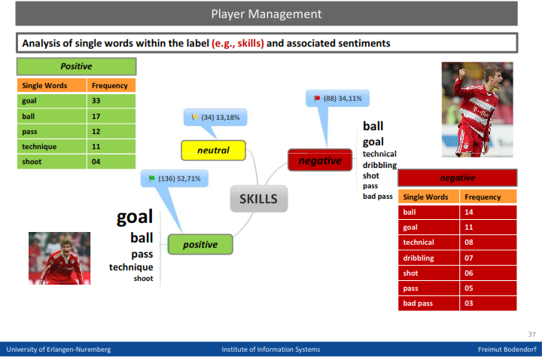
Sentiment classification (text)

Slide 60
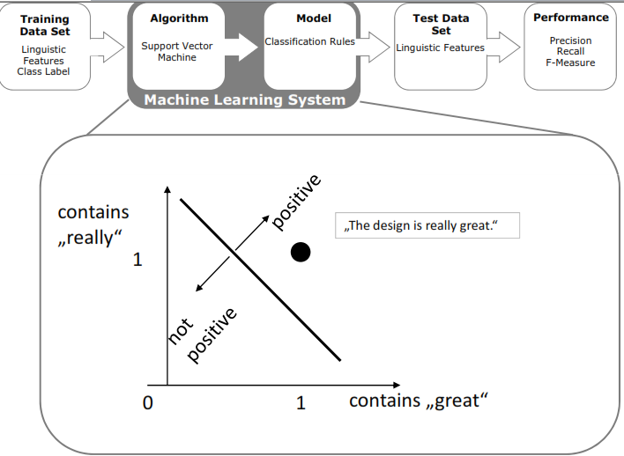
Classification (support vector machine SVM)

Slide 61
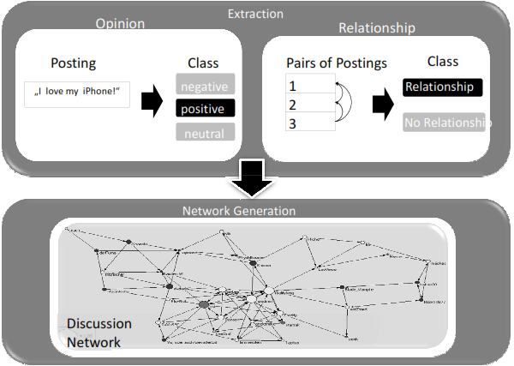
Social network generation for analysis

Slide 62
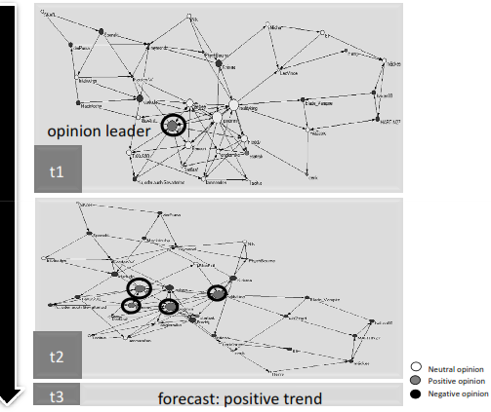
Social network analysis approach

Slide 63
Optimization of quantitative and qualitative values
Constraints-meet budget, exceed target sales
Qualitative goal- to obtain advertisement which could maximize the effectiveness of reach to public
The experts are invited (or surveys done) is order to define effectiveness of each media, also its dependency on number of shows
The quantification of expert opinion: the effectiveness change by the 10th show. It is expresses by number of people (out of 100) who watch the advertisement
The goal of the optimization experiment is to maximize the effectiveness

Slide 64
Literature
Berry, M.,J.A., Linoff, G.S. (2011), "Data Mining Techniques: For Marketing, Sales, and Customer Relationship Management", (3rd ed.), Indianapolis: Wiley Publishing, Inc.
(Electronic Version): StatSoft, Inc. (2012). Electronic Statistics Textbook. Tulsa, OK: StatSoft. WEB: http://www.statsoft.com/textbook/
(Printed Version): Hill, T. & Lewicki, P. (2007). STATISTICS: Methods and Applications. StatSoft, Tulsa, OK.
Sugar CRM Implementation http://www.optimuscrm.com/index.php?lang=en
Statsoft: the creators of Statistica http://www.statsoft.com
Viscovery Somine http://www.viscovery.net/

