Slide 1
Digit Recognition in Mobile Devices
Student: Jakub Kříž
Supervisor: doc. RNDr. Vlastislav Dohnal, Ph.D.

Slide 2
Main points
Thesis Objectives
Goggles
Android application – Environment
OCR – Preprocessing, Feature Extraction, Classification
OpenCV – Android, Manager, Examples, OpenCV Demo2, VLFeat
Tesseract – tess-two, NDK, Cygwin, Character recognition, android-ocr
Training Tesseract – Tesseract-OCR, Tesseract3, 3rdParty, fonts, images
Image Preprocessing – manual, automatic, Leptonica

Slide 3
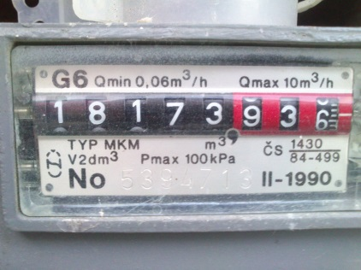
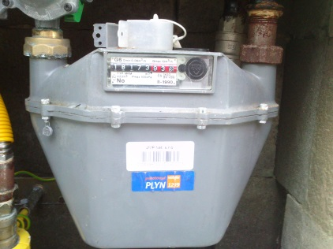
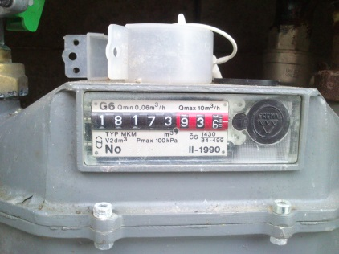
Thesis Objectives
Android Application – camera, box
OCR – digit recognition
High Success Rate
Electric, Gas, Water Meters
Extension – parts, Tomáš Lexmaul´s diploma thesis

Slide 4
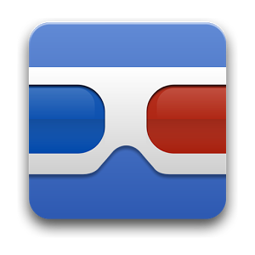
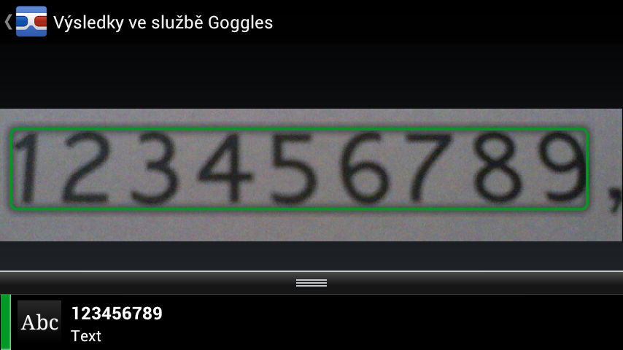
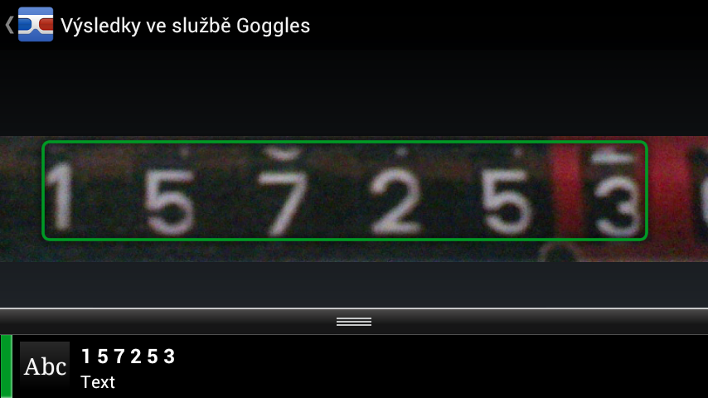
Goggles
Existing Solution – box, camera
Internet
Additional Functions (Search, Translation, Sudoku, QR, sightseeings)

Slide 5
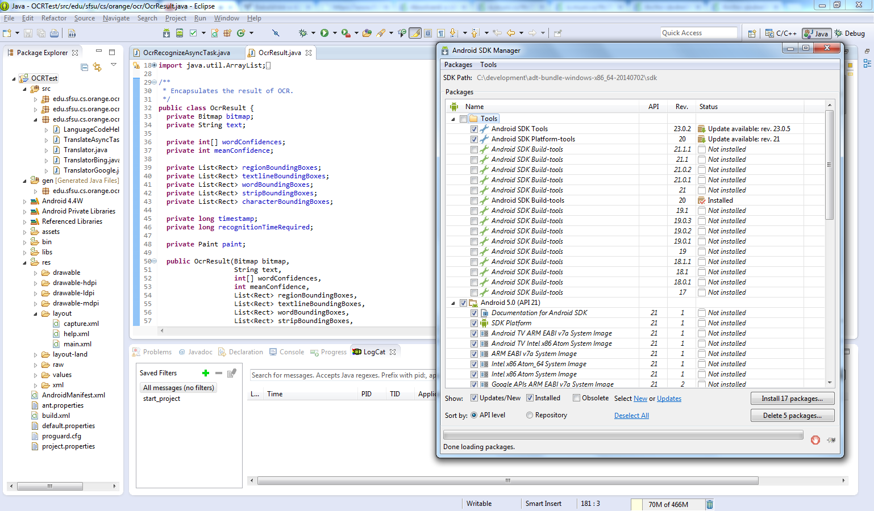
Android Application
developer.android.com/training
SDK (Eclipse ADT Bundle)
SDK Manager
Eclipse – Import… Existing Projects Into Workspace

Slide 6
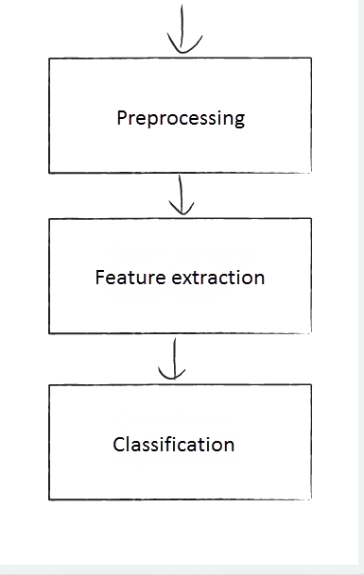
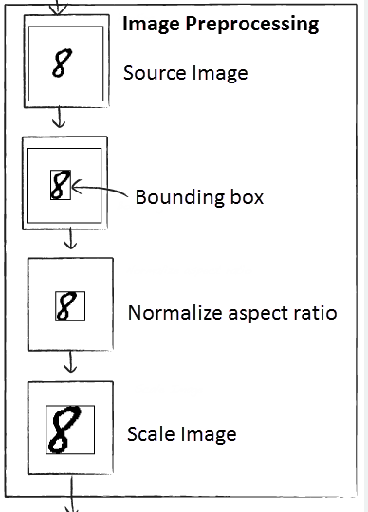
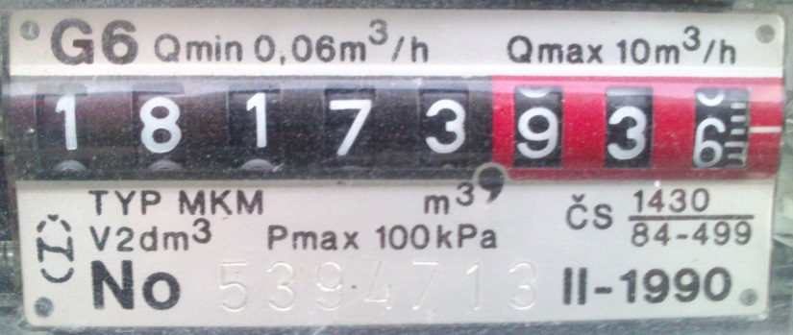
OCR
blog.damiles.com/2008/11/basic-ocr-in-opencv
Preprocessing – input image, filtering, size normalizing, colour converting, bounding boxes, …
Feature extraction – image conversion, vector of features to classify
Classification – feature vector, train system / classification method as knn
my topic – 1 row, digits only, gaps, artefacts

Slide 7
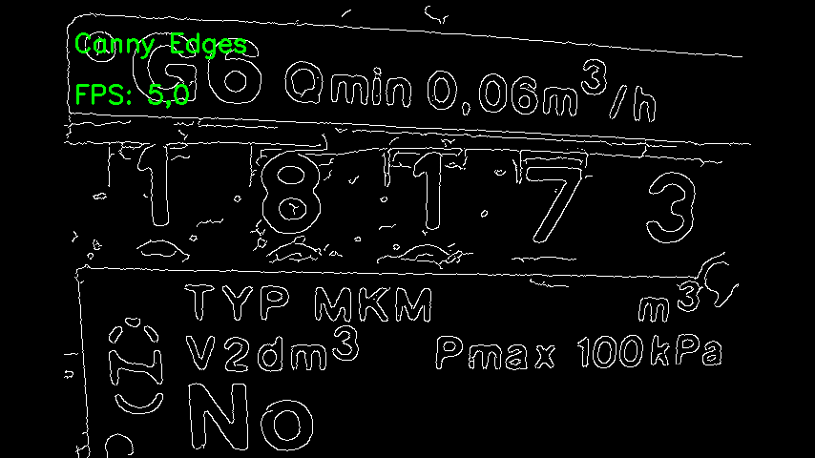
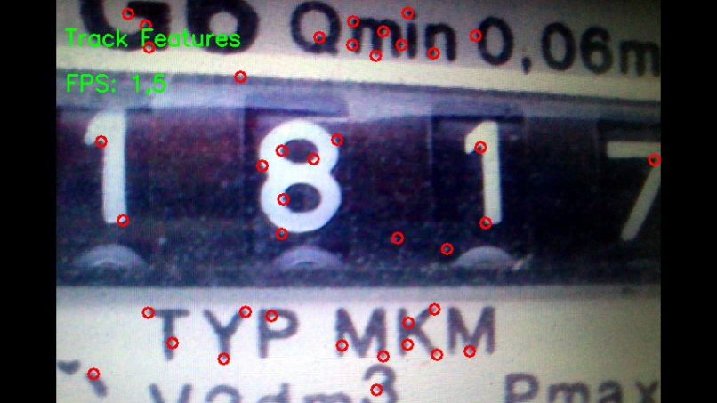
OpenCV
open source computer vision and machine learning software library
2500+ optimized algorithms
detect and recognize faces, identify objects, classify human actions in videos, …
Android v2.4.9 – library as project, added as referenced project
OpenCV Manager – needs to be installed along the app., does not require NDK
examples - C++, Python, face recognition
OpenCV Demo2 – Barry Thomas, source codes, Canny Edges, Track Features, …
VLFeat – above OpenCV, visual features (HOG), statistical methods (SVM)

Slide 8
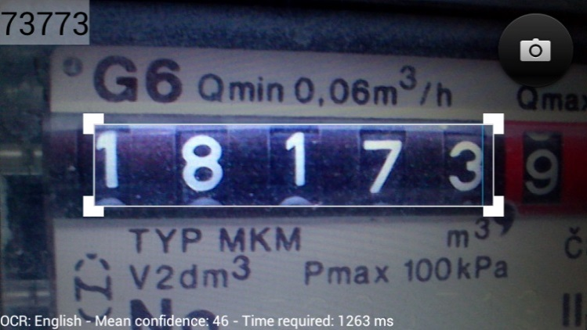
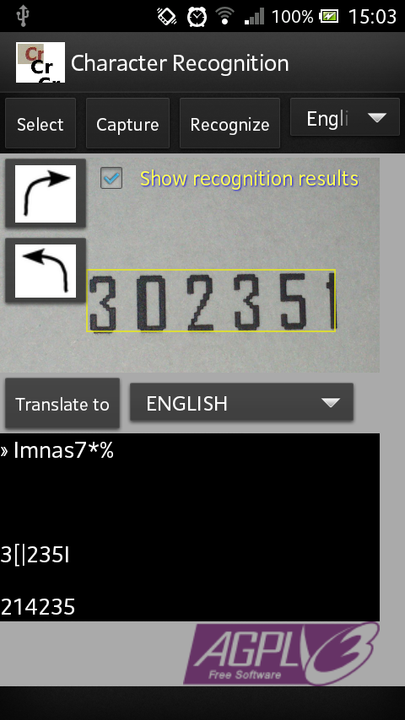
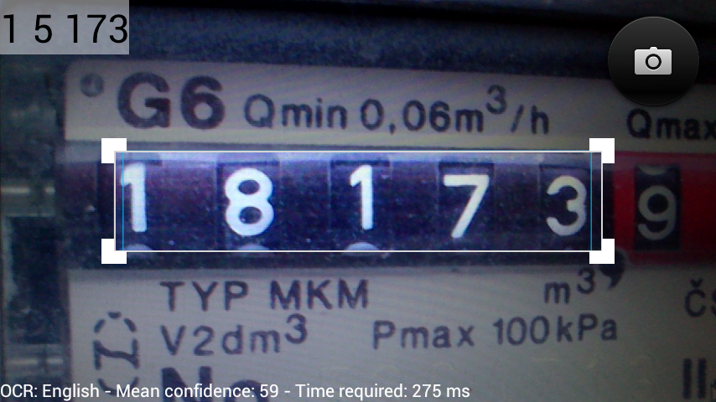
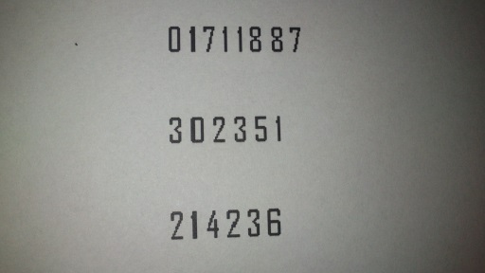
Tesseract
Open Source OCR engine, Apache 2.0 license
Use - directly / API, languages, built-in GUI not provided
tesseract imagename outputbase [-l lang] [-psm pagesegmode] [configfile...]
tess-two (tesseract-android-tools + Leptonica )
Android NDK 32, Cygwin
Character Recognition
android-ocr – box, settings

Slide 9
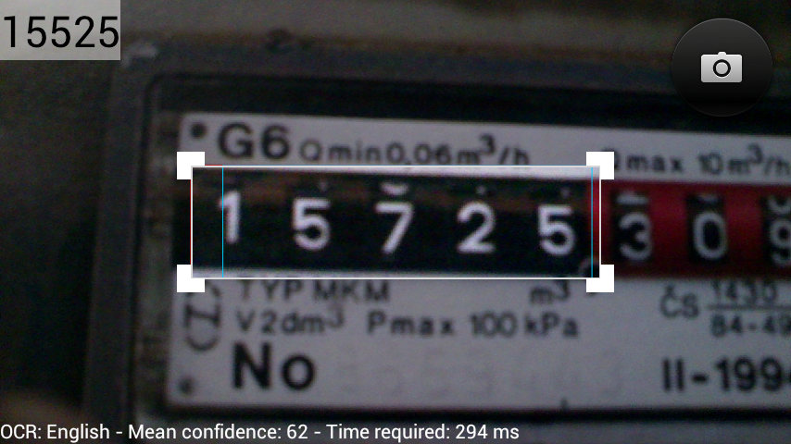
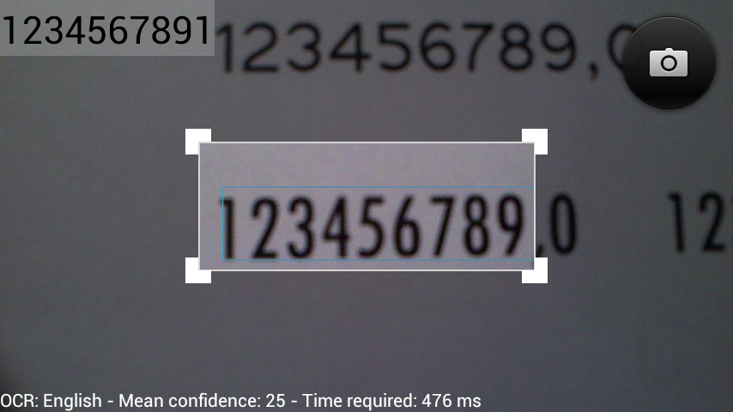
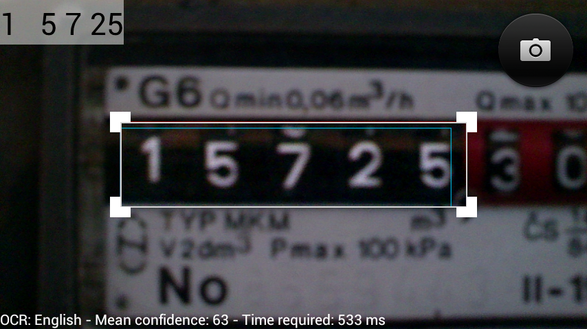
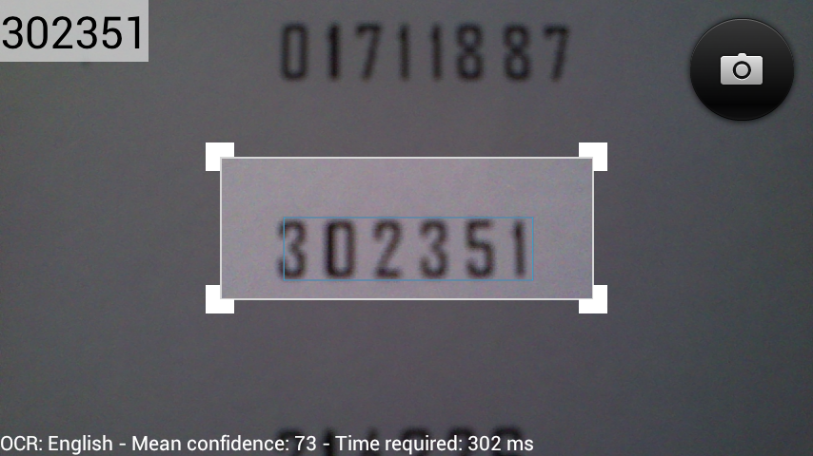
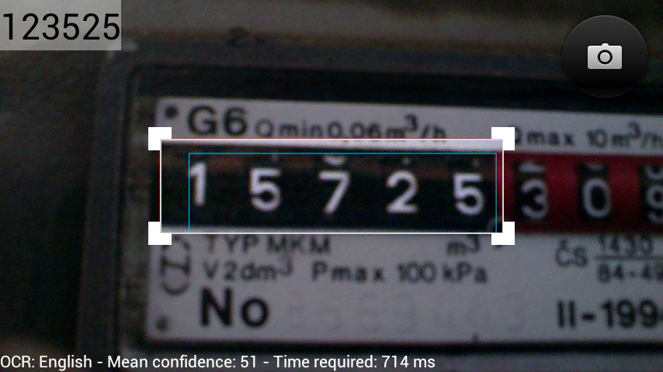
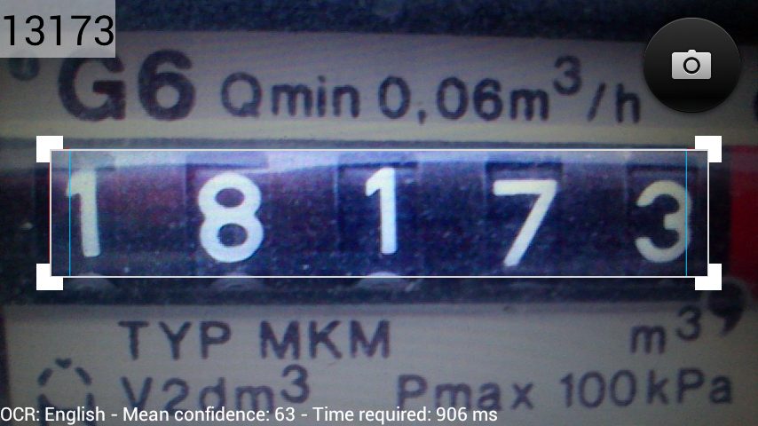

Slide 10
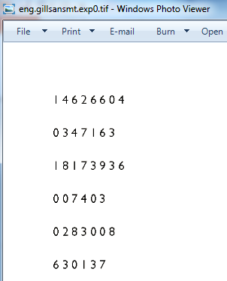
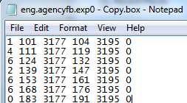
Training Tesseract
Tesseract-OCR download
Tesseract3 - box files ([0,0] bottom-left), train, font_properties, combine
- jTessBoxEditor, Serak
- fonts vs. images (real data)
Real data problem
<fontname> <italic> <bold> <fixed> <serif> <fraktur>
timesitalic 1 0 0 1 0

Slide 11
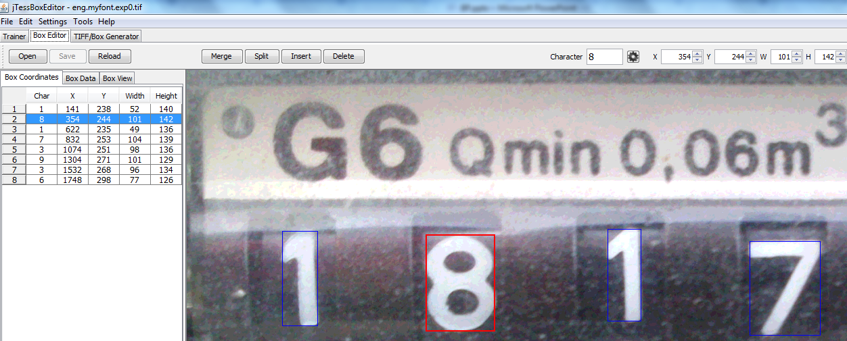

Slide 12
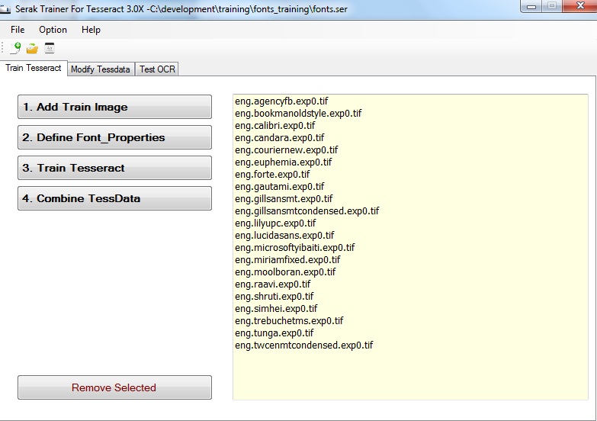
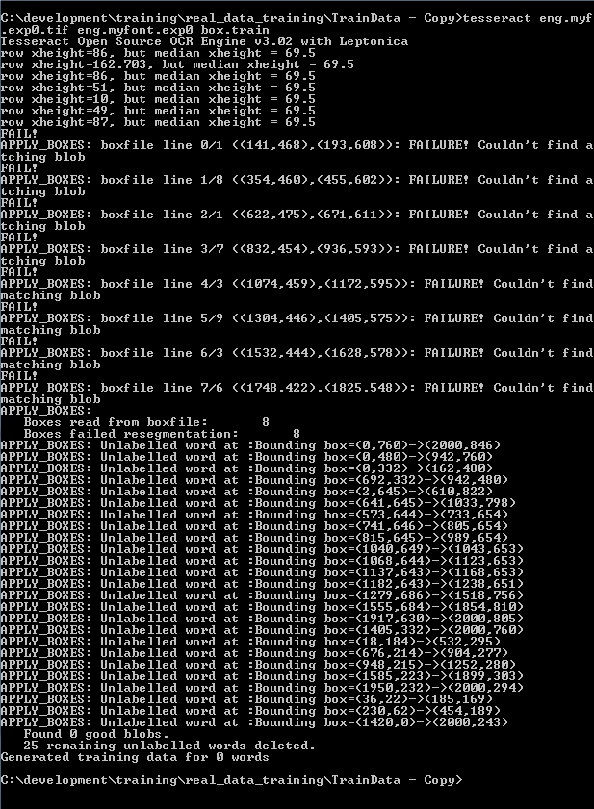

Slide 13
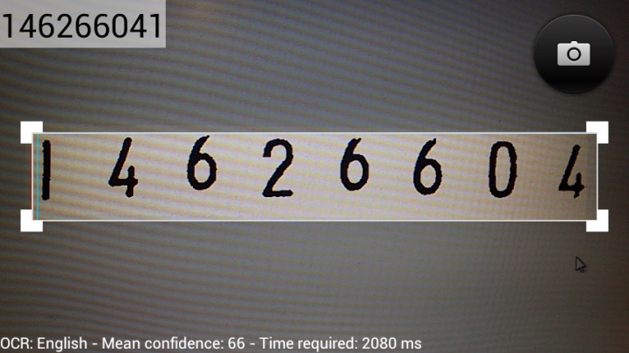
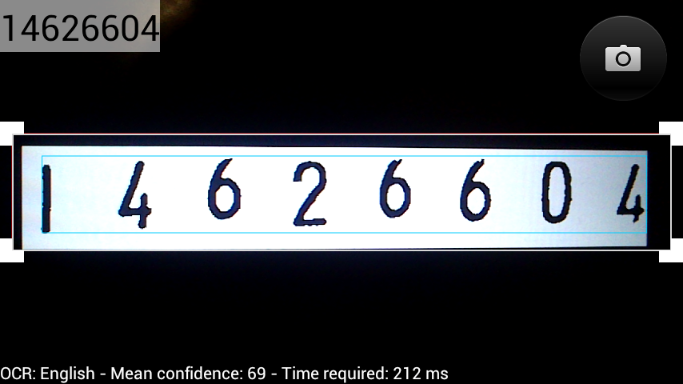
Image Preprocessing
opened problem
manual – Image Editor - grayscale, negative, manual threshold (remove artefacts)
automatic – Leptonica - Grayscale, Inversion, Binarization, Thresholding

Slide 14
Conclusion
Thesis Objectives
Goggles
Android application
OCR
OpenCV
Tesseract
Training Tesseract
Image Preprocessing

Slide 15
Thank you for your attention.

