Slide 1
PA193 - Secure coding principles and practices
Designing good and secure API
Automata-based programming
Petr Švenda svenda@fi.muni.cz

Slide 2
Overview
Lecture:
  How to write good & secure API
  automata-based programming
Labs
  Write small security API
  Model inner state with automata-based design

Slide 3
Organizational

Slide 4
Reuse of existing code
Code reuse is generally great thing, but..
NOT in homework or assignments!
It is NOTOK:
  Take any code from web when you should create code completely on your own (project - parser)
  Share code of your solution with others (homework)
Penalization points assigned
Next occurrences will be handled by faculty’s disciplinary committee

Slide 5
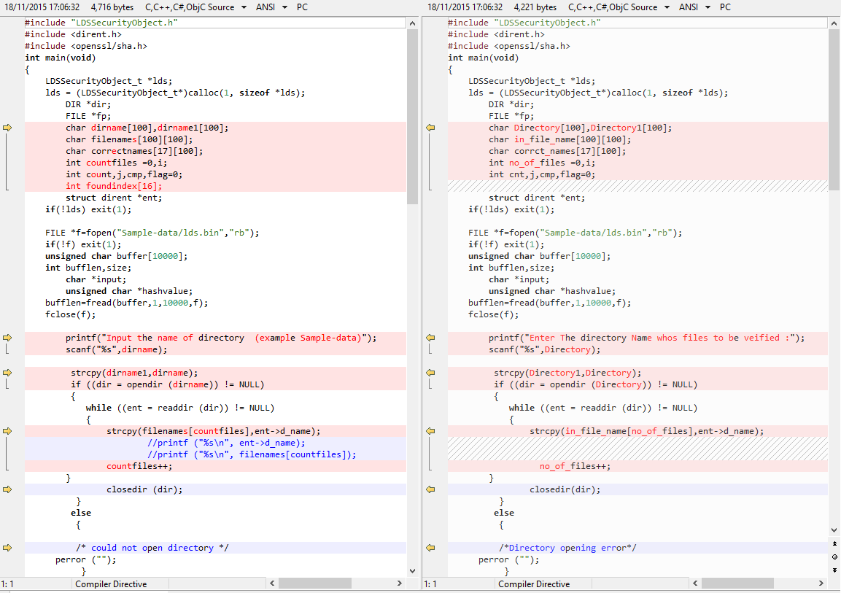

Slide 6
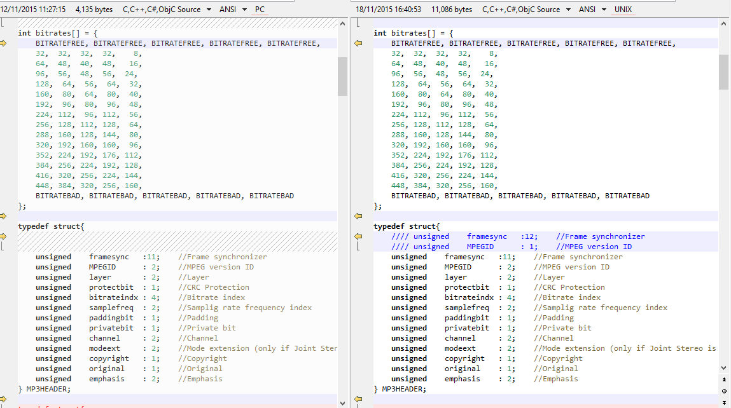
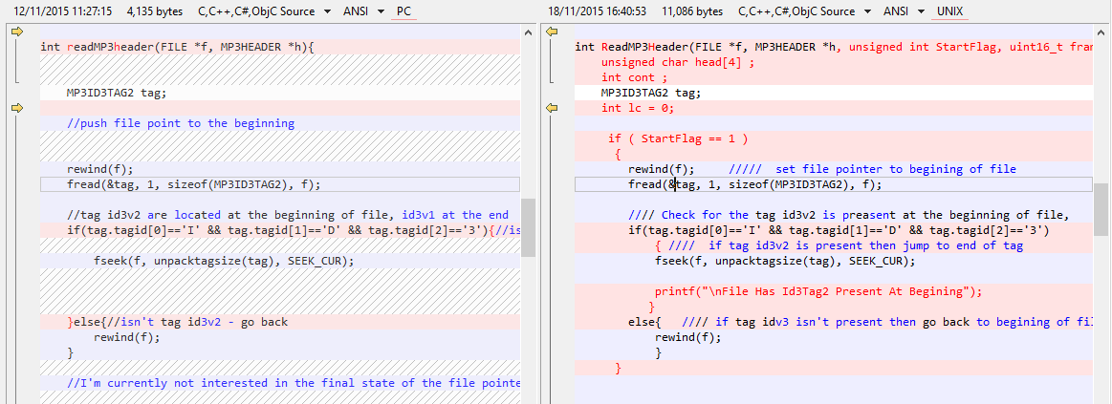

Slide 7
Projects – phase 2
Code review
  One other team (parser code, available in IS: Final_versions_of_the_first_part_TO_EVALUATE)
  Open-source project
https://is.muni.cz/auth/el/1433/podzim2015/PA193/um/59227670/PA193_P3_Projects_second_part_2015.pdf

Slide 8
Problem

Slide 9
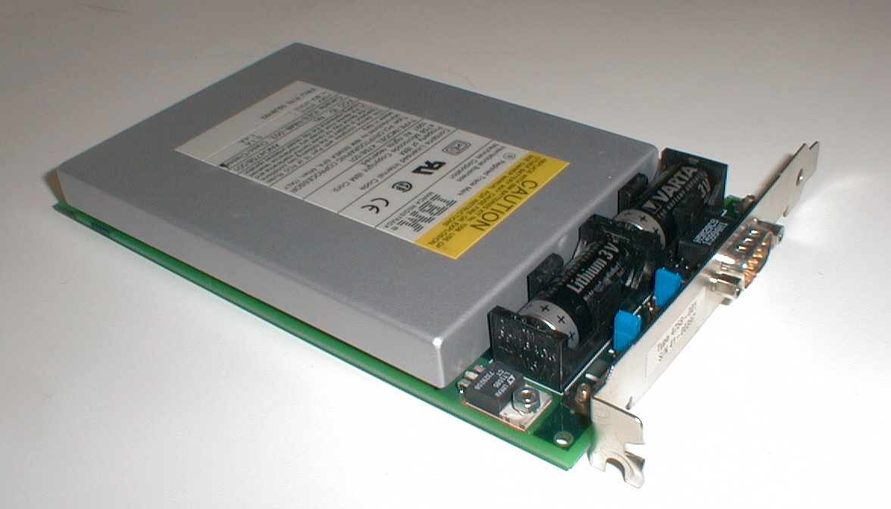
What is this device for?
IBM 4758 Hardware Security Module (HSM)

Slide 10
Hardware Security Modules (HSM)
Hardware Security Modules are high-security devices
  small security computer inside general purpose computer
    RAM, CPU, storage...
    resilience against tampering, side-channels...
  support various cryptographic operations
  keys are generated, stored and used directly on the device
  additional restricted code can be uploaded (firmware)
HSM exposes its functionality via API
  E.g., encrypt supplied data with key generated inside HSM
HSM is trusted, accessed by not-so-trusted applications
  HSM’s API serves as wall between different levels of trust
  Intentionally limits visibility and access
API
Security API

Slide 11

API

Slide 12
When we use API?
All the time ☺
When using function from standard library
When using external library
When calling system (Win32 API, POSIX...)
When calling methods of our own class
...

Slide 13
When we design API?
Almost all the time ☺
Function signature is API for this function usage
List of public methods in interface is its API
When we create good API?
  good programming habit is to create reusable modules
  every module has its own API
  once module will get reused, API cannot be changed easily

Slide 14
Application programming interface (API)
Different types of API
Non-security API
  any library API (module/library interface)
  e.g., C++ STL, Boost library, Web API...
Cryptographic API
  set of functions for cryptographic operations
  e.g., Microsoft CryptoAPI, OpenSSL API...
Security API
  allows untrusted code to access sensitive resources in secure way
  e.g., PKCS#11 HSM module, suExec, OAuth

Slide 15
Language (in)dependent API
Language dependent API
  API available only for one particular language
  ABI is relevant (calling convention, memory layout…)
Language independent API
  Not restricted to particular languages
  E.g., Web API based on HTTP/REST/JSON
Language bindings
  Bridge between particular language and library/OS API
  E.g., library implemented in C, but called from Python
  Additional API in target language with small proxy code

Slide 16
What is API and ABI?
API = Application Programming Interface
  source code-based specification intended to be used as an interface between software components to communicate
  classes, interfaces, methods...
ABI = Application Binary Interface
  specification of interface on binary level
  size, binary representation and layout of data types
  function calling conventions (stdcall, decl...)
  how to make system calls (functions outside program memory)
  binary formats of data produced (little/big endian…)
API != ABI, but both are necessary

Slide 17
Web API
Web API = API used to invoke method on web server
  Usually via HTTP(S) with REST
  Language independent API
E.g., Twitter API
  POST https://api.twitter.com/1.1/statuses/update.json?status=At%20PA193
Application programming interface key (API key)
  Code supplied by program calling an API
  Identifies program, developer, user…
  Can be used to control usage (e.g., limit requests…)

Slide 18

Quiz – where is API?
Language: C
  API: Functions listed in header files (*.h)
Language: C++
  API: public methods of class
  API: public methods of abstract class
Language: Java
  API: public methods of class
  API: methods of interface
Twitter Web API
  API: HTTP/REST requests, response in JSON format
API
© Martin Handford

Slide 19
Principles of good API

Slide 20
Principles of good API (Trolltech)
Be minimal
Be complete
Have clear and simple semantics
Be intuitive
Be easy to memorize
Lead to readable code
http://doc.qt.digia.com/qq/qq13-apis.html

Slide 21
Credits: Joshua Bloch
Joshua Bloch, How to Design a Good API and Why it Matters (Google)
  http://lcsd05.cs.tamu.edu/slides/keynote.pdf
  video: http://www.infoq.com/presentations/effective-api-design
Reading/watching is highly recommended
Many ideas taken from his presentation
  demonstrated on cryptographic libraries by myself

Slide 22
Principles of good API (Joshua Bloch)
Easy to learn
Easy to use, even without documentation
Hard to misuse
Easy to read and maintain code that uses it
Sufficiently powerful to satisfy requirements
Easy to extend
Appropriate to audience
http://lcsd05.cs.tamu.edu/slides/keynote.pdf

Slide 23
Process of API design (Joshua Bloch)
Gather requirements
Start with short specification (1 page)
Write API early and often
Test and use your API
  especially when designing SPI (Service Providers Interface)
  write more plugins (one – NOK, two – difficult, three - OK)
Prepare for evolution and mistakes
  displease everyone equally

Slide 24
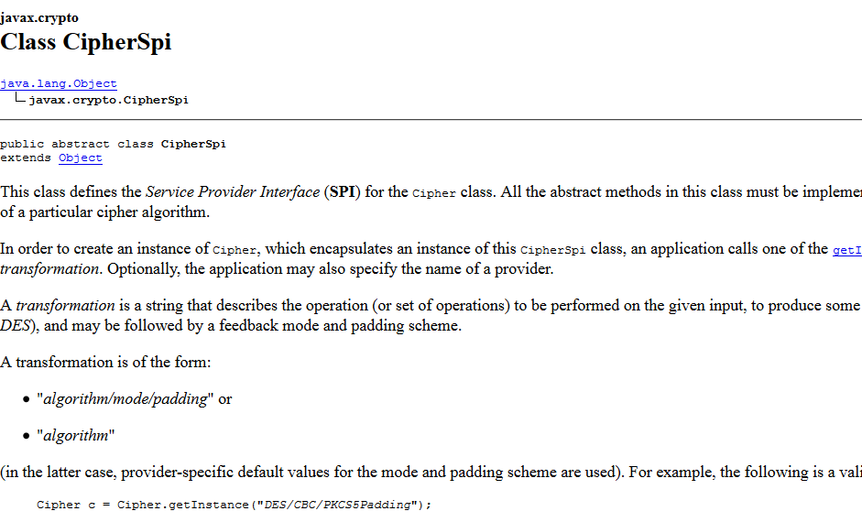
What is Service Provider Interface?

Slide 25
Process of API design (Arnab Biswas)
Understand the requirements
  gather from “customer”, write use cases
Think and discuss with others
  write down preliminary list, update
Not too many, not too less
  combine functionality, decrease complexity, make more general
Name them
  meaningful, self-explanatory, consistent with existing API
Signature
  methods signature for extensibility (generics/templates, interfaces, enums), no surprise when method is used
http://www.javacodegeeks.com/2013/05/fundamentals-of-good-api-designing.html

Slide 26
Process of API design (Arnab Biswas)
Prototype it
  write code prototype using your API and update
Implement
  discard method if unsure about functionality (add later)
  hide implementation details
Document it
  document every small thing, contracts, limitations, pre&post
  don’t over explain, do not document implementation details
Test it
Use it
  use internally before wider release, update

Slide 27
General principles - encapsulation
API should do one thing and do it well
As small as possible, but not smaller
  if in doubt, leave function out (you can add, but not remove)
Implementation details should not leak into API
  try to hide as much as possible from user
Minimalize accessibility (encapsulation)
  make public what really needs to be
  no public fields (attributes) except constants
Make understandable names (self-explanatory, consistent, easy to read when used)
if (key.length() < 80)
generateAlert(”NSA can crack!”);

Slide 28
General principles - documentation
/**
* \brief Output = HMAC-SHA-512( hmac key, input buffer )
*
* \param key HMAC secret key
* \param keylen length of the HMAC key
* \param input buffer holding the data
* \param ilen length of the input data
* \param output HMAC-SHA-384/512 result
* \param is384 0 = use SHA512, 1 = use SHA384
*/
Document rigorously
  JavaDoc, Doxygen…
  specify how function should be used
  class: what instance represents
  Method: contract between method and client
    preconditions, postconditions, side effects
  Parameters: who owns (ptr), units, format...
Specific case of documentation are Annotations
  e.g., Microsoft SAL, pre&post conditions, Java annotations…
void* memcpy(void* destination, const void* source, size_t num);
void* memcpy(__out_bcount(num) void* destination,
__in_bcount(num) const void* source, size_t num);

Slide 29
General principles
Consider “never remove, only add” strategy
  backward compatibility
Flexibility and learning curve / usability
  Continuous trade-off

Slide 30

Which one you like more? Why?
POLARSSL
/**
* \brief Output = HMAC-SHA-512( hmac key, input buffer )
*
* \param key HMAC secret key
* \param keylen length of the HMAC key
* \param input buffer holding the data
* \param ilen length of the input data
* \param output HMAC-SHA-384/512 result
* \param is384 0 = use SHA512, 1 = use SHA384
*/
void sha512_hmac( const unsigned char *key, size_t keylen,
const unsigned char *input, size_t ilen,
unsigned char output[64], int is384 );
OPENSSL
unsigned char *HMAC(const EVP_MD *evp_md, const void *key, int key_len,
const unsigned char *d, size_t n, unsigned char *md,
unsigned int *md_len);

Slide 31
OpenSSL – HMAC ☹ (hard to understand)
//hmac.h
unsigned char *HMAC(const EVP_MD *evp_md, const void *key, int key_len,
const unsigned char *d, size_t n, unsigned char *md,
unsigned int *md_len);
//ossl_typ.h
typedef struct env_md_st EVP_MD;
//envp.h
struct env_md_st
{
int type;
int pkey_type;
int md_size;
unsigned long flags;
int (*init)(EVP_MD_CTX *ctx);
int (*update)(EVP_MD_CTX *ctx,const void *data,size_t count);
int (*final)(EVP_MD_CTX *ctx,unsigned char *md);
int (*copy)(EVP_MD_CTX *to,const EVP_MD_CTX *from);
int (*cleanup)(EVP_MD_CTX *ctx);
/* FIXME: prototype these some day */
int (*sign)(int type, const unsigned char *m, unsigned int m_length,
unsigned char *sigret, unsigned int *siglen, void *key);
int (*verify)(int type, const unsigned char *m, unsigned int m_length,
const unsigned char *sigbuf, unsigned int siglen,
....
} /* EVP_MD */;

Slide 32
General principles - performance
Consider performance impact of API decisions
  but be not influenced by implementation details
  underlying performance issues will be fixed eventually, but API warping (for fixing past issue) remains
Examples of bad performance decisions
  need for frequent allocations and copy constructors
    pass arguments by reference or pointer
    use copy free functions
  usage of mutable objects instead of immutable
    use const everywhere possible
  need for frequent re-coding (byte[] -> string -> byte[])

Slide 33
Copy-free functions
API style which minimizes array copy operations
Frequently used in cryptography
  we take block, process it and put back
  can take place inside original memory array
int encrypt(byte array[], int startOffset, int length);
  encrypt data from startOffset to startOffset + length;
Wrong(?) example:
  int encrypt(byte array[], int length, byte outArray[], int* pOutLength);
  note: C/C++ can still use pointers arithmetic
  note: Java can’t (we need to create new array)

Slide 34
Sensitive data (keys) in memory
What is the difference?
Try to limit copies of sensitive data in memory
  potential unintended disclosure (memory, swap…)
Pass by value requires more memory erases
  What about Java’s pass by value of reference?
int set_key(Key_t key, pin_t seal_pin);
vs.
int set_key(Key_t* key, pin_t* seal_pin);

Slide 35
General principles – static factory
Use static factory instead of class constructor
  e.g., javacardx.crypto & class::getInstance()
  e.g., javacardx.crypto & class::buildKey()
import javacardx.crypto.*;
// CREATE DES KEY OBJECT
m_desKey = (DESKey) KeyBuilder.buildKey(KeyBuilder.TYPE_DES,
KeyBuilder.LENGTH_DES, false);
// CREATE OBJECTS FOR CBC CIPHERING
m_encryptCipher = Cipher.getInstance(Cipher.ALG_DES_CBC_NOPAD, false);
m_decryptCipher = Cipher.getInstance(Cipher.ALG_DES_CBC_NOPAD, false);
// CREATE RANDOM DATA GENERATOR
m_secureRandom = RandomData.getInstance(RandomData.ALG_SECURE_RANDOM);
// CREATE MD5 ENGINE
m_md5 = MessageDigest.getInstance(MessageDigest.ALG_MD5, false);

Slide 36
General principles – static factory
Advantages of static factory over constructors
  provides named "constructors“ (getInstance, buildKey)
  can return null, if appropriate
  can return an instance of a derived class, if appropriate
  reduce verbosity when instantiating variables of generic/template types (no need to write type twice)
  allows immutable classes to use preconstructed instances or to cache instances (speed)
  http://www.informit.com/articles/article.aspx?p=1216151
Map<String, list<String>>* m = new HashMap<String, List<String>>();
vs.
Map<String, list<String>> m = HashMap.newInstance();

Slide 37
General principles – behave as expected
Principle of last astonishment
  user should not be surprised of API behavior
Be careful with overloading
  use different names for methods when having same number of arguments
  same behavior for same (position of) arguments
Fail fast – report error as soon as possible
  failure in compile time is better
  during runtime, first method invocation with bad state should fail
Provide methods to obtain data elements from results provided originally in strings
  do not force programmer to parse strings

Slide 38
General principles – arguments types
Use appropriate types for parameters and return types
  use interface instead of class in method arguments
    provides base for extensibility later
  use most specific possible input parameter type
    errors will move to compile time
  don’t use strings if better type exists (error prone, slow)
    but also more user-friendly - tradeoff
  no floating point for monetary values (approximation)
  use double instead of float (precision gain, only low performance impact)

Slide 39
Example: Avoid long parameter lists
WIN32 API
HWND WINAPI CreateWindow(
_In_opt_ LPCTSTR lpClassName,
_In_opt_ LPCTSTR lpWindowName,
_In_ DWORD dwStyle,
_In_ int x,
_In_ int y,
_In_ int nWidth,
_In_ int nHeight,
_In_opt_ HWND hWndParent,
_In_opt_ HMENU hMenu,
_In_opt_ HINSTANCE hInstance,
_In_opt_ LPVOID lpParam
);
Which one you like more?
Why?
QT API
QWidget window;
window.setWindowTitle("Window title");
window.resize(320, 240);
...
window.show();

Slide 40
General principles - parameters
Avoid long parameter lists
  three or fewer parameters ideal (including default values)
    mistake in filling arguments might be missed in compile
When more parameters are required:
  break method into more methods
  or encapsulate multiple arguments into single class/struct
Use consistent parameter ordering (src vs. desc)
#include <string.h>
char *strcpy (char* dest, char* src);
void bcopy (void* src, void* dst, int n);

Slide 41
Security API
“A security API allows untrusted code to access sensitive resources in a secure way.” Graham Steel
Interface between different levels of trust
Security API is designed to enforce a policy
  certain predefined security properties should always hold
  e.g., private key cannot be used before user is authenticated
Security API is not equal to security protocols
  but closely related
  security protocol == short program how principals communicate
  security API == set of short programs called in any order
http://www.lsv.ens-cachan.fr/~steel/security_APIs_FAQ.html
http://www.cl.cam.ac.uk/~rja14/Papers/SEv2-c18.pdf

Slide 42
Security API attack
API attack is sequence of commands (function calls) which breach security policy of an interface
“Pure” API attacks – only sequence of commands
  e.g., key value is directly revealed
“Augmented” API attacks – additional brute-force computations required
  e.g., 128bits key value is exported under 56bits key

Slide 43
Security API – problems in time
Interfaces get richer and more complex over time
  pressure from customers to support more options
  economic pressures towards unsafe defaults
  failures tend to arise from complexity, KISS!!!
  hard to design secure API, even harder to keep it secure
Leaks when trusted component talks to less trusted
  interface often leaks more information than anticipated by designer of trusted component

Slide 44
Security API - typical problems
Unexpected command sequences
  methods called in different order than expected
  use method call fuzzer to test
  use automata-based programing to verify proper state
Unknown commands
  invalid values as method arguments
  always make extensive input verification
  use fuzzer to test

Slide 45
Method ordering fuzzer – the idea
Number uniquely every API function you like to test
Write switch construct with case X: calling function numbered with X
Generate (randomly) vector of numbers from range [1...# functions] with length of your choice
Wrap switch construct inside loop over vector’s content
  vector[i] == X will cause function call numbered with X
Prepare required variables for function arguments calls
  outside loop for persistency of variable value from previous call
Log trace information for analysis (errors, argument input and output values, return values, exceptions raised...)

Slide 46
Functions ordering fuzzer - code
int main() {
// Preparation of arguments
int arg1 = 0;
MyClass arg2;
// Generation of function call sequence
std::vector<int> fncCalls;
generate(fncCalls.begin(), fncCalls.end(), RandomNumber);
std::vector<int>::iterator iter;
// Looping over generated sequence and execution of functions
for (iter = fncCalls.begin(); iter != fncCalls.end(); iter++) {
// Log what is necessary (errors, input and output values...
switch (*iter) {
case fnc1: foo1(arg1, arg2); break;
case fnc2: foo2(arg1, arg2); break;
case fnc3: foo3(arg1); break;
}
}
return 0;
}

Slide 47
Functions ordering fuzzer – the idea
What if module is in the form of dynamically linked library?
  you may link statically (manual labor)
  you may obtain function pointers in runtime
    LoadLibrary, GetProcAddress
    list of available functions can be obtained from *.lib
    grep with replacement can generate necessary the code
    some libraries provides functions for querying available interface (COM objects)

Slide 48
Security API - typical problems
Commands in a wrong device mode
  sensitive operation (e.g., Sign()) called without previous authentication
  use methods order fuzzing to test
  use automata-based programing to ensure proper state
Existence of undocumented API
  debugging API not removed (unintentionally)
  security by obscurity (be aware of reverse engineering)
  example: Crysalis Luna module (key extraction)
    http://www.cl.cam.ac.uk/techreports/UCAM-CL-TR-592.pdf

Slide 49
Security API - typical problems
Multiple different APIs to single component/storage
  contracts within one set of API may be broken by second set
  possible interleaving of function calls from different APIs
  Example: Ultimaco HSM APIs
    Microsoft world: CNG, CSP, EKMI
    JCE, PKCS#11, OpenSSL
    administration API's: IT monitoring SNMP
  Example: IBM 4758 HSM APIs
    IBM CCA, VISA EMV, PKCS#11...
    IBM proprietary
Attacks already used in the wild for large scale attacks
  http://www.wired.com/threatlevel/2009/04/pins/

Slide 50
Security API: best practices
Use API keys, not Username/Password
  e.g., OAuth instead of Basic Auth
Don’t use sessions (if possible)
  build API as RESTful services
  “Each request from any client contains all of the information necessary to service the request, and any session state is held in the client.” REST Wikipedia
  check client input extensively
Supply methods for secure erase of sensitive data

Slide 51
Security API: best practices
Always use TLS when secure channel is required
  or other suitable secure channel, don’t build one yourself
Look at mature APIs for best practice examples
  Foursquare, Twitter, and Facebook...
Don’t use weak cryptographic algorithms
  MD5, RC4... Old NSA saying: “Cryptanalysis always gets better. It never gets worse.”
Don’t hardcode particular algorithm into API
  and be prepared for change (e.g., BlockCipher interface instead of AES)

Slide 52
Formal verification of security API
Harder than security protocol analysis
  security API typically consist of tens of functions called in any order
  security protocol only few messages executed in predefined sequence
Initially applied only to small APIs, now better
Many interesting practical results
  real attacks against PKCS#11 devices
  Ubikey token API problem
  PKCS#11 RSA’s token problem found
Proofs of security within given model may be given
http://www.lsv.ens-cachan.fr/~steel/security_APIs_FAQ.html

Slide 53
Formal verification of APIs
Tookan tool
  http://secgroup.ext.dsi.unive.it/projects/security-apis/tookan/
  probe PKCS#11 token with multiple function calls
  automatically create formal model for token
  run model checker and find attack
  try to execute attack against real token
No single “best” tool (Avispa, Proverif…)
A Generic API for Key Management
  http://www.lsv.ens-cachan.fr/~steel/genericapi/
International Workshop on Analysis of Security APIs
  http://www.lsv.ens-cachan.fr/~steel/asa/

Slide 54
References: Designing API
How to Design a Good API and Why it Matters (Google)
  http://lcsd05.cs.tamu.edu/slides/keynote.pdf
  video: http://www.infoq.com/presentations/effective-api-design
Designing Good API & Its Importance
  http://www.slideshare.net/imyousuf/designing-good-api-its-importance
What is good API design
  http://richardminerich.com/2012/08/what-is-good-api-design/
Fundamentals of good API designing
  http://www.javacodegeeks.com/2013/05/fundamentals-of-good-api-designing.html

Slide 55
References: Security API
Mike Bond’s Ph.D. thesis (attacks on HSMs)
  http://www.cl.cam.ac.uk/~mkb23/research/Thesis.pdf
Graham Steel’s Security API FAQ
  http://www.lsv.ens-cachan.fr/~steel/security_APIs_FAQ.html
Ross Anderson’s API attacks (Security Engineering)
  http://www.cl.cam.ac.uk/~rja14/Papers/SEv2-c18.pdf

Slide 56
References: API design for REST
https://blog.apigee.com/detail/api_design_ruminating_over_rest
http://www.stormpath.com/blog/how-secure-api-tips-rest-json-developers
https://www.stormpath.com/blog/secure-your-rest-api-right-way

Slide 57
Code Annotations

Slide 58
Motivation for making annotations
More semantics of code available for checker
  Capture otherwise missed bugs
More explicit documentation of code/API
  Ideally automatically testable
  Problems captured in compile time
Compliancy requirements
  Driver signature by Microsoft, a must for 64b Windows
…

Slide 59
Microsoft SDL C/C++ static checker
Problems not found by PREfast checker by default
Achievable via source-code annotation language (SAL)
  check of return value
  argument must be not NULL
  string must be terminated
  length of data read / written into buffer
Additional requirements are added to declaration of function, structure... via (non-standard) keywords
Validity of such requirements are checked by PREfast
  in pre-state (before fnc call) & in post-state (after fnc call)

Slide 60
Source-code annotation language (SAL)
Microsoft’s annotation language
Improves code checking done by MS static checker PREfast
MS Annotations
  http://msdn.microsoft.com/en-us/library/ms182032.aspx
  http://msdn.microsoft.com/en-us/library/hh916382.aspx
  http://msdn.microsoft.com/en-us/security/gg675036
Additional requirements are added to declaration of function, structure... via (non-standard) keywords
Validity of such requirements are checked by PREfast
  in pre-state (before fnc call) & in post-state (after fnc call)

Slide 61
SAL – basic terms
Element is valid if contains explicitly assigned value
  Item of allocated array with unassigned value is invalid
Valid in pre-condition (before function is called)
  Annotation typically starts with In_xxx
Valid in post-condition (when function ends)
  Annotation typically starts with Out_xxx
Number of specified bytes vs. items
  Default is number of items, bytes if _bytes_ added
  Number of elements valid

Slide 62
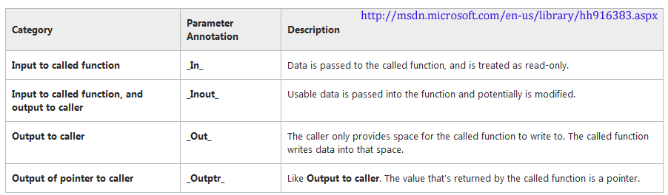
SAL functions basics
  Optional version of arguments
  argument might be NULL
  _In_opt, _Out_opt...
  function must perform check before use

Slide 63
SAL functions basics II.
Pointer type annotations
_Outptr_
  should not be NULL
  should be initialized
_Outptr_opt_
  can be NULL, must be checked

Slide 64
void salDemo(_In_ int* pInArray, _Outptr_ int** ppArray) {
}
int main(int argc, char* argv[]) {
int* pArray = NULL;
int* pArray2 = NULL;
if (strcmp(argv[1], "alloc") == 0) {pArray = new int[5];}
salDemo(pArray, &pArray2);
return 0;
}
PREfast analysis
test.cpp(34): warning : C6101: Returning uninitialized memory '*ppArray'. A successful
path through the function does not set the named _Out_ parameter.
test.cpp(49): warning : C6387: 'pArray' could be '0': this does not adhere to the
specification for the function 'salDemo'.
test.cpp(49): warning : C6001: Using uninitialized memory '*pArray'.

Slide 65
SAL annotations – much more
Annotations of functions
  http://msdn.microsoft.com/en-us/library/hh916382.aspx
Structs and classes can be also annotated
  http://msdn.microsoft.com/en-us/library/jj159528.aspx
Locking behavior for concurrency can be annotated
  http://msdn.microsoft.com/en-us/library/hh916381.aspx
Whole function can be annotated
  http://msdn.microsoft.com/en-us/library/jj159529.aspx
  _Must_inspect_result_
Best practices
  http://msdn.microsoft.com/en-us/library/jj159525.aspx

Slide 66
SAL – examples (in and out buffer)
// read from buffer with size equal to length
int readData( void *buffer, int length );
int readData(_In_reads_(length) void *buffer, int length );
// writes specified amount (length) of data into buffer
int fillData( void *buffer, int *length );
int fillData(_Out_writes_all_(length) void *buffer, const int length );
// writes into buffer maxLength at max, but possibly less and modifies also length argument
int fillData( void *buffer, const int maxLength, int *length );
// Check if no more then maxLength and *length is written, also check range of length
int fillData( __Out_writes_to_( maxLength, *length ) void *buffer,
const int maxLength, _Out_range_(0, maxLength-1) int *length );
// read AND write from buffer
int readWriteData( void *buffer, int length );
int readWriteData(_Inout_updates_(length) void *buffer, int length );

Slide 67
SAL – examples (pointers, strings)
// pass argument by value foo pointer
int getInfo( struct thing *thingPtr );
// value is used as input and output => _Inout_
int getInfo( _Inout_ struct thing *thingPtr );
// pass C null-terminated strings
int writeString( const char *string );
// must be null terminated string > _In_z_
int writeString( _In_z_ const char *string );

Slide 68
Using SAL with / without PREfast
Cross-platform code
  Compiled with MSVC for Windows (SAL is supported)
  Compiled with GCC for Linux (SAL not supported)
Issue: SAL annotations makes GCC compilation to fail
Solution
  Create custom #define for most common SAL annotations
  Define as empty if not compiled with MSVC
  Can be also tuned when SAL annotation changes itself
Peter Gutmann’ Experiences with SAL/PREfast
  http://www.cs.auckland.ac.nz/~pgut001/pubs/sal.html

Slide 69
Wrapping defines for SAL
#if defined( _MSC_VER ) && defined( _PREFAST_ )
#define IN_BUFSIZE _In_reads
#define IN_BUFSIZE_OPT _In_reads_opt
#define OUT_BUFSIZE _Out_writes
#define OUT_BUFSIZE_OPT _Out_writes_opt
#define OUT_PTR _Outptr_
#define OUT_PTR_OPT _Outptr_opt_
#else
#define IN_BUFSIZE( size )
#define IN_BUFSIZE_OPT( size )
#define OUT_BUFSIZE( max, size )
#define OUT_BUFSIZE_OPT( max, size )
#define OUT_PTR
#define OUT_PTR_OPT
#endif /* VC++ with source analysis enabled */
Modification of http://www.cs.auckland.ac.nz/~pgut001/pubs/sal.html

Slide 70
Annotations for GCC/LLVM
Deputy
  Not active any more ☹, last update 2006?
  http://www.stanford.edu/class/cs295/asgns/asgn5/www/
Clang Static Analyzer
  http://clang-analyzer.llvm.org/annotations.html
  Only few annotations

Slide 71
Splint (is simple to use?)
SAL version
Splint version
void strcpy( _Out_z char *s1, _In_z const char *s2 );
void /*@alt char * @*/ strcpy(
/*@unique@*/ /*@out@*/ /*@returned@*/ char *s1, char *s2 )
/*@modifies *s1@*/ /*@requires maxSet( s1 ) >= maxRead( s2 ) @*/
/*@ensures maxRead( s1 ) == maxRead( s2 ) @*/;

Slide 72
Automata-based programming

Slide 73
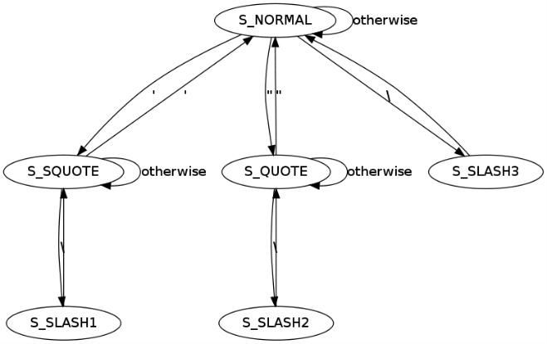
Automata-based style program
Program (or its part) is though of as a model of finite state machine (FSM)
Basic principles
  Automata state (explicit designation of FSM state)
  Automata step (transition between FSM states)
  Explicit state transition table (not all transitions are allowed)
Practical implementation
  imperative implementation (switch over states)
  object-oriented implementation (encapsulates complexity)
https://en.wikipedia.org/wiki/Automata-based_programming

Slide 74

Example: detect correct “ in input string

Slide 75
int main(void) {
t_states state = S_NORMAL;
char symbol;
init_data(&data, "\";\" \\\"& Test 'string &\\' really ' & ; ", 1024);
printf("Test string: %s\n", data.input_string);
symbol = get_next_char();
while (symbol != EOF) {
printf("[state:] %02d [symbol:] %c [output:] ", state, symbol);
switch (state) {
case S_NORMAL:
switch (symbol) {
case ';':
put_next_char('\\');
break;
case '&':
put_next_char('\\');
break;
case '"':
state = S_QUOTE;
break;
case '\'':
state = S_SQUOTE;
break;
case '\\':
state = S_SLASH3;
break;
}
break;
...
case S_SQUOTE:
switch (symbol) {
case '\'':
state = S_NORMAL;
break;
case '\\':
state = S_SLASH1;
break;
}
break;
case S_QUOTE:
switch (symbol) {
case '"':
state = S_NORMAL;
break;
case '\\':
state = S_SLASH2;
break;
}
break;
case S_SLASH1:
state = S_SQUOTE;
break;
case S_SLASH2:
state = S_QUOTE;
break;
case S_SLASH3:
state = S_NORMAL;
break;
case S_SPACE:
break;
}
/* There is no 'output symbol suppression'
needed in our example */
put_next_char(symbol);
printf("\n");
/* .. and prepare the next char waiting */
symbol = get_next_char();
} /* End while */

Slide 76
Example: SimpleSign applet
Simple smart card applet for digital signature
  Operation 1: user must verify UserPIN before private key usage for signature is allowed
  Operation 2: unblock of user pin allowed only after successful AdminPIN verification
Imperative solution:
  sensitive operation (Sign()) is wrapped into condition testing successful PIN verification
  more conditions may be required (PIN and < 5 signatures)
  same signature operation may be called from different contexts (SignHash(), ComputeHashAndSign())

Slide 77
SimpleSign –imperative solution
void SignData(APDU apdu) {
// ...
// INIT WITH PRIVATE KEY
if (m_userPIN.isValidated()) {
// INIT WITH PRIVATE KEY
m_sign.init(m_privateKey, Signature.MODE_SIGN);
// SIGN INCOMING BUFFER
signLen = m_sign.sign(apdubuf, ISO7816.OFFSET_CDATA,
(byte) dataLen, m_ramArray, (byte) 0);
// ... SEND OUTGOING BUFFER
}
else ISOException.throwIt(SW_SECURITY_STATUS_NOT_SATISFIED);
// ...
}
Test of required condition
Execution of sensitive operation

Slide 78
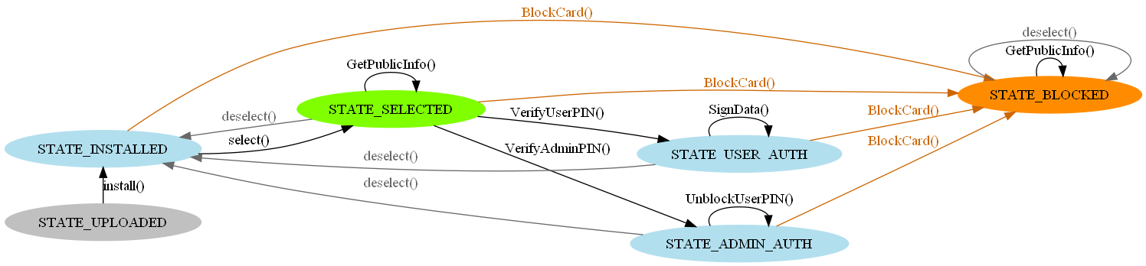
Example: states for smart card applet
digraph StateModel {
rankdir=LR;
size="6,6";
node [shape =ellipse color=green, style=filled];
{ rank=same; "STATE_UPLOADED";"STATE_INSTALLED";}
"STATE_INSTALLED";
"STATE_UPLOADED";
"STATE_UPLOADED" -> "STATE_INSTALLED" [label="install()"];
{ rank=same; "STATE_SELECTED";}
"STATE_SELECTED";
{ rank=same;"STATE_USER_AUTH";"STATE_ADMIN_AUTH";}
"STATE_USER_AUTH" ;
"STATE_ADMIN_AUTH" ;
"STATE_INSTALLED" -> "STATE_SELECTED" [label="select()" color="black" fontcolor="black"];
"STATE_SELECTED" -> "STATE_USER_AUTH" [label="VerifyUserPIN()" color="black" fontcolor="black"];
"STATE_SELECTED" -> "STATE_ADMIN_AUTH" [label="VerifyAdminPIN()" color="black" fontcolor="black"];
...

Slide 79
SimpleSign – automata-based solution
Mental model → .dot format (human readable)
  Graphviz visualization (visual inspection)
  source code generated for state check and transition check
  input for formal verification (state reachability)
Easy to extend by new states
  source code is generated again
More robust against programming mistakes and omissions

Slide 80
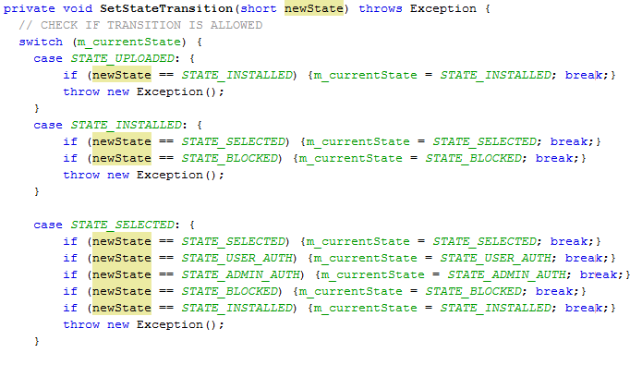
Is transition allowed between given states?
E.g., is allowed to change state directly from STATE_INITIALIZED to STATE_ADMIN_AUTH?

Slide 81
Is function call allowed in present state?
E.g., do not allow to use private key before UserPIN was verified
private void checkAllowedFunction(int requestedFunction) {
switch (requestedFunction) {
case FUNCTION_VerifyUserPIN:
if (m_currentState == STATE_SELECTED) break;
_OperationException(EXCEPTION_FUNCTIONEXECUTION_DENIED);
case FUNCTION_SignData:
if (m_currentState == STATE_USER_AUTH) break;
_OperationException(EXCEPTION_FUNCTIONEXECUTION_DENIED);
...
Sign data only when in STATE_USER_AUTH

Slide 82
How to react on incorrect state transition
Depends on particular application
  create error log entry
  throw exception
  terminate process
  ...
Error message should not reveal too much
  side-channel attack based on error content

Slide 83
SimpleSign – additional functionality
New functionality is now required:
  signature allowed also after verification of AdminPIN
Changes required in imperative solution:
  add additional condition before every Sign()
  when called from multiple places, developer may forgot to include conditions everywhere
  not easy to realize, what conditions are required from existing code
Changes required in automata-based solution:
  add new state transition (STATE_ADMIN_AUTH <-> SignData())
  generate new transition tables etc.

Slide 84
Summary

Slide 85

Summary
Designing good API is hard
  follow best practices, learn from well-established APIs
Designing security API is even harder
Automata-based programming
  make more robust state and transition validation
  good to combine with visualization and automatic code generation
Questions

