Slide 1
PA193 - Secure coding principles and practices
Security Code Review
Petr Švenda svenda@fi.muni.cz

Slide 2
Problem

Slide 3
Example problem – Debian RNG flaw
Linus’s law
  “Given enough eyeballs, all bugs are shallow”
  https://en.wikipedia.org/wiki/Linus%27_Law
Flaw in Debian’s random number generator (2008)
  CVE-2008-0166
  http://www.debian.org/security/2008/dsa-1571
  lead to predictable random numbers
  improper change to OpenSSL random generator
  persisted for almost two years!
  lead to only 262148 possible openSSH keys
Change made based on static and dynamic analysis tools recommendation!

Slide 4
Debian RNG flaw
Valgrind and IBM’s Purify reports problems
  usage of uninitialized variable
  OpenSSL crypto/rand/md_rand.c
Discussion of maintainers (before and after change)
  http://bugs.debian.org/cgi-bin/bugreport.cgi?bug=363516
MD_Update(&m,buf,j);
MD_Update(&m,buf,j); /* purify complains */

Slide 5
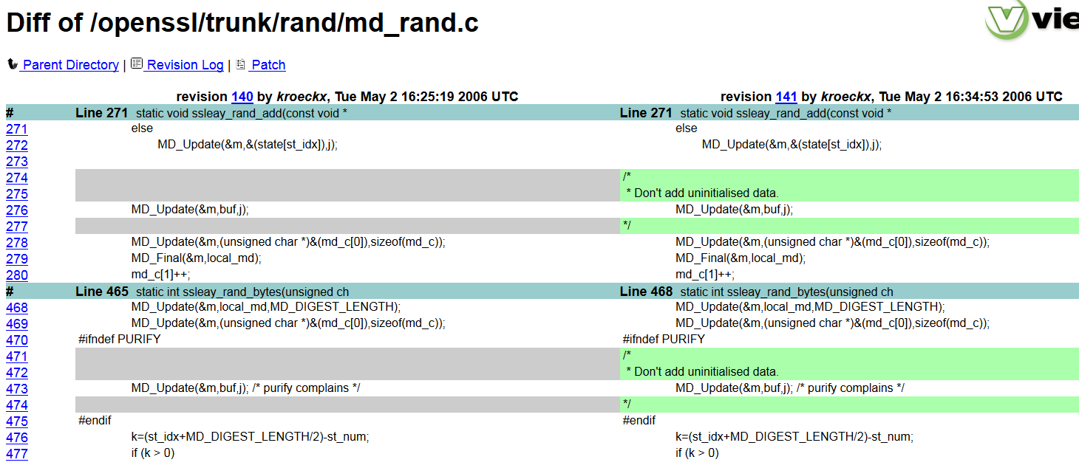
Fatal mistake

Slide 6
Morale
Access to source code doesn’t guarantee bug-free code
Usage of automated tools can provide great advantage, but deep understanding of code before change must remain
Code review eventually spotted the problem

Slide 7
Security code Review

Slide 8
Resources
Review process and techniques are extensively based on the excellent book “The Art of Software Security Assessment: Identifying and Preventing Software Vulnerabilities” by Mark Dowd, John McDonald, Justin Schuh
Book is available in faculty library

Slide 9
Security code review
Architecture overview
  Design choices and possible design flaws
Code review
  How well is architecture actually implemented
Whitebox, greybox & blackbox testing
  different level of access to code and documentation
Available tools
  mainly for code review

Slide 10
Application review phases
Pre-assessment
Application review
Documentation and analysis
Remediation support

Slide 11
Timeline
Good reviewer ranges between 100 to 1,000 lines of code an hour
  highly dependent also on code complexity
  flexibility must be allowed
Keep track of your previous progress
  and get feeling for your speed
  helping you making better future estimations

Slide 12
Information Collection
Developer interviews
Developer documentation
Standards documentation
Source profiling
System profiling

Slide 13
Common problems
Design documentation not available at all
Design documentation is outdated
Third party components without documentation
Developers not available or not cooperating
Limited time for everything

Slide 14
Iterative process
Plan your next work
Perform auditing strategy you selected
  and make extensive notes
Reflect on time spend
  what you have learned
Repeat from step 1.

Slide 15
Top-down approach
Top-down approach
  water-fall like approach
  start from design specification
  establish threat model
  find design vulnerabilities first
  find logical implementation vulnerabilities second
  find low-level implementation bugs third
Good results if design documentation is accurate
  but that is usually not the case
  something is missing or implemented differently

Slide 16
Bottom-up approach
Bottom-up approach
  starts with implementation
  targets low-level implementation vulnerabilities first
    e.g., by automated tools
  higher-level threat and design documentation later
    when understanding of application is much better
Works well even if design documentation is not accurate
  but is slow as you need to read a lot of code that is NOT security relevant
Necessity for maintaining design model continuously
  e.g., DFD sketches and class diagrams

Slide 17
Hybrid approach
Combination of top-down and bottom-up approaches
Focus on high-level characteristics
  General application purpose
  Assets and entry points
  Components and modules
  Inter-module relations
  Fundamental security
  Major trust boundaries

Slide 18
Verify the progress you are making
Ask often following questions:
What have you learned about the application?
Are you focusing on the most security-relevant components?
Have you gotten stuck on real problem or gone down some rabbit hole?
The Art of Software Security Assessment: Identifying and Preventing Software Vulnerabilities

Slide 19
Verify the progress you are making (cont.)
Ask often following questions:
Does your master ideas list have many plausible entries?
Have you been taking adequate notes and recorded enough detail for review purposes?
If you're working from application models and documentation, do these models reflect the implementation accurately?
The Art of Software Security Assessment: Identifying and Preventing Software Vulnerabilities

Slide 20
Security code review - hints
You will always have a limited time
  try to rapidly build overall picture
  use tools to find low hanging fruit
Focus on most sensitive and problematic areas
  use tools to focus your analysis scope
More eyes can spot more problems
  experts on different areas
It’s creative process
  be pragmatic, flexible, and results driven
Have the rights skills
  you should know programming as well as have security mindset

Slide 21
Present results (Finding summary)
Location of the vulnerability
Vulnerability class
Vulnerability description
Prerequisites (for exploiting vulnerability)
Business impact (on assets)
Remediation (how to fix)
Risk
Severity
Probability

Slide 22
Finding summary - example
Problem identification: DSA-1571-1 openssl
Severity: critical
Risk: high - directly exploitable by external attacker
  Problem description: crypto/rand/md_rand.c:276 & 473 – The random number generator in Debian's openssl package is predictable. This is caused by an incorrect Debian-specific change to the openssl package. One of the sources of a randomness based on usage of uninitialized buffer buff is removed.
Remediation: revert back to usage of uninitialized buffer buff

Slide 23
Architecture review

Slide 24
Architecture overview
Get all information you can quickly
Assets
  What has the value in the system?
  What damage is caused when successfully attacked?
  What mechanisms are used to protect assets?
Roles
  Who has access to what?
  What credentials needs to be presented?
Thread model
  What is expected to do harm?
  What are you defending against?

Slide 25
Architecture review (2)
Usage of well established techniques and standards
Comparison with existing schemes
  What is the advantage of new scheme?
  Why changes were made?
Security tradeoffs documented
  Possible threat, but unmitigated?
  Is documented or overlooked?

Slide 26
Sensitive data flow mapping
Identify sensitive data
  password, key, protected data...
Find all processing functions
  and focus on them
Create data flow between functions
  e.g. Doxygen call graph
Inspect when functions can be called
  Is key schedule validity checked?
  Can be function called without previous function calls?
Where are sensitive data stored between calls?

Slide 27
Protocol design (and implementation)
Packet confidentiality, integrity and authenticity
Packet removal/insertion detection
Replay attack
Reflection attack
Man in the middle

Slide 28
Cryptography usage
CIA (Confidentiality, Integrity, Availability)
  Plaintext data over insecure channel? Encrypted only?
  Can be packet send twice (replay)?
  What is the application response on data modification?
What algorithms are used
  Broken/insecure algorithms? MD5? simple DES?
What key lengths are used?
  < 90 bits symmetric crypto?
  < 1024 bits asymmetric crypto?
Random number generation
  Where the key comes from?
  Is source entropic enough?
  srand() & rand()?

Slide 29
Cryptography usage (2)
Key creation
  Where the keys originate? Enough entropy?
  Who has access?
Key storage
  Hard-coded keys
  Keys in files in plaintext
  Keys over insecure channels
  Keys protected by less secure keys
Key destruction
  How are keys erased from memory?
  Can exception prevent key erase?

Slide 30
Cryptography implementation
Implementation from well known libraries?
Own algorithms?
  security by obscurity?
  usually not secure enough
Own modifications?
  Why?
  sometimes used to prevent compatible programs
  decreased number of rounds?
  Performance optimization with security impact?

Slide 31
code inspection

Slide 32
Example process
Start review by suite of static analysis tools
  approximately up to 40-50% of software bugs can be found
  but incapable of finding application flaws and business logic vulns.
Results used to create prioritized list for human review
  security mechanisms to review
  potential security vulnerabilities to investigate
Manual inspection of issues in prioritized list
  use and abuse cases
  various code inspection strategies
Threat modeling used for large codebases (>100k loc)
  inspect impact of generally high-risk threat on application
http://www.praetorian.com/campaign/software-security/security-code-review.html

Slide 33
Code navigation
Control-flow sensitive navigation
  follow function calls
  e.g., what parts of program are reachable from set of functions callable without previous authentication?
Data-flow sensitive navigation
  follow flows of interesting data
  e.g., password from input to verification and storage
Code navigation tools provide great help
  call graphs (Doxygen, Performance profilers)
  tainted values (e.g., taintgrind)
  ...

Slide 34
Code auditing strategies
Code comprehension (CC) strategies
  analysing the source code directly to discover vulnerabilities
Candidate point (CP) strategies
  create a list of potential issues (via some mechanism)
  examine the source code for relevance of these issues
Design generalization (DG) strategies
  reviewing the implementation and inferring higher-level design abstractions
  medium- to high-level logic and design flaws

Slide 35
Code comprehension (CC) strategies

Slide 36
CC strategy - Trace Malicious Input
Start at entry point to the system
  e.g., user input
Trace flow of code forward with data flow analysis
  functions processing user input
Set of possible “bad” inputs is created
  e.g., escaped shell command
Code is examined for potential security issue
  where is user input “executed”?

Slide 37
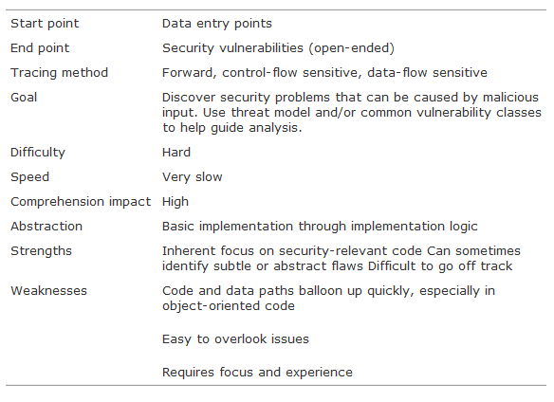
Trace Malicious Input - characteristics
The Art of Software Security Assessment: Identifying and Preventing Software Vulnerabilities

Slide 38
CC strategy - Analyse Module & Algorithm
Reading the code line by line from the beginning
Do not follow function calls
Writing down potential issues spotted
Algorithm analysis is similar to module analysis, but module implementation is usually longer
Effective, if the code is not too long, but mentally exhausting
  overlooked problems after some time, time-demanding

Slide 39
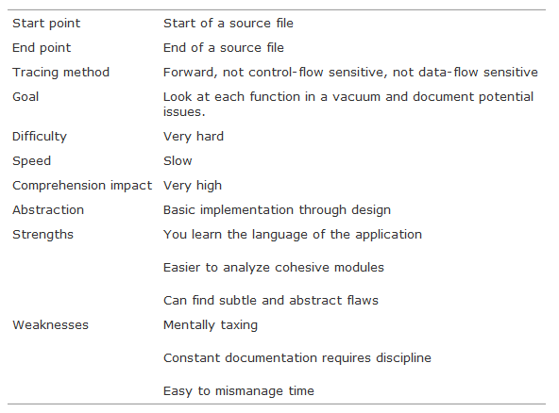
Analyse a Module - characteristics
The Art of Software Security Assessment: Identifying and Preventing Software Vulnerabilities

Slide 40
CC strategy – other useful strategies
Analyse a Class or Object
  implementation of small unit
Trace Black Box Hits
  focus on areas where fuzzers etc. found problems
  e.g., by debugging with value used to crash application
Automated Source Analysis Tool
  used to generate candidate points

Slide 41
Candidate points (CP) strategies

Slide 42
Candidate points strategies
Use some tool or process for identifying candidate points
Deeper follow-up inspection by other (e.g., CC) strategy
Simple Lexical Candidate Points
  patterns of common vulnerabilities (full text search, grep-like tool)
  deprecated functions (e.g., gets), strings like “key”, “password”...
  static analysis tools, e.g., Cppcheck rules

Slide 43
Candidate points strategies
Simple Binary Candidate Points
  generate candidate points from binary only (unavailable source code)
  list or search for specific strings in binary
  search for interesting system calls
  use disassembling, or binary debugging
Application-Specific Candidate Points
  patterns of mistakes for particular application
  learned from previous code/binary analysis
  e.g., new rule for Cppcheck

Slide 44
Tools

Slide 45
Handy tools
Syntax highlighting, full text search
  any reasonable editor
Regular expression tools (grep)
  allow for more complex searches
Automatic generation of call graphs
  Doxygen, Visual Studio and many other tools

Slide 46
Handy tools
Static and dynamic analyzers
  detect multiple issues
  annotations (e.g., SAL) will help even further
Fuzzing tools
  behavior under stress, error messages...
Mind-mapping software
  build and do not forget information you got
Pen&Pencil
  still of great help (flexible)

Slide 47
Anti-patterns

Slide 48
(Security) Antipatterns
Common defective process and implementation within organization
Opposite to design patterns
  see http://sourcemaking.com/design_patterns
Read http://sourcemaking.com/antipatterns
  good description, examples and how to solve
  not limited to object oriented programming!

Slide 49
Security anti-patterns
Software development anti-patterns
  http://sourcemaking.com/antipatterns/software-development-antipatterns
Tesco password handling
  http://www.troyhunt.com/2012/07/lessons-in-website-security-anti.html
Critique of some usages of OAuth
  http://adactio.com/journal/1357/

Slide 50
Recommended reading
Process of security code review
  http://ieeexplore.ieee.org/stamp/stamp.jsp?arnumber=01668009
Software Security Code Review
  http://www.softwaremag.com/l.cfm?doc=2005-07/2005-07code
Performing security Review (Microsoft)
  http://silverstr.ufies.org/blog/msdn-webcast-code-review.pdf
  SDL security code review process (MS Security Push)
  http://msdn.microsoft.com/en-us/library/cc307418.aspx
OWASP security review
  https://www.owasp.org/index.php/Security_Code_Review_in_the_SDLC
On the effectiveness of code review
  http://www.cs.berkeley.edu/~finifter/papers/coderev-essos13.pdf

Slide 51
Recommended reading
Why cryptosystems fail, R. Anderson
  http://www.cl.cam.ac.uk/~rja14/Papers/wcf.pdf
Static code analysis tools
  http://en.wikipedia.org/wiki/List_of_tools_for_static_code_analysis
Security in web applications (OWASP)
  http://www.owasp.org/index.php/Code_Review_Introduction

Slide 52
Conclusions

Slide 53

Conclusions
  Plan your work and time (work iteratively)
  Different reviews needs different techniques (be flexible)
  Code review is creative process (have fun)
  Tools can help you a lot (use them)
    but main part of work is up to you
  Code review also contains human interaction (be polite)
Questions

