Slide 1
PA193 - Secure coding principles and practices
Protecting integrity of modules and external components
Petr Švenda svenda@fi.muni.cz

Slide 2
Overview
Lecture:
  dynamic libraries, forging, protection
  code signing
  temporary files
  protections in whitebox attacker model
Labs
  Projects defense

Slide 3
Problem

Slide 4
Server application
Local I/O
Application binary
Remote I/O
Running application
Temporary files
Dynamic libraries
Configurations
(registry, files)
Secure element

Slide 5
Dynamic libraries

Slide 6
Dynamic library usage (Windows)
Static linking
  library.lib added to dependencies
Run-time dynamic linking
  controllable run-time search for dynamic library
  developer can control and respond on (un)available lib
  LoadLibrary(path) & FreeLibrary(hLib)
Run-time search for specific function
  GetProcAddress(hLib, “function_name”)
  cast to target function prototype (later)

Slide 7
Default order of directory search for DLL
The directory from which the application loaded
  “application directory”
The system directory
The 16-bit system directory
The Windows directory
The current directory
The directories that are listed in the PATH environment variable
Safe DLL search mode place current directory to 5.

Slide 8
DLL preloading attack
Called DLL preloading or binary planting attack
Attacker obtains write access to one directory in search list
Attacker places malicious DLL here
If application will not find DLL in directories searched before, attacker’s DLL gets loaded
Malicious code is executed with application privileges

Slide 9
How to execute man-in-the-middle for dll
Application wants to load dynamic library
  according to specified name, e.g., winscard.dll
  e.g. via LoadLibrary(“winscard.dll”) call
Create dynamic library (“stub”) with the same name and the same set of exported functions
Move stub DLL into directory where application looks first for requested DLL
  stub is loaded instead of original
  application will call stub function instead
When given function from stub is called, pass input arguments to the original DLL and return response
  or modify, log, delay, block...

Slide 10
Example: APDUPlay
Dynamic library for interception and manipulation of communication with smart cards
  winscard.dll, APDU-based communication
  http://www.fi.muni.cz/~xsvenda/apduinspect.html
What you can achieve:
  log input/output APDU commands (including keys, PINs...)
  manipulate APDUs content according to predefined rules
    e.g., return OK even when verification fails
    e.g., simulate presence of reader / smart card
  reverse engineer protocol used based on communication
  redirect communication to other computer via socket

Slide 11

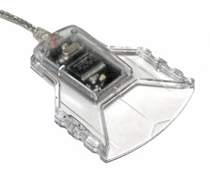
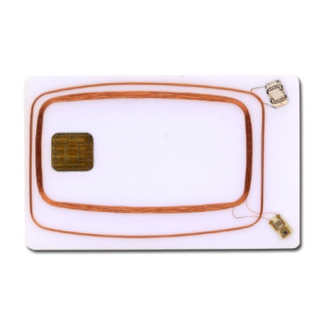
Let’s write own winscard.dll (PC/SC)
http://www.fi.muni.cz/~xsvenda/apduinspect.html
based on ApduView utility (by Fernandes)
User application
[begin]
SCardTransmit (handle 0xEA010001)# apduCounter:0#
totalBytesINCounter:1#
transmitted:00 a4 04 00 0a a0 00 00 00 28 80 10 30 01 ff
responseTime:31#
SCardTransmit result:0x0#
received:6a 81
SCardTransmit (handle 0xEA010001)# apduCounter:1#
totalBytesINCounter:16#
…
winscard.dll (stub)
original.dll
winscard.dll

Slide 12
DEMO: capturing PIN from GPG
Smart card with OpenPGP applet
  communication is realized via winscard.dll
gpg2 --card-edit
  gpg/card> verify
PIN is visible in captured log

Slide 13
How to load proper library?
Use fully qualified path to load library (LoadLibrary)
Dynamic-Link Library Redirection
  https://tinyurl.com/chy5wum
  redirection file is created in application directory
  App_name.local (e.g., explorer.exe → explorer.exe.local)
    (content of file is ignored)
  application directory is searched first for the target DLL
  good practice to install application DLLs in its directory
    will not overwrite other versions of same DLL
  (will not work if application has manifest)

Slide 14
How to load proper library? (2)
Application manifest
  XML file with various application configurations
  including versions and hash (SHA-1) of required DLLs
  when required DLL is loaded, hash is checked
  https://tinyurl.com/b2dz8u9
<?xml version="1.0" encoding="UTF-8" standalone="yes"?>
<assembly xmlns="urn:schemas-microsoft-com:asm.v1" manifestVersion="1.0">
...
<file name="bar.dll" hash="ac72753e5bb20446d88a48c8f0aaae769a962338" hashalg="SHA1"/>
<file name="foo.dll" hash="a7312a1f6cfb46433001e0540458de60adcd5ec5" hashalg="SHA1">
...

Slide 15
Security implications of dynamic libraries
Library can be forged and exchanged
Library-in-the-middle attack easy
  data flow logging
  input/output manipulation
Library outputs can be less checked then user inputs
  feeling that library is my “internal” stuff and should play by „my“ rules
Library function call can be behind logical access controls

Slide 16
References
Dynamic-Link Library Security
  http://msdn.microsoft.com/en-us/library/windows/desktop/ff919712%28v=vs.85%29.aspx
Assembly manifests
  http://msdn.microsoft.com/en-us/library/aa374219%28v=vs.85%29.aspx
Assembly signing example
  http://msdn.microsoft.com/en-us/library/aa374228%28v=vs.85%29.aspx

Slide 17
Code signing

Slide 18
Code authenticity
Why to authenticate binary/source codes?
  random transmission errors solved by transport layer (CRC)
  intentional modification on remote code repository
  intentional modification during transport (MITM)
  intentional modification locally (malware in user space)
  NSA Bullrun program...
Strong authentication often required implicitly
  relatively restricted platforms like iOS / Android...
  kernel drivers (no unsigned kernel driver from Vista 64bit)
  official software repositories…

Slide 19
Possibilities for code signature
Non-keyed hash function sign = H(your_package)
  everyone can compute H(modified_package)
  where to get “correct” hash value? (usually same webpage ☹)
  often MD5 algorithm (known collisions, insecure)
  often need for manual verification (lazy users)
Authentication based on symmetric cryptography
  keyed MAC, sign = HMAC(key, your_package)
  not suitable for one to many distribution (shared key)
Authentication based on asymmetric cryptography
  digital signatures of package sign = RSA(private_key, your_package)
  everybody can Verify(public_key, sign)
  most suitable, but may require PKI (trust to public key is critical)

Slide 20
Code signing (GPG/PGP)
PGP/GPG can be used for code signing
  same process as message signature
  signature is usually detached into separate file (*.sig)
Trust to signing key is needed
  public key should be obtained from trusted source
  but usually only publisher website or keyserver ☹
Can be used to sign packages (e.g., Debian RPM)
  http://fedoranews.org/tchung/gpg/
gpg --output app.sig --detach-sig app
gpg --verify app.sig app

Slide 21
Various code signing managers
Java certificates (also Android)
  java-based applications and applets (.jar)
Microsoft Authenticode
  Active-X controls, plug-ins, execs (.cab, .cat, .ctl, .ocx, .exe, .dll)
Adobe Air certificate
  Adobe Ajax and flex files (.air and .airi)
Microsoft Office and VBA certificate
  Microsoft Office macros and Visual Basic applications
Apple developer program
  applications for iOS platform
Difference: local sign vs. additional check on server

Slide 22
Code signing (Microsoft’s Authenticode)
Publisher obtains Code Signing Digital ID
  X.509 certificate with public key signed by trusted authority
  authority’s certificate imported in Trusted Publishers
Publisher creates code (application)
Publisher signs code with its private key
Application is distributed along with signature(s)
Application signature is verified, user is notified
  invalid signature of application → confirmation from user
  invalid signature of driver → no installation
  (problem with legacy apps, non-compliant developers)
(RSA 2048bit with SHA-1)

Slide 23
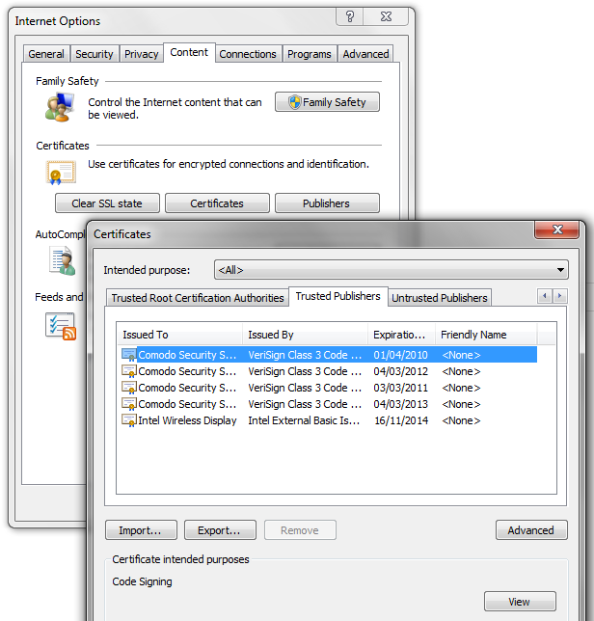

Slide 24
Microsoft WHQL
Windows Hardware Quality Labs (WHQL)
Intended for kernel-mode binaries (drivers, dll)
WHQL-certified binaries can be distributed through the Windows Update program
Signature stored in catalog file (*.cat)
Practical Windows Code and Driver Signing
  http://www.davidegrayson.com/signing/

Slide 25
Microsoft Authenticode – selfsign (testing)
Process of creating Authenticode selfsign certificate
  used for testing purposes
  your certificate imported as Trusted Publisher
  signing of exe, dll, scripts
http://msdn.microsoft.com/en-us/library/office/aa140234%28v=office.10%29.aspx
Why it will not work for other computers?

Slide 26
Signed code == secure code?
Developer can sign anything
  additional layer of validation of application needed
    Microsoft WHQL, Google Play, Apple App Store...
  but his/her key (and apps) can be revocated
Trusted authority can be compromised
  Comodo, DigiNotar...
Signature must be verified correctly
  Android Master key vulnerability
  https://tinyurl.com/kj63ae8, https://tinyurl.com/p5fu3j3
Signed application can execute unsigned code
  Apple's Nitro JavaScript engine, https://tinyurl.com/6tpvzpq

Slide 27
Temporary files

Slide 28
Why we use temporary files?
Temporary files are used only during the program run
  no persistence between runs is typically assumed
Used to offload (large) data from memory to disk
  too large to fit into memory of the application
Communication with other process
  transferring data through the file system

Slide 29
Creating temporary files in C/C++
#include <stdio.h>
FILE* tmpfile (void);
  creates new temporary binary file with unique file name and opens it for update (“wb”)
  file is created in TMP directory according to environment settings
  file is automatically closed at program end (including crash)
char* tmpnam (char * str);
  return unique file name not used yet (but is not opening file)
  additional call to fopen() is required
  if not specified, file is created in current directory
  Warning: file is not opened in the same time, attacker can open it and manipulate in between – Race condition
  tmpnam generates a different string each time you call it, up to TMP_MAX times (defined in stdio.h as 65,535)

Slide 30
Creating temporary files in C/C++ (2)
Function alternatives from Secure C library exist
  secure from the perspective of buffer manipulation
  not necessarily against various attacks described later
errno_t tmpnam_s(char *s, rsize_t maxsize);
  returns unique file name (same format as tmpnam)
errno_t tmpfile_s(FILE*restrict*restrict streamptr)
  creates new temporary binary file with unique file name and opens it for update (“wb”)
  NOTE: if program crashes, tmp file might NOT be removed (difference to tmpfile)

Slide 31
Removing temporary files in C/C++
_rmtmp()
  removes all temporary files created by tmpfile / tmpfile_s
  NOTE: will leave invalid FILE* handle(s)
Files created by tmpfile / tmpfile_s
  fclose() will remove the file
  normal program termination will remove the file
  abnormal program termination might not remove files
Temporary files opened by tmpnam() & fopen()
  not treated by system as temporary files
  developer is responsible for removal

Slide 32
Problem with temporary files - TOCTOU
#include <stdio.h>
int main() {
const size_t BUFFER_SIZE = 1000;
char filename[BUFFER_SIZE];
// Get unique file name
tmpnam_s(filename, BUFFER_SIZE);
// Test if no such file exists
FILE *fp = fopen(filename,"r");
if( !fp ) { // file does not exist
fp = fopen(filename,"w");
// use tmp file...
fclose(fp);
} else {
// file exists, go for other name
fclose(fp);
}
return 0;
}
Time Of Check
attacker can open filename
during this period (TOCTOU)
Time Of Use

Slide 33
Problem with temp. files - predictability
#include <stdio.h>
#include <windows.h>
int main(int argc, char* argv[]) {
const size_t BUFFER_SIZE = 1000;
const size_t NUM_FILES = 15;
char buffer[BUFFER_SIZE];
// Obtain directory for temporary files
GetTempPath(BUFFER_SIZE, buffer);
printf("Temporary directory: %s\n", buffer);
FILE * pFile1[NUM_FILES];
// Obtain unique file name
for (size_t i = 0; i < NUM_FILES; i++) {
tmpnam_s(buffer, BUFFER_SIZE);
printf("Unique file name: %s\n", buffer);
fopen_s(&pFile1[i], buffer + 1, "wb");
}
return 0;
}
Temporary directory:
C:\Users\petr\AppData\Local\Temp\
Unique file name: \s4sg.
Unique file name: \s4sg.1
Unique file name: \s4sg.2
Unique file name: \s4sg.3
Unique file name: \s4sg.4
Unique file name: \s4sg.5
Unique file name: \s4sg.6
Unique file name: \s4sg.7
Unique file name: \s4sg.8
Unique file name: \s4sg.9
Unique file name: \s4sg.a
Unique file name: \s4sg.b
Unique file name: \s4sg.c
Unique file name: \s4sg.d
Unique file name: \s4sg.e

Slide 34
Problem with temp. files – predictability (2)
#include <stdio.h>
int main(int argc, char* argv[]) {
const size_t NUM_FILES = 15;
FILE * pFile2[NUM_FILES];
// Open temporary files
for (size_t i = 0; i < NUM_FILES; i++) {
tmpfile_s(&pFile2[i]);
}
// Wait - tmp files can be spotted in tmp directory
getchar();
// Remove tmp files (only these opened by tmpfile / tmpfile_s)
// Handles FILE* inside pFile2 now have invalid value
_rmtmp();
return 0;
}
06/11/2013 15:28 0 t3oc
06/11/2013 15:28 0 t3oc.1
06/11/2013 15:28 0 t3oc.2
06/11/2013 15:28 0 t3oc.3
06/11/2013 15:28 0 t3oc.4
06/11/2013 15:28 0 t3oc.5
06/11/2013 15:28 0 t3oc.6
06/11/2013 15:28 0 t3oc.7
06/11/2013 15:28 0 t3oc.8
06/11/2013 15:28 0 t3oc.9
06/11/2013 15:28 0 t3oc.a
06/11/2013 15:28 0 t3oc.b
06/11/2013 15:28 0 t3oc.c
06/11/2013 15:28 0 t3oc.d
06/11/2013 15:28 0 t3oc.e

Slide 35
Problems with creating tmp files (MSVC)
tmpnam() / tmpnam_s()
  format as sxxx.#
  TOCTOU
tmpfile() / tmpfile_s()
  unique file name is generated as txxx.# where xxx is digit or character and # is sequential number or character
  predictability
Attacker can:
  predict file name, create own file (TOCTOU)
  then capture sensitive & forge malformed data

Slide 36
Temporary files in Java
File tempFile = File.createTempFile(prefix, suffix);
  Will keep file even when JVM exits
  Longer name then in C/C++ (by default)
Ask for delete on JVM exit
  tempFile.deleteOnExit();
  But deleted only during “normal” termination
  “Deletion will be attempted only for normal termination of the virtual machine, as defined by the Java Language Specification.”
Similar problems as for C/C++

Slide 37
Temporary files – security checklist

Slide 38
Temporary files security checklist
Avoid temporary files if possible ☺
Don’t use standard C function for temporary files
  mktemp(), tmpnam(), tempname(), tmpfile()...
  predictable names, race conditions
Don’t store sensitive information in temp files
  temp files are common attack vector, prevent it
Research where are temporary files stored
  no standard function for that in C/C++
  Windows: GetTempPath()

Slide 39
Temporary files security checklist (2)
Ensure strong uniqueness and unpredictability for name of temporary file
  don’t use tmpnam or tmpfile functions (predictable)
  generate long random name internally, open it, check
  use strong random generating function like CAPI’s CryptGenRandom(), OpenSSL’s RAND_bytes()...

Slide 40
Temporary files security checklist (2)
Ensure proper permissions for temporary file
  avoid publically writable directories if possible
  if publically writable directory is used, create subdirectory and set ACL’s (read and write) only for your application
Encrypt log file content with random key
  generate random secret key every time you run your application
  encrypt data before writing into log file (and decrypt when reading)
  when program is abnormally terminated, (encrypted) temporary file will stay but random key will is lost
  attacker cannot supply older temporary version (different key)

Slide 41
Temporary files security checklist (3)
Perform secure cleanup
  overwrite content of temporary file with random data before close
    even when performing log file encryption (key may leak in memory dump, pagefile etc.)
  leave no temporary files behind
    close temporary files as soon as possible
    call _rmtmp() if standard C functions were use for open
  still possible to leave temporary files during abnormal termination
    utilize own signal handlers
    wrap main into big exception handler and cleanup

Slide 42
Temporary files security checklist (4)
Rely on absolute, not on relative paths
  relative paths will change when application current directory change
  if user provides directory path for temporary files, sanitize it
  use file handles (e.g., FILE*) instead of file path (TOCTOU)
Open files exclusively and non-existing only
  C99: fopen(“filename”, “wb”) opens new as well as existing file ☹
  C11: new exclusive create-and-open mode ("…x") for fopen
  POSIX: open() with O_CREAT|O_EXCL
  WIN32 API:CreateFile() with CREATE_NEW

Slide 43

Example: (virtual LABs)
obtain temporary directory
create subdirectory, set proper ACL
generate long random file name
open file exclusively with absolute path
generate random key
encrypt data before write
shred content (overwrite) before close
close after use
handle abnormal termination (signal, exception)

Slide 44
References
Security Tips for Temporary File Usage in Applications
  http://www.codeproject.com/Articles/15956/Security-Tips-for-Temporary-File-Usage-in-Applicat
FIO43-C. Do not create temporary files in shared directories
  https://www.securecoding.cert.org/confluence/display/seccode/FIO43-C.+Do+not+create+temporary+files+in+shared+directories
MITRE CWE-377: Insecure temporary files
  http://cwe.mitre.org/data/definitions/377.html

Slide 45
Obfuscation, Protecting software modules

Slide 46

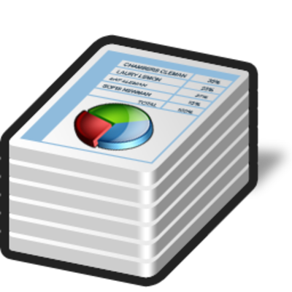



Standard vs. whitebox attacker model

Slide 47
Standard AES API (PolarSSL)
/**
* \brief AES key schedule (encryption)
*
* \param ctx AES context to be initialized
* \param key encryption key
* \param keysize must be 128, 192 or 256
*
* \return 0 if successful, or POLARSSL_ERR_AES_INVALID_KEY_LENGTH
*/
int aes_setkey_enc(aes_context *ctx, const unsigned char *key, unsigned int keysize);
/**
* \brief AES-ECB block encryption/decryption
*
* \param ctx AES context
* \param mode AES_ENCRYPT or AES_DECRYPT
* \param input 16-byte input block
* \param output 16-byte output block
*
* \return 0 if successful
*/
int aes_crypt_ecb( aes_context *ctx,
int mode,
const unsigned char input[16],
unsigned char output[16] );

Slide 48
Standard AES - usage
void simpleAES() {
unsigned char key[32];
unsigned char buf[16];
aes_context ctx;
memset( buf, 1, sizeof(buf));
memset( &ctx, 0, sizeof(ctx));
// Set the key
sprintf((char*)key, "%s", "SecurePassword:nbu123");
aes_setkey_enc( &ctx, key, 128);
printf("Input: ");
for (int i = 0; i < AES_BLOCK_SIZE; i++) printf("%2x", buf[i]);
printf("\n");
// Encrypt one block
aes_crypt_ecb( &ctx, AES_ENCRYPT, buf, buf );
printf("Output: ");
for (int i = 0; i < AES_BLOCK_SIZE; i++) printf("%x", buf[i]);
}

Slide 49
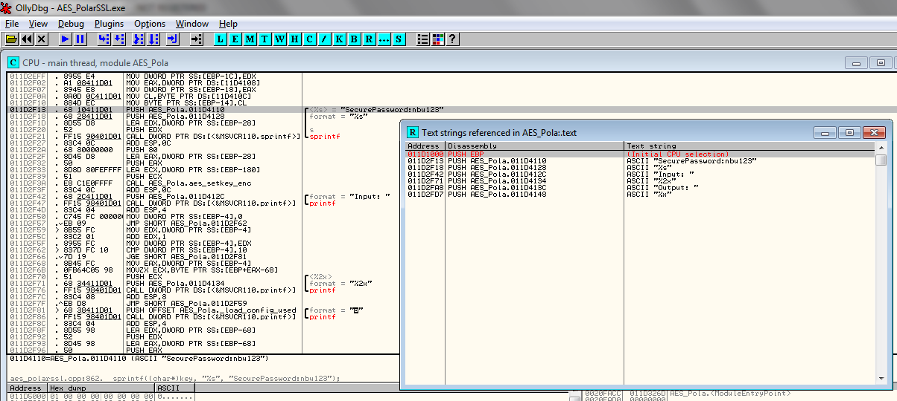
OllyDbg – key value is static string

Slide 50
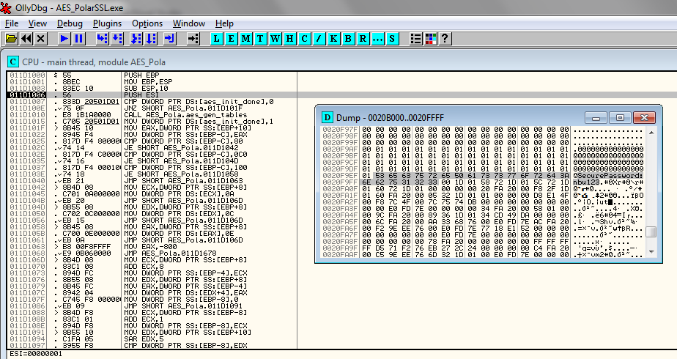
OllyDbg – key is visible in memory

Slide 51
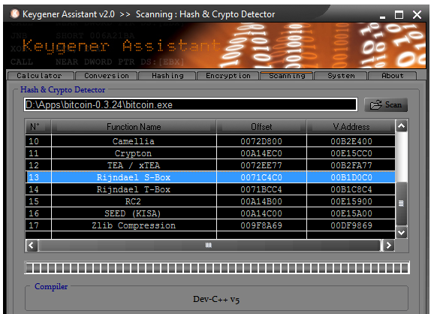
What if AES usage is somehow hidden?

Slide 52
Whitebox attacker model
The attacker is able to:
  inspect and disassemble binary (static strings, code...)
  observe/modify all executed instructions (OllyDbg...)
  observe/modify used memory (OllyDbg, memory dump...)
How to still protect value of cryptographic key?
Who might be white-box attacker?
  Mathematician (for fun)
  Security researcher / Malware analyst (for work)
  DRM cracker (for fun&profit)
  ...

Slide 53
Classical obfuscation and its limits
Time-limited protection
Obfuscation is mostly based on obscurity
  add bogus jumps
  reorder related memory blocks
  transform code into equivalent one, but less readable
  pack binary into randomized virtual machine
  ...
Barak’s (im)possibility result (2001)
  family of functions that will always leak some information
  but practical implementation may exists for others

Slide 54
CEF&CED
Computation with Encrypted Data and Encrypted Function

Slide 55
Scenario
We’d like to compute function F over data D
  secret algorithm F or sensitive data D (or both)
Solution with trusted environment
  my trusted PC, trusted server, trusted cloud…
Problem: can be cloud or client really trusted?
  server hack, DRM, malware...
Attacker model
  controls execution environment (debugging)
  sees all instructions and data executed

Slide 56

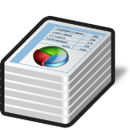

CEF
Computation with Encrypted Function (CEF)
  A provides function F in form of P(F)
  P can be executed on B’s machine with B’s data D as P(D)
  B will not learn function F during computation
A
B

Slide 57

CED
Computation with Encrypted Data (CED)
  B provides encrypted data D as E(D) to A
  A is able to compute its F as F(E(D)) to produce E(F(D))
  A will not learn D
A
B

Slide 58
CED via homomorphism
Convert your function into circuit with additions (xor) and multiplications (and) only
Compute addition and/or multiplication “securely”
  an attacker can compute E(D1+D2) = E(D1)+E(D2)
  but will learn neither D1 nor D2
Execute whole circuit over encrypted data
Partial homomorphic scheme
  either addition or multiplication is possible, but not both
Fully homomorphic scheme
  both addition and multiplication (unlimited)

Slide 59
Partial homomorphic schemes
Example with RSA (multiplication)
  E(d₁).E(d₂) = d₁e . d₂e mod m = (d₁d₂)^{e} mod m = E(d₁d₂)
Example Goldwasser-Micali (addition)
  E(d₁).E(d₂) = x^{d1}r₁^{2 .} X^{d2}r₂² = x^{d1+d2}(r₁r₂)² = E(d₁⊕d₂)
Limited to polynomial and rational functions
Limited to only one type of operation (mult or add)
  or one type and very limited number of other type
Slow – based on modular mult or exponentiation
  every operation equivalent to whole RSA operation

Slide 60
Fully homomorphic scheme (FHE)
Holy grail - idea proposed in 1978 (Rivest et al.)
  both addition and multiplication securely
But no scheme until 2009 (Gentry)!
  based on lattices over integers
  noisy FHE usable only to few operations
  combined with repair operation

Slide 61
Fully homomorphic scheme - usages
Outsourced cloud computing and storage (FHE search)
  Private Database Queries
  using Somewhat Homomorphic Encryption http://researcher.ibm.com/researcher/files/us-shaih/privateQueries.pdf
  protection of the query content
Secure voting protocols (yes/no + sum)
Protection of proprietary info - MRI machines
  very expensive algorithm analyzing MR data, HW protected
  central processing restricted due to processing of private patient data
Read more about current state of FHE
  http://www.americanscientist.org/issues/id.15906,y.2012,no.5,content.true,page.2,css.print/issue.aspx

Slide 62
Fully homomorphic scheme - practicality
Not very practical (yet ☺) (Gentry, 2009)
  2.7GB key & 2h computation for every repair operation
  repair needed every ~10 multiplication
FHE-AES implementation (Gentry, 2012)
  standard PC ⇒ 37 minutes/block (but 256GB RAM)

Slide 63
Whitebox cryptography
Computation with Encrypted Data and Encrypted Function

Slide 64
White-box attack resistant cryptography
Problem limited from every cipher to symmetric cryptography cipher only
  protects used cryptographic key (and data)
Special implementation fully compatible with standard AES/DES… 2002 (Chow et al.)
  series of lookups into pre-computed tables
Implementation of AES which takes only data
  key is already embedded inside
  hard for an attacker to extract embedded key

Slide 65


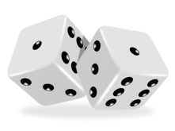
Whitebox transform

Slide 66
Impractical solution
Input block
Output block = AES(input, key_{X})
Secure, but 2¹²⁸ x 16B memory storage
00…00…00
10…01…11
Precomputed table
00…00…01
10…11…01
…
…
2¹²⁸
used as index into table
01…11…11
00…01…11
2¹²⁸
…
…
01…11…11
01…10…00
11…11…11
10…00…10

Slide 67
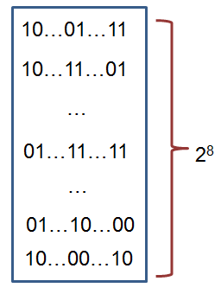
WBACR AES – some techniques
Pre-compute table for all possible inputs
  practical for one 16bits or two 8bits arguments table with up to 2¹⁶ rows (~64KB)
  AddRoundKey: data ⊕ key
    8bit argument data, key fixed
Pack several operations together
  AddRoundKey+SubBytes: T[i] = S[i ⊕ key];
Protect intermediate values by random bijections
  removed automatically by next lookup
  X = F⁻¹(F(X))
  T[i] = S[F⁻¹(i) ⊕ key];

Slide 68
Whitebox cryptography lifecycle
[Secure environment]
  Generate required key (random, database...)
  Generate WAES tables (in secure environment)
[Potential insecure environment]
  Compile WAES tables into target application
[Insecure environment (User PC)]
  Run application and use WAES as usual (with fixed key)

Slide 69
AES
key
Environment outside control
of an attacker
makeTable()
precompTable
Environment under control
of an attacker
data
encrypted data
encrypt(data)

Slide 70
Resulting implementation
More difficult to detect that crypto was used
  no fixed constants in the code
  precomputed tables change with every generation
  even two tables for same key are different
  (but can still be found)
Resistant even when precomputed tables are found
  when debugged, only table lookups are seen
  key value is never manipulated in plaintext
  transformation techniques should provide protection to key embedded inside tables

Slide 71
WBACR AES - pros
Performance is practically usable
  implementation size ~800KB (tables)
  speed ~MBs/sec (~6.5MB/s vs. 220MB/s)
Hard to extract embedded key
  Complexity semi-formally guaranteed
  (if the scheme is secure)
One can simulate asymmetric cryptography!
  implementation contains only encryption part of AES
  until attacker extracts key, decryption is not possible

Slide 72
WBACR AES - cons
Implementation can be used as oracle (black box)
  attacker can supply inputs and obtain outputs
  even if she cannot extract the key
  (can be partially solved by I/O encodings)
Problem of secure input/output
  protected is only AES, not code around
Key is fixed and cannot be easily changed
Successful cryptanalysis for several schemes
  several former schemes broken
  new techniques proposed
Fault induction attacks (2015, Riscure)!

Slide 73
List of proposals and attacks
(2002) First WB AES implementation by Chow et. al. [Chow02]
  IO bijections, linear mixing bijections, external coding
  broken by BGE cryptanalysis [Bill04]
    algebraic attack, recovering symmetric key by modelling round function by system of algebraic equations
(2006) White Box Cryptography: A New Attempt [Bri06]
  attempt to randomize whitebox primitives, perturbation & random equations added, S-boxes are enc. keys. 4 AES ciphers, major voting for result
  broken by Mulder et. al. [Mul10]
    removes perturbations and random equations, attacking on final round removing perturbations, structural decomposition. 2¹⁷ steps
(2009) A Secure Implementation of White-box AES [Xia09]
  broken by Mulder et. al. [Mul12]
    linear equivalence algorithm used (backward AES-128 compatibility => linear protection has to be inverted in next round), 2³² steps
(2011) Protecting white-box AES with dual ciphers [Kar11]
  broken by our work [Kli13]
    protection shown to be ineffective

Slide 74
More resources
Overviews, links
  http://whiteboxcrypto.com/research.php
  https://minotaur.fi.muni.cz:8443/~xsvenda/docuwiki/doku.php?id=public:mobilecrypto
Crackme challenges
  http://www.phrack.org/issues.html?issue=68&id=8
Whitebox crypto in DRM
  http://whiteboxcrypto.com/files/2012_MISC_DRM.pdf

Slide 75
Whitebox transform IS used in the wild
Proprietary DRM systems
  details are usually not published
  AES-based functions, keyed hash functions, RSA, ECC...
  interconnection with surrounding code
Chow at al. (2002) proposal made at Cloakware
  firmware protection solution
  Apple’s FairPlay & Brahms attack
    http://whiteboxcrypto.com/files/2012_MISC_DRM.pdf
  ...

Slide 76
Summary

Slide 77

Summary
Questions
Dynamic libraries can be forged
  make DLL preloding harder (manifest)
  check input from library as untrusted
Don’t use standard C functions for temporary files
  not use temporary files at all or follow security guidelines
Try to protect secrets inside binary
  don’t hardcode any secrets
  offload sensitive computation to secure environment (server, smart card, HSM)
  use whitebox-attacker protection techniques

