Slide 1
Create the Internet of Your Things
Chris Lanier
Director, Americas IoT Commercial

Slide 2
What is the Internet of Things?
Things
Connectivity
Data
Analytics

Slide 3







Operational
Technology
Information
Technology

Slide 4

Internet of Things
Enterprise

Slide 5

Microsoft’s view
The Internet of Things starts
with your things
    Build on the infrastructure
    you already have
    Add more devices to
    the ones you already own
    Get more from the data
    that already exists
    Stop just running your business. Start making it thrive. Start realizing the potential of the Internet of Your Things.

Slide 6





Bringing the Internet of Things to life
You have things…
Things produce data…
Services help you make sense of the data:
Windows
devices
Other devices &
line-of-business assets
Microsoft Azure IoT services
Azure Machine Learning | HDInsight | Power BI

Slide 7
Bringing the Internet of Things to life
You have things…
Things produce data…
Microsoft Azure
IoT services:
Services help you make sense of the data:
Windows
devices
Other devices &
line-of-business assets
Microsoft Azure IoT services
Azure Machine Learning | HDInsight | Power BI
Improve efficiency
Enable innovation
Transform
your business

Slide 8
Improve efficiency
Connect disparate line-of-business assets to automate and improve business processes
Monitor and track the health of your assets to
reduce costs
Things
Collect and secure large amounts of data from your assets in the cloud for analysis

Slide 9
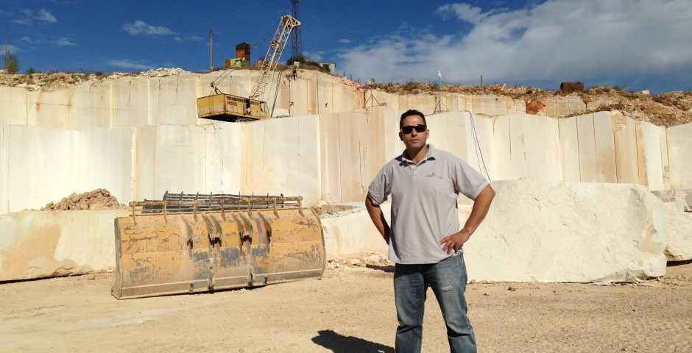

“We’re able to work more effectively with smaller crews for a variety of tasks and keep handwork to a minimum. We’ve increased productivity by at least 30 percent.”
ELIOT MAZZOCCA
PRESIDENT
LIDO STONE

Slide 10
Enable Innovation
Analyze data from multiple sources in near real time to drive revenue
Apply historical data to new problems to successfully predict future behavior and trends
Things
Create operational intelligence to improve performance and decision-making

Slide 11


“The mobile experience and loyalty program create a one-to-one relationship between us and our customers. Having a customer’s data really helps us offer them the best possible service, customized to their preferences and needs.”
KEVIN SMARTT
CEO
KWIK CHEK

Slide 12
Transform Your Business
Convert the raw data from your “things” into actionable insights and business results.
Create insights for the right people in your company to access and act on
Things
Leverage advanced analytics to create new business models and revenue streams

Slide 13
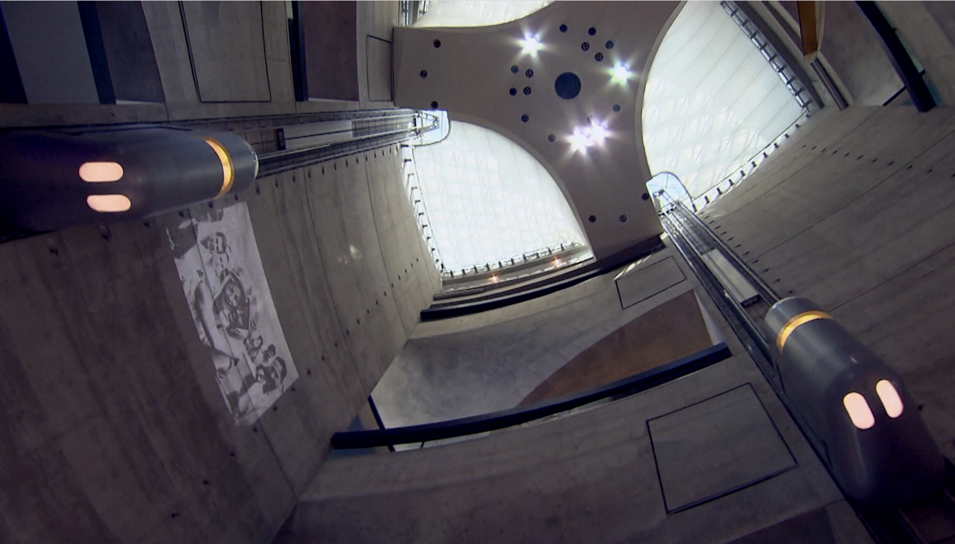
“We wanted to go beyond the industry standard of preventative maintenance, to offer predictive and even preemptive maintenance, so we can guarantee a higher uptime percentage on our elevators.”
ANDREAS SCHIERENBECK
CEO
THYSSEN KRUPP ELEVATORS

Slide 14
Bringing the Internet of Things to life
Improve efficiency
Enable innovation
Things
Transform your business

Slide 15















Microsoft Azure IoT services
Producers
Producers | Connect Devices | Storage | Analytics | Take Action
 | Event Hubs | SQL Database | Machine Learning | Azure Websites
 | Service Bus | Table/Blob Storage | Stream Analytics | Power BI
 | External Data Sources | DocumentDB | HDInsight | Notification Hubs
 |  | External Data Sources | Data Factory | Mobile Services
 |  |  |  | BizTalk Services
{ }

Slide 16
Announcing…
Microsoft Azure IoT Suite

Slide 17
Azure IoT Suite
IoT Applications …
Remote
Monitoring
Asset
Management
Predictive Maintenance
…future applications

Slide 18
Azure IoT Suite
IoT Applications … to build a Proof of Concept…
Remote
Monitoring
Pilot
Asset
Management
Plan
Proof
Predictive Maintenance
…future applications

Slide 19
Azure IoT Suite
IoT Applications … to build a Proof of Concept… that scale to full production …
Remote
Monitoring
Asset
Management
Predictive Maintenance
…future applications

Slide 20


Azure IoT Suite
IoT Applications … to build a Proof of Concept… that scale to full production … on any asset
Remote
Monitoring
Asset
Management
Predictive Maintenance
…future applications

Slide 21
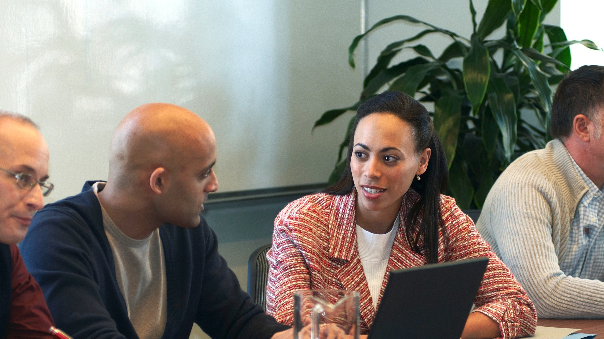
IoT Quick Start consultation
Identify business priorities
Apply Microsoft IoT capability model
Learn from other customers
Define financial benefits
Scope a proof-of-concept

Slide 22

Get started today!
Learn more about how to create the Internet of Your Things
Ask us to see if you qualify for the IoT Quick Starts program
Explore Microsoft Azure IoT services today at www.InternetofYourThings.com

