Slide 1

Git & GitHub
Have you met octocat?
Petr Svihlik - 2015
Notes:
Why git? OS tools on GH, MVC
Agenda, timescope
Level/for whom?

Slide 2
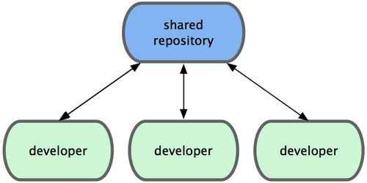
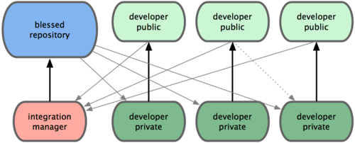
Git - a distributed version control system
Git & GitHub
In centralized systems, every developer is a node working more or less equally on a central hub.
In Git, however, every developer is potentially both a node and a hub
Distributed doesn‘t mean that there is no central repository. There is always a repo that is in a way leading or considered as a „reference“ (called „blessed“ in the figure below).
https://git-scm.com/book/no-nb/v1/Distributed-Git-Distributed-Workflows
Notes:
Comparison with TFS
TFS limitations in collaboration
Different branching/merging scenarios

Slide 3
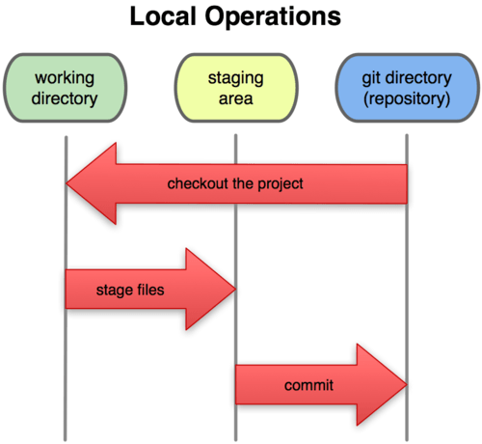
Git – the three states
Git & GitHub
File can be:
Commited – stored safely in a local repo database (in git directory)
Modified – changed = differs from version that has been checked out (in a working directory)
Staged – marked to go to the next commit (in staging area aka index)
https://git-scm.com/book/en/v1/Getting-Started-Git-Basics

Slide 4
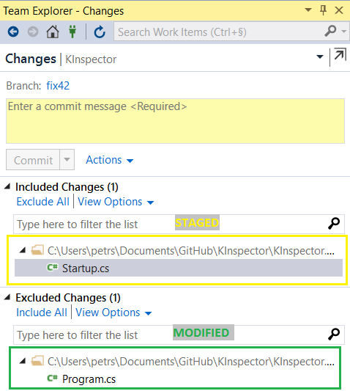
Git – staging in Team Explorer
Git & GitHub

Slide 5
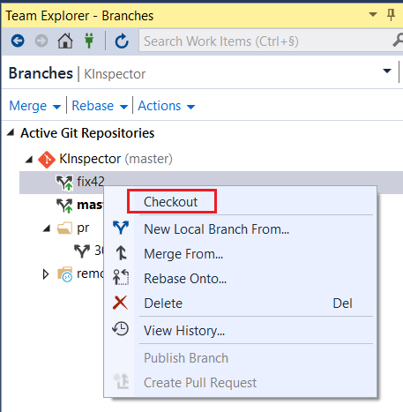
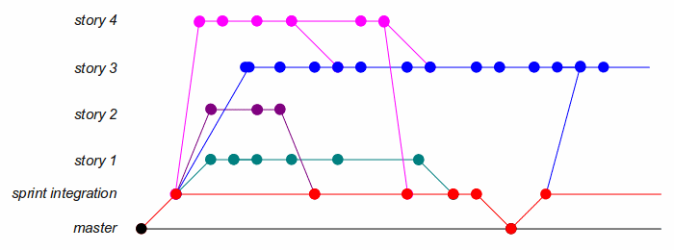
Git – Checkout
Git & GitHub
Each repository can have multiple branches. We switch between them using „git checkout“ command.
Notes:
- TFS vs Git checkout

Slide 6
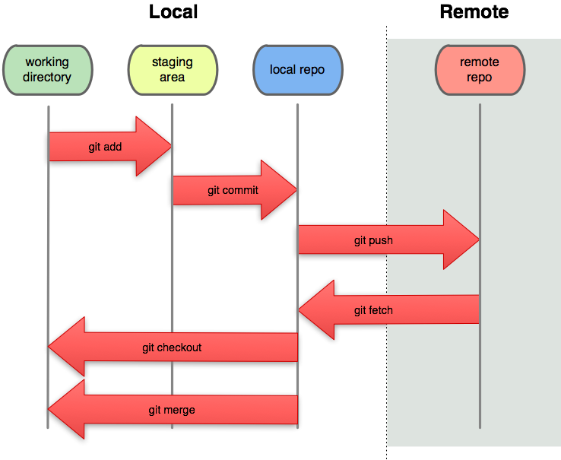
Git - remotes
Git & GitHub
Remote repositories are versions of your project that are hosted on the Internet or network somewhere.
You can have several of them, each of which generally is either read-only or read/write for you.
This is what allows you to collaborate
https://git-scm.com/book/en/v2/Git-Basics-Working-with-Remotes

Slide 7
Git(Hub) – Pull requests
Git & GitHub
PRs allow you to promote your changes to repositories you don‘t have write access to
You are basically requesting the maintainer of the repository to pull your changes
Based on commands:
  git request-pull - takes the base branch into which you want your topic branch pulled and the Git repository URL you want them to pull from, and outputs a summary of all the changes
  ->Make sure you create a branch for each topic/feature – it‘s easier to maintain (merge) them.
  git pull - Fetch from and integrate with another repository or a local branch
    git pull does a git fetch followed by a git merge
GitHub has its own Pull Request mechanism
https://git-scm.com/book/tr/v2/Distributed-Git-Contributing-to-a-Project

Slide 8
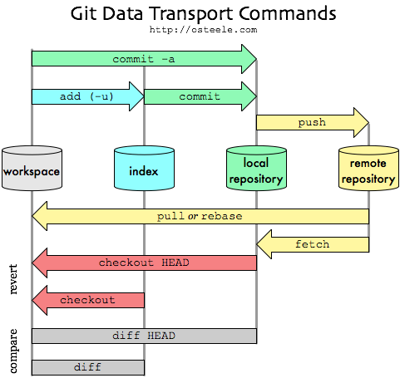
Git – Fitting together
Git & GitHub

Slide 9
Git – Getting a repo (Init, Clone, Fork)
Git & GitHub
Init – creates an empty repo out of a folder
Clone – Copies a repository and sets its „remotes“ to the original repo
Fork – Clones a repo server-side. Not a Git command. More info: http://stackoverflow.com/a/6286877/1332034
https://git-scm.com/book/en/v2/Git-Basics-Getting-a-Git-Repository

Slide 10
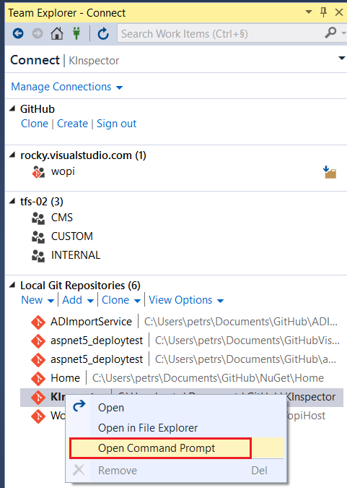
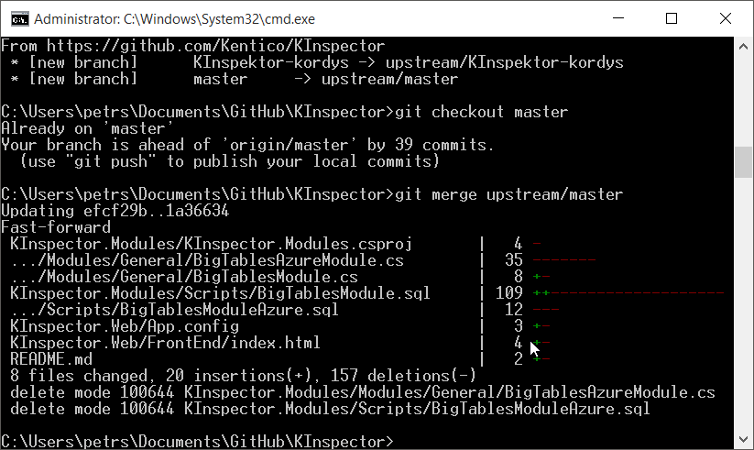

Git – Using command line from VS
Git & GitHub
Sometimes, especially when performing advanced operations (such as syncing a fork) there‘s no other way than doing it via command line.
In order to do that you need to install 3rd party Git cmd prompt tools.
Notes:
VS OOTB support of git from VS2013
GitHub desktop

Slide 11
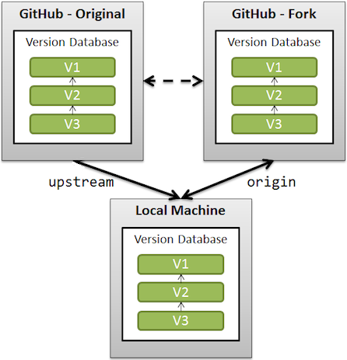
Git – Upstream vs Origin
Git & GitHub
upstream generally refers to the original repo that you have forked
origin is your fork: your own repo on GitHub, clone of the original repo of GitHub
upstream and origin are aliases on your local machine for particular repositories
More info: http://stackoverflow.com/questions/9257533/what-is-the-difference-between-origin-and-upstream-in-github
http://stackoverflow.com/questions/9529497/what-is-origin-in-git
Notes:
- Just explain terminology

Slide 12

GitHub – Creating your first pull request
Git & GitHub
Don‘t be afraid! http://firstpr.me/ + The Myth of the Genius Programmer
Step-by-step manual on confluence
Sign-in to GH
Go to KInspector and Fork it
Clone the repository to your local machine
Open the solution and do some changes
Go to changes and hit Commit & Sync
Go to GitHub and
Notes:
GitHub UI Walkthrough
Show some accounts at firstpr.me
Go step-by-step

Slide 13
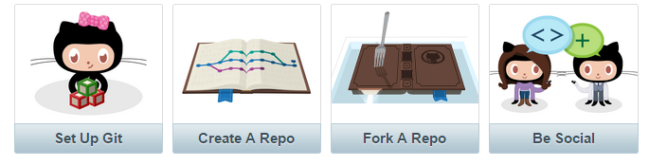
References
Git & GitHub
http://git-scm.com/
https://help.github.com/

Slide 14
Author
Git & GitHub
Follow me:
https://twitter.com/PetrSvihlik
https://github.com/petrsvihlik
http://stackoverflow.com/users/1332034/rocky
http://devnet.kentico.com/users/225882/petr-svihlik

