Slide 1
Identity & OWIN
Slavomír Moroz
2015

Slide 2
Authorization
Identity & OWIN
Authorization filter attributes
  AuthorizeAttribute
  AllowAnonymousAttribute
https://msdn.microsoft.com/en-us/library/system.web.mvc.authorizeattribute(v=vs.118).aspx
https://msdn.microsoft.com/en-us/library/system.web.http.allowanonymousattribute(v=vs.118).aspx
You can also return unauthorized access from your action by returning HttpUnauthorizedResult
https://msdn.microsoft.com/en-us/library/system.web.mvc.httpunauthorizedresult(v=vs.118).aspx

Slide 3
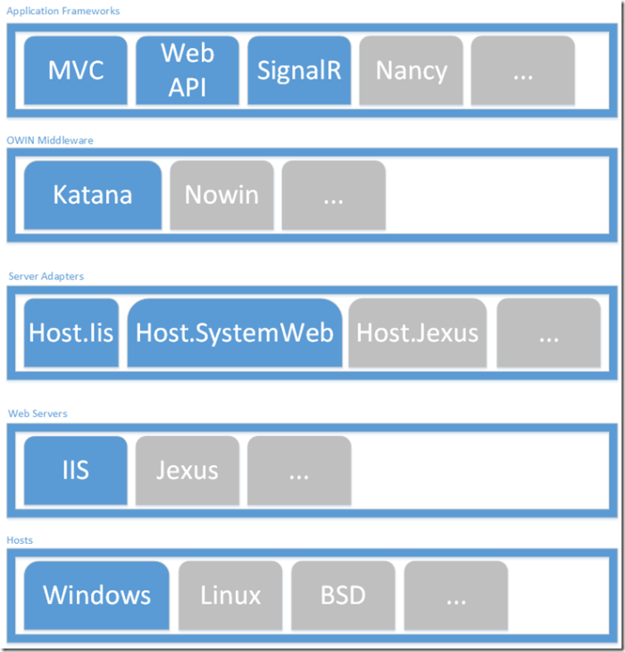
Owin
Identity & OWIN
OWIN defines a standard interface between .NET web servers and web applications.
Katana - OWIN implementations for Microsoft servers and frameworks
Notes:
ISS + System.Web vs. owin

Slide 4
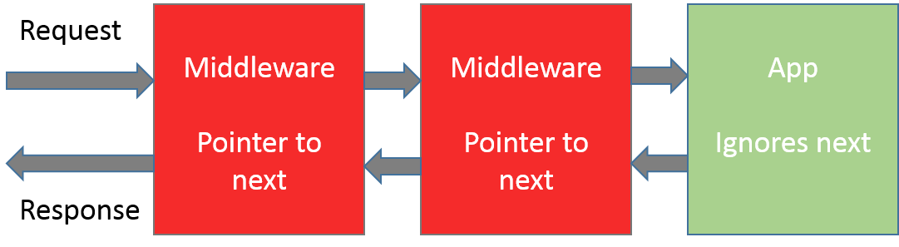
Owin pipeline
Identity & OWIN
Notes:
Explain middleware and System.Web
install-package Microsoft.Owin, Microsoft.Owin.Host.SystemWeb
Create Startup.cs
Explain IAppBuilder
install-package Microsoft.Owin.Diagnostics
UseWelcomePage
Register StartupClass
Explain Appfunc
Create HelloWorld component
Call next, show environment in debug
Write to response body
Create new OwinContext
Extension method to register HelloWorld component
IAppBuilder.Use method with OwinContext - log request path and status code

Slide 5
Owin resources
Identity & OWIN
http://www.asp.net/aspnet/overview/owin-and-katana/getting-started-with-owin-and-katana
http://benfoster.io/blog/how-to-write-owin-middleware-in-5-different-steps
http://www.asp.net/mvc/videos/pluralsight-aspnet-mvc-5-fundamentals (video)
“OWIN and katana” chapter

Slide 6
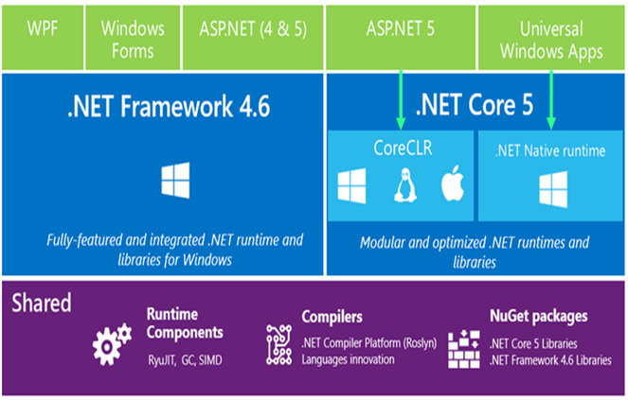
ASP.NET 5 (vNext)
Identity & OWIN
http://www.asp.net/vnext

Slide 7
Claim
Identity & OWIN
A claim is a statement that one subject makes about itself or another subject.
The statement can be about a name, identity, key, group, privilege, or capability,
https://msdn.microsoft.com/en-us/library/ff359101.aspx
https://msdn.microsoft.com/en-us/library/system.identitymodel.claims.claimtypes(v=vs.110).aspx
Pre-defined claim types:

Slide 8
Identity
Identity & OWIN
  Microsoft.Owin.Security
    Common types which are shared by the various authentication middleware components
    IAuthenticationManager
      Interacts with authentication middleware that have been chained in the pipeline.
      HttpContext.GetOwinContext().Authentication
  Microsoft.Owin.Security.Cookies
    Middleware that enables an application to use cookie based authentication, similar to ASP.NET's forms authentication.
Microsoft.AspNet.Identity.Core
  Core interfaces for ASP.NET Identity.
Microsoft.AspNet.Identity.EntityFramework
  ASP.NET Identity providers that use Entity Framework.
Microsoft.AspNet.Identity.Owin
  Owin extensions for ASP.NET Identity.
Notes:
Rewrite the code to use OWIN cookie auth
Set antiforgery claim type, explain why
Show that authorize attributes are working
Show how to access claims from controller

Slide 9
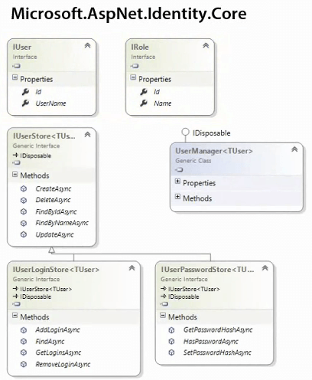
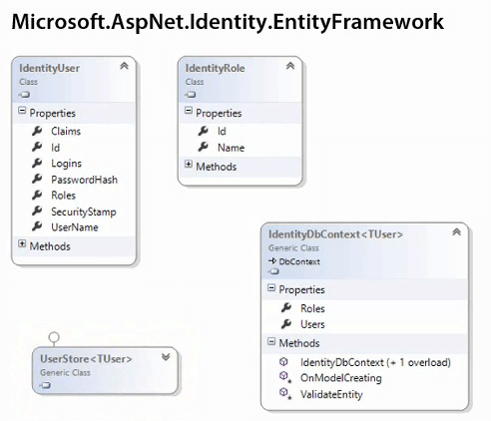
Identity & OWIN

Slide 10
Identity class overview
Identity & OWIN
Microsoft.AspNet.Identity.EntityFramework
IdentityUser – implementation of IUser
UserManager – APIs to CRUD user, claim and auth info via UserStore
RoleManager – APIs to CRUD roles via RoleStore
UserStore – Talks to data layer to store users, login providers (external auth), user claims, user roles
RoleStore – Talks to data layer to store roles
SignInManager (Microsoft.AspNet.Identity.Owin)
  High level API to sign in users
  Calls UserManager and IAuthenticationManager internally
Notes:
Add User, UserManager, IdentityDbContext
Enablemigrations, create seed
CreatePerOwinContext
Modify login action, use user manager and IAuthenticationManager
Use SignInManager
Show template and all it’s features
Explain revalidation – User.Identity vs. DB claims vs DB data (E.g. permissions table)
One DBContext vs multiple. String IDs, soft relationships.
Mention authentication options, external providers, two factor

Slide 11
Identity resources
Identity & OWIN
https://channel9.msdn.com/Series/Customizing-ASPNET-Authentication-with-Identity (video)
All videos except 05
http://www.asp.net/mvc/videos/pluralsight-aspnet-mvc-5-fundamentals (video)
“Identity and Security” chapter
http://www.asp.net/identity
Complete learning documentation

