Slide 1
Online Marketing Time

Slide 2
Miroslav Jirků – Kentico Software
Marketing Team Leader & WebPro Team Product Owner
mirek.jirku@gmail.com
linkedin.com/in/miroslavjirku

Slide 3
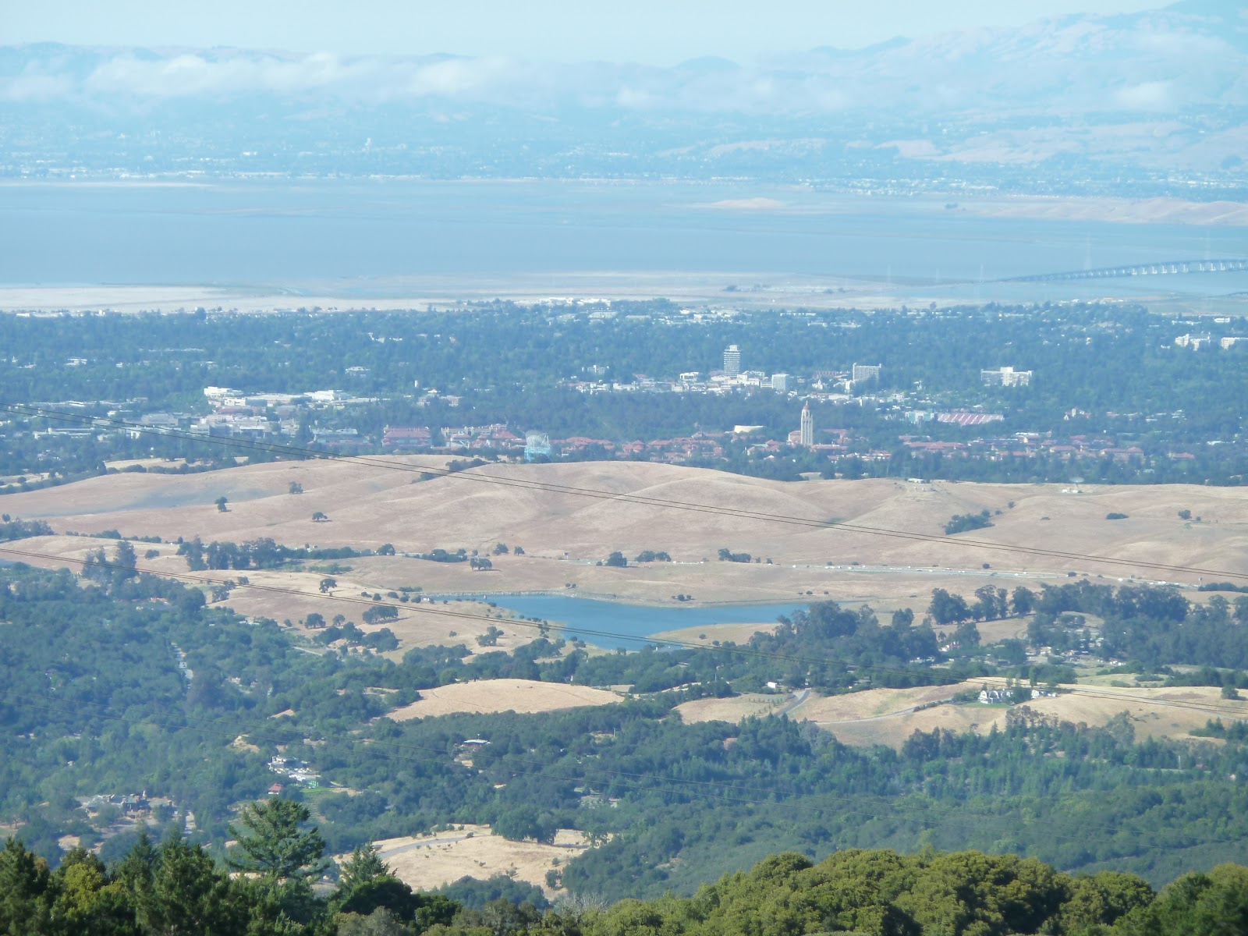
Miroslav Jirků – Kentico Software
Marketing Team Leader & WebPro Team Product Owner
mirek.jirku@gmail.com
linkedin.com/in/miroslavjirku

Slide 4
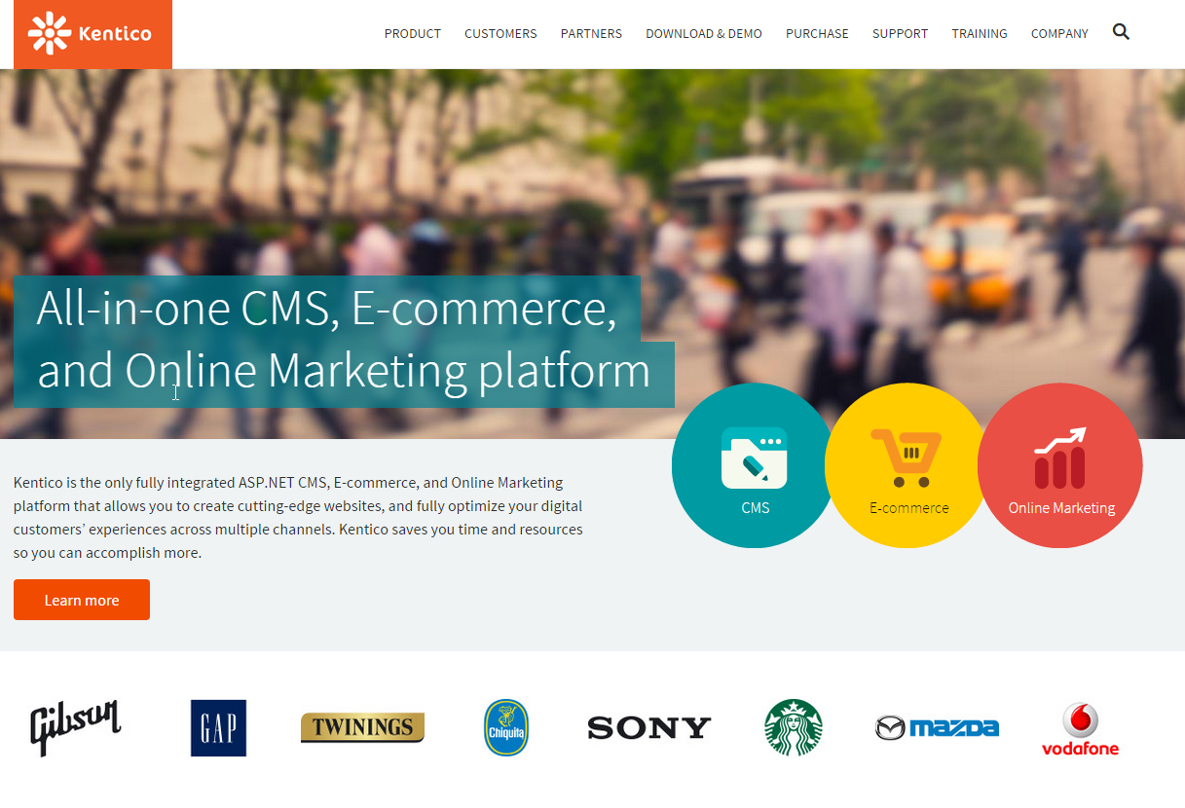

Slide 5
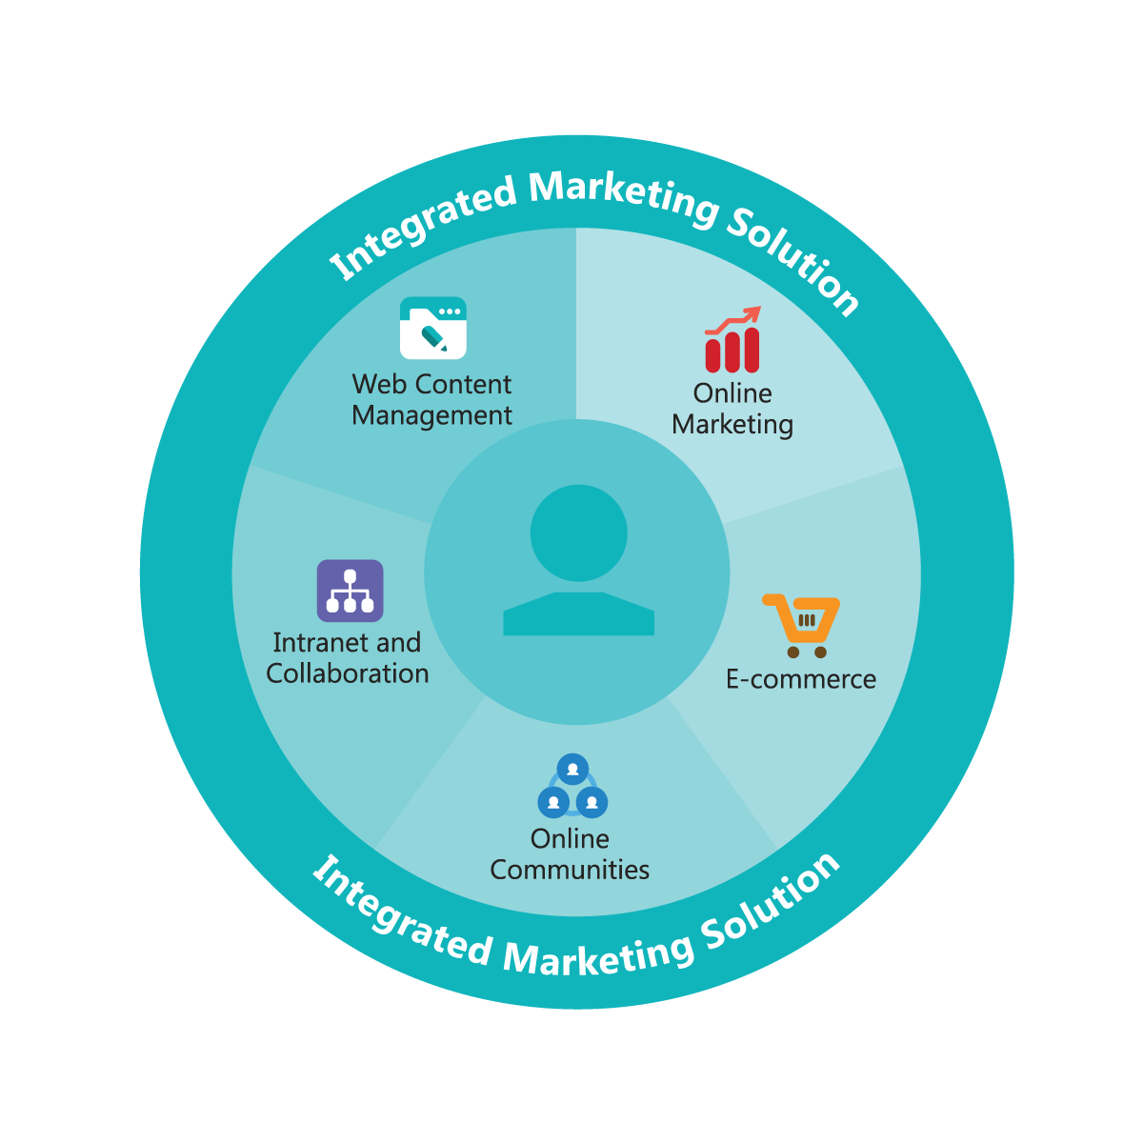
All-in-one CMS, E-commerce and Online Marketing Platform

Slide 6
What will we talk about
Market
Marketing abouts
Business decision making – What, How, For Whom
Marketing Process
General Marketing Disciplines
Online Marketing
Social Media
AdWords
PR - Blogs - Forums
SEO & Content Marketing
Display
Email Marketing
Analytics and Research
Key Takeaways

Slide 7
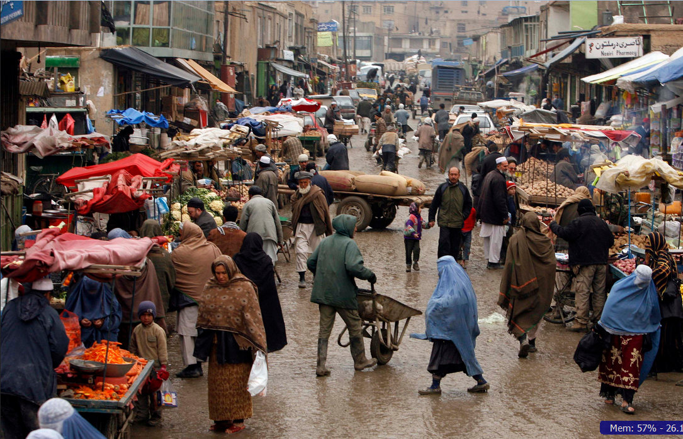
Market[ing]

Slide 8
Market[ing]

Slide 9
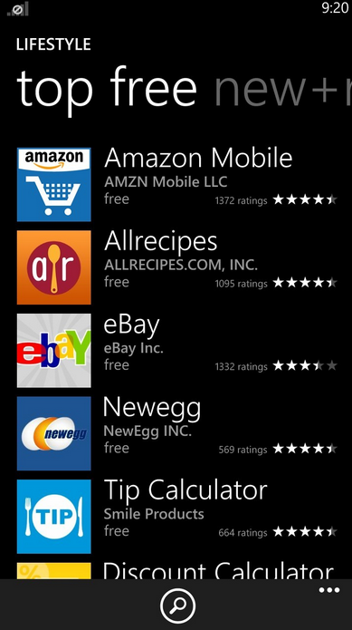
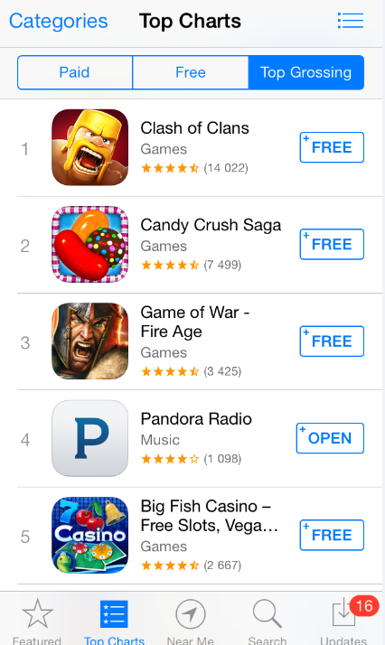

Slide 10
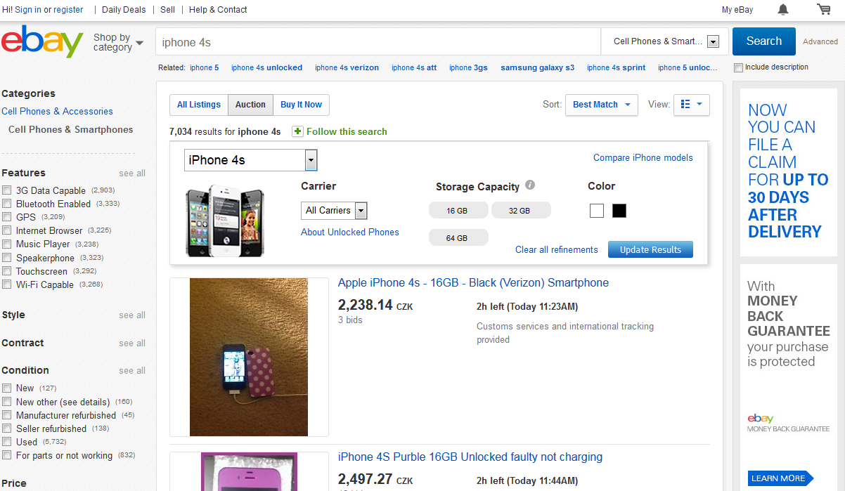
Market[ing]

Slide 11
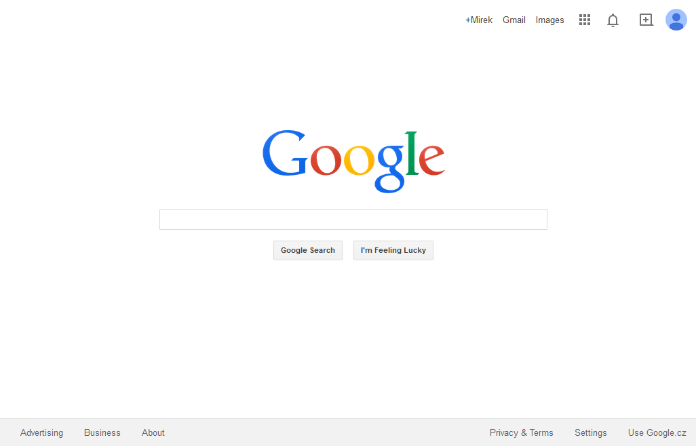
Market[ing]
Market[ing]

Slide 12
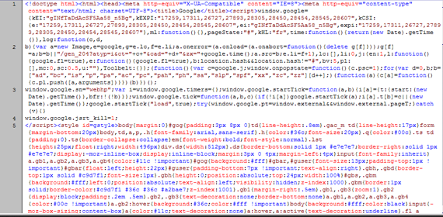
Market[ing]
Market[ing]

Slide 13
Marketing Meets Technology -> Digital Marketing

Slide 14
Marketing Meets Technology -> Digital Marketing
2.8 Billion People
10% of World Trade

Slide 15
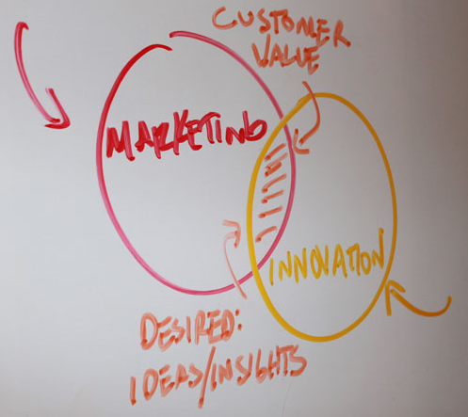
Marketing Abouts
“Business has only two functions – marketing and innovation.”
Milan Kundera

Slide 16
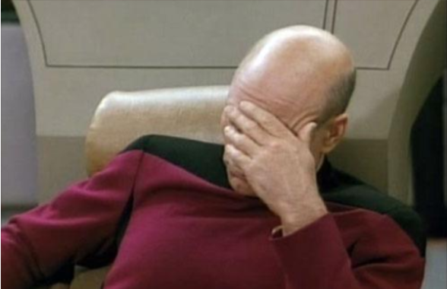
WHAT?
HOW?
FOR WHOM?

Slide 17
Marketing Abouts – Marketing Process
WHAT?
HOW?
FOR WHOM?
Marketing Research
Product Development
Adevrtising
Customer Satisfaction Research
Idea
Improvements

Slide 18
Marketing Abouts – General Marketing Disciplines
Online Marketing
Marketing Research
Branding & Messaging
Product Branding & Marketing
Positioning
Advertising
Public Relation
Content Marketing
Events Marketing & Tradeshows
Pricing
Direct Marketing
…

Slide 19
Marketing Abouts – General Marketing Disciplines
Online Marketing

Slide 20
Online Marketing - Categories
Bound
Content Marketing
In
Out

Slide 21
Online Marketing - Categories
Social Media
AdWords
PR - Blogs - Forums
SEO - Content Marketing
Display
Email Marketing
Viral Marketing
Analytics and Research

Slide 22
Online Marketing - Categories
Social Media
AdWords
PR - Blogs - Forums
SEO - Content Marketing
Display
Email Marketing
Viral Marketing
Analytics and Research

Slide 23
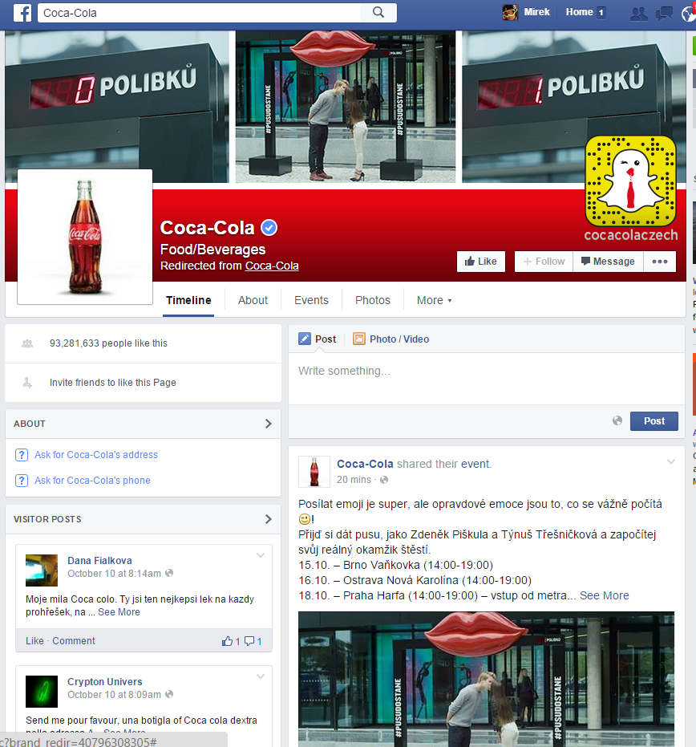
Online Marketing – Social Media

Slide 24
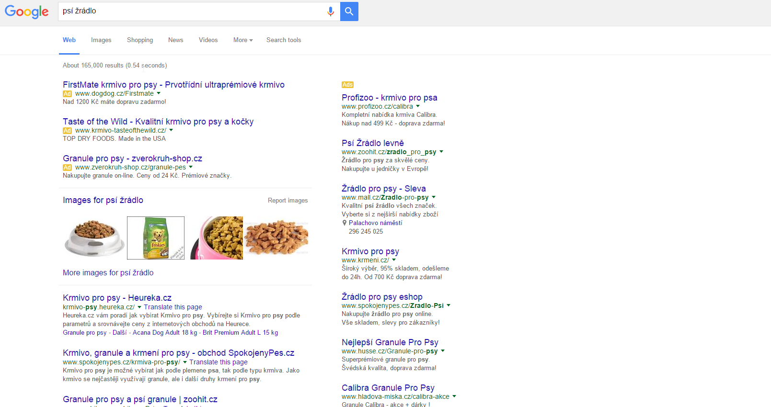
Online Marketing –AdWords
Social Media
AdWords
PR - Blogs - Forums
SEO - Content Marketing
Display
Email Marketing
Analytics and Research

Slide 25
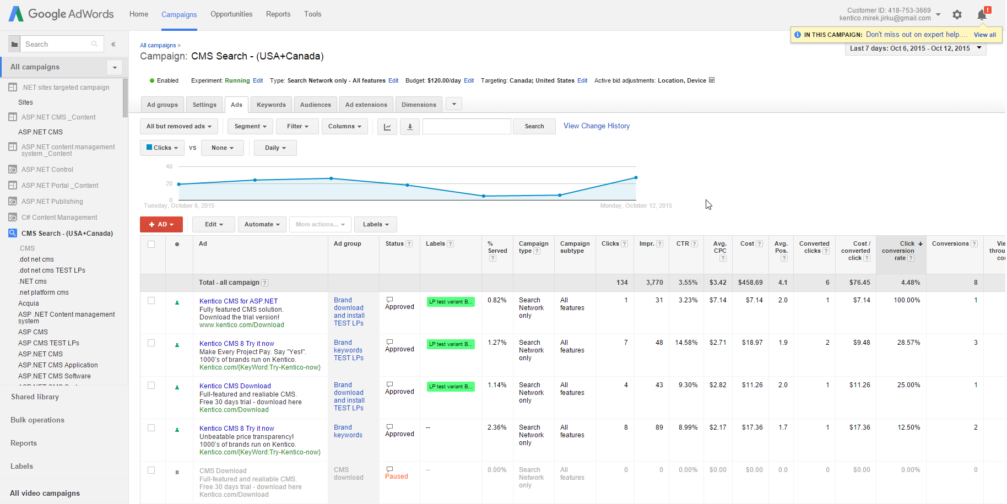
Online Marketing –AdWords
Social Media
AdWords
PR - Blogs - Forums
SEO - Content Marketing
Display
Email Marketing
Analytics and Research

Slide 26
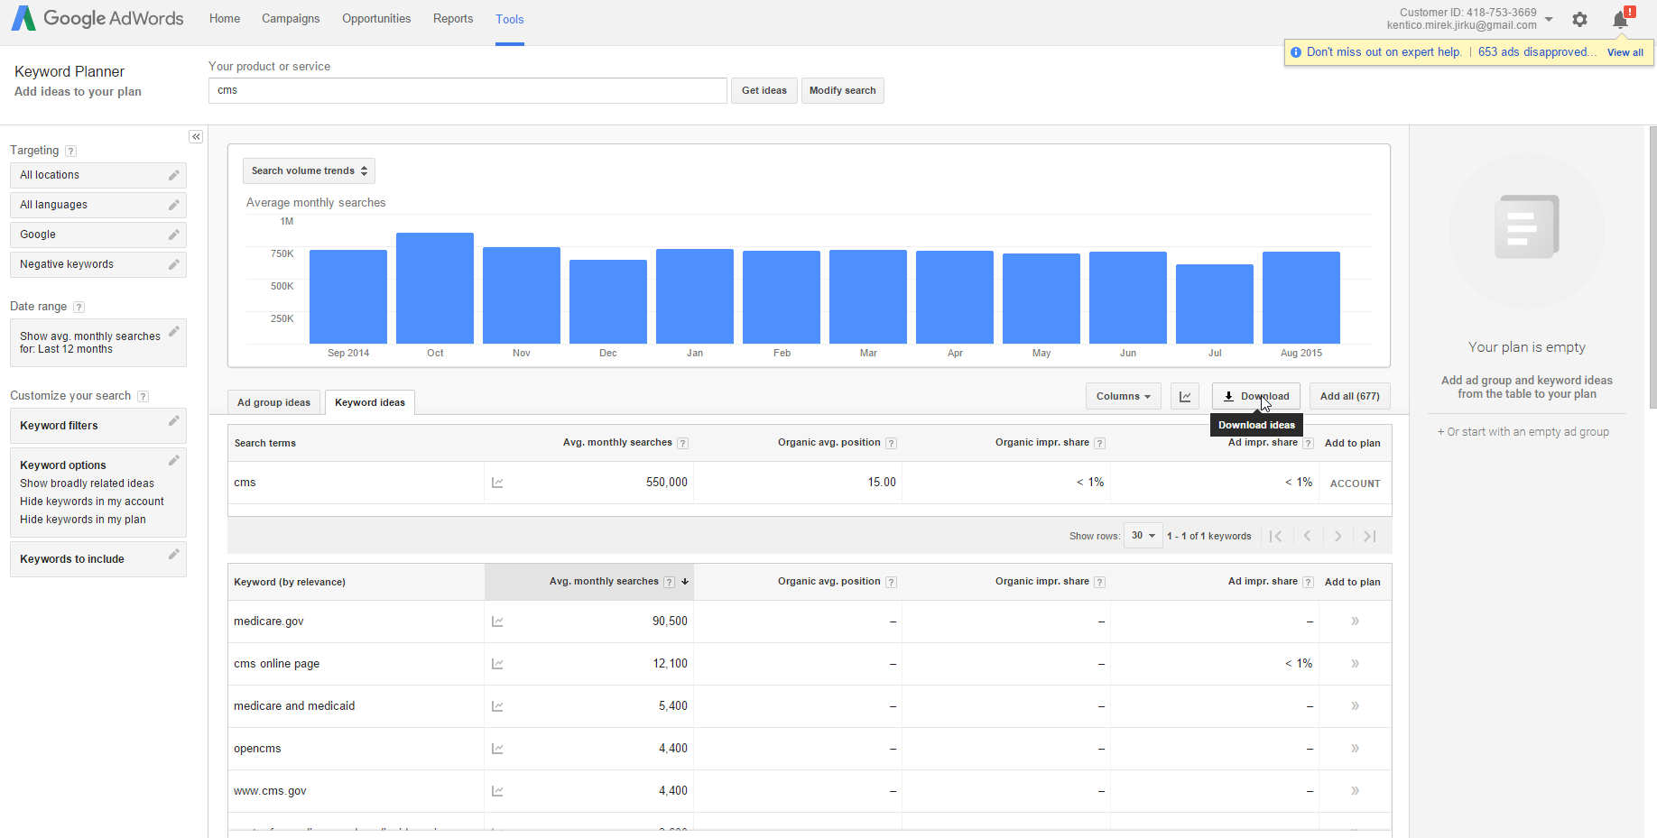
Online Marketing –AdWords
Social Media
AdWords
PR - Blogs - Forums
SEO - Content Marketing
Display
Email Marketing
Analytics and Research

Slide 27
Online Marketing – PR – Blogs - Forums
Social Media
AdWords
PR - Blogs - Forums
SEO - Content Marketing
Display
Email Marketing
Analytics and Research

Slide 28
Online Marketing – PR – Blogs – Forums
OBRAZEK

Slide 29
Online Marketing – PR – Blogs – Forums
PR – stay in touch with journalists, editors and bloggers
Forums – be active and ready to help

Slide 30
Online Marketing – PR – Blogs – Forums
Blog - have one on your website, write regularly, be relevant, fresh and interesting
Successful content – how to get there:
Pick your topic
Make a research before you start
Write your own way

Slide 31
Online Marketing – PR – Blogs – Forums
Blog - topics that people usually like to read
Guides/Tutorials/How To’s
Lists – “Top Ten Places to find your Remote Control!”
Contests/awards
Answers to FAQ’s
Reviews
“Web gemologist” – reposting blogs in meaningful lists
Success Stories/Failures (case studies)

Slide 32
Online Marketing – PR – Blogs – Forums
Predictions
Interviews or guest blog
Checklists (purchase, processes…)
Research results (hard to obtain)
Recycling own content (press releases, newsletters…)

Slide 33
Online Marketing – Search Engine Optimization – Content Marketing
Social Media
AdWords
PR - Blogs - Forums
SEO - Content Marketing
Display
Email Marketing
Analytics and Research

Slide 34
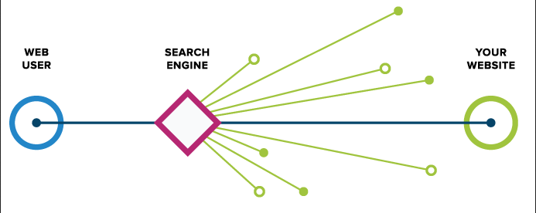
Online Marketing – SEO – Content Marketing
OBRAZEK

Slide 35
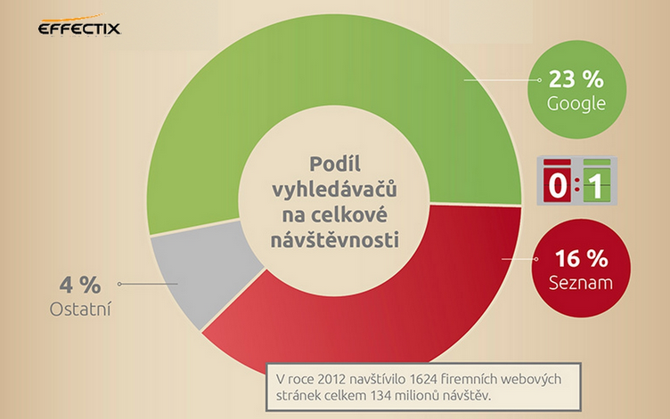
Online Marketing – SEO – Content Marketing

Slide 36
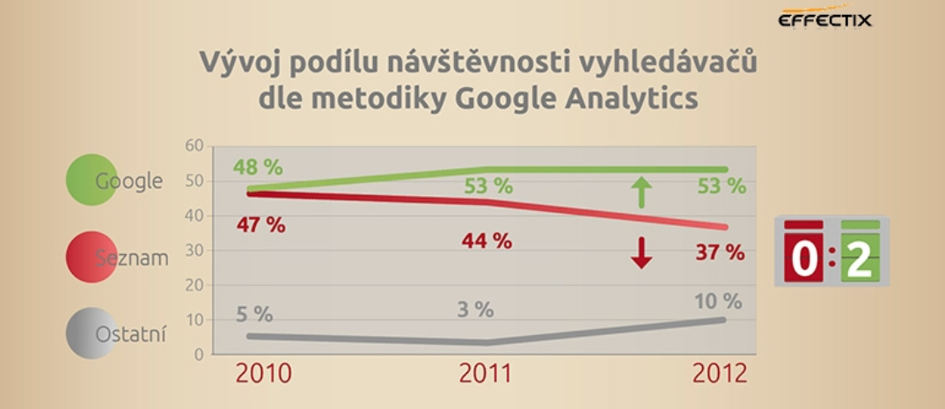
Online Marketing – SEO – Content Marketing

Slide 37
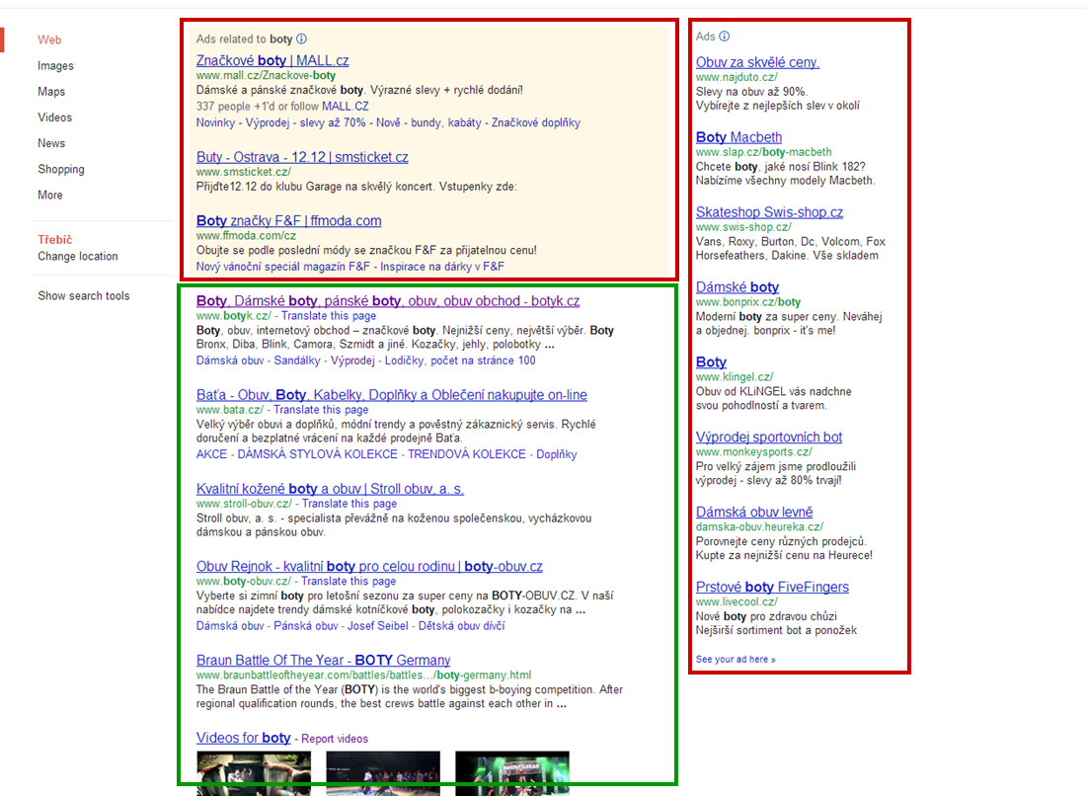

Slide 38
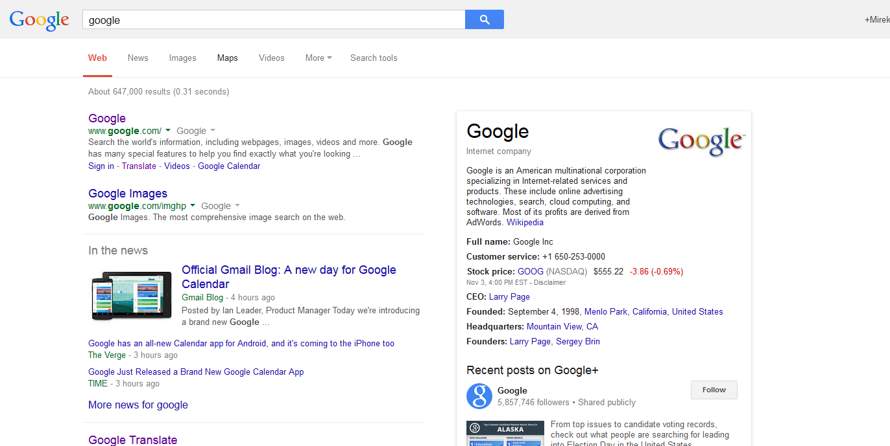
Online Marketing - Categories

Slide 39
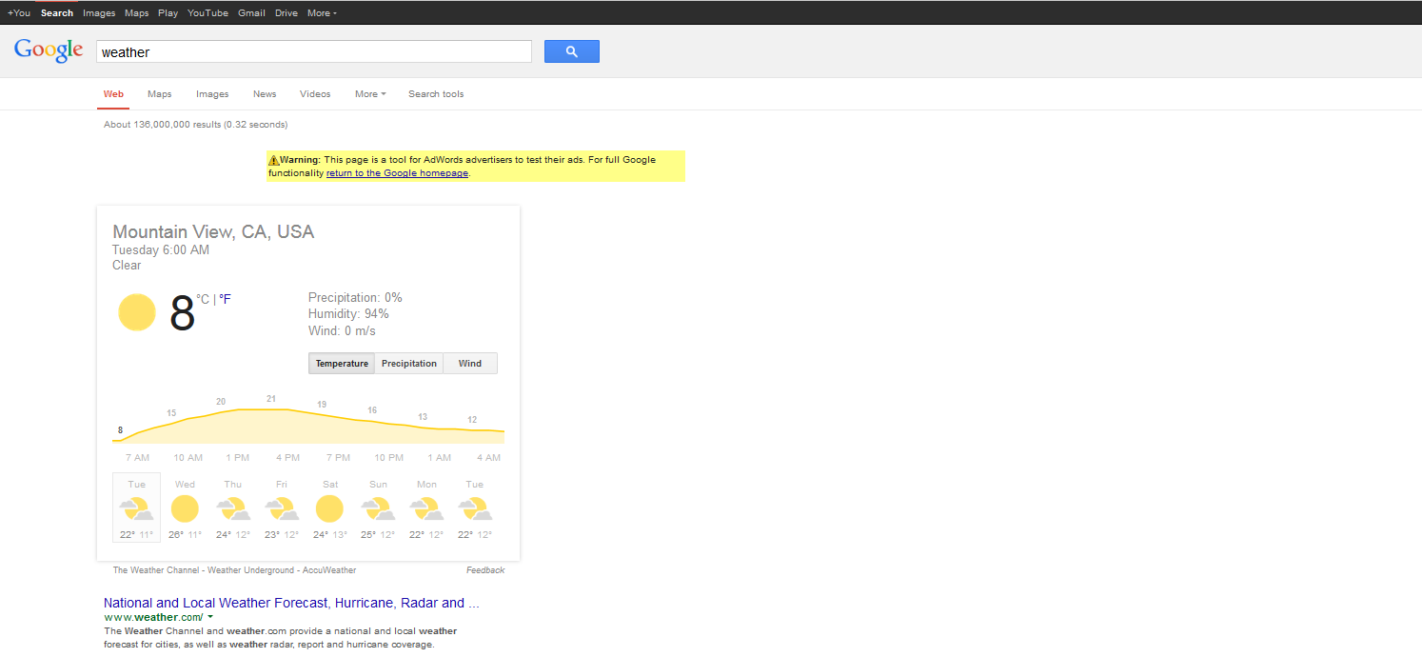
Online Marketing - Categories

Slide 40
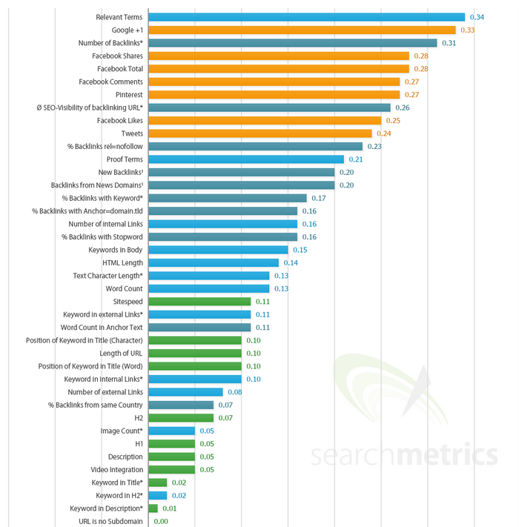
Online Marketing – SEO
Search Ranking Factors
Content relevancy
External backlinks
Social signals
Internal backlinks
Sitespeed

Slide 41
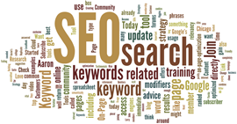
Online Marketing – SEO – Content Marketing
Content Relevancy
Relevant and interesting content optimized on relevant keywords
adwords.google.com/KeywordPlanner
www.wordtracker.com/
www.ubersuggest.org/

Slide 42
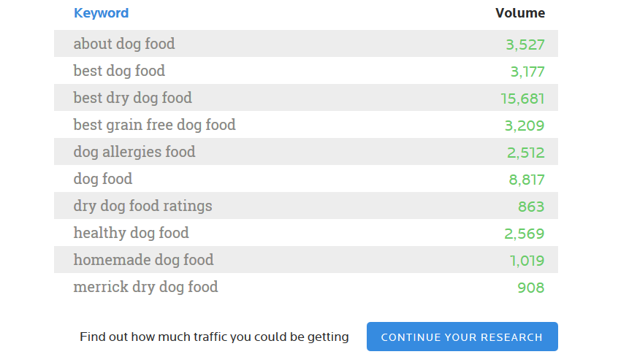
Online Marketing – SEO – Content Marketing

Slide 43
Online Marketing – SEO – Content Marketing
Optimized Page Titles , Page Description, Relevant page titles (H1, H2) and Image Alt texts
Character limits: Page Title ~ 55, Page Description ~ 140

Slide 44
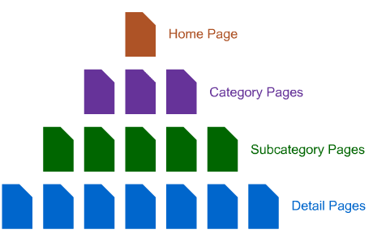
Online Marketing – SEO – Content Marketing
Good and logical page navigation and page interlinking

Slide 45
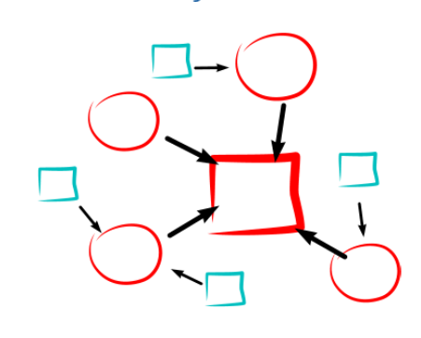
Online Marketing – SEO – Content Marketing
External Links – Link Building
Get links from relevant pages
Get links from Social Media (engagement)
Guest blogging
Backlink requesting
Catalogs and Listings
Be careful about poisoned links
Check GWT and Opensite Explorer

Slide 46
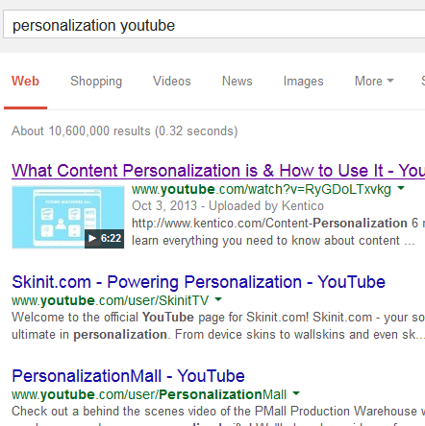
Online Marketing – SEO – Content Marketing
YouTube SEO
The same principles as on Google
Good chance to get on Google with
video snippet
Interlink videos and link back to your
website
Views counts, their source even more
Embed YouTube videos into your page

Slide 47
Online Marketing – Display
Social Media
AdWords
PR - Blogs - Forums
SEO - Content Marketing
Display
Email Marketing
Analytics and Research

Slide 48
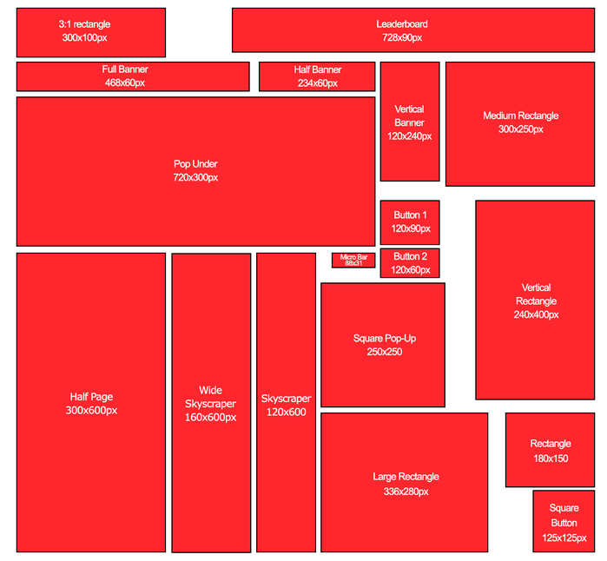

Slide 49
Online Marketing - Categories
Social Media
AdWords
PR - Blogs - Forums
SEO - Content Marketing
Display
Email Marketing
Analytics and Research

Slide 50
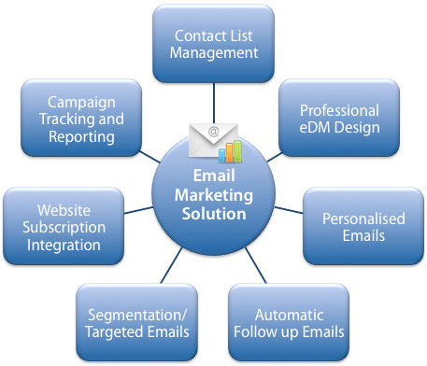
B2B Online Marketing – Email Marketing
https://www.youtube.com/watch?v=8bmS8j-qtOk

Slide 51
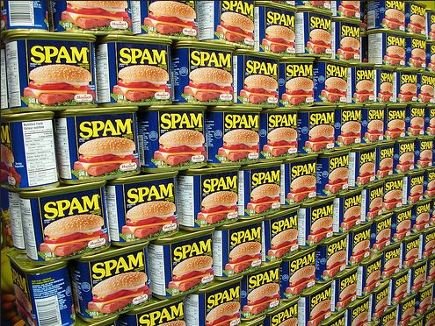

Slide 52
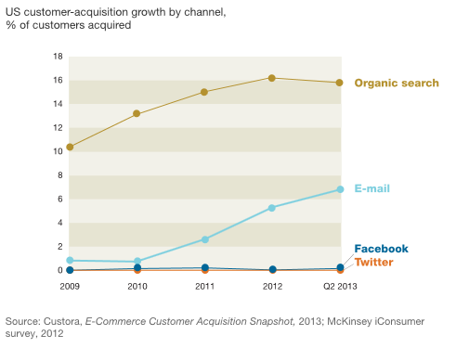
Online Marketing - Categories
Email Marketing
One of the most effective acquisition channel especially in B2B
Can be automated via Marketing Automation
Can be easily personalized
Demands to buy email database or build yours (via newsletter subscription boxes etc.)

Slide 53
Online Marketing - Categories
Social Media
AdWords
PR - Blogs - Forums
SEO & Content Marketing
Display
Email Marketing
Analytics and Research

Slide 54
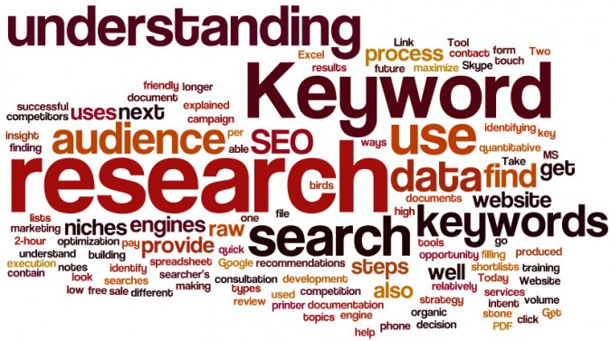
Marketing Research

Slide 55
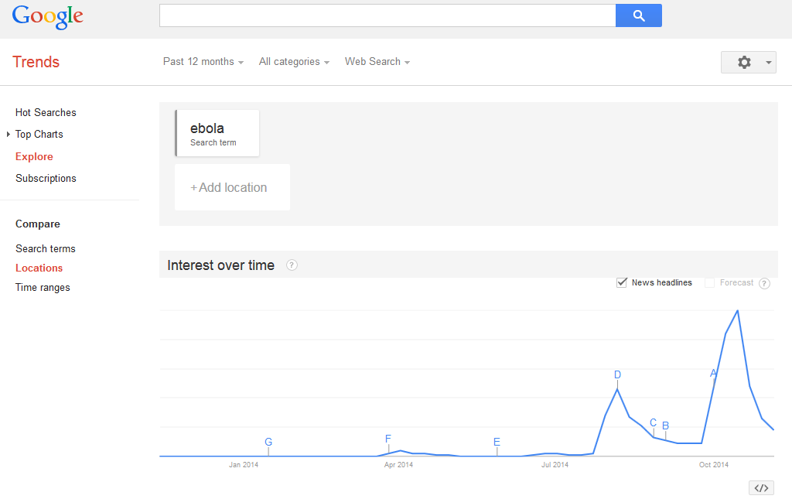
Marketing Research

Slide 56
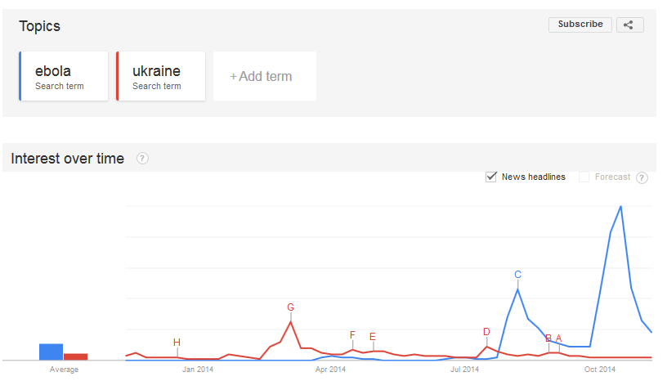
Marketing Research

Slide 57
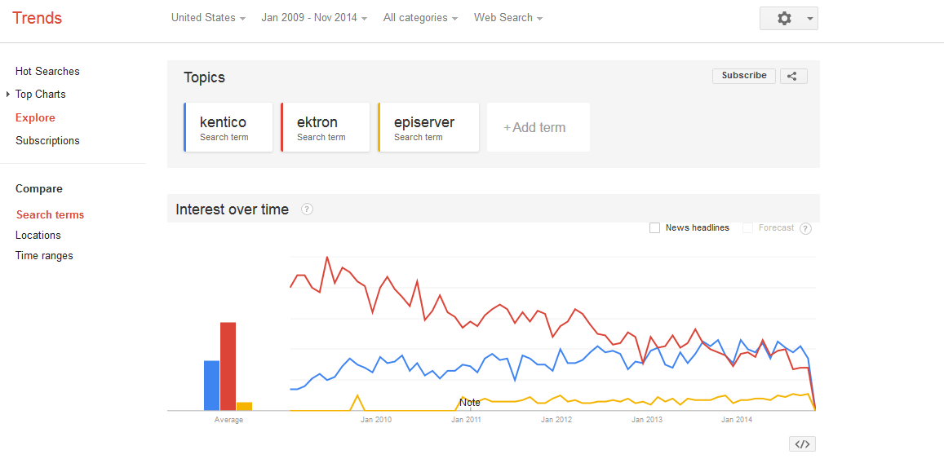
Marketing Research

Slide 58
Online Marketing – Research and Analysis
Survey Monkey / Survio
Installation survey
Satisfaction survey
Uninstallation survey
Google.com/ncr
Google Ad Preview
Ideally use VPN for local specs
Let your community/friends validate your ideas on Social Media or Forums

Slide 59
Online Marketing – Research and Analysis
Mobile Analytics
Google Play Store – Statistics in store by Google
App Annie – Apple Appstore and Google Play Store
Flurry
GA for Google Play Store and Android Apps

Slide 60
Online Marketing – Research and Analysis
Web Analytics
Google Analytics
Google Search Console
CrazyEgg
HotJar
Google Content Experiment (part of GA)
http://apps.ioninteractive.com/site/contest/guess-which-won

Slide 61
Online Marketing - Categories

Slide 62
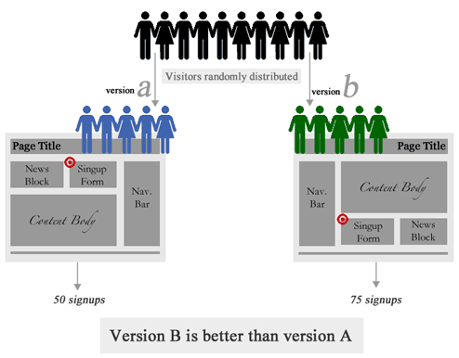

Slide 63
B2B Online Marketing
Email marketing
Marketing automation
Content Personalization
Lead Scoring

Slide 64
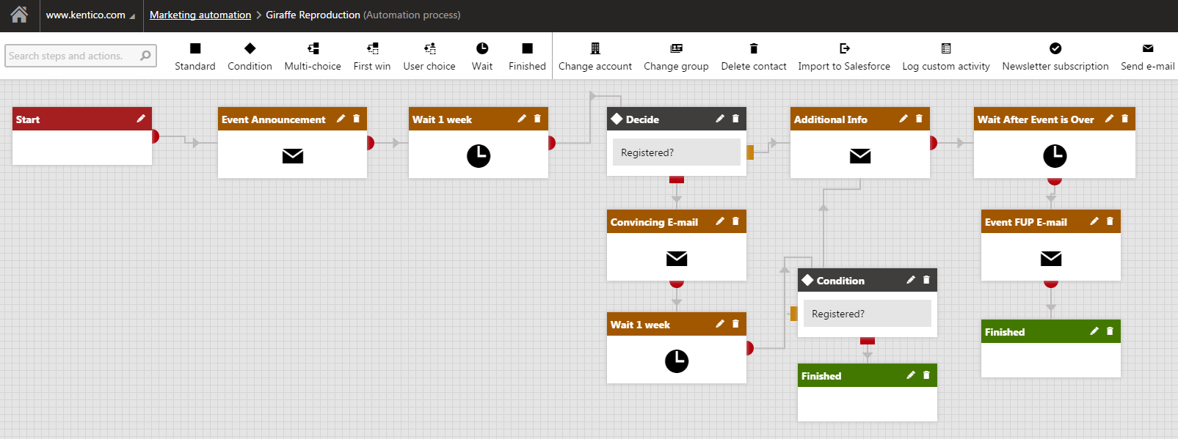
B2B Online Marketing – Marketing Automation
https://www.youtube.com/watch?v=dFZSSYsxE1o

Slide 65
B2B Online Marketing – Content Personalization
https://www.youtube.com/watch?v=xOh710-9pmk

Slide 66
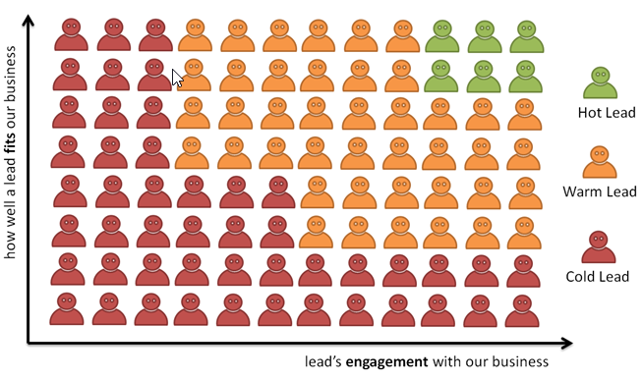
B2B Online Marketing – Lead Scoring
https://www.youtube.com/watch?v=HWeM3OX2cXM

Slide 67
Key Takeaways
Keep trying new things
Measure everything
Keep what works
Leave what doesn’t work
A/B test - use common sense

Slide 69
Developer v ASP.NET
QA Engineer
Technical Writer
CRM Developer/Consultant
www.kentico.com/company/careers

Slide 71
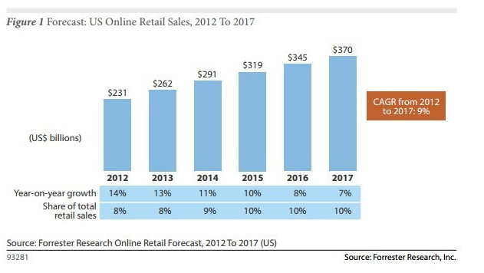

Slide 72
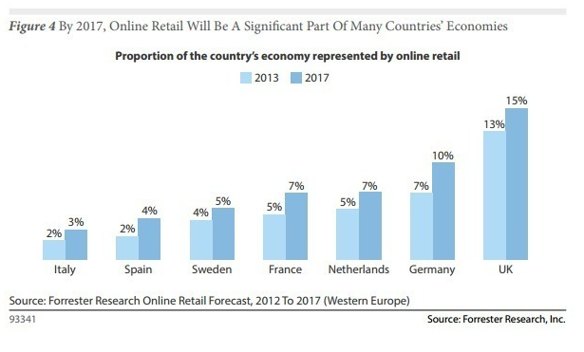

Slide 73
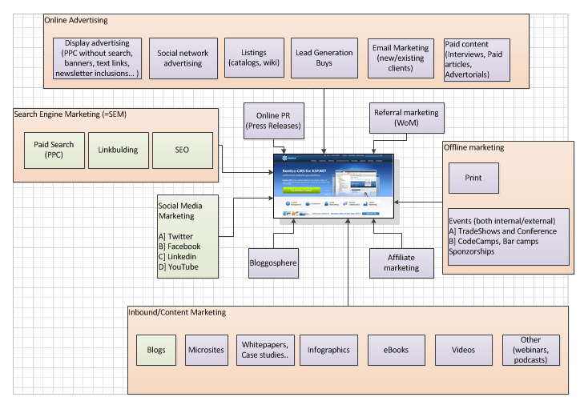

Slide 74
'Sales Lead' A prospective consumer of a product or service that is created when an individual or business shows interest and provides his or her contact information. Businesses gain access tosales leads through advertising, trade shows, direct mailings and other marketing efforts.

