Slide 1
Extension of ERP for marketing: internal system + external communication Microsoft AX Dynamics
Prof.dr. Dalia Krikščiūnienė

Slide 2
Microsoft AX Dynamics- marketing module

Slide 3
ERP in cloud

Slide 4
Industry trends for ERP (MS case)

Slide 5
MS key points for marketing applications
Marketing today starts at creating amazing brand experiences. This starts with the customer journey. Marketers have to deliver an engaging customer experience that is consistent, personalized and relevant across all channels. At the same time, marketers have to show impact on the business. They have to have an understanding how they contribute to revenue and pipeline, and they have to be able to provide detailed analytics of that contribution.
TALKING POINTS:
The most progressive companies focus on the customer journey AND embed analytics in their day-to-day operations to understand where and how marketing investments pay off
They plan and track all marketing assets and marketing programs and use customer insights to continuously improve their programs and to collaborate with sales.
Marketing is a data-driven science
Marketing is about using data to target audiences and create value. It’s about adding business value

Slide 6
MS key points for marketing applications
KEY TAKEAWAY
What does that mean? It means ENGAGING CUSTOMERS in a consistent way across channels to create amazing customer experiences. It means aligning marketing and sales to BUILD a better PIPELINE. And it means tracking your Marketing ROI to DEMONSTRATE IMPACT.
TALKING POINTS
You need to align the brand experience with the customer experience, and align your team around a single message.
You need to engage with customers, in the way that they want, at the time they want, with the content they need in order to drive conversion and revenue.
You need to be able to track your investments across channels and show your impact.
METRICS
Just to highlight a few metrics, it means an:
Increase qualified leads
Increase conversion rates
Decrease time-to-market
Prove ROMI
We all know marketers aren’t paid to plan – they’re paid to execute. With Dynamics Marketing, the plan is the campaign, allowing marketers to get all of the benefits of using a planning solution without wasting any time in the planning process. That means you can spend more time on the work that you love, and less time project managing.

Slide 7
MS newest modules for marketing

Slide 8
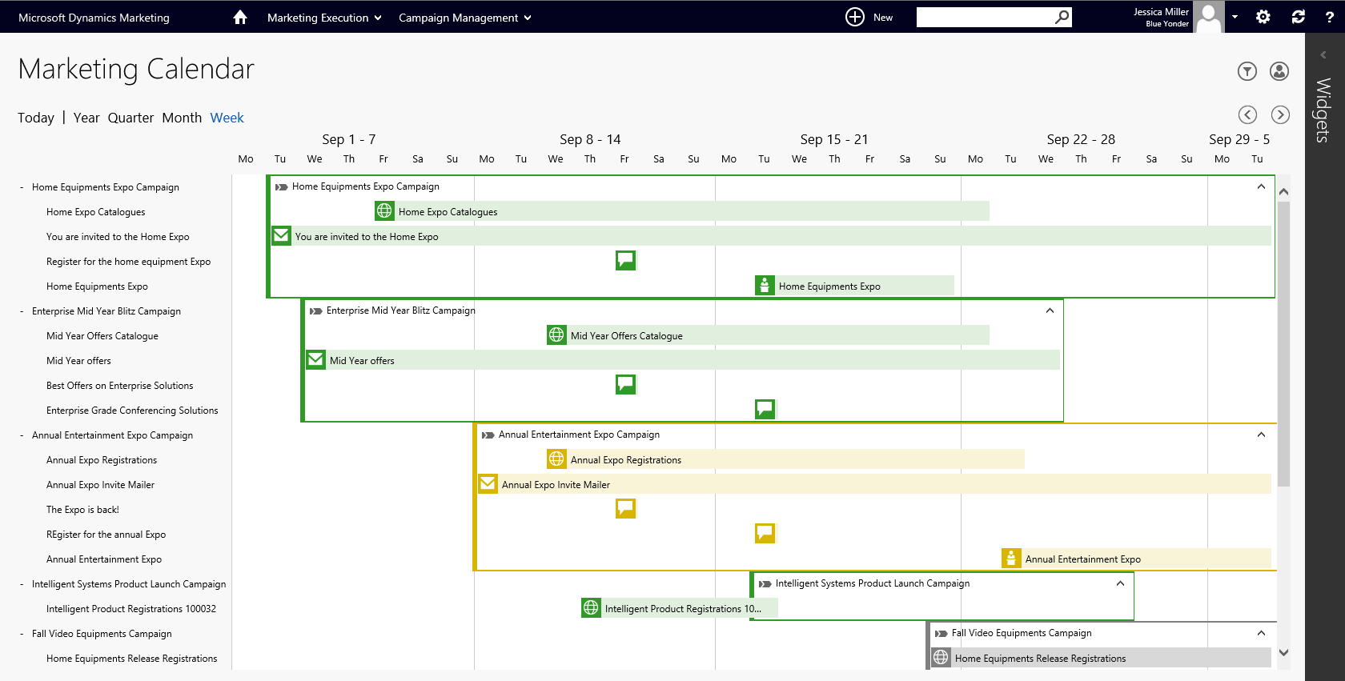
Marketing resource management
Marketing calendar Align teams & plan around an integrated calendar for increased transparency & collaboration
Budgeting Plan & manage marketing budget & spend across channels
Marketing workflow Integrate extended marketing teams with automated processes & approvals
Digital asset management Centrally manage digital assets with a powerful repository tied to campaigns & calendar
Budget Usage (last three months)
Notes:
KEY TAKEAWAY:
Integrate your marketing planning, budgeting and tracking across all channels, including email, digital, social and traditional. Scale your marketing with the ability to collaborate and manage processes and workflows across your team, other departments and agencies from a single platform.
TALKING POINTS:
No need for a separate application- all of your people, resources and assets are connected to the Campaign right from the start. Marketing gets the credit for every interaction.
By putting Planning at the center, each campaign starts with the right inputs and tracking codes to make sure that each interaction (web, email, etc) can be tracked to the right source for revenue attribution.
Without MRM, the marketer is constantly trying to interpret results after the fact
Most importantly, by aligning your team around the planning process, you can insure that you all contributing to the same, great customer experience. Scaling up resources with each campaign “sprint” is easier because you’re all on the same page.
We make managing marketing projects an easy and seamless part of the process, because marketers build out their campaigns and plans as a natural part of the design process. This means you have a great planning tool to coordinate your internal and external campaign stakeholders.

Slide 9
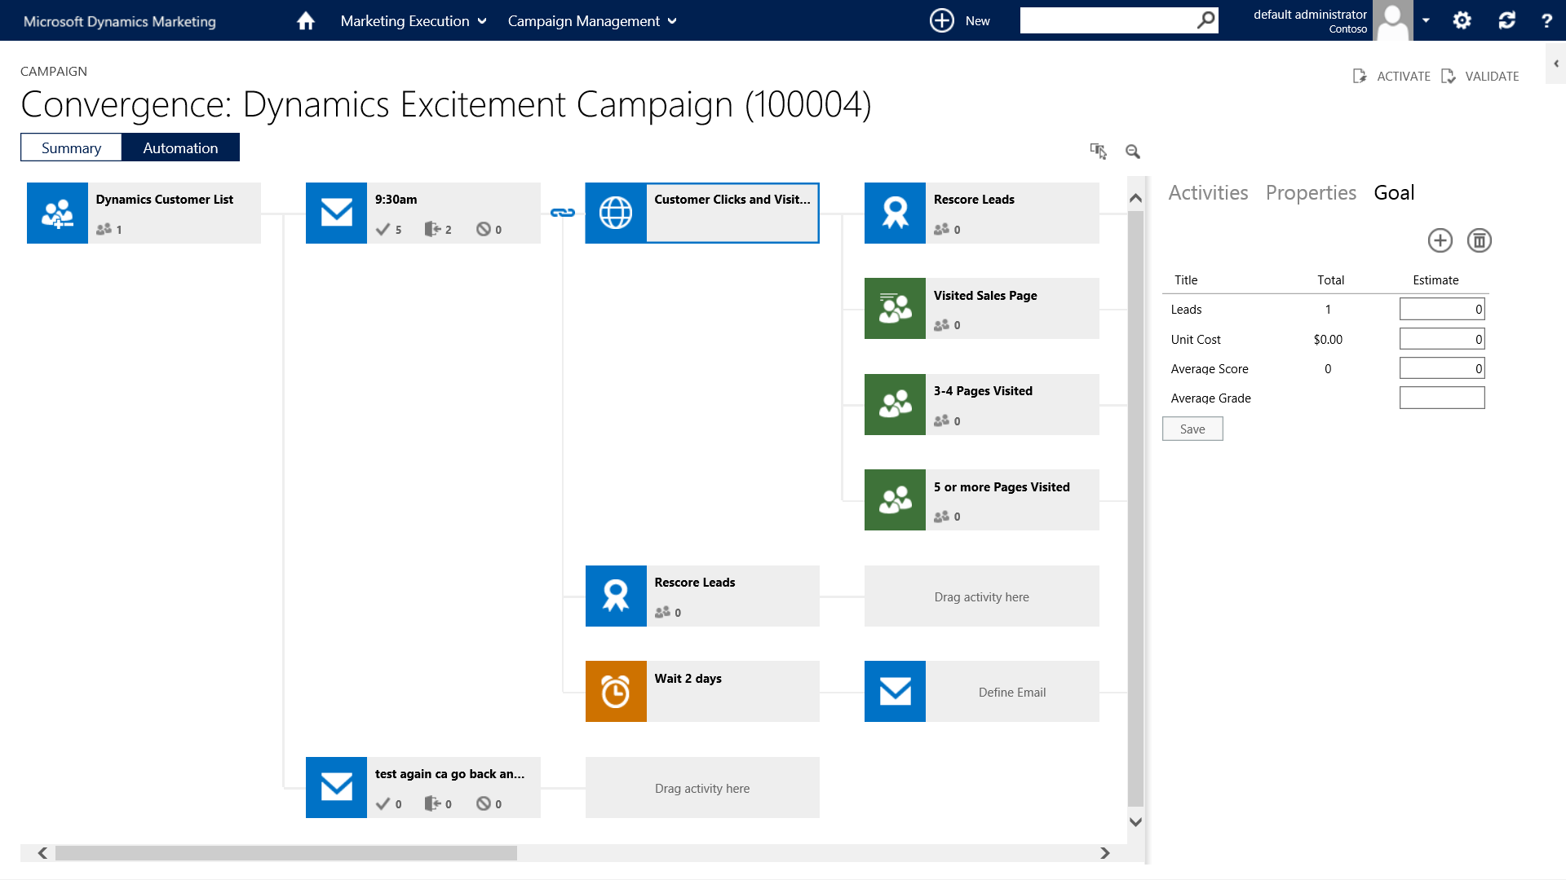
Multi-channel campaigns
Campaign design Easily manage campaigns with drag & drop design across email, digital, social & traditional channels
Personalized engagement Deliver one-to-one engagement with segmentation & targeting based on behavior & demographics
Email marketing Easily design, test & launch contextual, personalized email marketing campaigns
A/B testing Test marketing messaging & offers to optimize campaign performance
Notes:
KEY TAKEAWAY:
Engage customers with personalized, multichannel campaigns. Our visual campaign designer lets you drag and drop to create and manage campaigns in a single window—across email, social media, events, and direct mail. Streamline campaign creation, segment your customer and prospect base and test your campaign messaging and offers in order to improve conversion.
TALKING POINTS:
By setting up automated campaigns, the marketing manager can automate a complex selling process with multiple digital and traditional touchpoints and make sure that the customer experience is amazing- because they can map the right assets and content to the exact point in the customer lifecycle.
With the advanced email functionality embedded in the Campaign Automation Console, its easy to embed email campaigns and simplify the execution by aligning your marketing lists with your customer personas and your campaign flow. Event management is also integrated with our Campaign Management solution, so you can be sure that every single prospect interaction and conversion can be tracked for results.
Trigger based Campaigns can nurture your prospects through the customer journey, using all of your campaign assets to deliver exactly the right message to the right person at the right time. This means better customer experience, and improved conversion because you can tailor the experience to their needs.
Because Dynamics Marketing tracks engagement of the customer throughout the entire buying process (with anonymous and known contacts) both marketing and sales are empowered as a result. Marketers can design more segmented campaign flows based on engagement, and score those leads appropriately. Sales gets a view of the most actionable and engaged prospects.
Of course, because we have visual management reporting to see how many customers are at a given stage, we can quickly see if our campaign flow is working- real time.

Slide 10
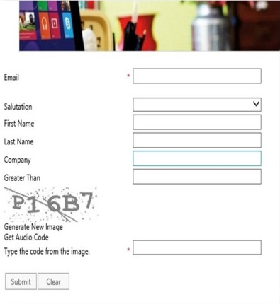
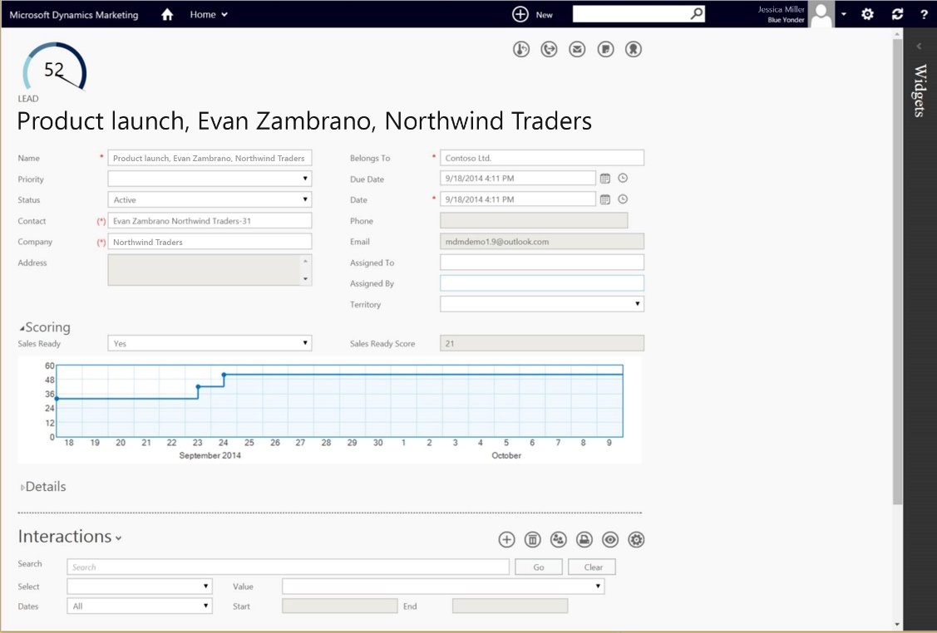
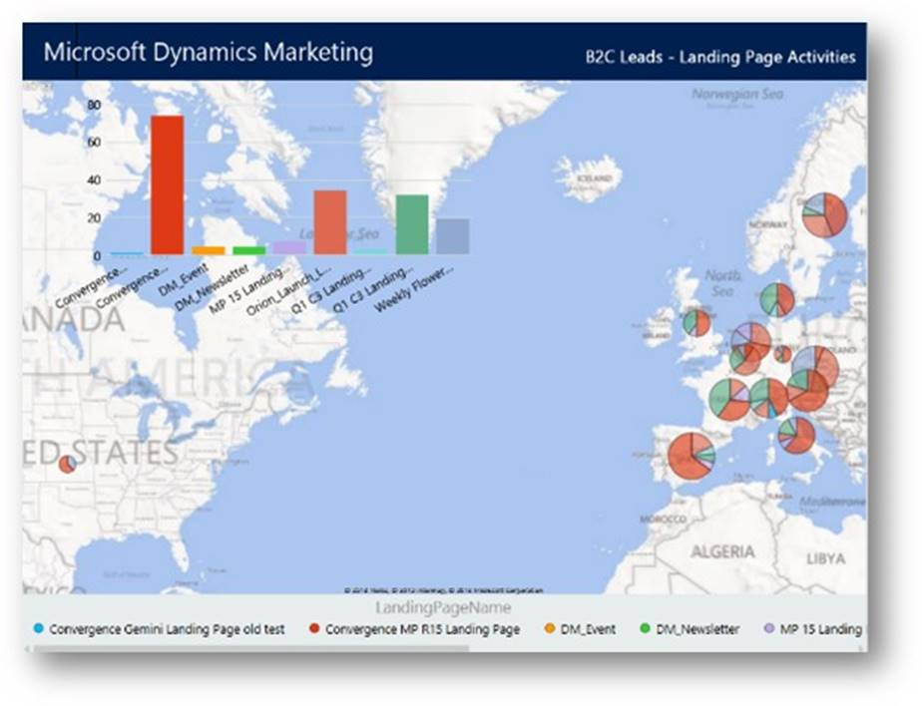
Lead management
Lead scoring Determine sales-ready leads with flexible scoring based on behavior, demographics & time
Nurture campaigns Foster prospect interest with multi-stage, trigger based nurture campaigns
Multiple scoring models Accommodate different product & customer types with multiple lead scoring models
Lead imports Enable leads from multiple sources with APIs for import from external lists
Notes:
KEY TAKEAWAY:
Generate more sales-ready leads with advanced segmentation and lead scoring. Foster prospect interest with multi-stage, trigger-based nurture programs that deliver relevant, personalized content and offers. Combine your sales and marketing funnel to better serve sales.
TALKING POINTS:
Dynamics Marketing is designed to help marketers drive more qualified leads to sales, with advanced segmentation and lead scoring rules to enable very precise qualification criteria. That means more sales ready leads.
Because we bring behavioral data right into our Lead scoring, that means we can score based on engagement and increase or decrease a lead score based on timing.
Customers rarely choose to interact on a single channel. The new world of marketing requires that we can not only execute multi-channel campaigns, but we need to build engagement across multiple channels Dynamics Marketing by nurturing customers using all the tools at our disposal.
Most important- that information is now visible on the lead, so when Sales receives a lead, they can quickly scan it and understand the next steps based on the customer behavior.

Slide 11
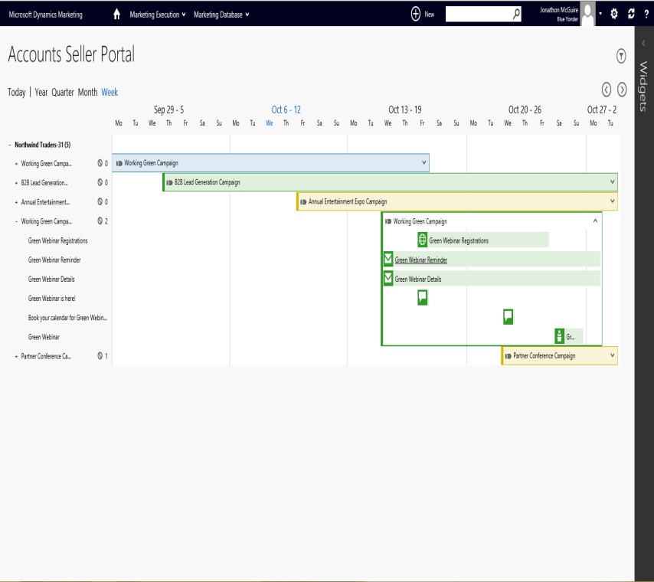
Sales collaboration
Marketing visibility Empower sales teams with visibility into marketing calendar & campaigns
Outside-in view Provide customer view of marketing activities & interactions vs CMO campaign view
Targeting input Allow sales to provide input into campaign targeting for key accounts
Marketing alerts Subscribe to alerts about customer behavior as part of an integrated campaign flow
Notes:
KEY TAKEAWAY:
The Sales Collaboration Panel is the most exciting new feature in the 2015 release. The Sales Collaboration Panel allows sales people to provide input to marketing campaigns and targeting. The Portal provides insight in all campaigns that are relevant for each customer and all interactions of each contact with marketing campaigns. A very cool feature is that sales people can exclude individual contacts from specific campaigns.
TALKING POINTS:
This is a new feature in Dynamics Marketing 2015
Strengthen your marketing and sales synergies by providing sales with visibility into the marketing calendar, along with how it impacts individual customers. Sales has the ability to provide input into campaigns and targeting. Both sales and marketing have visibility into the entire customer journey.

Slide 12
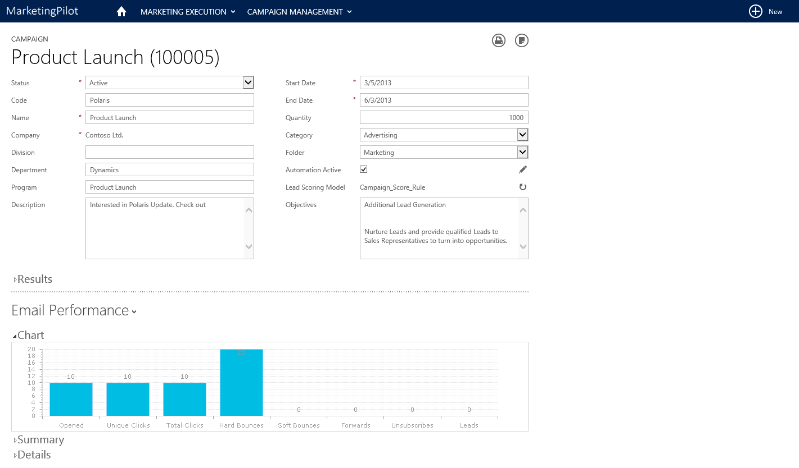
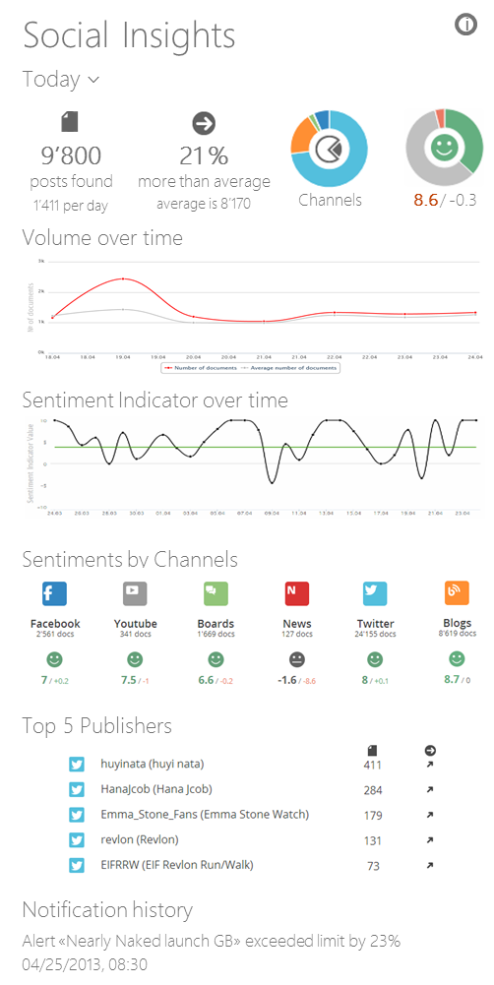
Social marketing
Social sentiment Analyze sentiment with easy-to-read charts on the home page
Social amplification Amplify campaign reach by posting directly to Facebook or Twitter
Collaboration Collaborate across internal & external teams with Yammer, Skype & Lync
Social curation Curate social messages to ensure compliance with brand standards
Notes:
KEY TAKEAWAY:
Enable your marketing organization to connect with customers and prospects with embedded, contextual social tools. See how your marketing campaign is performing by measuring impact across a number of social channels. Track your share of voice across the social web, including Twitter, Facebook, and YouTube. Monitor your global sentiment and brand presence.
TALKING POINTS:
Social sentiment comes from our Microsoft Social Listening product
Social Sentiment: Analyze sentiment with easy-to-read charts on your home page.
Social Amplification: Amplify campaign reach by posting directly to Facebook or Twitter.
Collaboration: Collaborate across internal and external teams with Yammer, Skype and Lync.
Curation: Curate social messages to ensure compliance with brand standards

Slide 13
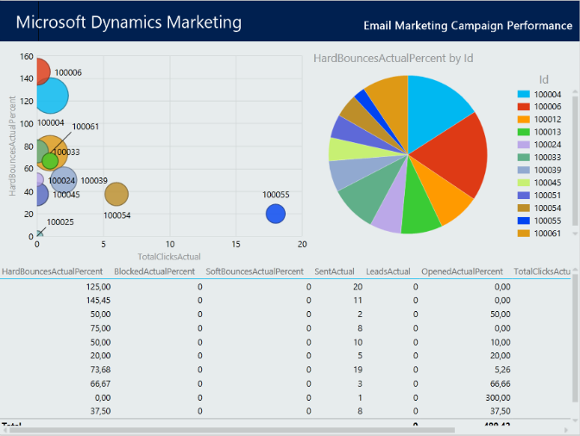
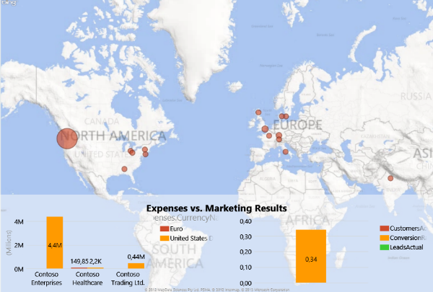
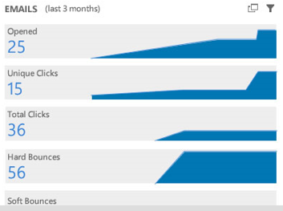
Marketing Analytics
Reporting View campaign performance, financials & resource management with out-of-the-box reporting
Rich analytics Analyze in depth campaign performance & marketing impact with powerful, flexible analytics
Time-based analysis Understand trends & get a complete picture of marketing ROI with time-based analytics
Notes:
KEY TAKEAWAY:
Measure pipeline and revenue across every marketing investment to get a true view of your marketing ROI. Empower your marketers with access to sales and marketing data through visual dashboards. Get a clear overview of campaign results so you can quickly understand performance. Make reporting easy by giving marketers familiar tools - Excel and PowerBI for real-time reporting.
TALKING POINTS:
Using Power Query's OData, you can connect directly to your Dynamics CRM Online account, and join this to your marketing data for a complete view of your marketing and sales funnel. Explore and visualize your sales, customer and marketing data directly in Excel
Monitor the performance of your campaigns using familiar tools that all marketers can use and understand. Adjust your initiatives based on actual performance and see the results in a holistic view for continuous improvement
Create dashboards to monitor performance through all your channels. Share dashboards with the rest of your organization who can consume them anywhere at any time. Unlock new growth opportunities enabling visual data discovery for everyone in your sales pipeline and encourage collaboration
Through data visualizations now it is easier than ever to understand the value of each your segments. Because DM includes both cost (marketing investments) and revenue, you can understand return and investment on each of your channels and segments to maximize your return. Create KPIs to monitor customer value, churn and profitability.
It doesn't matter where all your data is coming from. Schedule refreshes to always have the latest view of your performance and make decisions that will produce results faster and more effectively. All of this while keeping your data secure and consistent.

Slide 14
Microsoft Social Listening
Social Listening
Social Analytics
Social CRM

Slide 15
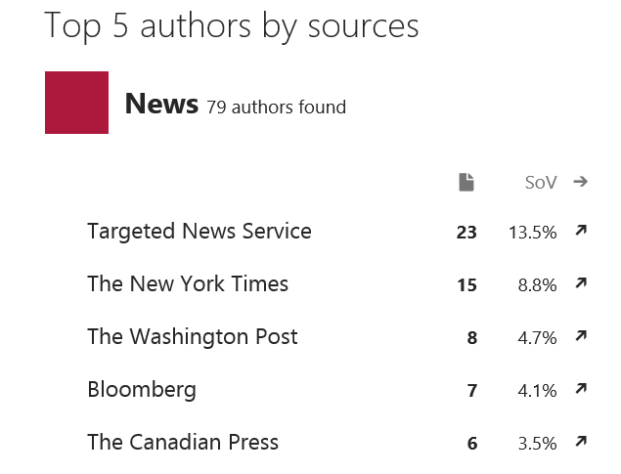
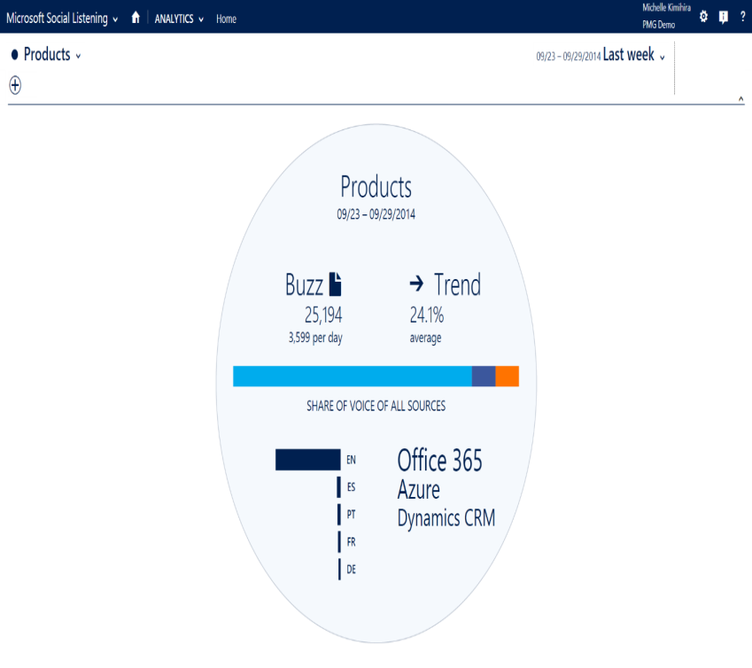
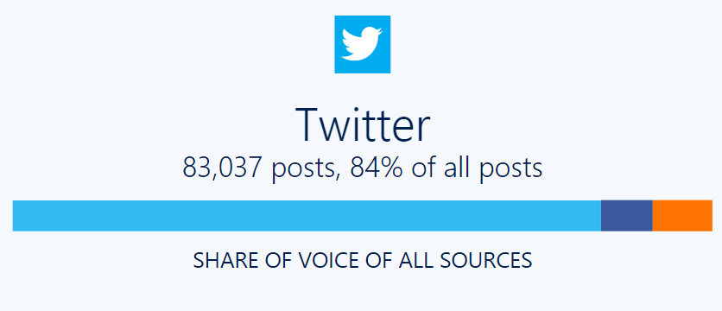
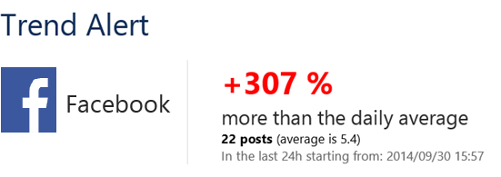
Social Listening
Powerful social listening Listen to what people are saying globally across the social web in 19 languages.
Key influencers Identify who is actively talking about your brand, products, or services.
Sophisticated alerts Detect trends and listen for specific posts to keep you informed on the topics you care about.
Notes:
Key Points:
Microsoft Social Listening can listen in up to 19 languages and let’s you know which ones have the most posts around the topics you care about you.
Know key influencers - not just on your topics, but on the social web as a whole.
Trend alerts notifies you of market trends around your topics and post alerts notifies designated people when key words are mentioned.

Slide 16
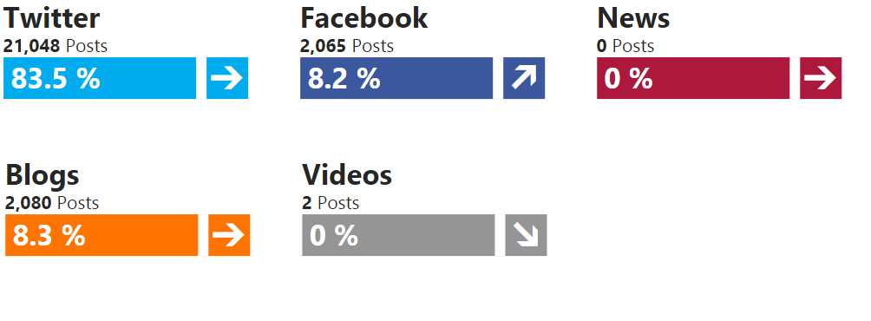
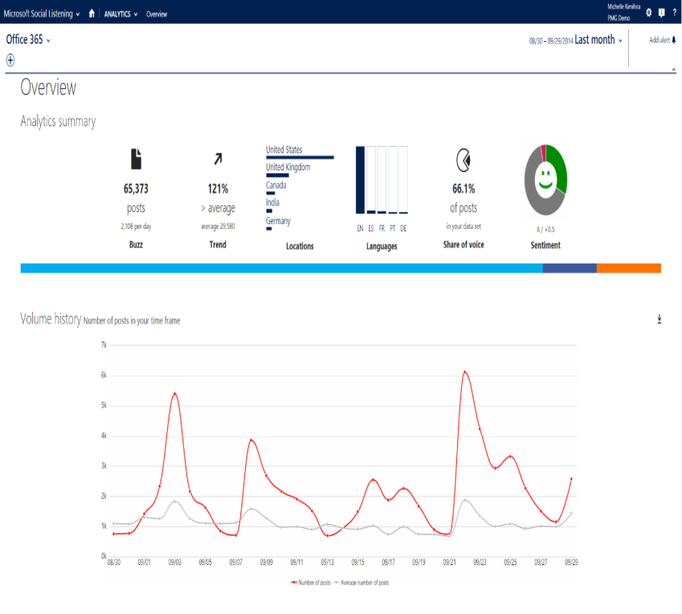
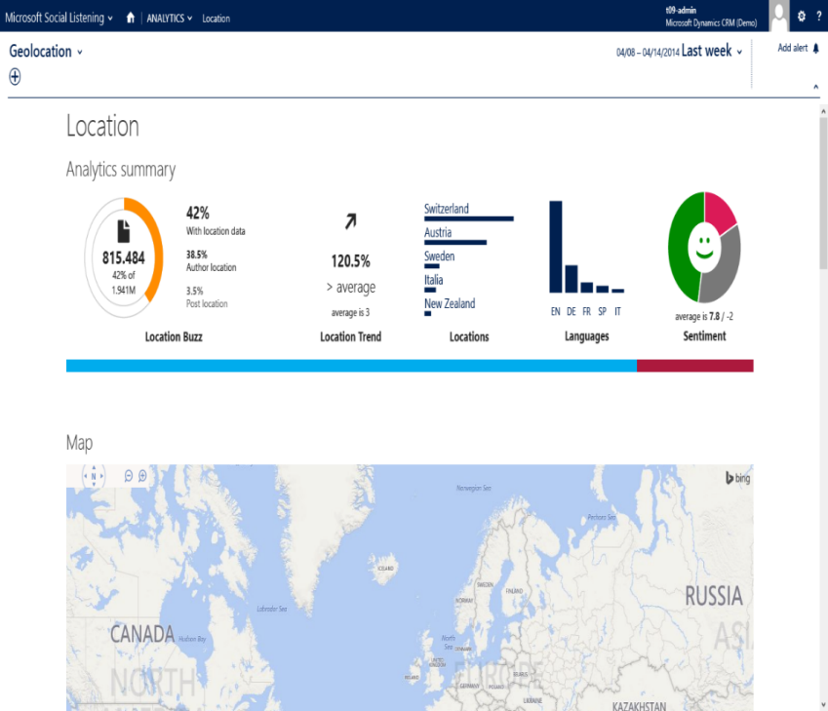
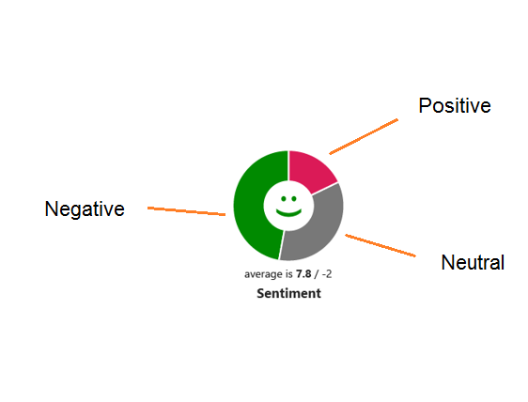
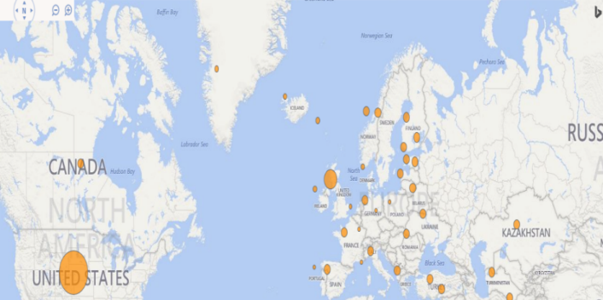
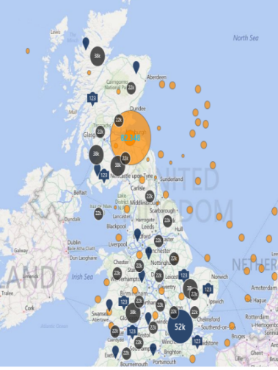
Social Analytics
Global sentiment analysis Gain a true understanding of your business, customers and topics that matter most.
Share of voice Track and measure topics you care about across Facebook, Twitter, Blogs, Videos and news publications.
Advanced filtering Flexible filters allow you to segment your data by source, sentiment, location, or author.
Notes:
Key Points:
Easy-to-read charts and graphs.
Sentiment monitoring is a tool which looks at posts and evaluates key words to assign value – words like “good or great” are given a positive sentiment. Words like “bad or terrible” are given a negative sentiment. This helps you identify whether there are positive, negative feelings about your product or brand and can be helpful for shaping messaging and sales conversations more effectively.
Share of Voice shows volume of discussion is coming happening on each source.
Advanced filtering allows you to view the social data the way you want to view it

Slide 17
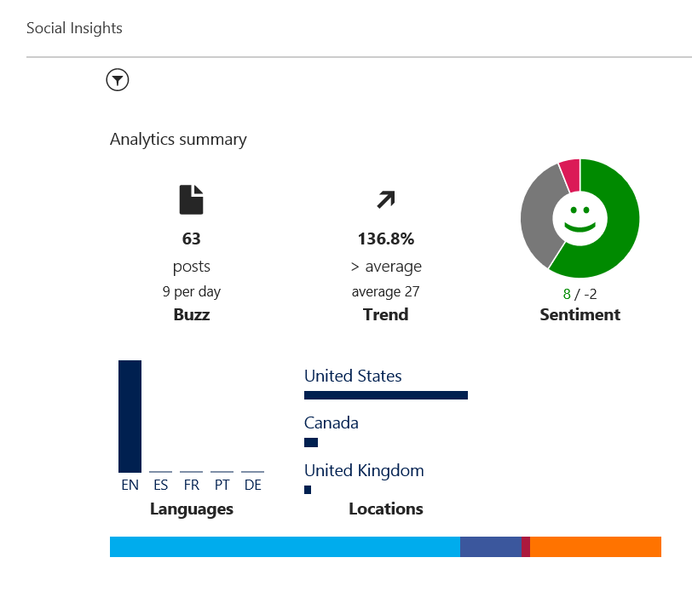
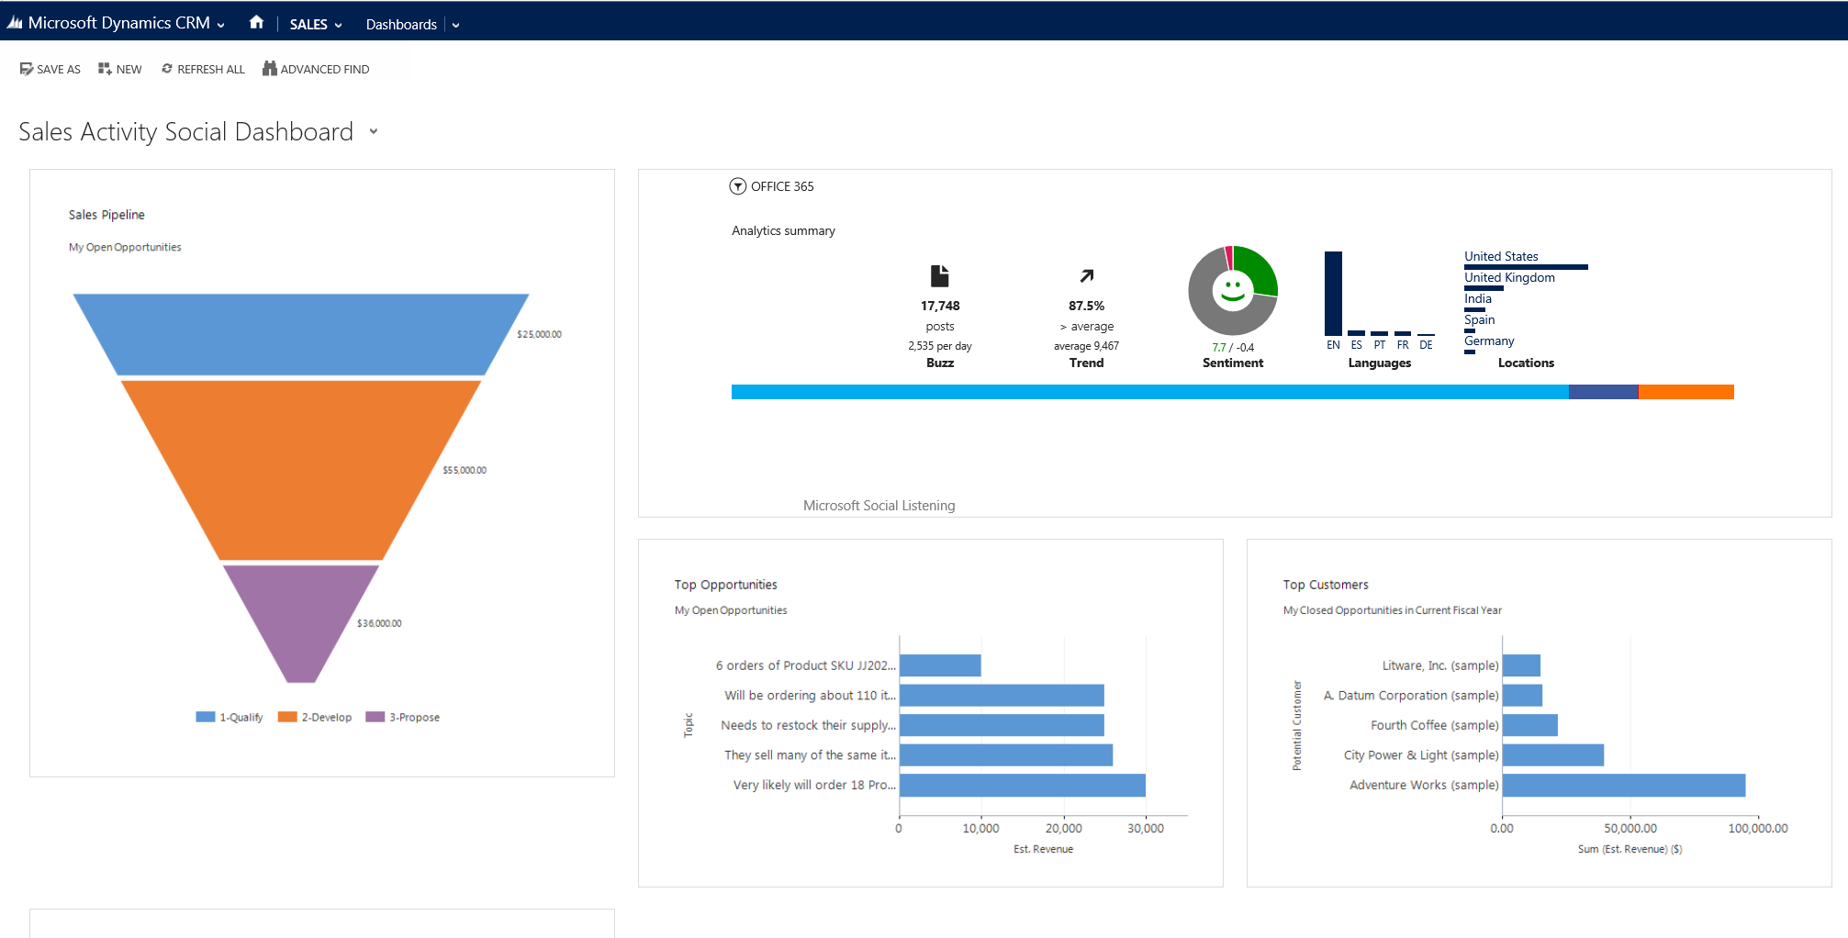
Social CRM
Social for Sales Watch for buying signals, monitor key developments and decision makers at your top accounts.
Social for Marketing Manage your brand reputation, nurture influencers and measure campaign effectiveness.
Social for Service See how happy your customers are and create alerts to identify any customer issues and trends early on.
Notes:
Key Points:
Some of the use cases around sales, marketing and service:
Sales
Social buying signals are an opportunity for sales to listen to social conversations and pick up on trends or signals.
Monitor developments at top accounts and use social signals to know if you need to check in.
Marketing
Marketer cares about protecting the brand. Important to know when the brand is damaged so they can fix.
Identify impact of different influencers and prioritize those who can deliver the greatest social impact.
Around campaigns, listen to social chatter, evaluate and adjust the campaign in real-time.
Service
Listen for when customer is complaining on the social web and proactively respond
Set up alerts to spot potential issues before they expand to damage the brand.

