Slide 1
Academic Communication Skills in English (DACSE)
Autumn Term 2016

Slide 2
DACSE 2016
course instructor
course administration
course introduction

Slide 3
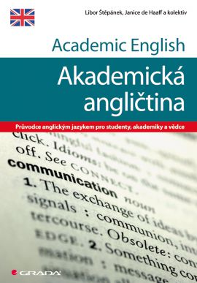
LIBOR ŠTĚPÁNEK (libor.stepanek@cjv.muni.cz)
Masaryk University Language Centre (CJV MU) Komenského nám 2
Education:
MA in English
(MA in History & PhD in Political Science)
Specialization and Research:
Academic Public Speaking
Academic Writing
Creative Approach Language Teaching

Slide 4
course objectives
After completing this course you will be able to:
communicate effectively within the international academic community setting
be a successful participant of an international conference/meeting;
recognize various organizational patterns found in academic speaking;
adjust communication to different tasks;
write short formal academic texts.

Slide 5
course organisation
10 face-to-face sessions
theoretical input combined with diverse practical activities based on individual needs

Slide 6
Materials
IS study materials
face-to-face classes
IS (or other) discussion forum
collaborative activities

Slide 7
requirements
Active participation in:
presentations / talks / teaching sessions giving
face-to-face discussions
online discussions
writing assignment

Slide 8
Introduction

Slide 9
Introduction
peer2peer → class

Slide 10
