Slide 1
Role of ERP system
Leonard Walletzký

Slide 2
Enterprise information systems
CRM - Customer Relationship Management
FMS – Financial Management System
SCM - Supply Chain Management
MIS - Management Information System
CMS - Content Management System
KMS - Knowledge Management System
DSS - Decision Support System
GIS - Geographic Information System

Slide 3
What is ERP
Enterprise Resource Planning, integrated system that help business to manage internal and external resources.
Built on a centralized database and normally utilizing a common computing platform,
ERP systems consolidate all business operations into a uniform and enterprise-wide system environment
ERP can integrates all systems mentioned before

Slide 4
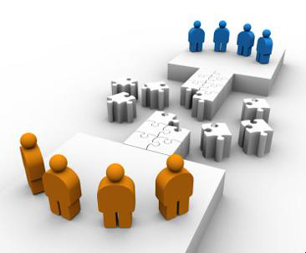
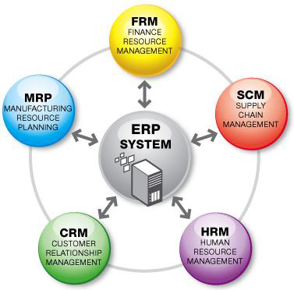
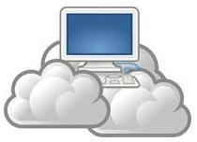
Providing ERP
ERP as a Service
Inventory, MRP, Production, Project, Accounting, CRM, HRM, etc.
ERP
1960
1990
2000

Slide 5
Example
ERP
Store / Shipment
Accounting
Sales
Sales Order
Sales Order
Internal documents
Stock card
Costing
Delivery note
customer
Invoice
Invoicing
Billing
Receipt
Banking

Slide 6
Basic facts
Every (even) small economic activity produce a lot of documents
Problems
  Managing all the documents together with their relations (metadata)
  Consistency of the documents
  Part of them is basis for the taxations
We do not need to store data only
We need them back!

Slide 7
Critical situation
When organization has not any ERP system at all
  Small or beginning companies
When they have bad system or their system is out of date, not power enough etc.
  Growing companies
  Join ventures

Slide 8
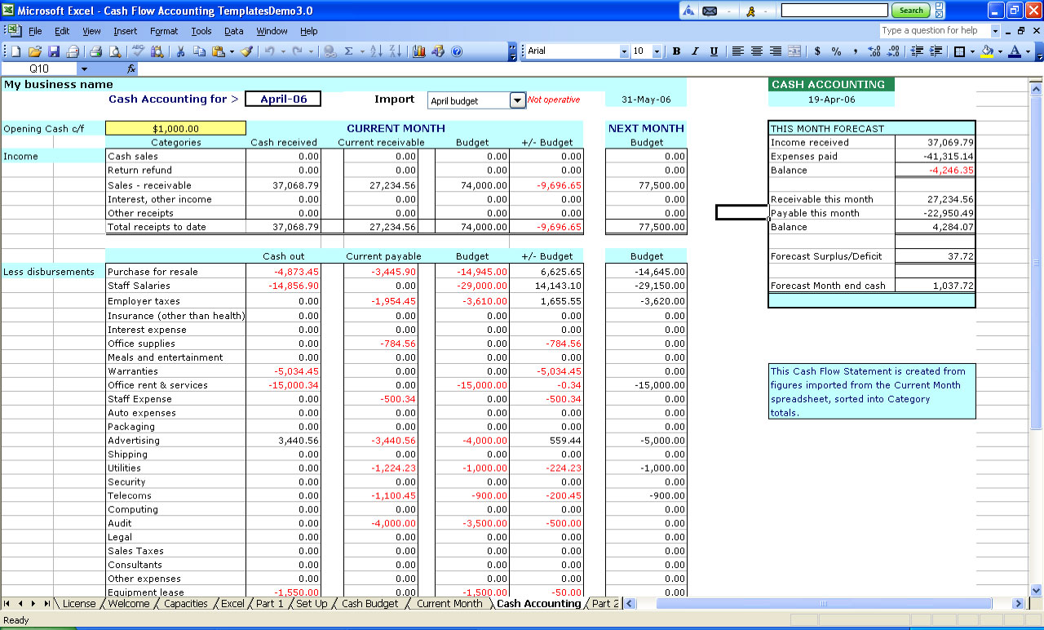
How to recognize problem?
Usage of Excel to manage your activity is not enough
External accountant does not give you all data you need
Data processing (document generating) takes more and more time, you need to control everything 2 – 3 times
You need pen and paper for the key decision, because you are not able to get all data from your accounting

Slide 9
How to identify out dated system?
You need to enter data more than 1 time
  To the accounting and than to internet banking
You are not able to use modern ways of collaboration (document sharing)
Your system has technical problems, it freezes or crash very often
Your system is no longer supported
Your system is not compatible with other systems you use (e-shop)
You need more than 30 minutes to crate report

Slide 10
Basic modules in ERP system
Sales – from the order to invoice
Purchases – from order to invoice
Banking and cash
Warehouse
Property and inventory
Human resources
Relation with customers
Accounting

Slide 11
Outside connections to and into ERP system
Banks and payment systems
POS
  Trade
  Restaurants / Hotels
  Others
Document management
Content management system
  Web shop
  Intranet
Other specialized systems
  DSS, MIS…

Slide 12
What features should ERP system have?
Work in groups you have created yesterday.
Develop at least 4 features of ERP you consider as important.
You can use internet and any kind of resources
Time: 15 minutes

Slide 13
Features of „ideal“ ERP system
Optimizes and simplifies the processes
Centralize the information
Optimizes data and document sharing
Is accessible from everywhere
It helps with your communication to your customers
Accelerate report´s generating
Gets you complete information about status of your company
Is open for the third party product (e-shops, Office, banking and payment systems, POS)

Slide 14
Special position of accounting
It is not just „a next module“
Accounting plays unique role
What is it accounting?
The systematic recording, reporting, and analysis of financial transactions of a business (http://www.investorwords.com/48/accounting.html)
Many SME separates accounting and ERP!!!!
Many big companies underestimate the control role of accounting

Slide 15
Separated ERP
ERP
Store / Shipment
Accounting
Sales
Sales Order
Sales Order
Internal documents
Stock card
Costing
Delivery note
customer
Invoice
Invoicing
Billing
Receipt
Banking

Slide 16
Why they do it, if they know
Accounting Software
  Create documents in Every Department
  Every departments (although it is the same information, duplicate work)
Generate report in Every department
  Why? It has to wait for Accounting input information into software.
Delay information e.g.
  Stock balance => Sale, Procurement, Manufacturing
  Account Receivable balance => Credit control, Bad debt
  Cash and Bank management
Waste time to collect all information

Slide 17
Reasons
People generally
  are afraid of accounting
  think it is better to let it on professionals
  assume they have all necessary information from other records
  do not like taxes
Why it is wrong
  accounting is here for more than 300 years with unchanged principles
  external professionals will never know your business in detail
  Without accounting you are loosing one of the most important ways of verifying your data
  Taxes are simply here and we need to accept that

Slide 18
Conclusion
Critical situation of ERP need
Value of ERP for the customer
Special position of accounting

