Slide 1
Chapter 1: Introduction to Switched Networks
Routing and Switching
Notes:
Cisco Networking Academy program
Routing & Switching
Chapter 1: Introduction to Switched Networks

Slide 2
Chapter 1
1.0 Introduction
1.1 LAN Design
1.2 Switched Environment
1.3 Summary
Notes:
Chapter 1

Slide 3
Chapter 1: Objectives
Upon completion of this chapter, you will be able to:
Describe convergence of data, voice, and video in the context of switched networks.
Describe a switched network in a small-to-medium-sized business.
Explain the process of frame forwarding in a switched network.
Compare a collision domain to a broadcast domain.
Notes:
1.

Slide 4
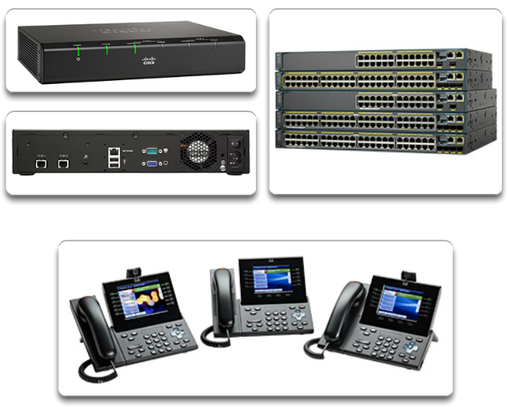
Converged Networks
Growing Complexity of Networks
Our digital world is changing.
Information must be accessed from anywhere in the world.
Networks must be secure, reliable, and highly available.
Notes:
1.1.1.1 Growing Complexity of Networks

Slide 5
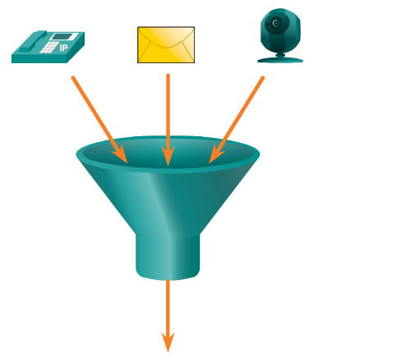
Converged Networks
Elements of a Converged Network
Collaboration is a requirement.
To support collaboration, networks employ converged solutions.
Data services include voice systems, IP phones, voice gateways, video support, and video conferencing.
Call control, voice messaging, mobility, and automated attendant are also common features.
Notes:
1.1.1.2 Elements Of A Converged Network

Slide 6
Converged Networks
Benefits of a Converged Network
  Multiple types of traffic; only one network to manage.
  Substantial savings over installation and management of separate voice, video, and data networks.
  Integrates IT management.
Notes:
1.1.1.2 Elements Of A Converged Network

Slide 7
Converged Networks
Borderless Switched Networks
The Cisco Borderless Network is a network architecture that allows organizations to connect anyone, anywhere, anytime, and on any device securely, reliably, and seamlessly.
Cisco Borderless Network is designed to address IT and business challenges, such as supporting the converged network and changing work patterns.
Notes:
1.1.1.3 Borderless Switched Networks

Slide 8
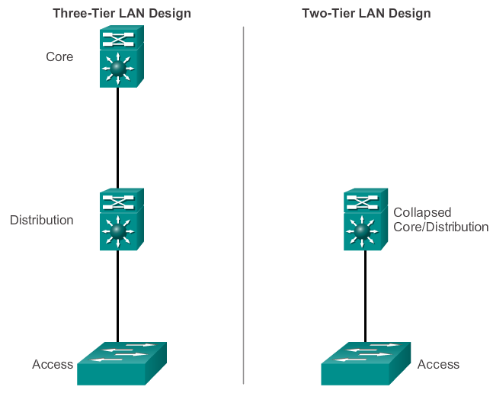
Converged Networks
Hierarchy in the Borderless Switched Network
Borderless switched network design guidelines are built upon the following principles:
  Hierarchical
  Modularity
  Resiliency
  Flexibility
Notes:
1.1.1.4 Hierarchy in the Borderless Switched Network

Slide 9
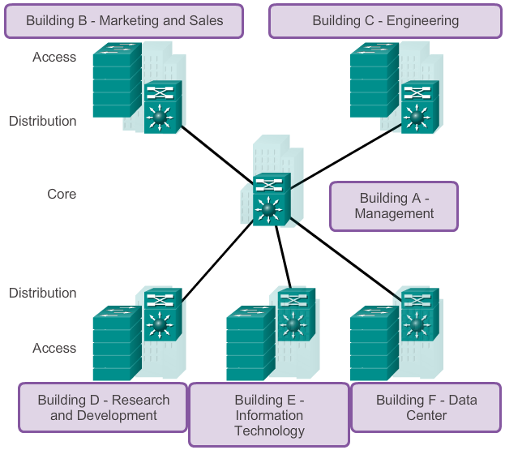
Converged Networks
Core, Distribution, Access
Notes:
1.1.1.5 Core, Distribution, Access

Slide 10
Switched Networks
Role of Switched Networks
Switching technologies are crucial to network design.
Switching allow traffic to be sent only where it is needed in most cases, using fast methods.
A switched LAN:
  Allows more flexibility
  Allows more traffic management
  Supports quality of service, additional security, wireless, IP telephony, and mobility services
Notes:
1.1.2.1 Role of Switched Networks

Slide 11
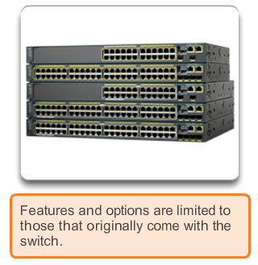
Switched Networks
Form Factor
Fixed Platform
Notes:
1.1.2.2 Form Factor

Slide 12
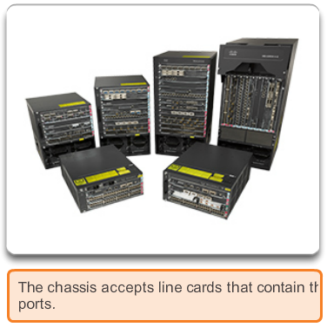
Switched Networks
Form Factor (cont.)
Modular Platform
Notes:
1.1.2.2 Form Factor

Slide 13
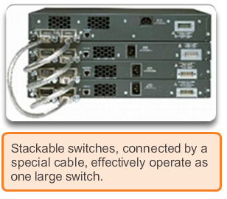
Switched Networks
Form Factor (cont.)
Stackable Platform
Notes:
1.1.2.2 Form Factor

Slide 14
Frame Forwarding
Switching as a General Concept
A switch makes a decision based on ingress and a destination port.
A LAN switch keeps a table that it uses to determine how to forward traffic through the switch.
Cisco LAN switches forward Ethernet frames based on the destination MAC address of the frames.
Notes:
1.2.1.1 Switching as a General Concept in Networking and Telecommunications

Slide 15
Frame Forwarding
Dynamically Populating a Switch MAC Address Table
A switch must first learn which devices exist on each port before it can transmit a frame.
It builds a table called a MAC address or content addressable memory (CAM) table.
The mapping device <-> port is stored in the CAM table.
CAM is a special type of memory used in high-speed searching applications.
The information in the MAC address table used to send frames.
When a switch receives an incoming frame with a MAC address that is not found in the CAM table, it floods it to all ports, but the one that received the frame.
Notes:
1.2.1.2 Dynamically Populating a Switch MAC Address Table

Slide 16
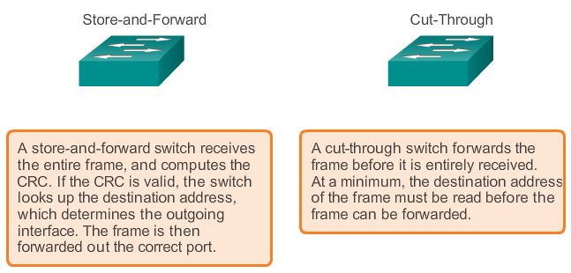
Frame Forwarding
Switch Forwarding Methods
Add a header
Notes:
1.2.1.3 Switch Forwarding Methods

Slide 17
Frame Forwarding
Store-and-Forward Switching
Allows the switch to:
  Check for errors (via FCS check)
  Perform automatic buffering
Slower forwarding process
Notes:
1.2.1.4 Store-and-Forward Switching

Slide 18
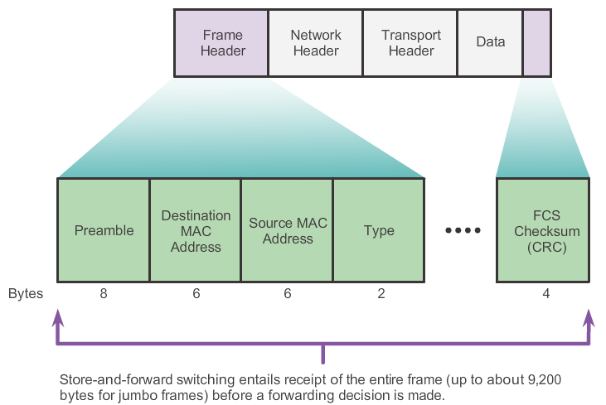
Frame Forwarding
Store-and-Forward Switching (cont.)
Notes:
1.2.1.4 Store-and-Forward Switching

Slide 19
Frame Forwarding
Cut-Through Switching
Allows the switch to start forwarding in about 10 microseconds
No FCS check
No automatic buffering
Notes:
1.2.1.5 Cut-Through Switching

Slide 20
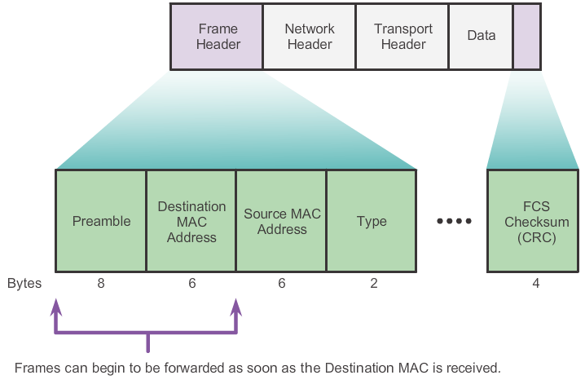
Frame Forwarding
Cut-Through Switching (cont.)
Notes:
1.2.1.5 Cut-Through Switching

Slide 21
Switching Domains
Collision Domains
A collision domain is the segment where devices must compete to communicate.
All ports of a hub belong to the same collision domain.
Every port of a switch is a collision domain on its own.
A switch break the segment into smaller collision domains, easing device competition.
Notes:
1.2.2.1 Collision Domains

Slide 22
Switching Domains
Broadcast Domains
A broadcast domain is the extend of the network where a broadcast frame can be heard.
Switches forward broadcast frames to all ports; therefore, switches do not break broadcast domains.
All ports of a switch, with its default configuration, belong to the same broadcast domain.
If two or more switches are connected, broadcasts are forwarded to all ports of all switches, except for the port that originally received the broadcast.
Notes:
1.2.2.2 Broadcast Domains

Slide 23
Switching Domains
Alleviating (zmírnění) Network Congestion
Switches help alleviating network congestion by:
Facilitating the segmentation of a LAN into separate collision domains
Providing full-duplex communication between devices
Taking advantage of their high-port density
Buffering large frames
Employing high-speed ports
Taking advantage of their fast internal switching process
Having a low, per-port cost
Notes:
1.2.2.4 Alleviating Network Congestion

Slide 24
Chapter 1: Summary
In this chapter, you learned:
The trend in networks is towards convergence using a single set of wires and devices to handle voice, video, and data transmission.
There has been a dramatic shift in the way businesses operate.
There are no physical offices or geographic boundaries constraints. Resources must now be seamlessly available anytime and anywhere.
The Cisco Borderless Network architecture enables different elements, from access switches to wireless access points, to work together and allow users to access resources from any place at any time.
Notes:
Chapter 1 Summary

Slide 25
Chapter 1: Summary (cont.)
The traditional, three-layer hierarchical design model divides the network into core, distribution, and access layers, and allows each portion of the network to be optimized for specific functionality.
It provides modularity, resiliency, and flexibility, which provides a foundation that allows network designers to overlay security, mobility, and unified communication features.
Switches use either store-and-forward or cut-through switching.
Every port on a switch forms a separate collision domain allowing for extremely high-speed, full-duplex communication.
Switch ports do not block broadcasts and connecting switches can extend the size of the broadcast domain, often resulting in degraded network performance.
Notes:
Chapter 1 Summary

Slide 26


