Slide 1
Marketing management © Leonard Walletzký

Slide 2
On previous presentation
Motivation
Why do we need marketing?
Why IT should cooperate and understand marketing?
Marketing of services basic
Diversity between goods and services
Why are services more important than goods (or are not?)
Tangibility spectrum

Slide 3
Characteristics of Services Compared to Goods
Intangibility
Heterogeneity
Simultaneous
Production
and
Consumption
Perishability

Slide 4
Implications of Intangibility
Services cannot be inventoried
Services cannot be easily patented
Services cannot be readily displayed or communicated
Pricing is difficult

Slide 5
Implications of Heterogeneity
Service delivery and customer satisfaction depend on employee and customer actions
Service quality depends on many uncontrollable factors
There is no sure knowledge that the service delivered matches what was planned and promoted

Slide 6
Implications of Simultaneous Production and Consumption
Customers participate in and affect the transaction
Customers affect each other
Employees affect the service outcome
Decentralization may be essential
Mass production is difficult

Slide 7
Implications of Perishability
It is difficult to synchronize supply and demand with services
Services cannot be returned or resold

Slide 8
What is Service? The New View
Service includes every interaction between any customer and anyone representing the company, including:
Dealers
Salespeople
Receptionists and Schedulers
Management and Executives
Service Employees
Billing and Accounting Personnel
Web site and any e-channel Interaction
Customer
Notes:
8

Slide 9
Marketing management
Analysis
What we are going to sell?
Who are our customers?
Planning
What information do we need?
How to schedule our actions?
Implementation
Acting according the plan
Control
What can we do better next time?
How can we characterize our production?

Slide 10
Marketing framework
5C
Customer
STP
Segmentation
Marketing Mix
4P
Company
Context
Collaborators
Competitors
Targeting
Positioning
7P
4C
7C
4S

Slide 11
Situation Analysis
Customer
Company
Context
Collaborators
Competitors
Who is our typical customer?
Whom are our products designed for?
What value do we bring to the customer?
What is our company bacground?
What is our position on the market?
How do we manage the company processes?
Whom do we need to finalize our production?
Are there any unreplacable companies?
What do we expect from our partners?
Do we know our competitors?
What is the highest danger?
How do we map the whole market?
What are political conditions?
Are there any economical issues?
What is level of technological development?

Slide 12
Customer
Need we are trying to satisfy
Value propositions
Significant groups
Frequency of purchases
Quantity of purchases
Retail chanels
Trends

Slide 13
Company
Are we able to meet customer´s needs?
SWOT analysis
Strengths
innovative products, expertise and procedures
Weaknesses
lack of knowledgeable technical support or average product quality
Opportunities
a new international market or a market led by a weak competitor
Threats
a new competitor or price war

Slide 14
Context PESTE analysis
Social
The level of society, social state
Technics and technological
Technological development, computer skills
Economics
Tax rate, interest rate, wage level
Political and law
Stability, corruption, law enforcement
Ecological
Attitude to environment

Slide 15
Collaborators
Are there any key partners?
Unique technology
Supply dependency
Distributors
Suppliers
Emploees
Experts
Stakeholders

Slide 16
Competitors
Are there active competitors?
Or do we identify any thread?
What are competitive products exactly?
What are their features?
What are their strengths and weaknesses?

Slide 17
Boston Consulting Group matrix
Portfolio Assessment Tool
Brands or products are classified according to whether each has a strong or weak market share and slow or growing market
Helps us to formulate marketing strategy
Very easy to use in any other cases

Slide 18
Boston matrix
Relative Market share
Star
???
Cash cow
Dog
High
Low
Market Growth Rate
High
Low

Slide 19
What strategy do we choose?
optimize or hold
minimize or divest
milk
unknown

Slide 20
Company
Marketing strategy is the link between corporate goals and operational tactics
There are two primary considerations in marketing strategy
Where are we?
Where do we want to go?
To see
Mission
Vison

Slide 21
Mission
Indicates the benefits for customers, suppliers, employees
Offers products and services to satisfy needs of the subjects
Appeals to wider customer groups
Attracts attention rather than explain usefulness exactly

Slide 22
Mission Examples
Google
to organize the world's information and make it universally accessible and useful.
Kofola
Kofola's mission is to enthusiastically create an attractive brand of beverages, which will offer consumers a functional and emotional value that they become an important part of their lifes.

Slide 23
Vision
Answers the question: What the business and company will look like in a distant future?
Reflects feelings and ideas of leaders
(emotional perspective)
Includes measurable parameters and its values indicating achievement of vision
(rational perspective)

Slide 24
Vision Examples
Google
to develop a perfect search engine.
Kofola
Kofola group's vision to be the preferred choice for customers, employees and shareholders. By 2012 we want to be an overall "number two" in the soft drinks market in the Czech Republic, Slovak Republic and Poland. In each of these countries, our goal is to have in the segments of cola drinks and water brands that will be 1 or 2 place in these segments. In other categories to be imaginary third place.

Slide 25
Corporate Identity
Corporate philosophy
What is the company’s typical philosophy toward the marketplace
Complexity
Originality and uniqueness
Stability
Synergy among collaborators and employees
Prestige
Company concepts
Design
Communication
Culture
Company Image

Slide 26
How do we evaluate?
Analysis is not static
How do we know we are right?
How to set key factors?
What factors can help us?

Slide 27
Marketing Metrics
Profitability
Sales
Share
Average prices
Levels of awareness
Penetration in trial
Customer satisfaction
Employee satisfaction, etc.

Slide 28
Example: How to increase profitability
Basic goal: Increase profit
Increase revenue
Decrease costs
Increase volume
Change price
Increase % market share
Increase market size

Slide 29
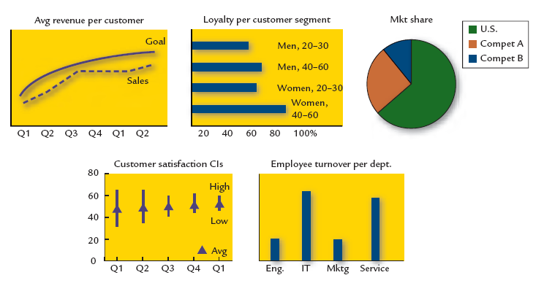
Example: Metrics

Slide 30
Conclusion
5C Analysis
Boston metrics
Corporate identity
Basic of metrics

Slide 31
Thank you for the attention

