Slide 1
Create a .NET Core app
Tomas Hruby
2016
Notes:
- Time consuming I/O op. or Web Request
- Synchronous calling blocks possible execution of independent code

Slide 2
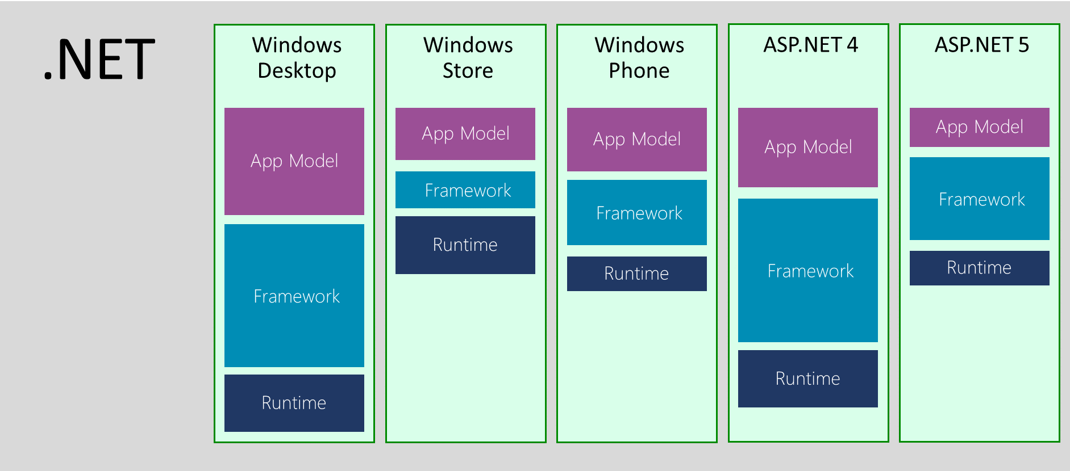
Before
.NET core
Notes:
.NET was intended as a single framework
After some time, it was branched for other platforms (Phone, Silverlight, Desktop)
Programming across verticals was hard – multiple projects for every platform, #if pragmas
PCL – portable class libraries
Compatibility issues (breaking changes) ->fork of .NET framework

Slide 3
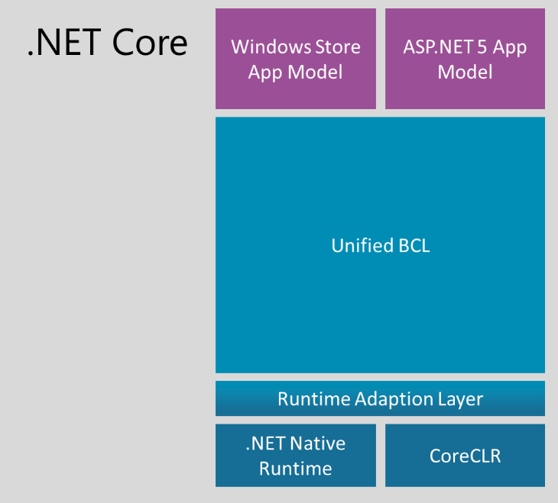
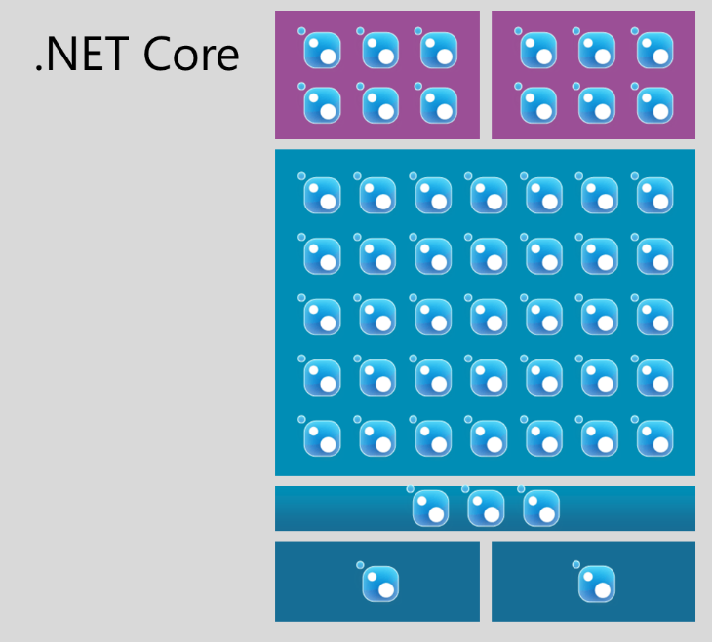
Now
.NET core
https://github.com/dotnet/core
https://github.com/dotnet/coreclr
Notes:
New, smaller subset of BCL
All distributed using NuGet
Runs on all devices
On GitHub

Slide 4
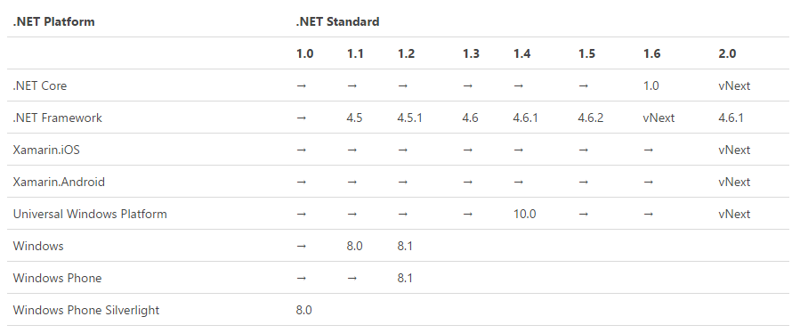
.NET Standard
.NET core
Notes:
NETStandard – runtime API specification, NETCore – implementation of the standard

Slide 5
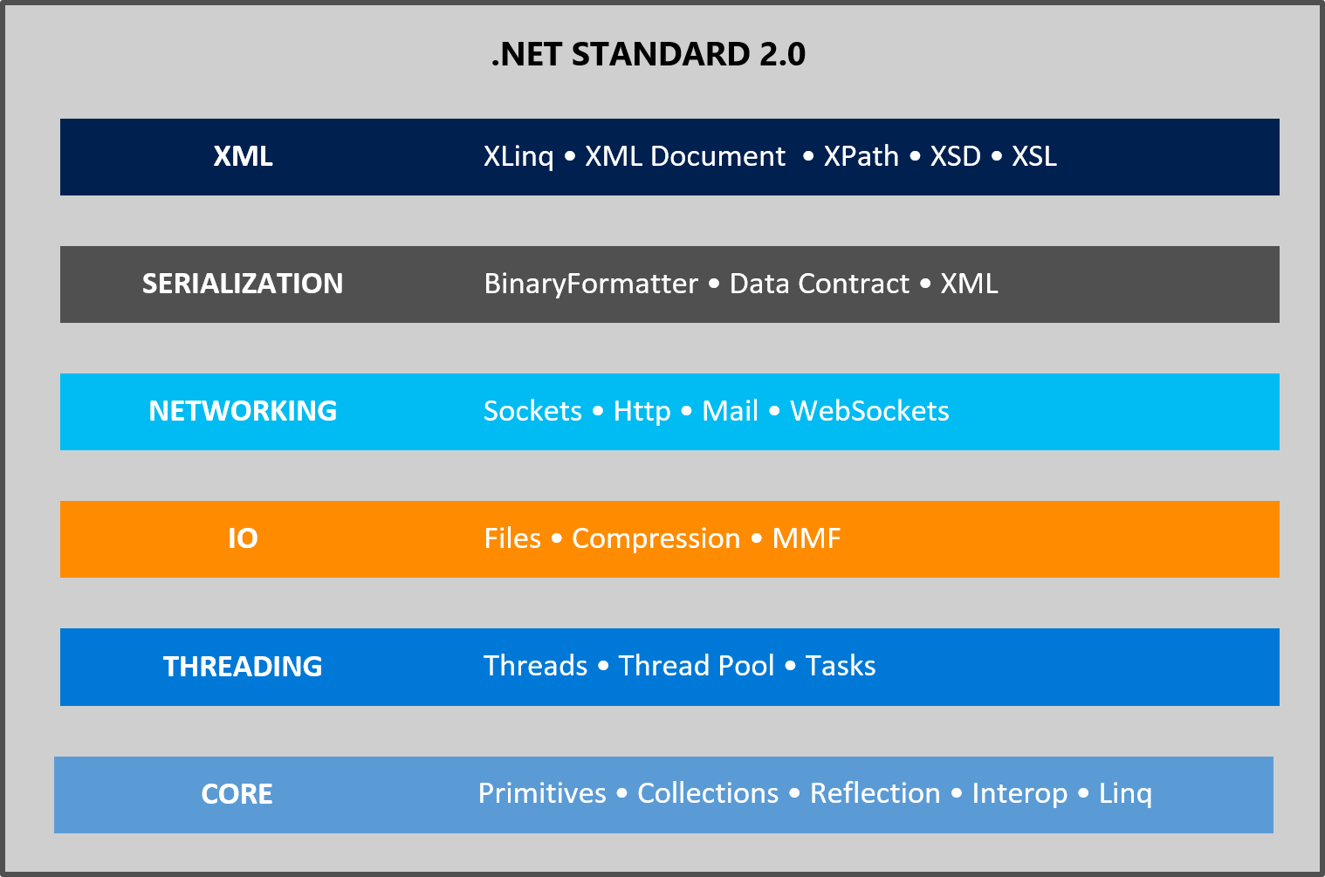
.NET Standard
.NET core
Notes:
NETStandard – runtime API specification, NETCore – implementation of the standard

Slide 6
It’s Demo time…
https://docs.asp.net/en/latest/fundamentals/index.html
Notes:
* Show how to create .NET Core Web App with WebAPI
Show .NET Core project structure on filesystem
Global.json, Project.json
Return to VS and explain project.json
Dependencies, frameworks, imports, framework dependencies, target: project
TFM – Frameworks – available API for the developer https://docs.microsoft.com/en-us/dotnet/articles/standard/library
Show Deprecated TFMs - https://github.com/dotnet/corefx/blob/master/Documentation/architecture/net-platform-standard.md
Metapackages
The NETStandard.Library metapackage targets the netstandard framework. The most common way to target netstandard is by referencing this metapackage. It describes and provides access to the ~40 .NET libraries and associated APIs that define the .NET Standard Library.
The Microsoft.NETCore.App metapackage targets the netcoreapp framework. It provides access to ~60 libraries, ~40 provided by the NETStandard.Library package and ~20 more in addition.
Show https://docs.microsoft.com/en-us/dotnet/articles/core/tools/project-json

Slide 7
Adding middlewares

Slide 8
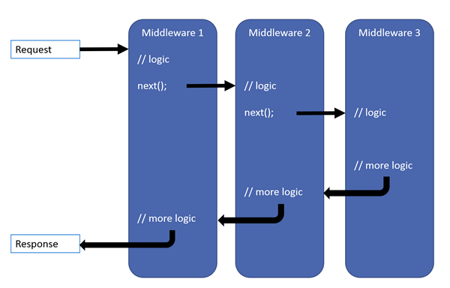
ASP.NET middlewares
.NET core
Notes:
Linear HTTP request-response pipeline

Slide 9
It’s Demo time…
Notes:
Program.cs is the main entry point
Startup.cs is the bootstrap for the whole application
Show writing simple middleware
Show enabling MVC

Slide 10
Developing a full-blown web app

Slide 11

Dependency Injection
a full-blown web App
Is available everywhere — Startup, Middleware, Services
Enables you to modularize your application
https://docs.asp.net/en/latest/fundamentals/dependency-injection.html
Notes:
Add new service that returns static data

Slide 12
App Configuration
a full-blown web App
Configuration is build on the project startup (Startup.cs)
Combine configuration from multiple sources
https://docs.asp.net/en/latest/fundamentals/configuration.html
Notes:
Add new configuration section

Slide 13
Logging
a full-blown web App
Access logger everywhere while maintaining IOC
Switch loggers application-wise (Startup.cs)
Specify level of details for every namespace
https://docs.asp.net/en/latest/fundamentals/logging.html
Notes:
Add Nlog logging
Add nlog.config
Add middleware

Slide 14
Routing
a full-blown web App
Map URI to Controller
URI – controller, action, query
Notes:
Attribute routing

Slide 15
Unit tests
a full-blown web App
xUnit
  https://xunit.github.io/docs/getting-started-dotnet-core.html
NSubstitute
  http://nsubstitute.github.io/help/getting-started/
Notes:
How to install xUnit, NSubstitute
How to configure runner
How to use Test Explorer
Fact / Theory
Mocking method / property

Slide 16
Asynchronous programming
Tomas Hruby
2015
Notes:
- Time consuming I/O op. or Web Request
- Synchronous calling blocks possible execution of independent code

Slide 17
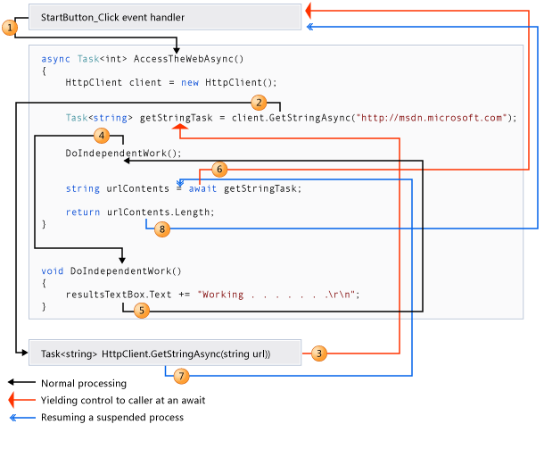

Slide 18
Async-Await
MVC basics
Put async-await only across the whole application
Don’t mix manipulation with threads with async-await
  Blocking context threads causes deadlocks
  To use async code from normal method use Task.Run
Method can continue in a different thread after awaiting
  Don’t depend on the thread context
  HTTP context copies context information to new thread from the thread pool
https://msdn.microsoft.com/en-us/library/hh191443.aspx
http://blog.stephencleary.com/2012/07/dont-block-on-async-code.html
Notes:
Show deadlock when blocking the context thread.

Slide 19
REST API design
Notes:
Describe REST application role.

Slide 20
Basics revisited
MVC basics
Stateless HTTP communication (Request-Response)
URL identifies an object
  ~/api/users/ngk67
  ~/api/users/ngk67/roles
  Use plural for endpoints (/api/users, /api/projects)
Method identifies action (GET, POST, PUT, PATCH, DELETE)
  GET ~/api/users (get all users)
  DELETE ~/api/users/ngld456 (delete user with given ID)
Request body represents the object identified by URI
  POST ~/api/users (object in request body is inserted as user)
Server answers with HTTP Status Code and response body containing requested object(s)

Slide 21
HTTP Status Codes
MVC basics
Method | URL pattern | Statuses | (Notes)
GET | /api/users | 200
GET | /api/users/{id} | 200, 404
POST | /api/users | 201, 400 | 201 – Created
PUT | /api/users/{id} | 200, 404, 400 | 400 – Bad request
DELETE | /api/users/{id} | 204, 404 | 204 – No content
401 – Unauthorized
500 – Internal Server Error
429 – Too many requests (response should contain time of renewal)
http://www.restapitutorial.com/httpstatuscodes.html
Notes:
Browse default UI showing controllers in action
Create an route without controller (for HomeController)

Slide 22
Filtering & Paging
MVC basics
Filtering using query parameters
  GET ~/api/students?semester=spring
Filtering using query objects
  GET ~/api/students?filter={“subjects”=[“PE”,“maths”],”age”=18}}
  REST calls remain the same even if new filter is added (forward compatible)
  Easy to write by hand in browser URL bar
Paging request
  GET ~/api/students?pagesize=10&page=3
Paging responses
  Pagination info in header (X-Total-Count, X-Page-Size, X-Current-Page)
  Pagination envelope
    { “total”: 40, “pageSize”: 10, “page”: 1, “data”: […] }
  Cursor based pagination (link to next page)

Slide 23
Versioning
MVC basics
Using URL prefixes
  ~/api/v1/users
Using HTTP headers
  X-API-Version: 7.1.3

Slide 24
Special actions
MVC basics
Don’t use special query parameters (as flags). Use special endpoints
  ~/api/students/:student_id/disable
  ~/api/users/resetpassword

