Slide 1
MUFIN Image Annotation vs. Google Label Detection: Who Wins?
Petra Budíková, Michal Batko

Slide 2
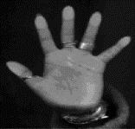
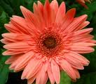
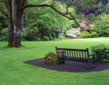
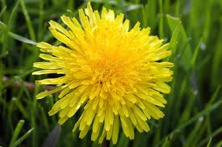
Motivation
There are many images out there…
To enable text search, we need images with keywords
dog?
Flower, yellow, dandelion, detail, close-up, nature, plant, beautiful
Manual annotation
Automatic annotation
MUFIN Image Annotation
Google Label Detection
P. Budikova, M. Batko, P. Zezula. Semantic Image Annotation by ConceptRank.
Submitted to Multimedia Tools And Applications, October 2016.

Slide 3
Presentation Outline
MUFIN Image Annotation
Basic idea of the search-based approach
ConceptRank algorithm outline
Implementation details
Google Label Detection
Basic idea of the model-based approach
Known and unknown details
Comparison
Data and metrics
Results
Examples
Conclusion

Slide 4
MUFIN Image Annotation
Part I

Slide 5
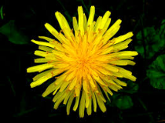
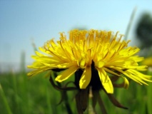
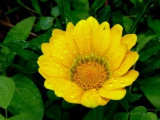
Solution Overview
Search-based annotation
Annotated image collection
Similar annotated images
d = 0.2
d = 0.5
d = 0.6
?
Content-based
image retrieval
Yellow, bloom, pretty
Meadow, outdoors, dandelion
Mary’s garden, summer
Final candidate keywords
with probabilities
Semantic resources
Candidate
keyword
processing
Plant 0.3
Flower 0.3
Garden 0.15
Sun 0.05
Human 0.1
Park 0.1

Slide 6
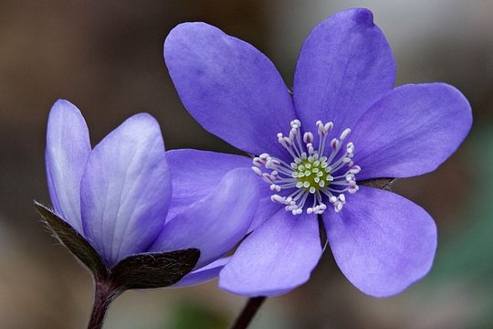
Phase 1: Content-based retrieval for annotations
What we need:
Large collection of reliably annotated images: Profiset
20 million general-purpose photos from the Profimedia photostock company
Descriptive keywords for each photo provided by authors who want to sell the pictures → rich and reliable annotations
Efficient and effective search: DeCAF descriptors and PPP-codes
DeCAF: 4096-dimensional vector obtained from the last layer of a neural network image classifier
PPP-codes: effective permutation-based metric space indexing method
Profiset keywords: botany, close, closeup, color, daytime, detail, exterior, flower, germany, hepatica, horticulture, laughingstock, liverwort, lobed, mecklenburg, nature, nobilis, outdoor, outside, plant, pomerania, purple, round, western

Slide 7
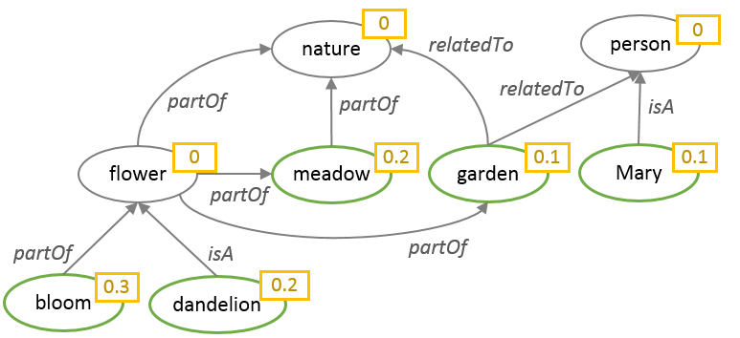
Phase 2: ConceptRank
Candidate keyword analysis inspired by Google PageRank
Uses semantic connections between candidate keywords to determine the probability of individual candidates
Main steps:
Construct a graph of candidate keywords related by WordNet semantic links
Apply biased random walk with restarts to compute the score of each keyword
Similar annotated images
d = 0.2
d = 0.5
d = 0.6
Yellow, bloom, pretty
Meadow, outdoors, dandelion
Mary’s garden, summer

Slide 8
ConceptRank – semantic network
Semantic network: graph representation of semantic relationships
Nodes: candidate objects
Node probability: current probability of the respective candidate concept
Edges: relationships between candidate objects
Edge weight: conditional probability of the target node concept, given that the source node concept is relevant
Semantic network construction
Initial nodes and their probabilities taken from CBIR result
For each node, relationships are found in the WordNet lexical database -> new edges and nodes

Slide 9
ConceptRank – node probability computation
Random walk idea (general directed graph)
User starts in random node and walks randomly in the graph. The importance of each node is equal to the probability that the random walker ends up in the given node.
Let M be a matrix describing the edges in the graph. Mathematically, we are looking for a vector r of node weights that satisfies the equation r = M.r
This can be computed by repeatedly multiplying a random initial vector r₀ by M until the steady state is found
Problem: in many real-world graphs, the matrix M is such that the equation does not work as expected
1
Transition matrix:
$$M=\left(\begin{matrix}0 & 0 & 0 \\ 0.5 & 0 & 0 \\ 0.5 & 1 & 1\end{matrix}\right)$$
C
0.5
1
Node probabilities:
$r_{0}$ $=\left(\begin{matrix}0.333 \\ 0.333 \\ 0.333\end{matrix}\right)$
$r_{1}$ $=\left(\begin{matrix}0 \\ 0.166 \\ 0.833\end{matrix}\right)$
$r_{2}$ $=\left(\begin{matrix}0 \\ 0 \\ 1\end{matrix}\right)$
A
0.5
B
Transition matrix:
$$M=\left(\begin{matrix}0 & 0 & 0 \\ 0.5 & 0 & 0 \\ 0.5 & 1 & 0\end{matrix}\right)$$
C
0.5
1
Node probabilities:
$r_{0}$ $=\left(\begin{matrix}0.333 \\ 0.333 \\ 0.333\end{matrix}\right)$
$r_{1}$ $=\left(\begin{matrix}0 \\ 0.166 \\ 0.5\end{matrix}\right)$
$r_{2}$ $=\left(\begin{matrix}0 \\ 0 \\ 0.166\end{matrix}\right)$
$r_{3}$ $=\left(\begin{matrix}0 \\ 0 \\ 0\end{matrix}\right)$
A
0.5
B

Slide 10
ConceptRank – node probability computation II
Random walk with restart
Proposed by Google to eliminate the problems of basic random walk + model more realistically real web users
With a given probability P_{restart}, the random walker can decide in each step whether to follow the links, or to randomly restart in any node
C
Transition matrix:
$$M=\left(\begin{matrix}0 & 0 & 0 \\ 0.5 & 0 & 0 \\ 0.5 & 1 & 0\end{matrix}\right)$$
0.5
1
0.5
Node probabilities:
$r_{0}$ $=\left(\begin{matrix}0.333 \\ 0.333 \\ 0.333\end{matrix}\right)$
$r_{1}$ $=\left(\begin{matrix}0 \\ 0.166 \\ 0.5\end{matrix}\right)$
$r_{2}$ $=\left(\begin{matrix}0 \\ 0 \\ 0.166\end{matrix}\right)$
$r_{3}$ $=\left(\begin{matrix}0 \\ 0 \\ 0\end{matrix}\right)$
A
B
0.33
P_{restart} = 0.15
0.05
C
0.05
Stochastic transition matrix:
$M=\left(\begin{matrix}0.05 & 0.05 & 0.333 \\ 0.475 & 0.05 & 0.333 \\ 0.475 & 0.9 & 0.333\end{matrix}\right)$
0.05
0.425
0.85
0.05
0.33
0.33
A
0.425
B
Node probabilities:
$r_{0}$ $=\left(\begin{matrix}0.333 \\ 0.333 \\ 0.333\end{matrix}\right)$
$r_{1}$ $=\left(\begin{matrix}0.144 \\ 0.286 \\ 0.569\end{matrix}\right)$
$r_{2}$ $=\left(\begin{matrix}0.211 \\ 0.272 \\ 0.515\end{matrix}\right)$
…
$r$ $=\left(\begin{matrix}0.197 \\ 0.281 \\ 0.520\end{matrix}\right)$
0.05
0.05

Slide 11
ConceptRank – node probability computation III
Random walk with biased restart
In standard RWR, all nodes are equal – the restart is equally probable in any node
Biased restart prefers some nodes over others for the restart
e.g. selected reliable web nodes
ConceptRank
Biased RWR on the semantic network model of candidate concepts
The probability of restart reflects the initial probability of nodes
The non-restart edges represent semantic relationships
0.1
P_{restart} = 0.15
0.1
C
$$M=\left(\begin{matrix}0.105 & 0.105 & 0.7 \\ 0.455 & 0.03 & 0.2 \\ 0.44 & 0.865 & 0.1\end{matrix}\right)$$
0.015
0.015
Stochastic transition matrix:
0.105
0.425
0.85
0.03
0.7
0.2
$r_{0}$ $=\left(\begin{matrix}0.333 \\ 0.333 \\ 0.333\end{matrix}\right)$
$r_{1}$ $=\left(\begin{matrix}0.303 \\ 0.228 \\ 0.468\end{matrix}\right)$
$r_{2}$ $=\left(\begin{matrix}0.383 \\ 0.238 \\ 0.377\end{matrix}\right)$
$r$ $=\left(\begin{matrix}0.346 \\ 0.246 \\ 0.406\end{matrix}\right)$
A
0.425
B
Node probabilities:
…
0.7
0.105
0.03
0.2

Slide 12
MUFIN Image Annotation – recapitulation
CBIR:
20M Profiset images
DeCAF descriptors, PPP-codes
100-NN query
Semantic analysis:
Initial candidate keywords provided by CBIR results
Semantic network built from initial candidates, using selected semantic relationships from WordNet
ConceptRank algorithm computes the final probability of all nodes
Output selection:
Postprocessing: remove instances and auxiliary semantic nodes
Return the most probable keywords

Slide 13
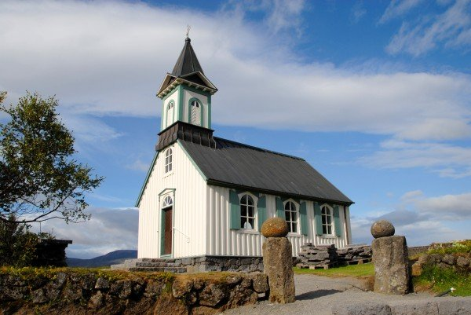
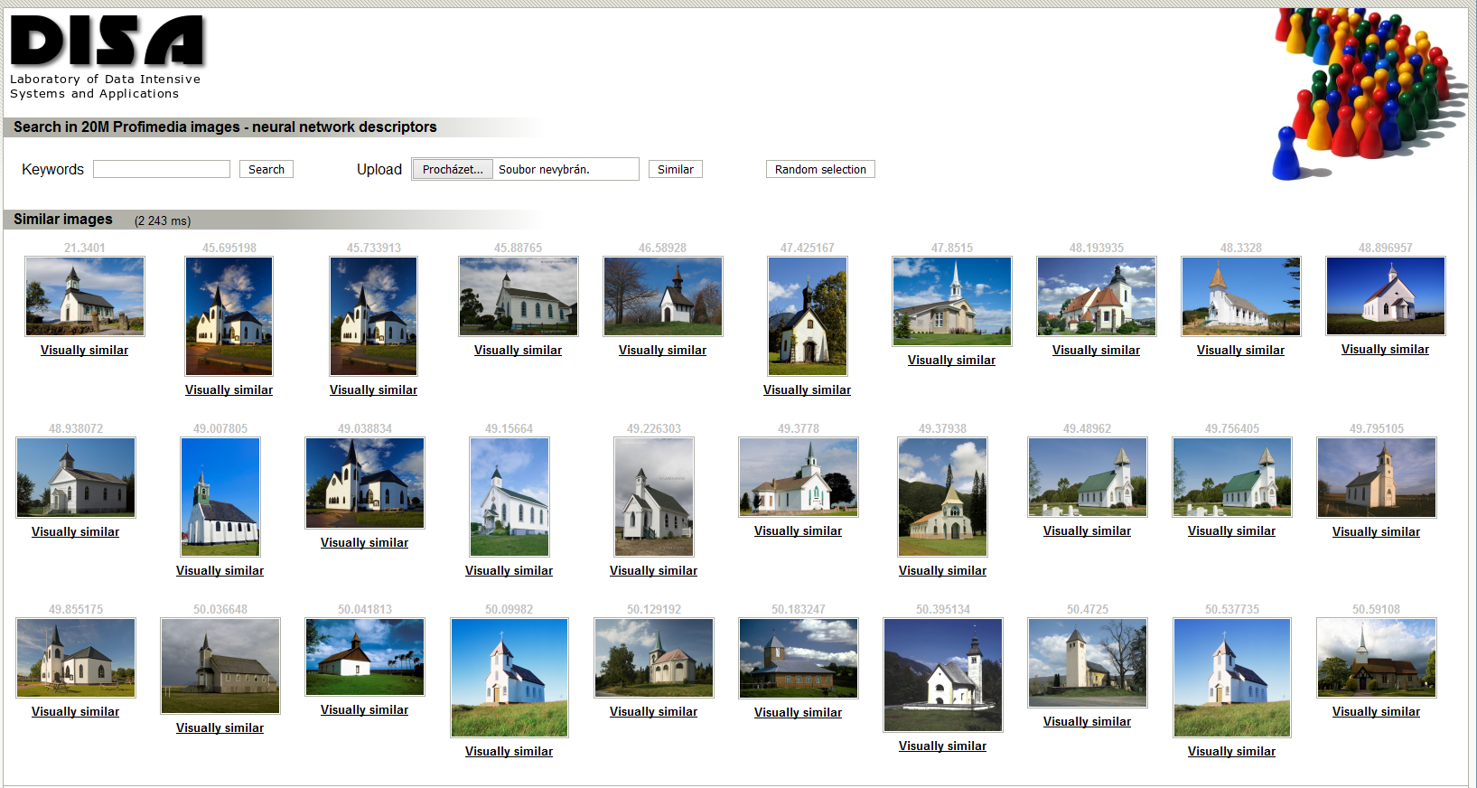
MUFIN Image Annotation – example
Retrieve 100 similar images from Profiset
Merge their keywords, compute frequencies
Build the semantic network using WordNet
Compute the ConceptRank
Apply postprocessing & return 20 most probable keywords
Candidate keywords after CBIR
church, architecture, travel, europe, building, religion, germany, buildings, north, churches, christianity, america, religious, exterior, st, historic, world, tourism, united, usa, …
Semantic network
4 relationships: hypernym (dog → animal), hyponym (animal → dog), meronym (leaf → tree), holonym (tree → leaf)
270 network nodes, 471 edges
ConceptRank scores
building (2.53), structure (2.41), LANDSCAPE (2.10), BUILDINGS (1.87), OBJECT (1.84), NATURE (1.78), place_of_worship (1.75), church (1.74), Europe (1.68), religion (1.64), continent (1.51), …
Final keywords
building, structure, church, religion, continent, group, travel, island, sky, architecture, tower, person, belief, locations, chapel, christianity, tourism, regions, country, district

Slide 14
MUFIN Image Annotation: summary
Main components
CBIR
DeCAF, PPP-codes, Profiset data
ConceptRank semantic analysis
WordNet
Final result selection
The K most probable keywords
From the whole English vocabulary!

Slide 15
Google Label Detection
Part II

Slide 16
Google Cloud Platform
https://cloud.google.com/
Commercial service
Offers various tools for developers
Computation power (Batch processing, Web Application Engines, Containers, …)
Storage and Databases (Cloud key-value store, Bigtable NoSQL, …)
Networking (Virtual networks, Load-balancing, …)
Big Data support (Warehousing, Data exploration, …)
Machine learning (Model training, Deep neural networks, …)
Tools for: speech, vision, language translation, natural language processing
Management tools (Monitoring, Logging, Debugging, …)
Developer Tools (Cloud SDK, Application deployment, …)
Identity and Security (Access control, Authentication, …)
Support for mobile applications
Trial period for any services
Free credit for using any commercial service
Small amounts of data can be processed for free

Slide 17
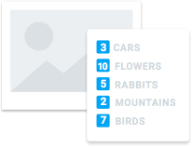
Google Cloud Vision API
https://cloud.google.com/vision/
Image analysis tools
Derive insight from images based on content
Exploits machine learning models
Classification of images
From flowers, animals, or transportation to thousands of categories
e.g., "sailboat", "lion", "Eiffel Tower"
Improves over time as new concepts are introduced and accuracy is improved
Detection of faces
Sentiment analysis
Text recognition within images
Offensive content filtering
Product logo detection
Available via REST API
Works either on images in Google storage or uploaded in the request

Slide 18
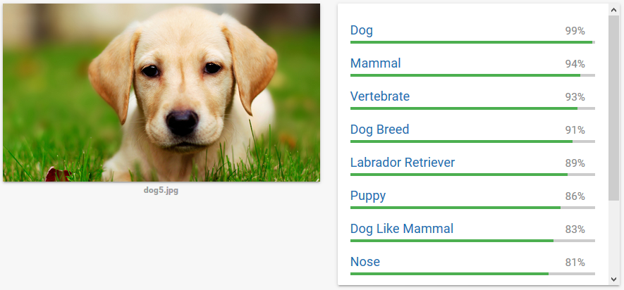
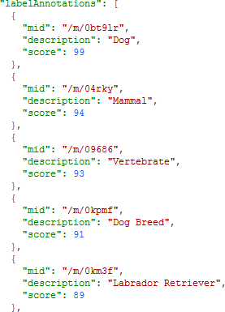
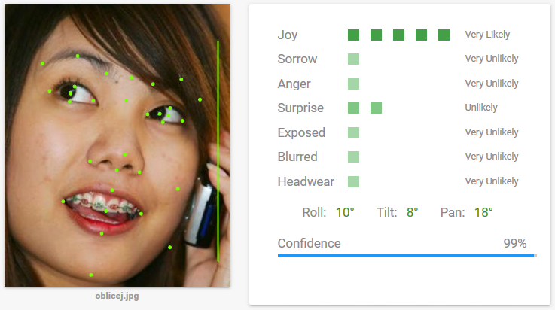
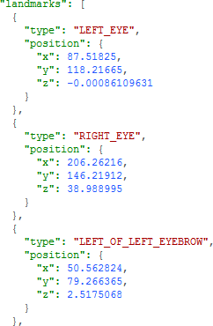
Vision REST API Example
https://cloud.google.com/vision/
Notes:
Google Knowledge Graph (https://developers.google.com/knowledge-graph/)

Slide 19
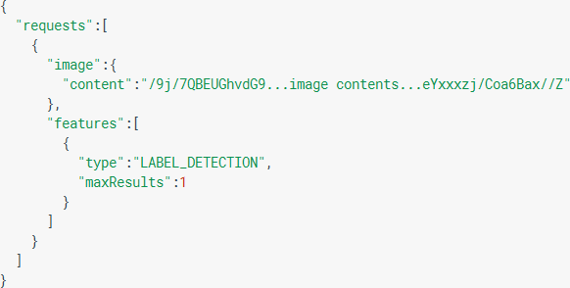
Vision REST API
https://cloud.google.com/vision/
One request method
Request specifies the image and the features to extract as JSON
Types of features to extract
LABEL_DETECTION, TEXT_DETECTION, FACE_DETECTION, IMAGE_PROPERTIES, LANDMARK_DETECTION, LOGO_DETECTION, SAFE_SEARCH_DETECTION
POST https://vision.googleapis.com/v1/images:annotate

Slide 20
Pricing
Feature | 1 - 1000 units/month | 1001- 1,000,000 units/month | 1,000,001 to 5,000,000 units/month | 5,000,001 - 20,000,000 units/month
Label Detection | Free | $5.00 | $4.00 | $2.00
OCR | Free | $2.50 | $1.50 | $0.60
Explicit Content Detection | Free | $2.50 | $1.50 | $0.60
Facial Detection | Free | $2.50 | $1.50 | $0.60
Landmark Detection | Free | $2.50 | $1.50 | $0.60
Logo Detection | Free | $2.50 | $1.50 | $0.60
Image Properties | Free | $2.50 | $1.50 | $0.60

Slide 21
Vision API – Under the Hood?
Only vague phrases mentioned by Google
Uses deep neural network
Classification into several thousands of labels
Specifics are not disclosed
Our guess
Probably some improved deep convolutional “Inception” model
Currently v3 (https://github.com/tensorflow/models/tree/master/inception)
Based on ImageNet training data
TensorFlow implementation (https://www.tensorflow.org)
We have seen quite specific detection of animals and cars
Not so good detection of person-related labels
But face-detection seems to work well, so it can be potentially combined
Google does not include the results of face detection and sentiment in labels?
Presents labels only if their scores are greater than 50%

Slide 22
Comparison
Part III

Slide 23
Data & Evaluation Metrics
Queries
166 images from Promedia: 86 photos selected manually, 80 chosen randomly
The query images were removed from the Profiset collection
so there is no overlap between the test queries and the annotated image collection used as knowledge base for the MUFIN Image Annotation processing
Ground Truth
Manual GT – created by manual evaluation of keywords provided by MUFIN and Google
Two types: GT-R contains all keywords assessed as “relevant”, GT-HR contains only “highly relevant”
Profiset GT – the original image descriptions
Quality measures
Precision: can be computed w.r.t. all types of GT
Recall w.r.t. Profiset GT
The manual GT is not complete

Slide 24
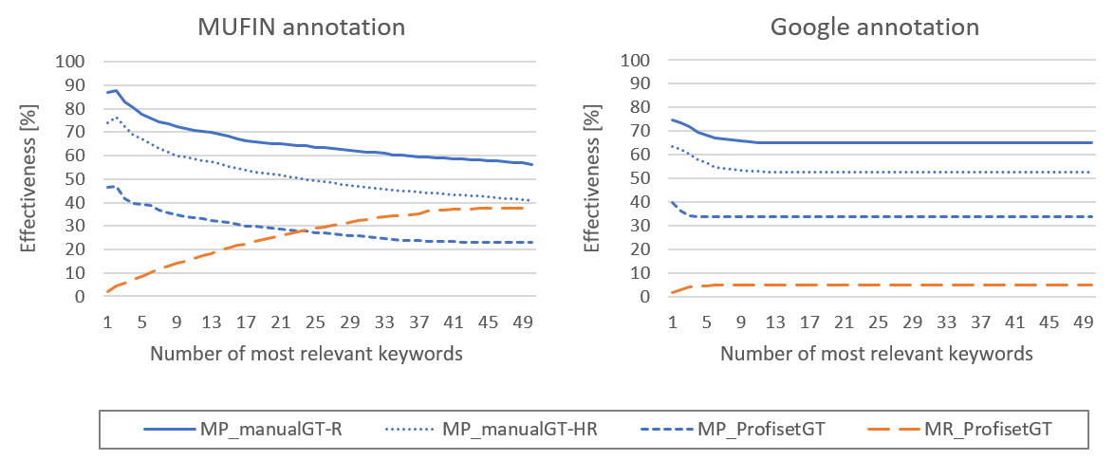
Results
On the first positions, MUFIN about 8 % better!
For the same precision, MUFIN gives significantly better recall

Slide 25
Results (cont.)
Failed annotations:
Google returned no keywords for 11 images out of 166
MUFIN failed to return anything relevant among the top 5 keywords only for 3 images
Average result size:
MUFIN: 50 keywords
Google: 5.7 keywords (maximum 16)
Average overlap:
1.9 keywords appear in both results
out of these, 1.75 keywords is relevant

Slide 26
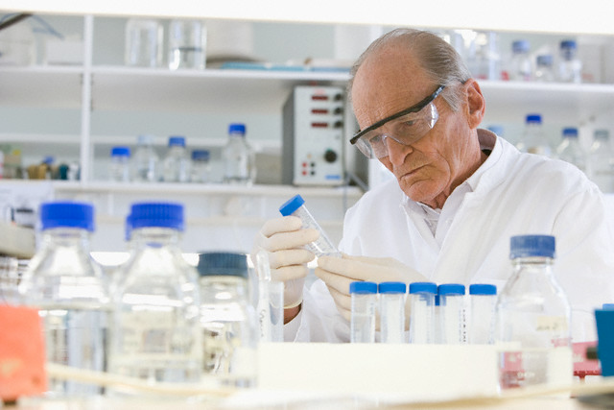
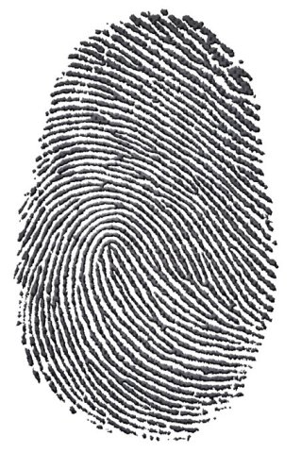
Where MUFIN wins
Google keywords product MUFIN keywords person, adult, animals, activity, scientist, woman, knowledge, people, health, research, work, wellbeing, science, indoors, one, laboratory, head, mid, years, man, clothing, female, medical, doctor, coat, care, prosperity, hospital, men, worker, male, think, equipment, personnel, technician, researcher, working, young, professionals, color, occupations, technology, bioscience, organization, two, photography, healthcare, holding, african
Google results t_shirt MUFIN results person, school, juvenile, blackboard, adult, classroom, mathematics, knowledge, science, student, subject, woman, female, objects, room, communication, child, one, activity, education, people, young, years, educator, teenager, teacher, indoors, professionals, youth, males, girl, hair, boy, teen, learning, mid, length, arithmetic, writing, building, head, color, man, teaching, part, board, ethnicity, high, schools, location
Google results line MUFIN results fingerprint, finger, print, individual, group, identification, hand, crime, evidence, thumbprint, identity, ideas, white, finding, concept, black, information, digit, change, smudge, discovery, biometrics, thumb, unique, id, security, recognition, closeup, representation, people, vector, close, criminal, privacy, police, science, safety, photo, tech, background, touch, heritage, theft, curves, verify, investigation, offender, ink, state, symbol

Slide 27
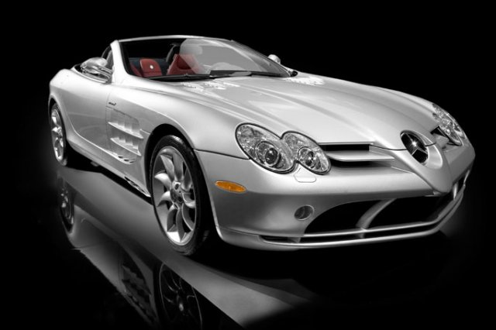
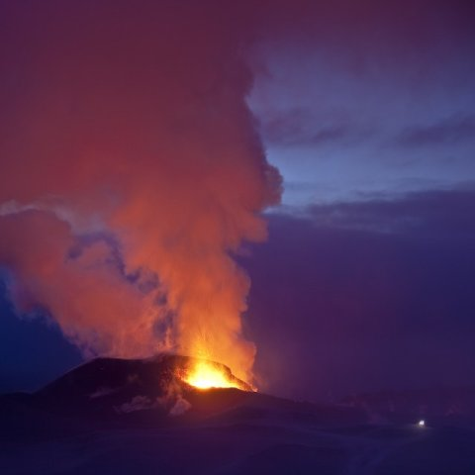
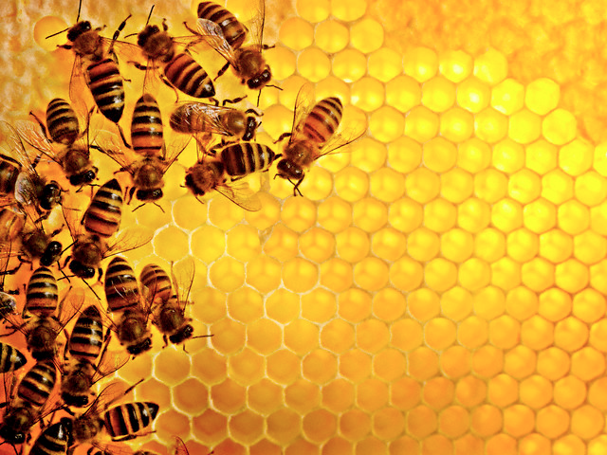
Where Google wins
Google keywords bumper, automotive_design, automotive_exterior, vehicle, car, wheel, land_vehicle, sports_car, mercedes_benz, supercar, automobile_make, mercedes_benz_slr_mclaren, model_car MUFIN keywords car, show, vehicle, travel, transport, sports, motor, automobile, speed, person, luxury, coupe, new, museum, road, indoors, concept, color, view, manufacturers, front, three, automotive, horizontal, expensive, nobody, convertible, business, photography, roadster, industry, european, study, transportation, fast, photo, silver, modern, salon, make, street, white, showpiece, cars, black, republic, city, studio, district, state
Google results volcanic_landform, lava, phenomenon, geological_phenomenon, landform MUFIN results sky, evening, water, ocean, change, island, set, cloud, sunrise, formations, dusk, clouds, light, sunset, morning, mountain, group, sundown, national, lava, nature, outdoors, daylight, volcanoes, color, sea, travel, weather, big, natural, geyser, scenery, sun, red, park, night, horizontal, scenic, coast, gap, vacation, region, rock, people, environment, eruption, power, shore, landscape, countries
Google results insect, pollen, pattern, membrane_winged_insect, honey_bee, flower MUFIN results tree, autumn, plant, season, travel, change, yellow, fall, leaves, flower, color, aspen, animal, quality, nature, poplar, sunflower, insect, discolored, person, arthropod, water, nobody, colors, horizontal, close, background, flora, invertebrate, summer, forest, image, detail, colour, creek, group, natural, outdoors, river, bee, mountains, grunge, deciduous, national, sierra, new, beautiful, supply, locations, treetop

Slide 28
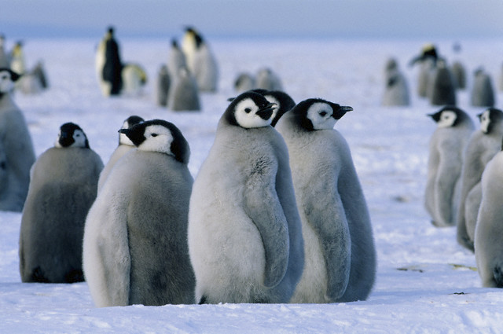
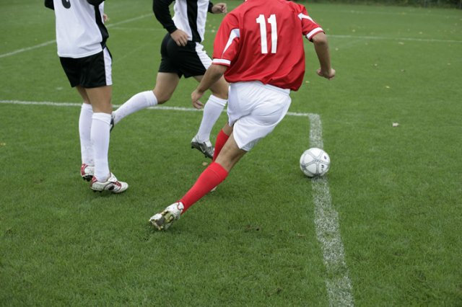
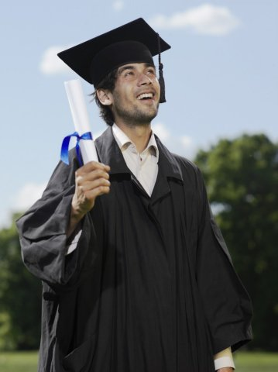
Where both MUFIN and Google are successful
Google results penguin, flightless_bird, vertebrate, bird, MUFIN results penguin, animal, group, bird, seabird, aptenodytes, wildlife, chicks, snow, continent, baby, emperor, children, hill, offspring, young, island, outdoors, sea, ice, water, nobody, birds, daytime, cold, weather, nature, color, flightless, wild, laughingstock, colony, adult, day, glacier, fauna, outdoor, body, polar, travel, photography, marine, antarctic, horizontal, region, natural, peninsula, cute, outside, regions,
Google results goal, soccer_kick, soccer_player, player, football_player, sports, soccer, kick, MUFIN results person, activity, football, recreation, sport, soccer, golf, adult, young, years, woman, game, men, ball, man, features, player, people, length, group, male, outdoors, color, athlete, view, playing, two, play, green, grass, child, equipment, one, team, compete, action, lifestyle, examining, juvenile, competition, female, rugby, baseball, ballgame, full, attitude, locations, lawn, outside, field,
Google results graduation, academic_dress, mortarboard, MUFIN results person, graduation, group, completion, student, body, clothing, adult, college, communication, woman, diploma, gown, young, juvenile, people, school, university, get, dress, cap, certificate, achievement, activity, graduate, education, headgear, years, document, female, smiling, man, teenager, male, glasses, portrait, eye, youth, asian, length, kids, happy, communicate, academic, ethnicity, holding, mid, men, caucasian, studio,

Slide 29
Efficiency
MUFIN: approximately 700 ms needed for single image annotation
54 ms for DeCAF descriptor extraction (GPU implementation)
390 ms for content-based search in 20M images (PPP-codes + PCA)
40 ms for semantic network construction
200 ms for ConceptRank computation (approximate RWR)
Google: approximately 200 ms needed for single image annotation
Including uploading the image and the REST service overhead
Network overhead (RTT) about 8ms

Slide 30
Conclusions
Part IV

Slide 31
Conclusions
MUFIN Image Annotation works!
In our experiments, even better than Google
Very good results also in the ImageCLEF competition
MUFIN Image Annotation is effective, efficient, and scalable
The MUFIN and Google solutions are in several aspects complementary
different basic approach (search-based vs. model-based)
provides different types of annotations
what is problematic to MUFIN is often easy for Google and vice versa
Promising direction for future: combining the two approaches
Ideally in a generalized ConceptRank model

