Slide 1
Business Process Modelling and Notation
DUM 09

Slide 2
What is BPMN?
Business Process Modelling and Notation (BPMN) is a standard developed by Business Process Management Initiative (BMNI) in 2004
The primary aim of BMPN is to provide a notation that would be easy to understand for all company users (analysts, developers, managers etc.)
BPMN provides a standardized bridge connecting the gap between process analysis and subsequent implementation
BPMN defines Busines Process Diagram (BPD)

Slide 3
Basics of BPMN
BPD is a set of graphic elements
These elements were chosen in order to be easily discernible from one another and used shapes are widely known
Aim of BPMN is to create a simple mechanism for designing business process model capable of capturing desired complexity

Slide 4
Basics of BPMN
BPMN consists of 4 basic categories of elements:
Flow objects
Connecting objects
Swimlanes
Artifacts

Slide 5
Flow objects
BPD has a small set of key elements that are Flow objects (3)
Therefore user does not need to learn how to distinguish between large number of different element shapes
Flow objects are:
Event
Activity
Gateway

Slide 6
Event
An event is represented by circle. It is something that “happened” during the business process
Events influence the flow of the process and usually have trigger and/or effect
Events are recorded as circles that can have internal notes
With regard to the process, we distinguish 3 types of events:

Slide 7
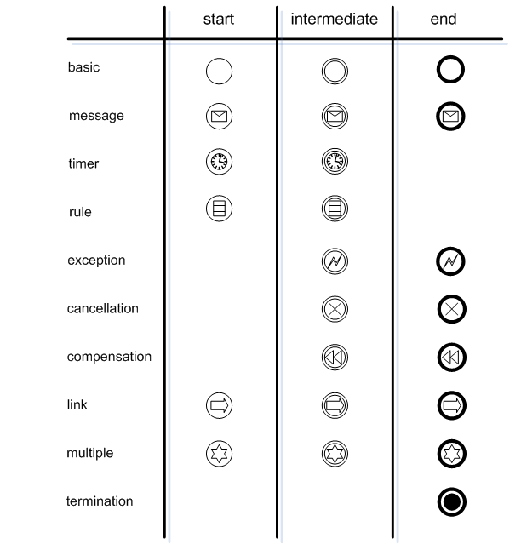
Types of events

Slide 8
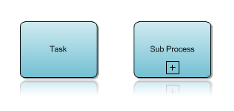
Activity
Activity is represented by a rectangle with round corners
It is a general graphic element representing some work
Activity can be atomic or non-atomic (compound)
Activity types are: Task and Sub-Process
A Sub-process is noted with a small + sign

Slide 9
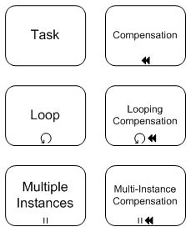
Types of activities

Slide 10
Gateway
Gateway is represented by a diamond shape. It is used for splitting and joining of process flow
Internal notation indicates behavior of gateway

Slide 11
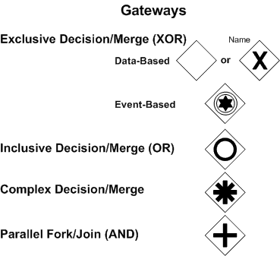
Types of gateways

Slide 12
Connecting objects
In a BPD, flow objects are mutually connected in order to create basic structure (backbone) of a business process
There are 3 types of connecting objects:
Sequence Flow
Message Flow
Association

Slide 13
Sequence Flow
A sequence flow is represented by an arrow and its orientation defines the order of activities being performed
In BPMN, the concept “Control flow” is not used (in contrast to UML)

Slide 14
Message Flow
A message flow is represented by dashed line with hollow arrow
It is used for displaying a message flow between different participants (process roles) which send and receive messages

Slide 15
Association
Association is represented by dotted line.
It is used for connecting an object with some additional information (data, text or other artifact)
Associations are used for displaying inputs and outputs of activities

Slide 16
Connecting objects

Slide 17
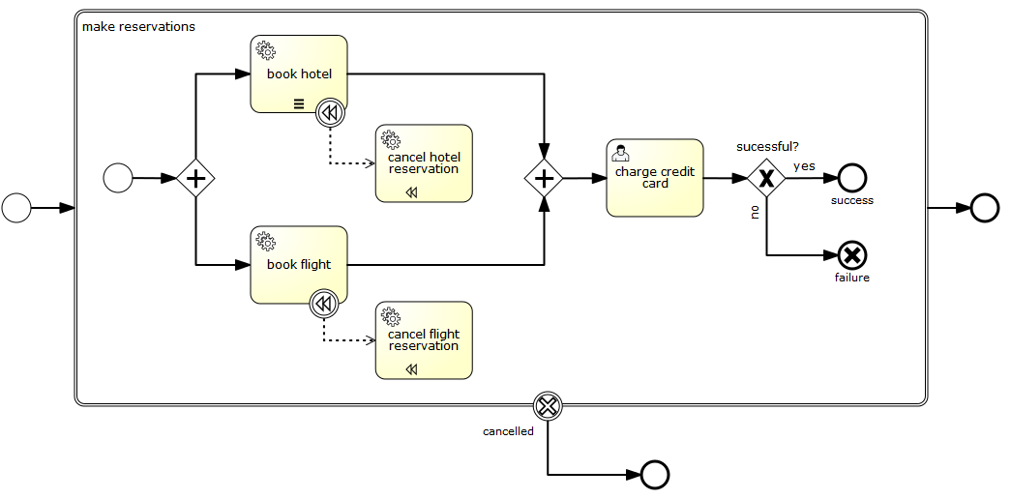
Simple business process example

Slide 18
Swimlanes
Many process oriented models and methods use the concept of swimlanes for displaying different functional competences or responsibilities
Two types of BPD swimlanes are:
Pool
Lane

Slide 19
Pool
Pool represents the participants within the process
It also behaves as graphic container for differentiating sets of activities from other pools (processes), usually with relation to Business to Business (B2B) situation

Slide 20
Lane
Lane is a sublevel of pool
It takes place across the whole pool, either horizontally or vertically
Lanes are used for organization and categorization of activities

Slide 21
Artifacts
BPMN was designed to allow certain flexibility in extending the original notation and offer possibilities of adding further context for modelling specific situations
There can be any number of artifacts in BPD but only if it is suitable for given business process context
BPMN standard predefined these artifacts:
Data Object
Group
Annotation

Slide 22
Data Object
Data objects represent a mechanism for expressing that certain data are required or produced by certain activity
They are connected to activities by association link

Slide 23
Group
A group is represented by dashed rectangle
Groups can be used during documentation or for object analysis but it has no effect on process flow

Slide 24
Annotation
An annotation is a way how user can provide additional information for future reader of the process diagram

Slide 25
General use of BPMN
Modelling of busines processes is used during communication of various users with significantly different information
BPMN is designed to cover many ways of modelling and allow to create not only basic process part but also complex processes within a company at various levels of decomposition
There are two basic types of business processes that are distinguished in BPD:
Cooperating (Public) B2B Processes
Internal (Private) Business Processes

Slide 26
Cooperating (Public) B2B Processes
Cooperating B2B processes show interaction between two or more business entities
These diagrams display general point of view - the process is not described from PoV of any participant. It describes interaction between participants.
Interactions are expressed as seqences of activities and exchange of messages between participants
Activities used for cooperation between participants are considered as “contact points.” This way the process defines the interaction visible for any participant

Slide 27
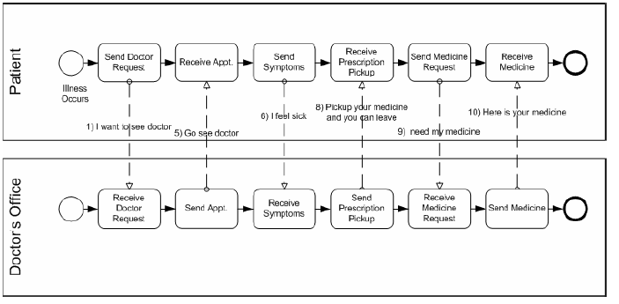
Example of B2B process

Slide 28
Internal business processes
Models of internal business processes are focused on process just from the company point of view - these processes are not usually visible for public
If swimlanes are used, internal process is shown as a single pool. Sequence flows within process cannot cross the border of pool. Any interaction outside pool (with third party) is recorded by message flow

Slide 29
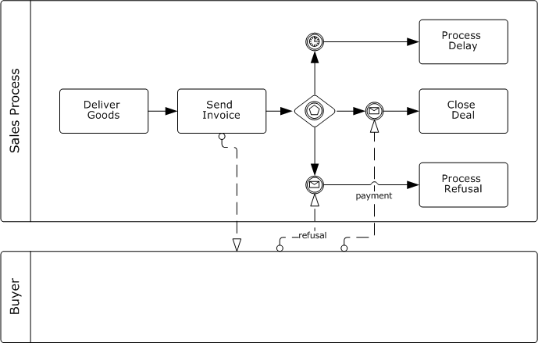
Internal business process example

Slide 30
Various levels of decomposition
Modelling of business processes usually starts with recording activities at the top level. These are subsequently modelled with finer and finer level of detail in further diagrams
Based on a method used, there can be more levels of diagram. However BPMN is independent from any specific process method.

