Slide 1
PA193 Secure coding principles and practices
Overview of the subject
Petr Švenda, Petr Ročkai, Marek Sýs, Kamil Dudka, Mirek Jaroš, Martin Ukrop

Slide 2
PA193 Secure coding principles and practices
Secure coding
How to write code in a more secure way
So that the program is harder to be attacked/exploited
Selected basic building blocks of security applications
2/2/2
Lecture: 2 hours weekly
Seminar: 2 hours weekly (2 seminar groups)
Homework: about 6-8 hours/each (6+1 bonus)
Project: about 30-40 hours/person

Slide 3
People
Main contact: Petr Švenda (CRoCS@FI MU)
Office hours: Monday 13:00-13:50, A406
svenda@fi.muni.cz, @rngsec
https://crocs.fi.muni.cz/people/svenda
Petr Ročkai (FI MU)
Office hours: Tuesday 12:00-12:50, A406
xrockai@fi.muni.cz
Other lectures and seminars
Marek Sýs (FI), Kamil Dudka (RedHat), Mirek Jaroš (RedHat), Martin Ukrop (FI)

Slide 4
Aims of the subject
To learn how to program in a way that the resulting application is more secure
Decrease number of security related bugs
Increase difficulty of exploitation
To understand security consequences of decisions made by programmer
Most issues are independent on particular programming language
examples will be mostly based on C/C++ and Java

Slide 5
Previous knowledge requirements
Basic knowledge of (applied) cryptography and IT security
symmetric vs. asymmetric cryptography, PKI
block vs. stream ciphers and usage modes
hash functions
random vs. pseudorandom numbers
basic cryptographic algorithms (AES, DES, RSA, EC, DH)
risk analysis
Basic knowledge in formal languages and compilers
User-level experience with Windows and Linux OS
Practical experience with C/C++/Java language

Slide 6
Organization
Lectures + seminars + assignments + project + exam
Assignments
6 homework assignments (+ 1 bonus)
Individual work of each student
Lab A403 available to students (except teaching hours)
Project
Team work (2-3 members)
Details at seminars, parser for a cryptocurrency blockchain
Exam
Written exam, open questions, pencil-only

Slide 7
Grading
Credits
2+2+2 credits, plus 2 for the final exams
Points [Notice minimal number of points required!]
Homework (30) – [minimum 15 required]
Project (20) – [minimum 10 required]
Written exam (50) – [no minimum limit]
Occasional bonuses ☺
Grading
A ≥ 90% of maximum number of points
B ≥ 80% of maximum number of points
C ≥ 70% of maximum number of points
D ≥ 60% of maximum number of points
E ≥ 50% of maximum number of points
F < 50% of maximum number of points
100 (max)
90
80
70
60
50

Slide 8
Attendance
Lectures
Attendance not obligatory, but highly recommended
Seminars
Attendance obligatory
Absences must be excused at the department of study affairs
2 absences are OK (even without excuse)
Assignments and projects
Done during students free time (e.g. at the dormitory)
Access to network lab and CRoCS lab is possible

Slide 9
Discussion forum in Information System
Discussion forum in Information System (IS)
https://is.muni.cz/auth/cd/1433/podzim2017/PA193/
Mainly for discussion among the students
Not observed by stuff all the time!
Write us email if necessarry
What to ask?
OK to ask about ambiguities in assignment
NOT OK to ask for the solution
NOT OK to post your own code and ask what is wrong

Slide 10
Plagiarism
Homeworks
Must be worked out independently by each student
Projects
Must be worked out by a team of 3 students
Every team member must show his/her contribution
Plagiarism, cut&paste, etc. is not tolerated
Plagiarism is use of somebody else words/programs or ideas without proper citation
Automatic tools used to recognize plagiarism
If plagiarism is detected student is assigned -7 points
More serious cases handled by the Disciplinary committee

Slide 11
Reuse of existing code
Code reuse is generally great thing, but..
NOT in homework or assignments!
It is NOTOK:
Take any code from web when you should create code completely on your own (project - parser)
Share code of your solution with others (homework)

Slide 12
Example of Plagiarism

Slide 13
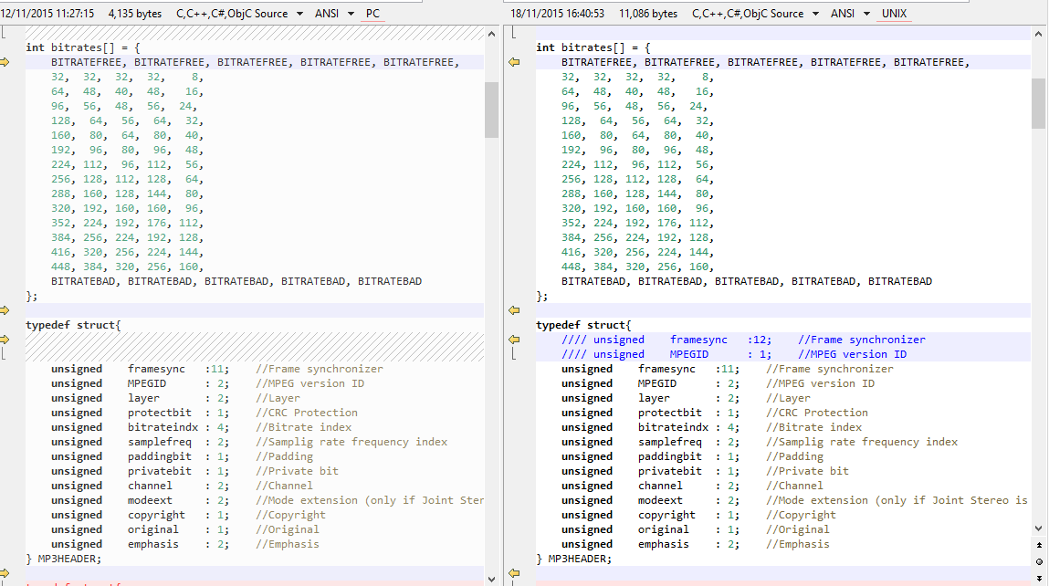
Example of Plagiarism

Slide 14
Course resources
Lectures (PDF) available in IS
IS = Information System of the Masaryk University
https://is.muni.cz/auth/el/1433/podzim2017/PA193/
Homeworks/assignments available in IS
Submissions also done via IS (Homework vaults)
Additional tutorials/papers/materials from time to time will also be provided in IS
To better understand the issues discussed
Recommended literatures
To learn more …

Slide 15
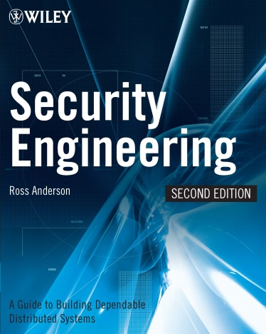
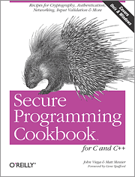
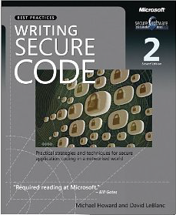
Recommended literature
Ross Anderson - Security engineering, Wiley
Michael Howard, Steve Lipner - Secure Development Lifecycle, MS Press
John Viega, Matt Messier - Secure programming cookbook, O'Reilly
Michael Howard - Writing secure code, MS Press

Slide 16
Questions

