Slide 1

(Pseudo)Random Data
PA193 – Secure coding
Petr Švenda
Zdeněk Říha
Faculty of Informatics, Masaryk University, Brno, CZ

Slide 2
Need for “random” data
Games
Simulations, …
Crypto
  Symmetric keys
  Asymmetric keys
  Padding/salt
  Initialization vectors
  Challenges (for challenge – response protocols)
  …

Slide 3
“Random” data
Sometimes (games, simulations) we only need data with some statistical properties
  Evenly distributed numbers (from an interval)
  Long and complete cycle
    Large number of different values
    All values can be generated
In crypto we also need unpredictability
  Even if you have seen all the “random” data generated until now you have no idea what will be the random data generated next

Slide 4
“Random” data generators
Insecure random number generators
  noncryptographic pseudo-random number generators
  Often leak information about their internal state with each output
Cryptographic pseudo-random number generators (PRNGs)
  Based on seed deterministically generate pseudorandom data
“True” random data generators
  Entropy harvesters
  gather entropy from other sources and present it directly

Slide 5
What (pseudo)random data to use?
Avoid using noncryptographic random number generators
For many purposes the right way is to get the seed from the true random number generator and then use it in the pseudorandom number generator (PRNG)
  PRNG are deterministic, with the same seed they produce the same pseudorandom sequence
There are situations, where PRNG are not enough
  E.g. one time pad
Notes:
Decreases key space

Slide 6
Noncryptographic generators
Standard rand()/srand(), random ()/srandom() functions
  libc
“Mersenne Twister”
linear feedback shift registers
Anything else not labeled as cryptographic PRNG…
Not to be used for most purposes….

Slide 7

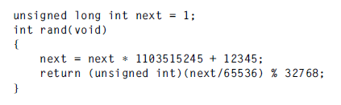
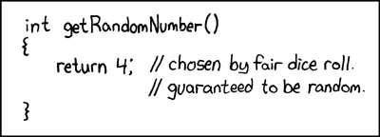
Noncryptographic generators
Source: Writing secure code, 2nd edition
Source: http://xkcd.com/
Notes:
Linear congruential

Slide 8
PRNG
Cryptographic pseudo-random number generators are still predictable if you somehow know their internal state.
Assuming the generator was seeded with sufficient entropy and assuming the cryptographic algorithms have the security properties they are expected to have, cryptographic generators do not quickly reveal significant amounts of their internal state.
Protect the seed of the PRNG!
Entropy of the seed matters!

Slide 9
Entropy of the seed
How much entropy do we need to seed a cryptographic generator securely?
Give as much entropy as the random number generator can accept. The entropy you get sets the maximum security level of your data protected with that entropy, directly or indirectly.
E.g. If a 256-bit AES key is obtained with a PRNG seeded with 56 bits of entropy, then any data encrypted with the 256-bit AES key will be no more secure than encrypted with a 56-bit DES key.
Source: Secure programming Cookbook

Slide 10

Entropy estimates
Entropy
  Definition Shannon
  Definition Min-entropy
Difficulty of measurement/estimates
  For example, the digits of π appear to be a completely random sequence that should pass any statistical test for randomness. Yet they are also completely predictable.

Slide 11
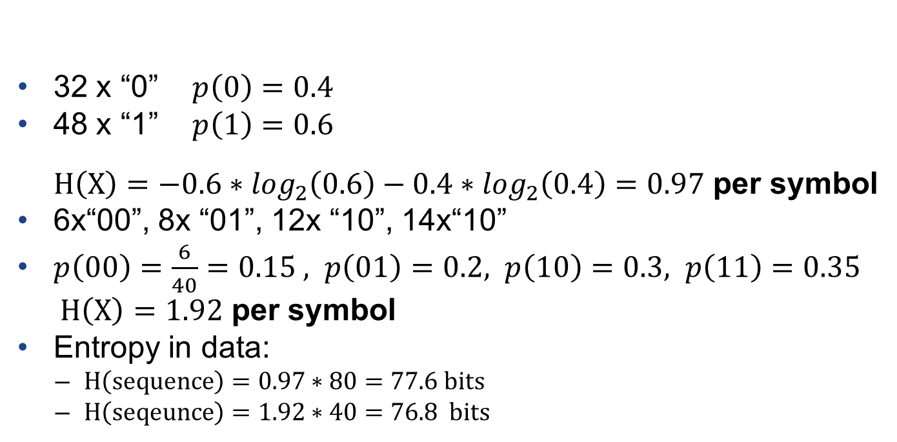
Entropy estimates
sequence=11001011111010010011001110100111111000101011110100101001001111100101100111011111 (80 bits)
32 x “0” $p\left(\text{0}\right)=0.4$
48 x “1” $p\left(1\right)=0.6$
$H\left(X\right)=−0.6∗\log_{2}\left(0.6\right)−0.4∗\log_{2}\left(0.4\right)=0.97$ per symbol
6x“00”, 8x “01”, 12x “10”, 14x“10”
$p\left(0\text{0}\right)=\frac{6}{40}=0.15 , p\left(01\right)=0.2, p\left(1\text{0}\right)=0.3, p\left(11\right)=0.35$
$H\left(X\right)=1.92$ per symbol
Entropy in data:
  $H\left(sequence\right)=0.97∗80=77.6$ bits
  $H\left(seqeunce\right)=1.92∗40=76.$8 bits

Slide 12
Entropy estimates
After figuring out how much entropy is in a piece of data (e.g. expected entropy is 160 bits), it is wise to divide the estimate by a factor of 4 to 8 to be conservative.
Because entropy is easy to overestimate, you should generally cryptographically postprocess any entropy collected (a process known as whitening) before using it.
  E.g. use hash functions (SHA2)
As most PRNG take a fixed-size seed, and you want to maximize the entropy in that seed. However, when collecting entropy, it is usually distributed sparsely through a large amount of data.
  E.g. use hash functions (SHA2)

Slide 13
Tips on collecting entropy
Make sure that any data coming from an entropy-producing source is postprocessed with cryptography to remove any lingering statistical bias and to help ensure that your data has at least as many bits of entropy input as bits you want to output.
Make sure you use enough entropy to seed any pseudo-random number generator securely. Try not to use less than 128 bits.
When choosing a pseudo-random number generator, make sure to pick one that explicitly advertises that it is cryptographically strong. If you do not see the word “cryptographic” anywhere in association with the algorithm, it is probably not good for security purposes, only for statistical purposes.
When selecting a PRNG, prefer solutions with a refereed proof of security bounds. Counter mode, in particular, comes with such a proof, saying that if you use a block cipher bit with 128-bit keys and 128-bit blocks seeded with 128 bits of pure entropy, and if the cipher is a pseudo-random permutation, the generator should lose a bit of entropy after 264 blocks of output.
Use postprocessed entropy for seeding pseudo-random number generators or, if available, for picking highly important cryptographic keys. For everything else, use pseudo-randomness, as it is much, much faster.
Source: Secure programming Cookbook

Slide 14
Unix Infrastructure
Special files – reading files provides (pseudo)random data
  /dev/random
    Always produces entropy
    Provides random data
    Can block the caller until entropy available (blocking)
  /dev/urandom
    Based on cryptographic pseudorandom generator
    Amount of entropy not quaranteed
    Always returns quickly (non-blocking)

Slide 15
Unix Infrastructure
Available on most modern Unix-like OS
  Including Linux, *BSD, etc.
Each OS implements the functionality independently
  Quality of the implementation can vary from OS to OS
Usually no need to worry
The core of the system is the seed of PRNG
  The entropy of the seed may be low during/just after booting (in particular at diskless stations, virtual HW etc.)
  The seed is often saved at shutdown

Slide 16
Unix infrastructure
Operation on files
  To get entropy use open the file and read it
    use read(2)
    it returns number of bytes read
    short read (even 0 if interrupted by a signal)
It is also possible to write to /dev/random.
  This allows any user to mix random data into the pool.
  Non-random data is harmless, because only a privileged user can issue the ioctl needed to increase the entropy estimate.
Linux
  The current amount of entropy and the size of the Linux kernel entropy pool are available in /proc/sys/kernel/random/.

Slide 17
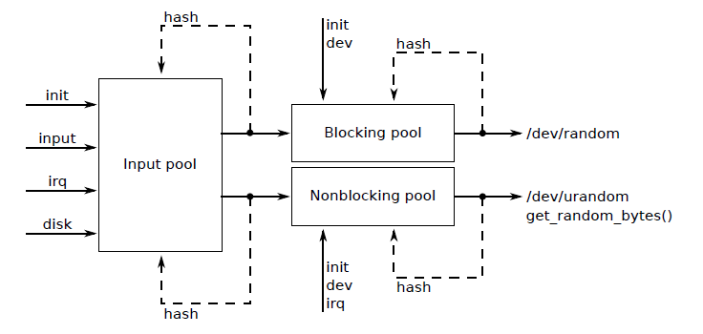
Example: Linux

Slide 18
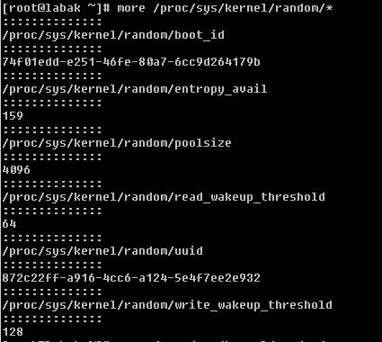
Example: Linux

Slide 19
Example: FreeBSD
FreeBSD implements a 256-bit variant of the Yarrow algorithm, intended to provide a cryptographically secure pseudorandom stream—this replaced a previous Linux style random device. Unlike the Linux /dev/random, the FreeBSD /dev/random device never blocks. Its behavior is similar to the Linux /dev/urandom, and /dev/urandom on FreeBSD is linked to /dev/random.
Yarrow is based on the assumptions that modern PRNGs are very secure if their internal state is unknown to an attacker, and that they are better understood than the estimation of entropy. Whilst entropy pool based methods are completely secure if implemented correctly, if they overestimate their entropy they may become less secure than well-seeded PRNGs. In some cases an attacker may have a considerable amount of control over the entropy, for example a diskless server may get almost all of it from the network—rendering it potentially vulnerable to man-in-the-middle attacks. Yarrow places a lot of emphasis on avoiding any pool compromise and on recovering from it as quickly as possible. It is regularly reseeded; on a system with small amount of network and disk activity, this is done after a fraction of a second.
Source: Wikipedia

Slide 20
MS Windows – (pseudo)random data
Function CryptGenRandom()
  Part of MS CryptoAPI
    First use CryptAcquireContext( )
    and then CryptGenRandom()
  Based on PRNG
Internally CryptGenRandom() is using RtlGenRandom()
  Direct call of RtlGenRandom() possible
  Does not require loading Crypto API

Slide 21
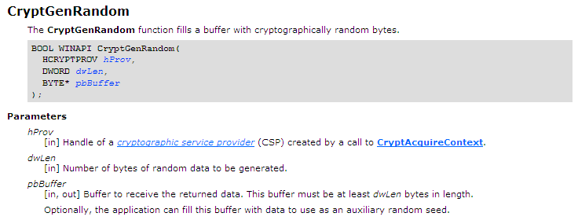
MSDN: CryptGenRandom()
Source: MSDN

Slide 22
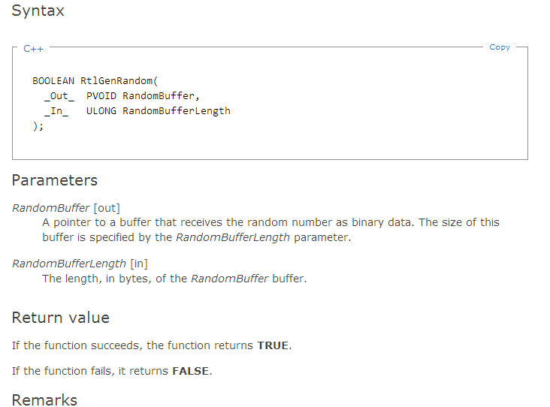
MSDN: RtlGenRandom()
Source: MSDN

Slide 23
CryptGenRandom() vs. RtlGenRandom()
"Historically, we always told developers not to use functions such as rand to generate keys, nonces and passwords, rather they should use functions like CryptGenRandom, which creates cryptographically secure random numbers. The problem with CryptGenRandom is you need to pull in CryptoAPI (CryptAcquireContext and such) which is fine if you're using other crypto functions.
On a default Windows XP and later install, CryptGenRandom calls into a function named ADVAPI32!RtlGenRandom, which does not require you load all the CryptAPI stuff. In fact, the new Whidbey CRT function, rand_s calls RtlGenRandom".
Source:http://blogs.msdn.com/b/michael_howard/archive/2005/01/14/353379.aspx

Slide 24
CryptGenRandom() documentation
With Microsoft CSPs, CryptGenRandom() uses the same random number generator used by other security components. This allows numerous processes to contribute to a system-wide seed. CryptoAPI stores an intermediate random seed with every user. To form the seed for the random number generator, a calling application supplies bits it might have—for instance, mouse or keyboard timing input—that are then combined with both the stored seed and various system data and user data such as the process ID and thread ID, the system clock, the system time, the system counter, memory status, free disk clusters, the hashed user environment block. This result is used to seed the pseudorandom number generator (PRNG). In Windows Vista with Service Pack 1 (SP1) and later, an implementation of the AES counter-mode based PRNG specified in NIST Special Publication 800-90 is used. In Windows Vista, Windows Storage Server 2003, and Windows XP, the PRNG specified in Federal Information Processing Standard (FIPS) 186-2 is used. If an application has access to a good random source, it can fill the pbBuffer buffer with some random data before calling CryptGenRandom(). The CSP then uses this data to further randomize its internal seed. It is acceptable to omit the step of initializing the pbBuffer buffer before calling CryptGenRandom().
Source: MSDN

Slide 25
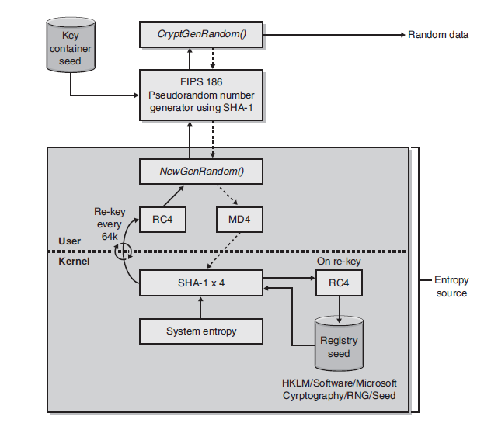
Design of the old Windows PRNG (up to Vista)
Source: Writing secure code, 2nd edition

Slide 26
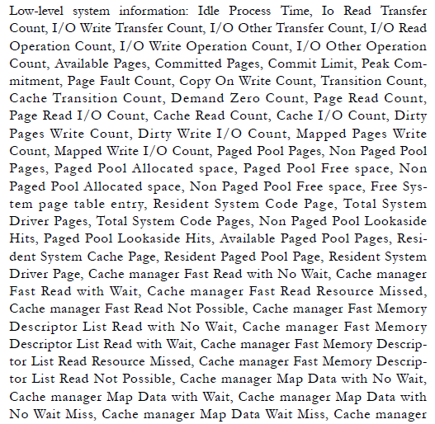
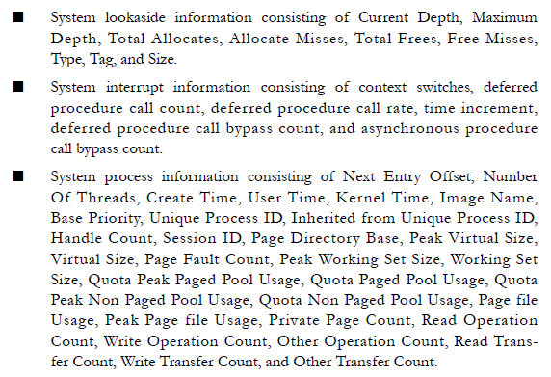
The entropy in Windows comes from …
Source: Writing secure code, 2nd edition

Slide 27
Random data in openSSL
OpenSSL exports its own API for manipulating random numbers. It has its own cryptographic PRNG, which must be securely seeded.
To use the OpenSSL randomness API, you must include openssl/rand.h in your code and link against the OpenSSL crypto library.
void RAND_seed(const void *buf, int num);
void RAND_add(const void *buf, int num, double entropy);
int RAND_load_file(const char *filename, long max_bytes);
  Pure entropy expected
int RAND_write_file(const char *filename);
  To save the state of PRNG
int RAND_bytes(unsigned char *buf, int num);
Notes:
Seed = add for full entropy

Slide 28
HW random number generators
Require specific devices
  More or less common
  Price
LavaRnd (Lava Lamp)
Random.org
Special devices
Crypto devices
  Smartcard
  HSM
  SSL cards

Slide 29
PRNG Standards
FIPS 186-2 (replaced later by -3 and -4)
NIST SP 800-90A
  Recommendation for Random Number Generation Using Deterministic Random Bit Generators
  Hash_DRBG
  HMAC_DRBG
  CTR_DRBG
  Dual EC DRBG (problematic)
Fortuna
ANSI X9.17-1985, Appendix C
ANSI X9.31-1998, Appendix A.2.4
ANSI X9.62-2005, Annex D

Slide 30
(P)RNG Standards
NIST SP 800-90B
  Recommendation for the Entropy Sources Used for Random Bit Generation
NIST SP 800-90C
  Recommendation for Random Bit Generator (RBG) Constructions

Slide 31
ANSI X9.17
ANSI X9.17 standard
  It takes as input a TDEA (with 2 DES keys) key bundle k and (the initial value of) a 64 bit random seed s. Each time a random number is required it:
    Obtains the current date/time D to the maximum resolution possible.
    Computes a temporary value t = TDEA_{k}(D)
    Computes the random value x = TDEA_{k}(s ⊗ t)
    Updates the seed s = TDEA_{k}(x ⊗ t)
  Obviously, the technique is easily generalized to any block cipher
    AES has been suggested…

Slide 32
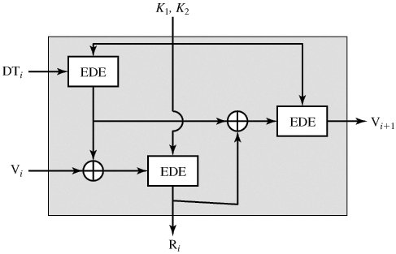
ANSI X9.17

Slide 33
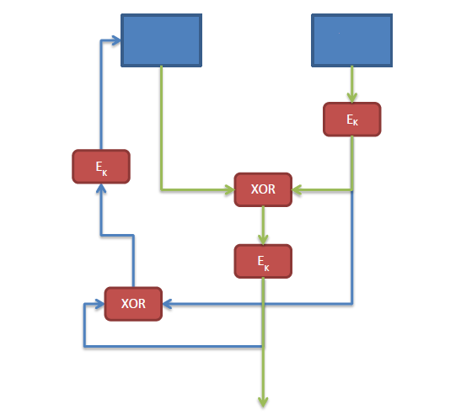
ANSI X9.31
Internal state
Timestamp
Pseudorandom data

Slide 34
ANSI X9.31
Security of X9.31 is not considered sufficient
Bad recovery after internal state compromise
The only entropy added later are the timestamps
The entropy of timestamps is problematic
Too much dependent on the entropy of initial values of
  The seed
  The symmetric encryption keys (3DES or AES)

Slide 35
Fortuna
Designed by Bruce Schneier and Niels Ferguson
Follower of the Yarrow algorithm
Efforts to recover quickly from the internal state compromise
Adding entropy frequently
Fortuna is state of the art

Slide 36
Fortuna
It is composed of :
  Generator: produces pseudo-random data.
    Based on any good block cipher (e.g. AES, Serpent,Twofish). Cipher is running in counter mode, encrypting successive values of an incrementing counter. Key is changed periodically (no more than 1 MB of data + key changed after every data request).
  Entropy accumulator: collects genuinely random data and reseeds the generator.
    The entropy accumulator is designed to be resistant against injection attacks thanks to the use of 32 pools of entropy (at the n^{th} reseeding of the generator, pool k is used only if 2^{k} divides n).
  Seed file: stores state

Slide 37
NIST SP 800-90A
NIST Special Publication 800-90A
  Recommendation for Random Number Generation Using Deterministic Random Bit Generators
Mechanisms based on hash functions
  Hash_DRBG
  HMAC_DRBG
Mechanisms based on block ciphers
  CTR_DRBG
Mechanisms Based on Number Theoretic Problems
  Dual Elliptic Curve Deterministic RBG (Dual_EC_DRBG)

Slide 38
ECC NIST random number generator (Dual_EC_DRBG)
Problematic
Even more problematic after Snowden
The Guardian and The New York Times have reported that the National Security Agency (NSA) inserted a CSPRNG into NIST SP 800-90 that had a backdoor which allows the NSA to readily decrypt material that was encrypted with the aid of Dual_EC_DRBG. Both papers report that, as independent security experts long suspected, the NSA has been introducing weaknesses into CSPRNG standard 800-90; this being confirmed for the first time by one of the top secret documents leaked to the Guardian by Edward Snowden. The NSA worked covertly to get its own version of the NIST draft security standard approved for worldwide use in 2006. The leaked document states that "eventually, NSA became the sole editor.“In spite of the known potential for a backdoor and other known significant deficiencies with Dual_EC_DRBG, several companies such as RSA Security continued using Dual_EC_DRBG until the backdoor was confirmed in 2013.
Source:http://en.wikipedia.org/wiki/Cryptographically_secure_pseudorandom_number_generator#NSA_backdoor_in_the_Dual_EC_DRBG_PRNG
Notes:
backdoor

Slide 39
Testing randomness
Testing whether the generated sequence of bits “looks random”, i.e. has got some statistical properties
  E.g. the number of 0s versus the number of 1s in the sequence of bits.
2 important test suits
  NIST
  Diehard

Slide 40
NIST tests
NIST Special Publication 800-22rev1a
  “A Statistical Test Suite for the Validation of Random Number Generators and Pseudo Random Number Generators for Cryptographic Applications”
  Revised in April 2010
  Textual description of the tests (+ mathematics/statistics behind)
  Software implementation
    STS-2.1.2
Source: NIST Special Publication 800-22rev1a

Slide 41
NIST tests
The 15 tests are:
  The Frequency (Monobit) Test,
  Frequency Test within a Block,
  The Runs Test,
  Tests for the Longest-Run-of-Ones in a Block,
  The Binary Matrix Rank Test,
  The Discrete Fourier Transform (Spectral) Test,
  The Non-overlapping Template Matching Test,
  The Overlapping Template Matching Test,
  Maurer's "Universal Statistical" Test,
  The Linear Complexity Test,
  The Serial Test,
  The Approximate Entropy Test,
  The Cumulative Sums (Cusums) Test,
  The Random Excursions Test, and
  The Random Excursions Variant Test.
Source: NIST Special Publication 800-22rev1a

Slide 42
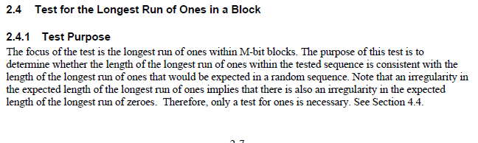
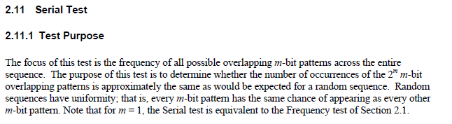
NIST test – examples of tests
Source: NIST Special Publication 800-22rev1a

Slide 43
Diehard tests
Set of statistical tests to verify the quality of random number generators.
Developed by George Marsaglia.
Description of the test and implemetation
Alternative GPL implemetation “Dieharder”
  Contains also implementation of NIST STS tests

Slide 44
Diehard tests
Birthday spacings: Choose random points on a large interval. The spacings between the points should be asymptotically exponentially distributed. The name is based on the birthday paradox.
Overlapping permutations: Analyze sequences of five consecutive random numbers. The 120 possible orderings should occur with statistically equal probability.
Ranks of matrices: Select some number of bits from some number of random numbers to form a matrix over {0,1}, then determine the rank of the matrix. Count the ranks.
Monkey tests: Treat sequences of some number of bits as "words". Count the overlapping words in a stream. The number of "words" that don't appear should follow a known distribution. The name is based on the infinite monkey theorem.
Count the 1s: Count the 1 bits in each of either successive or chosen bytes. Convert the counts to "letters", and count the occurrences of five-letter "words".
Parking lot test: Randomly place unit circles in a 100 x 100 square. If the circle overlaps an existing one, try again. After 12,000 tries, the number of successfully "parked" circles should follow a certain normal distribution.
Minimum distance test: Randomly place 8,000 points in a 10,000 x 10,000 square, then find the minimum distance between the pairs. The square of this distance should be exponentially distributed with a certain mean.
Random spheres test: Randomly choose 4,000 points in a cube of edge 1,000. Center a sphere on each point, whose radius is the minimum distance to another point. The smallest sphere's volume should be exponentially distributed with a certain mean.
The squeeze test: Multiply 231 by random floats on [0,1) until you reach 1. Repeat this 100,000 times. The number of floats needed to reach 1 should follow a certain distribution.
Overlapping sums test: Generate a long sequence of random floats on [0,1). Add sequences of 100 consecutive floats. The sums should be normally distributed with characteristic mean and sigma.
Runs test: Generate a long sequence of random floats on [0,1). Count ascending and descending runs. The counts should follow a certain distribution.
The craps test: Play 200,000 games of craps, counting the wins and the number of throws per game. Each count should follow a certain distribution.

Slide 45
Using Password to derive cryptokeys
Entropy of the password
  Length
  Character set
Do not use the password directly as key
Cryptographically process the password
  E.g. hash it
Derivation should slow (e.g. 1 second)
  To slow down brute force attacks

Slide 46
PKCS#5
PBKDF1 (Password-Based Key Derivation Function 1)
  Up to 160 bits
  Old, replaced by newer function
PBKDF2 (Password-Based Key Derivation Function 2)

Slide 47
PBKDF2
DK = PBKDF2(PRF, Password, Salt, c, dkLen)
  PRF is a pseudorandom function (output of hlen)
  c is the number of iterations
  dkLen is the length of the derived key
DK = T₁ || T₂ || ... || T_{dklen/hlen}
  T_{i} = F(Password, Salt, Iterations, i)
    F(Password, Salt, Iterations, i) = U₁ ^ U₂ ^ ... ^ U_{c}
      U1 = PRF(Password, Salt || INT_32_BE(i))
      U2 = PRF(Password, U1)
      …

Slide 48
Debian random number generator flaw
On May 13th, 2008 the Debian project announced that Luciano Bello found an interesting vulnerability in the OpenSSL package they were distributing. The bug in question was caused by the removal of the following line of code from md_rand.c
MD_Update(&m,buf,j);
[ .. ]
MD_Update(&m,buf,j); /* purify complains */
These lines were removed because they caused the Valgrind and Purify tools to produce warnings about the use of uninitialized data in any code that was linked to OpenSSL. You can see one such report to the OpenSSL team here. Removing this code has the side effect of crippling the seeding process for the OpenSSL PRNG. Instead of mixing in random data for the initial seed, the only "random" value that was used was the current process ID. On the Linux
platform, the default maximum process ID is 32,768, resulting in a very small number of seed values being used for all PRNG operations.
Source: https://www.schneier.com/blog/archives/2008/05/random_number_b.html
Notes:
Process ID 33 000 – no mixing just ID

Slide 49
Debian flaw- impact
This is a Debian-specific vulnerability which does not affect other operating systems which are not based on Debian. However, other systems can be indirectly affected if weak keys are imported into them.
It is strongly recommended that all cryptographic key material which has been generated by OpenSSL versions starting with 0.9.8c-1 on Debian systems is recreated from scratch. Furthermore, all DSA keys ever used on affected Debian systems for signing or authentication purposes should be considered compromised; the Digital Signature Algorithm relies on a secret random value used during signature generation.
The first vulnerable version, 0.9.8c-1, was uploaded to the unstable distribution on 2006-09-17, and has since that date propagated to the testing and current stable (etch) distributions. The old stable distribution (sarge) is not affected.
Affected keys include SSH keys, OpenVPN keys, DNSSEC keys, and key material for use in X.509 certificates and session keys used in SSL/TLS connections. Keys generated with GnuPG or GNUTLS are not affected, though.
Source: http://www.debian.org/security/2008/dsa-1571

Slide 50
Paper: Lousy Random Numbers Cause Insecure Public Keys
In this paper we complement previous studies by concentrating on computational and randomness properties of actual public keys, issues that are usually taken for granted. Compared to the collection of certificates considered in [12], where shared RSA moduli are "not very frequent", we found a much higher fraction of duplicates. More worrisome is that among the 4.7 million distinct 1024-bit RSA moduli that we had originally collected, more than 12500 have a single prime factor in common. That this happens may be crypto-folklore, but it was new to us, and it does not seem to be a disappearing trend: in our current collection of 7.1 million 1024-bit RSA moduli, almost 27000 are vulnerable and 2048-bit RSA moduli are affected as well. When exploited, it could act the expectation of security that the public key infrastructure is intended to achieve.
We checked the computational properties of millions of public keys that we collected on the web. The majority does not seem to suffer from obvious weaknesses and can be expected to provide the expected level of security. We found that on the order of 0.003% of public keys is incorrect, which does not seem to be unacceptable. We were surprised, however, by the extent to which public keys are shared among unrelated parties. For ElGamal and DSA sharing is rare, but for RSA the frequency of sharing may be a cause for concern. What surprised us most is that many thousands of 1024-bit RSA moduli, including thousands that are contained in still valid X.509 certificates, offer no security at all. This may indicate that proper seeding of random number generators is still a problematic issue....
Source: https://www.schneier.com/blog/archives/2012/02/lousy_random_nu.html

Slide 51
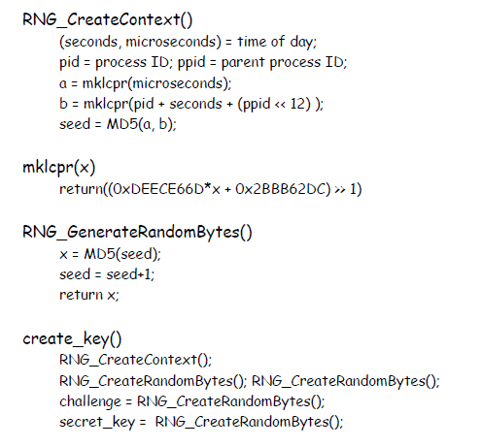
Netscape <2: SSL random number weakness
Source: http://www.hit.bme.hu/~buttyan/courses/Revkomarom/prng.pdf

Slide 52
Netscape <2: SSL random number weakness
Access to the machine with browser
  pid, ppid is known
  time can guessed +- 1 second
  microsecond unknown: 20 bits
No access to machine with browser
  Entropy of the seed increases to max. 47 bits
Contrast with 128 bit session key
Source: http://www.hit.bme.hu/~buttyan/courses/Revkomarom/prng.pdf

Slide 53
Code red worm: IP list generator
On July 12, 2001, a worm began to exploit the aforementioned buffer-overflow vulnerability in Microsoft's IIS webservers. Upon infecting a machine, the worm checks to see if the date (as kept by the system clock) is between the first and the nineteenth of the month. If so, the worm generates a random list of IP addresses and probes each machine on the list in an attempt to infect as many computers as possible. However, this first version of the worm uses a static seed in its random number generator and thus generates identical lists of IP addresses on each infected machine. The first version of the worm spread slowly, because each infected machine began to spread the worm by probing machines that were either infected or impregnable. The worm is programmed to stop infecting other machines on the 20th of every month. In its next attack phase, the worm launches a Denial-of-Service attack against www1.whitehouse.gov from the 20th-28th of each month.
Code-Red version 2 uses a random seed, so each infected computer tries to infect a different list of randomly generated IP addresses. This seemingly minor change had a major impact: more than 359,000 machines were infected with Code-Red version 2 in just fourteen hours.
Source: http://www.caida.org/research/security/code-red/

Slide 54
CVE-2014-9293
When no authentication key is set in the configuration file, ntpd(8) would generate a random key that uses a non-linear additive feedback random number generator seeded with very few bits of entropy. [CVE-2014-9293]
The ntp-keygen(8) utility is also affected by a similar issue. [CVE-2014-9294]

Slide 55
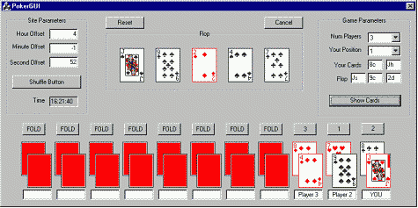
Texas hold’em Poker application
Based random number generation on standard borland random number generator
“Reliable Software Technologies” developed a tool that required five cards from the deck to be known.
Source: http://www.ibm.com/developerworks/library/s-playing/

Slide 56
How not to write ransomware
Ransomware for Linux ... they need a random number for the symmetric key
used to do the encryption. So they call rand() using the system time to
key the RNG.
But the system time gets recorded in the filesystem for the files that
are encrypted...
... so the good guys can get the AES key and give you back your files
Read more at:
http://labs.bitdefender.com/2015/11/linux-ransomware-debut-fails-on-predictable-encryption-key/

Slide 57
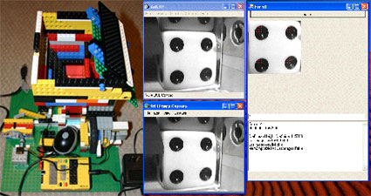
Dice-o-matic ☺

