Slide 1


PA193 - Secure coding principles and practices
Dynamic analysis, fuzzing
Petr Švenda
svenda@fi.muni.cz @rngsec

Slide 2
Overview
Lecture:
  Dynamic analysis of programs for potential bugs
  Memory analysis
  Fuzzing (blackbox testing)
  Tools

Slide 3
Dynamic analysis

Slide 4
What can dynamic analysis provide
Dynamic analysis compile and execute tested program
  real or virtualized processor
Inputs are supplied and outputs are observed
  sufficient number of inputs needs to be supplied
  code coverage should be high
Memory, function calls and executed operations can be monitored and evaluated
  invalid access to memory (buffer overflow)
  memory leak or double free
  calls to potentially sensitive functions
http://www.embedded.com/design/safety-and-security/4419779

Slide 5
Techniques used by dynamic analysis
Debugger (full control over memory read/write, even ops)
Insert data into program input points (integration tests, fuzzing…)
  stdin, network, files…
Insert manipulation proxy between program and library (dll stub, memory)
Trace of program’s external behavior (linux strace)
Change source code (instrumentation, logging…)
Change of application binary
Run in lightweight virtual machine (Valgrind)
Run in full virtual machine
Follow propagation of specified values (Taint analysis)
Mocking (create additional input points into program)
Restrict programs environment (low memory, limited file descriptors, limited rights…)

Slide 6
Dynamic analysis tools
Commercial
  HP/Fortify, IBM Purify, Veracode, Coverity, Klocwork, Parasoft... (together with static analysis)
Free
  GCC gcov tool
  Valgrind – set of dynamic analysis features
  Fuzzers
Most performance analyzers are dynamic analyzers
  MS Visual Studio→Analyze→Start performance analysis
  gcc -Wall -fprofile-arcs -ftest-coverage main.c
List of tools for dynamic analysis
  https://en.wikipedia.org/wiki/Dynamic_program_analysis

Slide 7
Debugging symbols

Slide 8
Release vs. Debug
Optimizations applied (compiler-specific settings)
  gcc –Ox (http://gcc.gnu.org/onlinedocs/gcc/Optimize-Options.html)
    -O0 no optimization (Debug)
    -O1 –g / -Og debug-friendly optimization
    -O3 heavy optimization
  msvc /Ox /Oi (http://msdn.microsoft.com/en-us/library/k1ack8f1.aspx)
    MSVS2010: Project properties→C/C++→optimizations
Availability of debug information (symbols)
  gcc –g
    symbols inside binary
  msvc /Z7, /Zi
    symbols in detached file ($projectname.pdb)

Slide 9
Stripping out debug symbols
Debug symbols are of great help for an “attacker”
  key called NSAKey in ADVAPI.dll? (Crypto 1998)
  http://www.heise.de/tp/artikel/5/5263/1.html
Always strip out debug symbols in released binary
  check compiler flag
  Linux: run file or objdump --syms command (stripped/not stripped)
  Windows: DependencyWalker

Slide 10
Valgrind suite

Slide 11
Valgrind http://www.valgrind.org/
Suite of multiple tools (valgrind --tool=<toolname>)
Memcheck - memory management dynamic analysis
  most commonly used tool (memory leaks)
  replaces standard C memory allocator with its own implementation and check for memory leaks, corruption (additional guards blocks)...
  dangling pointers, unclosed file descriptors, uninitialized variables
  http://www.valgrind.org/docs/manual/mc-manual.html
Massif – heap profiler
  Hellgrind - detection of concurrent issues
  Callgrind – generation of all graphs
  ...

Slide 12
Valgrind – core options
Compile with debug symbols
  gcc –std=c99 –Wall –g –o program program.c
  will allow for more context information in Valgrind report
Run program with Valgrind attached
  valgrind <options> ./program
  program cmd line arguments (if any) can be passed
  valgrind -v --leak-check=full ./program arg1
Trace also into sub-processed
  --trace-children=yes
  necessary for multi-process / threaded programs
Display unclosed file descriptors
  --track-fds=yes

Slide 13
Memcheck – memory leaks
Detailed report of memory leaks checks
  --leak-check=full
Memory leaks
  Definitely lost: memory is directly lost (no pointer exists)
  Indirectly lost: only pointers in lost memory points to it
  Possibly lost: address of memory exists somewhere, but might be just randomly correct value (usually real leak)

Slide 14
Memcheck – uninitialized values
Detect usage of uninitialized variables
  -undef-value-errors=yes (default)
Track from where initialized variable comes from
  --track-origins=yes
  introduces high performance overhead

Slide 15
Memcheck – invalid reads/writes
Writes outside allocated memory (buffer overflow)
Only for memory located on heap!
  allocated via dynamic allocation (malloc, new)
Will NOT detect problems on stack or static (global) variables
  https://en.wikipedia.org/wiki/Valgrind#Limitations_of_Memcheck
Writes into already de-allocated memory
  Valgrind tries to defer reallocation of freed memory as long as possible to detect subsequent reads/writes here

Slide 16
Examples of analysis

Slide 17
#include <iostream>
int Static[5];
int memcheckFailDemo(int* arrayStack, unsigned int arrayStackLen,
int* arrayHeap, unsigned int arrayHeapLen) {
int Stack[5];
Static[100] = 0;
Stack[100] = 0;
for (int i = 0; i <= 5; i++) Stack [i] = 0;
int* array = new int[5];
array[100] = 0;
arrayStack[100] = 0;
arrayHeap[100] = 0;
for (unsigned int i = 0; i <= arrayStackLen; i++) {
arrayStack[i] = 0;
}
for (unsigned int i = 0; i <= arrayHeapLen; i++) {
arrayHeap[i] = 0;
}
return 0;
}
int main(void) {
int arrayStack[5];
int* arrayHeap = new int[5];
memcheckFailDemo(arrayStack, 5, arrayHeap, 5);
return 0;
}

Slide 18
#include <iostream>
int Static[5];
int memcheckFailDemo(int* arrayStack, unsigned int arrayStackLen,
int* arrayHeap, unsigned int arrayHeapLen) {
int Stack[5];
Static[100] = 0; /* Error - Static[100] is out of bounds */
Stack[100] = 0; /* Error - Stack[100] is out of bounds */
for (int i = 0; i <= 5; i++) Stack [i] = 0; /* Error - for Stack[5] */
int* array = new int[5];
array[100] = 0; /* Error - array[100] is out of bounds */
arrayStack[100] = 0; /* Error - arrayStack[100] is out of bounds */
arrayHeap[100] = 0; /* Error - arrayHeap[100] is out of bounds */
for (unsigned int i = 0; i <= arrayStackLen; i++) { /* Error - off by one */
arrayStack[i] = 0;
}
for (unsigned int i = 0; i <= arrayHeapLen; i++) { /* Error - off by one */
arrayHeap[i] = 0;
}
/* Problem Memory leak – array */
return 0;
}
int main(void) {
int arrayStack[5];
int* arrayHeap = new int[5];
memcheckFailDemo(arrayStack, 5, arrayHeap, 5);
return 0;
}

Slide 19
Problems detected – compile time
g++ -ansi -Wall -Wextra -g -o test test.cpp
  clean compilation
MSVC (Visual Studio 2012) /W4
  only one problem detected, Stack[100] = 0;
MSVC (Visual Studio 2015) /W4
  No problem reported (detection moved into PREFast)
test.cpp(56): error C4789: buffer 'Stack' of size 20 bytes will
be overrun; 4 bytes will be written starting at offset 400

Slide 20
#include <iostream>
int Static[5];
int memcheckFailDemo(int* arrayStack, unsigned int arrayStackLen,
int* arrayHeap, unsigned int arrayHeapLen) {
int Stack[5];
Static[100] = 0; /* Error - Static[100] is out of bounds */
Stack[100] = 0; /* Error - Stack[100] is out of bounds */
for (int i = 0; i <= 5; i++) Stack [i] = 0; /* Error - for Stack[5] */
int* array = new int[5];
array[100] = 0; /* Error - array[100] is out of bounds */
arrayStack[100] = 0; /* Error - arrayStack[100] is out of bounds */
arrayHeap[100] = 0; /* Error - arrayHeap[100] is out of bounds */
for (unsigned int i = 0; i <= arrayStackLen; i++) { /* Error - off by one */
arrayStack[i] = 0;
}
for (unsigned int i = 0; i <= arrayHeapLen; i++) { /* Error - off by one */
arrayHeap[i] = 0;
}
/* Problem Memory leak – array */
return 0;
}
MSVC /W4

Slide 21
Visual Studio 2012 & GCC – runtime checks
Corruption (usually) causes runtime exceptions
  Stack around variable ‘Stack’ was corrupted
  Stack around variable ‘arrayStack’ was corrupted
MSVC: /RTC, /GS, /DYNAMICBASE (ASLR) and /NXCOMPAT (DEP)
GCC: -fstack-protector-all, --no_execstack (DEP), kernel.randomize_va_space=1 (ASLR)
May preventing successful exploit, but is only last defense

Slide 22

Cppcheck --enable=all static.cpp
(Some memory leaks also detected)
[static.cpp:7]: (error) Array 'Static[5]' accessed at index 100, which is out of bounds.
[static.cpp:8]: (error) Array 'Stack[5]' accessed at index 100, which is out of bounds.
[static.cpp:10]: (error) Buffer is accessed out of bounds: Stack
[static.cpp:30] -> [static.cpp:15]: (error) Array 'arrayStack[5]' accessed at
index 100, which is out of bounds.
[static.cpp:13]: (error) Array 'array[5]' accessed at index 100, which is out of bounds.
[static.cpp:25]: (error) Memory leak: array
[static.cpp:31]: (error) Memory leak: arrayHeap

Slide 23
#include <iostream>
int Static[5];
int memcheckFailDemo(int* arrayStack, unsigned int arrayStackLen,
int* arrayHeap, unsigned int arrayHeapLen) {
int Stack[5];
Static[100] = 0; /* Error - Static[100] is out of bounds */
Stack[100] = 0; /* Error - Stack[100] is out of bounds */
for (int i = 0; i <= 5; i++) Stack [i] = 0; /* Error - for Stack[5] */
int* array = new int[5];
array[100] = 0; /* Error - array[100] is out of bounds */
arrayStack[100] = 0; /* Error - arrayStack[100] is out of bounds */
arrayHeap[100] = 0; /* Error - arrayHeap[100] is out of bounds */
for (unsigned int i = 0; i <= arrayStackLen; i++) { /* Error - off by one */
arrayStack[i] = 0;
}
for (unsigned int i = 0; i <= arrayHeapLen; i++) { /* Error - off by one */
arrayHeap[i] = 0;
}
/* Problem Memory leak – array */
return 0;
}
Cppcheck --enable=all file.cpp
/* Not all memory leaks are caught! */
if (1 == 2) delete[] array; /* caught */
if (Stack[0] == 1) delete[] array; /* missed */
if (Stack[0] == 1) delete[] arrayHeap; /*-//-*/

Slide 24
Visual Studio 2012 & PREfast
Additional two problems detected
  Static[100] = 0;
  for (int i = 0; i <= 5; i++) Stack [i] = 0;
arrayStack and arrayHeap overruns still missed
test.cpp(55): warning : C6200: Index '100' is out of valid index
range '0' to '4' for non-stack buffer 'int * Static'.
test.cpp(58): warning : C6201: Index '5' is out of valid index
range '0' to '4' for possibly stack allocated buffer 'Stack'.
test.cpp(55): warning : C6386: Buffer overrun while writing to 'Static':
the writable size is '20' bytes, but '404' bytes might be written.
test.cpp(62): warning : C6386: Buffer overrun while writing to 'array':
the writable size is '5*4' bytes, but '404' bytes might be written.

Slide 25
Visual Studio 2012 & PREfast
#include <iostream>
int Static[5];
int memcheckFailDemo(int* arrayStack, unsigned int arrayStackLen,
int* arrayHeap, unsigned int arrayHeapLen) {
int Stack[5];
Static[100] = 0; /* Error - Static[100] is out of bounds */
Stack[100] = 0; /* Error - Stack[100] is out of bounds */
for (int i = 0; i <= 5; i++) Stack [i] = 0; /* Error - for Stack[5] */
int* array = new int[5];
array[100] = 0; /* Error - array[100] is out of bounds */
arrayStack[100] = 0; /* Error - arrayStack[100] is out of bounds */
arrayHeap[100] = 0; /* Error - arrayHeap[100] is out of bounds */
for (unsigned int i = 0; i <= arrayStackLen; i++) { /* Error - off by one */
arrayStack[i] = 0;
}
for (unsigned int i = 0; i <= arrayHeapLen; i++) { /* Error - off by one */
arrayHeap[i] = 0;
}
/* Problem Memory leak – array */
return 0;
}

Slide 26
Visual Studio 2015 & PREfast & SAL
int memcheckFailDemo(
_Out_writes_bytes_all_(arrayStackLen) int* arrayStack,
unsigned int arrayStackLen,
_Out_writes_bytes_all_(arrayHeapLen) int* arrayHeap,
unsigned int arrayHeapLen);
test.cpp(11): warning : C6200: Index '100' is out of valid index
range '0' to '4' for non-stack buffer 'int * Static'.
test.cpp(14): warning : C6201: Index '5' is out of valid index
range '0' to '4' for possibly stack allocated buffer 'Stack'.
test.cpp(11): warning : C6386: Buffer overrun while writing to 'Static':
the writable size is '20' bytes, but '404' bytes might be written.
test.cpp(17): warning : C6386: Buffer overrun while writing to 'array':
the writable size is '5*4' bytes, but '404' bytes might be written.
test.cpp(23): warning : C6386: Buffer overrun while writing to 'arrayStack':
the writable size is '_Old_2`arrayStackLen' bytes, but '8' bytes might be written.
test.cpp(26): warning : C6386: Buffer overrun while writing to 'arrayHeap':
the writable size is '_Old_2`arrayHeapLen' bytes, but '8' bytes might be written.

Slide 27
#include <iostream>
int Static[5];
int memcheckFailDemo(int* arrayStack, unsigned int arrayStackLen,
int* arrayHeap, unsigned int arrayHeapLen) {
int Stack[5];
Static[100] = 0; /* Error - Static[100] is out of bounds */
Stack[100] = 0; /* Error - Stack[100] is out of bounds */
for (int i = 0; i <= 5; i++) Stack [i] = 0; /* Error - for Stack[5] */
int* array = new int[5];
array[100] = 0; /* Error - array[100] is out of bounds */
arrayStack[100] = 0; /* Error - arrayStack[100] is out of bounds */
arrayHeap[100] = 0; /* Error - arrayHeap[100] is out of bounds */
for (unsigned int i = 0; i <= arrayStackLen; i++) { /* Error - off by one */
arrayStack[i] = 0;
}
for (unsigned int i = 0; i <= arrayHeapLen; i++) { /* Error - off by one */
arrayHeap[i] = 0;
}
/* Problem Memory leak – array */
return 0;
}
Visual Studio 2015 & PREfast & SAL
/* Error – still off by one, but not detected by SAL */
for (unsigned int i = 0; i < arrayStackLen + 1; i++) {
arrayStack[i] = 0;
}

Slide 28
Valgrind --tool=memcheck
Invalid write detected
(array[100] = 0;)
: valgrind --tool=memcheck ./test
==17239== Invalid write of size 4
==17239== at 0x4006AB: memcheckFailDemo(int*, unsigned int, int*, unsigned int) (test.cpp:14)
==17239== by 0x40075D: main (test.cpp:33)
==17239== Address 0x595f230 is not stack'd, malloc'd or (recently) free'd
==17239==
==17239== Invalid write of size 4
==17239== at 0x4006CB: memcheckFailDemo(int*, unsigned int, int*, unsigned in t) (test.cpp:17)
==17239== by 0x40075D: main (test.cpp:33)
==17239== Address 0x595f1d0 is not stack'd, malloc'd or (recently) free'd
==17239==
==17239== Invalid write of size 4
==17239== at 0x400710: memcheckFailDemo(int*, unsigned int, int*, unsigned int) (test.cpp:23)
==17239== by 0x40075D: main (test.cpp:33)
==17239== Address 0x595f054 is 0 bytes after a block of size 20 alloc'd
==17239== at 0x4C28152: operator new[](unsigned long) (vg_replace_malloc.c:363)
==17239== by 0x40073F: main (test.cpp:32)
...
==17239== LEAK SUMMARY:
==17239== definitely lost: 40 bytes in 2 blocks
...
==17239== ERROR SUMMARY: 3 errors from 3 contexts (suppressed: 6 from 6)
Invalid write detected
(arrayHeap[100] = 0;)
Invalid write detected
(arrayHeap[i] = 0;)
Memory leaks detected
(array, arrayHeap)

Slide 29
#include <iostream>
int Static[5];
int memcheckFailDemo(int* arrayStack, unsigned int arrayStackLen,
int* arrayHeap, unsigned int arrayHeapLen) {
int Stack[5];
Static[100] = 0; /* Error - Static[100] is out of bounds */
Stack[100] = 0; /* Error - Stack[100] is out of bounds */
for (int i = 0; i <= 5; i++) Stack [i] = 0; /* Error - for Stack[5] */
int* array = new int[5];
array[100] = 0; /* Error - array[100] is out of bounds */
arrayStack[100] = 0; /* Error - arrayStack[100] is out of bounds */
arrayHeap[100] = 0; /* Error - arrayHeap[100] is out of bounds */
for (unsigned int i = 0; i <= arrayStackLen; i++) { /* Error - off by one */
arrayStack[i] = 0;
}
for (unsigned int i = 0; i <= arrayHeapLen; i++) { /* Error - off by one */
arrayHeap[i] = 0;
}
/* Problem Memory leak – array */
return 0;
}
Valgrind --tool=memcheck

Slide 30
Valgrind --tool=exp-sgcheck
Invalid write detected
for (int i = 0; i <= 5; i++) Stack[i] = 0;
==15979== Invalid write of size 4
==15979== at 0x40067C: memcheckFailDemo(int*, unsigned int, int*,
unsigned int) (test.cpp:11)
==15979== by 0x40075D: main (test.cpp:33)
==15979== Address 0x7fefffe34 expected vs actual:
==15979== Expected: stack array "Stack" of size 20 in this frame
==15979== Actual: unknown
==15979== Actual: is 0 after Expected
==15979==
==15979== Invalid write of size 4
==15979== at 0x4006E5: memcheckFailDemo(int*, unsigned int, int*,
unsigned int) (test.cpp:20)
==15979== by 0x40075D: main (test.cpp:33)
==15979== Address 0x7fefffe74 expected vs actual:
==15979== Expected: stack array "arrayStack" of size 20 in frame 1 back from here
==15979== Actual: unknown
==15979== Actual: is 0 after Expected
==15979==
==15979==
==15979== ERROR SUMMARY: 2 errors from 2 contexts (suppressed: 28 from 28)
Invalid write detected
... arrayStack[i] = 0;

Slide 31
Valgrind --tool=exp-sgcheck
#include <iostream>
int Static[5];
int memcheckFailDemo(int* arrayStack, unsigned int arrayStackLen,
int* arrayHeap, unsigned int arrayHeapLen) {
int Stack[5];
Static[100] = 0; /* Error - Static[100] is out of bounds */
Stack[100] = 0; /* Error - Stack[100] is out of bounds */
for (int i = 0; i <= 5; i++) Stack [i] = 0; /* Error - for Stack[5] */
int* array = new int[5];
array[100] = 0; /* Error - array[100] is out of bounds */
arrayStack[100] = 0; /* Error - arrayStack[100] is out of bounds */
arrayHeap[100] = 0; /* Error - arrayHeap[100] is out of bounds */
for (unsigned int i = 0; i <= arrayStackLen; i++) { /* Error - off by one */
arrayStack[i] = 0;
}
for (unsigned int i = 0; i <= arrayHeapLen; i++) { /* Error - off by one */
arrayHeap[i] = 0;
}
/* Problem Memory leak – array */
return 0;
}

Slide 32
(MSVS 2012) _CrtDumpMemoryLeaks();
Detected memory leaks!
Dumping objects ->
{155} normal block at 0x00600AD0, 20 bytes long.
Data: < > CD CD CD CD CD CD CD CD CD CD CD CD CD CD CD CD
{154} normal block at 0x00600A80, 20 bytes long.
Data: < > 00 00 00 00 00 00 00 00 00 00 00 00 00 00 00 00
Object dump complete.

Slide 33
Tools - summary
Compilers (MSVC, GCC) will miss many problems
Compiler flags (/RTC and /GS; -fstack-protector-all) flags
  detect (some) stack based corruptions at runtime
  additional preventive flags /DYNAMICBASE (ASLR) and /NXCOMPAT (DEP)
Valgrind memcheck
  will not find stack based problems, only heap corruptions (dynamic allocation)
Valgrind exp-sgcheck
  will detect stack based problem, but miss first (possibly incorrect) access
Cppcheck
  detect multiple problems (even memory leaks), but mostly limited to single function
PREfast will find some stack based problems, limited to single function
PREfast with SAL annotations will find additional stack and some heap problems, but not all

Slide 34
Fuzzing (Blackbox)

Slide 35


Slide 36
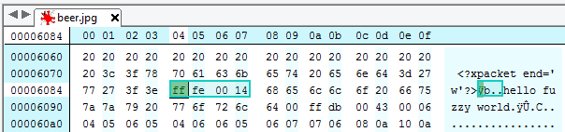
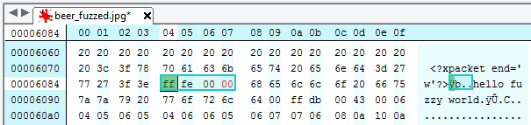
What is wrong?
MS04-028: Microsoft's JPEG GDI+ vulnerability (2004)
Tag ‘ff fe’ + length of COM section
length of comment = length – 2;
strlen(“hello fuzzy world”) == ?
length of COM section == 00 00
length of comment = 0 – 2;
-2 == 0xFFFFFFFFFFFFFFFE == ~4GB
byte* pComment = new byte[MAX_SHORT];
memcpy(pComment, buffer, length);

Slide 37
Microsoft's JPEG GDI+ vulnerability (2004)
Problem how GDI+ handles comments in JPEG picture
Comment header segment starts with marker 0xFFFE followed by 16bits length of comment
Length of comment is including the length word itself (2 bytes)
Subtract 2 bytes (length of length) to obtain comment length
If length of comment field is maliciously 0 or 1 then
  0 – 2 == -2 length of comment as signed integer
  converted to unsigned integer 0xFFFFFFFFFFFFFFFE
  Comment with length about 4GB instead 65kB max
Buffer overflow when comment is copied into heap buffer
  http://technet.microsoft.com/en-us/security/bulletin/ms04-028
http://www.slideshare.net/ashishmalik10/microsoft-gdi-jpeg-integer-underflow-vulnerability
http://www.securityfocus.com/bid/11173/exploit

Slide 38
I love GDI+ vulnerability because…
Lack of proper input checking
Type signed/unsigned mismatch
Type overflow
Buffer overflow
Heap overflow
Source code was not available (blackbox testing)
Huge impact (core MS library)
Easily exploitable
Found by fuzzing ☺

Slide 39
Intro to Fuzzing

Slide 40

Very simple fuzzer
cat /dev/random | ./target_app
What do you miss here?

Slide 41
What is missing?
Where fuzzing fits in development process? (developer side, CI, SDL)
What type of bugs fuzzing tends to find?
Which apps can be fuzzed?
How to detect that app mishandled fuzzed input (“hit”)? (crash, signal, exception, error…)
How to react on detected “hit”? (save seed and crashing inputs, bucketing of inputs)
How to create more meaningful inputs then random bytes? (valid inputs, proxy)
How to fuzz non-binary inputs? (string patterns, regexpr, mouse movements…)
How to fuzz applications without input as files? (http requests, dll injection, ZAP example)
How to fuzz efficiently? (known problematic values (fuzz vectors))
How to fuzz files/inputs with defined structure? (grammar, example Peach)
How to make fuzzer protocol-aware? (Peach example)
How to fuzz state-full protocols? (proxy like fuzzing)
How to analyse and react on detected hits?
Which tools one can use?
How to detect less visible “hits”? (side-channels)
What else can we fuzz? (test coverage testing, DDOS resiliency, hardware inputs)

Slide 42

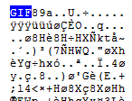
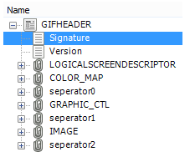
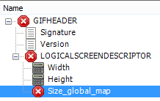










1. Investigate app in/out
2. Prepare data model (optional)
3. Validate data model
5. Send fuzzed input to app
F
4. Generate fuzzed inputs
http://iconarchive.com, http://awicons.com, http://www.pelfusion.com
7. Analyze logs
6. Monitor target app

Slide 43
Fuzzing process
Investigate input and output of target application
Prepare model for fuzzed input generation
Validate your model against reality
Start sending fuzzed inputs to application
Monitor application for faults, errors, crashes…
Analyze results
Mitigate problems found

Slide 44
Fuzzing: key characteristics
More or less random modification of inputs
Monitoring of target application
Huge amount of inputs for target are send
Automated and repeatable

Slide 45
Why to fuzz?
Black-box negative testing software technique
Good cost per bug ratio
“Research” fuzzing
  Dedicated effort, e.g., pen-testing, QA…
  Mostly human analysis of results (with help of tools)
  Whole process not necessary fully automated
Fuzzing as part of Secure Development Lifecycle
  Automated run “every day” (CI)
  Limited time to complete (parallelization?)
  Automated analysis (no human involved)

Slide 46
Fuzzing - advantages/disadvantages
+
Fuzzing advantages
  Very simple design
  Allow to find bugs missed by human eye
  Sometimes the only way to test (closed system)
  Repeatable (crash inputs stored)
Fuzzing disadvantages
  Usually simpler bugs found (low hanging fruit)
  Increased difficulty to evaluate impact or dangerosity
  Closed system is often evaluated, black box testing
-

Slide 47
What type of bugs fuzzing tends to find?
Fuzzers tend to find simpler bugs
Success of fuzzing depends on input structure
  E.g., checksums prevents large parts of random fuzzing
  Bugs in format parsing vs. bugs in data interpretation
Success increases with time spend on modelling
  More protocol-aware fuzzer is, problems are found faster (and less weird ones)

Slide 48
What kind of bugs is usually found?
Memory corruption bugs (buffer overflows...)
Parser bugs (crash of parser on malformed input)
Invalid error handling (other then expected error)
Threading errors (requires sufficient setup)
Correctness bugs (reference vs. new impl.)

Slide 49
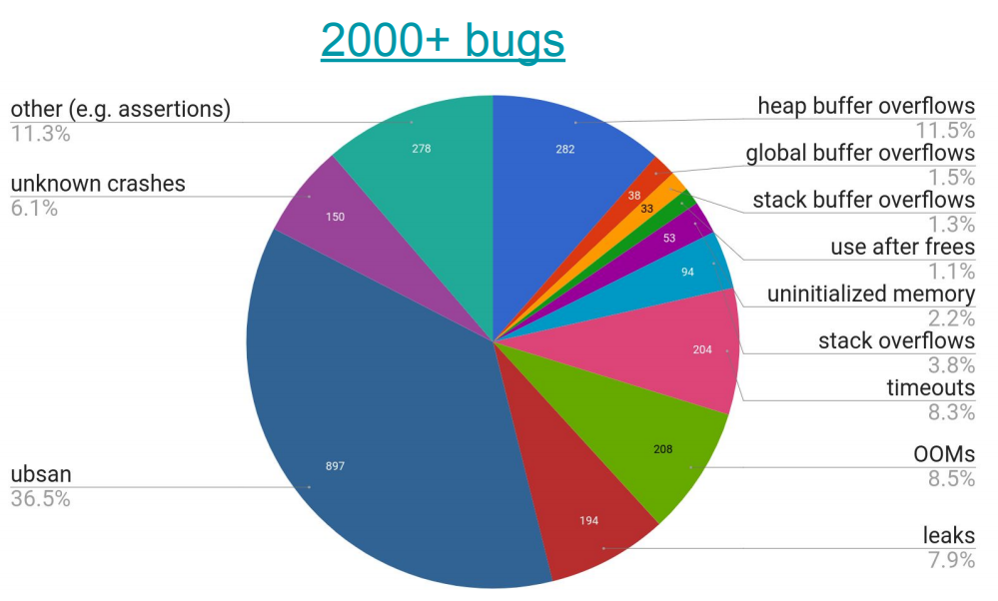
Google’s OSS-Fuzz
https://www.usenix.org/sites/default/files/conference/protected-files/usenixsecurity17_slides_serebryany.pdf

Slide 50
What kind of bugs are usually missed?
Bugs after input validation (if not modeled properly)
High-level / architecture bugs (e.g. weak crypto)
Usability bugs
…

Slide 51
What kind of applications can be fuzzed?
Any application/module with an input
  (sometimes even without inputs, e.g., fault induction)
Custom (“DIY”) fuzzer
  Usually full knowledge about target app
  Kind of randomized integration test (but still repeatable!)
File fuzzer – input via files
Network fuzzer – input received via network
General fuzzing framework
  Preprepared tools and functions for common tasks (file, packet…)
  Custom plugins, pre-prepared and custom data models

Slide 52

Microsoft’s SDL MiniFuzz File Fuzzer
Application input files fuzzer
  http://www.microsoft.com/en-us/download/details.aspx?id=21769
Templates for valid input files (multiple)
Modify valid input file (randomly, % aggressiveness)
Run application with partially modified inputs
Log resulting crash (if happen)
  exception, CPU registers...
Can be incorporated into Visual Studio, part of SDL
Video overview
  http://msdn.microsoft.com/en-us/security/gg675011.aspx

Slide 53
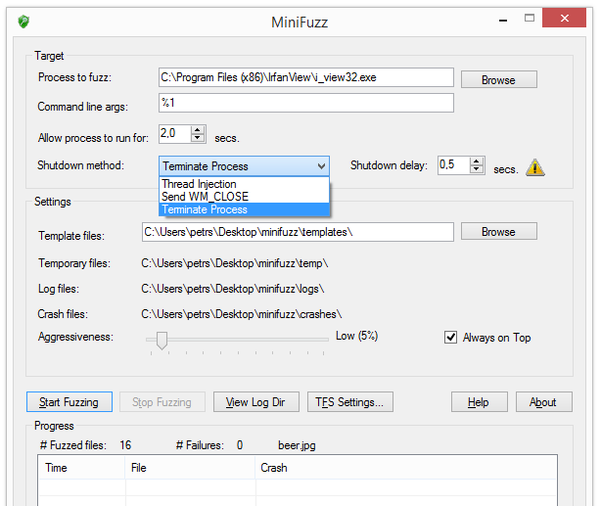
Microsoft’s SDL MiniFuzz File Fuzzer

Slide 54
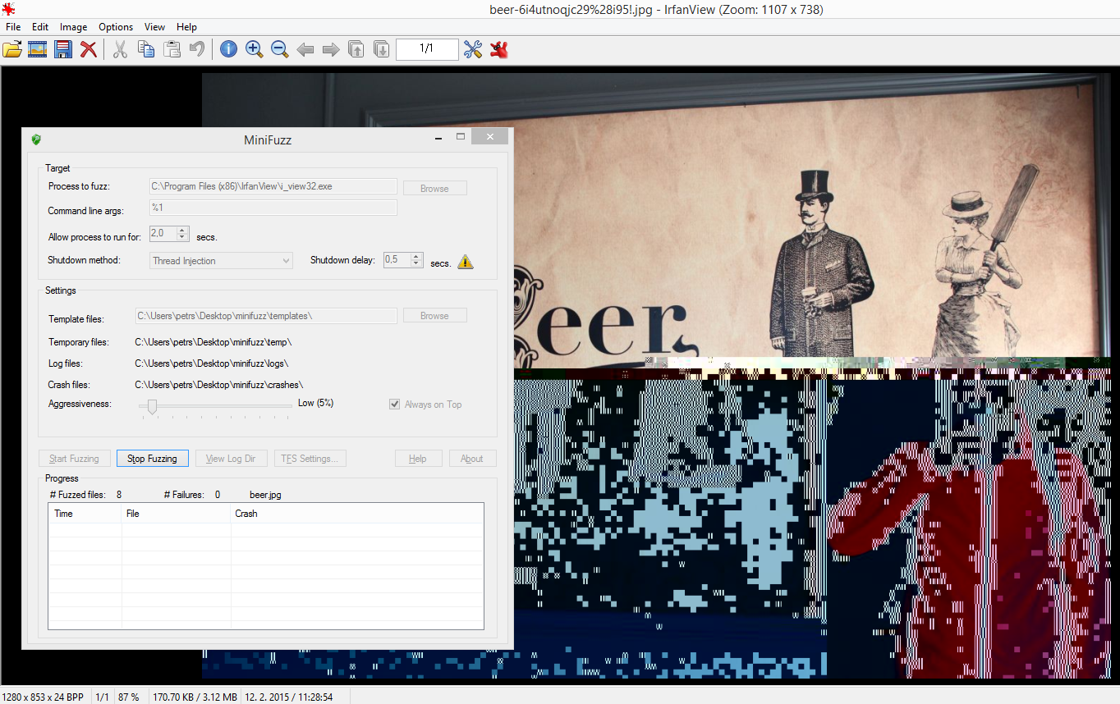
<?xml version="1.0"?>
<failures>
<failure type="Exception Event:Tid=8504, 0x80000003, unhandled, address=0x7740e34d" datetime="11:21:12 12. 2. 2015">
<registers RAX="00000000" RBX="00000000" RCX="7FFF5FC5180A" RDX="00000000" RSI="00000000" RDI="00000000" RBP="00000000" RSP="002EFCD0" RIP="7740E34D" />
<process name="C:\Program Files (x86)\IrfanView\i_view32.exe" />
<file name="-std=c99 -Wall C:\minifuzz\temp\beer-0rsw9!h2jf.jpg" />
</failure>
</failures>

Slide 55
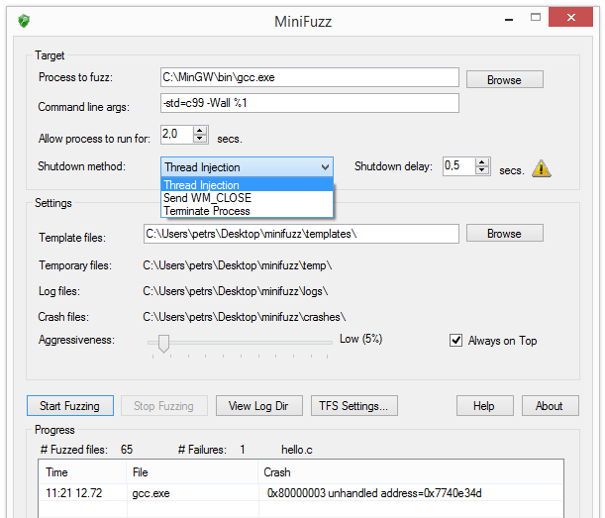
MiniFuzz: gcc fuzzing
#include<stdio.h>
int main() {
printf("Hello Fuzzy World");
return 0;
}
Binary fuzzing of source code???
How to improve test coverage?
What if file is not an input?

Slide 56
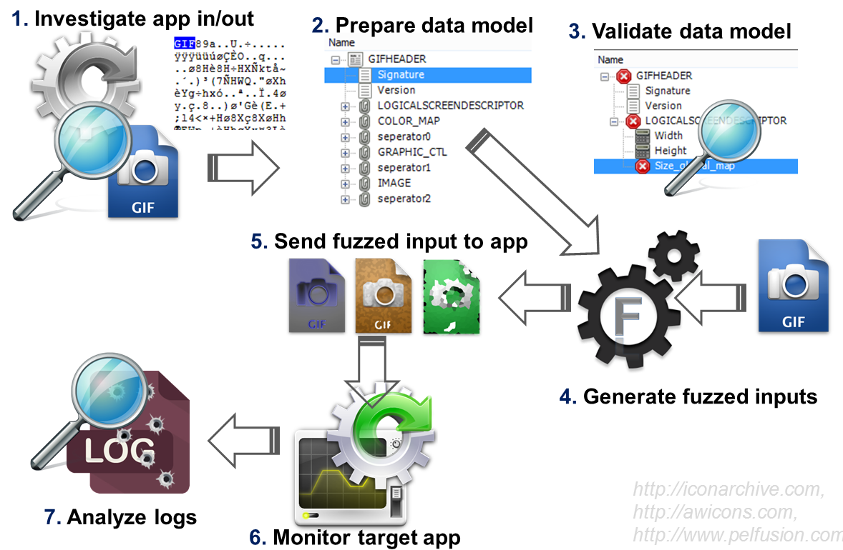
Investigate application

Slide 57
What kind of inputs and strategy?
Type of inputs?
  File, network packets, structure, data model, state(-less)
What environment setup is necessary?
  Fuzzing on live system?
  Multiple entities inside VMs? Networking?
Isolated vs. cooperating components?
  We don’t like to mock everything
What tools are readily available?

Slide 58
Microsoft’s SDL Regex Fuz
Test of regular expressions evaluations
  May cause denial-of-service attack
Use when your program use regex evaluation
  Extract all your used patterns, test it by SDL Regex Fuz
Video overview
  http://msdn.microsoft.com/en-us/security/gg675012.aspx
  http://blogs.msdn.com/b/sdl/archive/2010/10/12/new-tool-sdl-regex-fuzzer.aspx
Example: ^(\d+)+$

Slide 59
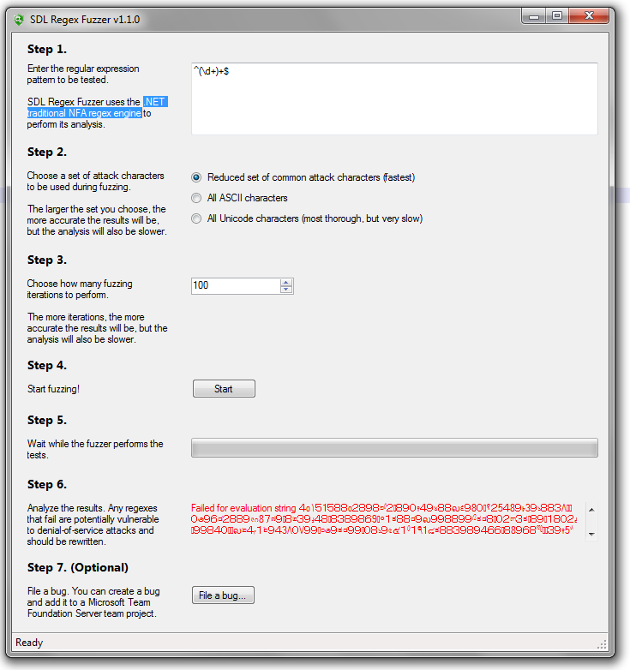

Slide 60
Modelling

Slide 61
Input preparation
Time intensive part of fuzzing (if model !exists yet)
Fully random data
Random modification of valid input
Modification of valid input with fuzz vectors
Modification of valid input with mutator
Fuzzing via intermediate proxy

Slide 62
Radamsa fuzzer
“…easy-to-set-up general purpose shotgun test to expose the easiest cracks…”
  https://code.google.com/p/ouspg/wiki/Radamsa
Just provide input files, all other settings automatic
  cat file | radamsa > file.fuzzed
>echo "1 + (2 + (3 + 4))" | radamsa --seed 12 -n 4
1 + (2 + (2 + (3 + 4?)
1 + (2 + (3 +?4))
18446744073709551615 + 4)))
1 + (2 + (3 + 170141183460469231731687303715884105727))

Slide 63
How to generate fuzzed input?
Generational fuzzing (Recursive fuzzing)
  Produces data based only on data model description
  E.g., iterates over range of values of given alphabet
Mutational fuzzing (Replacive fuzzing)
  Produces data based on templates and supplied model
  Known border values or malicious malformed input
  Fuzz test vectors
  String-based mutators, number-based mutators…

Slide 64
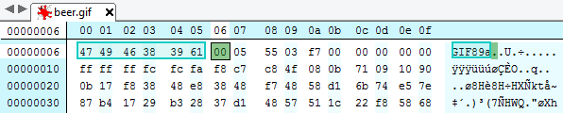
Peach fuzzer: DataModel (gif)
<DataModel name="GIFHEADER">
<String name="Signature" length="3" value="GIF" token="true" />
<String name="Version" length="3" value="89a" token="true" />
<Block name="LOGICALSCREENDESCRIPTOR">
<Number name="Width" size="16" endian="little" signed="false" />
<Number name="Height" size="16" endian="little" signed="false" />
<Number name="Sort_flag" size="8" value="F7" valueType="hex"/>
<String name="Color_res" length="3" value="7" />
<Number name="Background" size="8" endian="little" signed="false" />
<Number name="pixel_aspect_ration" size="8" endian="little" signed="false" />
</Block>
<Block name="COLOR_MAP">
<Blob name="Color0" length="64" valueType="hex" />
</Block>
<Block name="seperator0">
<String name="character" length="1" value="|" />
</Block>
…
</DataModel>
http://pastebin.com/9Y2yENqG

Slide 65
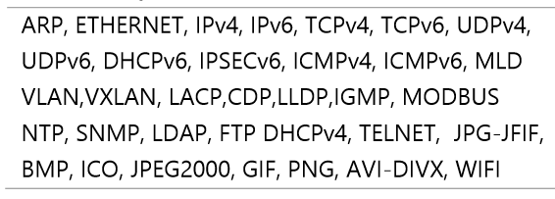
Peach Pit Library
Predefined support for various protocols
Peach Fuzzer™ Overview – datasheet, 2014
(available only in Professional and higher versions)

Slide 66




Fuzzing via intermediate proxy
Fuzzer modifies valid flow according to data model
Usually used for fuzzing of state-full protocols
  Modelling states and interactions would be difficult
  Target application(s) takes care of states and valid input

Slide 67
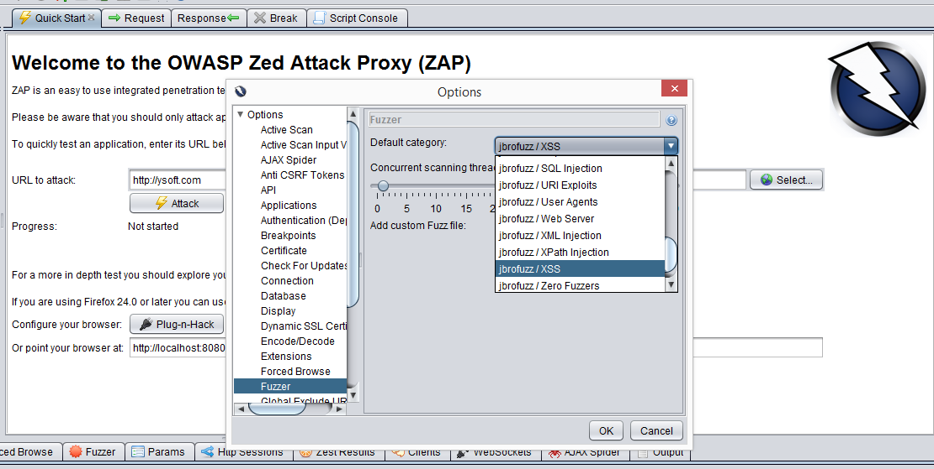
OWASP’s ZAP – fuzz strategy settings

Slide 68
TLS fuzzer
https://github.com/tomato42/tlsfuzzer/

Slide 69
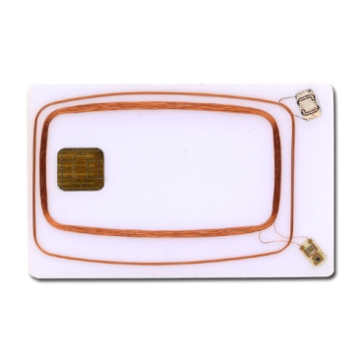

APDUPlay - Smart card fuzzing
http://www.fi.muni.cz/~xsvenda/apduinspect.html
Host to smart card communication done via PC/SC
Custom winscard.dll stub written
Manipulate incoming/outgoing APDUs
  modify packet content
  replay of previous packets
  …
00 a4 04 00 08 01 02 03 04 05 06 07 08
winscard.dll (stub)
90 00
[RULE1]
MATCH1=in=1;t=0;cla=00;ins=a4;p1=04;
ACTION=in=0;data0=90 00;le=02;

Slide 70
Validation

Slide 71
Validation of model
Are fuzzed inputs according to your need?
  Smarter fuzzing understands a data format
  Wrong data format usually fails early on initial parsing
Check between fuzzing data model and real input
  E.g., Peach Validator tool
Are template files providing good test coverage?
  E.g., Peach minset tool

Slide 72
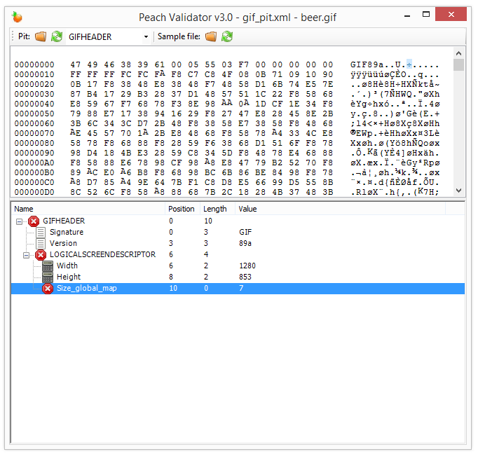
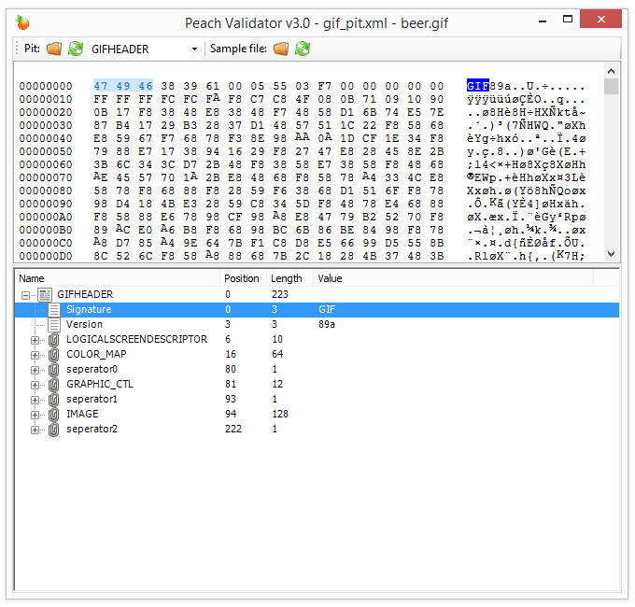
Peach Validator 3.0
Model doesn’t match valid input

Slide 73
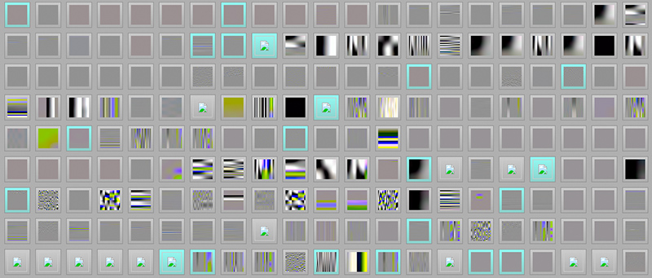
American fuzzy lop
Relatively new, but actively developed tool
High speed fuzzer http://lcamtuf.coredump.cx/afl/
Sophisticated generation of test cases (coverage)
Automatic generation of input templates
  E.g., valid JPEG image from “hello” string after few days
  http://lcamtuf.blogspot.cz/2014/11/pulling-jpegs-out-of-thin-air.html
Lots of real bugs found

Slide 74
Test coverage
Random inputs have low coverage (usually)
  Number of blocks visited in target binary
Smart fuzzing tries to improve coverage
  Way how to generate new inputs from existing
E.g., Peach’s minset tool
  Gather a lot of inputs (files)
  Run minset tool, traces with coverage stats are collected
  Minimal set of files to achieve coverage is computed
  Selected files are used as templates for fuzzing
E.g. AFL fuzzer uses compile time instrumentation + genetic programming to create test cases

Slide 75
Start, Generate, monitor

Slide 76

How to detect “hit”?
Application crash, uncaught exception…
  Clear faults, easy to detect
Error returned
  Some errors are valid response
  Some errors are valid response only in selected states
Input accepted even when it shouldn't be
  E.g., packet with incorrect checksum or modified field
Some operation performed in incorrect state
  E.g., door open without proper authentication
Application behavior is impaired
  E.g., response time significantly increases
…

Slide 77
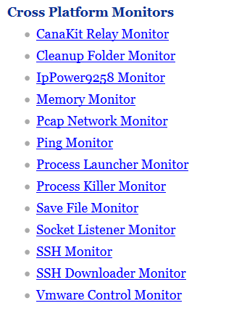
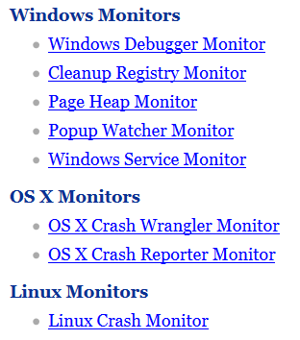
Peach monitors

Slide 78
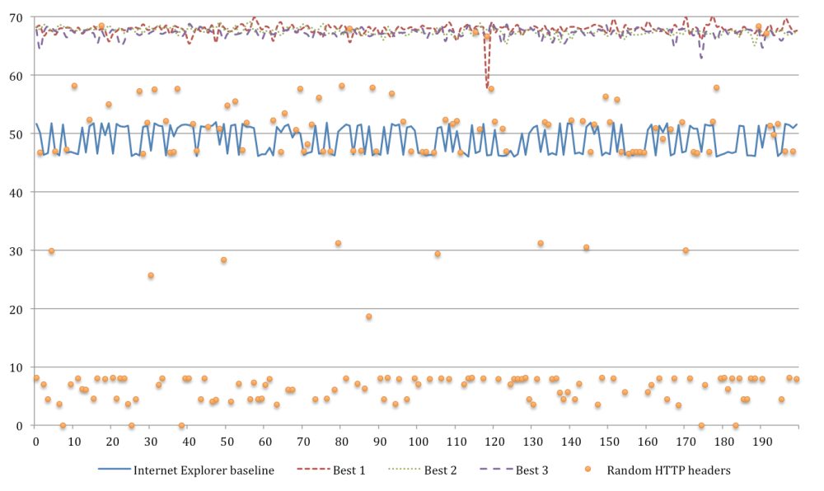
GANet fuzzer
Are there any inputs processed longer then usual?
Deny of service as target of fuzzing
  Can we craft input causing significant load?
  Fuzzing, but not completely random (GA, GP)
Input: http / SSL request (fuzzed – content, time)
Setup: application inside VMs
Monitor: memory/CPU/network load
Analyze: outstanding load detected
Bukac et al., Challenges of fiction in network security – perspective of virtualized environments, SPW’15, Cambridge, 2015

Slide 79
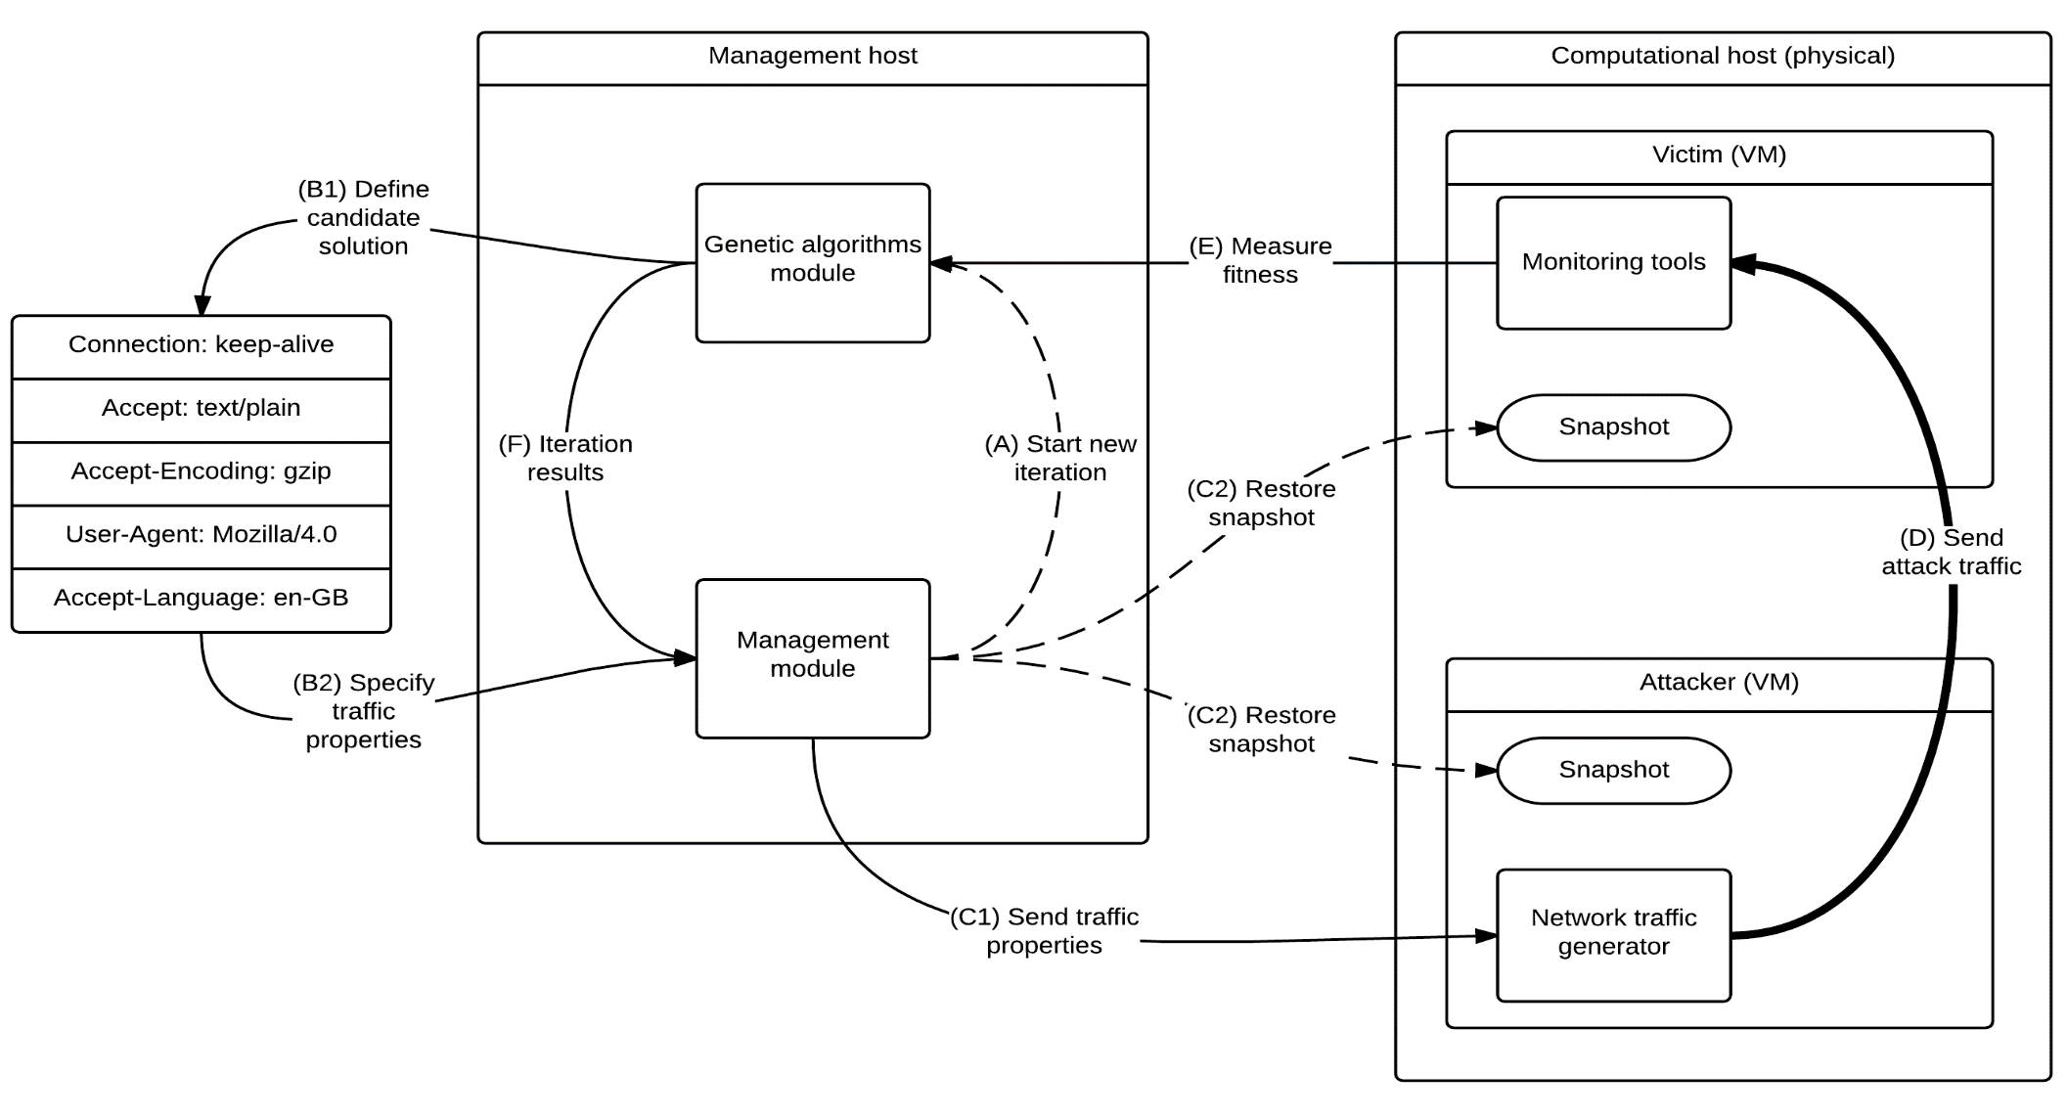
GANet fuzzing setup

Slide 80
Peach Pit – specifying fuzz actions
Peach Pit is XML file
  http://old.peachfuzzer.com/v3/TutorialFileFuzzing/CreateDataModel.html
  Data Models http://old.peachfuzzer.com/v3/DataModel.html
  Format description of input data
  State Models http://old.peachfuzzer.com/v3/StateModel.html
  How fuzzer should behave in different states
  Agents http://old.peachfuzzer.com/v3/AgentsMonitors.html
  Peach processes running program you fuzz, debugger for monitoring…
  WinDbg, Linux Crash Monitor, Ping monitor, SSH monitor…
Publisher http://old.peachfuzzer.com/v3/Publisher.html
  How to communicate wit target application (TCP, files…)
Tests http://old.peachfuzzer.com/v3/TestConfig.html
  Setting all parameters of test (Publishers, Loggers, Agents and StateModel)

Slide 81
<DataModel name="DataHTER">
<String value="HTER " mutable="false" token="true"/>
<String value=""/>
<String value="\r\n" mutable="false" token="true"/>
</DataModel>
<StateModel name="StateHTER" initialState="Initial">
<State name="Initial">
<Action type="input" ><DataModel ref="DataResponse"/></Action>
<Action type="output"><DataModel ref="DataHTER"/></Action>
<Action type="input" ><DataModel ref="DataResponse"/></Action>
</State>
</StateModel>
<DataModel name="DataResponse">
<String value=""/>
</DataModel>
<Agent name="RemoteAgent" location="tcp://127.0.0.1:9001">
<!-- Run and attach windbg to a vulnerable server. -->
<Monitor class="WindowsDebugger">
<Param name="CommandLine" value="c:\Install\Fuzzers\Peach tutorial\VulnServer\vulnserver.exe"/>
<Param name="WinDbgPath" value="c:\Program Files (x86)\Windows Kits\8.1\Debuggers\x64\" />
</Monitor>
</Agent>
<Test name="TestHTER">
<Agent ref="RemoteAgent"/>
<StateModel ref="StateHTER"/>
<Publisher class="TcpClient">
<Param name="Host" value="127.0.0.1"/>
<Param name="Port" value="9999"/>
</Publisher>
<Logger class="File">
<Param name="Path" value="Logs"/>
</Logger>
Model of input data
‘HTER anything \r\n’
Read any string
Send fuzzed input
Read any string
Agent responsible for starting target application with debugger connected
Test scenario with specified settings
How to communicate with target application
How to store results

Slide 82
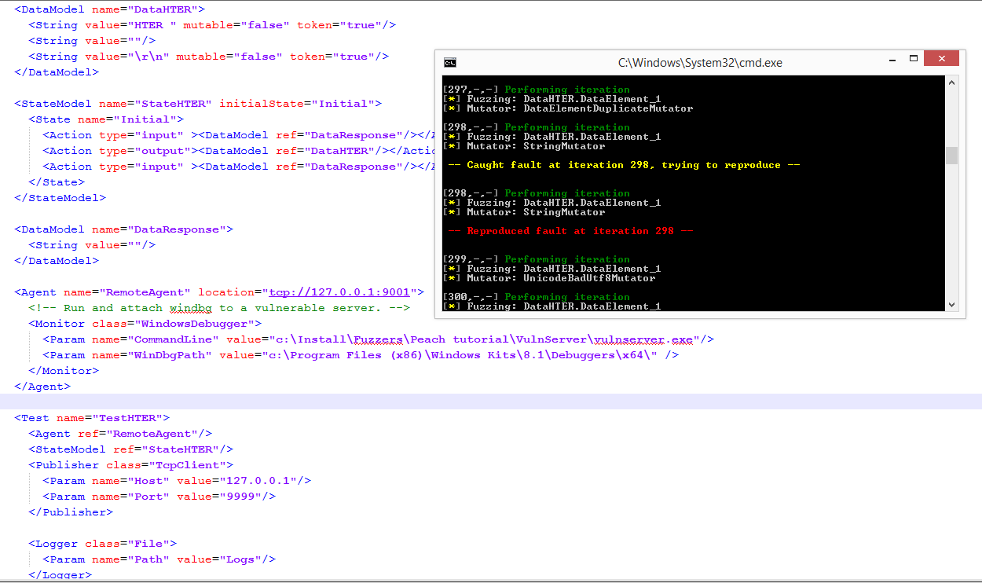
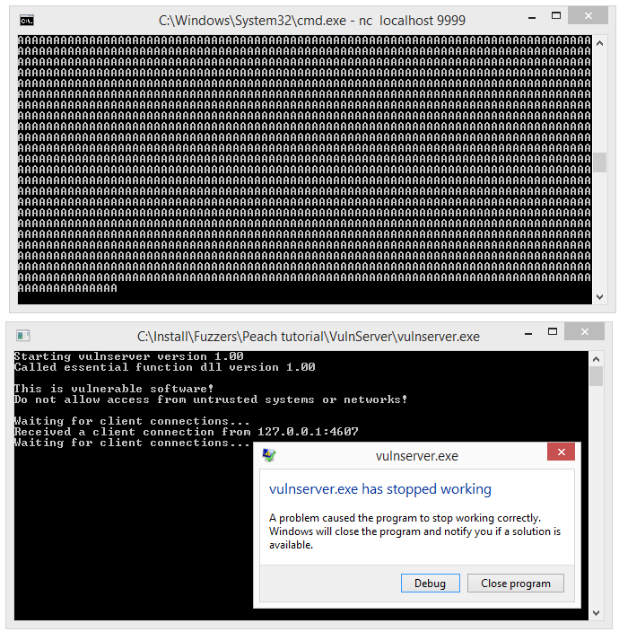
Example from http://rockfishsec.blogspot.ch/2014/01/fuzzing-vulnserver-with-peach-3.html

Slide 83
Analyze

Slide 84
What to do with hit results?
Time intensive part of fuzzing
Not all hits are relevant (at least at the beginning)
  Crashes by values not controllable by an attacker
  !exploitable https://msecdbg.codeplex.com/
Hits reproduction
  Hit can be result of cumulative series of operations
Many hits are duplicates
  Inputs are different, but hit caused in the same part of code
(Automatic) Bucketing of hits
  E.g., Peach performs bucking based on signature of callstack

Slide 85
Motto: “Test your test coverage”
Sebastian Kurfürst’s php fuzzer
Idea:
  Ordinary UT coverage tool just count visited LoC
  Run tests and compute test coverage
  Foreach (line:source_code)
    Comment out / modify line of code
    Verify valid syntax – if yes, then run unit tests again
    Detect if tests pass even when line was removed / modified
    If yes, then your UT is not sufficient
https://github.com/sandstorm/Fuzzer

Slide 86
Teaser: Fuzzing hands-on
Some file fuzzing
General fuzzing framework - Peach
  Setup, components, plugins, configuration…
  Custom input modeling and validation
Some network fuzzing with OWASP ZAP?
  Setup, options…
  Proxy-based network fuzzing

Slide 87
Summary for fuzzing
Fuzzers are cheap way to detect simpler bugs
  If you don’t use it, others will
Try to find tool that fits your particular scenario
  Check activity of development, support
Fuzzing frameworks can ease variety of setups
  But bit steeper learning curve
If fuzzing will not find any bugs, check your model
Try it!

Slide 88
Fuzzing driven development (FDD)
Test-driven development (TDD)
  Write tests first, only later implement functionality
  Will result in testable code (smaller functions, well defined)
Fuzzing driven development (FDD)
  Continuous fuzzing of an application
  Structure application to enable and support fuzzing
  Will result in “fuzzable” code (deep penetration into app)
Google OSS-Fuzz
  Large-scale continuous fuzzing of important open-source projects on Google’s servers
  Can be replicated in your Continuous Integration server

Slide 89
Taint analysis

Slide 90
Taint analysis
Form of flow analysis
Follow propagation of sensitive values inside program
  e.g., user input that can be manipulated by an attacker
  find all parts of program where value can “reach”
“Information flows from object x to object y, denoted x→y , whenever information stored in x is transferred to, object y.” D. Denning
Native support in some languages (Ruby, Perl)
  But not C++/Java ☹, FindSecurityBugs adds taint for Java

Slide 91
Taint sources
Files (*.pdf, *.doc, *.js, *.mp3...)
User input (keyboard, mouse, touchscreen)
Network traffic
USB devices
...
Every time there is information flow from value from untrusted source to other object X, object X is tainted
  labeled as “tainted”

Slide 92
Execution of sensitive operation
Before sensitive operation (e.g., system()) is executed with value, taint label is checked
  if value is tainted, alert is issued
Untrusted data reaching privilege location is detected
  can detect even unknown attacks
  (but sometimes we need to use user input)

Slide 93
Taint analysis - tools
Taintgrind
  http://www.cl.cam.ac.uk/~wmk26/taintgrind/
  additional module to Valgrind
  dynamic taint analyzer for C/C++
  output memory traces (information flows) already produced by Valgrind
Tanalysis
  http://code.google.com/p/tanalysis/
  static taint analyzer for C
  plugin for Frama-C http://frama-c.com/
Read more about taint analysis
  http://users.ece.cmu.edu/~ejschwar/papers/oakland10.pdf

Slide 94
Microsoft PREfast + Taint analysis
Warning C6029 is issued when tainted value is passed to parameter marked as [Post(Tainted=No)]
  without any checking (any condition statement)
http://msdn.microsoft.com/en-us/library/ms182047%28v=vs.100%29.aspx
// C
#include <CodeAnalysis\SourceAnnotations.h>
void f([SA_Pre(Tainted=SA_Yes)] int c);
// C++
#include <CodeAnalysis\SourceAnnotations.h>
using namespace vc_attributes;
void f([Pre(Tainted=Yes)] int c);

Slide 95
Coverity taint analysis
TAINTED_SCALAR
  http://blog.coverity.com/2014/04/18/coverity-heartbleed-part-2/#.U1l4k2dOURo
  http://security.coverity.com/blog/2014/Apr/on-detecting-heartbleed-with-static-analysis.html

Slide 96

Conclusions
Dynamic analyzers can profile application
  and find bugs not found by static analysis
Fuzzing is “cheap” blackbox approach via malformed inputs
Mandatory reading
  Kostya Serebryany, OSS-Fuzz Google's continuous fuzzing service for open source software
  https://www.usenix.org/sites/default/files/conference/protected-files/usenixsecurity17_slides_serebryany.pdf
Questions

Slide 97
Extension slides – for ignited ☺

Slide 98
References
Some books available, but…
Michael Eddington, Demystifying fuzzers
  Comparison of open-source tools, cost of adoption
  BlackHat 2009, https://www.blackhat.com/presentations/bh-usa-09/EDDINGTON/BHUSA09-Eddington-DemystFuzzers-PAPER.pdf
  https://www.blackhat.com/presentations/bh-usa-09/EDDINGTON/BHUSA09-Eddington-DemystFuzzers-SLIDES.pdf
  RSA Conference 2010 talk https://www.youtube.com/watch?v=Bm3Mfndrl1Y
OWASP fuzzing guidelines
  https://www.owasp.org/index.php/Fuzzing
  https://www.owasp.org/index.php/OWASP_Testing_Guide_Appendix_C:_Fuzz_Vectors
Tutorials and research papers on fuzzing http://fuzzing.info/papers/

Slide 99
Peach tutorials
Basic usage against vulnserver
  http://rockfishsec.blogspot.ch/2014/01/fuzzing-vulnserver-with-peach-3.html
Advanced tutorial (ZIP format fuzzing) – very good
  http://www.flinkd.org/2011/07/fuzzing-with-peach-part-1/
Tutorial for RAR fuzzing
  http://www.flinkd.org/2011/11/fuzzing-with-peach-part-2-fixups-2/

Slide 100
References
MS post on Test coverage by fuzzing
  http://blogs.technet.com/b/srd/archive/2010/02/24/using-code-coverage-to-improve-fuzzing-results.aspx
Application and file fuzzing
  http://resources.infosecinstitute.com/application-and-file-fuzzing/
How I Learned to Stop Fuzzing and Find More Bugs
  https://www.defcon.org/images/defcon-15/dc15-presentations/dc-15-west.pdf

Slide 102
Dynamic analysis - Profiling (Whitebox)

Slide 103
Automatic measurement - profiling
Automatic tool to measure time and memory used
“Time” spend in specific function
How often a function is called
Call tree
  what function called actual one
  based on real code execution (condition jumps)
Many other statistics, depend on the tools
Helps to focus and scope security analysis

Slide 104
MS Visual Studio Profiler
Analyze→Launch Performance Wizard
Profiling method: CPU Sampling
  check periodically what is executed on CPU
  accurate, low overhead
Profiling method: Instrumentation
  automatically inserts special accounting code
  will return exact function call counter
  (may affect performance timings a bit)
    additional code present
May require admin privileges (will ask)

Slide 105
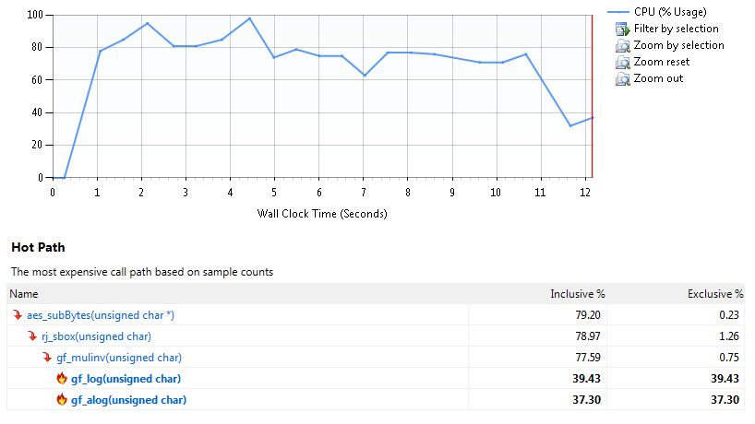
MS VS Profiler – results (Summary)
Where to start the optimization work?

Slide 106
MS VS Profiler – results (Functions)
Result given in number of sampling hits
  meaningful result is % of total time spend in function
Inclusive sampling
  samples hit in function or its children
  aggregate over call stack for given function
Exclusive sampling
  samples hit in exclusively in given function
  usually what you want
    fraction of time spend in function code (not in subfunctions)

Slide 107
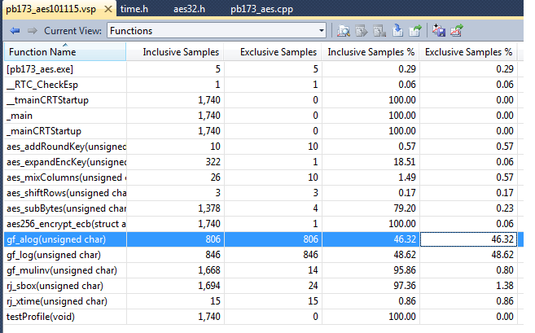
MS VS Profiler – results (Functions)
Doubleclick to move into Function Details view

Slide 108
GCC gcov tool
http://gcc.gnu.org/onlinedocs/gcc/Gcov.html#Gcov
Compile program by GCC with additional flags
  gcc -Wall -fprofile-arcs -ftest-coverage main.c
  gcc -Wall --coverage main.c
  additional monitoring code is added to binary
Execute program
  files with “.bb" ".bbg" and ".da" extension are created
Analyze resulting files with gcov
  gcov main.c
  annotated source code is created
Lcov - graphical front-end for gcov
  http://ltp.sourceforge.net/coverage/lcov.php

Slide 109
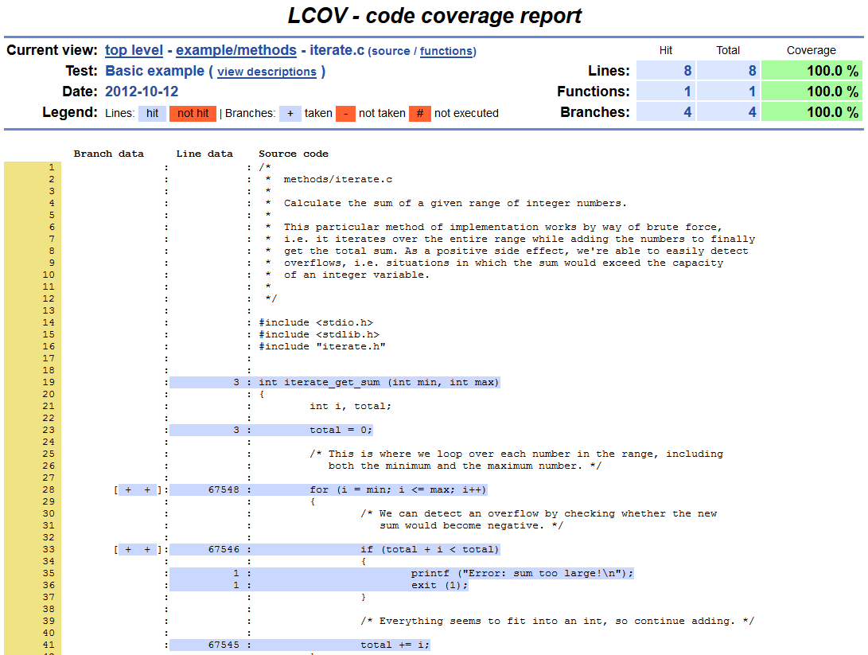
Taken from http://ltp.sourceforge.net/coverage/lcov/output/example/methods/iterate.c.gcov.html

Slide 110
reverse engineering (Blackbox)

Slide 111
Reverse engineering
Art of discovering principles through analysis of structure, functions and operation
Legality
  Own binary without documentation
  Interoperability
  Anti-virus research
  Fair use, education
  Forensics
Problem with recent copyright laws
  even attempt to circumvent is illegal
  not only selling circumvented content

Slide 112
Disassembler vs. debugger
Static vs. dynamic code analysis
Debugger vs. Debugger with advanced modification tools (Visual Studio vs. OllyDbg)
Assembler vs. bytecode
  Instruction set
  Register-based vs. stack-based execution

Slide 113
Lena tutorials
Nice introduction tutorials for reversing/cracking
Win32 binary
  Lena tutorials 1 and 2
Name of the registers
  (EAX 32bit, AX 16bit, AH/AL 8bit)
Registers (FPU):
  Z – zero flag, C – carry flag, S – sign flag
  EIP ... next address to execute (instruction pointer)
  EBX ... usually loop counter

Slide 114
Startup resources
The Reverse Code Engineering Community: http://www.reverse-engineering.net/
Tutorials for You: http://www.tuts4you.com
RE on Wikipedia: http://en.wikipedia.org/wiki/Reverse_engineering

Slide 115
Disassembling binary code
Interactive Disassembler is legendary full-fledged disassembler with ability to disassemble many different platforms.
  Free version available for non-commercial uses
  Free version disassemble only Windows binaries
  http://www.hex-rays.com/idapro/idadownfreeware.htm
Very nice visualization and debugger feature (similar as OllyDbg)
  Try it!

Slide 116
Decompiling binary code
Decompiler is able to produce source code from binary code. Decompiler needs to do disassembling first and then try to create code that will in turn produce binary code you have at the beginning.
Resulting code will NOT contain information removed during compilation
  (comments, function names, formatting...)
  Read http://www.debugmode.com/dcompile/ for more info
Still can be of great help
Problem to find well working free disassembler
  http://en.wikibooks.org/wiki/X86_Disassembly/Disassemblers_and_Decompilers

Slide 117
Resources
The Reverse Code Engineering Community: http://www.reverse-engineering.net/
Tutorials for You: http://www.tuts4you.com
Disassembling tutorial http://www.codeproject.com/KB/cpp/reversedisasm.aspx

Slide 118
OLD fuzzing

Slide 119
Example with many possible inputs
Multiple inputs to application
Not possible to evaluate manually
  or done very frequently: UT, TDD, continuous integration
Sometimes not possible to bruteforce at all
  to many combinations
  usual situation!
Easy to overlook potential problem

Slide 120
Fuzzer - principle
Send high number of different inputs into application
  user interface (UI), command line options, import/export capabilities
Inputs generated randomly or according to predefined pattern
  Protocol/file-format/data-type dependant
  E.g., input string with different lengths (1MB user name)
  E.g., valid input with certain percentage of random modifications (jpg file with random changes)
Fuzzer monitors application for crash or emitted error
  Memory corruption, invalid state…
  When detected, problem is manually inspected
https://www.owasp.org/index.php/Fuzzing

Slide 121
Fuzzing – advantages/disadvantages
Fuzzers tend to find simple bugs
  more protocol-aware fuzzer is, less weird problems will find
Fuzzing advantages
  very simple design
  allow to find bugs missed by human eye
  sometimes only way to test (completely closed system)
Fuzzing disadvantages
  increased difficulty to evaluate impact/dangerosity
    closed system is evaluated, black box testing

Slide 122
Types of fuzzing
Application fuzzing
  generates inputs for application (stdin, memory...)
Protocol fuzzing
  manipulation of protocol level
File format fuzzing
  generates malformed file samples
  if program crashes, debug log is created
  attack against parser layer
  attack against codec/application layer
  example: MS04-028 Microsoft's JPEG GDI+ vulnerability
    http://technet.microsoft.com/en-us/security/bulletin/ms04-028

Slide 123
Fuzzing – approaches
Capture valid inputs and modify some bytes
  randomly
  according to given regular expression
  Random changes with post-processing (e.g., correct CRC)
Binary vs. text oriented fuzzing

Slide 124
Available tools
Microsoft’s SDL MiniFuzz File Fuzzer
Microsoft’s SDL Regex Fuzzer
Ilja van Sprundel’s mangle.c
  https://ext4.wiki.kernel.org/index.php/Filesystem_Testing_Tools/mangle.c
  filename and header size
  change between 0 and 10% of header with random bytes
  example data
zzuf - multi-purpose fuzzer
  application input fuzzer
  intercepting file and network operations and changing random bits in the program’s input
  http://sam.zoy.org/zzuf/

Slide 125
Microsoft’s SDL MiniFuzz File Fuzzer
Application input files fuzzer
  http://www.microsoft.com/en-us/download/details.aspx?id=21769
  UsingMiniFuzz.htm
Templates for valid input files (multiple)
Modify valid input file (randomly, % aggressiveness)
Run application with partially modified inputs
Log resulting crash (if happen)
  exception, CPU registers...
Can be incorporated directly into Visual Studio
Video overview
  http://msdn.microsoft.com/en-us/security/gg675011.aspx

Slide 126
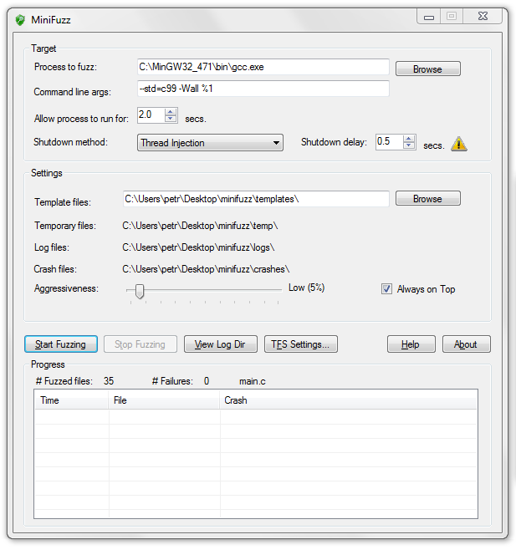

Slide 127
Microsoft’s SDL Regex Fuz
Test of regular expressions evaluations
May cause denial-of-service attack
Use when your program use regex evaluation
Video overview
  http://msdn.microsoft.com/en-us/security/gg675012.aspx
http://blogs.msdn.com/b/sdl/archive/2010/10/12/new-tool-sdl-regex-fuzzer.aspx
Example: ^(\d+)+$

Slide 129
SPIKE
Tool for fuzzing analysis of network protocols
  http://www.immunitysec.com/resources-freesoftware.shtml
Overview of SPIKE capabilities
  https://www.blackhat.com/presentations/bh-usa-02/bh-us-02-aitel-spike.ppt
Fuzzing tutorial with SPIKE on Vulnserver
  http://resources.infosecinstitute.com/intro-to-fuzzing/
  Windows & Linux version
Another SPIKE tutorial
  http://pentest.cryptocity.net/fuzzing/

