Slide 1

PA193 - Secure coding principles and practices
LABS: Language level vulnerabilities:
Buffer overflow, type overflow, strings
Petr Švenda svenda@fi.muni.cz

Slide 2
Plan
Information about project, forming groups
Fun with buffer overflow and memory layouts
Analysis of disassembly

Slide 3
// Note: GCC and MSVC uses different memory alignment
// Try "12345678DevilEvecosia" as a password for gcc build
// Try "1234567812345678Devil I am. Ha Ha" as a password for MSVC debug build
void demoBufferOverflowData() {
int unused_variable = 30;
#define NORMAL_USER 'n'
#define ADMIN_USER 'a'
int userRights = NORMAL_USER;
#define USER_INPUT_MAX_LENGTH 8
char userName[USER_INPUT_MAX_LENGTH];
char passwd[USER_INPUT_MAX_LENGTH];
// print some info about variables
printf("%-20s: %p\n", "userName", userName);
printf("%-20s: %p\n", "passwd", passwd);
printf("%-20s: %p\n", "unused_variable", &unused_variable);
printf("%-20s: %p\n", "userRights", &userRights);
printf("\n");
// Get user name
memset(userName, 1, USER_INPUT_MAX_LENGTH);
memset(passwd, 2, USER_INPUT_MAX_LENGTH);
printf("login as: ");
fflush(stdout);
gets(userName);
// Get password
printf("%s@vulnerable.machine.com: ", userName);
fflush(stdout);
gets(passwd);
// Check user rights (set to NORMAL_USER and not changed in code)
if (userRights == NORMAL_USER) {
printf("\nWelcome, normal user '%s', your rights are limited.\n\n", userName);
fflush(stdout);
}
if (userRights == ADMIN_USER) {
printf("\nWelcome, all mighty admin user '%s'!\n", userName);
fflush(stdout);
}
// How to FIX:
//memset(userName, 0, USER_INPUT_MAX_LENGTH);
//fgets(userName, USER_INPUT_MAX_LENGTH - 1, stdin);
//memset(passwd, 0, USER_INPUT_MAX_LENGTH);
//fgets(passwd, USER_INPUT_MAX_LENGTH - 1, stdin);
}

Slide 4
Setup
Create new Visual Studio 2015 Project
  File->New->Project->VisualC++->Win32 Console app
  Turn off ‘Precompiled header’ and ‘SDL checks’
Paste BufferOverflow.cpp from IS instead of project’s main file
Try to compile (disable warning on gets() function)
  #define _CRT_SECURE_NO_WARNINGS
Insert breakpoint (begin of demoBufferOverflowData()) – F9
Run program in debug mode – F5
Execute next step of program – F10
Display memory
  Debug → Windows → Memory
  Program must be in debugging session and running!

Slide 5
Variable containing current access rights
void demoBufferOverflowData() {
int unused_variable = 30;
#define NORMAL_USER 'n'
#define ADMIN_USER 'a'
int userRights = NORMAL_USER;
#define USER_INPUT_MAX_LENGTH 8
char userName[USER_INPUT_MAX_LENGTH];
char passwd[USER_INPUT_MAX_LENGTH];
// print some info about variables
printf("%-20s: %p\n", "userName", userName);
printf("%-20s: %p\n", "passwd", passwd);
printf("%-20s: %p\n", "unused_variable", &unused_variable);
printf("%-20s: %p\n", "userRights", &userRights);
printf("\n");
// Get user name
printf("login as: ");
gets(userName);
// Get password
printf("%s@vulnerable.machine.com: ", userName);
gets(passwd);
// Check user rights (set to NORMAL_USER and not changed in code)
if (userRights == NORMAL_USER) {
printf("\nWelcome, normal user '%s', your rights are limited.\n\n", userName);
}
if (userRights == ADMIN_USER) {
printf("\nWelcome, all mighty admin user '%s'!\n", userName);
}
}
Array with fixed length (will be overwritten)
Help output of address of local variables stored on the stack
Reading username and password (no length checking)
Print information about current user rights

Slide 6
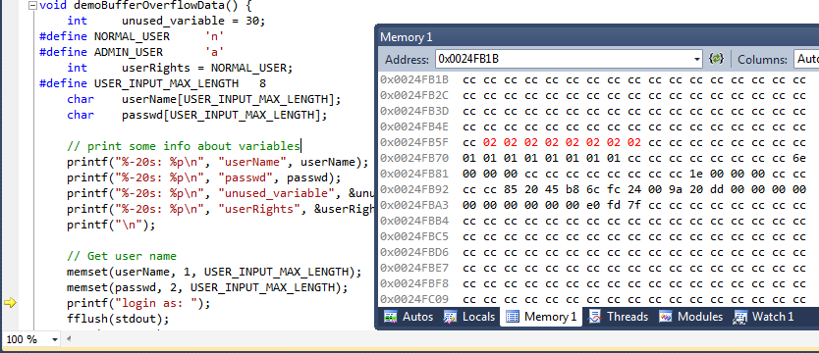
Data in memory
userName
passwd
userRights
unused_variable

Slide 7
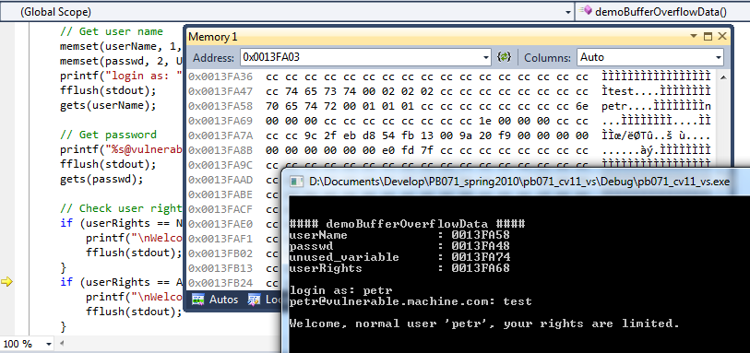
Running without malicious input
userName
passwd

Slide 8
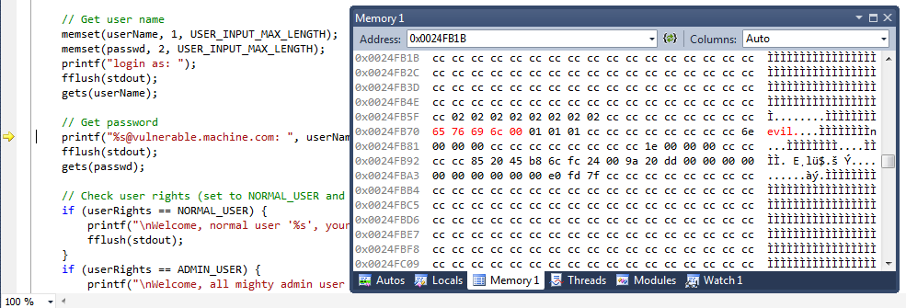
Running with malicious input – userName
insert ‘evil’ into userName

Slide 9
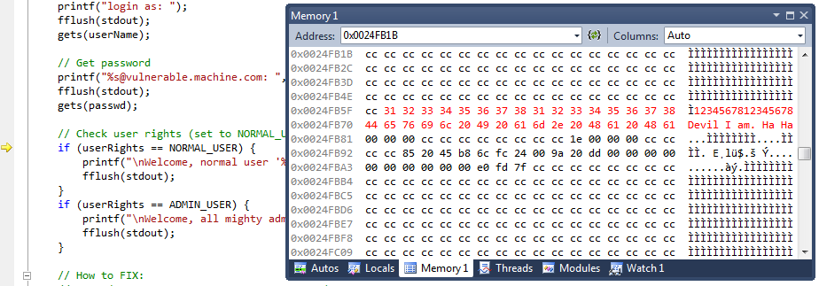
Running with malicious input - passwd
Insert
‘1234567812345678Devil I am. Ha Ha’ into passwd
Too long password overflow userName and userRights

Slide 10
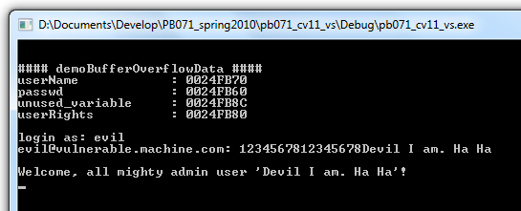
Running with attacker input - result

Slide 11
Questions (debug mode)
How are userName, password and userRights positioned in memory?
How you will find memory location (address) of userRights variable?
How many bytes you need to write into userName variable to change userRights ?
Can you get admin rights by changing userName only?

Slide 12
Questions (debug mode)
Why is program throwing debugger exception when finishing function demoBufferOverflowData()?
How program was able to detect memory corruption?
Why 0xcc bytes are here? How you can type 0xcc into terminal?
Can you get admin rights without raising runtime exception (memory around userName variable corrupted) when leaving demoBufferOverflowData()?
Where you can find return address?
What should be the return address value?
  Try R-Click -> Go to Disassembly

Slide 13
Questions (release mode)
Release mode, /GS on
  What is memory layout with respect to debug mode?
  Can you still execute buffer overflow and change userRights?
  What is the value of canary word?
Release mode, /GS off
  What is the influence of /GS disabled?
  What is the impact on addresses of variables?
  Can you become admin in Release? Why?

Slide 14
Lab – compiler protections
GCC (e.g., QT Creator) & MSVC (Visual Studio)
  list of compiler flags, release mode
Compile program with/without compiler protection
  bufferoverflowdemo.cpp::demoBufferOverflowData()
    download from IS materials
  return pointer smash behavior (crash, exception)
Disassembly display of resulting binary
  instruction-wise mode in IDE (Visual Studio), OllyDbg
  existence of canary word (function with/without GS buffer)
Display address of variable, function...,
    run program multiple times – memory randomization (ASLR)

Slide 15
Compiler flags
Locate all flags discussed during lecture
Visual Studio Projects Settings
Observe memory layout for stack frame with and without the flag
  what is changing?
  what is missing?

Slide 16
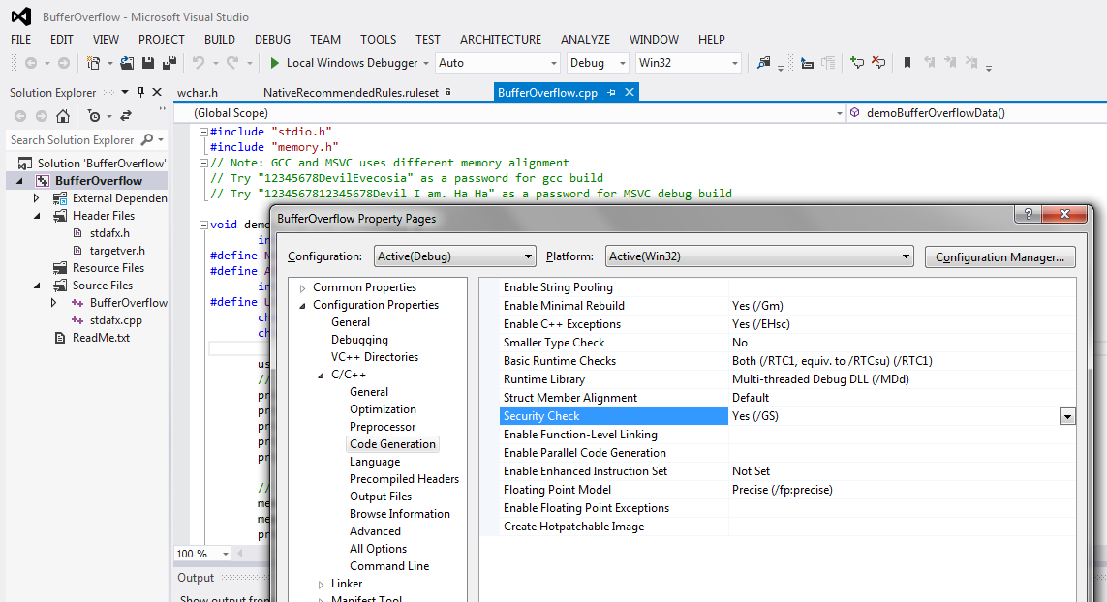
Compiler settings for /DEP and /ASLR

Slide 17
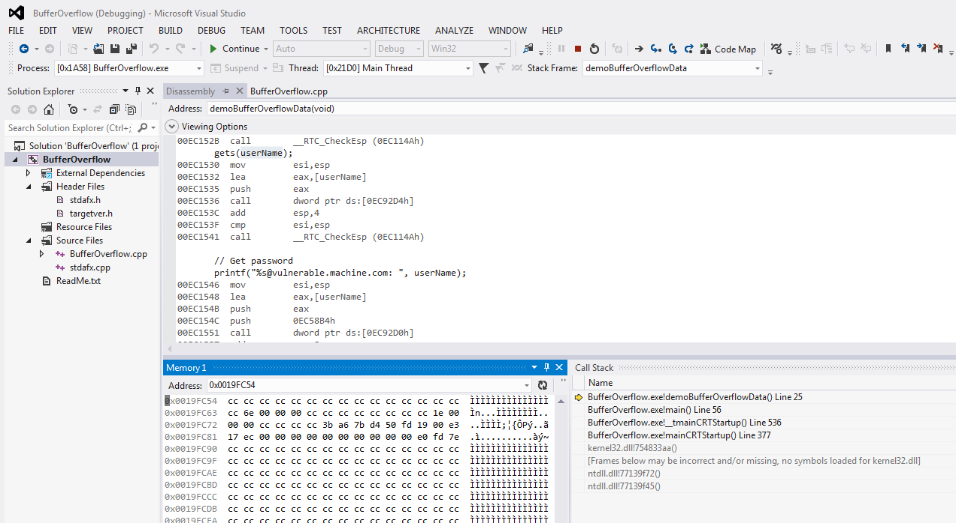
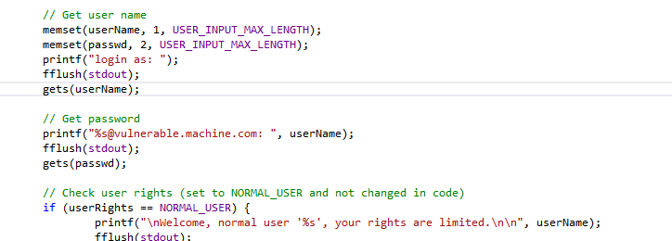
Deeper look into disassembly

Slide 18
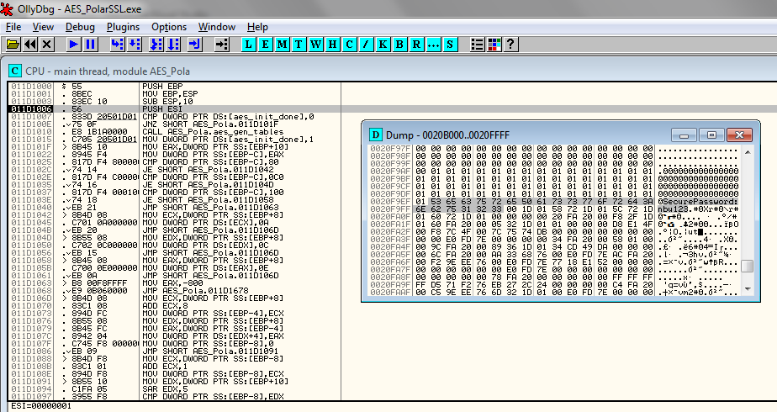
Deeper look into disassembly (cont.)

Slide 19
BinScope Binary Analyzer
Download Microsoft SDL’s Binscope
  https://blogs.microsoft.com/microsoftsecure/2012/08/15/microsofts-free-security-tools-binscope-binary-analyzer/
  https://www.microsoft.com/en-us/download/details.aspx?id=44995
Run BinScope Binary Analyzer (cmd or GUI)
  binscope.exe
  binscope.exe /o results.xml targetApp.exe
Run on the binaries produced with different compiler settings
  /GS...

Slide 20
Homework
No homework this week, work on parser project
  Implementation presentation till 13.10. (your seminar)
What should you have already:
  Formed group confirmed with me
  Format for parsing confirmed with me
  Setup Github repository for project
    And link send to me!

Slide 22
Optional: if you like to have more fun!

Slide 23
Exploiting exercises
Protostar image (http://exploit-exercises.com)
  pre-prepared virtual machine
  http://exploit-exercises.com/protostar (task description)
Important: site now not available, use this link:
  https://web.archive.org/web/20140922114755/http://exploit-exercises.com/protostar
  Or protostar.zip in IS
Login credentials: user / user; root / godmode
Challenges stored in /opt/protostar/bin/ directory
  stack0-7
Run it, supply malformed input leading to crash
Think about how to fix the source code

Slide 24
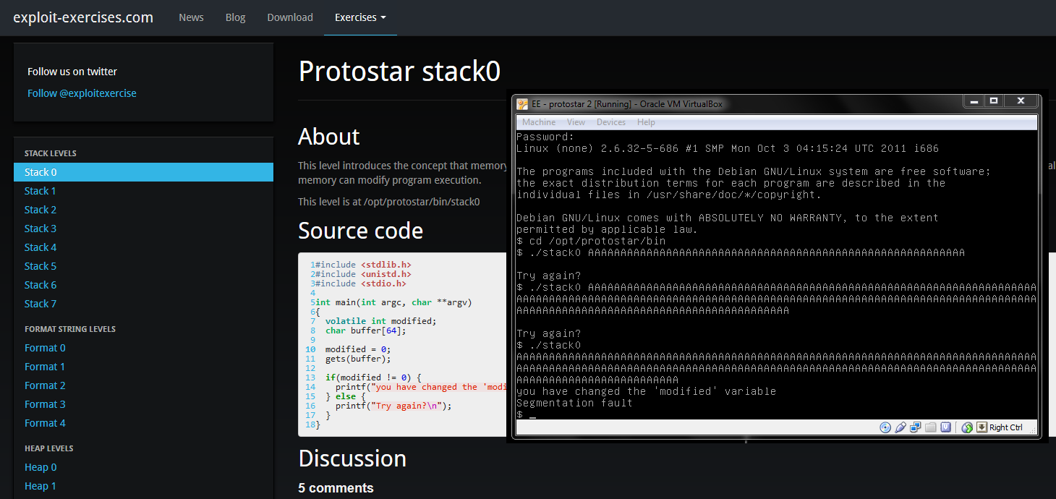
Protostar virtual image with exercises

