Slide 1
PA193 - Secure coding principles and practices
LABS: Static analysis of source code
Petr Švenda svenda@fi.muni.cz

Slide 2
Overview - Lab
Goal: Learn how to use basic tools
Discuss false positives / false negatives
Check C/C++ code with compiler warnings
Check C/C++ code with VS PREFast
Check C/C++ code with CppCheck
Check Java code with FindBugs

Slide 3
MS Visual Studio: Warnings and PREfast
Set project warning level to /W4 (or /Wall)
Run and compile bufferOverflowDemo.cpp
(don’t forget: new project must be created)
Fix all warnings for clean compilation in VS /W4
Run Code analysis on bufferOverflowDemo.cpp
Analyze→Run code analysis on …
You need have Project selected inside Project explorer (otherwise Run code analysis… option will not appear)
Try difference between ‘minimum’ and ‘all rules’
Try at home: gcc -Wall -Wextra

Slide 6
Questions (inspect whole BODemo.cpp)
What is the difference between /W3 and PREFast analysis?
Why you should compile without warning?
Are all bugs caught by static analysis?
Which bugs are not caught?

Slide 7
Cppcheck
Download Cppcheck and unpack (or install)
Use Cppchcek against bufferOverflow.cpp
run command line, cppcheck bufferOverflow.cpp
cppcheck --enable=all bufferOverflow.cpp
Setup Cppcheck GUI viewer for Cppcheck
(Notepad++ is already predistributed on lab computers or download at http://sourceforge.net/projects/notepadpp-usb/)
Edit → Preferences → Applications → Add
Executable: "C:\Program Files\Notepad++\notepad++.exe“
Parameters: -n(line) (file)
Run Cppcheck GUI and analyze files or directories

Slide 9
FindBugs/FindSecurityBugs - Java
Download FindBugs http://findbugs.sourceforge.net/
Download FindSecurityBugs (plugin)
https://find-sec-bugs.github.io/download.htm
copy findsecbugs-plugin-1.5.0.jar into FindBugs\plugin\ directory
List of patterns: https://h3xstream.github.io/find-sec-bugs/bugs.htm
Run FindBugs\bin\findbugs.bat (on Windows)
Or directly FindBugs\lib\findbugs.jar
Enable plugin in Edit → Preferences → Plugins

Slide 10
FindBugs/FindSecurityBugs - Java
Note: you need compiled *.jar for analysis
And source code for quick display of problems ☺
Extract content of crypto-java.zip
Run FindBugs
Start analysis
File → New project
Classpath for analysis: select target *.jar file (crypto_java.jar)
Source directories: select parent dir of target package
crypto-java\src\main\java\ in our case

Slide 13
Questions: FindBugs & FindSecurityBugs
Which issues were found?
Are all reported issues from project source code?
How you would rate severity of different issues?
How can you use FindBugs in team collaboration?
Is FindBugs working on source code or compiled code? Compare to CppCheck.

Slide 14
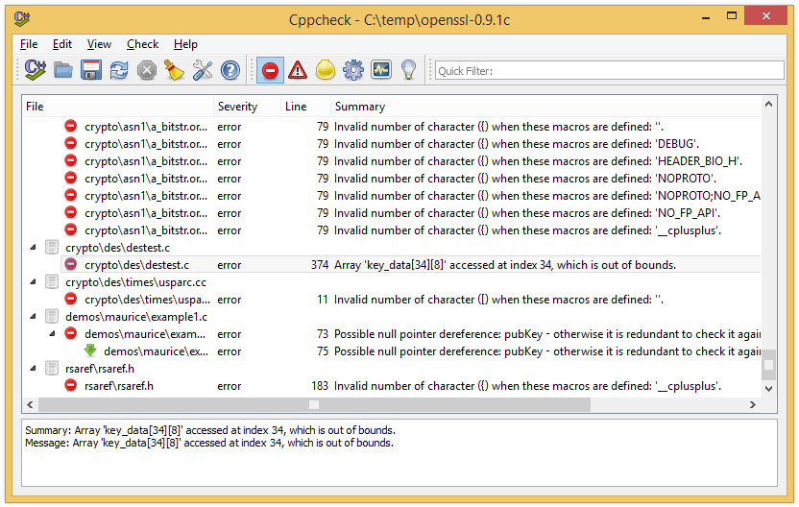
CPPCheck + OpenSSL
Run against OpenSSL0.9.1c (1998)
https://www.openssl.org/source/old/0.9.x/
What are the bugs?
Run against newest OpenSSL
ftp://ftp.openssl.org/source/
Why not completely clean yet?

Slide 15
Questions
Which bugs are found in bufferOverflowDemo.cpp? Compare to PREFast in Visual Studio.
Which bugs are found in old OpenSSL?
Are style warnings important?

Slide 16
Hearthbleed bug
OpenSSL 1.0.1 through 1.0.1f
Download https://www.openssl.org/source/openssl-1.0.1e.tar.gz
Locate function dtls1_process_heartbeat(SSL *s)
Ssl\t1_lib.c
Will your static analyzers find anything?
Don’t be sad, even Coverity didn’t before bug was exposed
http://security.coverity.com/blog/2014/Apr/on-detecting-heartbleed-with-static-analysis.html

Slide 17
Homework
Nothing this week ☺
Focus on implementation of parser

