Slide 1
Imperfect information and IT

Slide 2
On previous lesson
Knowing information
  Perfect, imperfect and asymmetric information
Knowing the behaviour of the others and rules
  Imperfect
  Incomplete
Searching and consequences
Information about price and quality
Auction models

Slide 3

Role of IT
IT is a tool to:
  fill the gap – to distribute information
  To eliminate the gap – using IT services to interconnect subject with negative effects of a gap
  Manage the information
    To prevent the influence of the gaps
    To eliminate the gaps

Slide 4
The price of information
Is almost individual
It is equal to the searching (opportunity) costs
It is important to divide the price of information and the price of access to information
  To buy the possibility to search
  To buy a possibility to share information
  The question of technology
  Higher speed means higher probability to find what I am looking for

Slide 5
Technology progress
costs
B
A
N
T
T₂
speed

Slide 6
Government and information
It needs the information for making of the decisions
It is important source of information
It is supervisor on the market with information

Slide 7
Government as the information receiver
The most of analysis is done by
  state institutions
  ministry clerks
  National bank
The government is the source of information for itself
  The analysis can be wrong
  The decisions can be wrong – moral hazard
  The question of time

Slide 8
The government and searching of information
Where is the equilibrium of searching
Stigler model does not work
  The process of searching is excluded from the process of evaluating and using of the information
  The person who is searching does not know the effect
We can not be sure that the government has right information
We can not be sure the information are correct
  Moral hazard
  The Greece

Slide 9
The government as the source of information
The government is not one source of information
The motivation of the clerks
  To publish only the information that are good for them
  Moral hazard
The subjects need the information from other source to prove it

Slide 10
The government regulates the market of information
Direct approach
  Problem of the identification of information gap
  Absolute filling
    How to do it
    Law – market subject must give some information to the register
  Relative filling
    Not necessary to identify a specific problem, just a group of problems
    Mandatory insurance

Slide 11
The government regulates the market of information
Indirect approach
  Development of information sources and channels
  Support of using services
    Digital mail-boxes
    Digital signature
    E-government
  Supporting the development of the information access

Slide 12
Knowledge we need more
Service System
Elements of service system
  Client
  Provider
  Target
Consequences and relations

Slide 13
Service system
Provider
  Individual
  Organization
  Any of previous combined with the technology and/or piece of environment
  Technology that provider is responsible for
Client
  Individual
  Organization
  Any of previous combined with the technology and/or piece of environment
  Portion of reality owned by Client
Target
  The reality to be transformed or operated on by Provider for sake of Client
  People, dimensions of business
  Dimensions of products, technology artefacts & environment
  Information, codified knowledge

Slide 14
Mention - Use
Forms of relationship
value co-creation
value proposition
information sharing
Provider
Client
Mention
Forms of ownership
C is owner of T or
C needs an added
value on T
Forms of responsibility
P is responsible for
the actions with T
Mention/Use
Use
Target

Slide 15
Problem of moral hazard
a tendency to take undue risks because the costs are not borne by the party taking the risk
The customer is able to affect an event he is insured against, but the seller has no power to monitor or affect this event.
  ERP supplier has limited information about customers IT security
  Provider has limited information about the basement of the real client´s problem
Double moral hazard
  Client does not know if the provider is able to operate on the particular target

Slide 16
Double moral hazard
Illusion of value proposition
Provider is not able to see the basis of target
Client is not able to see the benefits of the cooperation
Both are motivated to share information and knowledge
Value proposition can not be set up

Slide 17
Example
The company needs information system to support its core business
The company has serious problems with
  communication with customers
But also hidden problems
  publishing information
  time spent on one particular business case is too long – mostly caused by bad communication inside the company

Slide 18
IT company
Offers a big customised ERP system together with CMS system
  CMS system has connection to Social Networks
The problem to solve is the communication
But it is not a part of the problem
IT company needs to find its paths through particular targets – to analyse the situation if the client

Slide 19
Value
Value proposition is hidden
  is hidden by the hill
Hierarchy of barriers hiding the target
  have to be overcame step by step
  leads to process of value estimation
Value can not be proposed
It can be only estimated
  is used to find value proposition
  there is not a target, only target area
    target area is the space of all sub-targets, corresponding with particular value estimation

Slide 20
Value estimation
modified by the value co-creation process
motivated by the decreasing of the level of information asymmetry of both parties
the process is about particularize of value estimations
till the moment of founding the value proposition

Slide 21
Value proposition
can be found in the moment client and provider can see the target
  share the same point of view
  both can see the utility level
  and share as well
both partners agree with concrete mutual criteria of success
  variables to test
    no of customers
    profitability
  target values
    number of customers rise of 30%
    profitability rises more than 10%

Slide 22
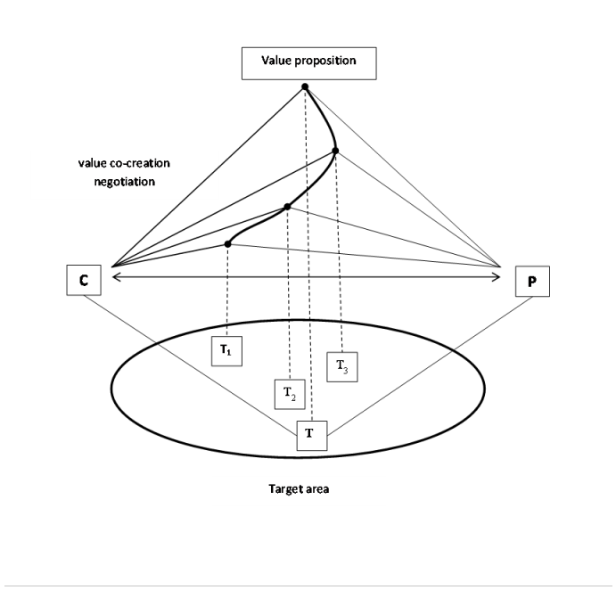
Value proposition

Slide 23
Costs of value estimation
must be shared and paid
  problem is complex
  must be understood and explored
provider must be paid for using his sources to do it
Client is paying for the analysis of the target area

Slide 24
Conclusion
Information asymmetry and its role in service system
Value estimation
Target area
Negotiation and information sharing
  Leeds to target finding

