Slide 1
Context adaptive modeling tool in service design
Petr Štěpánek
Leonard Walletzký
Mouzhi Ge

Slide 2
Why do we need modelling?
To understand the problém?
To find possible solution?
To cover the situation?
We model, because we need to use tools and methods from one domain to solve the problém in other domain.
From the provider perspective we need to know how we can help the customer.
From customer perspective we want to be sure we are not wasting time and money

Slide 3
How do we model?
We have a lot of different tools
Some of them are well known and used in different domains, like
UML
BPMN
CASE tools
And many others

Slide 4
Current limitations
Current modeling tools are describing one situation in one particular context
That can be used in very simple situations
The development goes in oposite direction
Problems are more complex
Services become more complex
Modeling tools are more complicated
Stakeholeders are not able to understand the models

Slide 5
Example – street lighting
Inteligent LED lamps
They dim the light if there is no pedestrian to save the energy
For this purpose the lamp must be equipped by camera and/or the sensor monitoring the situation on the street
This device can be used for other different purposes
To help with parking
To monitor suspicious behaviour
To announce the police or emergency services
It means the device can be used in many different contexts
The question is if there is some relation among those contexts?

Slide 6
Decomposing services
For modeling such a complex services we need a new generation of modelling tool with following features:
Enable to decompose any situation into a set of elements
Build any related model by a specic use of those elements in any context
Recognize the dierences among the contexts and describe them
Moreover, this modeling tools must be understandable to the stakeholders from more than one discipline

Slide 7
4 – diamonds model
Based on theoretical concept published by Staníček, 2008
Practically it tries to find a universal way how to describe the proces of thinking in our brains
The main issue is there are too many unique brains with specific way of thinking
Therefore it is never possible to be fully certain if all involved stakeholders are really understand the context

Slide 8
How do we model reality in our heads?
We identify...
Object
-s
...we find interesting

Slide 9
Then, we find...
Relationship
-s
...between our...
Object
-s

Slide 10
Each relationship can connect multiple objects...
Relationship
Relationship
Relationship
Relationship
Object
Object
Object
Object
...and each object can be present in multiple connections.

Slide 11
Each relationship can connect multiple objects...
Relationship is specifically defined n-dimensional set of objects
Relationship
projection
Object
...and each object can be present in multiple connections.

Slide 12
Which objects do we find interesting for modelling?
I can describe anything now!
I know when to perform particular operation
Relationship
Now I can change the state
Category
Rule
Operation

Slide 13
MENTION – USE duality
I am using category here.
Relationship
R
P
Category
R
Object
R
Rule
I am thinking about category here.
R
Operation

Slide 14
Diamond of Attention Focussing
I am in syntactic part
I can connect relationship with dynamic rule!
Relationship
characteristic
characteristic
R
P
Category
R
Object
R
Rule
I am in dynamic part
I can connect operation with specific categories!
R
characteristic
characteristic
Operation

Slide 15
Diamond of Attention Focussing
Objects and relationships between them
Mention-use duality
Modelling a modelling tool
Referring to itself
Relationship
characteristic
characteristic
R
P
Category
R
Object
R
Rule
characteristic
R
characteristic
Operation

Slide 16
Classification example
killing
killing
Juliet
In love with
Romeo
In love with
killing
Paris

Slide 17
We can see that some connections are somehow similar – they belong to the same category:
killing
killing
Juliet
In love with
Romeo
In love with
killing
Paris

Slide 18
It‘s possible to classify everything we see in the diagram. But how to classify our objects?
killing
killing
Juliet
In love with
Romeo
In love with
killing
Paris

Slide 19
We could certainly divide the objects to men and women:
killing
killing
Juliet
In love with
Romeo
In love with
killing
Paris

Slide 20
But won‘t it be more useful to show, which character belongs to the house of Montague and which one to the house of Capulet?
killing
killing
Juliet
In love with
Romeo
In love with
killing
Paris

Slide 21
It probably depends on a context – a mental model we want to build. Sometimes, both categorizations may be useful:
killing
killing
Juliet
In love with
Romeo
In love with
killing
Paris

Slide 22
Classifications are blurred Good or bad?

Slide 23
Certainty
Items (= objects as such, not their constructs) belongs to a category with a given certainty
Item can belong to more categories!
Category
CI-connection
Item

Slide 24
Attention
The fact is manifested with a certain attention in a given context
Category
CI-connection
Item
Context
And context gives a design to the manifestaion.
And here it is about particular manifestation of CI connection
Manifestation

Slide 25
Context base
Context serves as a model. The base edge defines the set of categories to classify its items to
One category can exist in more contexts and vice versa.
Category
base
R
CI-connection
Item
R
Context
R
R
Manifestation

Slide 26
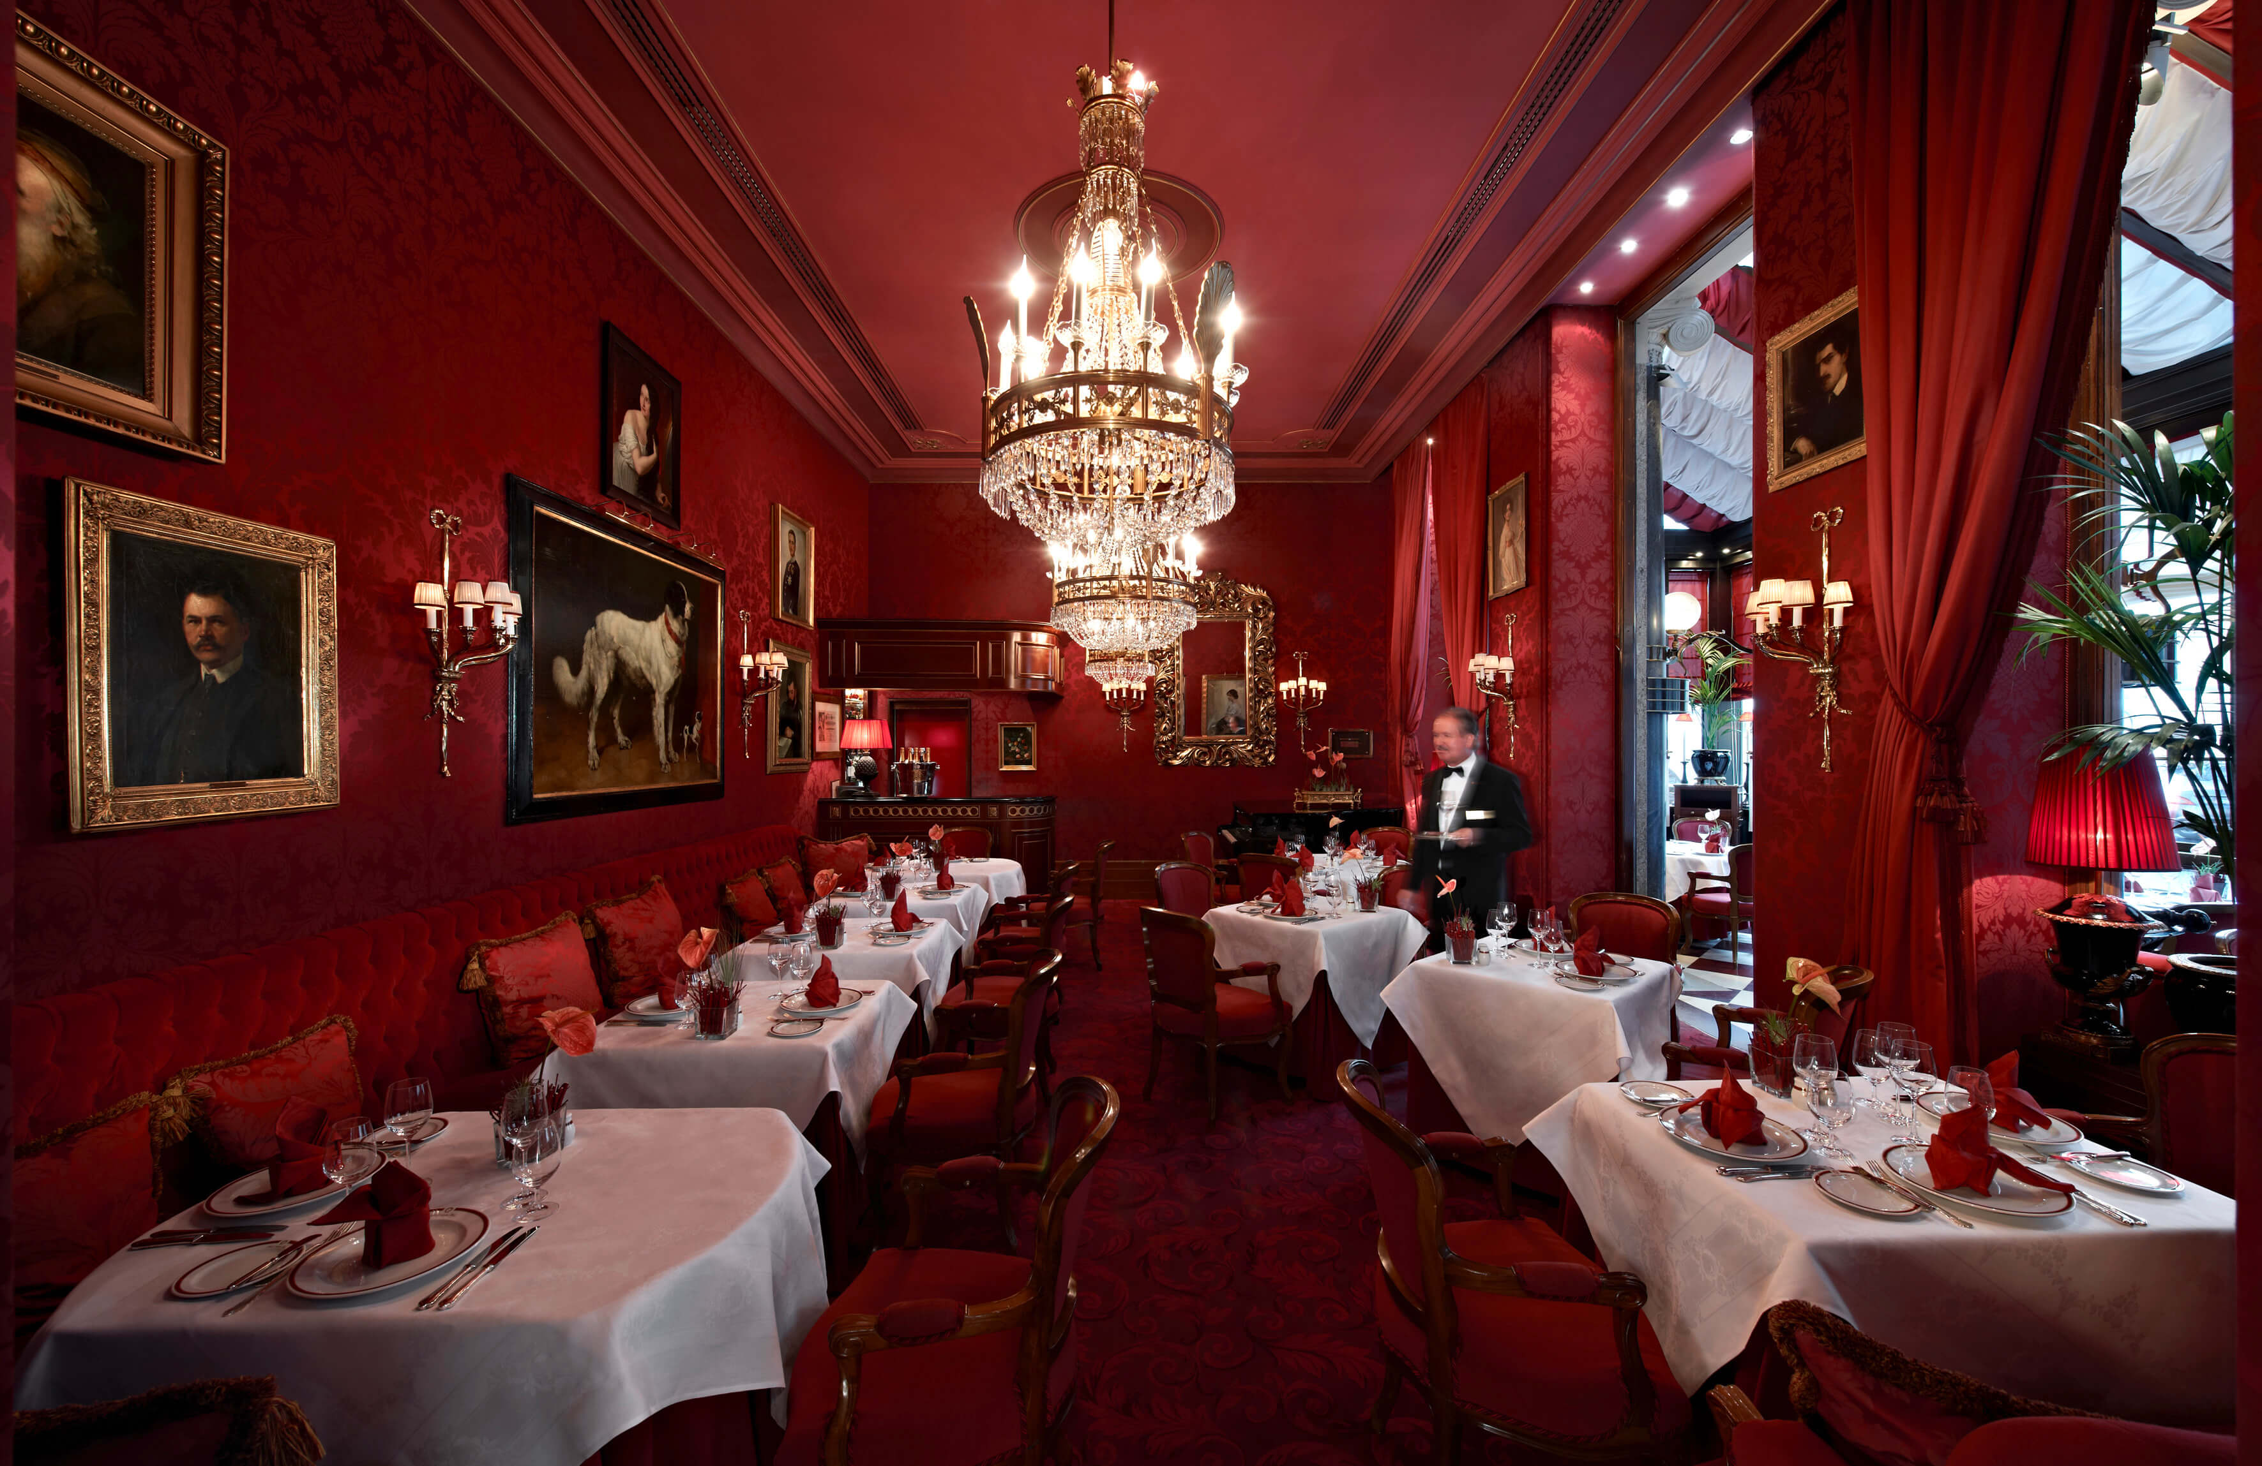
Independent models
Geography
Restaurant
Geography: Context
Restaurant: Context
Sahara: Manifestation
Sacher Cake: Manifestation
Sand desert: CI-connection
Sweet desert: CI-connection
Sand: Category
Desert: Item
Sweet: Category

Slide 27
Diamond of Organization
GBS
R22
Goal
reaching
reaching
fulfilling
fulfilling
follower
establisher
composite
R11
Action
Agent
Flow
organizer
organizer
member
member
author
learner
covering
superior
collaborator
focusing
R01
R02
Activity
detail
R33

Slide 28
Diamond of predictive behaviour
Goal
Model
fulfilling
recorded in
Use Case
Request
Context
forming / formed by
occurring within
addressing
Agent
solved by
Service

Slide 29
Conclusion
In modelling tools we need to go back into the mind
We need to realize we need modelling tools to be more universal
To be used in different domains
The modeling tool must cover the increasing complexity of the services
Context is the essential part of the service realization and must be included into the models

