Slide 1
iDempiere and its history
© Leonard Walletzký 2016

Slide 2
Basic ideas
To create ERP system for SMEs
system that supports:
  Multiple tenants
  Multiple organizations (branches, plants, etc.)
  Multiple languages (29 localizations; mixed access in a single installation is possible)
  Multiple currencies
  Multiple account schemas
And can be provided as direct installation and/or a service
Easy for maintenance and development
Based on modern platforms

Slide 3
Workflow of the project
2000
Founded project Compiere
2006
Project Adempiere separated from Compiere
2011
Project iDempiere separated from Adempiere

Slide 4
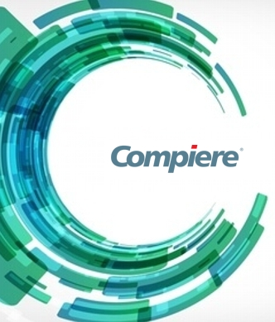
Compiere
First version released in 1999 by Jorg Janke
Top 10 Source forge project from 2004 - 2006
Based on Java platform
First installation sponsored by Good Year Germany
From the first version focused to SMEs
The code closed in 2006
Compiere used mainly Oracle database

Slide 5

Adempiere
Founded in 2006
Based on disagreement between a part of the Compiere user community and Compiere, Inc.
The philosophy of the model remain the same (MDA)
Whole time presented as Open Source project
Replaced Compiere on SourceForge.net
Based on Java EE technology
Utilizing JBoss application server
Database support is restricted to Oracle and PostgreSQL

Slide 6
Architecture of Adempiere
Adempiere inherited Data Dictionary from Compiere
Adempiere architecture extends this concept into application:
  The application entities
  Their validation rules
  Screen layout
All mentioned can be controlled from within application itself
That means for 95% of customization you do not need to code anything
Support of Business Process Management in Workflow engine

Slide 7

iDempiere
Also known as OSGi + Adempiere
Based on disagreement in Adempiere community in 2011
  Based on OSGi architecture
Extend Data Dictionary to Active Data Dictionary to manage
  Entities
  validation rules
  Windows
  Formats
  and other customizations of the application
All without new Java code
iDempiere is not ERP only, but the platform or Framework to build database driven applications

Slide 8

OSGi
Open Service Gateway initiative
  Founded in 1999
OSGi specification
  Describes modular system and service platform for Java
  Implements a dynamic component model
  Applications or components
    Are coming in the form of bundles for deployment
    Can be remotely installed, started, stopped, updated and uninstalled without restart or reboot

Slide 9
Versions of iDempiere
Release date^{[13]} | Version number | Notes
October 31, 2012 | 1.0.a Halloween Edition () | First official version Alpha version
April 24, 2013 | v1.0b Devina | Beta version
June 27, 2013 | v1.0c Devina LTS[ | Stable version
October 31, 2013 | 2.0 | Stable version
October 31, 2014 | 2.1 | Stable version 266 weekly downloads
October 31, 2015 | 3.1 (Maitreyi) | Daily maintained version Stable version 411 weekly downloads

Slide 10
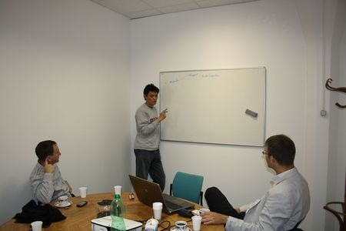
iDempiere on Faculty of informatics
Since 2011
  First installed version – Adempiere 360 TLC
  Not working anymore
From 2013 we are cooperating only on project iDempiere
  25.5.2013 – visit of the founder of iDempiere on Faculty of informatics
  Redhuan D. Oon (red1)

Slide 11
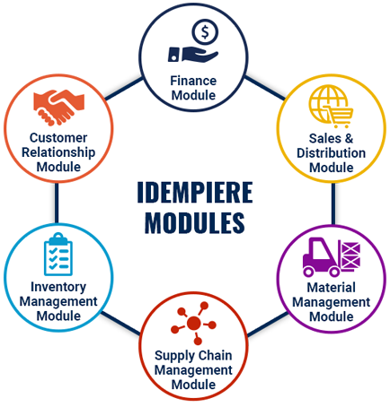
Main modules in iDempiere

Slide 12
Main sources to study
The server of iDempiere project – www.iDempiere.org
The pages of Laboratory of service systems - http://ssme.fi.muni.cz/student/laborator-ses
The running installation of iDempiere on FI:
https://iDempiere.fi.muni.cz:8443/

Slide 13
Conclusion from the presentations
Basic types of information systems
ERP system as a mix of other systems
  Advantages
  Functionality
  Special role of accounting
Why do companies need the ERP systems?
The main features of ERP system
The process of implementation of ERP system
The main objectives of ERP system implementation and the system of supporting mean objectives

