Slide 1
Lecture 6
Vít Svoboda

Slide 2
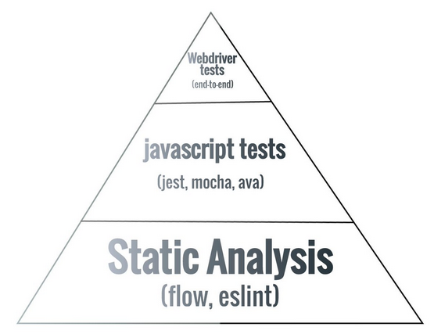
Testing
Source: https://twitter.com/aaronabramov_/status/805913874704674816

Slide 3
Test categories
Unit tests
Integration tests
End-to-end tests

Slide 4
TDD
Write a test
See the test fail
Fix the test by adding an implementation

Slide 5
Frameworks
A lot of them, as it happens with JavaScript, e.g.:
Jasmine
Mocha + Chai
Jest
Mostly similar API.

Slide 6
What to Test in a React App?
Reducers
Thunk actions
Utility functions
Action creators?
Components?

Slide 7
Dependency Injection
You may know from SOLID.
A bit different in JavaScript due to the lack of proper types. Closure to the rescue!
const stuffs = []; function getStuff() { // Whatever implementation } function loadStuff() { const stuff = getStuff(); stuffs.push(stuff); }
const stuffs = []; function getStuff() { // Whatever implementation } function loadStuffFactory(dependencies) { return function () { const stuff = dependencies.getStuff(); stuffs.push(stuff); }; } const loadStuff = loadStuffFactory({ getStuff });

Slide 8
Mocking
Passing a “mock” instead of a real dependency.
Test can check whether the mock was called and the parameters it was called with.
https://facebook.github.io/jest/docs/en/mock-functions.html

Slide 9
Testing Components
How to check the render returned correct elements?
Relatively normal tests using Enzyme.
Jest snapshot tests using react-test-renderer.

Slide 10
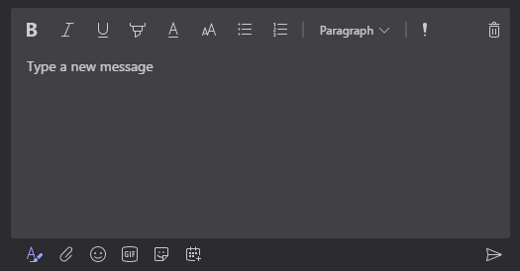
Rich Text Editor
A text area allowing to format the text and insert inline images etc.
People love it!

Slide 11
Draft.js
React friendly
It’s a framework – no built-in features
https://draftjs.org/

Slide 12
Building Own Rich-text Editor
Formatting
Decorators
Entities with custom renderer
Much more…
https://draftjs.org/docs/overview.html

Slide 13
EditorState
What to do with it?
Functions convertToRaw & convertFromRaw for persistence.
https://draftjs.org/docs/api-reference-data-conversion.html
Export to HTML.
https://github.com/sstur/draft-js-utils/tree/master/packages/draft-js-export-html

Slide 14
Editors Based on Draft.js
Foundation for many fully-featured editors
https://github.com/sstur/react-rte
https://github.com/draft-js-plugins/draft-js-plugins

Slide 15
Questions?

