Slide 1
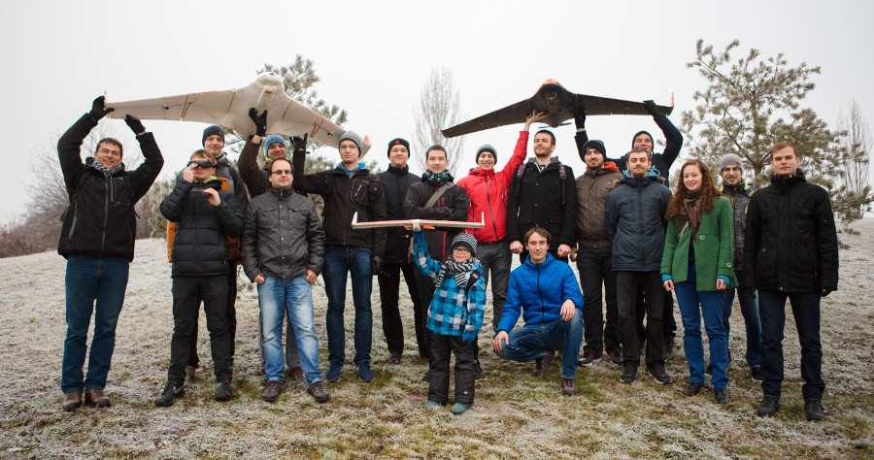
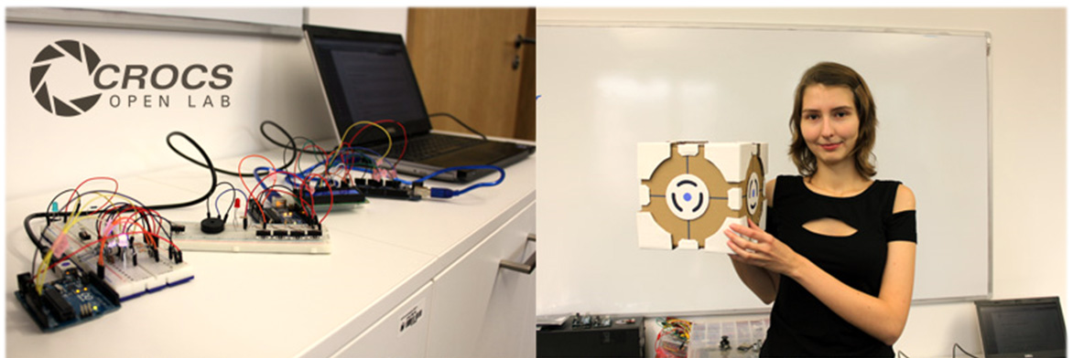
OpenLab – basic idea
Informal collection of active students and CRoCS’s members
Wide range of topics: security, cryptography, lockpicking, 3D print, Bitcoin, UAV, juggling, CPU tunning…
See archives of the previous years at https://crocs.fi.muni.cz/openlab/
Running every week the during teaching semester
but not a formal course (come as you like)

Slide 2
21.9.2018, 10:00, A403: Available Bc/Mgr thesis topics
Come if looking for the thesis topic (2-4 semesters before end)
Short introduction to the current main laboratory themes
List of available thesis topics
And space for questions towards potential supervisors
All active students are welcome, tell others as well ☺
Planned topics this semester: Networking with Raspi Zero, Deep Neural Networks, JavaCards, LaserGame, Fun with osciloscope …

Slide 3
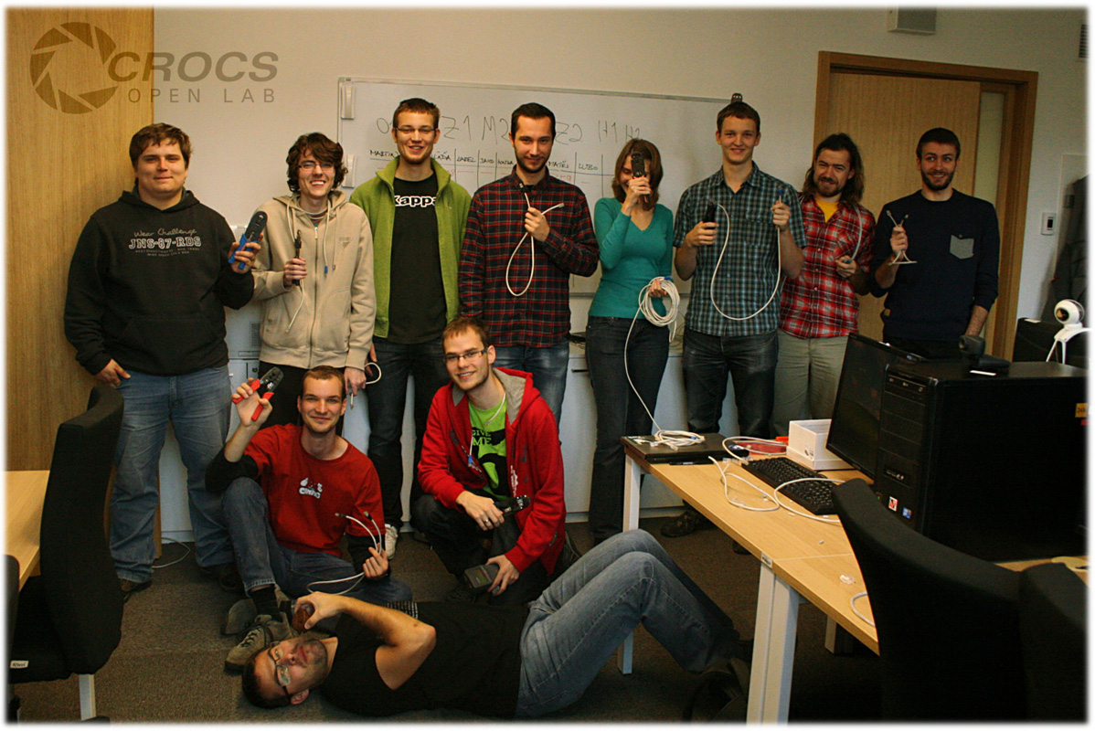
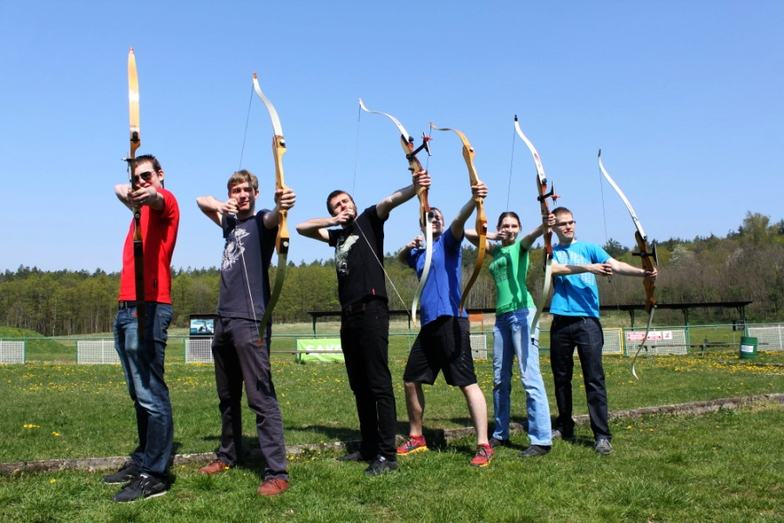
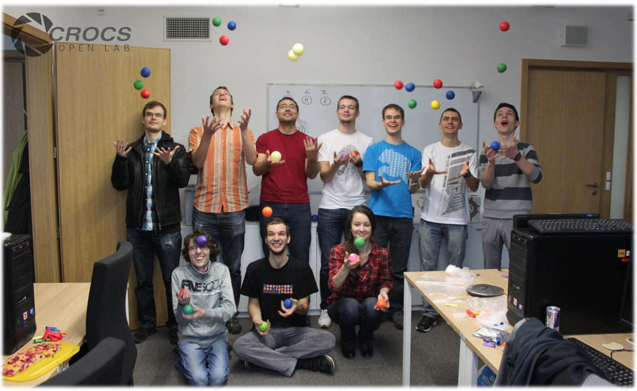
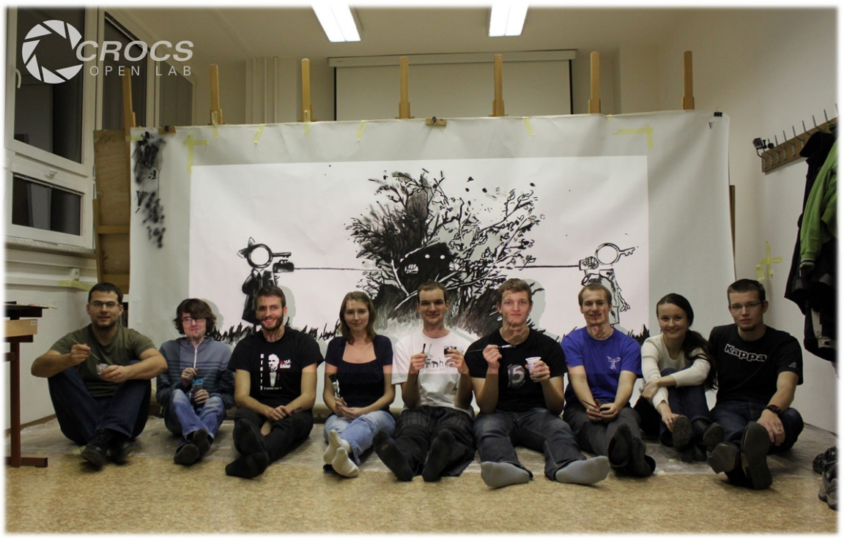
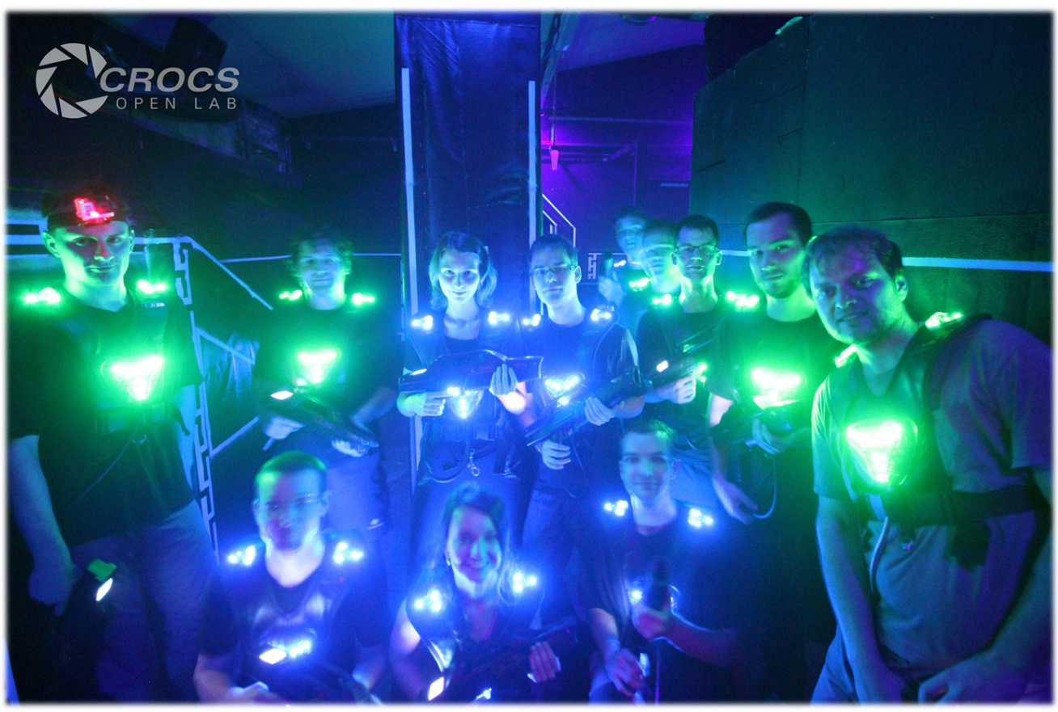
21.9.2018, 10:00 A403
https://crocs.fi.muni.cz/openlab

