Slide 1
Final summary
Introduction to Service Science

Slide 2
Main topics to remember
Service economy
Service Dominant Logic
Service system modelling
Service environment and service cooperation
Asymmetric information and its role in IT
Software as a Service
Basic of Diamond Path (4 diamonds)

Slide 3
Service economy
Product economy and basic consequences
Development of service economy, why it is important
Role of service in global economy
Why everything is a service?

Slide 4
Service dominant logic
Product dominant logic and its paradigm
Service dominant logic basic paradigms
SDL advanced paradigms
What is value proposition?
Difference in the role of customer in PDL and SDL

Slide 5
Service system modelling
Basic entities and their roles
  Provider
  Client (Customer)
  Target
Relation among them
Mention and use principle
Role of time

Slide 6
Service environment
How we build service environment
Basic features of the environment
Special cases of cooperation between service systems
  Cooperating service systems
  Dual service system

Slide 7
Asymmetric information
Definition and differences
Basic concepts and models
  Information about the price
  Information about the quality
Auction models
Moral hazard
Role of IT in the Framework of Asymmetric information

Slide 8
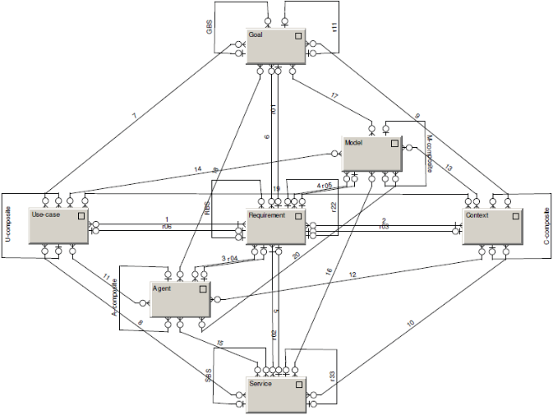
Diamond-Path Framework
Overview
See
Recognize
Organize
Do
Attention
Focussing
Cognitive
Elements
Agent-Team
Organization
Predictive
Behaviour
Category
base
R
CI-connection
R
Item
R
Context
GBS
R22
Relationship
Goal
characteristic
characteristic
R
reaching
reaching
fulfilling
follower
fulfilling
R
P
Manifestation
composite
establisher
R11
Category
R
Object
R
Rule
Action
organizer
Agent
organizer
Flow
member
member
author
learner
characteristic
R
characteristic
covering
superior
collaborator
focusing
Operation
R01
Activity
R02
detail
R33

Slide 9
Simple case study
Assignment:
To develop a service that recommend a proper road to the user, depending on the particular situation of the user.

Slide 10
Realization
Context | Requirement | Service | Agent | Goal | Model | Use Case
Healthy run of the citizen | To find optimal road | Road planner | Citizen | To be healthy | Relaxing roads | Current status of weather and air pollution
Race of the moto bikers | To find optimal road | Road planner | Moto driver | To win the race | Race maps | Weather (rain / sunny), position of other participants
Emergency service | To find optimal road | Road planner | Driver of emergency vehicle | To get to the place of accident | City street map | Current situation of traffic

Slide 11
Exam
Two parts
  5 closed question
  3 open question
Exams will be open in IS this Wednesday

