Slide 1
Application of Service Science
© Leonard Walletzký

Slide 2
Value estimation
How to find proper value proposition

Slide 3

Problem of moral hazard
a tendency to take undue risks because the costs are not borne by the party taking the risk
The customer is able to affect an event he is insured against, but the seller has no power to monitor or affect this event.
  ERP supplier has limited information about customers IT security
  Provider has limited information about the basement of the real client´s problem
Double moral hazard
  Client does not know if the provider is able to operate on the particular target

Slide 4
Double moral hazard
Illusion of value proposition
Provider is not able to see the basis of target
Client is not able to see the benefits of the cooperation
Both are motivated to share information and knowledge
Value proposition can not be set up

Slide 5
Example
The company needs information system to support its core business
The company has serious problems with
  communication with customers
But also hidden problems
  publishing information
  time spent on one particular business case is too long – mostly caused by bad communication inside the company

Slide 6
IT company
Offers a big customised ERP system together with CMS system
  CMS system has connection to Social Networks
The problem to solve is the communication
But it is not a part of the problem
IT company needs to find its paths through particular targets – to analyse the situation if the client

Slide 7
Value
Value proposition is hidden
  is hidden by the hill
Hierarchy of barriers hiding the target
  have to be overcame step by step
  leads to process of value estimation
Value can not be proposed
It can be only estimated
  is used to find value proposition
  there is not a target, only target area
    target area is the space of all sub-targets, corresponding with particular value estimation

Slide 8
Value estimation
modified by the value co-creation process
motivated by the decreasing of the level of information asymmetry of both parties
the process is about particularize of value estimations
till the moment of founding the value proposition

Slide 9
Value proposition
can be found in the moment client and provider can see the target
  share the same point of view
  both can see the utility level
  and share as well
both partners agree with concrete mutual criteria of success
  variables to test
    no of customers
    profitability
  target values
    number of customers rise of 30%
    profitability rises more than 10%

Slide 10
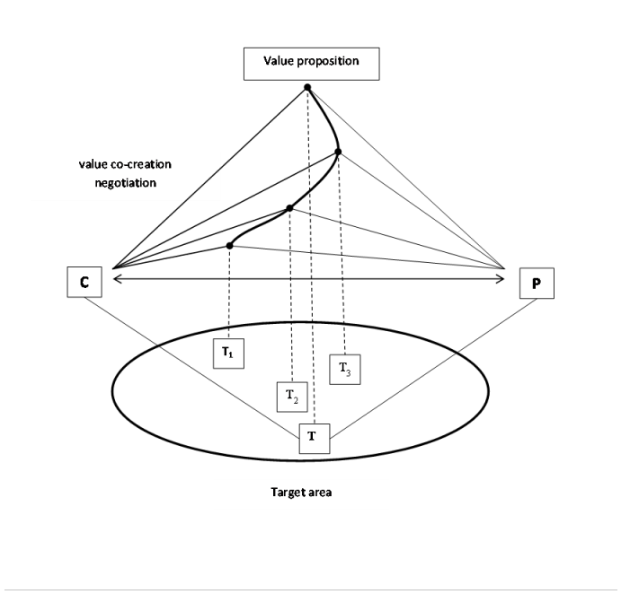
Value proposition

Slide 11
Costs of value estimation
must be shared and paid
  problem is complex
  must be understood and explored
provider must be paid for using his sources to do it
Client is paying for the analysis of the target area

Slide 12
Software as a Service

Slide 13
History
60s
  Centralized hosting of business applications
  service bureau
    company which provides business services for a fee
    eg. IBM
    time-sharing
    sharing of a computing resource among many users by means of multiprogramming and multi-tasking
  utility computing
    a service provisioning model in which a service provider makes computing resources and infrastructure management available to the customer as needed, and charges them for specific usage rather than a flat rate
  mainframes

Slide 14

History
90s
  Application Service Provider (ASP)
    thanks to expansion of the Internet
  class of centralized computing
  services of
    hosting
    managing specialized business applications
  reducing costs through
    the solution provider's specialization in a particular business application
    central administration

Slide 15
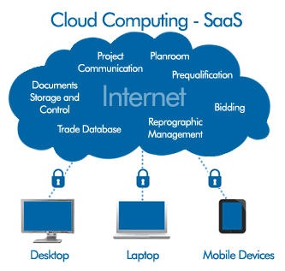
History
2001
  Software as a Service
  extends the idea of the ASP model
  software vendors
    first ASPs were focused on managing and hosting of third-party independent software vendors' software
  SaaS
    typically develop and manage their own software

Slide 16
History
application clients
  ASP
    Client - Server
    initial ASP used thick clients
  SaaS
    Thin Clients
    Web browsers
software architecture
  ASP
    maintaining a separate instance of the application for each business
  SaaS
    utilize a multi-tenant architecture
    multiple businesses and users

Slide 17
Applications
Well known SaaS
  Gmail
  Google Drive
  Office 365
Messaging
DBMS software
management software

Slide 18
Applications
CAD software
development software
accounting
collaboration
project management
customer relationship management
management information systems
enterprise resource planning
invoicing
human resource management
content management
service desk management

Slide 19
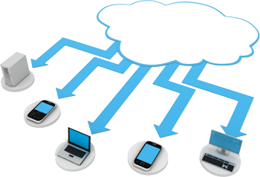
Architecture - provider
Cloud
Cloud Service models
support of scalability
  horizontal scaling
  the application is installed on multiple machines
tenant

Slide 20
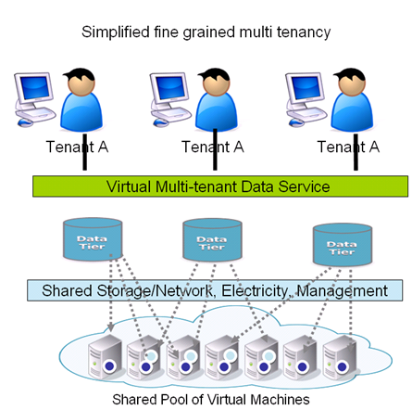
Architecture - provider
  multi-tenant services
    Vast majority of SaaS solutions
    a single
      version of the application
      configuration
      hardware, network, operating system
    advantage in comparison with traditional software
    multiple physical copies
    potentially different versions
    different configurations

Slide 21



Architecture - client
Thin Client
  Web Browser
Hybrid
  Dropbox
For integration with internal systems
  Application programming interfaces

Slide 22
Business models
Subscription fee
  User
  Time unit
    typically
      month
      annual
  Transaction
  Support
Advertising
Freemium
  basic functionality is for free
  restrictions in
    capacity
    functionality
    support
    users
    time
    bandwidth
  money si charged for
    proprietary functions
    functionality
    ...
  multi-tenant

Slide 23
How to describe to managers?
Managers are not IT experts
They are focused on core business of the companies
They understand the language of the money
They see IT as the source of problems and non stability
Positive
Negative
Strengths
Opportunities
Weaknesses
Threats

Slide 24
Strengths
Less risky
Immediate
Reduce IT support costs
Initial setup cost for SaaS is typically lower than the equivalent enterprise software
Architecture
Economy of Scale
Enables Mashups

Slide 25
Low risk level
Customer
  Lower initial investment
    Software and hardware
  Even the long time usage price is higher
    Compare with better ROI (return of investments)
    Avoiding the peaks of cash flow (the highest danger is based on unexpected costs)
  Example
    CRM or ERP system
Provider has regular income

Slide 26
Immediate
SW deploy
Updates
  more often
  update is decided and executed by provider, not by customer
single configuration
faster testing
vendor has access to
  all customer data
    expediting of design
    regression testing
  analytics of user behaviour

Slide 27
Weaknesses
Migration of data
Integration of clients
Tailored customization
Can't directly access a company's internal systems
Customer might be forced to use a new versions

Slide 28
Opportunities
SaaS Integration Platforms
  Complex systems that integrates particular services
    CRM
    ERP
Growth of SaaS sales on global market
Enables Mashups
  integrating content from more than one SaaS
  to create a single new service displayed in a single graphical interface

Slide 29
Threats
Unreliable provider of the service
  Bankrupt
  The physical presence of data
Security and privacy
  is common corporate infrastructure more secured than data centres of cloud?
  HTTPS
Connection
  Latency
  Reliability

Slide 30
Sence of SWOT
SaaS is only one from many solution
Task is to give proper service for concrete situation
Managers need to understand
  Advantages
  Risks
To have real expectations

Slide 31
Conclusion
SaaS is one way to distribute service
In many points of view has positive influence to both parties business
Needs to be described and set properly

