Slide 1
Crypto libraries OpenSSL (cont.)
Milan Brož xbroz@fi.muni.cz
PV181, FI MUNI, Brno

Slide 2
OpenSSL – www.openssl.org
opensource cryptography toolkit
Apache-style license
hash, symmetric/asymmetric encryption, PKI, CA, ...
ASN.1, PKCS-5,7,8,12, X509, OCSP, PEM
SSL and TLS
command line tool
C/C++ library bindings (+many other library wrappers)
on Linux compile with -lcrypto –lssl
#include <openssl/...>

Slide 3
Today’s exercise
Continue with OpenSSL on Linux
Symmetric Encryption
Demonstration of failures in some modes
BIO (I/O abstraction)
Assignment (see separate file, 10 points)

Slide 4
Example 4: Symmetric encryption
OpenSSL
Encryption with EVP interface. Cipher mode is for example EVP_aes_256_cbc(). EVP_CIPHER_CTX_new() EVP_EncryptInit_ex(context, EVP_cipher_mode, NULL/*engine*/, key, iv) EVP_EncryptUpdate(context, ciphertext, &clen, plaintext, plen) EVP_EncryptFinal_ex(context, ciphertext + clen, &len) EVP_CIPHER_CTX_free(context)
See 4_encryption_openssl directory.

Slide 5
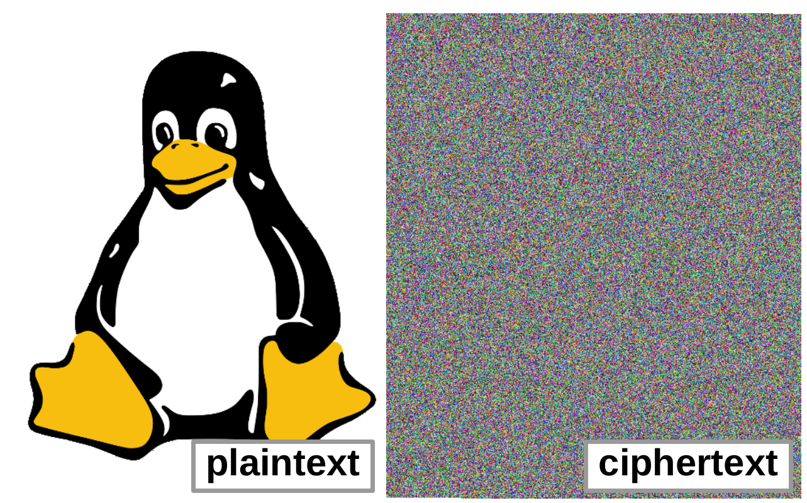
Symmetric encryption: ciphertext

Slide 6
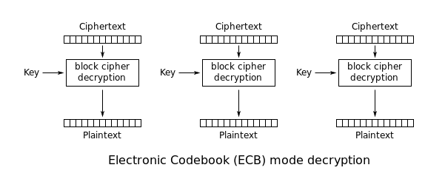
ECB mode …should be never used ☺
Wrong use demo: ciphertext patterns, block relocation.
See 4a_encryption_fails_openssl directory.
picture: Wikipedia

Slide 7
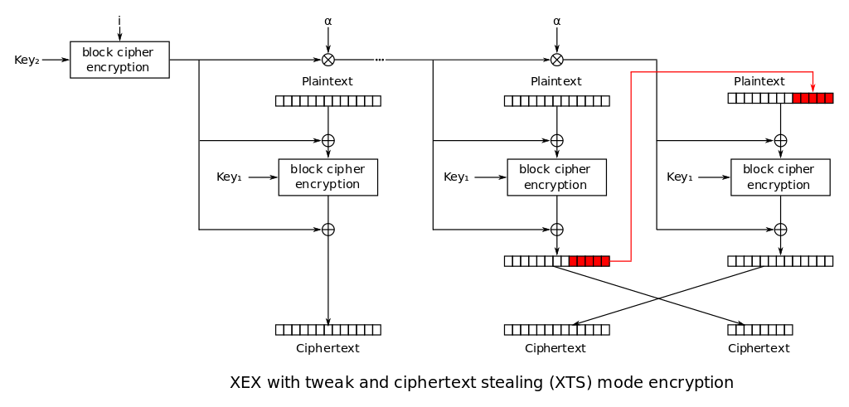
XTS mode storage (file, disk) encryption
Wrong use demo: block patterns with constant IV.
See 4a_encryption_fails_openssl directory.
picture: Wikipedia

Slide 8
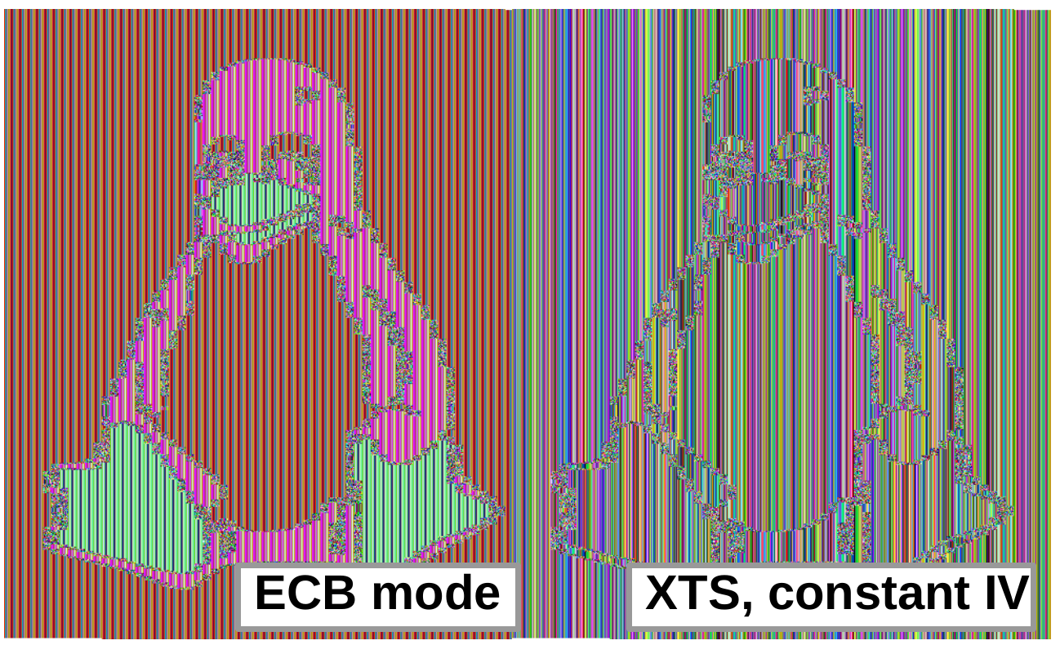
Symmetric encryption fails: patterns in ciphertext

Slide 9
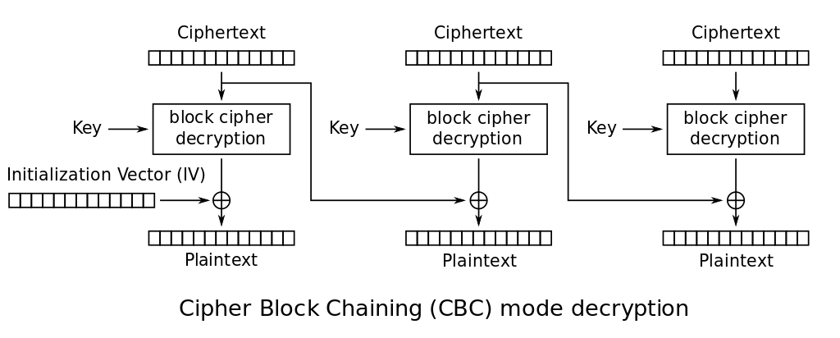
CBC mode
Wrong use demo: first block bit flips (IV) and consecutive block change.
See 4a_encryption_fails_openssl directory.
picture: Wikipedia

Slide 10
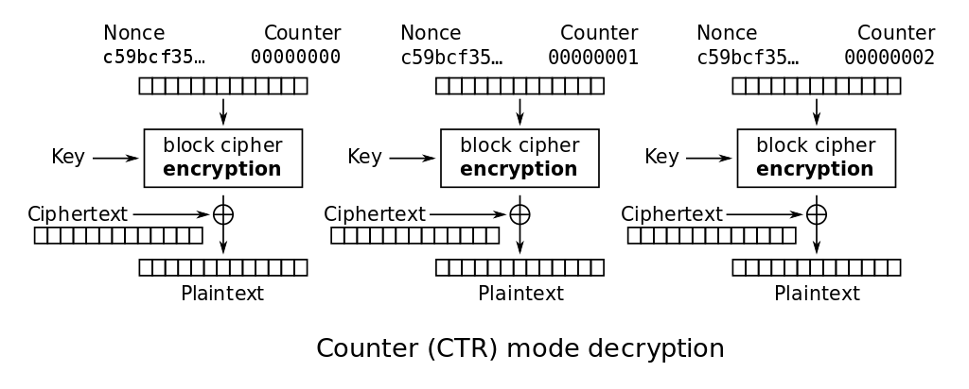
CTR mode (counter mode)
Wrong use demo: re-use key from known ciphertext/plaintext pair.
See 4a_encryption_fails_openssl directory.
picture: Wikipedia

Slide 11
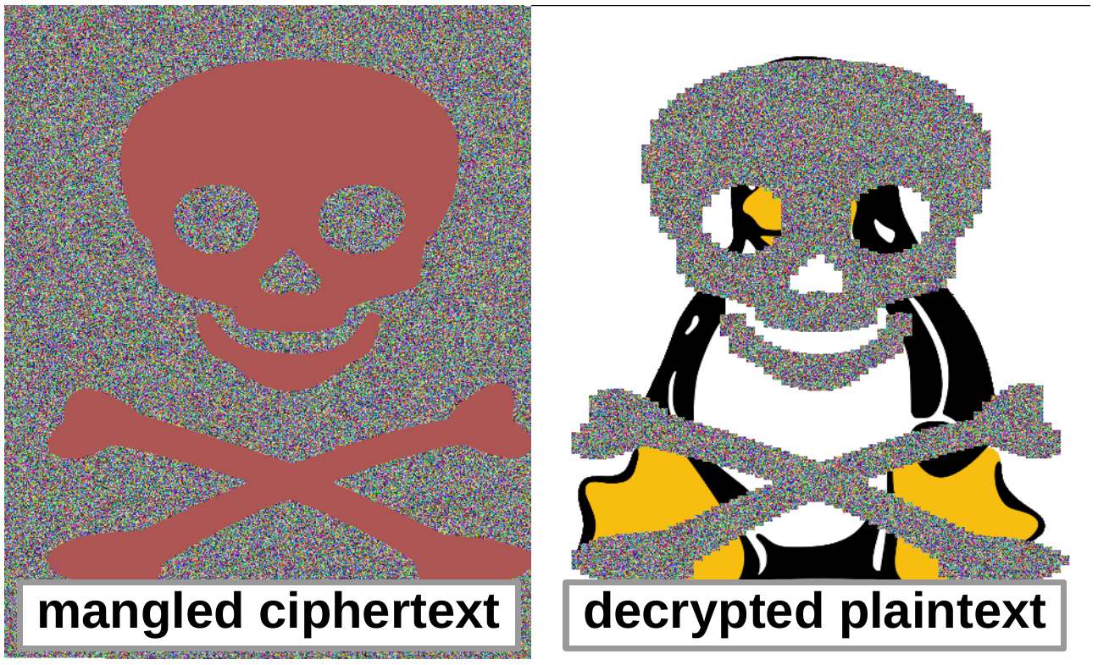
No integrity protection… (no authentication of data)

Slide 12
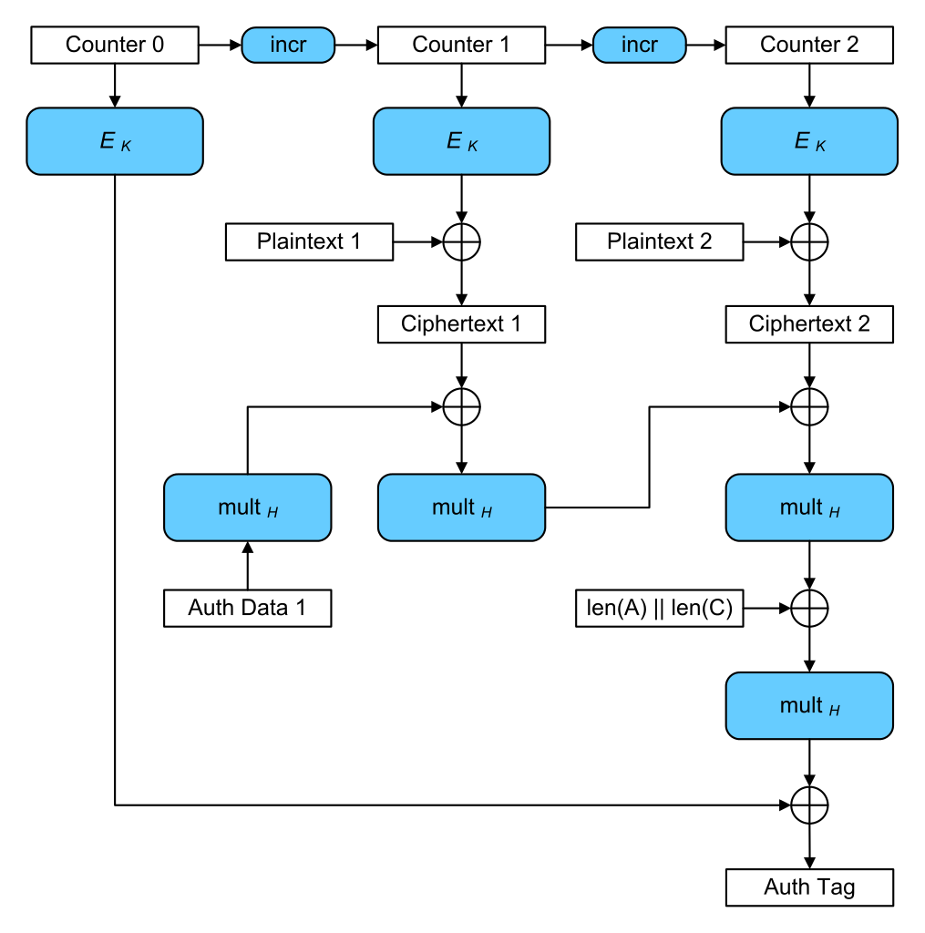
Authenticated mode GCM - Galois/Counter Mode
Authenticated Encryption with Additional Data (AEAD):
confidentiality + integrity.
additional auth. data (AAD)
data (plaintext/ciphertext)
authentication tag
See 4a_encryption_fails_openssl directory.
picture: Wikipedia

Slide 13
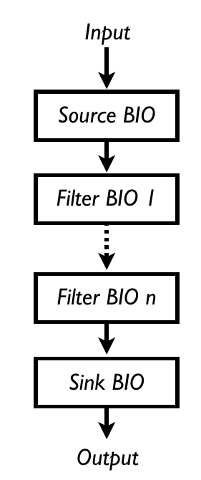
Example 5: OpenSSL BIO (I/O abstraction)
Source/sink BIOs: BIO_s_mem() - memory I/O BIO_s_file() - file I/O BIO_s_fd() - file descriptor IO BIO_s_socket() - sockets BIO_s_accept() BIO_s_connect() BIO_s_null() - discard (like /dev/null)
Filters BIO_f_base64() - Base64 encoding BIO_f_buffer() - buffering I/O BIO_f_cipher() - encryption/decryption BIO_f_md() - message digest BIO_f_ssl() - SSL support for BIO
Example 5: the same encryption as in Example 4 using BIO interface. See 5_bio_openssl directory.

Slide 14
Assignment
Two goals:
Use symmetric encryption (AES128-CBC) for a file.
Self-study OpenSSL manual/wiki and examples.
Max. 10 points.
See Assignment.txt in IS for details and deadline
You can start with examples in git
Comment your code
Note: for encryption expect binary input
You can use provided Fedora VM or aisa server (or any OpenSSL Linux, even Win10 embedded Linux)

