Slide 1
JCA/JCE
Java Crypto Architecture / Java Crypto Extensions
Dušan Klinec deadcode.me
Notes:
JCA = basic framework, providers, basic algorithms,
JCE = extensions on top of that, addeed ciphers, macs (subject to regulations before)
Since 1.4 merged together

Slide 2
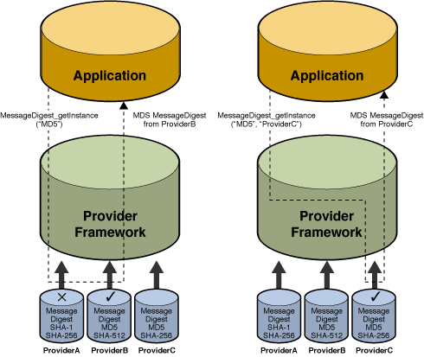
Provider architecture

Slide 3
Provider architecture
MessageDigest.
getInstance(“MD5”);

Slide 4
Provider architecture
MessageDigest.
getInstance(“MD5”,
“ProviderC”);

Slide 5
JCA
java.security.*
SecureRandom - PRNG
MessageDigest – SHA256, MD5, ...
Signature – RSA, DSA
KeyStore – PKCS12
KeyPairGenerator, KeyFactory, CertificateFactory,

Slide 6
JCE
javax.crypto.*
Cipher – AES, RSA, ElGamal, RC4, Salsa20
Mac – HMACWithSHA256
KeyGenerator

Slide 7
Provider architecture
Implementation independence
Implementation interoperability
Algorithm extensibility

Slide 8
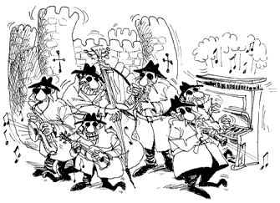
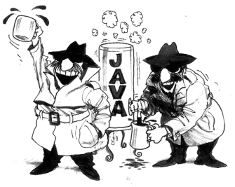
Bouncy Castle

Slide 9
Bouncy Castle
BouncyCastle

Slide 10
Bouncy Castle
Implements a LOT OF ciphers, cipher suites, algorithms, modes, ASN.1, PEM, Certs, …
Origin: Australian, former advantage (crypto regulations)
Android

Slide 11
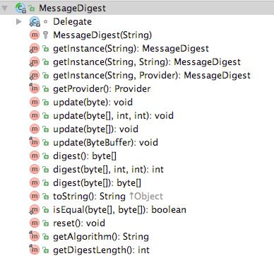
Provider architecture – Engine classes
getInstance()
update()
digest()
reset()

Slide 12
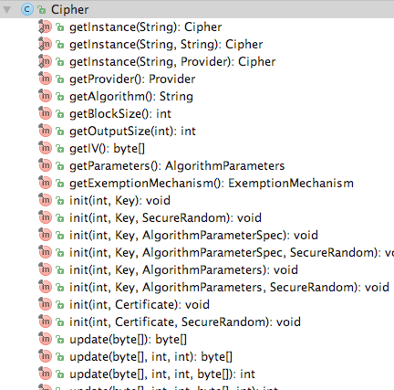
Provider architecture – Engine classes
getInstance()
init()
update()
doFinal()

Slide 13
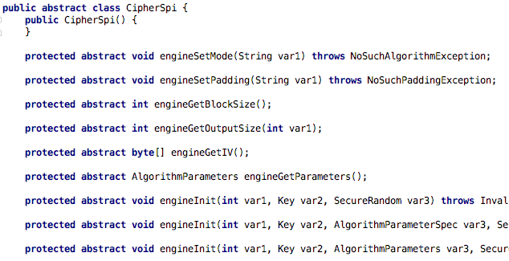
Provider architecture – Spi skeleton

Slide 14
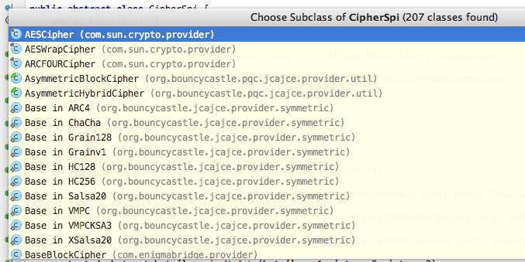
Provider architecture – Spi skeleton

Slide 15
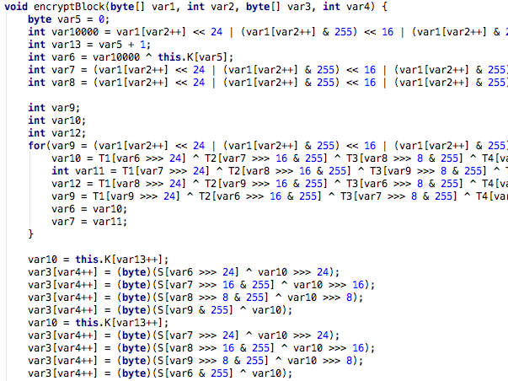
Provider architecture – Spi skeleton
Notes:
Pure java implementation of crypto. Tradeoffs interoperability vs. speed.
Some providers with C-accelerated or HW accelerated implementations.

Slide 16
Strong cryptography
Limits the strength of your crypto
the size of the Key
AES-256, RSA-2048 not available by default
Java Cryptography Extension (JCE) Unlimited Strength Jurisdiction Policy Files

Slide 17
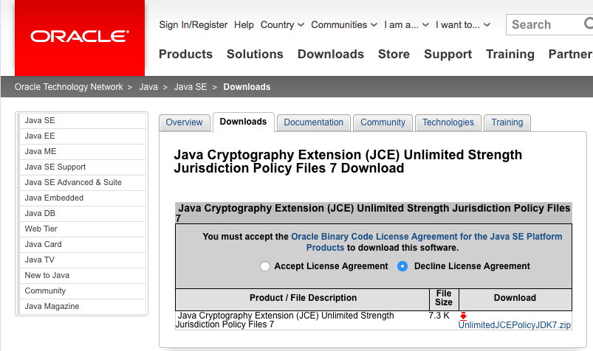
Strong cryptography

Slide 18
Strong cryptography
Algorithm | Key size
DES | 64
DESede | *
RC2 | 128
RC4 | 128
RC5 | 128
RSA | * (KeyPairGenerator 1024)
other | 128

Slide 19
Download NetBeans project
goo.gl/ntSDHP
Case sensitive

Slide 20
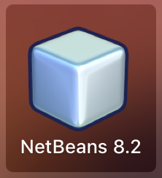
Pls open
NetBeans

Slide 21
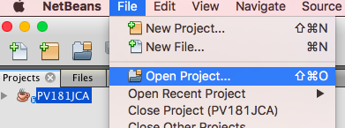
Pls open

Slide 22
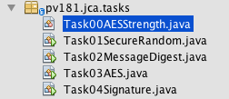
Getting started

Slide 23
Cipher – import missing

Slide 24
Cipher – import missing

Slide 25
Lighbulb helps

Slide 26
Getting started
CTRL+SHIFT+I

Slide 27
Problem again

Slide 28
Problem again

Slide 29
The web

Slide 30
Pls open – the guide
goo.gl/4Ztqen
Case sensitive

Slide 31
Task01 - SecureRandom
SecureRandom rnd = new SecureRandom()
rnd.nextDouble()
rnd.nextByte()
rnd. ....

Slide 32
SecureRandom - solution
SecureRandom rnd = new SecureRandom();
rnd.nextBytes(buffer);
System.out.println(Globals.bytesToHex(buffer));

Slide 33
Task02 - MessageDigest
MessageDigest md5 = MessageDigest.getInstance(“MD5”);

Slide 34
MessageDigest
MessageDigest md5 = MessageDigest.getInstance(“MD5”);
md5.update(inputBuffer, 0, bytesRead);
md5.update(inputBuffer, 0, bytesRead);
md5.update(inputBuffer, 0, bytesRead);
byte[] md5hash = md5.digest()

Slide 35
MessageDigest – incremental API
MD5
md5.update(data)
md5.update(data)
md5.update(data)
md5.digest()
md5.update(data)
byte[] hash
md5.update(data)
md5.update(data)

Slide 36
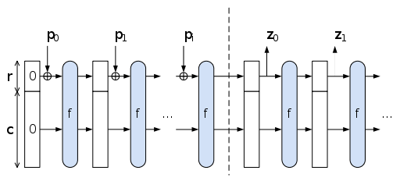
MessageDigest – incremental API

Slide 37
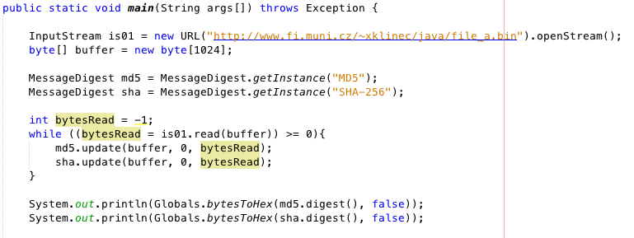
MessageDigest – solution
Notes:
Catch: http -> https redirect. Bonus

Slide 38
Task03 - Cipher
getInstance(“algorithm/mode/padding”);
Default mode: ECB
Default padding: PKCS5

Slide 39
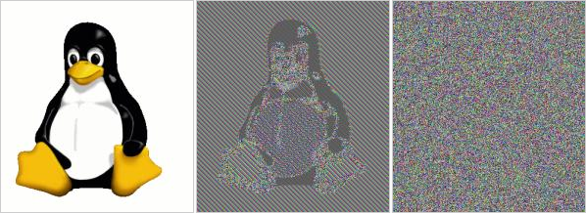
Cipher

Slide 40
Cipher
init(mode, key, algorithmParameterSpec)
Cipher.DECRYPT_MODE
new SecretKeySpec(aesKey, "AES")
new IvParameterSpec(iv)
Notes:
Wrapping keys to opaque key objects.
Provider generates key objects, it has to understand it. Underlying implementation is hidden.

Slide 41
Cipher – Key vs KeySpec
Key – opaque key, used in engine
getAlgoritm(), getEncoded()
KeySpec – key specification, transport & storage
getP(), getQ(), getN()

Slide 42
Cipher – Key vs KeySpec
SecretKeySpec = Spec & Key in the same time

Slide 43
Cipher – Key vs KeySpec

Slide 44
Cipher – Key vs KeySpec
Why separated?

Slide 45
Cipher – Key vs KeySpec
Why separated?
Cipher.init(Cipher.DECRYPT_MODE, key)

Slide 46
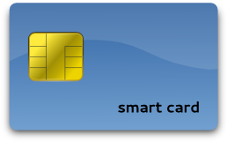
Cipher – Key vs KeySpec
Why separated?
Cipher.init(Cipher.DECRYPT_MODE, key)
Handle=0x123330

Slide 47
Cipher – Key vs KeySpec
Why separated?
Cipher.init(Cipher.DECRYPT_MODE, key)
Cloud encryption HSM
Handle=0x123330, endpoint=https://…

Slide 48
Cipher – Key materials
String vs. char[]
String is immutable, cannot zero out
Zero-out mutable byte[] after use to prevent key leakage to swap files (or Heartblead)

Slide 49
Cipher – Key materials
GC deallocates but does not zero-out – key still there
Modern GC can copy, reorder mem (heap defrag), unable to properly delete keys from memory nowadays (Java does not specify behaviour, can differ).

Slide 50
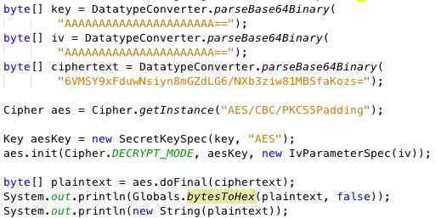
Cipher – Solution
Notes:
Catch: swap IV/Key, 3rd example has intentionally swapped key vs IV to demonstrate invalid padding.
Padding oracle attack. Invalid key demo.

Slide 51
Key Factories
KeySpec → Key
Key → KeySpec
KeyFactory – asymetric keys
SecretKeyFactory – symmetric keys

Slide 52
Key generators
KeyGenerator – symmetric
generateSecret() → SecretKey
KeyPairGenerator – asymmetric
generateKeyPair() → KeyPair

Slide 53
Certificate Builder
X509V3CertificateGenerator
goo.gl/I9WLUD

Slide 54
Diffie Hellman
KeyPairGenerator
KeyAgreement
goo.gl/Lus40Y

Slide 55
Thank you for your attention!
Questions

Slide 56
References / resources
TBD

