Slide 1
Task-Centered System Design
How to develop task examples
How to evaluate designs via task-centered walkthroughs
Exercise: The Cheap Shop interface
Slide deck by Saul Greenberg. Permission is granted to use this for non-commercial purposes as long as general credit to Saul Greenberg is clearly maintained.
Notice: some material in this deck is used from other sources without permission. Credit to the original source is given if it is known,

Slide 2
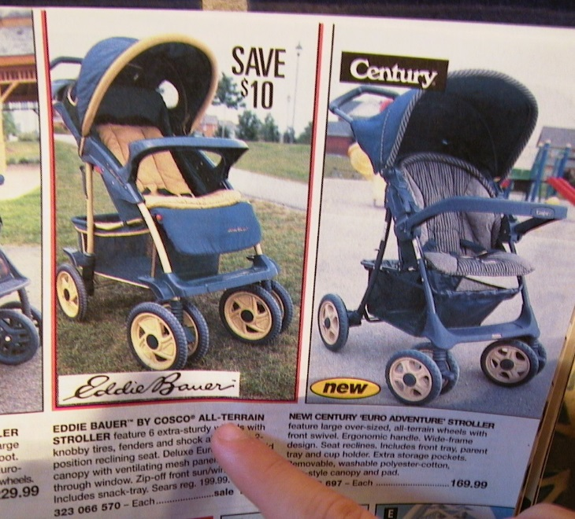
The Cheap Shop Catalog Store
  In Cheap Shop, people shop by browsing paper catalogs scattered around the store.
  When people see an item they want, they enter its item code from the catalog onto a form.
  People give this form to a clerk, who brings the item(s) from the back room to the front counter.
  People then pay for the items they want.
Item code Amount

Slide 3
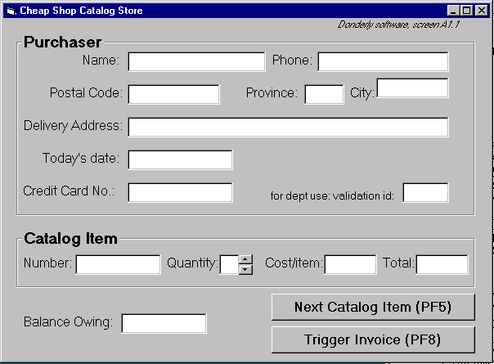
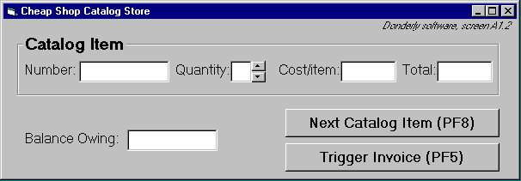
Cheap Shop
Screen 1
Screen 2

Slide 4
Seat-of-your-pants interface design
Is this a good or bad interface?
  do you go by gut feel?
  do you go by how it looks?
  do you judge it by familiarity to other interfaces?
  if there are problems, are they minor or serious?
  did you miss anything that you really shouldn’t have?
  is your opinion correct?
  how can you tell?
Alternative: are there methods where you can
  systematically determine if this interface matches the needs of its end users?
  systematically discover the usability bugs?

Slide 5
Requirements analysis
A software perspective
  exactly what functions should the system have?
The User
a person who will mould themselves to fit your system

Slide 6
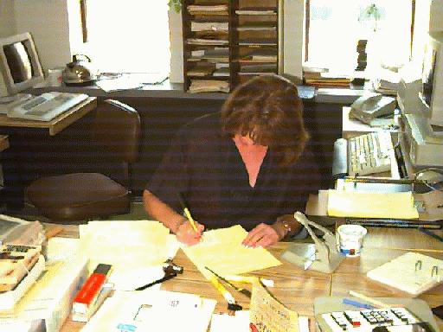
Requirements analysis
An end-users perspective
  exactly who would use the system to do exactly what?
Mary Franklin
a real person with real constraints trying to get her job done

Slide 7
Task Centered System Design
An end-users perspective
  exactly who would use the system to do exactly what?
Phases:
1. Identification
  identify specific users and articulate their concrete tasks
2. Requirements
  decide which of these tasks and users the design will support
3. Design
  base design representation & dialog sequences on these tasks
4. Walkthrough Evaluations
  using your design, walk through these tasks to test the interface
Adapted from Lewis, C. and Rieman, J. (1993) Task-Centered User Interface Design: A Practical Introduction. http://hcibib.org/tcuid/

Slide 8
Foreshadowing…
Task example 1
  Fred Johnson, who is caring for his demanding toddler son, wants a good quality umbrella stroller (red is preferred, but blue is acceptable).
  He browses the catalog and chooses the JPG stroller
  (cost $98. item code 323 066 697).
  He pays for it in cash, and uses it immediately.
  Fred is a first-time customer to this store, has little computer experience, and says he types very slowly with one finger. He lives nearby on Dear Bottom Avenue NW.

Slide 9
Foreshadowing…
JPG Stroller. This well made but affordable stroller fits children between 1-3 years old. Its wheels roll well in light snow and mud.
…$98.
Red: 323 066 697
Blue: 323 066 698

Slide 10
Foreshadowing…
Discussion
  Fred has many properties of our typical expected user:
    many customers are first time shoppers,
    a good number have no computer experience
    a good number are poor typists.
  The task type is routine and important.
    many people often purchase only one item
    a good number of those pay by cash
    as with Fred, people often have a general sense of what they want to buy, but decide on the actual product only after seeing what is available.

Slide 11
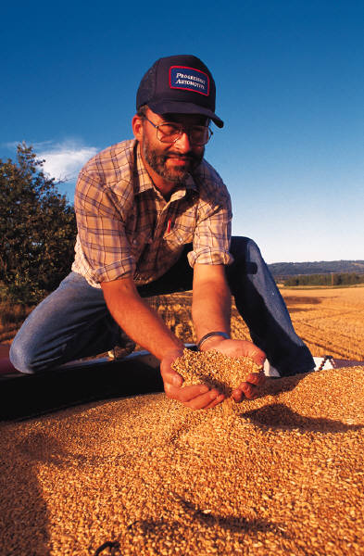

Phase 1: Identify users + tasks
Get in touch with real people who will be
potential users of your system
    prototypical categories
    extremes
Learn about their real tasks
  articulate concrete, detailed examples of tasks
  they perform or want to perform
  that your system should support
    routine
    infrequent but important
    infrequent and incidental

Slide 12
Phase 1: Identify users + tasks
How do you identify tasks?
  Immerse yourself in a real person’s environment
  Observe people in their actual work context
  Interview people as they do their work
  Shadow a person over the course of his or her day
  Serve people’s requests
  …

Slide 13
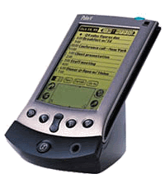
Phase 1: Identify users + tasks
If there are no real users or tasks…
  think again, there probably are!
  Jeff Hawkins, the inventor of the Palm Pilot, was said to
  have carried a small block of wood around in his shirt pocket … As various everyday situations arose, he would take out the block of wood and imagine how he would use the device.
    The same technique can be used to evoke a response from expected end-users
video Tangible Camera

Slide 14
Phase 1: Identify users + tasks
If all else fails…
  describe your expected set of users,
  describe your expected set of tasks
These will become your ‘assumed users and tasks’
  verify them later as information comes in
  modify them as needed

Slide 15
Ph 1: Developing good task examples
Says what the user wants to do but does not say how they would do it
  no assumptions made about the interface
  can be used to compare design alternatives in a fair way
2. Are very specific
  says exactly what the user wants to do
  specifies actual items the user would somehow
  want to input

Slide 16
Ph 1: Developing good task examples
3. Describes a complete job
  forces designer to consider how interface features work together
  contrasts how information input / output flows through the dialog
    where does information come from?
    where does it go?
    what has to happen next?
  Do not, do not, do not …
    create a list of simple things the system should do
    present a sub-goal independent of other sub-goals

Slide 17
Ph 1: Developing good task examples
4. Says who the users are
  name names, if possible
  says what they know
  Why?
    design success strongly influenced by what users know
    can go back and ask them questions later
    reflects real interests of real users
    helps you find tasks that illustrate functionality in that person’s real work context

Slide 18
Ph 1: Developing good task examples
Are evaluated
  Circulate descriptions to users, and rewrite if needed
    ask users for
      omissions
      corrections
      clarifications
      suggestions
As a set, identifies a broad coverage of users and task types
  the typical ‘expected’ user, typical routine tasks
  the occasional but important user, infrequent but important tasks
  the unusual user unexpected or odd tasks

Slide 19
Phase 2: Requirements
Which user types will be addressed by the interface?
  designs can rarely handle everyone!
  includes why particular users are included / excluded
Which tasks will be addressed by the interface?
  designs can rarely handle all tasks
  requirements listed in terms of how they address tasks
    Absolutely must include:
    Should include
    Could include:
    Exclude:
  Discussion includes why items are in those categories

Slide 20
Phase 3: Design as Scenarios
Develop designs to fit users and specific tasks
  ground interfaces in reality
Use tasks to
  get specific about possible designs
  consider the real world contexts of real users
  consider how design features work together
    what would the user do / see step-by-step when performing this task?

Slide 21
Phase 4: Walk-through Evaluation
Good for debugging an interface
Process
1 Select one of the task scenarios
2 For each user’s step/action in the task:
  can you build a believable story that motivates the user’s actions?
  can you rely on user’s expected knowledge and training about system?
  if you cannot:
    you’ve located a problem in the interface!
    note the problem, including any comments
    assume it has been repaired
  go to the next step in the task

Slide 22
The Cheap Shop Catalog Store
  In Cheap Shop, people shop by browsing paper catalogs scattered around the store.
  When people see an item they want, they enter its item code from the catalog onto a form.
  People give this form to a clerk, who brings the item(s) from the back room to the front counter.
  People then pay for the items they want.
Item code Amount

Slide 23
Developing task examples: Cheap Shop
Task example 1
  Fred Johnson, who is caring for his demanding toddler son, wants a good quality umbrella stroller (red is preferred, but blue is acceptable).
  He browses the catalog and chooses the JPG stroller
  (cost $98. item code 323 066 697).
  He pays for it in cash, and uses it immediately.
  Fred is a first-time customer to this store, has little computer experience, and says he types very slowly with one finger. He lives nearby on Dear Bottom Avenue NW.

Slide 24
Developing task examples: Cheap Shop
Discussion
  Fred has many properties of typical expected user:
    many customers are first time shoppers,
    a good number have no computer experience
    a good number are poor typists.
  The task type is routine and important.
    many people often purchase only one item
    a good number of those pay by cash
    people often have a general sense of what they want to buy, but decide on the actual product only after seeing what is available.

Slide 25
Developing task examples: Cheap Shop
Task example 2
  Mary Vogel is price-comparing the costs of a child’s bedroom set, consisting of a wooden desk, a chair, a single bed, a mattress, a bedspread, and a pillow all made by Furnons Inc.
  She takes the description and total cost away with her to check against other stores.
  Three hours later, she returns and decides to buy everything but the chair.
  She pays by credit card,
  She asks for the items to be delivered to her daughter’s home at 31247 Lucinda Drive, in the basement suite at the back of the house.
  Mary is elderly and arthritic.

Slide 26
Developing task examples: Cheap Shop
Discussion
  Like Mary,
    a reasonable number of store customers are elderly, with infirmities that inhibit their physical abilities.
    a modest number of them also enjoy comparison shopping, perhaps because they have more time on their hands or because they are on low income.
  The task type is less frequent, but still important.
    although this would be considered a ‘major’ purchase in terms of the total cost, the number of items purchased is not unusual.
    delivery of large items is the norm
    most customers pay by credit card for larger orders.

Slide 27
Developing task examples: Cheap Shop
Task example 3
  John F, the sole salesperson in the store, is given a list of 10 items by a customer who does not want to use the computer.
  The items are:
    4 pine chairs, 1 pine table, 6 blue place mats, 6 “lor” forks, 6 “lor” table spoons, 6 “lor” teaspoons, 6 “lor” knives, 1 “tot” tricycle, 1 red ball, 1 “silva” croquet set
  After seeing the total, the customer tells John he will take all but the silverware
  The customer then decides to add 1 blue ball to the list.
  The customer starts paying by credit card, but then decides to pay cash. The customer tells John he wants the items delivered to his home the day after tomorrow. While this is occurring, 6 other customers are waiting for John.
  John has been on staff for 1 week, and is only partway through his training program

Slide 28
Developing task examples: Cheap Shop
Discussion
  This task introduces the clerk as a system user.
    Because of a high turnover in its staff, new employees such as John are also common.
    Thus John reflects a ‘rare’ but important group of users.
  The task type is less frequent, but still important
    The task is fairly typical i.e., people making large numbers of purchases often ask the clerk to help them.
    The customers often change their mind partway through a transaction i.e., by changing what they want to buy and/or by changing how they want to pay for it.
    Customers, however, rarely give specific delivery dates, with most wanting delivery as soon as possible.
    Lineups for clerks are common during busy times.

Slide 29
Cheap Shop
Screen 1
Screen 2

Slide 30
Specifications
  To create an order
    On screen 1, shoppers enter their personal information and their first order
    text is entered via keyboard
    the tab or mouse is used to go between fields.
  Further orders
    shoppers go to the 2nd screen by pressing the Next Catalog Item button
  Order completion
    shoppers select ‘Trigger Invoice’.
    the system automatically tells shipping and billing about the order
    the system returns to a blank screen #1

Slide 31
Specifications
  To cancel order
    Shoppers do not enter input for 30 seconds (as if they walk away)
    The system will then clear all screens and return to the main screen
  Input checking
    all input fields checked when either button is pressed.
    erroneous fields will blink for 3 seconds, and will then be cleared.
    the shopper can then re-enter the correct values in those fields.

Slide 32
Walkthrough template
Task number: ____
Description of
Step
Does the user have the knowledge/training to do this?
Is it believable that they would do it?
Are they motivated?
Comment / solution
A walkthrough for this exercise is found in Greenberg, S. “Working through Task-Centered System Design. in Diaper, D. and Stanton, N. (Eds) The Handbook of Task Analysis for Human-Computer Interaction. Lawrence Erlbaum Associates.

Slide 33
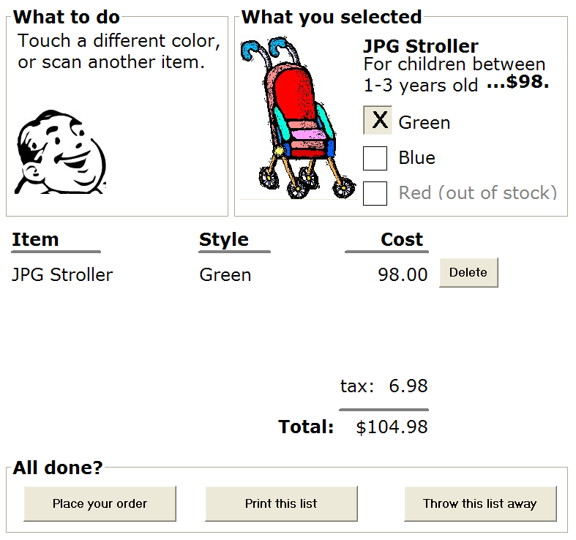
Are there better ways to do it?
A task-centered prototype
  partial wizard approach to tasks
  prototyped several different ways
    paper - 45 minutes
    scripted animation
    - 2 hours
Does it work?
  do a task-centered
  walkthrough
  to find out!

Slide 34
Goal-centered system design
Articulate user goals instead of task sequences
  Goal:
    a desired end condition
    tend to be stable
  Task:
    an intermediate process needed to achieve the goal
    may change as technology / work patterns change
See Allan Cooper ‘The inmates are running the asylum’, Sams (Macmillan), especially Chapter 9 and 11.

Slide 35
Goal-centered system design
Designer
  looking for solutions that satisfy these goals
  task sequence may differ substantially from current process
Approach:
  Develop a persona
    precise, specific description of the user and the goal they wish to accomplish
    a pretend user that are hypothetical archetypes of actual users
    discovered as a by-product of investigating the problem domain
  Develop a cast of characters
    3 – 12 unique personas
    one will be the primary persona – the main focus of the design

Slide 36
You know now
How to develop concrete task examples
How to use task examples to motivate your designs
How to evaluate designs through task-centered walkthroughs

Slide 37
Interface Design and Usability Engineering
Articulate:
who users are
their key tasks
Brainstorm designs
Refined designs
Completed designs
Goals:
Task centered system design
Participatory design
User-centered design
Psychology of everyday
things
User involvement
Representation & metaphors
Graphical screen design
Interface guidelines
Style
guides
Participatory interaction
Task scenario walk-
through
Evaluate
tasks
Usability testing
Heuristic evaluation
Field testing
Methods:
low fidelity prototyping methods
high fidelity prototyping methods
Products:
User and task descriptions
Throw-away paper prototypes
Testable prototypes
Alpha/beta systems or complete specification

