Slide 1
Visual Variables
Characteristics of visual symbols
How we distinguish between them
Slides by Sheelagh Carpendale, University of Calgary

Slide 2
Visual variables - attributes
position
changes in the x, y (z) location
size
change in length, area or repetition
shape
infinite number of shapes
value
changes from light to dark
orientation
changes in alignment
colour
changes in hue at a given value
texture
variation in pattern
motion

Slide 3
Visual variables - characteristics
Different variable attributes may be:
selective
is a change enough to allow us to select it from a group?
associative
is a change enough to allow us to perceive them as a group?
quantitative
is there a numerical reading obtainable from changes in this variable?
order
are changes in this variable perceived as ordered?
length
across how many changes in this variable are distinctions perceptible?

Slide 4
Position
selective
associative
quantitative
order
length
100
0
0
10

Slide 5
Size
selective
associative
quantitative
order
length
theoretically infinite but practically limited
association and selection ~ 5 and distinction ~ 20
4 X
=
?
>
>
>
>
>
>

Slide 6
Shape
selective
associative
quantitative
order
length - infinite variation
>
>
>
>
>
>
>

Slide 7
Shape

Slide 8
Value
selective
associative
quantitative
order
length
theoretically infinite but practically limited
association and selection ~ < 7 and distinction ~ 10
<
<
<
<
<
<

Slide 9
Color
selective
associative
quantitative
order
length
theoretically infinite but practically limited
association and selection ~ < 7 and distinction ~ 20
>
>
>
>
>
>
>
>

Slide 10
Color

Slide 11
Encoding color
Common advice says use a rainbow scale
Marcus, Murch, Healey
problems with rainbows

Slide 12
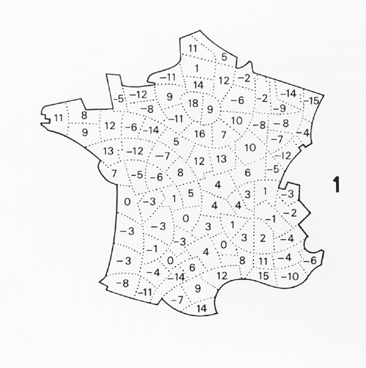
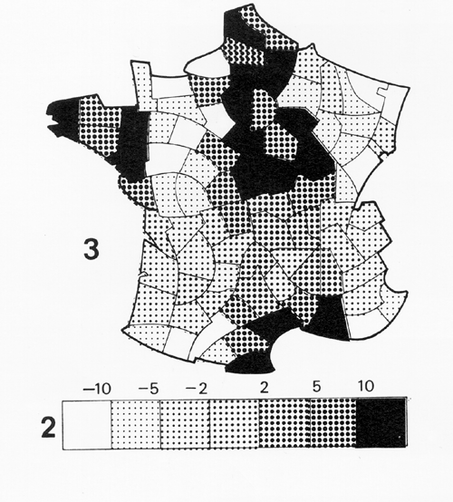
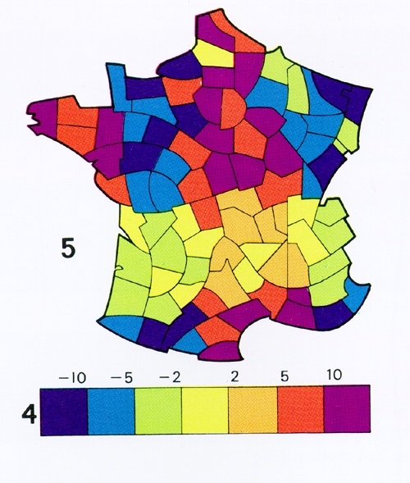
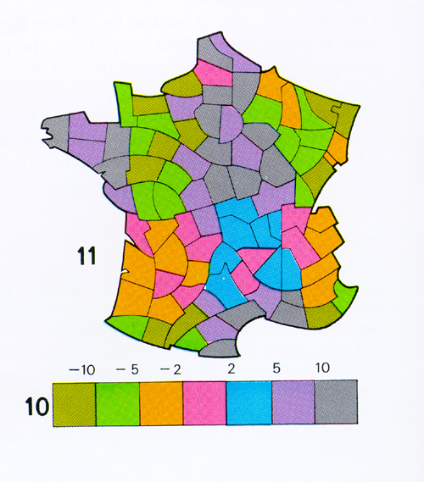
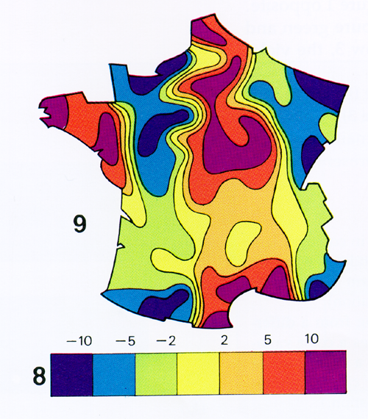
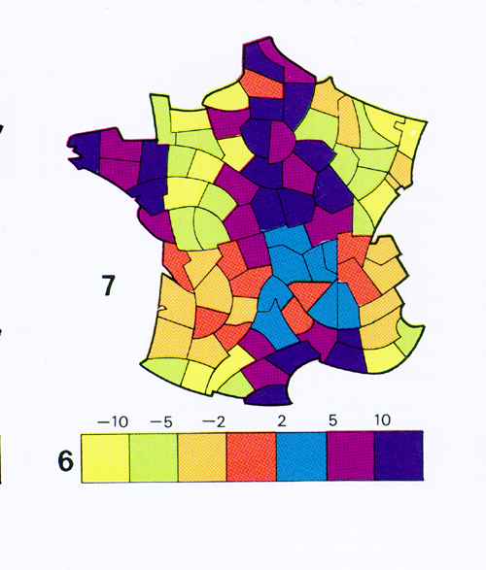

Slide 13
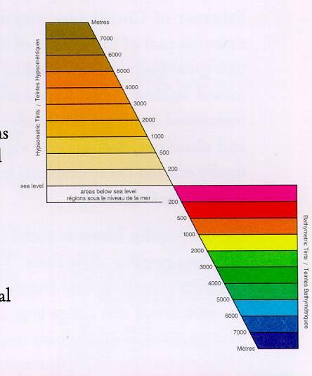
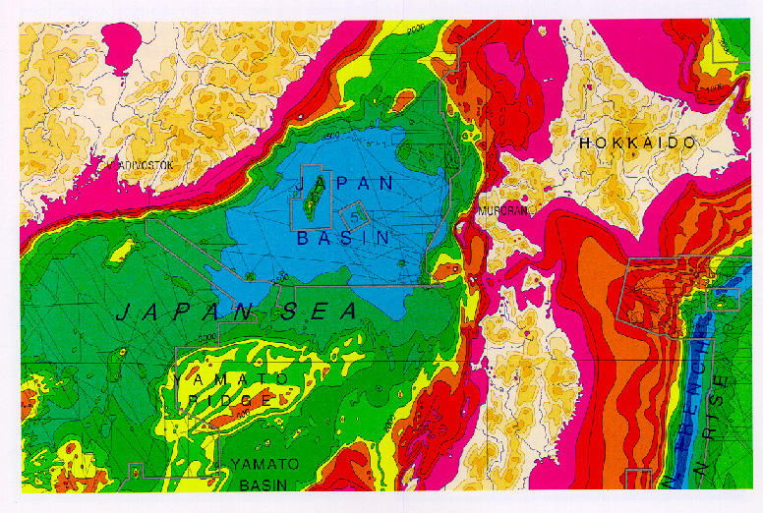

Slide 14
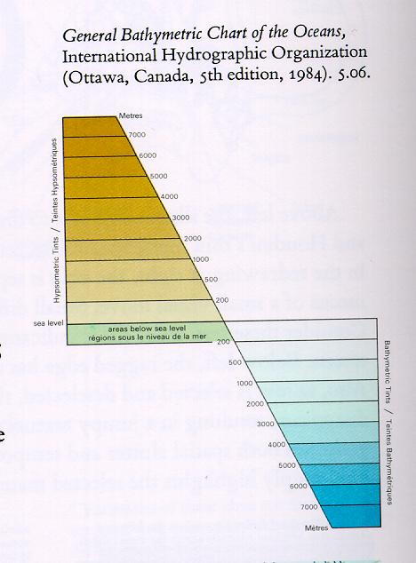
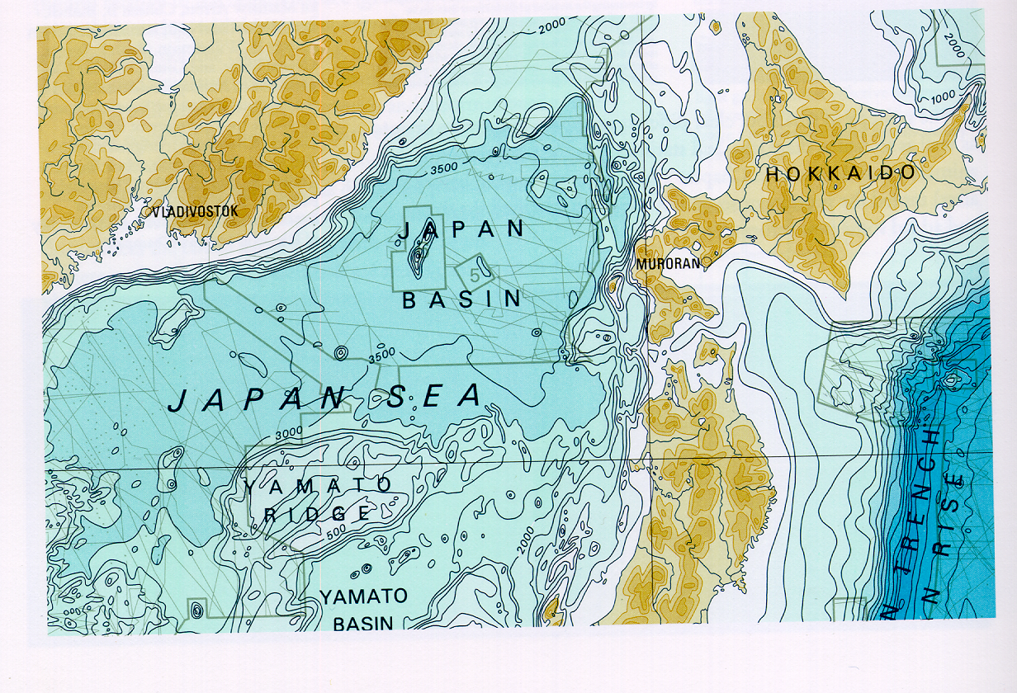

Slide 15
Orientation
selective
associative
quantitative
order
length
~5 in 2D; ? in 3D
<
<
<
?
<
<
<
<

Slide 16
Texture
selective
associative
quantitative
order
length
theoretically infinite
>
>
>
>

Slide 17
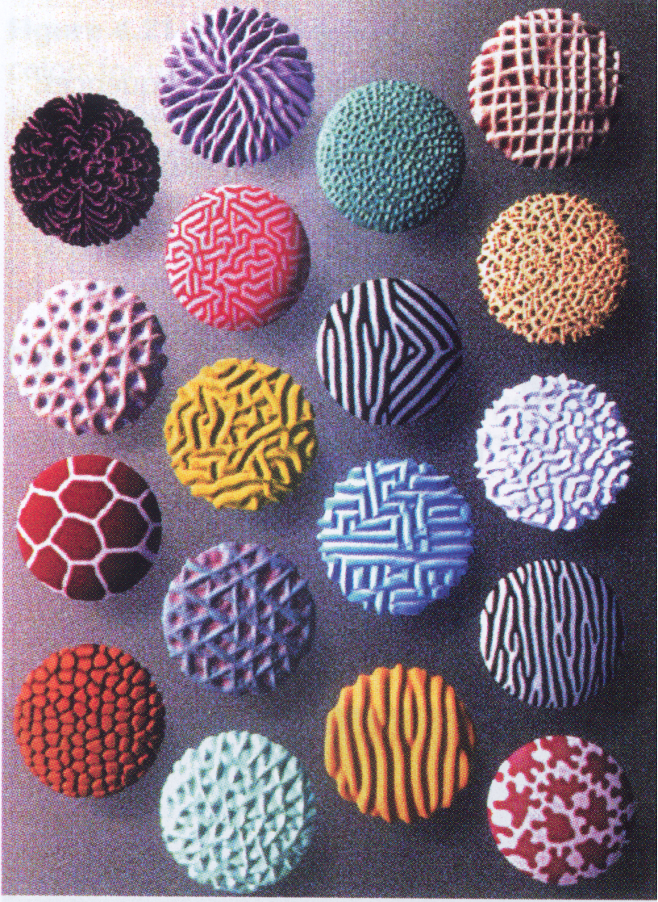
Textures

Slide 18
Motion
selective
motion is one of our most powerful attention grabbers
associative
moving in unison groups objects effectively
quantitative
subjective perception
order
length
distinguishable types of motion?
?

Slide 19
Motion

Slide 20
What you know now
Attributes of visual variables
position size
shape value
orientation color
texture motion
Characteristics of visual variables
selective
associative
quantitative
order
length

