Slide 1

PA193 Secure coding principles and practices
Overview of the subject
Petr Švenda, Petr Ročkai, Milan Patnaik, Marek Sýs, Kamil Dudka, Mirek Jaroš, Martin Ukrop, Jan Masarik

Slide 2
PA193 Secure coding principles and practices
Secure coding
  How to write code in a more secure way
  So that the program is harder to be attacked/exploited
  Selected basic building blocks of security applications
2/2/2
  Lecture: 2 hours weekly
  Seminar: 2 hours weekly
  Homework: about 6-? hours/each
  Project: about 30-40 hours/person

Slide 3




People
Main contact: Petr Švenda (CRoCS@FI MU)
  Office hours: Tuesday 13:00-13:50, A406
  svenda@fi.muni.cz, @rngsec
  https://keybase.io/petrs
  https://crocs.fi.muni.cz/people/svenda
Other lectures and seminars
  Milan Patnaik (DRDO) Marek Sýs (FI), Jan Masrik (Kiwi) Kamil Dudka (RedHat), Mirek Jaroš (RedHat), Martin Ukrop (FI)

Slide 4
Aims of the subject
To learn how to program in a way that the resulting application is more secure
  Decrease number of security related bugs
  Increase difficulty of exploitation
To understand security consequences of decisions made by programmer
Most issues are independent on particular programming language
  examples will be mostly based on C/C++ and Java

Slide 5
Previous knowledge requirements
Basic knowledge of (applied) cryptography and IT security
  symmetric vs. asymmetric cryptography, PKI
  block vs. stream ciphers and usage modes
  hash functions
  random vs. pseudorandom numbers
  basic cryptographic algorithms (AES, DES, RSA, EC, DH)
  risk analysis
Basic knowledge in formal languages and compilers
User-level experience with Windows and Linux OS
Practical experience with C/C++/Java language

Slide 6
Organization
Lectures + seminars + assignments + project + exam
Assignments
  10 homework assignments
  Individual work of each student
  Lab A403 available to students (except teaching hours)
Project
  Team work (2-3 members)
  Details next week (cryptowallet derivation, CI, fuzzing…)
Exam
  Written exam, open questions, pencil-only

Slide 7
Grading
Credits
  2+2+2 credits, plus 2 for the final exams
Points [Notice minimal number of points required!]
  Homework (50) – [minimum 25 required]
  Project (20) – [minimum 10 required]
  Written exam (50) – [minimum 25 limit]
  Occasional bonuses ☺
  TLDR: must get at least half points from each area
Grading 120 (max)
  A ≥ 110
  B ≥ 100
  C ≥ 90
  D ≥ 80
  E ≥ 65
  F < 65

Slide 8
Attendance
Lectures
  Attendance not obligatory, but highly recommended
Seminars
  Attendance obligatory
  Absences must be excused at the department of study affairs
  2 absences are OK (even without excuse)
Assignments and projects
  Done during student free time (e.g. at the dormitory)
  Access to network lab and CRoCS lab is possible

Slide 9
Discussion forum in Information System
Discussion forum in Information System (IS)
  https://is.muni.cz/auth/cd/1433/podzim2019/PA193/
Mainly for discussion among the students
  Not observed by stuff all the time!
  Write us email if necessary
What to ask?
  OK to ask about ambiguities in assignment
  NOT OK to ask for the solution
  NOT OK to post your own code and ask what is wrong

Slide 10

Plagiarism
Homeworks
  Must be worked out independently by each student
Projects
  Must be worked out by a team of 3 students
  Every team member must show his/her contribution
Plagiarism, cut&paste, etc. is not tolerated
  Plagiarism is use of somebody else words/programs or ideas without proper citation
  Automatic tools used to recognize plagiarism
  If plagiarism is detected student is assigned -7 points
  More serious cases handled by the Disciplinary committee

Slide 11
Reuse of existing code
Code reuse is generally great thing, but..
NOT in homework or assignments!
It is NOTOK:
  Take any code from web when you should create code completely on your own (project - parser)
  Share code of your solution with others (homework)

Slide 12
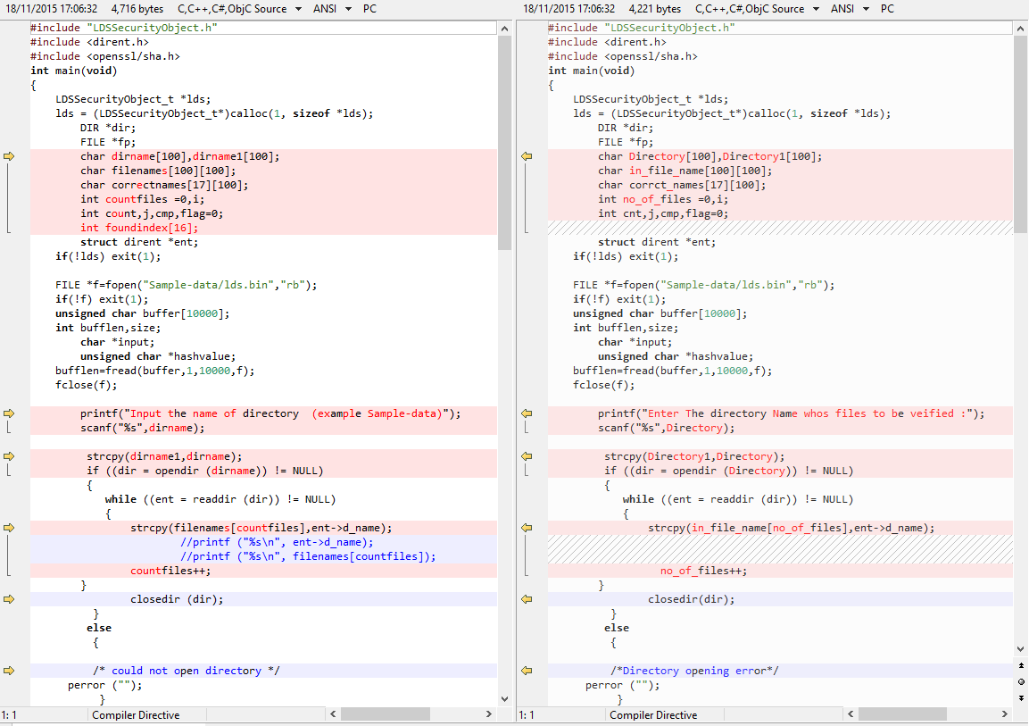
Example of Plagiarism

Slide 13
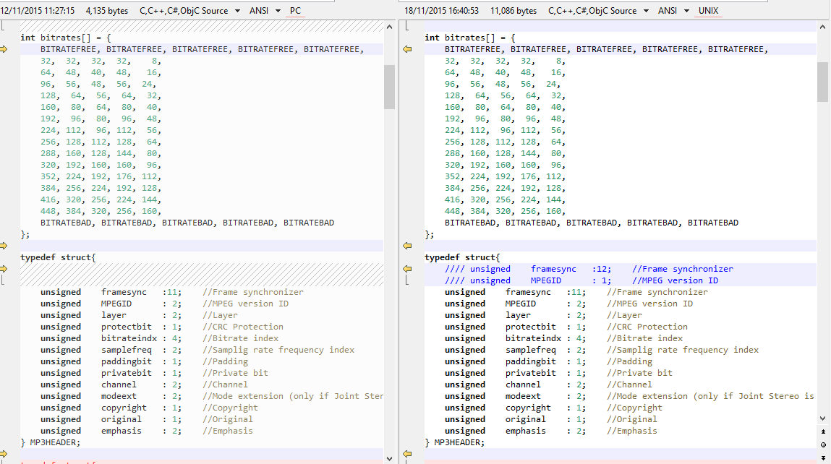
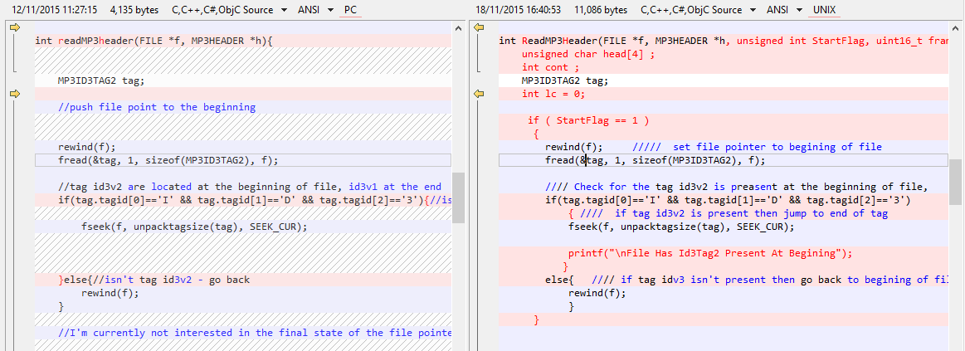
Example of Plagiarism

Slide 14
Course resources
Lectures (PDF) available in IS
  IS = Information System of the Masaryk University
  https://is.muni.cz/auth/el/1433/podzim2019/PA193/
Homeworks/assignments available in IS
  Submissions also done via IS (Homework vaults)
Additional tutorials/papers/materials from time to time will also be provided in IS
  To better understand the issues discussed
Recommended literatures
  To learn more …

Slide 15
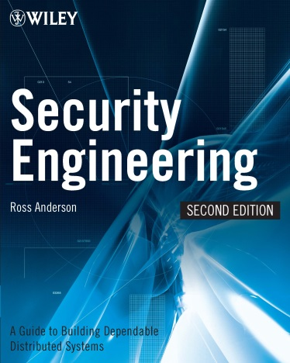

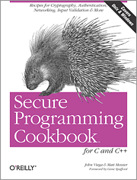
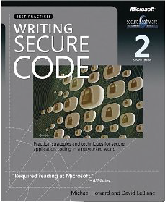
Recommended literature
Ross Anderson - Security
engineering, Wiley
Michael Howard, Steve Lipner - Secure Development Lifecycle, MS Press
John Viega, Matt Messier - Secure
programming cookbook, O'Reilly
Michael Howard - Writing
secure code, MS Press

Slide 16
Lectures and content
16. 9. Intro, Language level vulnerabilities: Buffer overflow, type overflow, strings (PS)
23. 9. Security testing: blackbox vs. whitebox testing, static analysis (PS)
30. 9. Security testing: dynamic analysis, fuzzing (PS)
7. 10. Security code review, automata-based programming, securing API (PS, KD)
14. 10. Exploits writing (MP)
21. 10. Return-oriented Programming (MP)
PS – Petr Švenda, KD – Kamil Dudka, MP – Milan Patnaik

Slide 17
Lectures and content
National holidays, no lecture
28. 10. Security primitives: secure channel, secure storage, key management (PS)
4. 11. Web programming security, 3rd party libs security, patch management (JM)
11. 11. Integrity of modules, parameters, temp files (PR)
18. 11. Proper use of (pseudo)-random data (MS)
25. 11. Defense in depth (PR)
2. 12. Concurrent issues: IPC, race conditions (PR)
9. 12. Access control, privilege separation (PR)
PS – Petr Švenda, JM – Jan Masarik, PR – Petr Ročkai, MS – Marek Sýs

Slide 18

Questions

