Slide 1
PA193 - Secure coding principles and practices
LABS: Static analysis of source code
Petr Švenda svenda@fi.muni.cz @rngsec
Centre for Research on Cryptography and Security, Masaryk University

Slide 2
Overview - Lab
Goal: Learn how to use basic tools
Discuss false positives / false negatives
Check C/C++ code with compiler warnings
Check C/C++ code with VS PREFast
Check C/C++ code with CppCheck
Check Java code with FindBugs

Slide 3
MS Visual Studio: Warnings and PREfast
Set project warning level to /W4 (or /Wall)
Run and compile bufferOverflowDemo.cpp
(don’t forget: new project must be created)
Fix all warnings for clean compilation in VS /W4
Run Code analysis on bufferOverflowDemo.cpp
Analyze→Run code analysis on …
You need have Project selected inside Project explorer (otherwise Run code analysis… option will not appear)
Try difference between ‘minimum’ and ‘all rules’
Or try with gcc: gcc -Wall -Wextra

Slide 6
Questions (inspect whole BODemo.cpp)
What is the difference between /W3 and PREFast analysis?
Why you should compile without any warnings?
Are all bugs caught by static analysis?
Which bugs are not caught? Can you explain why?

Slide 7
Cppcheck
Download Cppcheck and unpack (or install)
Use Cppchcek against bufferOverflow.cpp
run command line, cppcheck bufferOverflow.cpp
cppcheck --enable=all bufferOverflow.cpp
Setup Cppcheck GUI viewer for Cppcheck
(Notepad++ is already predistributed on lab computers or download at http://sourceforge.net/projects/notepadpp-usb/)
Edit → Preferences → Applications → Add
Executable: "C:\Program Files\Notepad++\notepad++.exe“
Parameters: -n(line) (file)
Run Cppcheck GUI and analyze files or directories

Slide 9
Questions for CppCheck
What additional bugs were found?
Can you reason why it was found by CppCheck and not compiler/PREfast?
If there would be no new bugs found by CppCheck, is it better to use only previous tools (compiler, PREfast…)?

Slide 10
Activity: FindSecurityBugs (15 min):
Form groups of 3
Roll virtual dice with 100 sides three times (note)
https://freeonlinedice.com/
Open list of FindSecurityBugs patterns
https://find-sec-bugs.github.io/bugs.htm
Display ‘Table of Contents’
Find the xth pattern based on your dice results
Read and discuss what are these vulnerabilities (3 min each)
Sort them based on the severity (5 min)

Slide 11
FindBugs/FindSecurityBugs - Java
Download FindBugs http://findbugs.sourceforge.net/
Download FindSecurityBugs (plugin)
https://find-sec-bugs.github.io/download.htm
copy findsecbugs-plugin-1.9.0.jar into FindBugs\plugin\ directory
List of patterns: https://find-sec-bugs.github.io/bugs.htm
Run FindBugs\bin\findbugs.bat (on Windows)
Or directly FindBugs\lib\findbugs.jar
Enable plugin in Edit → Preferences → Plugins

Slide 12
FindBugs/FindSecurityBugs - Java
Note: you need compiled *.jar for analysis
And source code for quick display of problems ☺
Extract content of IS → crypto-java.zip
Run FindBugs
Start analysis
File → New project
Classpath for analysis: select target *.jar file (crypto_java.jar)
Source directories: select parent dir of target package
crypto-java\src\main\java\ in our case

Slide 15
Questions: FindBugs & FindSecurityBugs
Which issues were found?
Are all reported issues from project source code?
How you would rate severity of different issues?
How can you use FindBugs in team collaboration?
Is FindBugs working on source code or compiled code? Compare to CppCheck.

Slide 16
Assignment
No new individual assignment this week
(Assignment 1 - ASLR and Canary)

Slide 18
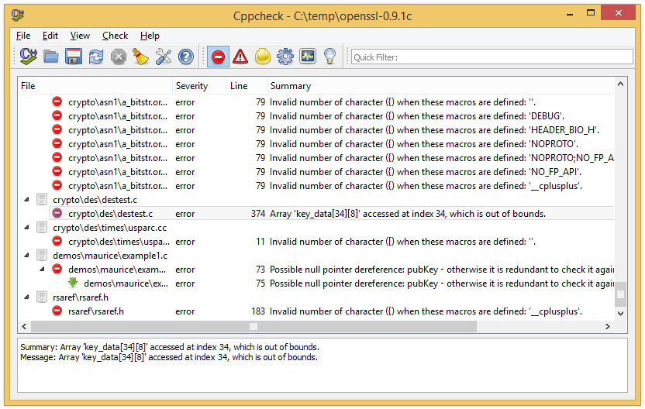
CPPCheck + OpenSSL
Run against some old OpenSSL0.9.xx (around 1998)
https://www.openssl.org/source/old/0.9.x/
What are the bugs?
Run against newest OpenSSL
ftp://ftp.openssl.org/source/
Why not completely clean yet?

Slide 19
Questions
Which bugs are found in bufferOverflowDemo.cpp? Compare to PREFast in Visual Studio.
Which bugs are found in old OpenSSL?
Are style warnings important?

Slide 20
Hearthbleed bug
OpenSSL 1.0.1 through 1.0.1f
Download https://www.openssl.org/source/openssl-1.0.1e.tar.gz
Locate function dtls1_process_heartbeat(SSL *s)
Ssl\t1_lib.c
Will your static analyzers find anything?
Don’t be sad, even Coverity didn’t before the bug was exposed
http://security.coverity.com/blog/2014/Apr/on-detecting-heartbleed-with-static-analysis.html

