Slide 1
Instructor Materials
Chapter 4: Access Control Lists
CCNA Routing and Switching
Connecting Networks
Notes:
Cisco Networking Academy Program
Connecting Networks
Chapter 4: Access Control Lists

Slide 2
Instructor Materials – Chapter 4 Planning Guide
This PowerPoint deck is divided in two parts:
Instructor Planning Guide
  Information to help you become familiar with the chapter
  Teaching aids
Instructor Class Presentation
  Optional slides that you can use in the classroom
  Begins on slide # 9
Note: Remove the Planning Guide from this presentation before sharing with anyone.
Notes:
2

Slide 3
Connecting Networks
Planning Guide
Chapter 4: Access Control Lists
Notes:
Course Planning Guide
Chapter 4: Access Control Lists

Slide 4
Chapter 4: Activities
What activities are associated with this chapter?
Page # | Activity Type | Activity Name | Optional?
4.1.1.5 | Activity | Determine the Correct Wildcard Mask | -
4.1.1.6 | Activity | ACL Operation | -
4.1.2.6 | Activity | Placing Standard and Extended ACLs | -
4.1.3.5 | Packet Tracer | Configure Standard IPv4 ACLs | Optional
4.1.3.6 | Video | Standard ACL Configuration Part 1 | -
4.1.3.7 | Video | Standard ACL Configuration Part 2 | -
4.2.2.7 | Activity | Create an Extended ACL Statement | -
4.2.2.8 | Activity | Evaluating Extended ACEs | -
4.2.2.9 | Activity | ACL Testlet | -
4.2.2.10 | Packet Tracer | Configuring Extended ACLs – Scenario 1 | Optional
4.2.2.11 | Packet Tracer | Configuring Extended ACLs – Scenario 2 | Optional
4.2.2.12 | Packet Tracer | Configuring Extended ACLs – Scenario 3 | Optional
4.2.2.13 | Lab | Configuring and Verifying Extended ACLs | Recommended
4.3.2.6 | Packet Tracer | Configuring IPv6 ACLs | Optional
Notes:
4

Slide 5
Chapter 4: Activities cont…
What activities are associated with this chapter?
Page # | Activity Type | Activity Name | Optional?
4.3.2.7 | Lab | Configuring and Verifying IPv6 ACLs | Recommended
4.4.1.5 | Activity | Place in Order the Steps of the ACL Decision Making Process | -
4.4.2.9 | Packet Tracer | Troubleshooting IPv4 ACLs | Recommended
4.4.2.10 | Packet Tracer | Troubleshooting IPv6 ACLs | Recommended
4.4.2.11 | Lab | Troubleshooting ACL Configuration and Placement | Optional
4.5.1.1 | Packet Tracer | Skills Integration Challenge | Recommended
The password used in the Packet Tracer activities in this chapter is: PT_ccna5
Notes:
5

Slide 6
Chapter 4: Assessment
Students should complete Chapter 4, “Assessment” after completing Chapter 4.
Quizzes, labs, Packet Tracers and other activities can be used to informally assess student progress.
Notes:
6

Slide 7
Chapter 4: Best Practices
Prior to teaching Chapter 4, the instructor should:
Complete Chapter 4 Assessment.
Ensure all activities are completed. This is a very important concept and hands-on time is vital.
Provide the students many ACL building activities.
Encourage students to login with their cisco.com login and read
http://www.cisco.com/c/en/us/td/docs/ios-xml/ios/sec_data_acl/configuration/15-sy/sec-data-acl-15-sy-book/sec-acl-ov-gdl.html
Notes:
7

Slide 8
Chapter 4: Additional Help
For additional help with teaching strategies, including lesson plans, analogies for difficult concepts, and discussion topics, visit the CCNA Community at community.netacad.net.
If you have lesson plans or resources that you would like to share, upload them to the CCNA Community in order to help other instructors.
Notes:
8

Slide 9


Slide 10
Chapter 4: Access Control Lists
Connecting Networks
Notes:
Cisco Networking Academy Program
Connecting Networks
Chapter 4: Access Control Lists

Slide 11
Chapter 4 - Sections & Objectives
4.1 Standard ACL Operation and Configuration
  Configure standard IPv4 ACLs.
4.2 Extended IPv4 ACLs
  Configure extended IPv4 ACLs.
4.3 IPv6 ACLs
  Configure IPv6 ACLs.
4.4 Troubleshoot ACLs
  Troubleshoot ACLs.
Notes:
11

Slide 12
4.1 Standard ACL Operation and Configuration Review
Notes:
Cisco Networking Academy Program
Connecting Networks
Chapter 4: Access Control Lists

Slide 13
ACL Operation Overview
ACLs and the Wildcard Mask
An ACL is a sequential list of permit or deny statements, known as access control entries (ACEs).
As network traffic passes through an interface configured with an ACL, the router compares the information within the packet against each ACE.
An IPv4 ACE includes the use of a wildcard mask to filter IPv4 addresses.
Notes:
4.1 - Standard ACL Operation and Configuration
4.1.1 – ACL Operation Overview
4.1.1 – ACLs and the Wildcard Mask

Slide 14
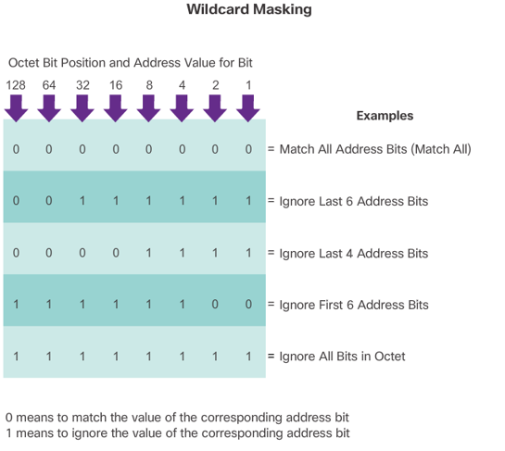
ACL Operation Overview
ACLs and the Wildcard Mask cont…
Notes:
4.1 - Standard ACL Operation and Configuration
4.1.1 – ACL Operation Overview
4.1.1 – ACLs and the Wildcard Mask

Slide 15
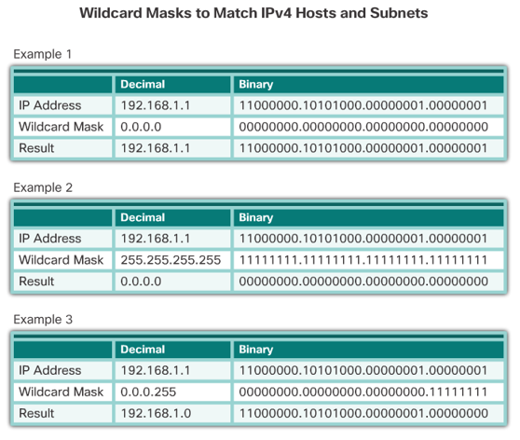
ACL Operation Overview
ACLs and the Wildcard Mask cont…
Notes:
4.1 - Standard ACL Operation and Configuration
4.1.1 – ACL Operation Overview
4.1.1 – ACLs and the Wildcard Mask

Slide 16
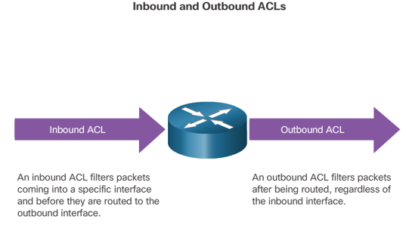
ACL Operation Overview
Applying ACLs to an Interface
Notes:
4.1 - Standard ACL Operation and Configuration
4.1.1 – ACL Operation Overview
4.1.2 – Applying ACLs to an Interface

Slide 17
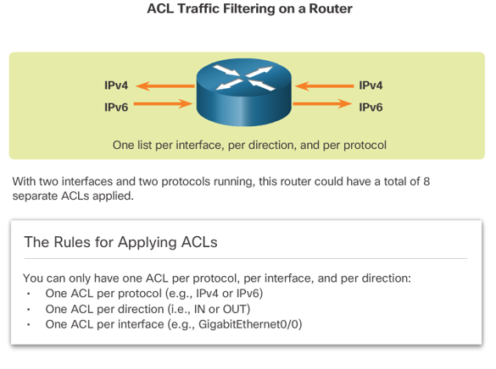
ACL Operation Overview
Applying ACLs to an Interface cont…
Notes:
4.1 - Standard ACL Operation and Configuration
4.1.1 – ACL Operation Overview
4.1.2 – Applying ACLs to an Interface

Slide 18
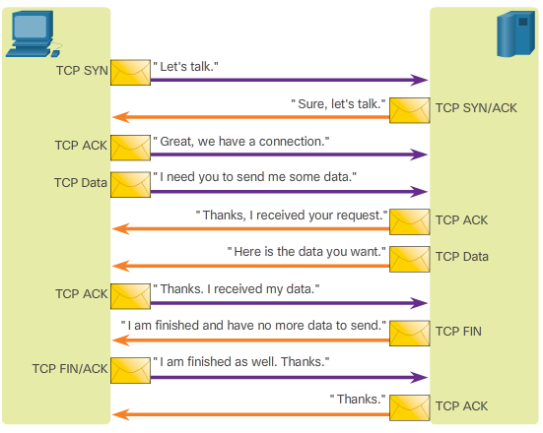
ACL Operation Overview
A TCP Conversation
TCP segments are marked with flags that denote their purpose:
a SYN starts (synchronizes) the session
an ACK is an acknowledgment that an expected segment was received
a FIN finishes the session.
Notes:
4.1 - Standard ACL Operation and Configuration
4.1.1 – ACL Operation Overview
4.1.1.3 – A TCP Conversation

Slide 19
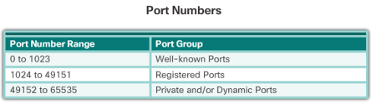
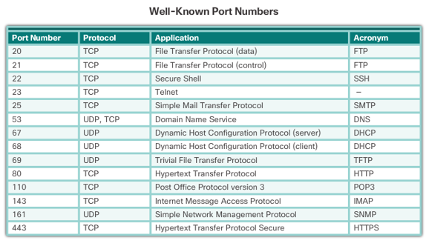
ACL Operation Overview
A TCP Conversation cont…
The TCP data segment also identifies the port which matches the requested service.
Notes:
4.1 - Standard ACL Operation and Configuration
4.1.1 – ACL Operation Overview
4.1.1.3 – A TCP Conversation

Slide 20
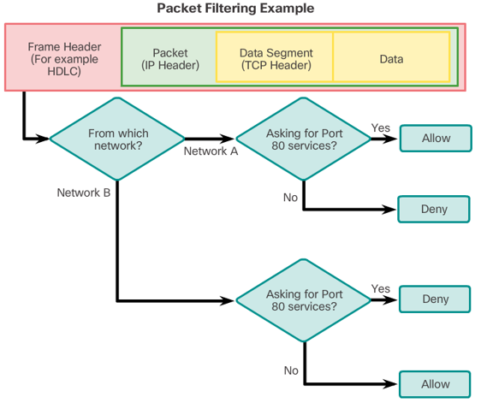
ACL Operation Overview
ACL Packet Filtering
Packet filtering controls access to a network by analyzing the incoming and outgoing packets and forwarding them or discarding them based on given criteria.
Notes:
4.1 - Standard ACL Operation and Configuration
4.1.1 – ACL Operation Overview
4.1.1.4 – ACL Packet Filtering

Slide 21
Types of IPv4 ACLs
Standard and Extended IPv4 ACLs
Two types of Cisco IPv4 ACLS:
  Standard
    Standard ACLs can be used to permit or deny traffic only from source IPv4 addresses. The destination of the packet and the ports involved are not evaluated
  Extended
    Extended ACLs filter IPv4 packets based on several attributes:
      Protocol type
      Source IPv4 address
      Destination IPv4 address
      Source TCP or UDP ports
      Destination TCP or UDP ports
      Optional protocol type information for finer control
Notes:
4.1 - Standard ACL Operation and Configuration
4.1.2 – Types of IPv4 ACLs
4.1.2.1 – Standard and Extended IPv4 ACLs

Slide 22
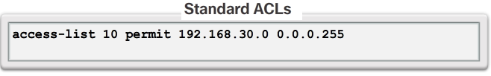
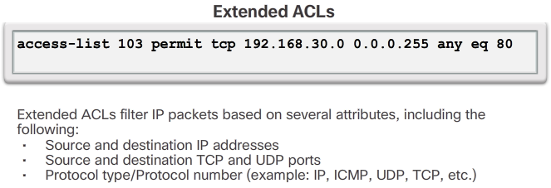
Types of IPv4 ACLs
Standard and Extended IPv4 ACLs cont…
Notes:
4.1 - Standard ACL Operation and Configuration
4.1.2 – Types of IPv4 ACLs
4.1.2.1 – Standard and Extended IPv4 ACLs

Slide 23
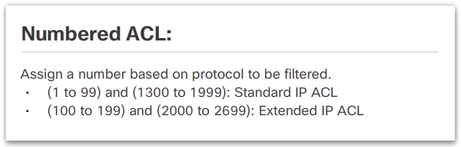
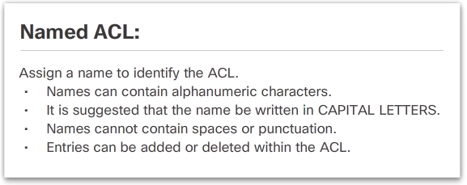
Types of IPv4 ACLs
Numbered and Named ACLs
Standard and extended ACLs can be created using either a number or a name to identify the ACL.
Notes:
4.1 - Standard ACL Operation and Configuration
4.1.2 – Types of IPv4 ACLs
4.1.2.2 – Numbered and Named ACLs

Slide 24
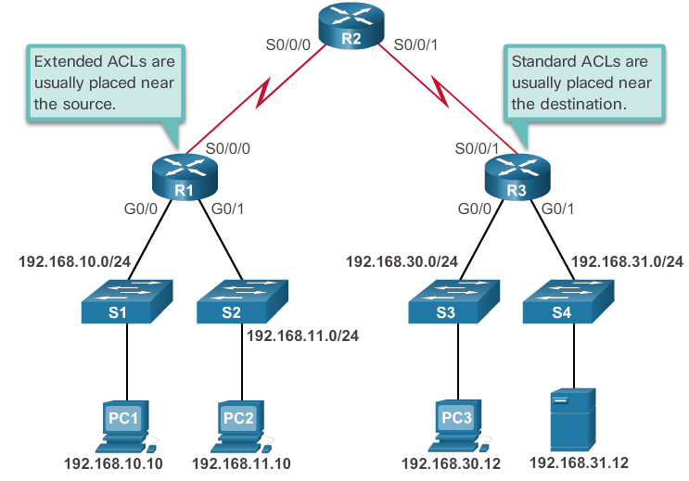
Types of IPv4 ACLs
Where to Place ACLs
Notes:
4.1 - Standard ACL Operation and Configuration
4.1.2 – Types of IPv4 ACLs
4.1.2.3 – Where to Place ACLs

Slide 25
Types of IPv4 ACLs
Where to Place ACLs cont…
Every ACL should be placed where it has the greatest impact on efficiency. The basic rules are:
  Extended ACLs - Locate extended ACLs as close as possible to the source of the traffic to be filtered.
  Standard ACLs - Because standard ACLs do not specify destination addresses, place them as close to the destination as possible.
  Placement of the ACL, and therefore the type of ACL used, may also depend on: the extent of the network administrator’s control, bandwidth of the networks involved, and ease of configuration.
Notes:
4.1 - Standard ACL Operation and Configuration
4.1.2 – Types of IPv4 ACLs
4.1.2.3 – Where to Place ACLs

Slide 26
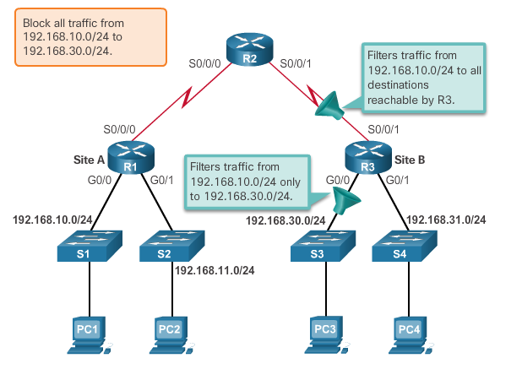
Types of IPv4 ACLs
Standard ACL Placement Example
The administrator wants to prevent traffic originating in the 192.168.10.0/24 network from reaching the 192.168.30.0/24 network.
Notes:
4.1 - Standard ACL Operation and Configuration
4.1.2 – Types of IPv4 ACLs
4.1.2.4 – Standard ACL Placement Example

Slide 27
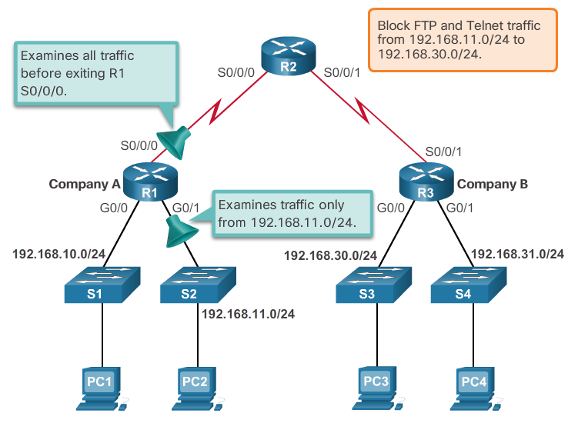
Types of IPv4 ACLs
Extended ACL Placement Example
The administrator wants to deny Telnet and FTP traffic from the 192.168.11.0/24 network to Company B’s 192.168.30.0/24 network. All other traffic from the .11 network must be permitted to leave Company A without restriction.
Notes:
4.1 - Standard ACL Operation and Configuration
4.1.2 – Types of IPv4 ACLs
4.1.2.5 – Extended ACL Placement Example

Slide 28
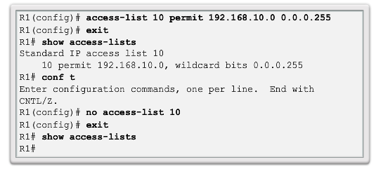
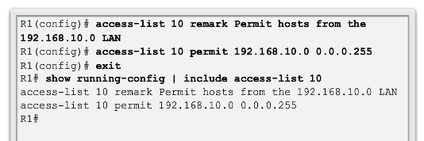
Standard IPv4 ACL Configuration
Configure a Standard IPv4 ACL
Router(config)# access-list access-list-number { deny | permit | remark } source [ source-wildcard ] [ log ]
Notes:
4.1 - Standard ACL Operation and Configuration
4.1.3 – Standard IPv4 ACL Configuration
4.1.3.1 – Configure a Standard IPv4 ACL

Slide 29
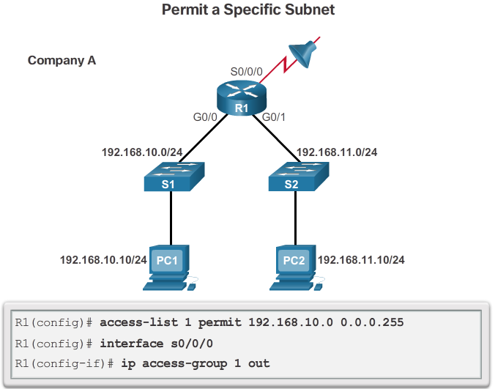
Standard IPv4 ACL Configuration
Apply a Standard IPv4 ACL
Notes:
4.1 - Standard ACL Operation and Configuration
4.1.3 – Standard IPv4 ACL Configuration
4.1.3.2 – Apply a Standard IPv4 ACL

Slide 30
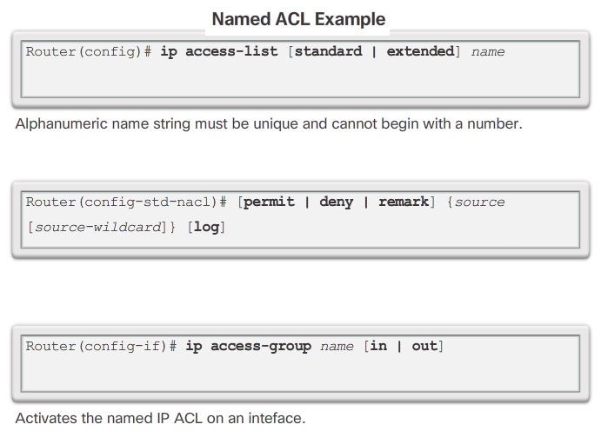
Standard IPv4 ACL Configuration
Named Standard IPv4 ACLs
Notes:
4.1 - Standard ACL Operation and Configuration
4.1.3 – Standard IPv4 ACL Configuration
4.1.3.3 – Named Standard IPv4 ACLs

Slide 31
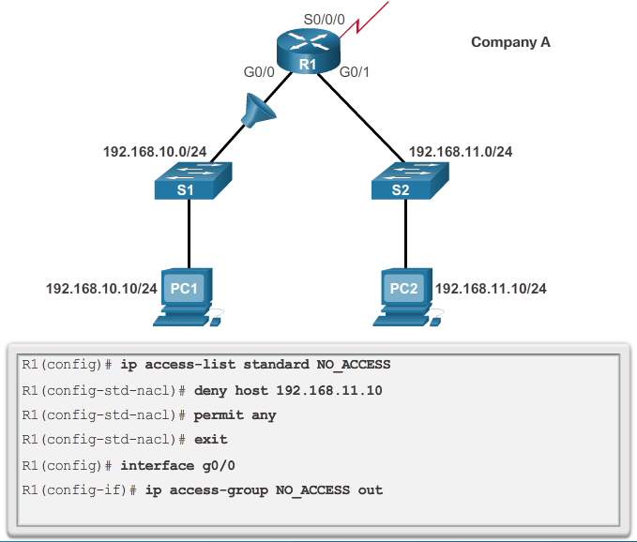
Standard IPv4 ACL Configuration
Named Standard IPv4 ACLs cont…
Notes:
4.1 - Standard ACL Operation and Configuration
4.1.3 – Standard IPv4 ACL Configuration
4.1.3.3 – Named Standard IPv4 ACLs

Slide 32
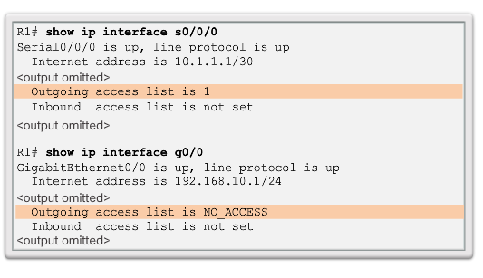
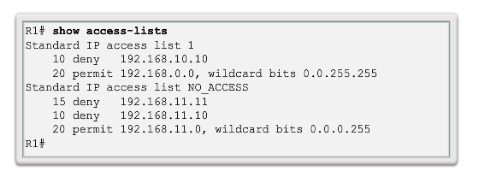
Standard IPv4 ACL Configuration
Verify ACLs
Notes:
4.1 - Standard ACL Operation and Configuration
4.1.3 – Standard IPv4 ACL Configuration
4.1.3.4 – Verify ACLs

Slide 33
4.2 Extended IPv4 ACLs
Notes:
Cisco Networking Academy Program
Connecting Networks
Chapter 4: Access Control Lists

Slide 34
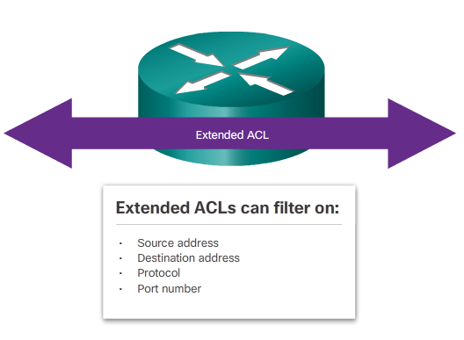
Structure of an Extended IPv4 ACLs
Extended ACLs
Extended ACLs are used more often than standard ACLs because they provide a greater degree of control.
Notes:
4.2 – Extended IPv4 ACLs
4.2.1 – Structure of an Extended IPv4 ACLs
4.2.1.1 – Extended ACLs

Slide 35
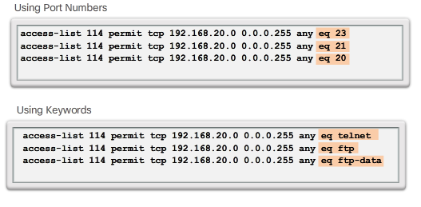
Structure of an Extended IPv4 ACLs
Filtering Ports and Services
The ability to filter on protocol and port number allows network administrators to build very specific extended ACLs.
An application can be specified by configuring either the port number or the name of a well-known port.
Notes:
4.2 – Extended IPv4 ACLs
4.2.1 – Structure of an Extended IPv4 ACLs
4.2.1.2 – Filtering Ports and Services

Slide 36
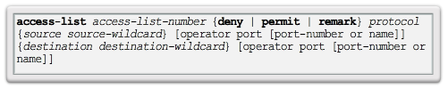
Configure Extended IPv4 ACLs
Configuring Extended ACLs
The procedural steps for configuring extended ACLs are the same as for standard ACLs. The extended ACL is first configured, and then it is activated on an interface. However, the command syntax and parameters are more complex to support the additional features provided by extended ACLs.
Notes:
4.2 – Extended IPv4 ACLs
4.2.2 – Configure Extended IPv4 ACLs
4.2.2.1 – Configuring Extended ACLs

Slide 37
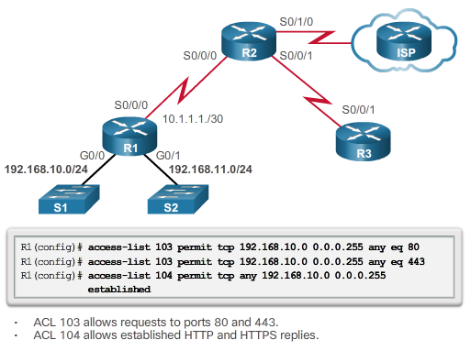
Configure Extended IPv4 ACLs
Configuring Extended ACLs cont…
Notes:
4.2 – Extended IPv4 ACLs
4.2.2 – Configure Extended IPv4 ACLs
4.2.2.1 – Configuring Extended ACLs

Slide 38
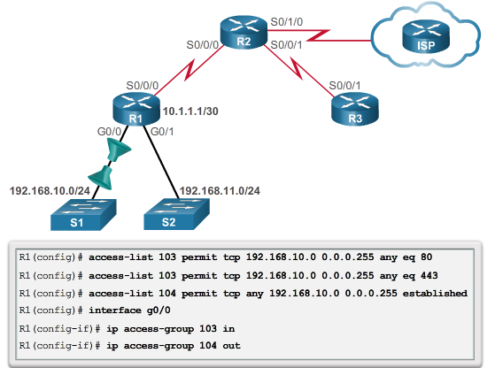
Configure Extended IPv4 ACLs
Applying Extended ACLs to Interfaces
Notes:
4.2 – Extended IPv4 ACLs
4.2.2 – Configure Extended IPv4 ACLs
4.2.2.2 – Applying Extended ACLs to Interfaces

Slide 39
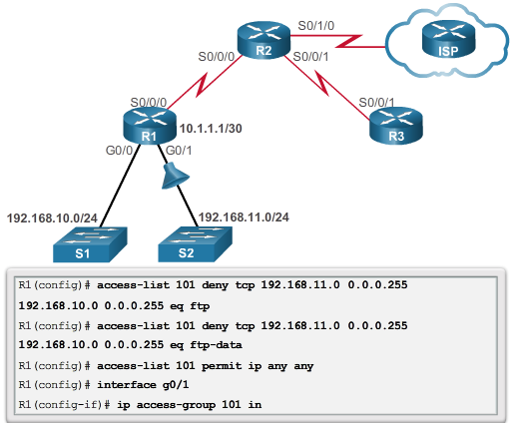
Configure Extended IPv4 ACLs
Filtering Traffic with Extended ACLs
Notes:
4.2 – Extended IPv4 ACLs
4.2.2 – Configure Extended IPv4 ACLs
4.2.2.3 – Filtering Traffic with Extended ACLs

Slide 40
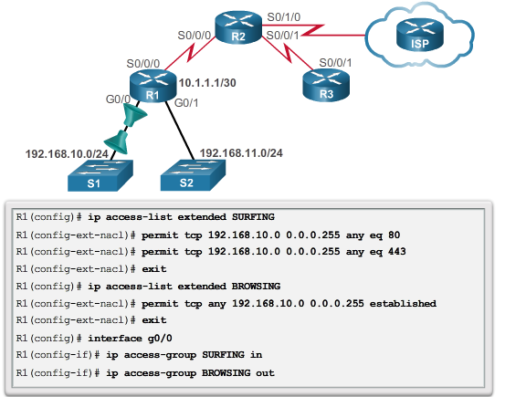
Configure Extended IPv4 ACLs
Creating Named Extended ACLs
Notes:
4.2 – Extended IPv4 ACLs
4.2.2 – Configure Extended IPv4 ACLs
4.2.2.4 – Creating Named Extended ACLs

Slide 41
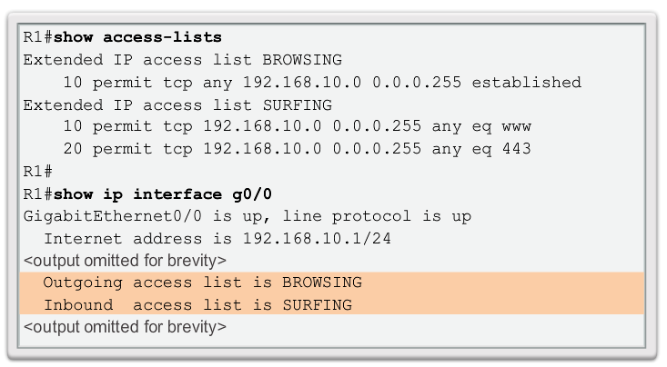
Configure Extended IPv4 ACLs
Verifying Extended ACLs
Notes:
4.2 – Extended IPv4 ACLs
4.2.2 – Configure Extended IPv4 ACLs
4.2.2.5 – Verifying Extended ACLs

Slide 42
Configure Extended IPv4 ACLs
Editing Extended ACLs
Editing an extended ACL can be accomplished using the same process as editing a standard. An extended ACL can be modified using:
  Method 1 - Text editor
    The ACL is copied and pasted into the text editor where the changes are made. The current access list is removed using the no access-list command. The modified ACL is then pasted back into the configuration.
  Method 2 – Sequence numbers
    Sequence numbers can be used to delete or insert an ACL statement.
Notes:
4.2 – Extended IPv4 ACLs
4.2.2 – Configure Extended IPv4 ACLs
4.2.2.6 – Editing Extended ACLs

Slide 43
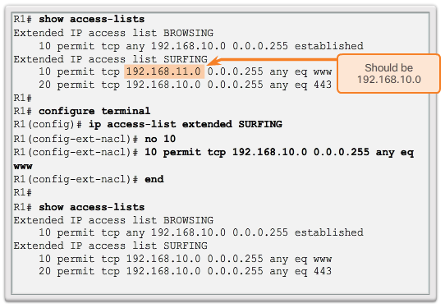
Configure Extended IPv4 ACLs
Editing Extended ACLs cont…
Editing an extended ACL via Sequence Numbers:
Notes:
4.2 – Extended IPv4 ACLs
4.2.2 – Configure Extended IPv4 ACLs
4.2.2.6 – Editing Extended ACLs

Slide 44
4.3 IPv6 ACLs
Notes:
Cisco Networking Academy Program
Connecting Networks
Chapter 4: Access Control Lists

Slide 45
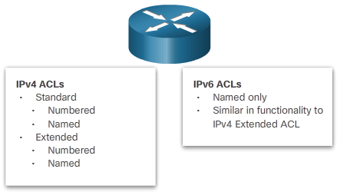
IPv6 ACL Creation
Types of IPv6 ACLs
Notes:
4.3 – IPv6 ACLs
4.3.1 – IPv6 ACL Creation
4.3.1.1 – Types of IPv6 ACLs

Slide 46
IPv6 ACL Creation
Comparing IPv4 and IPv6 ACLs
Although IPv4 and IPv6 ACLs are very similar, there are three significant differences between them.
Applying an IPv6 ACL
  IPv6 uses the ipv6 traffic-filter command to perform the same function for IPv6 interfaces.
No Wildcard Masks
  The prefix-length is used to indicate how much of an IPv6 source or destination address should be matched.
Additional Default Statements
  permit icmp any any nd-na
  permit icmp any any nd-ns
Notes:
4.3 – IPv6 ACLs
4.3.1 – IPv6 ACL Creation
4.3.1.2 – Comparing IPv4 and IPv6 ACLs

Slide 47
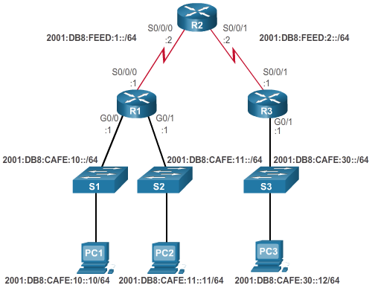
Configuring IPv6 ACLs
Configuring IPv6 Topology
Notes:
4.3 – IPv6 ACLs
4.3.2 – Configuring IPv6 ACLs
4.3.2.1 – Configuring IPv6 Topology

Slide 48
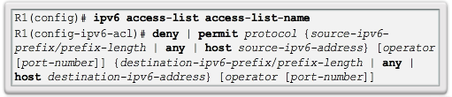
Configuring IPv6 ACLs
Configuring IPv6 ACLs
There are three basic steps to configure an IPv6 ACL:
From global configuration mode, use the ipv6 access-list name command to create an IPv6 ACL.
From the named ACL configuration mode, use permit or deny statements to specify one or more conditions to determine if a packet is forwarded or dropped.
Return to privileged EXEC mode
Notes:
4.3 – IPv6 ACLs
4.3.2 – Configuring IPv6 ACLs
4.3.2.2 – Configuring IPv6 ACLs

Slide 49
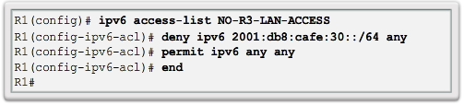
Configuring IPv6 ACLs
Configuring IPv6 ACLs cont…
This IPv6 ACL does the following:
  The first statement names the IPv6 access list NO-R3-LAN-ACCESS.
  The second statement denies all IPv6 packets from the 2001:DB8:CAFE:30::/64 destined for any IPv6 network.
  The third statement allows all other IPv6 packets.
Notes:
4.3 – IPv6 ACLs
4.3.2 – Configuring IPv6 ACLs
4.3.2.2 – Configuring IPv6 ACLs

Slide 50
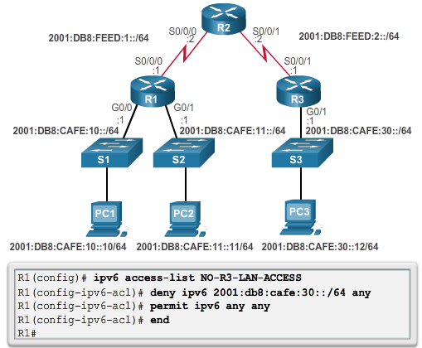
Configuring IPv6 ACLs
Configuring IPv6 ACLs cont…
Notes:
4.3 – IPv6 ACLs
4.3.2 – Configuring IPv6 ACLs
4.3.2.2 – Configuring IPv6 ACLs

Slide 51
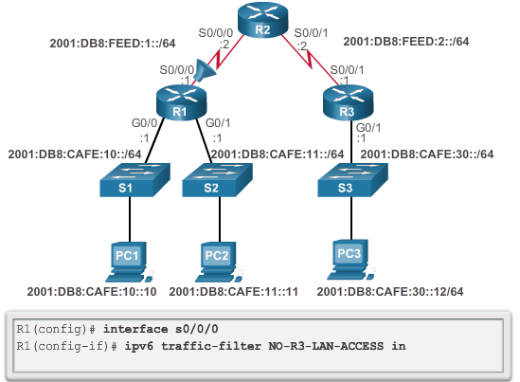
Configuring IPv6 ACLs
Applying an IPv6 ACL to an Interface
Notes:
4.3 – IPv6 ACLs
4.3.2 – Configuring IPv6 ACLs
4.3.2.3 – Applying an IPv6 ACL to an Interface

Slide 52
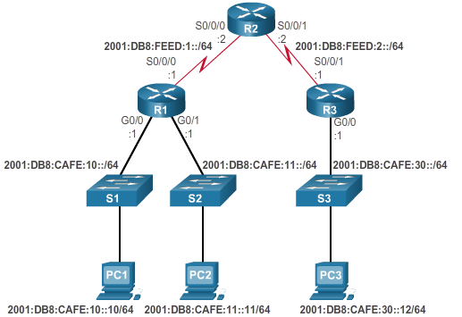
Configuring IPv6 ACLs
IPv6 ACL Examples
Notes:
4.3 – IPv6 ACLs
4.3.2 – Configuring IPv6 ACLs
4.3.2.4 – IPv6 ACL Examples

Slide 53
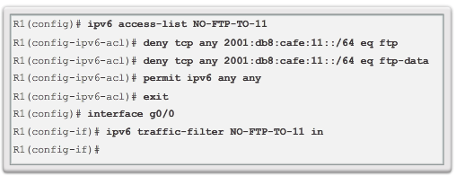
Configuring IPv6 ACLs
IPv6 ACL Examples cont…
Router R1 is configured with an IPv6 access list to deny FTP traffic to 2001:DB8:CAFE:11::/64. Ports for both FTP data (port 20) and FTP control (port 21) need to be blocked.
Because the filter is applied inbound on the G0/0 interface on R1, only traffic from the 2001:DB8:CAFE:10::/64 network will be denied.
Notes:
4.3 – IPv6 ACLs
4.3.2 – Configuring IPv6 ACLs
4.3.2.4 – IPv6 ACL Examples

Slide 54
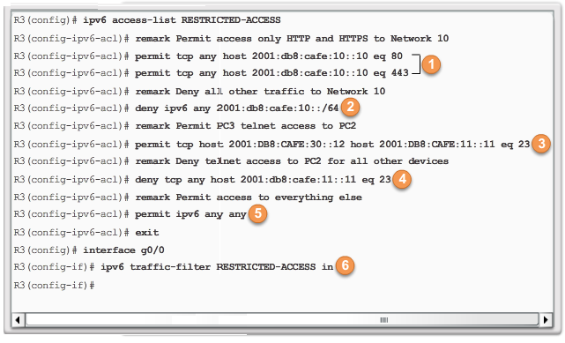
Configuring IPv6 ACLs
IPv6 ACL Examples cont…
  1. The first two permit statements allow access from any device to the web server at 2001:DB8:CAFE:10::10.
  2. All other devices are denied access to network 2001:DB8:CAFE:10::/64.
  3. PC3 at 2001:DB8:CAFE:30::12 is permitted Telnet access to PC2 which has the IPv6 address 2001:DB8:CAFE:11::11.
Notes:
4.3 – IPv6 ACLs
4.3.2 – Configuring IPv6 ACLs
4.3.2.4 – IPv6 ACL Examples

Slide 55
Configuring IPv6 ACLs
IPv6 ACL Examples cont…
  4. All other devices are denied Telnet access to PC2.
  5. All other IPv6 traffic is permitted to all other destinations.
  6. The IPv6 access list is applied to interface G0/0 in the inbound direction, so only the 2001:DB8:CAFE:30::/64 network is affected.
Notes:
4.3 – IPv6 ACLs
4.3.2 – Configuring IPv6 ACLs
4.3.2.4 – IPv6 ACL Examples

Slide 56
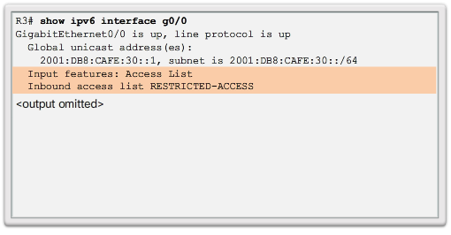
Configuring IPv6 ACLs
Verifying IPv6 ACLs
Notes:
4.3 – IPv6 ACLs
4.3.2 – Configuring IPv6 ACLs
4.3.2.5 – Verifying IPv6 ACLs

Slide 57
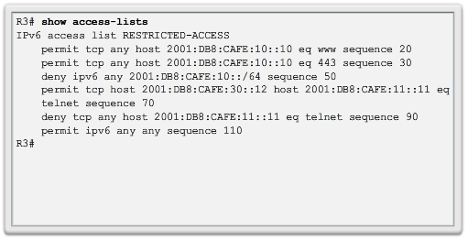
Configuring IPv6 ACLs
Verifying IPv6 ACLs cont…
Notes:
4.3 – IPv6 ACLs
4.3.2 – Configuring IPv6 ACLs
4.3.2.5 – Verifying IPv6 ACLs

Slide 58
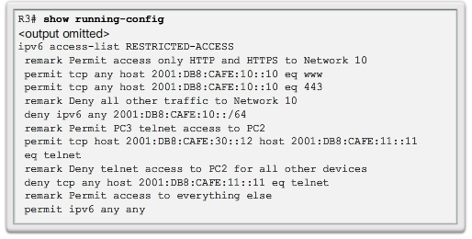
Configuring IPv6 ACLs
Verifying IPv6 ACLs cont…
Notes:
4.3 – IPv6 ACLs
4.3.2 – Configuring IPv6 ACLs
4.3.2.5 – Verifying IPv6 ACLs

Slide 59
4.4 Troubleshoot ACLs
Notes:
Cisco Networking Academy Program
Connecting Networks
Chapter 4: Access Control Lists

Slide 60
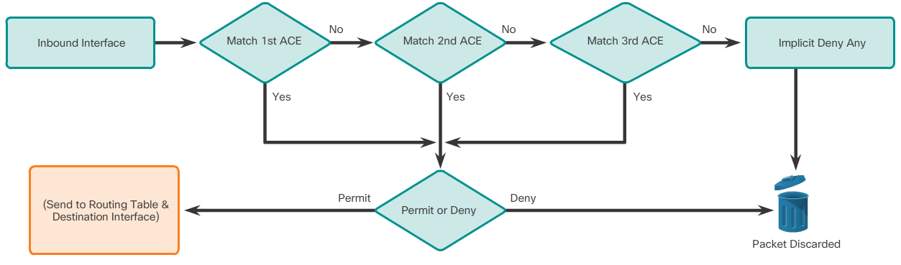
Processing Packets with ACLs
Inbound and Outbound ACL Logic
Notes:
4.4 – Troubleshoot ACLs
4.4.1 – Processing Packets with ACLs
4.4.1.1 – Inbound and Outbound ACL Logic

Slide 61
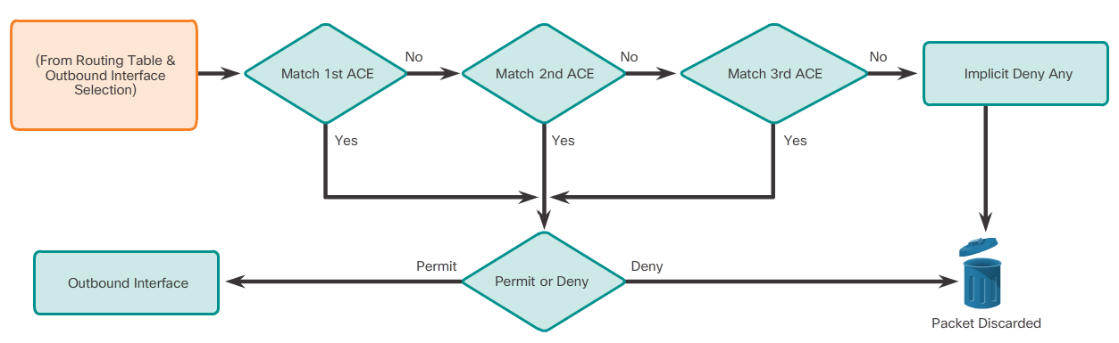
Processing Packets with ACLs
Inbound and Outbound ACL Logic
Notes:
4.4 – Troubleshoot ACLs
4.4.1 – Processing Packets with ACLs
4.4.1.1 – Inbound and Outbound ACL Logic

Slide 62
Processing Packets with ACLs
ACL Logic Operations
As a frame enters an interface, the router checks to see whether the destination Layer 2 address matches its interface Layer 2 address, or whether the frame is a broadcast frame.
If the frame address is accepted, the frame information is stripped off and the router checks for an ACL on the inbound interface.
If an ACL exists, the packet is tested against the statements in the list.
If the packet matches a statement, the packet is either permitted or denied.
If the packet is accepted, it is then checked against routing table entries to determine the destination interface.
If a routing table entry exists for the destination, the packet is then switched to the outgoing interface, otherwise the packet is dropped.
Next, the router checks whether the outgoing interface has an ACL. If an ACL exists, the packet is tested against the statements in the list. If the packet matches a statement, it is either permitted or denied.
If there is no ACL or the packet is permitted, the packet is encapsulated in the new Layer 2 protocol and forwarded out the interface to the next device.
Notes:
4.4 – Troubleshoot ACLs
4.4.1 – Processing Packets with ACLs
4.4.1.2 – ACL Logic Operations

Slide 63
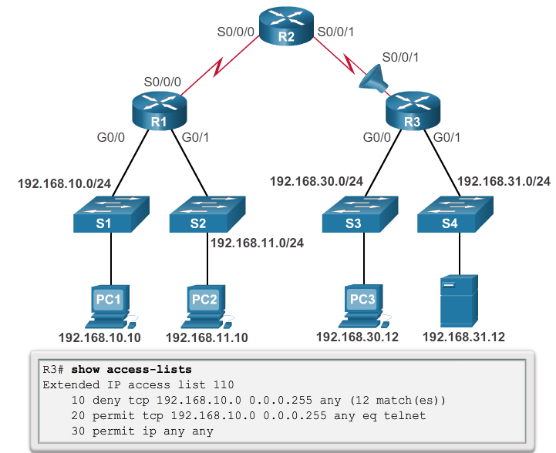
Common ACL Errors
Troubleshooting IPv4 ACLs- Example 1
Host 192.168.10.10 has no Telnet connectivity with 192.168.30.12.
Notes:
4.4 – Troubleshoot ACLs
4.4.2 – Common ACL Errors
4.4.2.1 – Troubleshooting IPv4 ACLs – Example 1

Slide 64
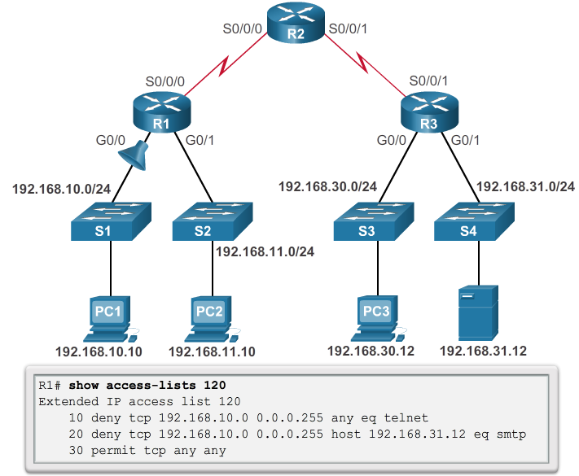
Common ACL Errors
Troubleshooting IPv4 ACLs- Example 2
The 192.168.10.0/24 network cannot use TFTP to connect to the 192.168.30.0/24 network.
Notes:
4.4 – Troubleshoot ACLs
4.4.2 – Common ACL Errors
4.4.2.2 – Troubleshooting IPv4 ACLs – Example 2

Slide 65
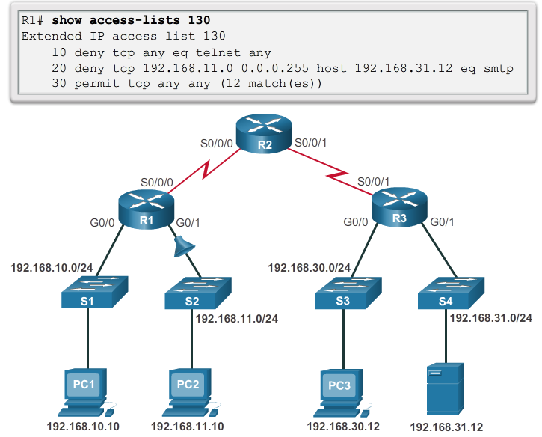
Common ACL Errors
Troubleshooting IPv4 ACLs- Example 3
The 192.168.11.0/24 network can use Telnet to connect to 192.168.30.0/24, but this connection should not be allowed.
Notes:
4.4 – Troubleshoot ACLs
4.4.2 – Common ACL Errors
4.4.2.3 – Troubleshooting IPv4 ACLs – Example 3

Slide 66
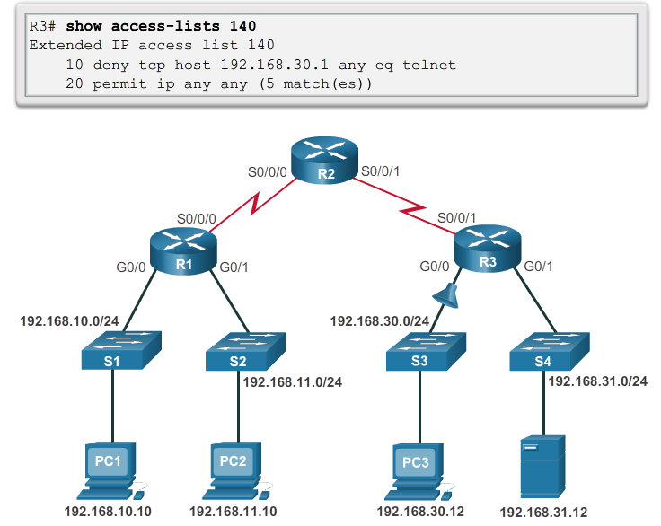
Common ACL Errors
Troubleshooting IPv4 ACLs- Example 4
Host 192.168.30.12 is able to Telnet to connect to 192.168.31.12, but this connection should not be allowed.
Notes:
4.4 – Troubleshoot ACLs
4.4.2 – Common ACL Errors
4.4.2.4 – Troubleshooting IPv4 ACLs – Example 4

Slide 67
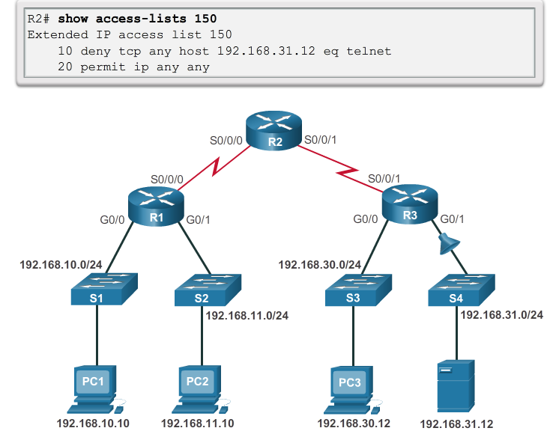
Common ACL Errors
Troubleshooting IPv4 ACLs- Example 5
Host 192.168.30.12 can use Telnet to connect to 192.168.31.12, but this connection should not be allowed.
Notes:
4.4 – Troubleshoot ACLs
4.4.2 – Common ACL Errors
4.4.2.5 – Troubleshooting IPv4 ACLs – Example 5

Slide 68

Common ACL Errors
Troubleshooting IPv6 ACLs- Example 1
R1 is configured with an IPv6 ACL to deny FTP access from the :10 network to the :11 network, but PC1 is still able to connect to the FTP server running on PC2.
Notes:
4.4 – Troubleshoot ACLs
4.4.2 – Common ACL Errors
4.4.2.6 – Troubleshooting IPv6 ACLs – Example 1

Slide 69

Common ACL Errors
Troubleshooting IPv6 ACLs- Example 1 cont…
Notes:
4.4 – Troubleshoot ACLs
4.4.2 – Common ACL Errors
4.4.2.6 – Troubleshooting IPv6 ACLs – Example 1

Slide 70

Common ACL Errors
Troubleshooting IPv6 ACLs- Example 1 cont…
Notes:
4.4 – Troubleshoot ACLs
4.4.2 – Common ACL Errors
4.4.2.6 – Troubleshooting IPv6 ACLs – Example 1

Slide 71

Common ACL Errors
Troubleshooting IPv6 ACLs- Example 2
R3 is configured with IPv6 ACL RESTRICTED-ACCESS that should enforce the following policy for the R3 LAN:
However, after configuring the ACL, PC3 cannot reach the 10 network or the 11 network, and it cannot SSH into the host at 2001:DB8:CAFE:11::11.
Notes:
4.4 – Troubleshoot ACLs
4.4.2 – Common ACL Errors
4.4.2.7 – Troubleshooting IPv6 ACLs – Example 2

Slide 72

Common ACL Errors
Troubleshooting IPv6 ACLs- Example 2 cont…
Notes:
4.4 – Troubleshoot ACLs
4.4.2 – Common ACL Errors
4.4.2.7 – Troubleshooting IPv6 ACLs – Example 2

Slide 73

Common ACL Errors
Troubleshooting IPv6 ACLs- Example 2 cont…
Notes:
4.4 – Troubleshoot ACLs
4.4.2 – Common ACL Errors
4.4.2.7 – Troubleshooting IPv6 ACLs – Example 2

Slide 74

Common ACL Errors
Troubleshooting IPv6 ACLs- Example 2 cont…
Notes:
4.4 – Troubleshoot ACLs
4.4.2 – Common ACL Errors
4.4.2.7 – Troubleshooting IPv6 ACLs – Example 2

Slide 75

Common ACL Errors
Troubleshooting IPv6 ACLs- Example 3
R1 is configured with IPv6 ACL DENY-ACCESS that should enforce the following policy for the R3 LAN:
However, after applying the ACL to the interface the :10 network is still reachable from the :30 network.
Notes:
4.4 – Troubleshoot ACLs
4.4.2 – Common ACL Errors
4.4.2.8 – Troubleshooting IPv6 ACLs – Example 3

Slide 76

Common ACL Errors
Troubleshooting IPv6 ACLs- Example 3 cont…
Notes:
4.4 – Troubleshoot ACLs
4.4.2 – Common ACL Errors
4.4.2.8 – Troubleshooting IPv6 ACLs – Example 3

Slide 77

Common ACL Errors
Troubleshooting IPv6 ACLs- Example 3 cont…
Notes:
4.4 – Troubleshoot ACLs
4.4.2 – Common ACL Errors
4.4.2.8 – Troubleshooting IPv6 ACLs – Example 3

Slide 78
4.5 Chapter Summary
Notes:
Cisco Networking Academy Program
Connecting Networks
Chapter 4: Access Control Lists

Slide 79
Chapter Summary
Summary
By default a router does not filter traffic. Traffic that enters the router is routed solely based on information within the routing table.
An ACL is a sequential list of permit or deny statements. The last statement of an ACL is always an implicit deny any statement which blocks all traffic. To prevent the implied deny any statement at the end of the ACL from blocking all traffic, the permit ip any any statement can be added.
When network traffic passes through an interface configured with an ACL, the router compares the information within the packet against each entry, in sequential order, to determine if the packet matches one of the statements. If a match is found, the packet is processed accordingly.
ACLs can be applied to inbound traffic or to outbound traffic.
Standard ACLs can be used to permit or deny traffic only from a source IPv4 addresses. The basic rule for placing a standard ACL is to place it close to the destination.
Extended ACLs filter packets based on several attributes: protocol type, source or destination IPv4 address, and source or destination ports. The basic rule for placing an extended ACL is to place it as close to the source as possible.
Notes:
2.4 – Chapter Summary

Slide 80
Summary Continued
The access-list global configuration command defines a standard ACL with a number in the range of 1 through 99 or an extended ACL with numbers in the range of 100 to 199. The ip access-list standard name is used to create a standard named ACL, whereas the command ip access-list extended name is for an extended access list.
After an ACL is configured, it is linked to an interface using the ip access-group command in interface configuration mode. A device an only have one ACL per protocol, per direction, per interface.
To remove an ACL from an interface, first enter the no ip access-group command on the interface, and then enter the global no access-list command to remove the entire ACL.
The show running-config and show access-lists commands are used to verify ACL configuration. The show ip interface command is used to verify the ACL on the interface and the direction in which it was applied.
The access-class command configured in line configuration mode is used to link an ACL to a particular VTY line.
Unlike IPv4, IPv6 ACLs e is no need for a standard or extended option.
From global configuration mode, use the ipv6 access-list name command to create an IPv6 ACL. Unlike IPv4 ACLs, IPv6 ACLs do not use wildcard masks. Instead, the prefix-length is used to indicate how much of an IPv6 source or destination address should be matched.
After an IPv6 ACL is configured, it is linked to an interface using the ipv6 traffic-filter command.

Slide 81
Summary Continued
Unlike IPv4, IPv6 ACLs do not have support for a standard or extended option.
From global configuration mode, use the ipv6 access-list name command to create an IPv6 ACL.
Unlike IPv4 ACLs, IPv6 ACLs do not use wildcard masks. Instead, the prefix-length is used to indicate how much of an IPv6 source or destination address should be matched.
After an IPv6 ACL is configured, it is linked to an interface using the ipv6 traffic-filter command.

Slide 83


