Slide 1
Chapter 10: Device Discovery, Management, and Maintenance
Instructor Materials
CCNA Routing and Switching
Routing and Switching Essentials v6.0
Notes:
Cisco Networking Academy Program
Routing and Switching Essentials v6.0
Chapter 10: Device Discovery, Management, and Maintenance

Slide 2
Instructor Materials – Chapter 10 Planning Guide
This PowerPoint deck is divided in two parts:
Instructor Planning Guide
  Information to help you become familiar with the chapter
  Teaching aids
Instructor Class Presentation
  Optional slides that you can use in the classroom
  Begins on slide # 12
Note: Remove the Planning Guide from this presentation before sharing with anyone.
Notes:
2

Slide 3
Chapter 10: Device Discovery, Management, and Maintenance
Routing and Switching Essentials 6.0 Planning Guide
Notes:
Cisco Networking Academy Program
Routing & Switching Essentials v6.0
Chapter 10: Device Discovery, Management, and Maintenance

Slide 4
Chapter 10: Activities
What activities are associated with this chapter?
Page # | Activity Type | Activity Name | Optional?
10.1.1.4 | Packet Tracer | Map a Network Using CDP | Recommended
10.1.2.2 | Syntax Checker | Configure and Verify LLDP | Recommended
10.1.2.4 | Interactive Activity | Compare CDP and LLDP | Recommended
10.1.2.5 | Lab | Configure CDP and LLDP | Recommended
10.2.1.3 | Syntax Checker | Configure and Verify NTP | Recommended
10.2.1.4 | Packet Tracer | Configure and Verify NTP | Recommended
10.2.2.5 | Interactive Activity | Interpreting Syslog Output | Recommended
10.2.3.4 | Syntax Checker | Configuring and Verifying Syslog | Recommended
10.2.3.5 | Packet Tracer | Configuring Syslog and NTP | Recommended
10.2.3.6 | Lab | Configuring Syslog and NTP | Recommended
The password used in the Packet Tracer activities in this chapter is: PT_ccna5
Notes:
4

Slide 5
Chapter 10: Activities (Cont.)
What activities are associated with this chapter?
Page # | Activity Type | Activity Name | Optional?
10.3.1.7 | Syntax Checker | Password Recovery on a Router | Recommended
10.3.1.8 | Packet Tracer | Backing Up Configuration Files | Recommended
10.3.1.9 | Lab | Managing Router Configuration Files with Tera Term | Recommended
10.3.1.10 | Lab | Managing Device Configuration Files Using TFTP, Flash, and USB | Recommended
10.3.1.11 | Lab | Researching Password Recovery Procedures | Recommended
10.3.3.2 | Syntax Checker | Steps to Backup IOS Image to TFTP Server | Recommended
10.3.3.5 | Packet Tracer | Using a TFTP Server to Upgrade a Cisco IOS Image | Recommended
10.3.3.6 | Video Demonstration | Managing Cisco IOS Images | Recommended
10.3.4.4 | Syntax Checker | Displaying the License UDI on R2 | Recommended
The password used in the Packet Tracer activities in this chapter is: PT_ccna5
Notes:
5

Slide 6
Chapter 10: Activities (Cont.)
What activities are associated with this chapter?
Page # | Activity Type | Activity Name | Optional?
10.3.4.5 | Syntax Checker | Installing the Security License on R2 | Recommended
10.3.5.2 | Syntax Checker | Activate an Evaluation Right-To-Use License | Recommended
10.3.5.3 | Syntax Checker | Back up the License | Recommended
10.3.5.4 | Syntax Checker | Uninstall the License | Recommended
10.3.5.5 | Video Demonstration | Working with IOS 15 Image Licenses | Recommended
10.4.1.1 | Packet Tracer | Skills Integration Challenge | Recommended
The password used in the Packet Tracer activities in this chapter is: PT_ccna5
Notes:
6

Slide 7
Chapter 10: Assessment
Students should complete Chapter 10, “Assessment” after completing Chapter 10.
Quizzes, labs, Packet Tracers and other activities can be used to informally assess student progress.
Notes:
7

Slide 8
Chapter 10: Best Practices
Prior to teaching Chapter 10, the instructor should:
Complete Chapter 10, “Assessment.”
The objectives of this chapter are:
  Use CDP to map a network topology.
  Use LLDP to map a network topology.
  Implement NTP between a NTP client and NTP server.
  Explain syslog operation.
  Configure syslog servers and clients.
  Use commands to back up and restore an IOS configuration file.
  Explain the IOS image naming conventions implemented by Cisco.
  Upgrade an IOS system image.
  Explain the licensing process for Cisco IOS software in a small- to medium-sized business network.
  Configure a router to install an IOS software image license.
Notes:
8

Slide 9
Chapter 10: Best Practices (Cont.)
  Prove that a TFTP server can be used to store and backup an IOS image and router configuration.
  Demonstrate backing up the IOS to a TFTP server.
  Show how to access and download the correct image from http://www.cisco.com, ensuring that it meets your router and network needs in terms of platform, feature set, and software. Also ensure that your router has enough memory for the new or updated IOS.
Notes:
9

Slide 10
Chapter 10: Additional Help
For additional help with teaching strategies, including lesson plans, analogies for difficult concepts, and discussion topics, visit the CCNA Community at: https://www.netacad.com/group/communities/community-home
Best practices from around the world for teaching CCNA Routing and Switching. https://www.netacad.com/group/communities/ccna
If you have lesson plans or resources that you would like to share, upload them to the CCNA Community in order to help other instructors.
Students can enroll in Introduction to Packet Tracer (self-paced).
Notes:
10

Slide 12
Chapter 10: Device Discovery, Management, and Maintenance
CCNA Routing and Switching
Routing and Switching Essentials v6.0
Notes:
Cisco Networking Academy Program
Routing and Switching Essentials v6.0
Chapter 10: Device Discovery, Management, and Maintenance

Slide 13
Chapter 10 - Sections & Objectives
10.1 Device Discovery
  Use discovery protocols to map a network topology.
  Use CDP to map a network topology.
  Use LLDP to map a network topology.
10.2 Device Management
  Configure NTP and Syslog in a small to medium-sized business network.
  Implement NTP between a NTP client and NTP server.
  Explain syslog operation.
  Configure syslog servers and clients.
Notes:
13
Cisco Networking Academy Program
Routing and Switching Essentials v6.0
Chapter 10: Device Discovery, Management, and Maintenance

Slide 14
Chapter 10 - Sections & Objectives (Cont.)
10.3 Device Maintenance
  Maintain router and switch configuration and IOS files.
  Use commands to back up and restore an IOS configuration file.
  Explain the IOS image naming conventions implemented by Cisco.
  Upgrade an IOS system image.
  Explain the licensing process for Cisco IOS software in a small- to medium-sized business network.
  Configure a router to install an IOS software image license.
Notes:
14
Cisco Networking Academy Program
Routing and Switching Essentials v6.0
Chapter 10: Device Discovery, Management, and Maintenance

Slide 15
10.1 Device Discovery
Notes:
Ch 10 – Device Discovery, Management, and Maintenance
10.1 – Device Discovery

Slide 16

Device Discovery with CDP
CDP Overview
Cisco Discovery Protocol (CDP)
  Cisco proprietary Layer 2 protocol used to gather information about Cisco devices sharing a link
  Periodic CDP advertisements sent to connected devices
  Share type of device discovered, name of devices, and number and type of interfaces
  Determine information about neighboring devices to build a logical topology when documentation is missing
Notes:
10.1 – Device Discovery
10.1.1 – Device Discovery with CDP
10.1.1.1 – CDP Overview

Slide 17
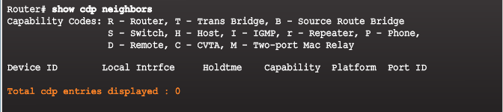
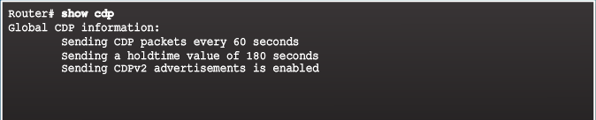
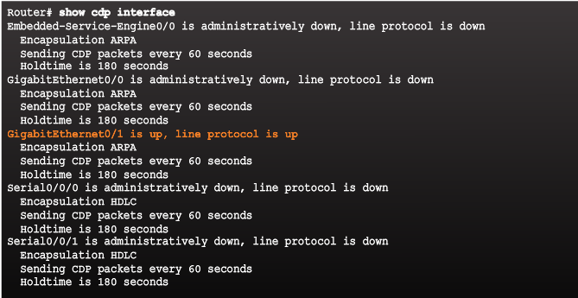

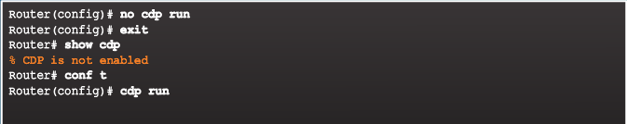
Device Discovery with CDP
Configure and Verify CDP
No neighbors detected
Verify status and display information
Enables CDP on interface (no CDP enable disables)
no cdp run globally disables (cdp run enables)
Indicates the interfaces with CDP enabled
Notes:
10.1 – Device Discovery
10.1.1 – Device Discovery with CDP
10.1.1.2 – Configure and Verify CDP

Slide 18
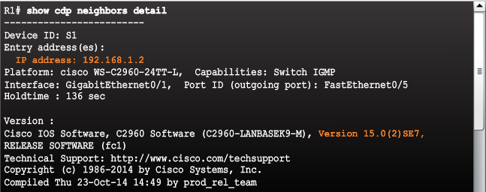

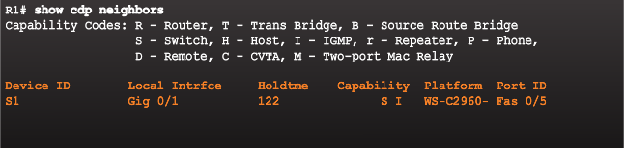
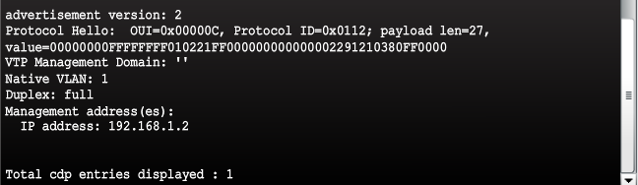
Device Discovery with CDP
Discover Devices Using CDP
show cdp neighbors discovers:
S1 (Device ID)
Gig 0/1 (local port identifier)
Fas 0/5 (remote port identified)
S for switch (R for router)
WS-C2960 (hardware platform)
show cdp neighbors detail command provides additional information:
IPv4 address
IOS version
Notes:
10.1 – Device Discovery
10.1.1 – Device Discovery with CDP
10.1.1.3 – Discover Devices Using CDP

Slide 19
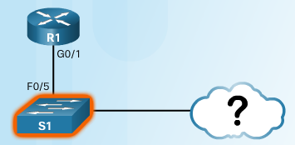
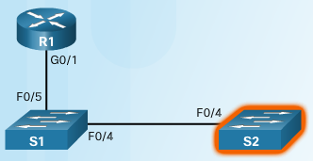
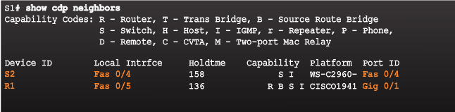
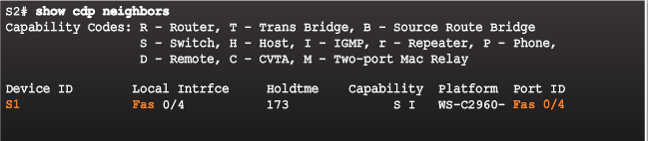
Device Discovery with CDP
Discover Devices Using CDP (Cont.)
Other devices connected to S1 can be determined
S2 is revealed in the output!
No more devices to discover!
Notes:
10.1 – Device Discovery
10.1.1 – Device Discovery with CDP
10.1.1.3 – Discover Devices Using CDP

Slide 20
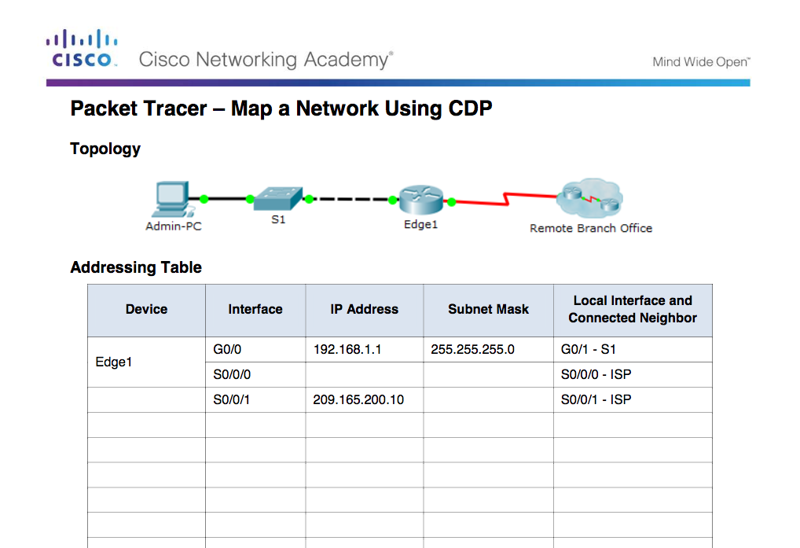
Device Discovery with CDP
Packet Tracer – Map a Network Using CDP
Notes:
10.1 – Device Discovery
10.1.1 – Device Discovery with CDP
10.1.1.4 – Packet Tracer - Map a Network Using CDP

Slide 21

Device Discovery with LLDP
LLDP Overview
Link Layer Discovery Protocol
  Vendor-neutral neighbor discovery similar to CDP
  Works with routers, switches, and wireless LAN access points
  Advertises its identity and capabilities to other devices and information from a connected Layer 2 device
Notes:
10.1 – Device Discovery
10.1.2 –Device Discovery with LLDP
10.1.2.1 – LLDP Overview

Slide 22
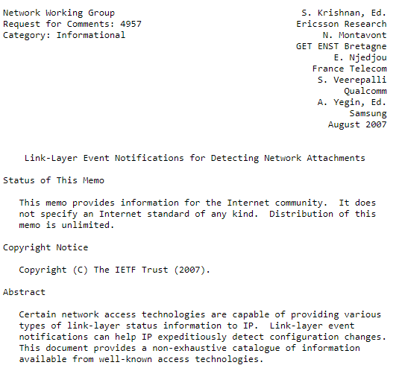
IEEE 802.1AB and IEEE 802.3-2012 section 6 clause 79, i RFC

Slide 23
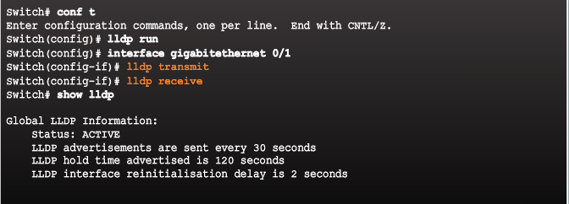
Device Discovery with LLDP
Configure and Verify LLDP
lldp run enables globally
LLDP can be configured on separate interfaces, configured separately to transmit and receive
To disable LLDP globally – no lldp run
Notes:
10.1 – Device Discovery
10.1.2 –Device Discovery with LLDP
10.1.2.2 – Configure and Verify LLDP

Slide 24
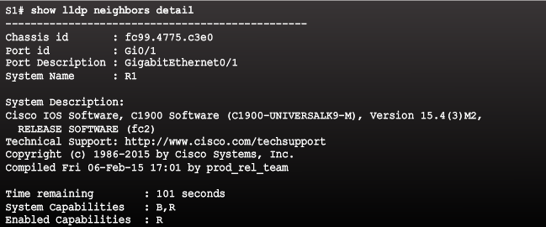

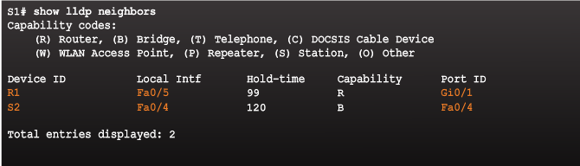
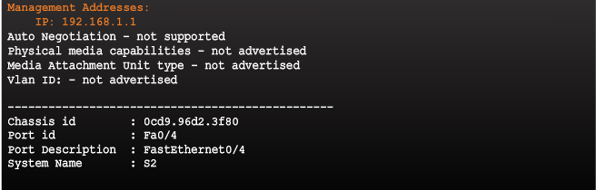

Device Discovery with LLDP
Discover Devices Using LLDP
Notes:
10.1 – Device Discovery
10.1.2 –Device Discovery with LLDP
10.1.2.3 – Discover Devices Using LLDP

Slide 25
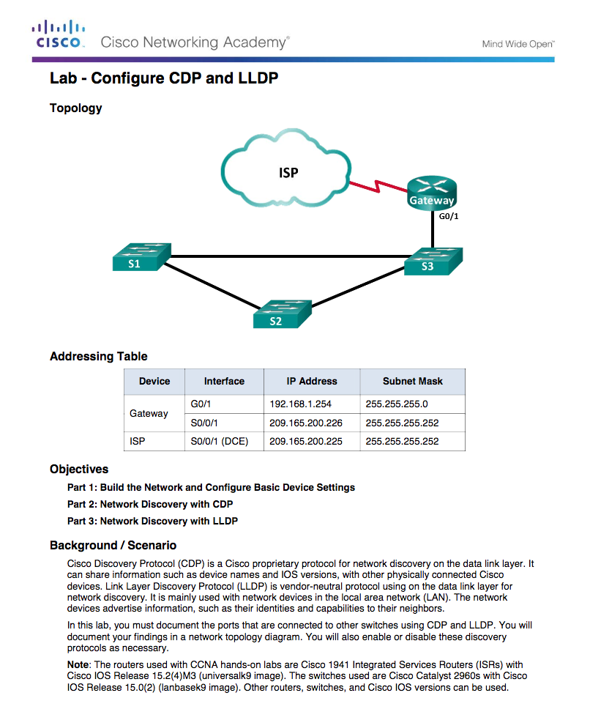
Device Discovery with LLDP
Lab – Configure CDP and LLDP
Notes:
10.1 – Device Discovery
10.1.2 –Device Discovery with LLDP
10.1.2.5 – Lab – Configure CDP and LLDP

Slide 26
10.2 Device Management
Notes:
10 – Device Discovery, Management, and Maintenance
10.2 – Device Management

Slide 27
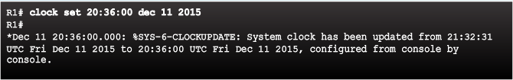
NTP
Setting the System Clock
Managing, securing, troubleshooting, and planning networks requires accurate timestamping
Date and time settings on a router or switch can be set using one of two methods:
Manually configure the date and time, as shown in the figure
Configure the Network Time Protocol (NTP)
  NTP uses UDP port 123
  NTP clients obtain time and date from a single source
Notes:
10.2 – Device Management
10.2.1 – NTP
10.2.1.1 –Setting the System Clock

Slide 28
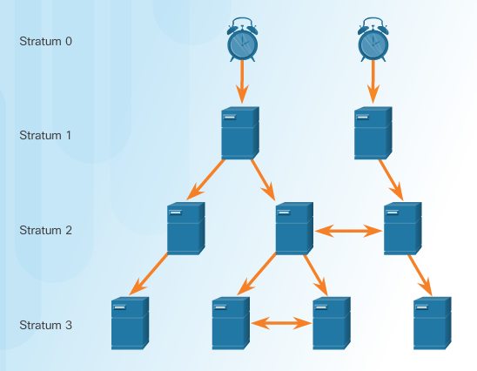
NTP
NTP Operation
Stratum 0 – top level of hierarchical system, authoritative time sources, assumed to be accurate
Stratum 1 – directly connected to authoritative sources and act as primary network time standard
Stratum 2 and Lower – connected to stratum 1 devices via network connections, act as servers for stratum 3 devices
Smaller stratum numbers closer to authoritative time source
Larger the stratum number, the lower the stratum level (max hop is 15)
Stratum 16, lowest stratum level, indicates device is unsynchronized
Notes:
10.2 – Device Management
10.2.1 – NTP
10.2.1.2 – NTP Operation

Slide 29
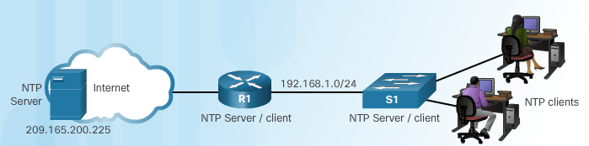
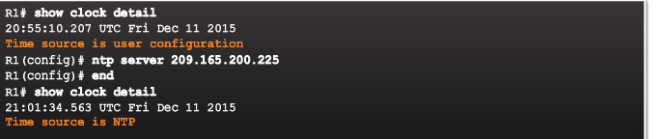
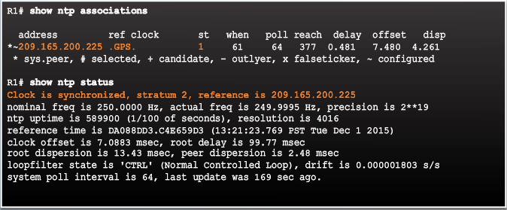
NTP
Configure and Verify NTP
Configure Stratum 2 NTP Server
Verify NTP Server Configuration
R1 is synchronized with a stratum 1 NTP server at 209.165.200.225 which is synchronized with a GPS clock
Notes:
10.2 – Device Management
10.2.1 – NTP
10.2.1.3 – Configure and Verify NTP

Slide 30
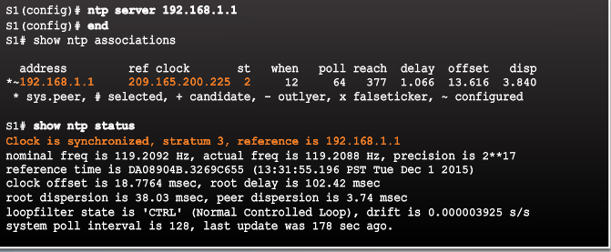
NTP
Configure and Verify NTP (Cont.)
Configure Stratum 3 NTP Server
R1 is a stratum 2 device and NTP server to S1
S1 is a stratum 3 device that can provide NTP service to end devices
Notes:
10.2 – Device Management
10.2.1 – NTP
10.2.1.3 – Configure and Verify NTP

Slide 31
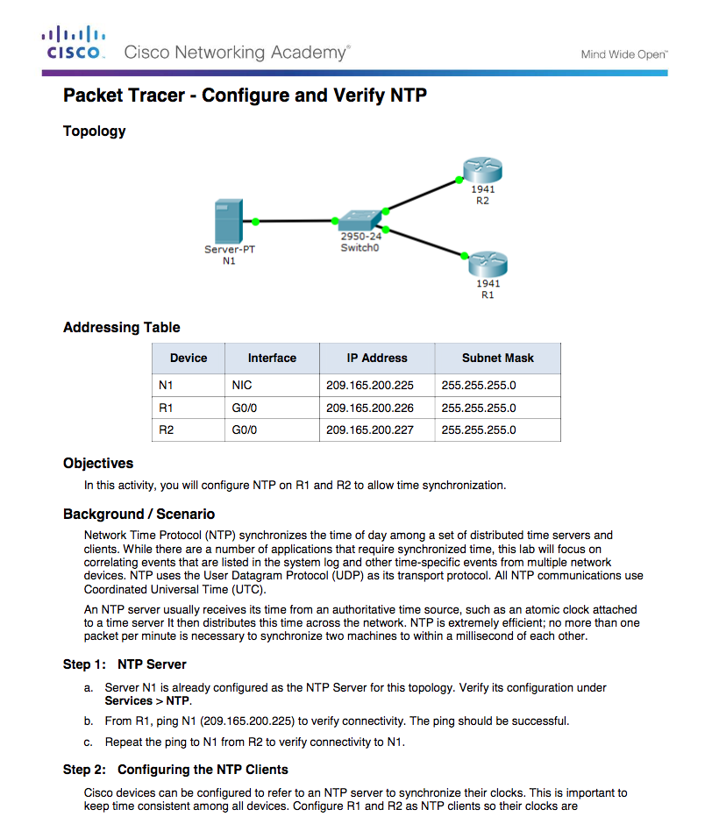
NTP
Packet Tracer - Configure and Verify NTP
Notes:
10.2 – Device Management
10.2.1 – NTP
10.2.1.4 – Packet Tracer – Configure and Verify NTP

Slide 32
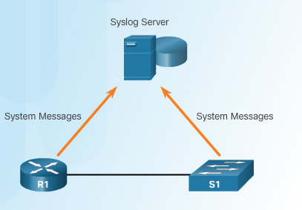
Syslog Operation
Introduction to Syslog
Syslog
  Describes a standard and protocol
  Uses UDP port 514
  Send event notification messages across IP networks to event message collectors
  Routers, switches, servers, firewalls support syslog
Syslog logging service provides three primary functions:
  Ability to gather logging information for monitoring and troubleshooting
  Ability to select the type of logging information that is captured
  Ability to specify the destinations of captured syslog messages
Notes:
10.2 – Device Management
10.2.2 – Syslog Operation
10.2.2.1 – Introduction to Syslog

Slide 33
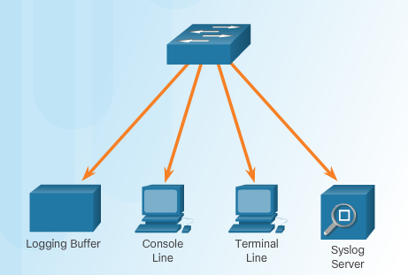
Syslog Operation
Syslog Operation
Syslog protocol starts by sending system messages and debug output to a local logging process internal to the device.
How the logging process manages these messages and outputs is based on device configurations.
Syslog messages may be sent across the network to an external syslog server. Can be pulled into various reports.
Syslog messages may be sent to an internal buffer. Only viewable through the CLI of the device.
Destinations for syslog messages include:
  Logging buffer (RAM inside a router or switch)
  Console line
  Terminal line
  Syslog server
Notes:
10.2 – Device Management
10.2.2 – Syslog Operation
10.2.2.2 – Syslog Operation

Slide 34
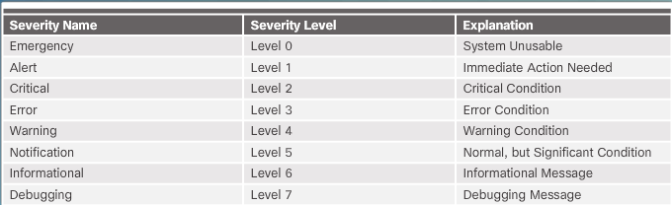
Syslog Operation
Syslog Message Format
Cisco devices produce syslog messages as a result of network events
Every syslog message contains a severity level and a facility.
  Smaller are more critical
Notes:
10.2 – Device Management
10.2.2 – Syslog Operation
10.2.2.3 – Syslog Message Format

Slide 35
Syslog Operation
Syslog Message Format (Cont.)
Each syslog level has its own meaning:
  Warning Level 4 - Emergency Level 0: Error messages about software or hardware malfunctions; functionality of the device is affected.
  Notification Level 5: The notifications level is for normal events. Interface up or down transitions, and system restart messages are displayed at the notifications level.
  Informational Level 6: A normal information message that does not affect device functionality. For example, when a Cisco device is booting, you might see the following informational message: %LICENSE-6-EULA_ACCEPT_ALL: The Right to Use End User License Agreement is accepted.
  Debugging Level 7: This level indicates that the messages are output generated from issuing various debug commands.
Notes:
10.2 – Device Management
10.2.2 – Syslog Operation
10.2.2.3 – Syslog Message Format

Slide 36


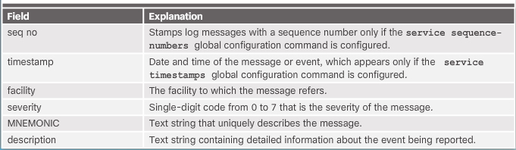
Syslog Operation
Syslog Message Format (Cont.)
By default, the format of syslog messages on the Cisco IOS Software is:
Sample output on a Cisco switch for an EtherChannel link changing state to up is:
Facility is LINK and the severity level is 3, with a MNEMONIC of UPDOWN.
Notes:
10.2 – Device Management
10.2.2 – Syslog Operation
10.2.2.3 – Syslog Message Format

Slide 37
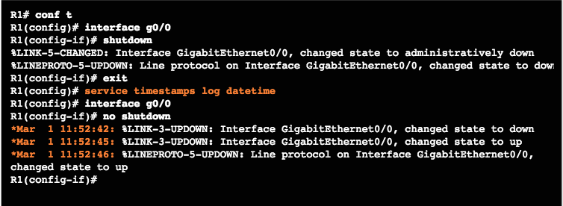
Syslog Operation
Service Timestamp
By default, log messages are not timestamped
Log messages should be timestamped so when sent to destination (syslog server) there is a record of when the message was generated
Notice date below once timestamp is activated
Notes:
10.2 – Device Management
10.2.2 – Syslog Operation
10.2.2.4 - Service Timestamp

Slide 38
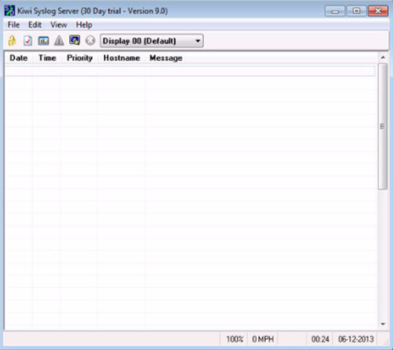
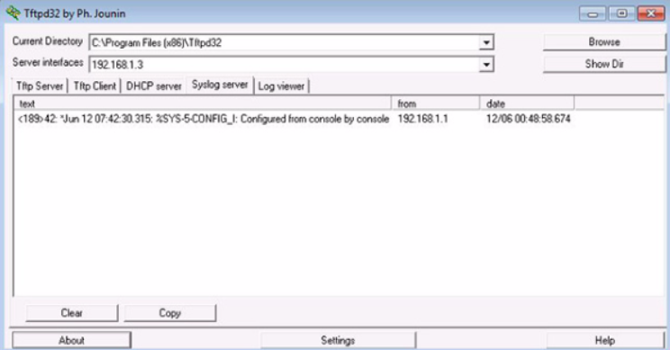
Syslog Configuration
Syslog Server
  To view syslog messages, a syslog server must be installed on a networked PC
Notes:
10.2 – Device Management
10.2.3 – Syslog Configuration
10.2.3.1 – Syslog Server

Slide 39
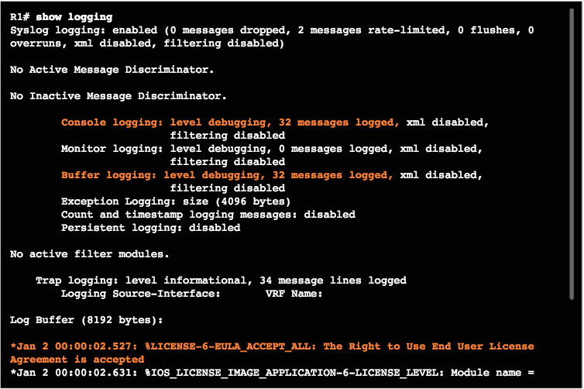
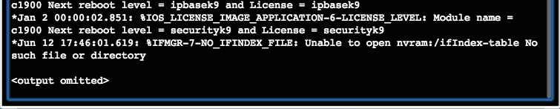
Syslog Configuration
Default Logging
By default, log messages sent to the console.
Some IOS versions buffer log messages by default too.
First highlighted line states that this router logs to the console and includes debug messages.
  all debug level messages, as well as any lower level messages are logged to the console
Second highlighted line states that this router logs to an internal buffer.
System messages that have been logged are at the end of the output.
Notes:
10.2 – Device Management
10.2.3 – Syslog Configuration
10.2.3.2 – Default Logging

Slide 40
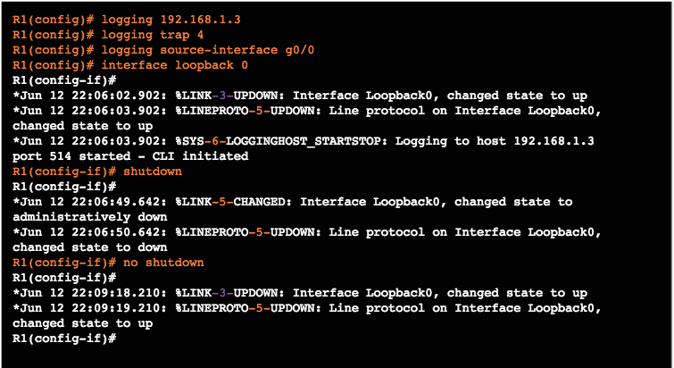
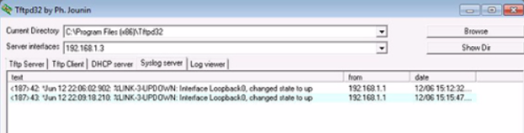
Syslog Configuration
Router and Switch Commands for Syslog Clients
R1 is configured to send log messages of levels 4 and lower to the syslog server at 192.168.1.3
Source interface is set as the G0/0 interface
Loopback interface is created, then shut down, and then brought back up
Console output reflects these actions
Notes:
10.2 – Device Management
10.2.3 – Syslog Configuration
10.2.3.3 – Router and Switch Commands for Syslog Clients

Slide 41
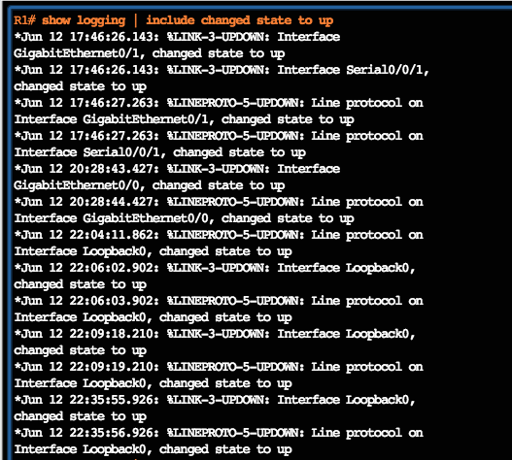
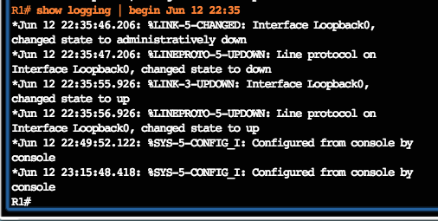
Syslog Configuration
Verifying Syslog
Notes:
10.2 – Device Management
10.2.3 – Syslog Configuration
10.2.3.4 – Verifying Syslog

Slide 42
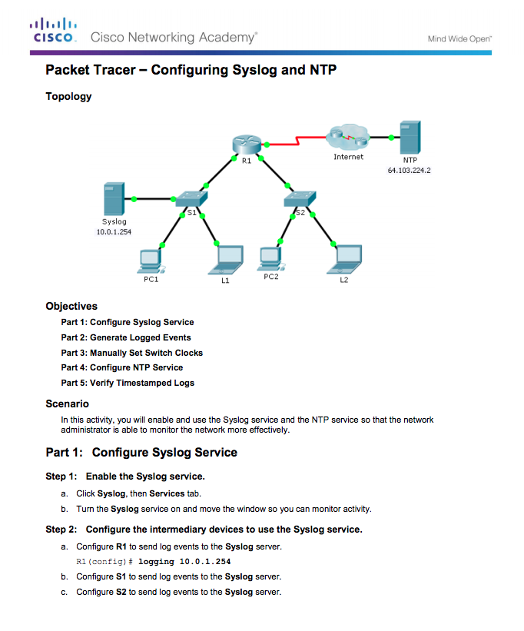
Syslog Configuration
Packet Tracer – Configuring Syslog and NTP
Notes:
10.2 – Device Management
10.2.3 – Syslog Configuration
10.2.3.5 – Packet Tracer – Configuring Syslog and NTP

Slide 43
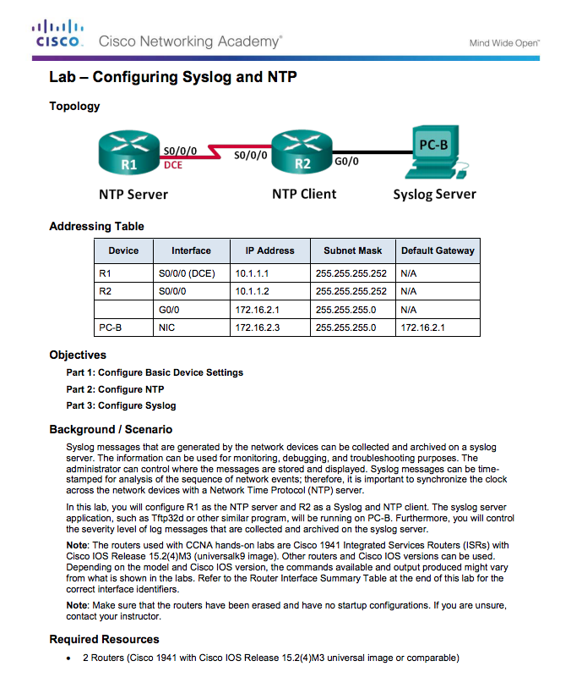
Syslog Configuration
Lab – Configuring Syslog and NTP
Notes:
10.2 – Device Management
10.2.3 – Syslog Configuration
10.2.3.6 – Lab – Configuring Syslog and NTP

Slide 44
10.3 Device Maintenance
Notes:
10 – Device Discovery, Management, and Maintenance
10.3 – Device Maintenance

Slide 45
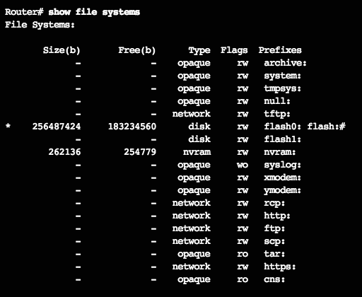
Router and Switch File Maintenance
Router File Systems
show file systems lists all the available file systems
Provides information such as memory, type of file system, and permissions (read only (ro), read and write (rw))
Interested in tftp, flash, and nvram file systems
Bootable IOS is located in flash so has a *
Notes:
10.3 – Device Maintenance
10.3.1 – Router and Switch File Maintenance
10.3.1.1 – Router File Systems

Slide 46
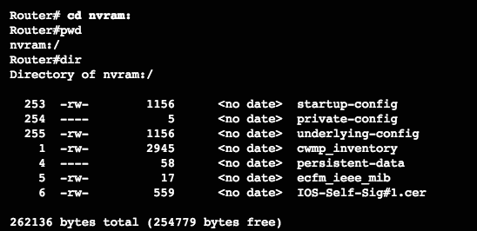
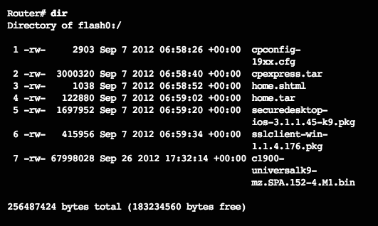
Router and Switch File Maintenance
Router File Systems (Cont.)
To view the contents of NVRAM, change the current default file system using the cd (change directory) command
pwd (present working directory) command verifies that we are viewing the NVRAM directory
dir lists the contents of NVRAM, included is the startup-configuration file
dir lists the contents of flash
Last listing is the name of the current Cisco IOS file that is running in RAM
Notes:
10.3 – Device Maintenance
10.3.1 – Router and Switch File Maintenance
10.3.1.1 – Router File Systems

Slide 47
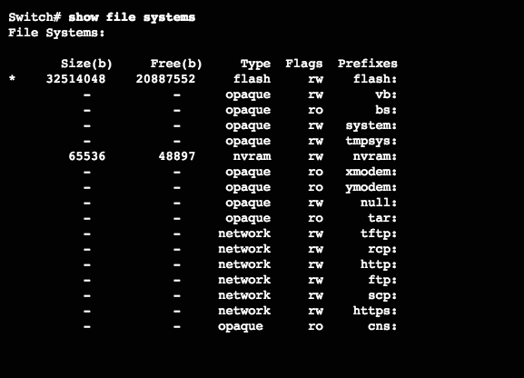
Router and Switch File Maintenance
Switch File Systems
Command is same as with the router!
Notes:
10.3 – Device Maintenance
10.3.1 – Router and Switch File Maintenance
10.3.1.2 – Switch File Systems

Slide 48
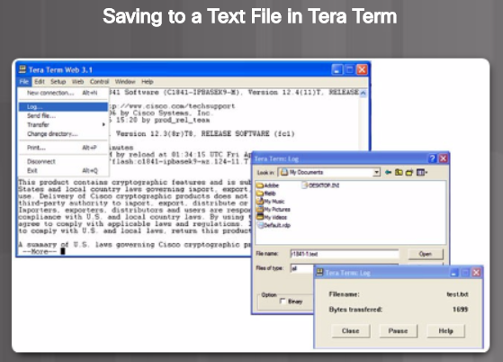
Router and Switch File Maintenance
Backing up and Restoring using Text Files
On the File menu, click Log.
Choose the location to save the file. Tera Term will begin capturing text.
After capture has been started, execute the show running-config or show startup-config command at the privileged EXEC prompt. Text displayed in the terminal window will be directed to the chosen file.
When the capture is complete, select Close in the Tera Term Log window.
View the file to verify that it was not corrupted.
Notes:
10.3 – Device Maintenance
10.3.1 – Router and Switch File Maintenance
10.3.1.3 – Backing up and Restoring using Text Files

Slide 49
Router and Switch File Maintenance
Backing up and Restoring using Text Files (Cont.)
Restoring Text Configurations
A configuration can be copied from a file to a device.
When copied from a text file and pasted into a terminal window, the IOS executes each line of the configuration text as a command.
At the CLI, the device must be set at the global configuration mode to receive the commands from the text file being pasted into the terminal window.
When using Tera Term, the steps are:
Step 1. On the File menu, click Send file.
Step 2. Locate the file to be copied into the device and click Open.
Step 3. Tera Term will paste the file into the device.
Note: The text in the file will be applied as commands in the CLI and become the running configuration on the device.
Notes:
10.3 – Device Maintenance
10.3.1 – Router and Switch File Maintenance
10.3.1.3 – Backing up and Restoring using Text Files

Slide 50
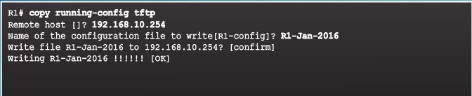
Router and Switch File Maintenance
Backing up and Restoring using TFTP
Configuration files should be backed up and included in network documentation
Commands - copy running-config tftp (see figure) or copy startup-config tftp
To restore the running configuration or the startup configuration from a TFTP server, use copy tftp running-config or copy tftp startup-config command
Notes:
10.3 – Device Maintenance
10.3.1 – Router and Switch File Maintenance
10.3.1.4– Backing up and Restoring using TFTP

Slide 51
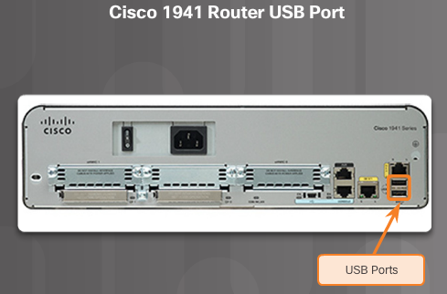

Router and Switch File Maintenance
Using USB Ports on a Cisco Router
Certain models of Cisco routers support USB flash drives.
USB can be used for storage and booting.
USB flash can hold multiple copies of the Cisco IOS and multiple router configurations.
Use the dir command to view the contents of the USB flash drive.
Notes:
10.3 – Device Maintenance
10.3.1 – Router and Switch File Maintenance
10.3.1.5 – Using USB Ports on a Cisco Router

Slide 52
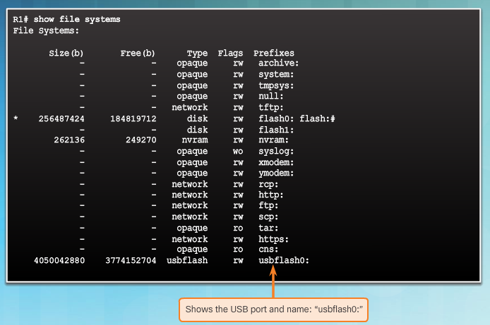
Router and Switch File Maintenance
Backing up and Restoring Using USB
show file systems verifies USB drive and name
Notes:
10.3 – Device Maintenance
10.3.1 – Router and Switch File Maintenance
10.3.1.6 – Backing up and Restoring Using USB

Slide 53
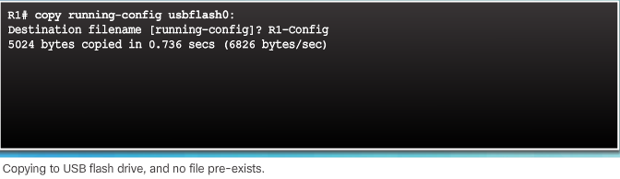
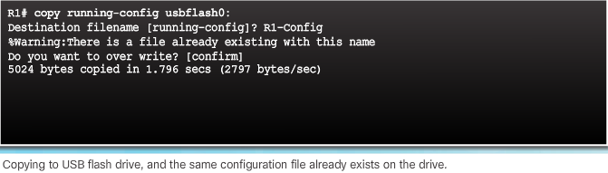
Router and Switch File Maintenance
Backing up and Restoring Using USB (Cont.)
copy run usbflash0:/ command copies the running-config file to the USB flash drive (slash is optional but indicates the root directory of the USB flash drive)
IOS will prompt for the filename
If the file already exists on the USB flash drive, the router will prompt to overwrite
Notes:
10.3 – Device Maintenance
10.3.1 – Router and Switch File Maintenance
10.3.1.6 – Backing up and Restoring Using USB

Slide 54

Router and Switch File Maintenance
Backing up and Restoring Using USB (Cont.)
Use the dir command to see the file on the USB drive
Use the more command to see the contents
Use copy usbflash0:/R1-Config running-config to restore running config
Notes:
10.3 – Device Maintenance
10.3.1 – Router and Switch File Maintenance
10.3.1.6 – Backing up and Restoring Using USB

Slide 55


Router and Switch File Maintenance
Password Recovery
Step 1. Enter the ROMMON mode.
With console access, a user can access the ROMMON mode by using a break sequence during the boot up process or removing the external flash memory when the device is powered off.
Step 2. Change the configuration register to 0x2142 to ignore the startup config file.
Use the confreg 0x2142 command
Type reset at the prompt to restart the device
Step 3. Make necessary changes to the original startup config file.
Copy the startup config to the running config
Configure all necessary passwords
Change the configuration register back to 0X2102
Step 4. Save the new configuration.
Notes:
10.3 – Device Maintenance
10.3.1 – Router and Switch File Maintenance
10.3.1.7 – Password Recovery

Slide 56

Router and Switch File Maintenance
Packet Tracer – Backing Up Configuration Files
Notes:
10.3 – Device Maintenance
10.3.1 – Router and Switch File Maintenance
10.3.1.8 – Packet Tracer – Backing Up Configuration Files

Slide 57

Router and Switch File Maintenance
Lab – Managing Router Configuration Files with Tera Term
Notes:
10.3 – Device Maintenance
10.3.1 – Router and Switch File Maintenance
10.3.1.9 – Lab – Managing Router Configuration Files with Tera Term

Slide 58

Router and Switch File Maintenance
Lab – Managing Device Configuration Files Using TFTP, Flash, and USB
Notes:
10.3 – Device Maintenance
10.3.1 – Router and Switch File Maintenance
10.3.1.10 – Lab – Managing Device Configuration Files Using TFTP, Flash, and USB

Slide 59

Router and Switch File Maintenance
Lab – Researching Password Recovery Procedures
Notes:
10.3 – Device Maintenance
10.3.1 – Router and Switch File Maintenance
10.3.1.11 – Lab – Researching Password Recovery Procedures

Slide 60

IOS System Files
IOS 15 System Image Packaging
  G2 router is shipped with a single universal Cisco IOS and a license is used to enable the specific feature set packages.
  Each router ships with one of two types of universal images in ISR G2:
  “universalk9" – offers all of the Cisco IOS software features, including strong payload cryptography features, such as IPsec VPN, SSL VPN, and Secure Unified Communications
  “universalk9_npe” – some countries have import requirements that require that the platform does not support any strong cryptography functionality, this image does not support any strong payload encryption
  Features are activated through licensing.
  Other technology packages enabled using Cisco Software Activation licensing keys.
Notes:
10.3 – Device Maintenance
10.3.2 – IOS System Files
10.3.2.1 – IOS 15 System Image Packaging

Slide 61


IOS System Files
IOS Image Filenames
Displays the files stored in flash memory
  The most common designation for memory location and compression format is mz. The first letter indicates the location where the image is executed on the router. The locations can include:
    f - flash
    m - RAM
    r - ROM
    l - relocatable
  The compression format can be z for zip or x for mzip.
Notes:
10.3 – Device Maintenance
10.3.2 – IOS System Files
10.3.2.2 – IOS Image Filenames

Slide 62

IOS Image Management
TFTP Servers as a Backup Location
  Cisco IOS Software images and configuration files can be stored on a central TFTP server.
  It is good practice to keep a backup copy of the Cisco IOS Software image in case the system image in the router becomes corrupted or accidentally erased.
  Using a network TFTP server allows image and configuration uploads and downloads over the network. The network TFTP server can be another router, a workstation, or a host system.
Notes:
10.3 – Device Maintenance
10.3.3 – IOS Image Management
10.3.3.1 – TFTP Servers as a Backup Location

Slide 63


IOS Image Management
Steps to Backup IOS Image to TFTP Server
  The network administrator wants to create a backup of the current image file on the router (c1900-universalk9-mz.SPA.152-4.M3.bin) to the TFTP server at 172.16.1.100.
Notes:
10.3 – Device Maintenance
10.3.3 – IOS Image Management
10.3.3.2 - Steps to Backup IOS Image to TFTP Server

Slide 64


IOS Image Management
Steps to Backup IOS Image to TFTP Server (Cont.)
Notes:
10.3 – Device Maintenance
10.3.3 – IOS Image Management
10.3.3.2 - Steps to Backup IOS Image to TFTP Server

Slide 65


IOS Image Management
Steps to Copy an IOS Image to a Device
A new image file (c1900-universalk9-mz.SPA.152-4.M3.bin) will be copied from the TFTP server at 2001:DB8:CAFE:100::99 to the router.
Notes:
10.3 – Device Maintenance
10.3.3 – IOS Image Management
10.3.3.3 - Steps to Copy an IOS Image to a Device

Slide 66


IOS Image Management
Steps to Copy an IOS Image to a Device (Cont.)
Notes:
10.3 – Device Maintenance
10.3.3 – IOS Image Management
10.3.3.3 - Steps to Copy an IOS Image to a Device

Slide 67


IOS Image Management
The boot system Command
  To upgrade to the copied IOS image after that image is saved on the router's flash memory, configure the router to load the new image during boot up using the boot system command.
  To verify the new image has loaded, use the show version command.
  Several boot system commands can be entered to provide a fault-tolerant boot plan.
  If there is no boot system commands, the router defaults to loading the first valid Cisco IOS image in flash memory.
Notes:
10.3 – Device Maintenance
10.3.3 – IOS Image Management
10.3.3.4 - The boot system Command

Slide 68

IOS Image Management
Packet Tracer - Using a TFTP Server to Upgrade a Cisco IOS Image
Notes:
10.3 – Device Maintenance
10.3.3 – IOS Image Management
10.3.3.5 - Packet Tracer - Using a TFTP Server to Upgrade a Cisco IOS Image

Slide 69

IOS Image Management
Video Demonstration - Managing Cisco IOS Images
Objective:
  Use a TFTP server to upload an updated IOS image file to a Cisco Router.
  Use the boot system command to boot the router to the new IOS image file.
  Reload the router and successfully boot to the new IOS image file.
Notes:
10.3 – Device Maintenance
10.3.3 – IOS Image Management
10.3.3.6 – Video Demonstration - Managing Cisco IOS Images

Slide 70

Software Licensing
Licensing Overview
  Each device ships with the same universal image.
  Technology packages are enabled in the universal image via Cisco Software Activation licensing keys.
  The Cisco IOS Software Activation feature allows the user to enable licensed features and register licenses.
  Technology packages that are available:
    IP Base
    Data
    Unified Communications (UC)
    Security (SEC)
Notes:
10.3 – Device Maintenance
10.3.4 – Software Licensing
10.3.4.1 – Licensing Overview

Slide 71

Software Licensing
Licensing Process
The figure shows the three steps to permanently activate a new software package or feature on a router.
PAK – Product Activation Key
UDI – Unique Device Identifier
Notes:
10.3 – Device Maintenance
10.3.4 – Software Licensing
10.3.4.2 – Licensing Process

Slide 72

Software Licensing
Step 1. Purchase the Software Package or Feature to Install
  Customers receive a PAK with purchase that serves as a receipt and is used to obtain a license.
  A PAK is an 11 digit alpha numeric key created by Cisco manufacturing. It defines the Feature Set associated with the PAK.
  As shown in the figure, a separate license is required for each package, IP Base, Data, UC, and SEC.
Notes:
10.3 – Device Maintenance
10.3.4 – Software Licensing
10.3.4.3 – Step 1. Purchase the Software Package or Feature to Install

Slide 73


Software Licensing
Step 2. Obtain a License
  The UDI is a combination of the Product ID (PID), the Serial Number (SN), and the hardware version. The SN is an 11 digit number which uniquely identifies a device. The PID identifies the type of device. Only the PID and SN are used for license creation.
  This UDI can be displayed using the show license udi command shown.
Notes:
10.3 – Device Maintenance
10.3.4 – Software Licensing
10.3.4.4 – Step 2. Obtain a License

Slide 74

Software Licensing
Step 3. Install the License
  A permanent license is a license that never expires. After a permanent license is installed on a router, it is good for that particular feature set for the life of the router, even across IOS versions.
Notes:
10.3 – Device Maintenance
10.3.4 – Software Licensing
10.3.4.5 – Step 3. Install the License

Slide 75


License Verification and Management
License Verification
Notes:
10.3 – Device Maintenance
10.3.5 – License Verification and Management
10.3.5.1 – License Verification

Slide 76


License Verification and Management
Activate an Evaluation Right-To-Use License
Notes:
10.3 – Device Maintenance
10.3.5 – License Verification and Management
10.3.5.2 – Activate an Evaluation Right-To-Use License

Slide 77


License Verification and Management
Back up the License
  The license save command is used to copy all licenses in a device and store them.
  Saved licenses are restored by using the license install command.
  The command to back up a copy of the licenses on a device is:
    Router# license save file-sys://lic-location
  Use the show flash0: command to verify that the licenses have been saved.
Notes:
10.3 – Device Maintenance
10.3.5 – License Verification and Management
10.3.5.3 – Back up the License

Slide 78

License Verification and Management
Uninstall the License
  Only licenses that have been added by using the license install command are removed.
Notes:
10.3 – Device Maintenance
10.3.5 – License Verification and Management
10.3.5.4 – Uninstall the License

Slide 79

License Verification and Management
Video Demonstration - Working with IOS 15 Image Licenses
  Objective
  Identify the additional licensing types of Cisco ISR-G2 routers
  Identify the differences between permanent licensing and evaluation right-to-use licensing
  Activate the security technology package on a Cisco 1941 router
  Accept the end user license agreement
  Verify the securityk9 license and save it to flash memory
Notes:
10.3 – Device Maintenance
10.3.5 – License Verification and Management
10.3.5.5 – Video Demonstration - Working with IOS 15 Image Licenses

Slide 80
10.4 Chapter Summary
Notes:
10 - Device Discovery, Management, and Maintenance
10.4 – Summary

Slide 81

Conclusion
Packet Tracer – Skills Integration Challenge
Notes:
10.4 – Summary
10.4.1 – Conclusion
10.4.1.1 – Packet Tracer – Skills Integration Challenge

Slide 82
Conclusion
Chapter 10: Device Discovery, Management, and Maintenance
  Use discovery protocols to map a network topology.
Configure NTP and Syslog in a small to medium-sized business network.
Maintain router and switch configuration and IOS files.
Notes:
10.4 – Summary
10.4.1 – Conclusion
10.4.1.2 – Chapter 10: Device Discovery, Management, and Maintenance

Slide 83
Section 10.1
New Terms and Commands
Cisco Discovery Protocol (CDP) | Link Layer Discovery Protocol (LLDP)
Notes:
New Terms and Commands

Slide 84
Section 10.2
New Terms and Commands
Syslog Network Time Protocol (NTP) NTP client NTP server software clock | stratum authoritative time source severity level facility
Notes:
New Terms and Commands

Slide 85
Section 10.3
New Terms and Commands
ROMMON mode configuration register Services on Demand Product Activation Key (PAK) Cisco IOS Software Activation technology package licenses permanent licenses | evaluation license End User License Agreement (EULA) Cisco License Manager (CLM) Cisco License Registration Portal Unique Device Identifier (UDI) Evaluation Right-To-Use licenses (RTU)
Notes:
New Terms and Commands

