Slide 1
Chapter 5: Switch Configuration
Instructor Materials
CCNA Routing and Switching
Routing and Switching Essentials v6.0
Notes:
Cisco Networking Academy Program
Routing and Switching Essentials v6.0
Chapter 5: Switch Configuration

Slide 2
Chapter 5 - Sections & Objectives SMB
5.1 Basic Switch Configuration
5.2 Basic Device Configuration
Configure the management virtual interface on a switch.
Configure the port security feature to restrict network access.
Notes:
2
Cisco Networking Academy Program
Routing and Switching Essentials v6.0
Chapter 5: Switch Configuration

Slide 3
5.1 Configure a Switch with Initial Settings
Notes:
5 – Switch Configuration
5.1 – Configure a Switch with Initial Settings

Slide 4
Switch Boot Sequence
Power-on self-test (POST), a program stored in ROM, executes and checks hardware like CPU and RAM.
The boot loader, also stored in ROM, runs and initializes parts within the CPU, initializes the flash file system, and then locates and loads an IOS image.
The IOS image can be defined within the BOOT environment variable.
If the variable is not set, the switch scours through the flash file system searching for an executable image file, loading it into RAM, and launching it if found.
If an executable image file is not found, the switch shows the prompt switch: where a few commands are allowed in order to provide access to operating system files found in flash memory and files used to load or reload an operating system.
If an IOS operating system loads, the switch interfaces are initialized and any commands stored in the startup-config file load.
The startup-config file is stored in NVRAM.
Notes:
5.1 – Basic Switch Configuration
5.1.1 – Configure a Switch with Initial Settings
5.1.1.1 – Switch Boot Sequence

Slide 5
Switch Boot Sequence (Cont.)
Notes:
5.1 – Basic Switch Configuration
5.1.1 – Configure a Switch with Initial Settings
5.1.1.1 – Switch Boot Sequence

Slide 6
Recovering From a System Crash
The boot loader prompt can be accessed through a console connection to the switch:
1. Cable the PC to the switch console port.
2. Configure the terminal emulation software on the PC.
3. Unplug the switch power cord.
4. Reconnect the power cord and at the same time or within 15 seconds, press and hold the Mode button on the front of the switch until the System LED turns an amber color briefly and then turns a solid green.
The boot loader command prompt is switch: (instead of Switch>).
The commands available through the boot loader command prompt are limited.
Use the help command to display the available commands.
Notes:
5.1 – Basic Switch Configuration
5.1.1 – Configure a Switch with Initial Settings
5.1.1.2 – Recovering From a System Crash

Slide 7
Switch LED Indicators
System LED shows if the switch has power applied.
Port LED states:
Off – no link or shut down
Green – link is present
Blinking green – data activity
Alternating green and amber – link fault
Amber – port is not sending data; common for first 30 seconds of connectivity or activation
Blinking amber – port is blocking to prevent a switch loop
Notes:
5.1 – Basic Switch Configuration
5.1.1 – Configure a Switch with Initial Settings
5.1.1.3 – Switch LED Indicators

Slide 8
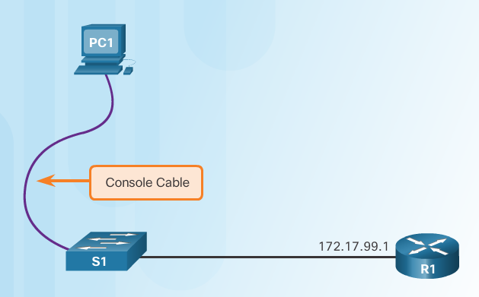
Preparing for Basic Switch Management
To configure a switch for remote access, the switch must be configured with an
IP address, subnet mask, and default gateway.
One particular switch virtual interface (SVI) is used to manage the switch:
A switch IP address is assigned to an SVI.
By default the management SVI is controlled and configured through VLAN 1.
The management SVI is commonly called the management VLAN.
For security reasons, it is best practice to use a VLAN other than VLAN 1 for the management VLAN.
Remember that the switch console port is on the back of the switch.
Notes:
5.1 – Basic Switch Configuration
5.1.1 – Configure a Switch with Initial Settings
5.1.1.4 – Preparing for Basic Switch Management

Slide 9
Switching Process: Learn
Examining the Source MAC Address
Switches examine all incoming frames for new source MAC address information to learn.
If the source MAC address is unknown, it is added to the table along with the port number.
If the source MAC address does exist, the switch updates the refresh timer for that entry.
By default, most Ethernet switches keep an entry in the table for 5 minutes.

Slide 10
Switching Process: Forward
Examining the Destination MAC Address
If the destination MAC address is a broadcast or a multicast, the frame is also flooded out all ports except the incoming port.
If the destination MAC address is a unicast address, the switch will look for a match in its MAC address table.
If the destination MAC address is in the table, it will forward the frame out the specified port.
If the destination MAC address is not in the table (i.e., an unknown unicast) the switch will forward the frame out all ports except the incoming port.

Slide 11
Configuring Basic Switch Management Access with IPv4
exit
Important Concept
The default gateway is the router address and is used by the switch to communicate with other networks.
Notes:
5.1 – Basic Switch Configuration
5.1.1 – Configure a Switch with Initial Settings
5.1.1.5 – Configuring Basic Switch Management Access with IPv4

Slide 12
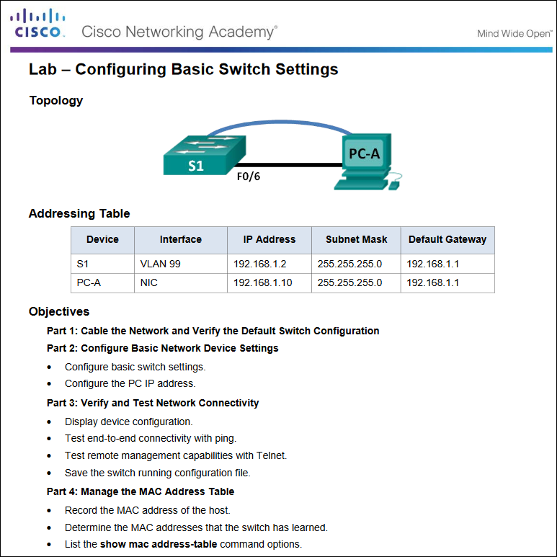
Basic Switch Configuration
Notes:
5.1 – Basic Switch Configuration
5.1.1 – Configure a Switch with Initial Settings
5.1.1.6 – Lab - Basic Switch Configuration

Slide 13
Duplex Communication
Gigabit Ethernet and 10Gb Ethernet NICs require full-duplex connections to operate.
Bidirectional communication
Unidirectional communication
Obvody pro detekci kolize jsou vypnuty
Notes:
5.1 – Basic Switch Configuration
5.1.2 – Configure Switch Ports
5.1.2.1 – Duplex Communication

Slide 14
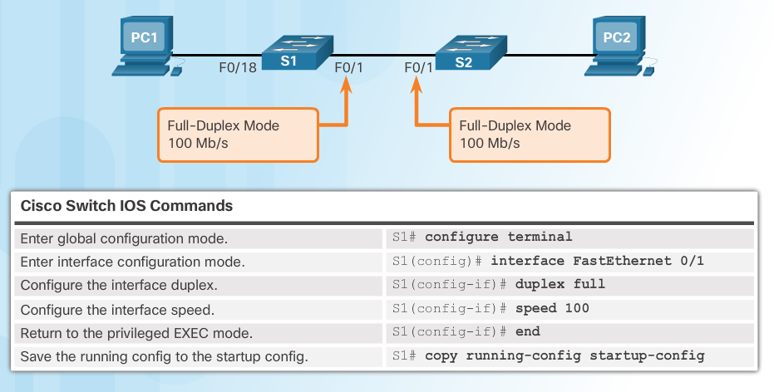
Configure Switch Ports at the Physical Layer
Some switches have the default setting of auto for both duplex and speed.
Mismatched duplex and/or speed settings can cause connectivity issues.
Always check duplex and speed settings using the show interface interface_id command.
All fiber ports operate at one speed and are always full-duplex.
Notes:
5.1 – Basic Switch Configuration
5.1.2 – Configure Switch Ports
5.1.2.2 – Configure Switch Ports at the Physical Layer

Slide 15
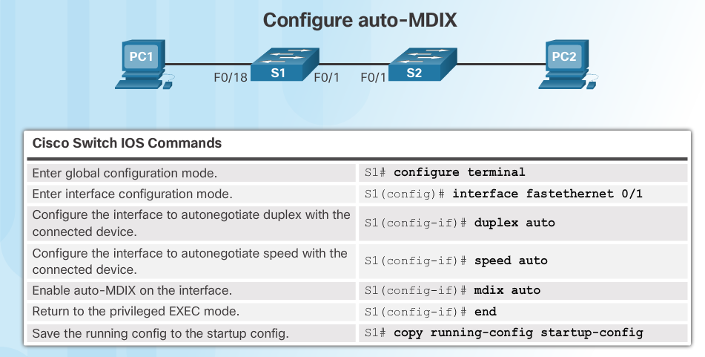
Auto-MDIX
Some switches have the automatic medium-dependent interface crossover (auto-MDIX) feature that allows an interface to detect the required cable connection type (straight-through or crossover) and configure the connection appropriately.
Notes:
5.1 – Basic Switch Configuration
5.1.2 – Configure Switch Ports
5.1.2.3 – Auto-MDIX

Slide 16
Auto-MDIX (Cont.)
Use the show controllers Ethernet-controller command to verify auto-MDIX settings.
Notes:
5.1 – Basic Switch Configuration
5.1.2 – Configure Switch Ports
5.1.2.3 – Auto-MDIX (Cont.)

Slide 17
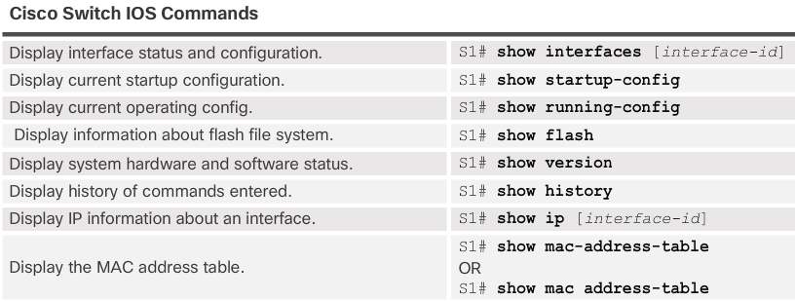
Verifying Switch Port Configuration
Notes:
5.1 – Basic Switch Configuration
5.1.2 – Configure Switch Ports
5.1.2.4– Verifying Switch Port Configuration

Slide 18
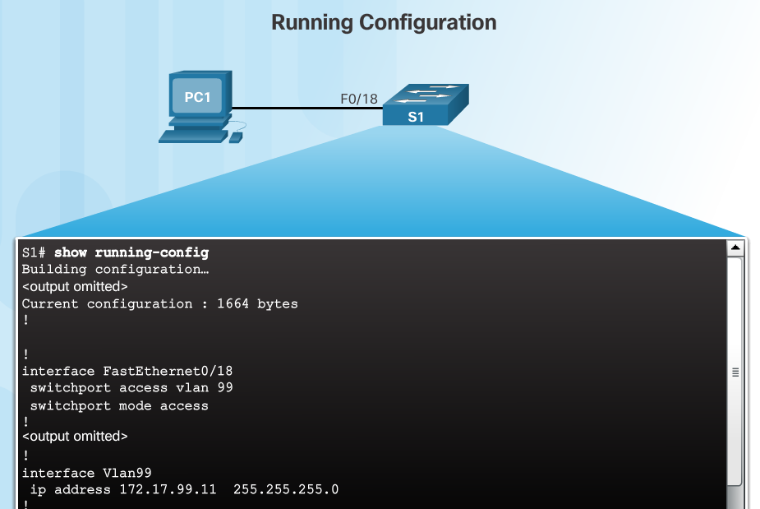
Verifying Switch Port Configuration (Cont.)
Notes:
5.1 – Basic Switch Configuration
5.1.2 – Configure Switch Ports
5.1.2.4– Verifying Switch Port Configuration (Cont.)

Slide 19
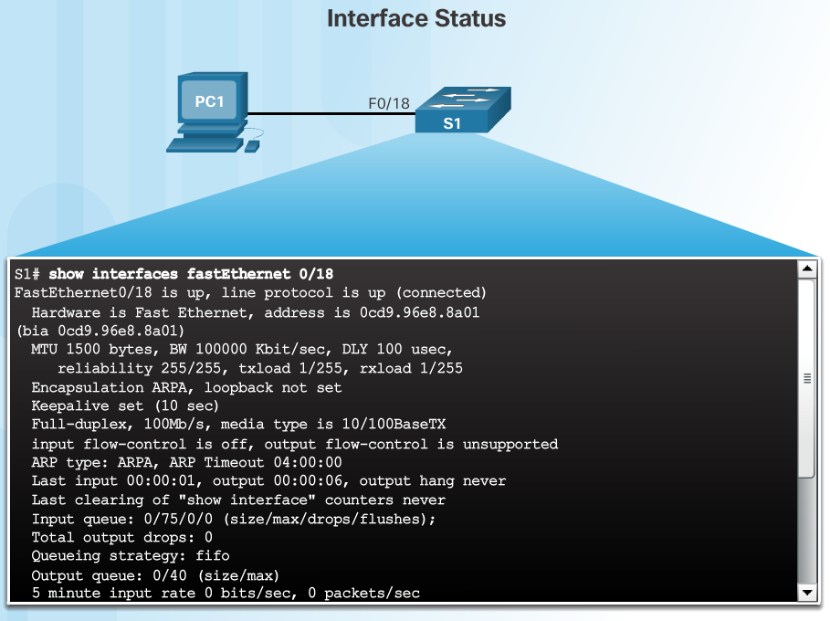
Verifying Switch Port Configuration (Cont.)
Layer 1 OK
Layer 2 OK
Notes:
5.1 – Basic Switch Configuration
5.1.2 – Configure Switch Ports
5.1.2.4– Verifying Switch Port Configuration (Cont.)

Slide 20
Network Access Layer Issues
Use the show interfaces command to detect common media issues.
The first parameter refers to Layer 1, the physical layer, and indicates if the interface is receiving a carrier detect signal.
The second parameter (protocol status) refers to the data link layer and indicates whether the data link layer protocol has been configured correctly and keepalives are being received.
Notes:
5.1 – Basic Switch Configuration
5.1.2 – Configure Switch Ports
5.1.2.5 – Network Access Layer Issues

Slide 21
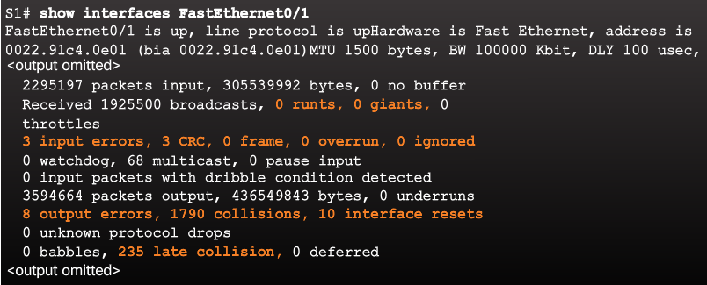
Network Access Layer Issues (Cont.)
Notes:
5.1 – Basic Switch Configuration
5.1.2 – Configure Switch Ports
5.1.2.5 – Network Access Layer Issues (Cont.)

Slide 23
Late collision
Pozdní kolize jsou problémem, protože jakmile NIC zmešká skutečnost, že došlo ke kolizi, zotavení a opakovaný přenos jsou ponechány na horních vrstvách a doba zotavení drasticky vzroste. Zatímco síťová karta obvykle obnoví a znovu vysílá rámec za 2 –3 ms, u horních vrstev trvá obvykle 10x až 100x déle.

Slide 24
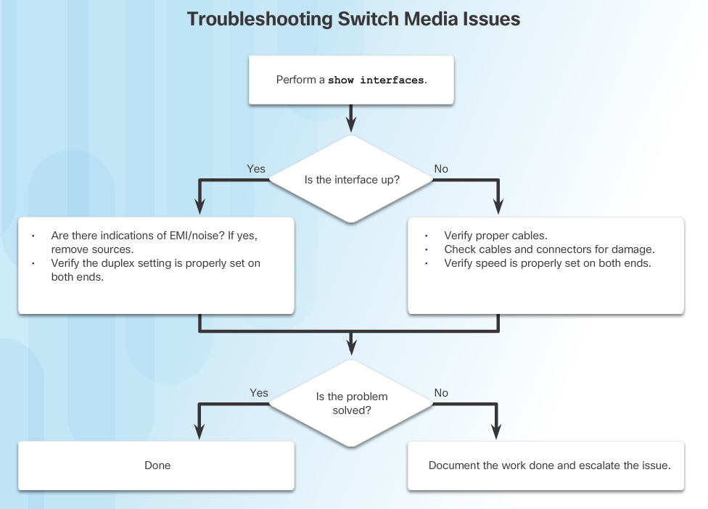
Troubleshooting Network Access Layer Issues
Notes:
5.1 – Basic Switch Configuration
5.1.2 – Configure Switch Ports
5.1.2.6– Troubleshooting Network Access Layer Issues

Slide 25
5.2 Switch Security
Notes:
5 - Switch Configuration
5.2 – Switch Security

Slide 26
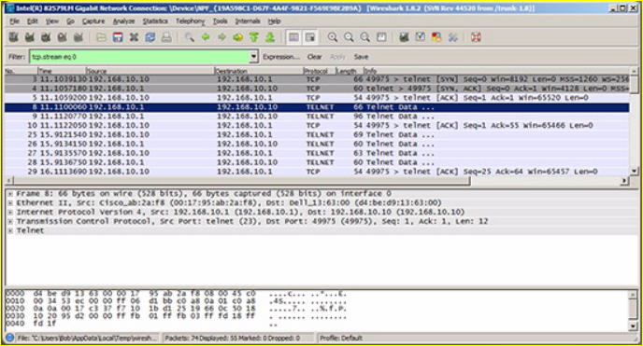
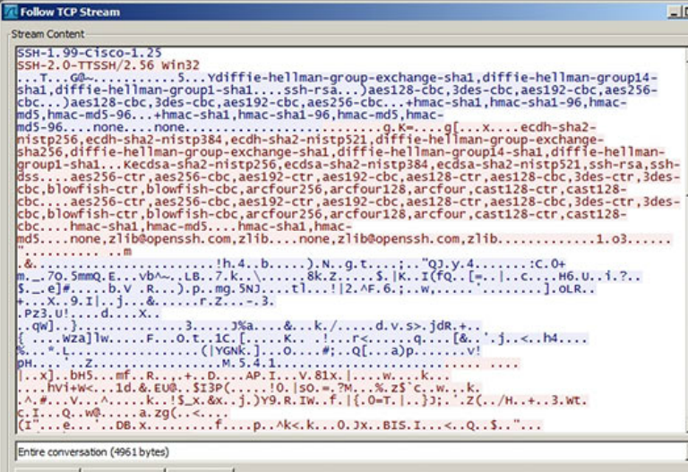
SSH Operation
Secure Shell (SSH)
An alternative protocol to Telnet. Telnet uses unsecure plaintext of the username and password as well as the data transmitted.
SSH is more secure because it provides an encrypted management connection.
Wireshark Capture of Telnet
Wireshark Capture of SSH
Notes:
5.2 – Switch Security
5.2.1 – Secure Remote Access
5.2.1.1 – SSH Operation

Slide 27
SSH Operation (Cont.)
A switch must have an IOS version (k9 at the end of the IOS file name) that includes cryptographic capabilities in order to configure and use SSH.
Use the show version command to see the IOS version.
Notes:
5.2 – Switch Security
5.2.1 – Secure Remote Access
5.2.1.1 – SSH Operation (Cont.)

Slide 28
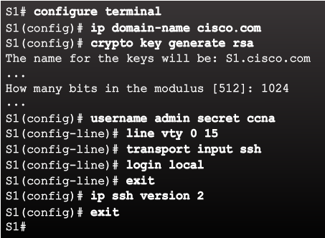
Configuring SSH
Commonly forgotten command that is used in key generation
Verify SSH support.
Configure the IP domain name.
Generate RSA key pairs.
Configure user authentication.
Configure the vty lines.
Enable SSH version 2.
Default is to accept both Telnet and SSH (transport input all)
The login local command forces the use of the local database for username/ password.
Notes:
5.2 – Switch Security
5.2.1 – Secure Remote Access
5.2.1.2 – Configuring SSH

Slide 29
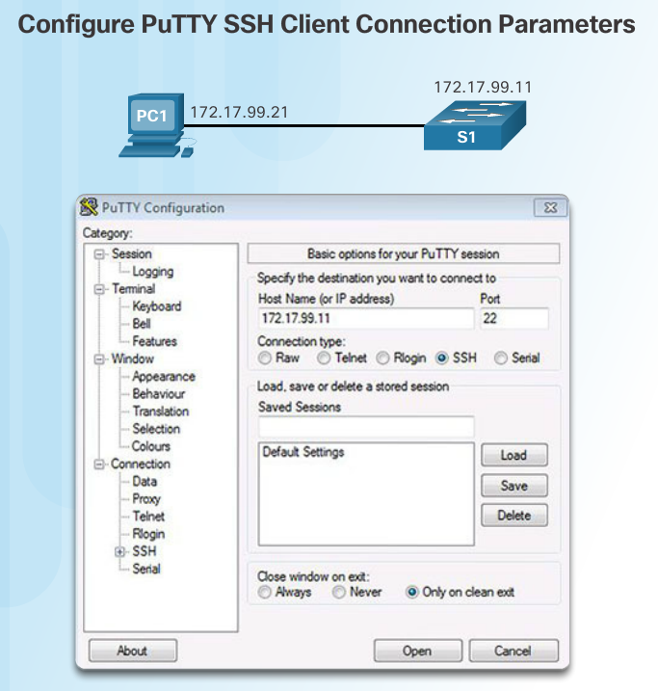
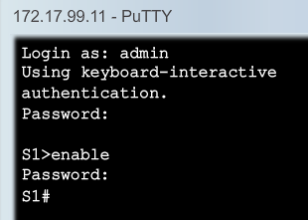
Verifying SSH
On the PC, connect to the switch using SSH.
Packet Tracer: ssh –l 172.17.99.11
Switch IP address
Notes:
5.2 – Switch Security
5.2.1 – Secure Remote Access
5.2.1.3 – Verifying SSH

Slide 30
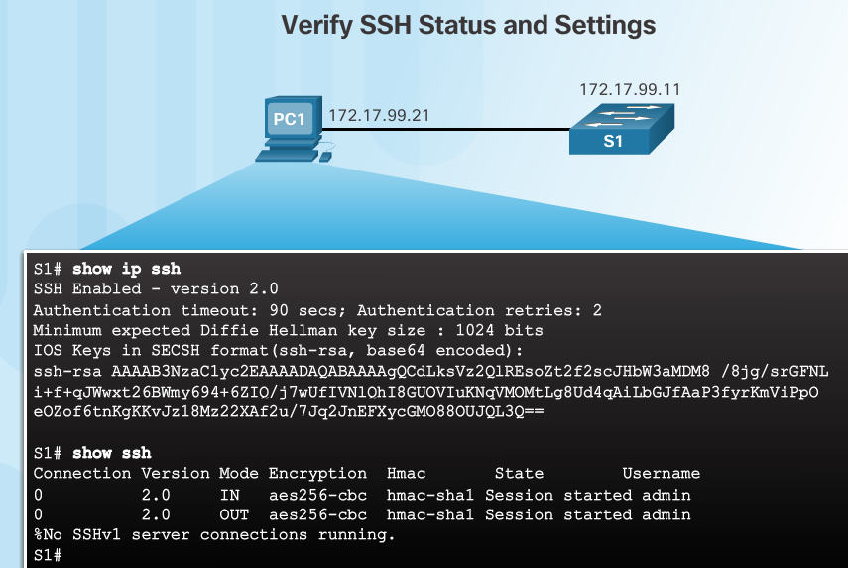
Verifying SSH
On the PC, connect to the switch using SSH.
Switch IP address
The PC is using SSH to communicate and issue commands on the switch.
Notes:
5.2 – Switch Security
5.2.1 – Secure Remote Access
5.2.1.3 – Verifying SSH

Slide 31
Packet Tracer – Configuring SSH
Notes:
5.2 – Switch Security
5.2.1 – Secure Remote Access
5.2.1.4 – Packet Tracer – Configuring SSH

Slide 32
Secure Unused Ports
The interface range command can be used to apply a configuration to several switch ports at one time.
Notes:
5.2 – Switch Security
5.2.2 – Switch Port Security
5.2.2.1 – Secure Unused Ports

Slide 33
Port Security: Operation
Port security limits the number of valid MAC addresses allowed to transmit data through a switch port.
If a port has port security enabled and an unknown MAC address sends data, the switch presents a security violation.
Default number of secure MAC addresses allowed is 1.
Methods use to configure MAC addresses within port security:
Static secure MAC addresses – manually configure
switchport port-security mac-address mac-address
Dynamic secure MAC addresses – dynamically learned and removed if the switch restarts
Sticky secure MAC addresses – dynamically learned and added to the running configuration (which can later be saved to the startup-config to permanently retain the MAC addresses)
switchport port-security mac-address sticky mac-address
Note: Disabling sticky learning converts sticky MAC addresses to dynamic secure addresses and removes them from the running-config.
Notes:
5.2 – Switch Security
5.2.2 – Switch Port Security
5.2.2.2 – Port Security: Operation

Slide 34
Port Security: Violation Modes
Protect – data from unknown source MAC addresses are dropped; a security notification IS NOT presented by the switch
Restrict - data from unknown source MAC addresses are dropped; a security notification IS presented by the switch and the violation counter increments.
Shutdown – (default mode) interface becomes error-disabled and port LED turns off. The violation counter increments. Issues the shutdown and then the no shutdown command on the interface to bring it out of the error-disabled state.
Notes:
5.2 – Switch Security
5.2.2 – Switch Port Security
5.2.2.3 – Port Security: Violation Modes

Slide 35
Port Security example: Configuring
Notes:
5.2 – Switch Security
5.2.2 – Switch Port Security
5.2.2.4 – Port Security: Configuring

Slide 36
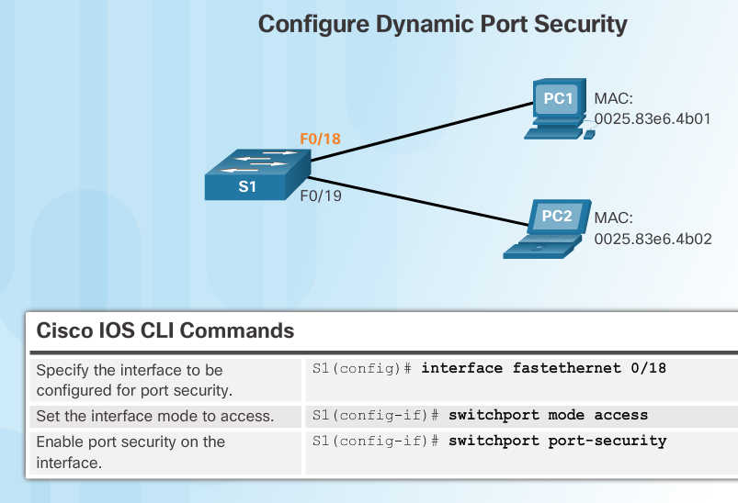
Port Security: Configuring (Cont.)
Before configuring port-security features, place the port in access mode and use the switchport port-security interface configuration command to enable port security on an interface.
Most common configuration error is to forget this command!
Notes:
5.2 – Switch Security
5.2.2 – Switch Port Security
5.2.2.4 – Port Security: Configuring (Cont.)

Slide 37
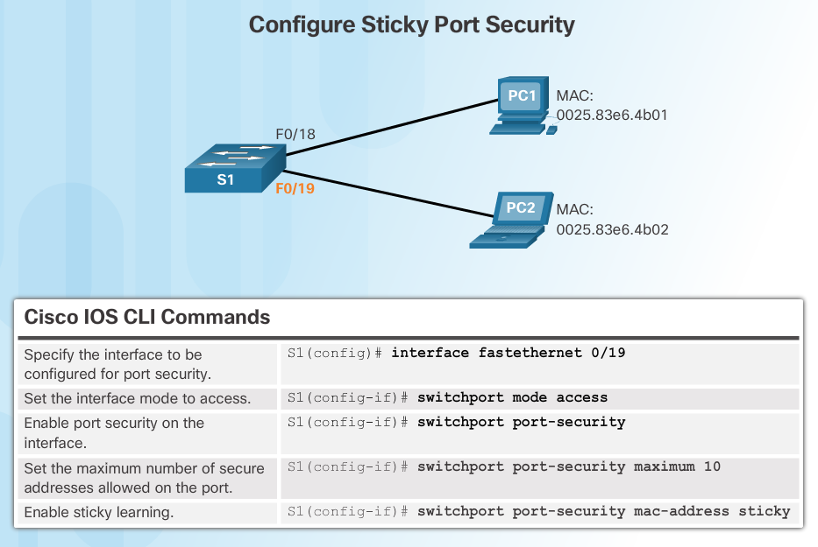
Port Security: Configuring (Cont.)
Most common configuration error is to forget this command!
Notes:
5.2 – Switch Security
5.2.2 – Switch Port Security
5.2.2.4 – Port Security: Configuring (Cont.)

Slide 38
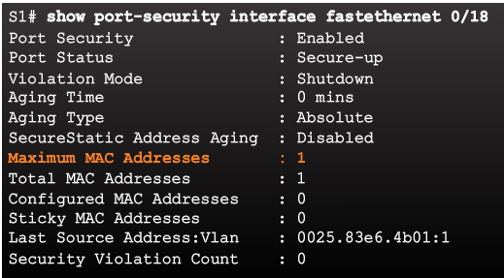
Port Security: Verifying
Use the show port-security interface command to verify the maximum number of MAC addresses allowed on a particular port and how many of those addresses were learned dynamically using sticky.
Dynamic
Notes:
5.2 – Switch Security
5.2.2 – Switch Port Security
5.2.2.5 – Port Security: Verifying

Slide 39
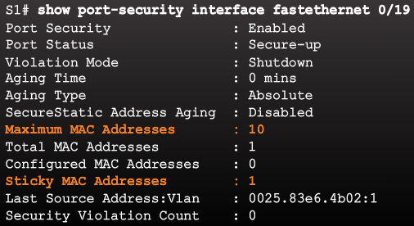
Port Security: Verifying
Use the show port-security interface command to verify the maximum number of MAC addresses
Sticky
Notes:
5.2 – Switch Security
5.2.2 – Switch Port Security
5.2.2.5 – Port Security: Verifying

Slide 40
Port Security: Verifying (Cont.)
Use the show running-config command to see learned MAC addresses added to the configuration.
Notes:
5.2 – Switch Security
5.2.2 – Switch Port Security
5.2.2.5 – Port Security: Verifying (Cont.)

Slide 41
Port Security: Verifying (Cont.)
The show port-security address command shows how MAC addresses were learned on a particular port.
Notes:
5.2 – Switch Security
5.2.2 – Switch Port Security
5.2.2.5 – Port Security: Verifying (Cont.)

Slide 42
Ports in Error Disabled State
Switch console messages display when a port security violation occurs. Notice the port link status changes to down.
Notes:
5.2 – Switch Security
5.2.2 – Switch Port Security
5.2.2.6 – Ports in Error Disabled State

Slide 43
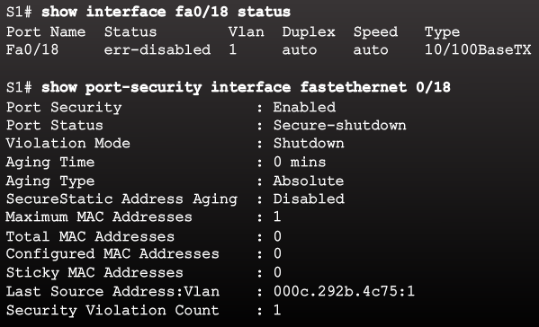
Ports in Error Disabled State (Cont.)
Check the port status and the port security settings.
Notes:
5.2 – Switch Security
5.2.2 – Switch Port Security
5.2.2.6 – Ports in Error Disabled State (Cont.)

Slide 44
Ports in Error Disabled State (Cont.)
Do not re-enable a port until the security threat is investigated and eliminated.
Notice that you must first shut the port down and then issue the no shutdown command in order to use the particular port again after a security violation has occurred.
Notes:
5.2 – Switch Security
5.2.2 – Switch Port Security
5.2.2.6 – Ports in Error Disabled State (Cont.)

Slide 45
Hrátky s časem

Slide 46
Typická konfigurace

Slide 47
Jiný typický příklad

Slide 48
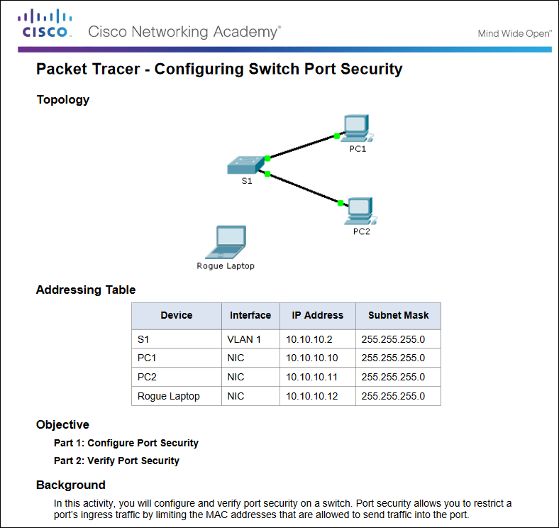
Packet Tracer – Configuring Switch Port Security
Notes:
5.2 – Switch Security
5.2.2 – Switch Port Security
5.2.2.7 – Packet Tracer – Configuring Switch Port Security

Slide 49
Packet Tracer – Troubleshooting Switch Port Security
Notes:
5.2 – Switch Security
5.2.2 – Switch Port Security
5.2.2.8 – Packet Tracer – Troubleshooting Switch Port Security

Slide 50
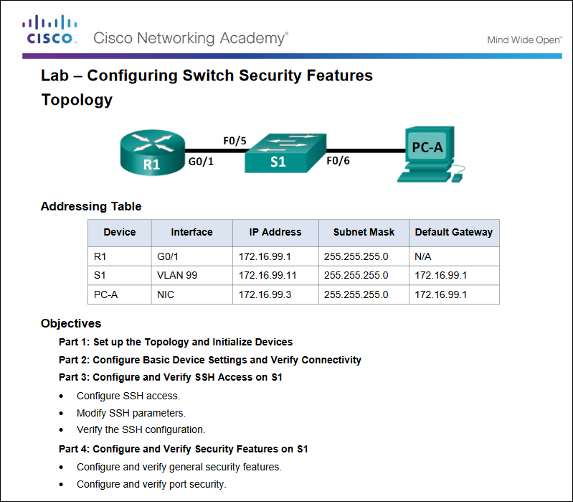
Packet Tracer – Configuring Switch Security Features
Notes:
5.2 – Switch Security
5.2.2 – Switch Port Security
5.2.2.9 – Lab – Configuring Switch Security Features

Slide 51
5.3 Chapter Summary
Notes:
5 - Switch Configuration
5.3 – Summary

Slide 52
Packet Tracer - Skills Integration Challenge
Notes:
5.3 – Summary
5.3.1 – Conclusion
5.3.1.2 – Packet Tracer - Skills Integration Challenge

Slide 53
Security best practices:
Disable ports that do not have a device connected to them using the shutdown command.
Avoid using VLAN 1 because it is commonly attacked.
Use port security to keep private devices from being attached to a network in place of a corporate wired device.
Notes:
53

Slide 54
Nutné k zapamatování
config t interface vlan 99 ip address 172.17.99.11 255.255.255.0 no shutdown ip default-gateway 172.16.99.1 (address on the router that is on the same 172.17.99.0 network) vlan 99 name Management exit

Slide 55
Používejte příkazy show
show interfaces interface_id or show ip interface brief
show ip interface interface_id
show running-config
show flash
show version
show mac-address-table
Notes:
55

Slide 56
? is a KEY to IOS. Promts
Switch> (User EXEC mode that is shown when a switch first boots)
Switch# (Privileged EXEC mode that is shown after someone types enable)
switch: (Boot loader mode shown when a switch does not have, or cannot find, an operating system)

Slide 57
sh boot
Notes:
5.3 – Summary
5.3.1 – Conclusion
5.3.1.3 – Switch Configuration

Slide 58
New Terms and Commands
POST Boot loader boot system command show boot command switch: prompt Mode button System LED Port LED SVI VLAN Management VLAN interface vlan command vlan command name command | Full-duplex Half-duplex Port speed duplex command speed command mdix command show interfaces command SSH configuration ip domain-name command crypto key generate rsa command transport input local command username secret command ip ssh version 2 command | login local command show ip ssh command Unused ports Port security switchport mode access command switchport port-security command switchport port-security maximum command switchport port-security mac-address sticky command show port-security interface command show port-security address command
Notes:
Chapter 5 - New Terms and Commands

