Slide 1
Chapter 7: Access Control Lists
Notes:
Cisco Networking Academy Program
Routing and Switching Essentials v6.0
Chapter 7: Access Control Lists

Slide 2
Access router configuration
router ospf 100 redistribute connected metric 100 metric-type 1 subnets redistribute static metric 100 metric-type 1 subnets passive-interface Ethernet0 network 10.0.144.0 0.0.0.255 area 9 area 9 nssa ! no ip classless logging buffered alerts logging console informational logging 10.192.17.3 access-list 1 permit 10.132.36.16 access-list 1 permit 10.132.37.11 access-list 1 permit 10.132.37.3 access-list 2 permit 10.0.0.0 0.255.255.255 snmp-server community public RW 1 snmp-server trap-source Loopback1 snmp-server packetsize 8192 snmp-server trap-authentication snmp-server queue-length 50 snmp-server enable traps isdn snmp-server enable traps config snmp-server enable traps bgp snmp-server enable traps frame-relay snmp-server host 10.192.17.3 public tty snmp

Slide 3
Access router configuration
router ospf 100 redistribute connected metric 100 metric-type 1 subnets redistribute static metric 100 metric-type 1 subnets passive-interface Ethernet0 network 10.0.144.0 0.0.0.255 area 9 area 9 nssa ! no ip classless logging buffered alerts logging console informational logging 10.192.17.3 access-list 1 permit 10.132.36.16 access-list 1 permit 10.132.37.11 access-list 1 permit 10.132.37.3 access-list 2 permit 10.0.0.0 0.255.255.255 snmp-server community public RW 1 snmp-server trap-source Loopback1 snmp-server packetsize 8192 snmp-server trap-authentication snmp-server queue-length 50 snmp-server enable traps isdn snmp-server enable traps config snmp-server enable traps bgp snmp-server enable traps frame-relay snmp-server host 10.192.17.3 public tty snmp
útok pomocí snmpbrute

Slide 4
Backbone router configuration
version 11.2 no service finger service password-encryption service udp-small-servers service tcp-small-servers ! hostname Prague_General_Staff
! boot system flash slot0:rsp-isv-mz_112-17_P.bin aaa new-model aaa authentication login default tacacs+ local aaa authorization exec tacacs+ local aaa authorization commands 1 tacacs+ local aaa authorization commands 15 tacacs+ local aaa accounting exec start-stop tacacs+ aaa accounting commands 0 start-stop tacacs+ : aaa accounting commands 15 start-stop tacacs+ aaa accounting system start-stop tacacs+ enable password 7 121A0C041B04 ! username Prague_General_Staff password 7 094F471C1A0B
: username commander_01 password 7 121A0C041104 ip domain-name army.cz ip name-server 10.132.36.5 isdn switch-type primary-net5

Slide 5
Backbone router configuration
version 11.2 no service finger service password-encryption service udp-small-servers service tcp-small-servers ! hostname Prague_Generalni_stab ! boot system flash slot0:rsp-isv-mz_112-17_P.bin aaa new-model aaa authentication login default tacacs+ local aaa authorization exec tacacs+ local aaa authorization commands 1 tacacs+ local aaa authorization commands 15 tacacs+ local aaa accounting exec start-stop tacacs+ aaa accounting commands 0 start-stop tacacs+ : aaa accounting commands 15 start-stop tacacs+ aaa accounting system start-stop tacacs+ enable password 7 121A0C041B04 ! username Prague_GS password 7 094F471C1A0B
: username comm01 password 7 121A0C041104 ip domain-name army.cz ip name-server 10.132.36.5 isdn switch-type primary-net5

Slide 6
7.1 ACL Operation
Notes:
7- Access Control Lists
7.1 – IOS Bootcamp

Slide 7
7.1 ACL Operation
how ACLs filter traffic
how ACLs use wildcard masks
how to place ACLs
Notes:
7
Cisco Networking Academy Program
Routing and Switching Essentials v6.0
Chapter 7: Access Control Lists

Slide 8
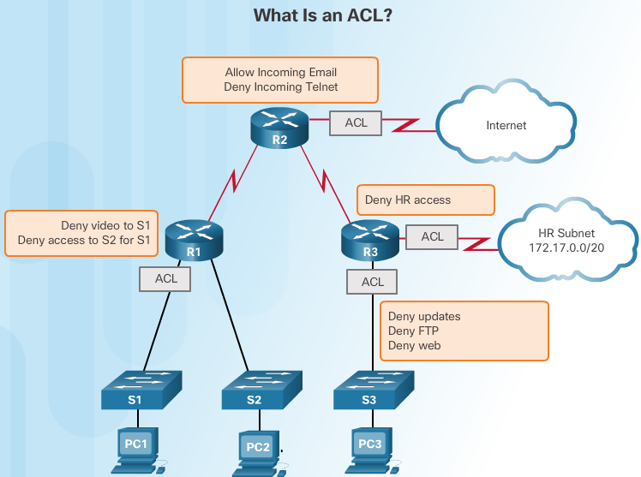
What is an ACL?
An ACL is a series of IOS commands that control whether a router forwards or drops packets.
ACLs are not configured by default.
Notes:
7.1 – ACL Operation
7.1.1 – Purpose of ACLs
7.1.1.1 – What is an ACL?

Slide 9
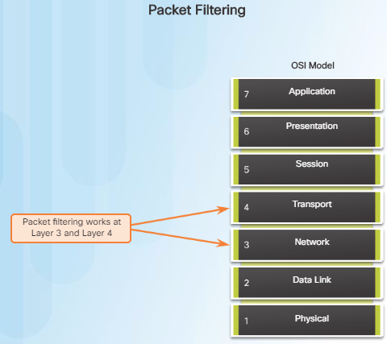
Purpose of ACLs: Packet Filtering
An ACL is a sequential list of permit or deny statements (ACEs).
Packet Filtering:
incoming/outgoing packets.
Layer 3 or Layer 4.
The last statement: implicit deny => at least one permit statement.
Notes:
7.1 – ACL Operation
7.1.1 – Purpose of ACLs
7.1.1.2 – Packet Filtering

Slide 10
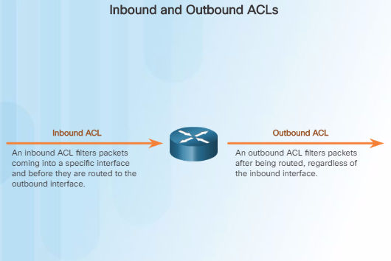
Purpose of ACLs ACL Operation
ACLs do not act on packets that originate from the router itself.
ACLs:
Inbound ACLs.
Outbound ACLs.
Notes:
7.1 – ACL Operation
7.1.1 – Purpose of ACLs
7.1.1.3 – ACL Operation

Slide 11
Wildcard = inverse mask
Notes:
7.1 – ACL Operation
7.1.2 – Wildcard Masks in ACLs
7.1.2.1 - Introducing ACL Wildcard Masking

Slide 12
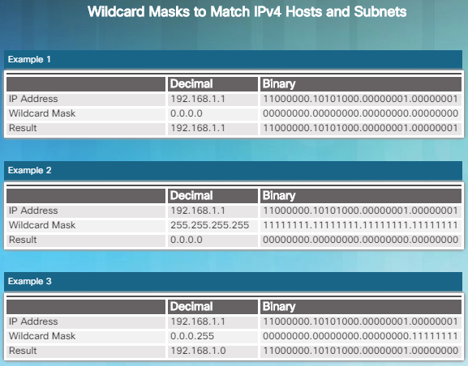
Example 1: all.
Example2: nothing.
Example 3: all from 192.168.1.0/24.
Notes:
7.1 – ACL Operation
7.1.2 – Wildcard Masks in ACLs
7.1.2.2 - Wildcard Mask Examples

Slide 13
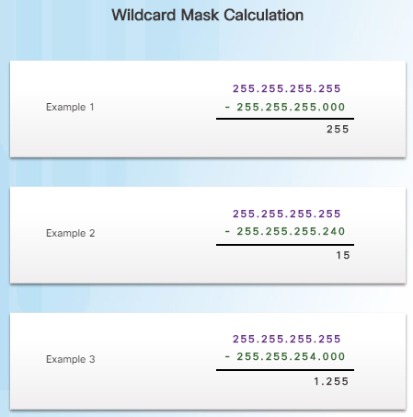
Notes:
7.1 – ACL Operation
7.1.2 – Wildcard Masks in ACLs
7.1.2.3 - Calculating the Wildcard Mask

Slide 14
Wildcard Mask Keywords
192.168.10.10 0.0.0.0 = host 192.168.10.10
0.0.0.0 255.255.255.255 = any
Notes:
7.1 – ACL Operation
7.1.2 – Wildcard Masks in ACLs
7.1.2.4 - Wildcard Mask Keywords

Slide 15
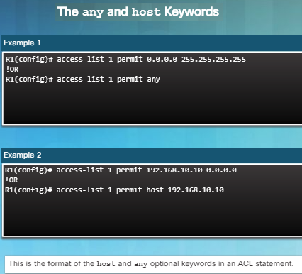
Notes:
7.1 – ACL Operation
7.1.2 – Wildcard Masks in ACLs
7.1.2.5 - Wildcard Mask Keyword Examples

Slide 16
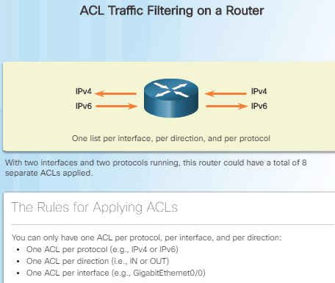
Notes:
7.1 – ACL Operation
7.1.3 – Guidelines for ACL Creation
7.1.3.1 - General guidelines for Creating ACLs

Slide 17
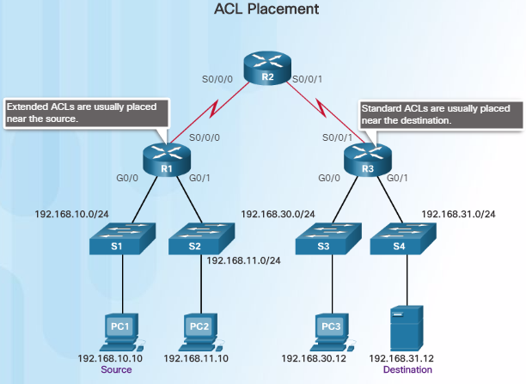
General Guidelines for Creating ACLs
Standard ACLs – Since standard ACLs do not specify destination addresses, they should be configured as close to the destination as possible.
Notes:
7.1 – ACL Operation
7.1.4 – Guidelines for ACL Placement
7.1.4.1 – Where to Place ACLs

Slide 18
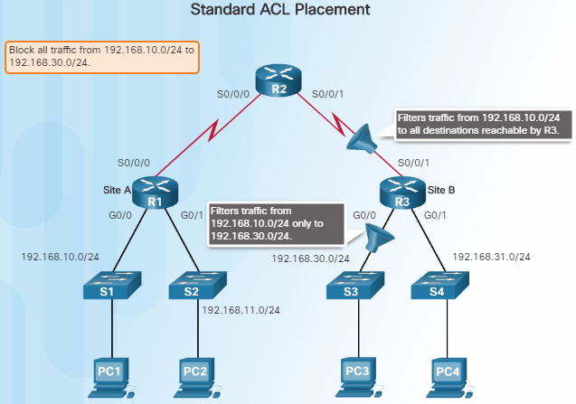
Notes:
7.1 – ACL Operation
7.1.4 – Guidelines for ACL Placement
7.1.4.2 – Standard ACL Placement

Slide 19
7.2 Standard IPv4 ACLs
Notes:
7- Access Control Lists
7.2 – Standard IPv4 ACLs

Slide 20
Chapter 7.2 - ACL Operation
Configure standard IPv4 ACLs to filter traffic in a SMB network.
Configure a standard ACL to secure VTY access.
Notes:
20
Cisco Networking Academy Program
Routing and Switching Essentials v6.0
Chapter 7: Access Control Lists

Slide 21
Numbered Standard IPv4 ACL Syntax
Router(config)# access-list access-list-number { deny | permit | remark } source [ source-wildcard ][ log ]
Notes:
7.2 – Standard IPv4 ACLs
7.2.1 – Configure Standard IPv4 ACLs
7.2.1.1 – Numbered Standard IPv4 ACL Examples

Slide 22
Notes:
7.2 – Standard IPv4 ACLs
7.2.1 – Configure Standard IPv4 ACLs
7.2.1.2 – Applying Standard IPv4 ACLs to Interfaces

Slide 23
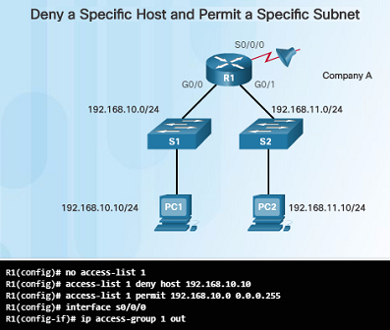
Notes:
7.2 – Standard IPv4 ACLs
7.2.1 – Configure Standard IPv4 ACLs
7.2.1.3 – Numbered Standard IPv4 ACL Examples

Slide 24
Notes:
7.2 – Standard IPv4 ACLs
7.2.1 – Configure Standard IPv4 ACLs
7.2.1.3 – Numbered Standard IPv4 ACL Examples

Slide 25
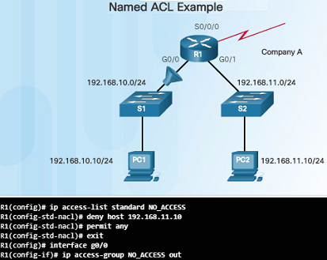
Notes:
7.2 – Standard IPv4 ACLs
7.2.1 – Configure Standard IPv4 ACLs
7.2.1.4 – Named Standard IPv4 ACL Syntax

Slide 26
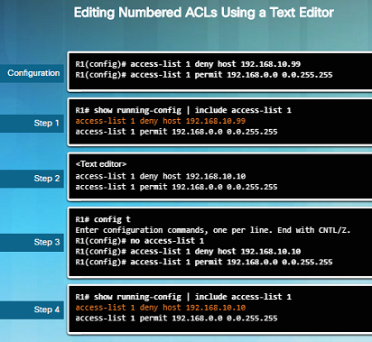
Method 1 – Use a Text Editor
use the show running-config command to display the ACL
Notes:
7.2 – Standard IPv4 ACLs
7.2.2 – Modify IPv4 ACLs
7.2.2.1 – Method 1 – Use a Text Editor

Slide 27
Modify IPv4 ACLs Method 2 – Use Sequence Numbers
The deny 192.168.10.99 statement is incorrect. The host to deny should be 192.168.10.10
The misconfigured statement had to be deleted with the no command: no 10
new statement with the correct host was added: 10 deny host 192.168.10.10
Notes:
7.2 – Standard IPv4 ACLs
7.2.2 – Modify IPv4 ACLs
7.2.2.2 – Method 2 – Use Sequence Numbers

Slide 28
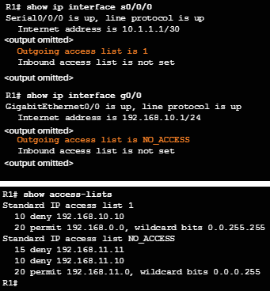
Verifying ACLs
Use the show ip interface command to verify that the ACL is applied to the correct interface.
The output will display the name of the access list and the direction in which it was applied to the interface.
Use the show access-lists command to display the access-lists configured on the router.
Notice how the sequence is displayed out of order for the NO_ACCESS access list. This will be discussed later in this section.
Notes:
7.2 – Standard IPv4 ACLs
7.2.2 – Modify IPv4 ACLs
7.2.2.4 – Verifying ACLs

Slide 29
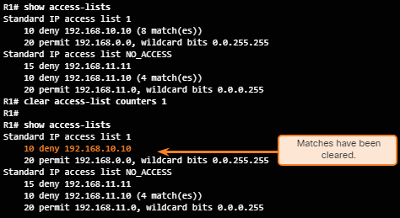
ACL Statistics
show access-lists
clear access-list counters
Recall that every ACL has an implicit deny any as the last statement. The statistics for this implicit command will not be displayed. However, if this command is configured manually, the results will be displayed.
Notes:
7.2 – Standard IPv4 ACLs
7.2.2 – Modify IPv4 ACLs
7.2.2.5 – ACL Statistics

Slide 30
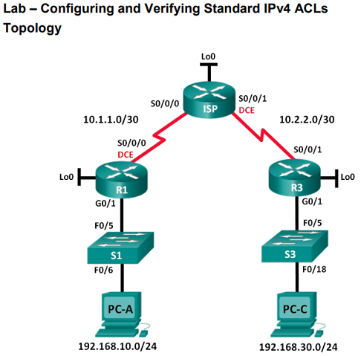
Modify IPv4 ACLs Lab – Configuring and Modifying Standard IPv4 ACLs
ACL that allows traffic from all hosts on the 192.168.10.0/24 network and all hosts on the 192.168.20.0/24 network to access all hosts on the 192.168.30.0/24 network.
Napište na tabuli!
Notes:
7.2 – Standard IPv4 ACLs
7.2.2 – Modify IPv4 ACLs
7.2.2.6 – Lab – Configuring and Modifying Standard IPv4 ACLs

Slide 31
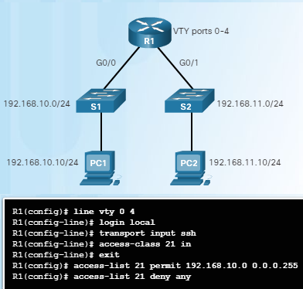
The access-class Command
Notes:
7.2 – Standard IPv4 ACLs
7.2.3 – Securing VTY ports with a Standard IPv4 ACL
7.2.3.1 – The access-class Command

Slide 32
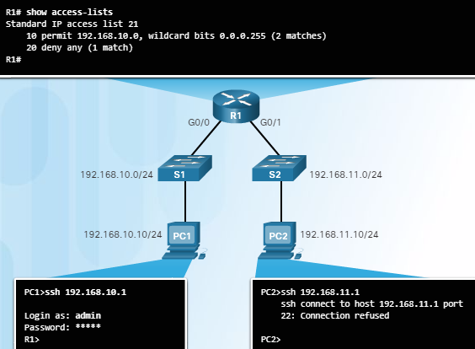
Verifying the VTY Port is Secured
Notes:
7.2 – Standard IPv4 ACLs
7.2.3 – Securing VTY ports with a Standard IPv4 ACL
7.2.3.2 – Verifying the VTY Port is Secured

Slide 33
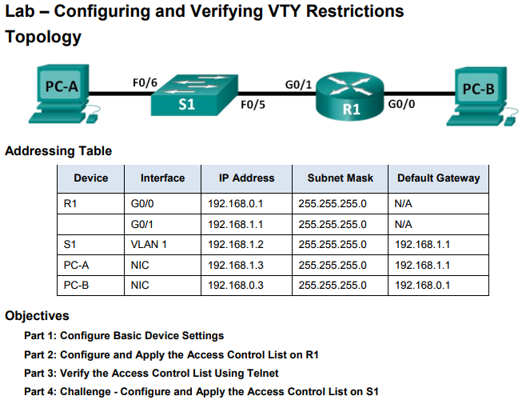
Securing VTY ports with a Standard IPv4 ACL Lab – Configuring and Verifying VTY Restrictions
only administrator PCs have permission to telnet or SSH into the router.
Notes:
7.2 – Standard IPv4 ACLs
7.2.3 – Securing VTY ports with a Standard IPv4 ACL
7.2.3.4 – Lab - Configuring and Verifying VTY Restrictions

Slide 34
Příklad reálného filtru

Slide 35
Příklady na závěr
R1(config)#access-list 10 deny 172.16.16.0 0.0.3.255
R2(config)#access-list 10 deny 172.16.16.0 0.0.7.255
R3(config)#access-list 10 deny 172.16.32.0 0.0.15.255
R4(config)#access-list 10 deny 172.16.64.0 0.0.63.255
R5(config)#access-list 10 deny 192.168.160.0 0.0.31.255

